Slide 1
GLUE 2.0
Felix Ehm
CERN IT-GD
EGEE 2008

Slide 2
Introduction
What is GLUE
  Information Model
GLUE = Grid Laboratory Unified Environment
How does the Environment which the information model tries to unify look like ?

Slide 3



Introduction
Environment with resources and consumers
Where can I run a job requiring OS Linux, IA64 architecture, with software package X and Y
As part of the VO A, how much storage can I use on the Grid?
I offer 15 TB of storage, 10 TB are free and usable by GREEN VO
I can offer IA64 machines with OS Linux using BES interface to users of BLUE VO

Slide 4
Problem statement
Resources have heterogeneous characteristics
Service Interfaces are yet heterogeneous
  Converging towards common standards
Users have needs to be satisfied
How to describe resources/services shared in Grid systems in order to enable:
  Resource awareness
  Resource discoverability
  Resource requirements expression
  Resource basic monitoring
Infrastructures want to Interoperate

Slide 5
Introduction
What is GLUE ?
  Information Model
  Defines a common conceptual data model to be used for Grid resource/service discovery and monitoring
    Do we mean the same thing ?
    Agreement on entities

Slide 6
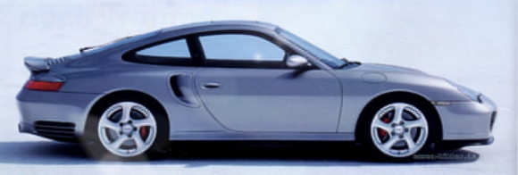
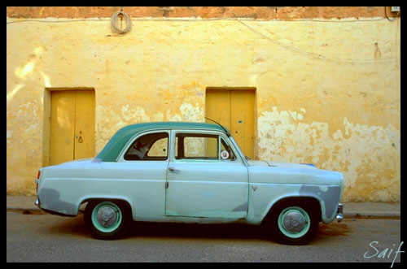
Common Understanding
Definition:
  CAR = 4 Weels, Steering, Engine, (at least) 2 seats, 2 doors
CAR ?
CAR !
Consumer
Resource

Slide 7
History
History
  First version released in April 2002 by collaboration effort
  of EU-DataTAG,EU-DataGrid and US-iVDGL
  v1.2 released Dec 2005 EGEE, LCG, Grid3/OSG,
  Globus and NorduGrid
  Working group part of the OpenGridForum (OGF)
  from Oct 2006
  v1.3 released Jan 2007
  Current production version : 1.3

Slide 8
Current Situation
Several Grid infrastructures using different schema definitions
  e.g.: NorduGrid, TeraGrid, NAREGI
The most widely deployed schema definition is GLUE Schema 1.x
  Designed to support service/resource selection
  Adopted by gLite and other grid middlewares (e.g. OSG)
Information basis for Grid Services

Slide 9
GLUE 2.0
GLUE v2.0
  Ideas raised during 1.3 discussions
  Elaborated in respect of 1.3 limitations
  Design started Feb 2007
Two documents have recently terminated the Public Comment period
  GLUE Specification – v.2.0
    Conceptual model in three sub-models
      Main Entities
      Computing Entities
      Storage Entities
  GLUE v. 2.0 – Reference Realizations to Concrete Data Models
    XSD
    SQL
    LDAP

Slide 10
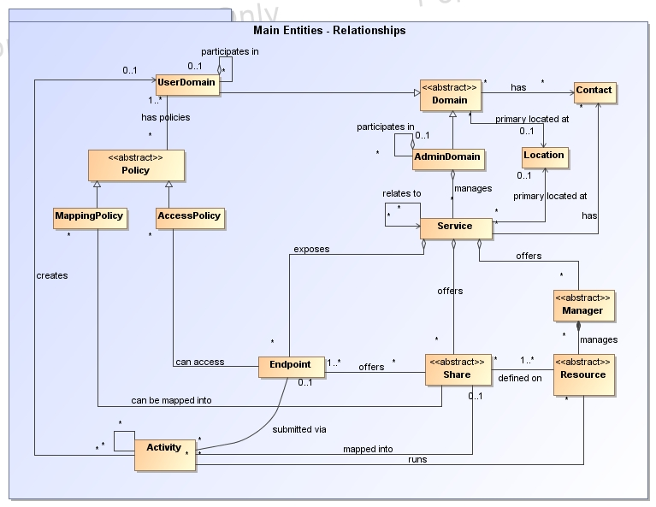
Main Entities

Slide 11
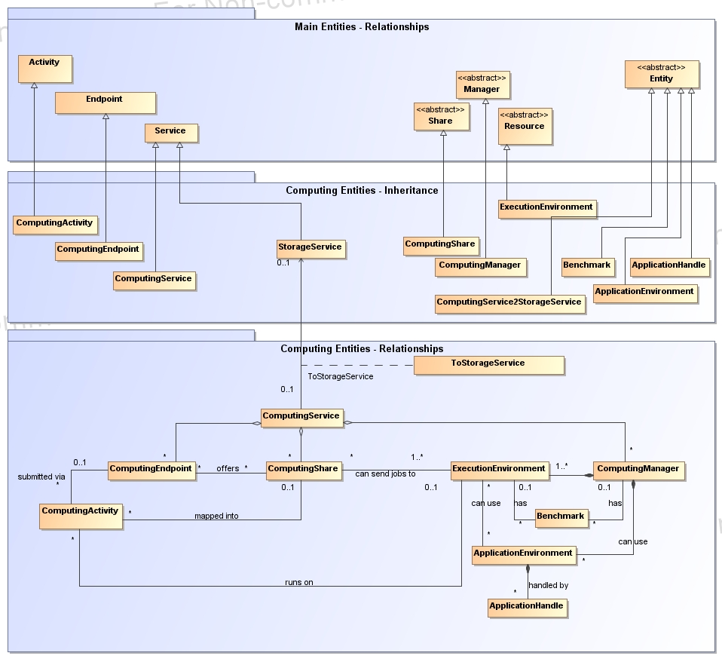
Computing Entities

Slide 12
Computing Entities Example
BLUE VO
GREEN VO
GLUE 2.0
concepts
CREAM-BES
CREAM
UserDomain
AdminDomain
blue
share
green
share
ComputingService
OpenPBS
ComputingEndpoint
ComputingShare
#50 P4 2 GHz, 1 GB RAM
#50 Xeon 5160 2.66 GHZ, 4 GB RAM
ComputingManager
ExecutionEnvironment
ApplicationEnvironment
AdminDomain

Slide 13
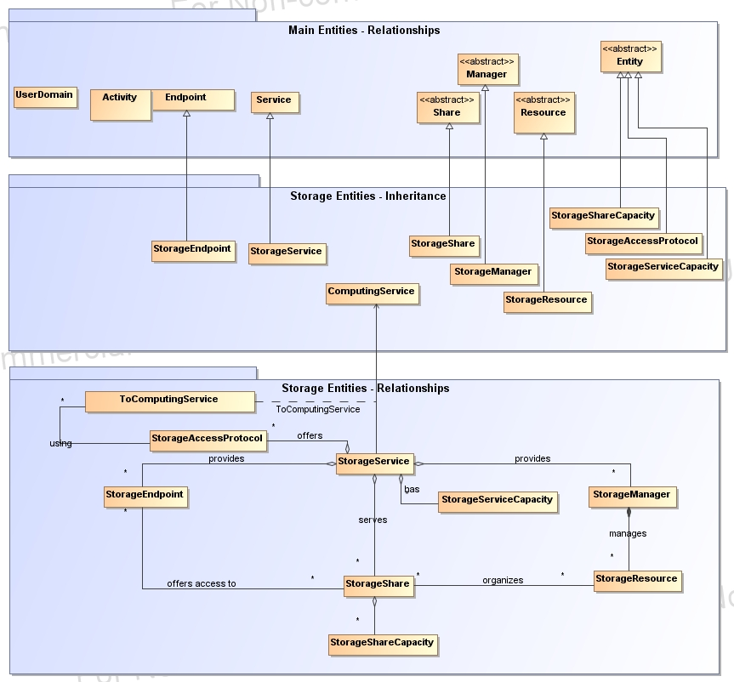
Storage Entities

Slide 14
Storage Entities Example
BLUE VO
GREEN VO
GLUE 2.0
concepts
blue
share
green
share
UserDomain
StoRM
AdminDomai
StorageService
GPFS
StorageEndpoint
10 TB Disk
StorageShare
StorageManager
StorageResource
AdminDomain

Slide 15
Benefits
So, makes the difference to Glue 1.3 ?
  Identification of main entities
  Higher flexibility
    Attributes/Entities are optional
    Service2Service relationship
    Domain2Domain relationship
  Predefined Values for Attributes
    Closed / open enumeration
  Less ambiguity
    Attributes are more defined
    e.g. total CPUs accounting
  Allows non model specific attributes by Extention entity
However:
  Gained complexity
  Not backward compatible to v1.3

Slide 16
Contributors for Adoption
OMII-Europe
EGEE
ARC
TeraGrid
UNICORE
DEISA
D-Grid
AustralianGrid
NAREGI
NGS
OSG
BREIN

Slide 17
Whats next?
Need to resume regular phone-conferences to digest all the comments and move to final version
  From October ’08
Preliminary Implementation Experience reports
Deployment plans
  Deployment of schema on BDII instances : 2 months
    Parallel with 1.3
  New Infoproviders after 4-6 months
  Obsoleting old info providers after 1,5-2 years

Slide 18
A Calculation Of Effort
Discussions, discussions..
  45 telephone conferences within 422days (~1,15years)
  ~6 participants / phone conference
  min 1,5h each => 67h of talking (rather 90h)
  42 draft versions => every 10days a new version
  18,261 words, 55pages => solidified ~272words/hour

Slide 19
References
OGF GLUE Working Group
  http://forge.ogf.org/sf/sfmain/do/viewProject/projects.glue-wg
GLUE 2.0 Documents
  http://www.ogf.org/pipermail/glue-wg/2008-May/000740.html

