Slide 1
EURISOL Initiatives
EURISOL-NET in ENSAR
EURISOL JRA in ENSAR2
EURISOL as a Distributed Facility

Slide 2
EURISOL-NET in ENSAR
4 topical meetings held: Catania (2009), Valencia(2011), Lisbon (2012), Krakow(2013)
2 technical meetings held: CERN(2010), Jyväskylä (2013)
1 Town Meeting held: Lisbon (2012)
1 deliverable submitted: Technical report
5th Topical meeting in York: Innovative instrumentation for EURISOL July 15-17, 2014 http://eurisol5.iopconfs.org/home
Joint Town Meeting with ECOS: Orsay Oct 28-31, 2014 (the EURISOL part is Oct. 30-31)

Slide 3
EURISOL-JRA in ENSAR2
4 tasks
  EBIB: Improving charge breeding and designing a future EBIS (led by CERN, F. Wenander)
  BEAMLAB: ISOL targets and ion sources with focus on molecular beams. (led by IPN Orsay, C. Lau)
  CRIBE: Chart of ISOL beam intensities in Europe (led by GANIL, M. Fadil)
  STUC: networking and Town meeting organization (led by INFN, A. Bonaccorso)
Total EU contribution: 670 KE ( 180 KE to CERN)
Coordinated by Y.B.
Submission of ENSAR2 in Sept. 2014.

Slide 4
EURISOL – Distributed Facility (DF)
Y. Blumenfeld, M.J.G Borge, M. Lewitowicz, P. Van Duppen, A. Facco, A. Maj
Background
2001-2005: EURISOL RTD
2005-2009: EURISOL Design Study
2010: EURISOL endorsed by NuPECC as highest long term priority for low energy nuclear physics in Europe
Existing & planned ISOL facilities in Europe:
  GANIL-SPIRAL2, HIE-ISOLDE, SPES, ISOL@MYRHHA, ALTO, JYFL , ECXYT
Eurisol collaboration : ISOL-based RIB facilities, other labs, funding agencies, university groups
  EURISOL Office
  EURISOL User group
  EURISOL MoU signed by GANIL (France), CERN, COPIN-IFJ (Poland) , SCK-CEN for Belgian EURISOL Consortium (BEC) (+ INFN on the way) -> Steering Committee
  EU support through ENSAR and ENSAR 2
  EURISOL NA in ENSAR
  EURISOL JRA in ENSAR 2

Slide 5
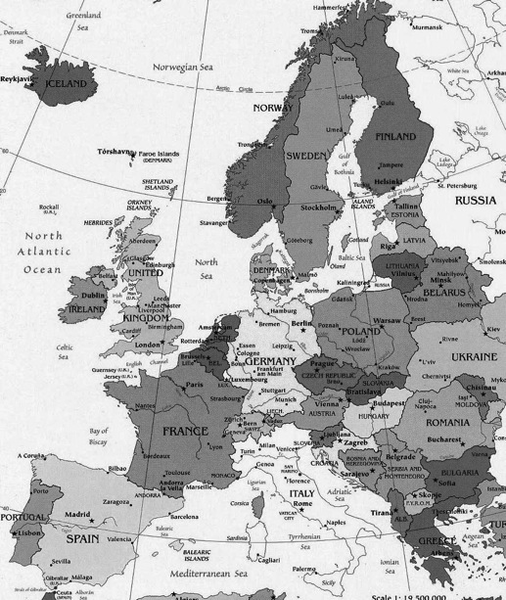
EURISOL – Distributed Facility (DF)
JYFL
6 European RIB ISOL Facilities
ISOLA@MYRRHA
GANIL/SPIRAL2
ALTO-CNRS
CERN-ISOLDE
LNL-SPES

Slide 6
EURISOL – Distributed Facility (DF)
Goals:
  Current ISOL-based projects and physics supported, optimized and coordinated
  EURISOL as a single site facility as a long term goal
Eurisol on the ESFRI list?: EU funding and trigger local funding
Note: FAIR and SPIRAL2 moved to the implementation phase and are no longer on the ESFRI list
Eurisol as a Distributed Facility :
Upgrade of the major ISOL facilities
Physics, R&D on RIB production, Instrumentation towards EURISOL
To be defined:
Members
Initially: GANIL-SPIRAL2, HIE-ISOLDE and SPES ?
Other potential candidates: ISOL@MYRHHA?
Smaller scale ISOL facilities; ALTO, JYFL?
Legal structure, coordination, responsibilities, etc. ?
More detailed presentation at the next NuPECC meeting ?

