Slide 1
News of the Group
Maria J. G. Borge

Slide 2
Outline
Fellows Associates and students
Courses and workshops during 2014
ENSAR 1
ENSAR 2
Financial situation of the collaboration
Collaboration Matters
News on 50th Anniversary of the Approval of ISOLDE
Letter of Intend to host AGATA@HIE-ISOLDE

Slide 3

Fellows, Associates & Students
Associates (new deadline 13th of September)
Alfredo Poves January - June 2014
Claes Fahlander July – Dec 2014
  New Applications: Palle Gunnlaugnnon
Corresponding Associates (new deadline 13th of September)
  Amandina Lima Lopes July-october 2014
  New Applications: Janne Pakarinen
Fellows: (new deadline 3th of September)
    Susanne Kreim, Dec 2014 (ground state properties)
    Elisa Rapisarda, Dec 2014 (Nuclear structure)
    Monika Stachura, April 2013- March 2015 ( Applied Sciences)
    Jan Kurcewicz, Nov 2011 - Aug 2014 (ENSAR, 5 months prolongation, EU)
    Miguel Madurga ( June 2014 – May 2016) (Nuclear structure)
    Stephan Ettenbauer (June 2014 – jan 2017, COLLAPS, Polarisastion beams)
    Akira Miyazaki (SC cavities)
    Kara Lynch ( Jan 2015 – Dec 2017)
    Doctoral student: Next deadline 6th of May 2014.
    DOCTORAL STUDENT For FIXED DECAY STATION : NEW
    Doctoral Program with Greece for life sciences (50% GR, 50% CERN):
      Stavroula Pallada (March 2014 - Feb 2017)
    Doctoral Program with Germany
      Laura Grob Jun2014 –
Technical student: : One next year for the ISOLDe Tape Transport system (50% PH + 50% EN)
Technicien: Julien Thiboud, -August 2014 (Col + EU support)
User support: Jennifer Wetterings (50% Col + 50% PH)
Notes:
discussion with Ph to get a Limited term contract 50% collaboration + 50% PH

Slide 4
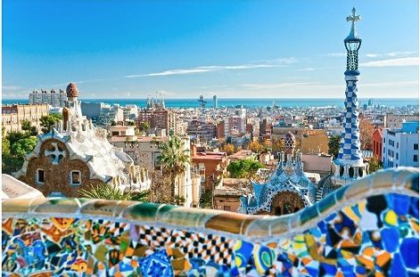
Courses 2014 / Workshops
Courses
Nuclear Reactions and Nuclear Structure Course
Wilton Cartford, Alexia DiPietro, and Antonio Moro
  22-25 April 2014
Separator courses in December 2014
Workshops
ISOLDE Workshop 15 – 17 Dicember 2014
One session dedicated to celebrate
the 50 years anniversary of ISOLDE approval.
CATHI (Cryogenics, Accelerators and Targets for Hie-ISOLDE) Review Meeting: The goal is to present to the ISOLDE community the results achieved throughout the duration of the CATHI project and their contribution to the HIE-ISOLDE project.
Date: 22nd – 26th September 2014; Deadline for inscription June 27th
Hotel H10 Marina, Barcelona, Spain http://www.hotelh10marinabarcelona.com/fr/index.html

Slide 5
ENSAR prolong until December 2014
Number of beam hours-Full Contract | 5200
provided as of 31/12/12 | 6946,4
Number of users- full contract | 400
Supported as of 31/12/12 | 352 (User counted 1 per IS-exp)
Number of days support- full contract | 2800
Supported as of 31/12/12 | 2244
Number of projects – full contract | 60
Supported as of 31/12/12 | 75 (different experiments)
T&S – full contract (EUR) | 252000
Distributed as of 31/12/12 | 256947 (309672CHF)
Number Experiments / researchers | 75 / 352
Rate of days per experiment | 4.69 researcher / exp
Access costs – full contract (EUR) | 291408
Access costs up to 31/12/12 | 389276 (= 6946,4 x 56,04)
Remining 32.759 CHF for 2014
Equivalent to 237 days.

Slide 6
ENSAR² (European Nuclear Structure and Application Research)
Mimbres of SSC: R. Alba, F. Azaiez, M.J.G. Borge, D. Cortina Gil, M. Freer, J. Gerl, H. Goutte (substituting for W. Korten), M. N. Harakeh (Chair), P-H. Heenen, R.D. Herzberg, : R. Julin, M. Lewitowicz, A. Maj, N. Pietralla, K. Riisager, K. Rusek, S. Szilner, L. Trache, K. Turzó, W. Weise
Maximum Budget 10 Meuros
Deadline for the application September 2nd 2014
Meetings 2014 @ GSI 10 April 2014, Paris 16-17 June 2014
  TNA for ENSAR^{2 :} : 47.4 %
    GANIL (France)
    GSI (Germany)
    LNL / LNS (Italy)
    JYFL (Finland)
    ISOLDE – CERN (Switzerland): 712.000 Euros (10 M)/ ENSAR 2009: 543.380 (8M) Euros
    ALTO – CNRS (France)
    KVI (The Netherlands)
    SLCJ-HIL / IFJ PAN (Poland)
    ELI-NP / IFIN-HH (Romania)
    ECT* (Italy)

Slide 7
JRA / NA
All Integrating Activity (IA) should be for the benefit of the Research Infrastructures (RIs) within the IA. The Trans National Access Activities (TNAs) are to serve the community by offering access to the advanced unique RIs of an IA.
NAs @ ENSAR² : 15,2 %
FISCO: Management NA
    NUSPRA: Network of facilities to propose common DAQ, electronics..
    MEDINET: nuclear applications (medical applications, e.g., hadrontherapy?)
    ENSAF: small scale accelerator facilities
    NUSPIN: Strengthen nuclear structure community
    GDS: Active targets (TPC gaseous detectors)
    MIDAS: ECR ion sources
The JRAs @ ENSAR² : 37.4 %
    TheoS(Nuclear Structure & Reactions)
    AGATA detector + applications
    ECOS: stable ion beams + medical isotopes
    EURISOL facility (all stages)
    RESIST: resonant ionisation techniques for separators
    PASPAG: particle and gamma detection
    SiNuRSE2: simulations

Slide 8
ENSAR² Beneficiaries per Country

Slide 9
Collaboration Matters

Slide 10
Income of the collaboration
Country | Amount per year (CHF) | 2013 contribution Received
Belgium | 60.000 | ✔
CERN | 60.000 | ✔
Denmark | 60.000 | ✔
Finland | 60.000 | ✔
France | 60.000
Germany | 60.000 | ✔
Greece
India | 40.000
Ireland | 10.000
Italy | 60.000 | ✔
Norway | 60.000 | ✔
Romania | 60.000 | ✔
Spain | 60.000
Sweden | 60.000 | ✔
United Kingdom | 60.000 | ✔
Bulgaria has agreed with the ISOLDE-MoU & Sergio Bertolucci has signed the 21st of March 2014
Poland is in the process to apply.
Algeria is interested in joining.
Paid 2010-2011
Notes:
The committee agrees that until Greece signs the updated MoU and has paid its outstanding fees it will no longer be considered a member of the ISOLDE collaboration.

Slide 11
Expenditure 2013
Expenditure Collaboration
Contribution 2013 and 2014 to HIE-ISOLDE already transferred.
Minimum Expenditure foreseen for 2014 250.00 – 300.000
(presently: 134.264 SCHF)
Balance 23 June 2014 431. 810,15 SCHF
Contribution 2012 96,2 % received
Contributions 2013 75 % received
Contributions 2014 52.5 % received

Slide 12
HIE-ISOLDE 2
Revised MTP in May: "From a physics point of view, an early implementation of the TSR at the HIE-ISOLDE facility would be desirable. However, given the shortage of manpower and the need to focus on the LHC programme, this revised plan proposes the completion of HIE-ISOLDE Phase 2 a year later than previously foreseen, provided external funding is secured. This implies physics exploitation of HIE-ISOLDE Phase 2 (10 MeV/n) and the integration of the TSR only after the completion of LS2. The TSR commissioning would be 2.5 years later.”
It Is Important to maintain the contribution of the collaboration for the period 2016-2020.
As we have to pay the loan at a rate of 140 kCHF/y we should engage 400 kCHF / y
The SPC afterwards after some lobbing was informed that the 10 MeV/u is foreseen for physics in 2017. The full SPC was reassured by this statement and Mark hopes it is taken up in the minutes. Concerning the TSR, the SPC recommends the revision of the plan to postpone the integration to after LS2.

Slide 13
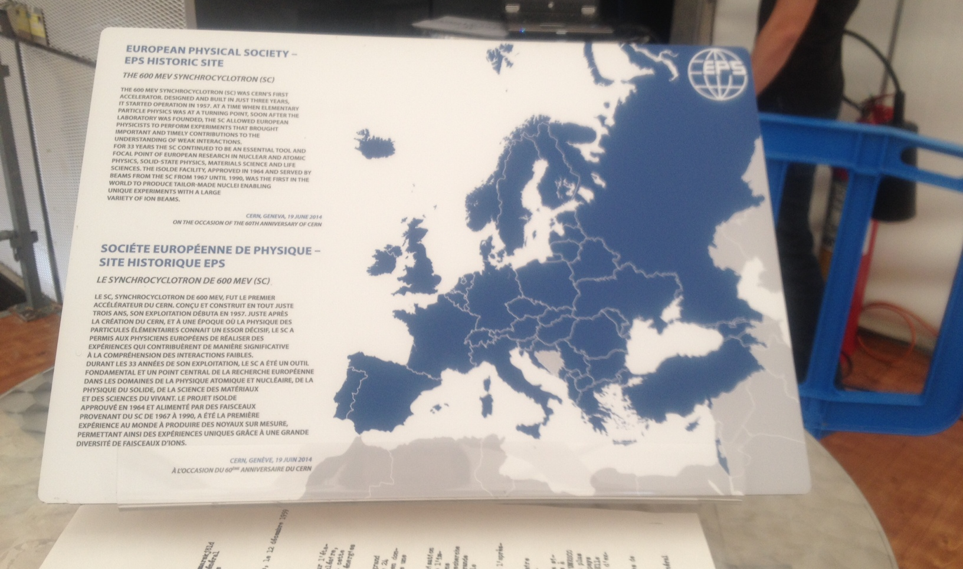
Celebration 60 y: Inaguration of the Synchrocyclotron Visit Point:EPS historical Building
“The ISOLDE Facility, approved in 1964 and served by beams fro the SC from 1967 till 1990 was the first in the world to produced tailored made nuclei enabling unique experiments with a large variety of ion beams.”

Slide 14
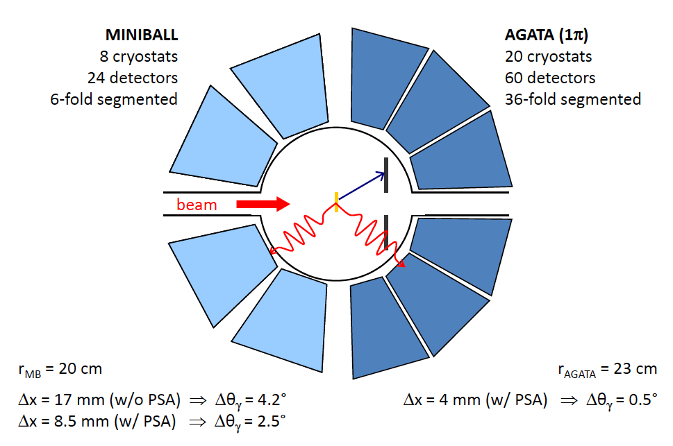
AGATA @ ISOLDE
The AGATA Collaboration has to decide soon on where to locate the instrument from 1/1/17 for its next science campaign (typically 18-36 months). Two applications: prolongation at GANIL and RIKEN
LoI’s submitted to the AGATA collaboration (to Giacomo de Angelis)
27th of May 2014.
Proposal submitted for 2020-2021 based
Have full energy
Increase of intensity from
LINAC 4 + 2 GeV of PS Booster.
It will be defended by the Miniball chair
P. Reiter June 26th
CONCLUSIONS: The ISOLDE community is interested to host the AGATA detector. Considering the time scale of the HIE-ISOLDE project and the expected increase in intensity due to the advent of Linac4 and the increase of energy of the PS-Booster we would like that the AGATA collaboration considers the option of moving the AGATA detector to couple to Miniball for 2020-2022. This move will require a certain effort for the AGATA collaboration, as ISOLDE as such has no strong technical in-house support. At the same time we think we can guarantee ample beam time and the largest variety of tailored made radioactive beams in the world. The period from 2017-2018 is not very efficient as the second Long-shutdown at CERN is foreseen now for mid-2018.

Slide 15
Call for Physics Coordinator
Description
The coordinator is responsible for the management of the experimental physics programme at ISOLDE.
He/she defines the beam schedule and oversees its implementation in cooperation with the ISOLDE technical staff. He/She acts as liaison between the users and the technical staff.
The coordinator also serves as Group Leader In Matters Of Safety (GLIMOS) at ISOLDE and as scientific secretary of the ISOLDE Neutron Time of flight Committee (INTC).
Qualifications: PhD in Physics with some post-doctoral experience.
Prerequisites: -good communication and organizational skills-experience or knowledge of ISOL techniques for radioactive ion beam production-research experience employing radioactive ion beams-some acquaintance with the physics programme at ISOLDE.
Procedure:
1) call for candidates: 1 August – 1 October
2) set a committee to look at the candidates and build a short list of 3-4 candidates.
Invite them for a short presentation in the ISCC meeting of 4th of November

Slide 16
PUBLICATIONS
YEAR | N. PUBLICATIONS | PH. D thesis
2010 | 67 | V. Bilstein T.E. Cocoolios R. Domínguez Reyes D. Fink S. Naimi D. Neidherr K. Wimmer A. Meaney
2011 | 49 | M. Albers J. Lommen O. Müller M. Thürauf M. Zboril
2012 | 62 | Ch. Borgmann E. Estevez J.G. Johansen T. E. Mølholt A.B. Perez Cerdán M. Seidlitz M. Stachura
2013 | 90 | P. Kessler B. Siebeck T.J. Procter D. Di Julio J. Cullen K. Kreim K Lynch J.A. Briz B. Olaizola
Please send us the reference and if possible a copy of the thesis done based in data from ISOLDE

