Slide 1


ISOLDE: Status report building 508
70th ISCC meeting
CERN, 24 June 2014
Erwin Siesling, Magda Kowalska

Slide 2
Outline
  Status new building 508:
  Progress on the construction
  Building layout
  Progress on infrastructure
  Costs and timeline

Slide 3
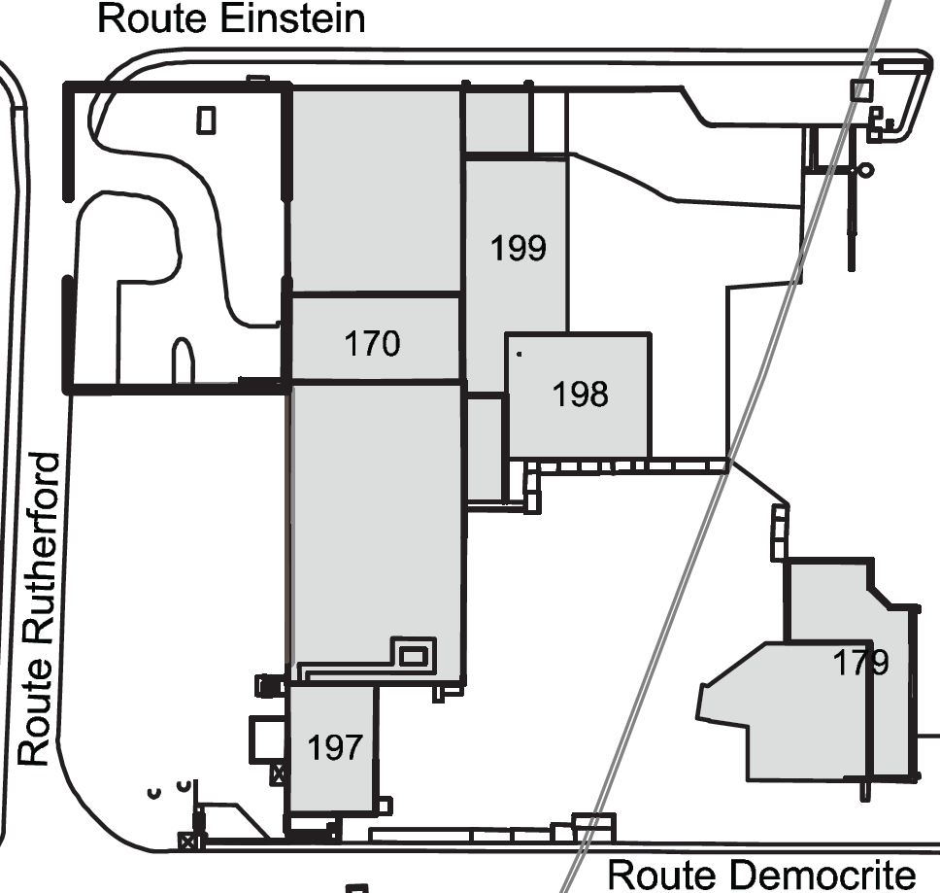
New building 508
Reserved for TSR
New user facilities building 508
(replacing 507, 115, 601)
ISOLDE experimental hall
New ISOLDE Control Room, 1st floor 508
508
Target zone and separators area
water station
Present ISOLDE Control Room, basement 197

Slide 4
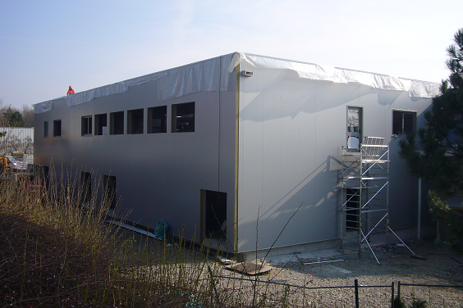
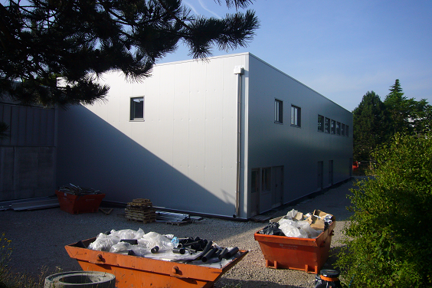
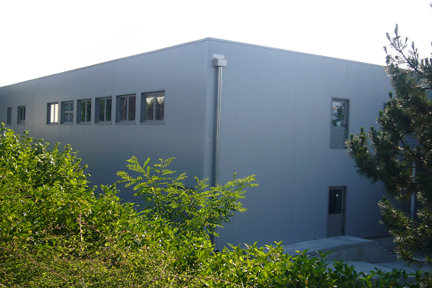
Construction progress
Progress since the 69th ISCC (31 March ‘14):
Roof finished and tight
All windows, outer doors, stairs and inner walls installed
Openings and windows towards the Isolde hall in place
Outdoor concrete ramp and stairs done
Drainage and piping sanitaria ongoing
March 2014

Slide 5
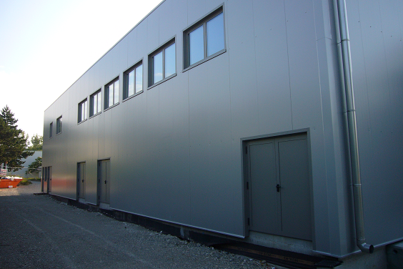
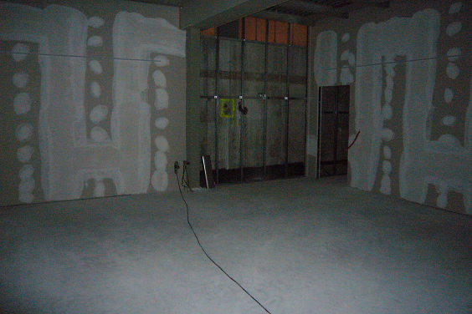
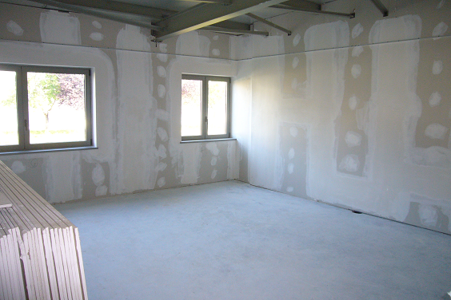
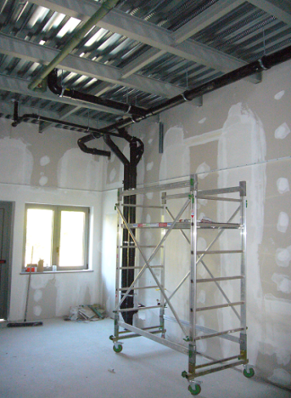
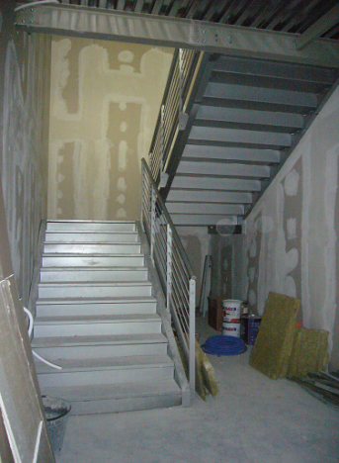
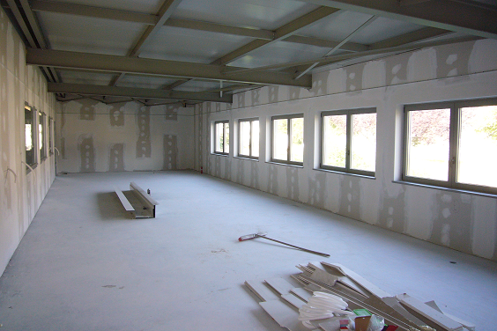
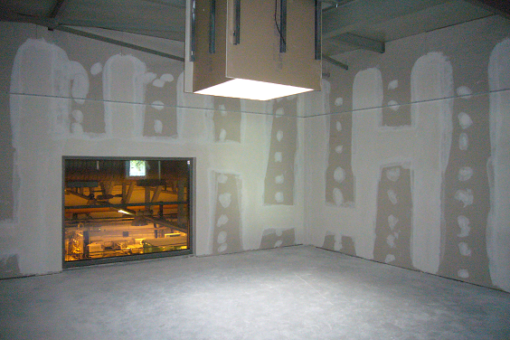
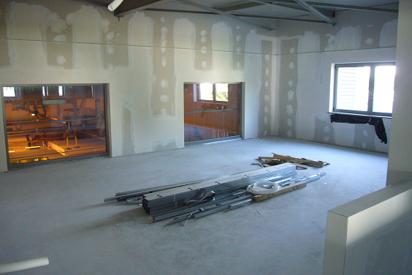
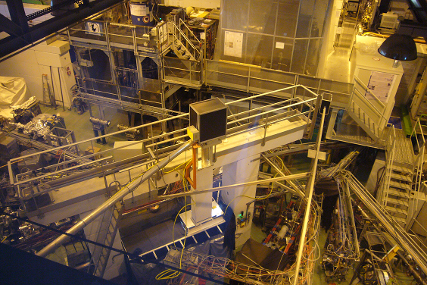
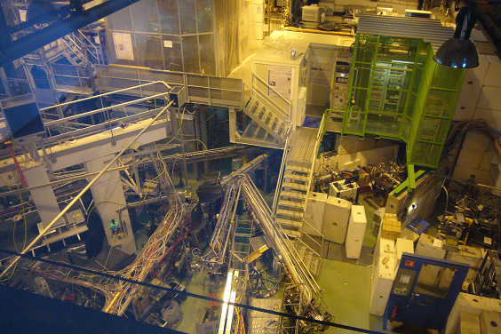
Construction progress

Slide 6
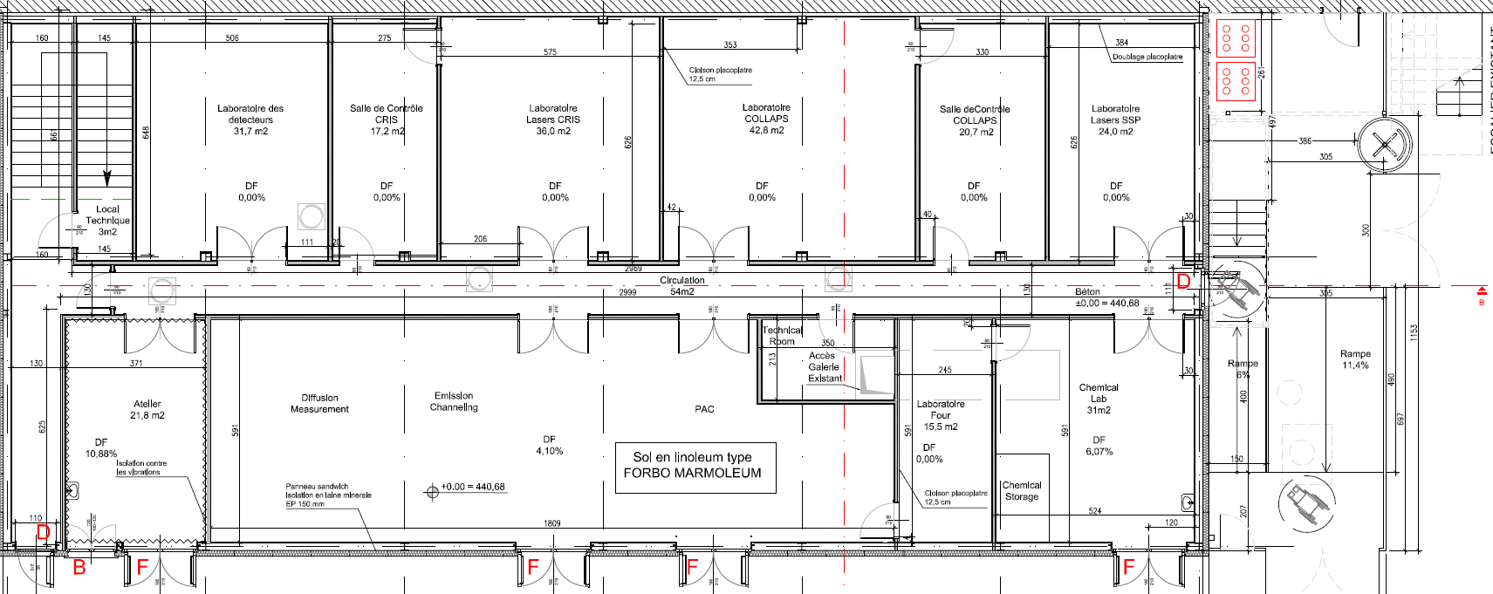












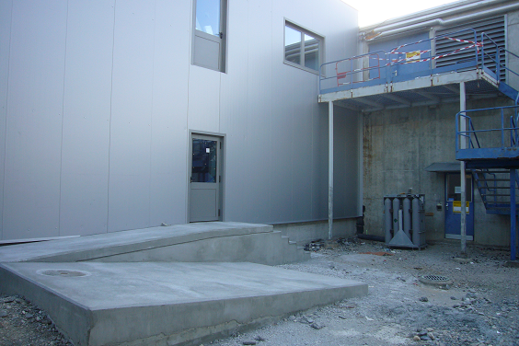

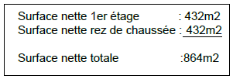
Layout 508
Ground floor B508:
Access hall
Access 508
1st floor
Controlled Access
508 ground floor and Isolde hall
Access 508 1st floor

Slide 7
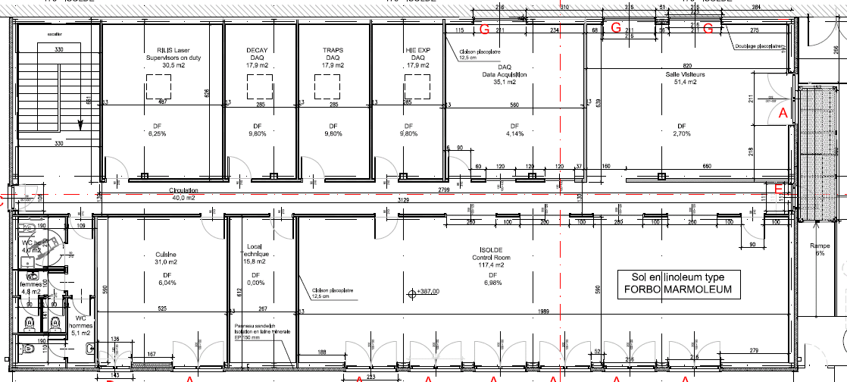









Layout 508
1st floor B508:
Access 1st floor
Access 1st floor
Courtesy Eliseo Perez-Duenas GS/SE

Slide 8
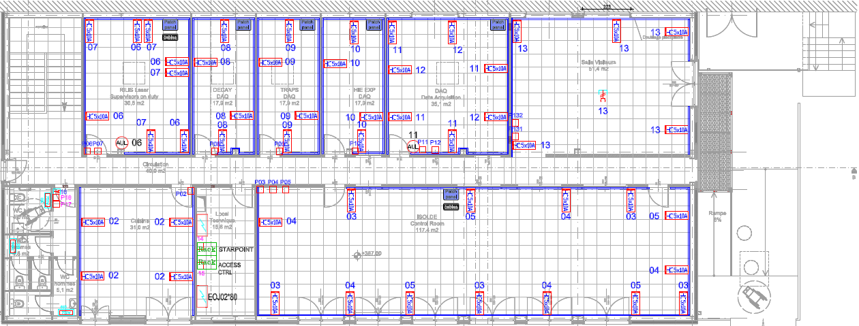
Infrastructure 508
Electricity:
- User needs: 200kW
- Cooling& Ventilation needs (re-designed): 130, 170, or 220kW - 40kW
Equipment cooling:
- New building, new rules.. Negotiating with HSE to use eau brut as before (with future change to a closed, chilled water, system)
User needs: COLLAPS, CRIS each: 50kW -> 20l/min, 3 wks/yr running
(Total 2 x 1.2m3/hr x 24hrs x 7days x 3wks = 1209.6m3 (about 1500chf))

Slide 9
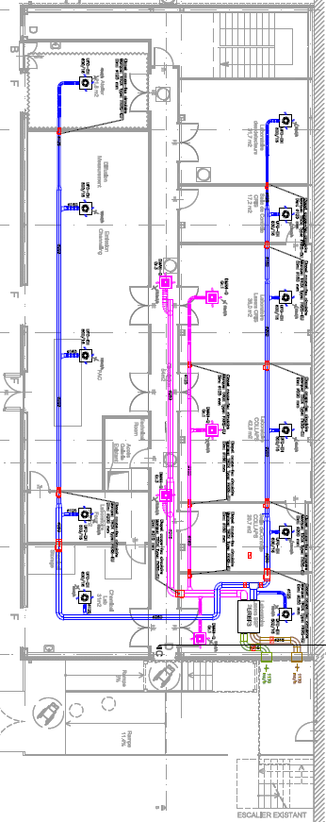
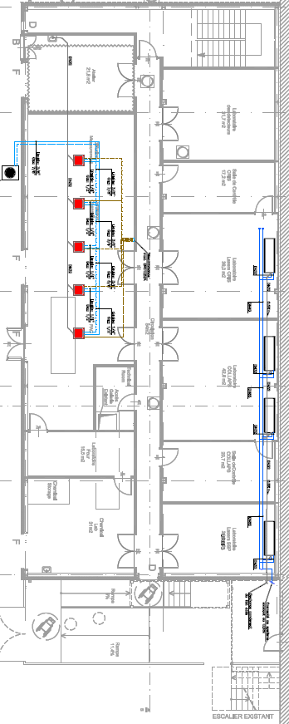
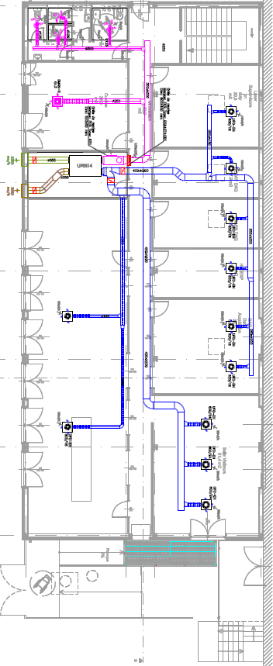
Infrastructure 508
Cooling and ventilation:
The proposed solution by the contractor was two HVAC (Heating Ventilation and Air Conditioning) systems based on a refrigerant liquid => too expensive and a new design was required:
  General ventilation: fresh air to all rooms
  Heating: through electrical radiators
  Labs air-conditioning:
    For the laser labs SSP, COLLAPS and CRIS labs fan-coils (4x7kW using existing ISOLDE chilled water)
    For the SSP lab a separate refrigerant airco system (27kW)

Slide 10
Costs and Timeline
Total costs building 508 (incl. services):
estimate 2MCHF (staying within with adapted CV systems)
Timeline:
Building ready April 2014 -> May
  ready since May
  to do inside: doors, sanitaria, false ceiling & walls (waiting for CV/EL)
Infrastructure ready June 2014 -> September
  Re-design caused substantial delay (3 mnts)
  EL and CV to start asap
  Asphalt & metal passage structure this month
Installation controlled access June 2014 -> July
  Tourniquet and fences installation
Installations users as of July 2014 -> As soon as possible
  Emphasis on COLLAPS (SSP & CRIS workaround)
  Move of the ICR during shutdown 2014/15
ISOLDE Milestones: Protons to Isolde 10 July 2014;
physics ISOLDE start 21 July
    physics from 508 start ..

