Slide 1
CERN-MEDICIS:
Production d’isotopes selon l’approche « ISOLDE » pour la recherche médicale: A NEW INSTALLATION
Thierry Stora
ISCC
June 2014

Slide 2

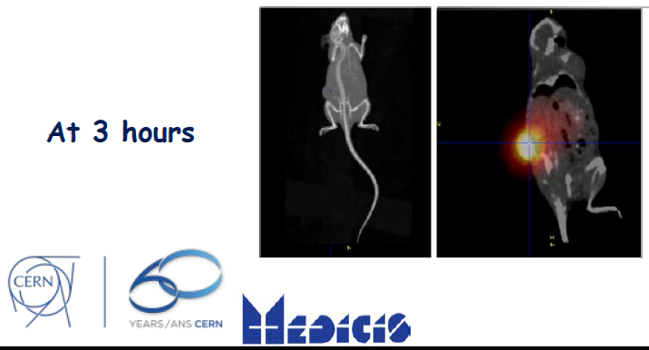
The idea behind
This is not:
But will rather serve that purpose
(shown at last ICTR-PHE conference in Feb 2014 )

Slide 3
It made its way
to the local newspapers

Slide 4
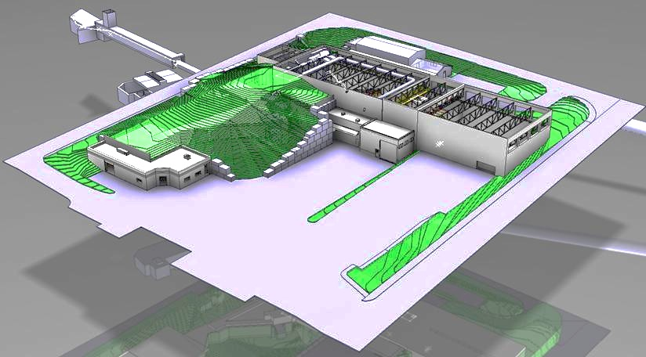
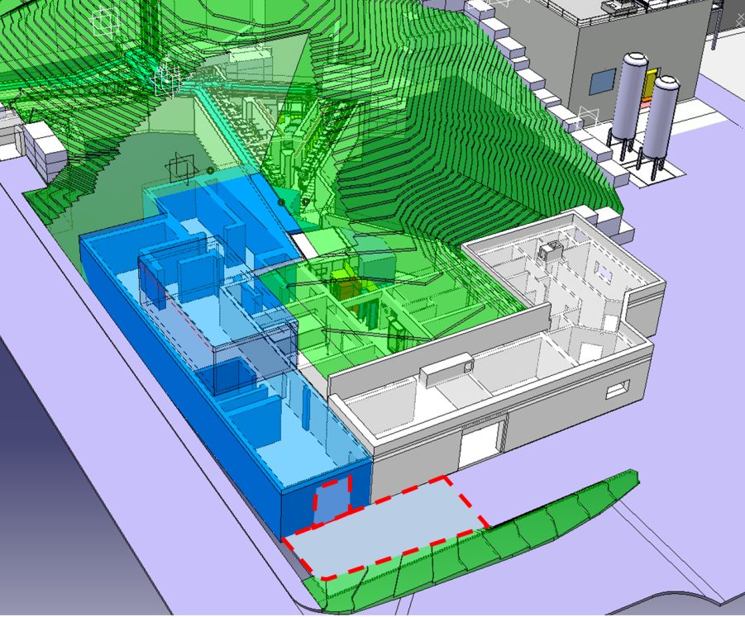
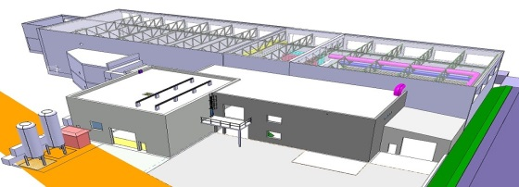
Ongoing upgrades
Long-Shutdown 1 (~18 months)
Ca 50% of PSB Protons are sent for the ISOLDE physics program
Bld 508
(soon a TSR ?)
Tunnel :
Proton Synchrotron Booster
transfer line to ISOLDE
Target building (Class A)
HIE-ISOLDE
MEDICIS building

Slide 5

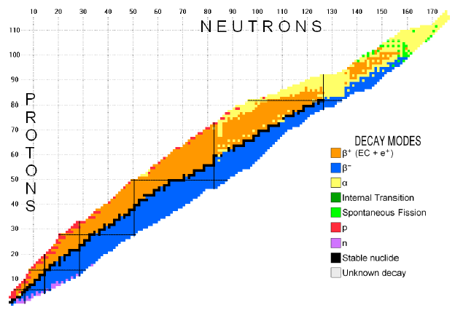
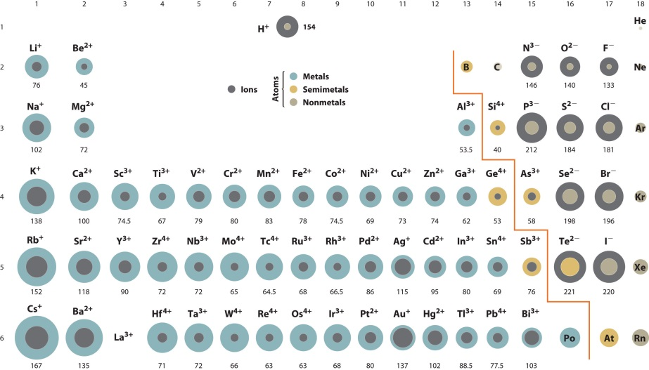
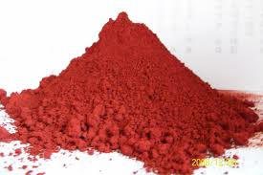
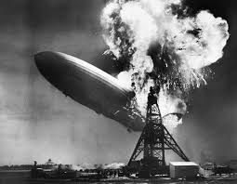
Production of Radioactive ion Beams

Slide 6
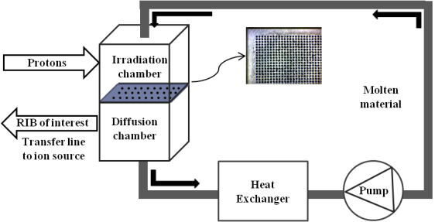
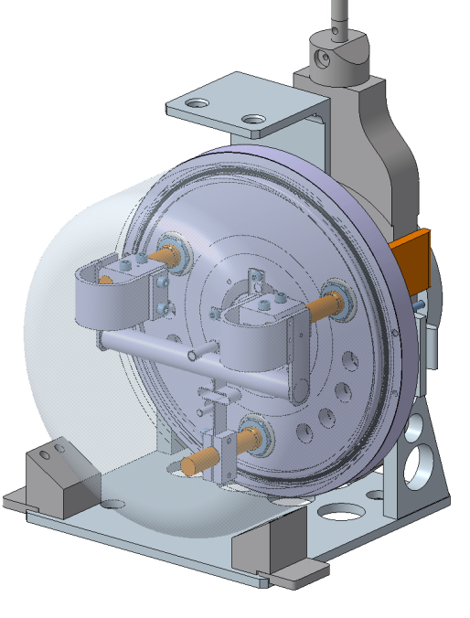
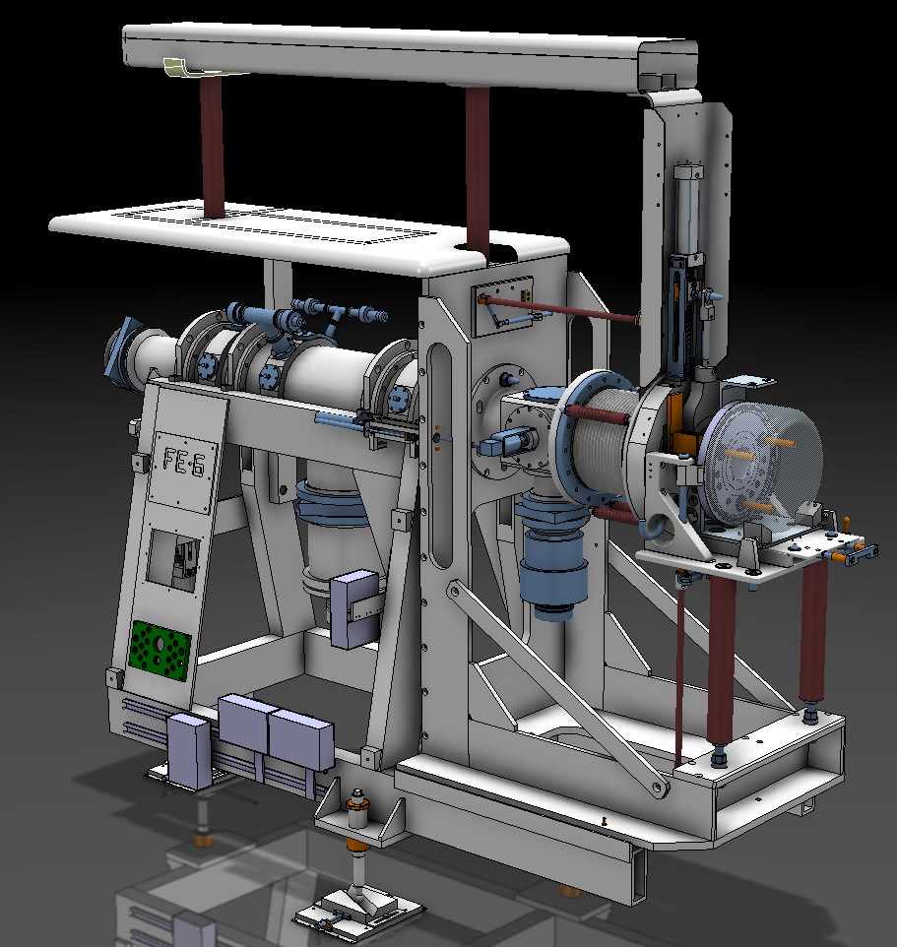
The ISOL method
spallation
1.4 GeV protons
fragmentation
fission
Target unit
Front End (target station)

Slide 7
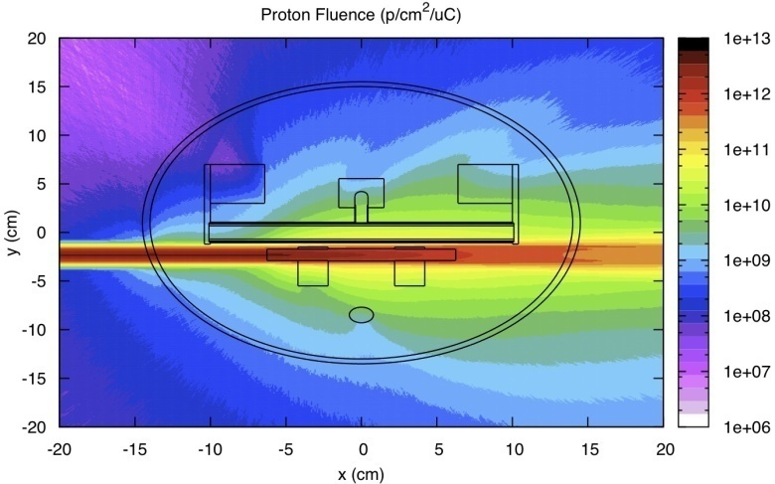
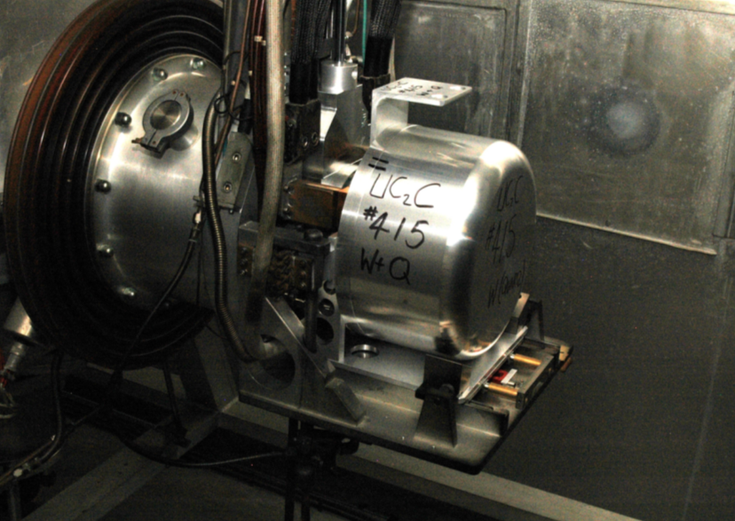
The MEDICIS fingerprint
90% are
going to the dump:
We can recycle them

Slide 8
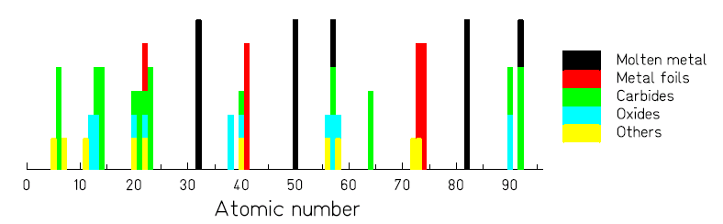
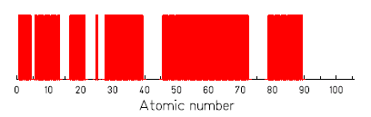
1000+ isotopes of 70+ chemical elements
Exotic isotopes down to t_{1/2} ~ 10 ms)
Intensities up to 10¹¹ ions/s
30+ types of targets
Transfer lines
10+ ion sources

Slide 9
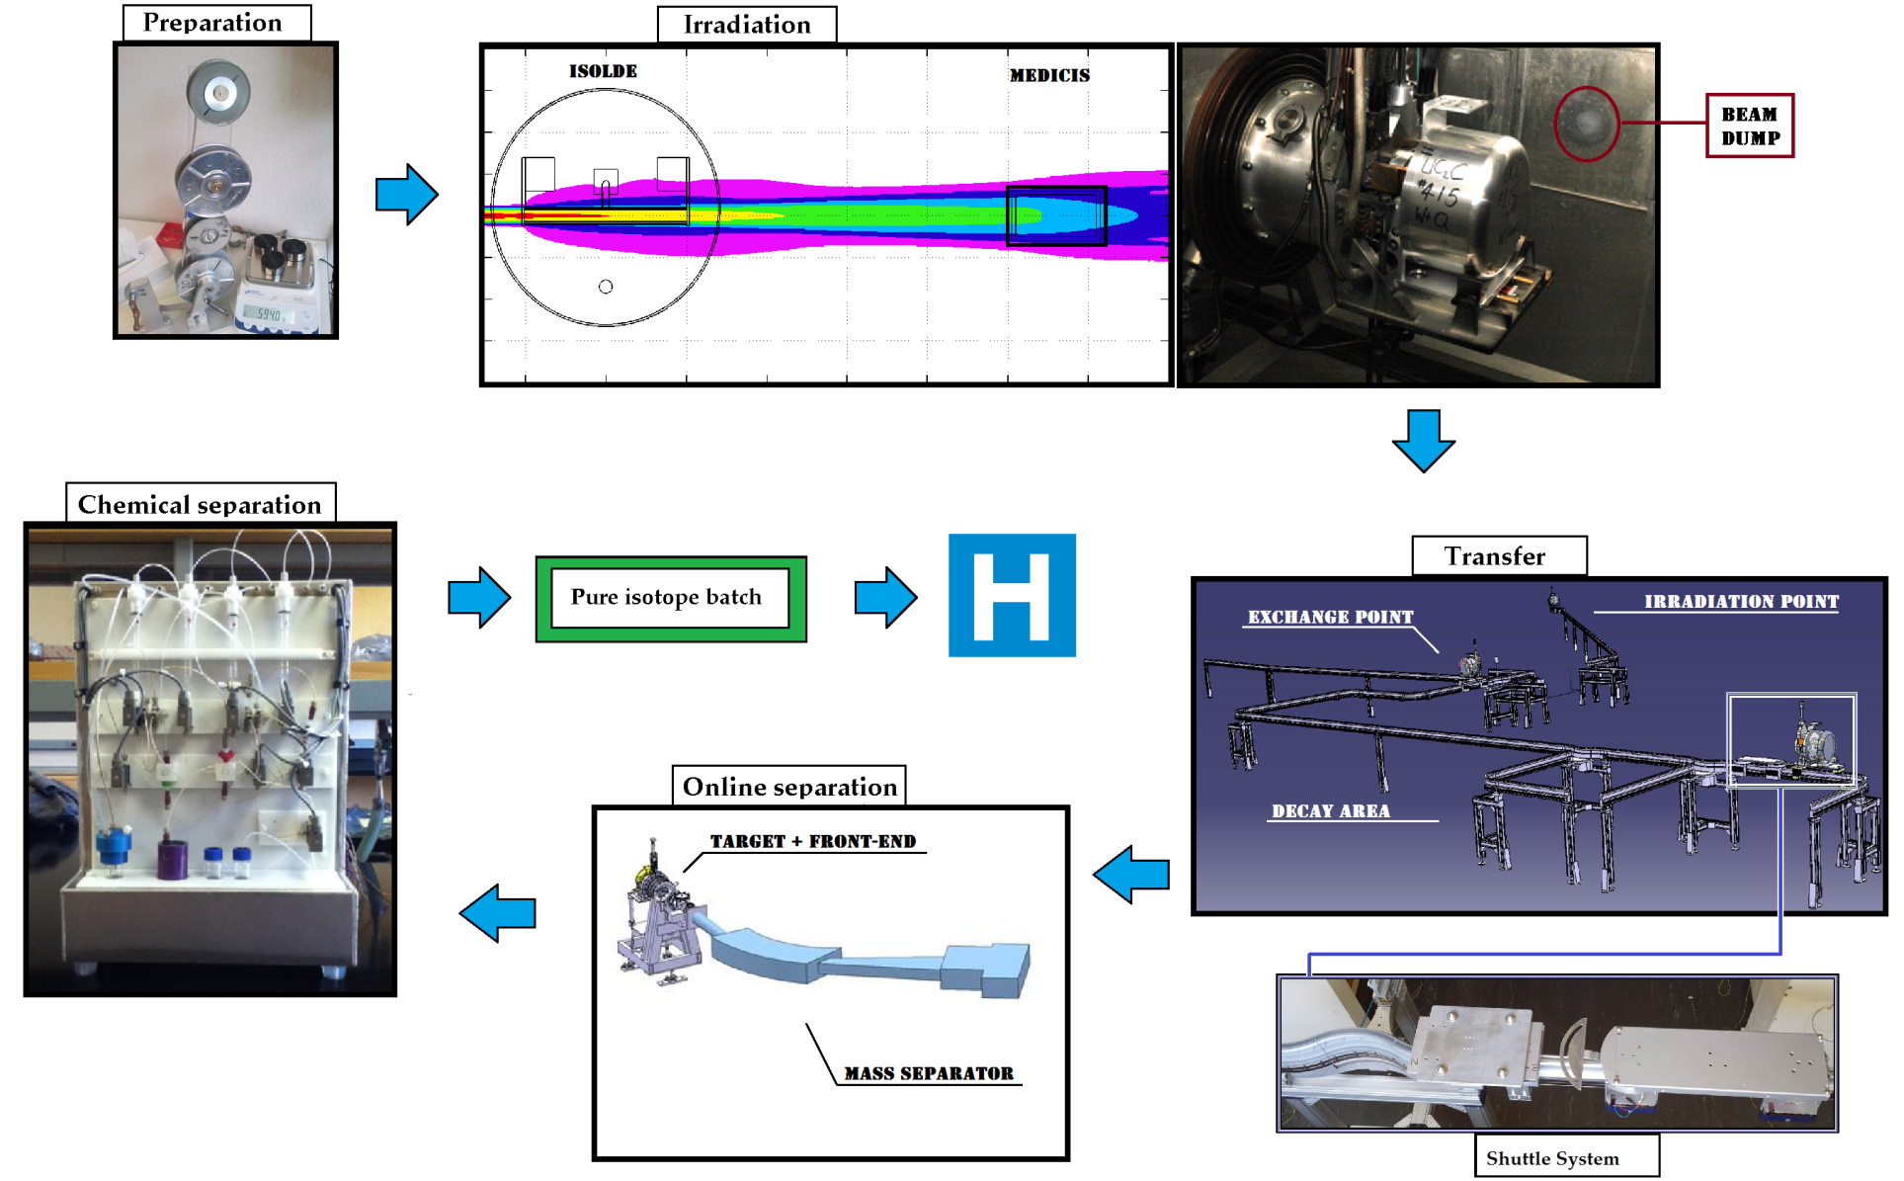
The complete cycle of MEDICIS

Slide 10
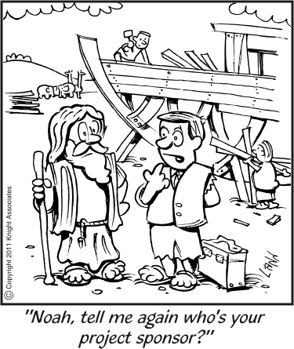
The Project

Slide 11
The planning proposal *
*subject to modification…
 | Construction | 2013-2015
PHASE I | Commissioning : No beam | end 2015
PHASE II | Commissioning with beam and light targets to gain operational experience | 2016
PHASE II B | Isotope production with light targets | mid 2016
PHASE III | Extending to heavy targets up to Tantalum | end 2016
PHASE IV | Collection of short lived alpha emitters (e.g. 149Tb) | 2017
PHASE IVB | Operation with Lasers
PHASE V | Operation with Uranium targets/possible proton beam upgrade | 2018

Slide 12
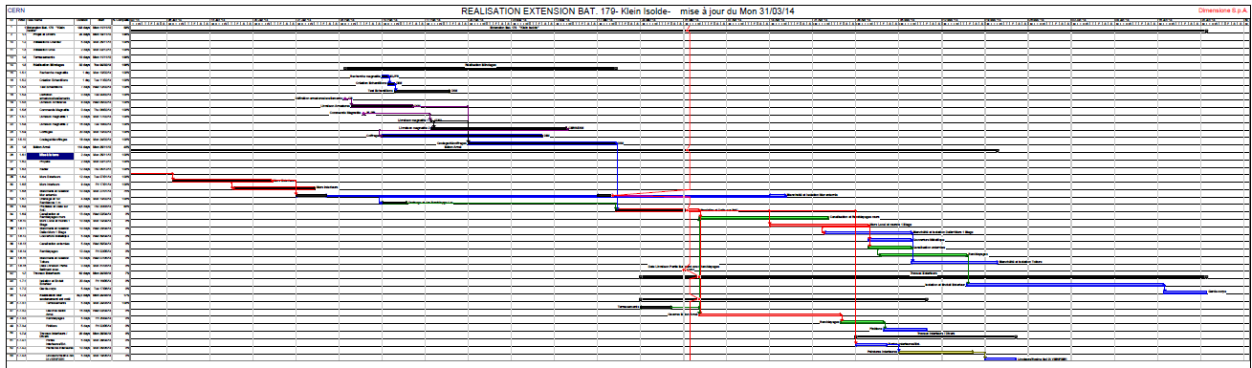
Planning for the building *
*It will be finished for the ISOLDE start-up this coming July

Slide 13
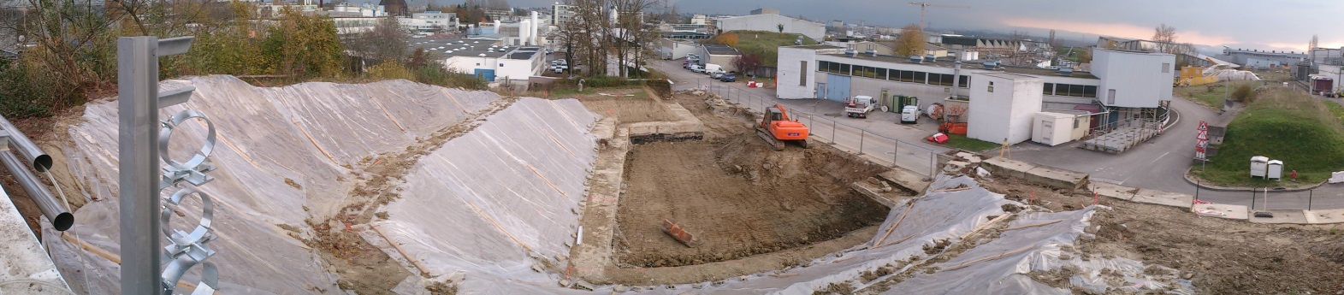
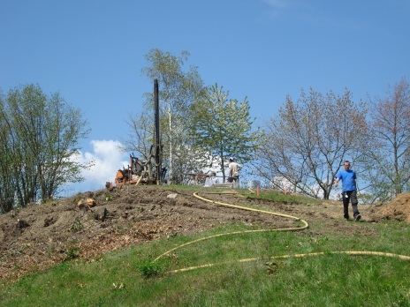
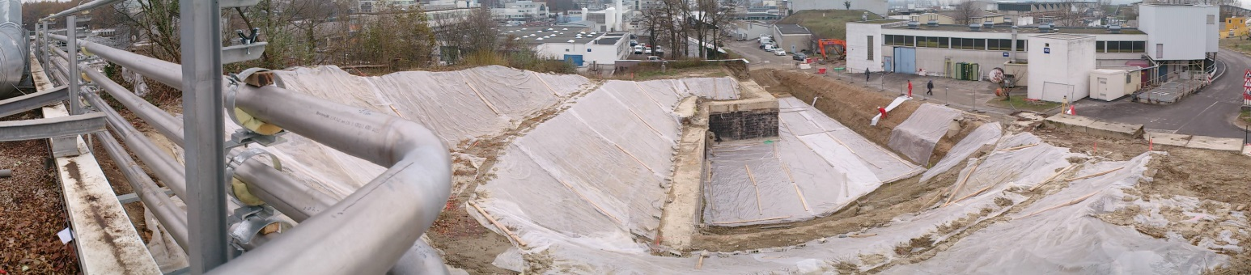
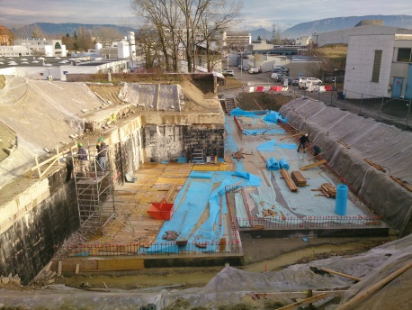
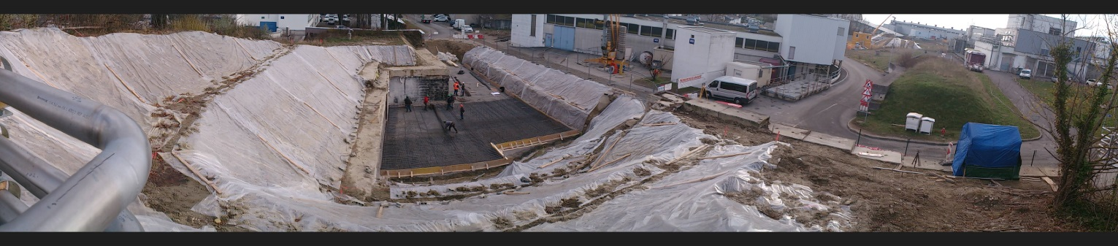
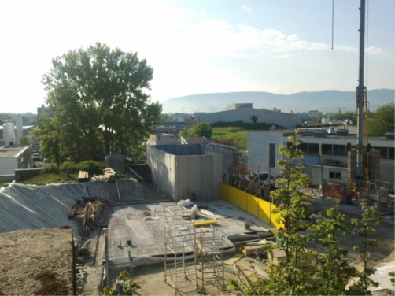
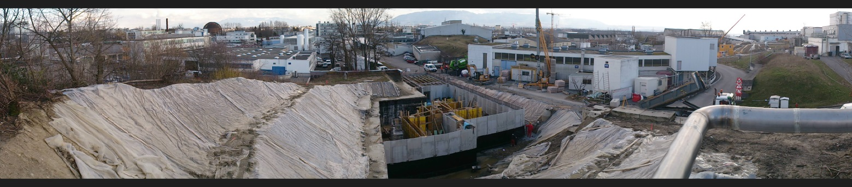
Building (Sept 2013→Jun 2014)

Slide 14
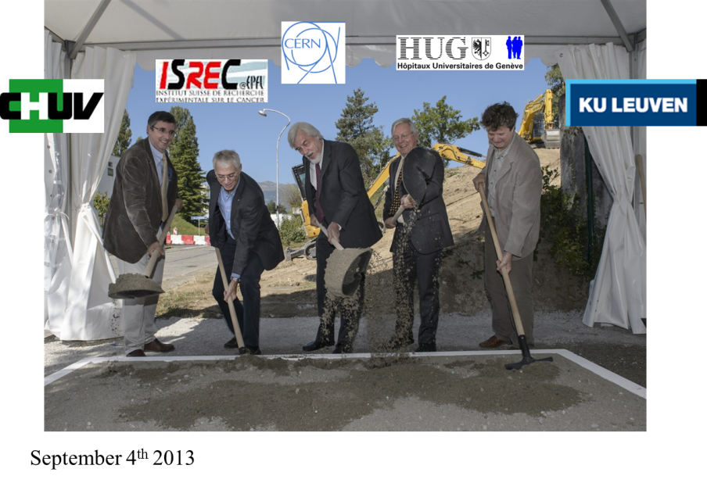
The Ground-breaking

Slide 15
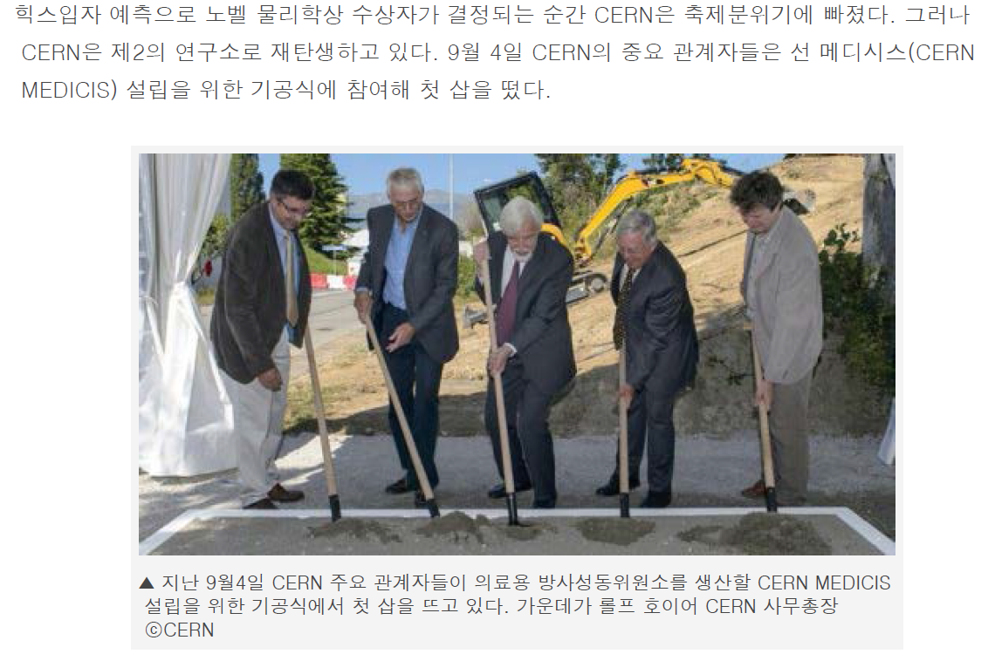

Slide 16
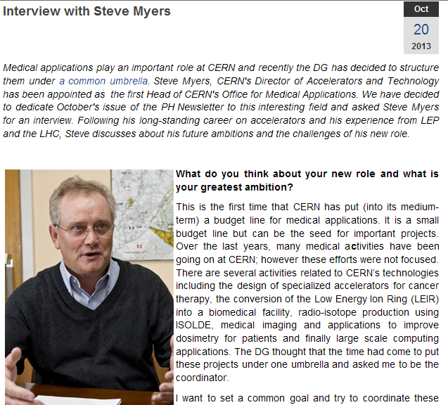
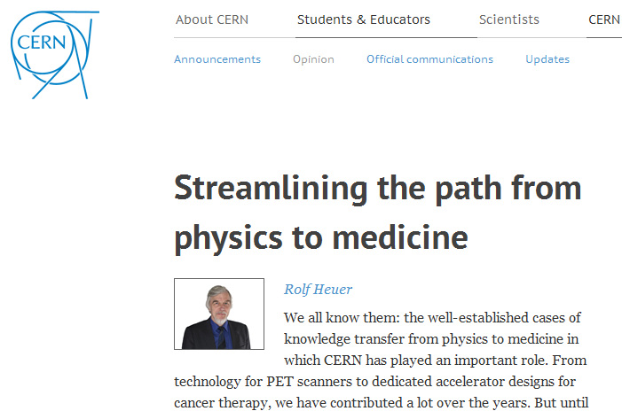
A new office for biomedical applications at CERN
Kick-off meeting : 22 Nov 2013
Brainstorming in Divonne Les Bains 15-16 Feb. 2014

Slide 17
Overview of the team
The MEDICIS team at CERN:
T. Stora (MEDICIS), S. Marzari (Building, WPs), R. Catherall (HIE-DS coord, WPs), A.P. Bernardes (g-al safety, WPs), K. Kershaw (remote systems, WPs), Z. Lawson (KT aspects)
M. Vagnoni (RCS), R. Augusto (Fluka), A. Polato (CV), E. Perez-Duenas (Bld), V. Barozier (Intégration), R. Necca (EL), J.L. Grenard (Robot), C. Mitifiot, M. Stachura (Bio R&D), J. Vollaire (RP), A. Dorsival (RP), EN-MEF (tbc, doors), Y. Martinez (isotope separator), T. Wijnands (quality), etc
tbcont’d

Slide 18
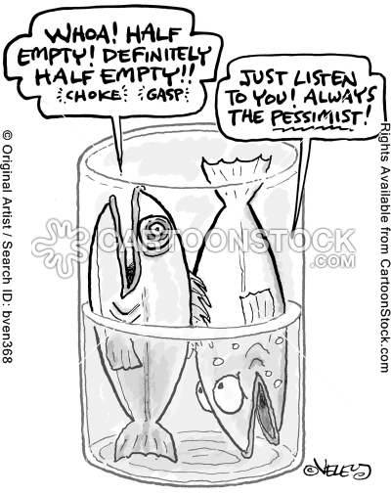
Some recent news

Slide 19
Building integration
Laser source barrack
Revue de Safety en été 2013

Slide 20
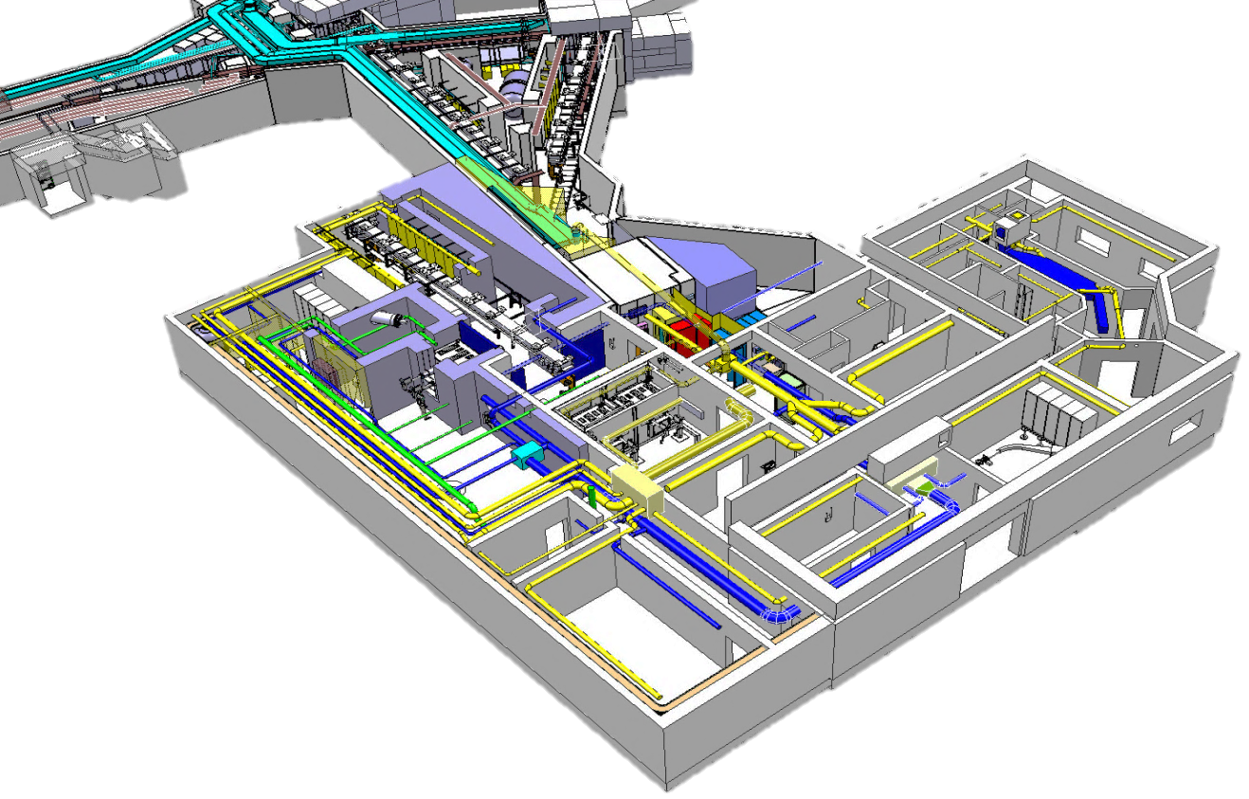
Integration

Slide 21
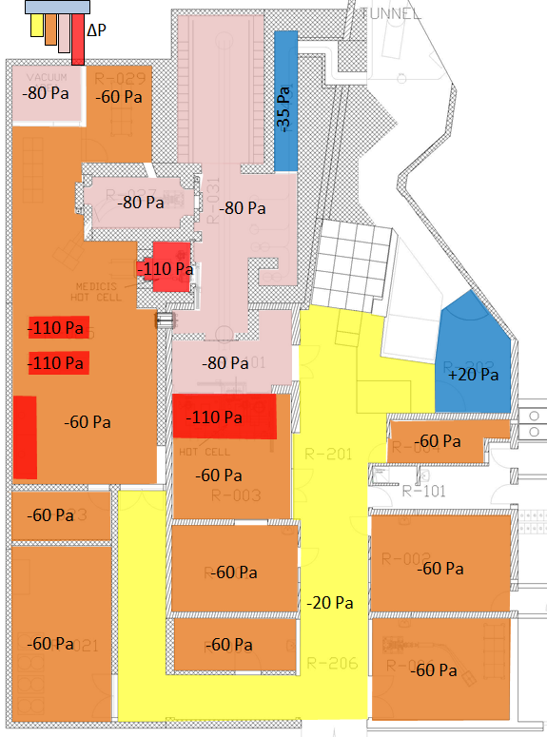
Ventilation : an important aspect
Next steps:
Final validation (meeting with OFSP Yesterday)
Installation
Connection in 2014-2015

Slide 22
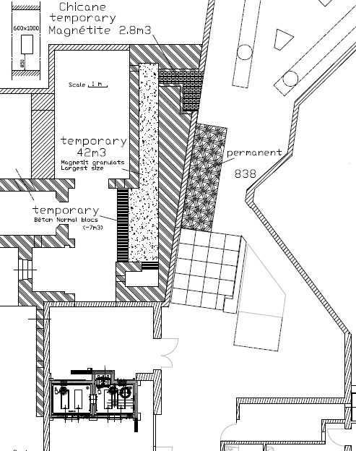
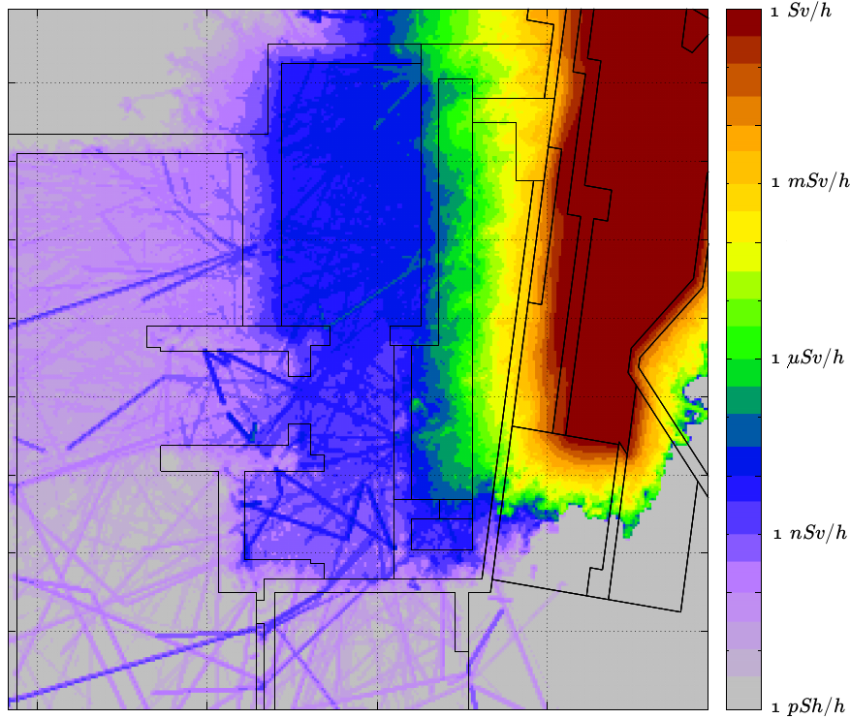
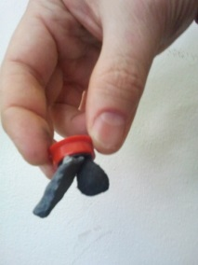
Magnetite concrete for temporary and permanent shielding

Slide 23
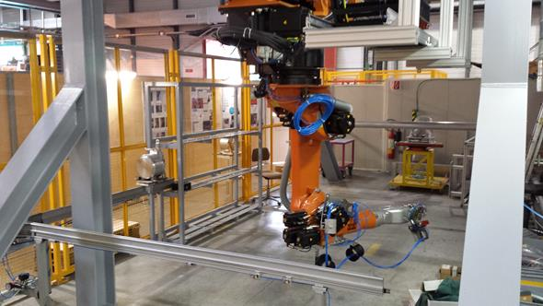
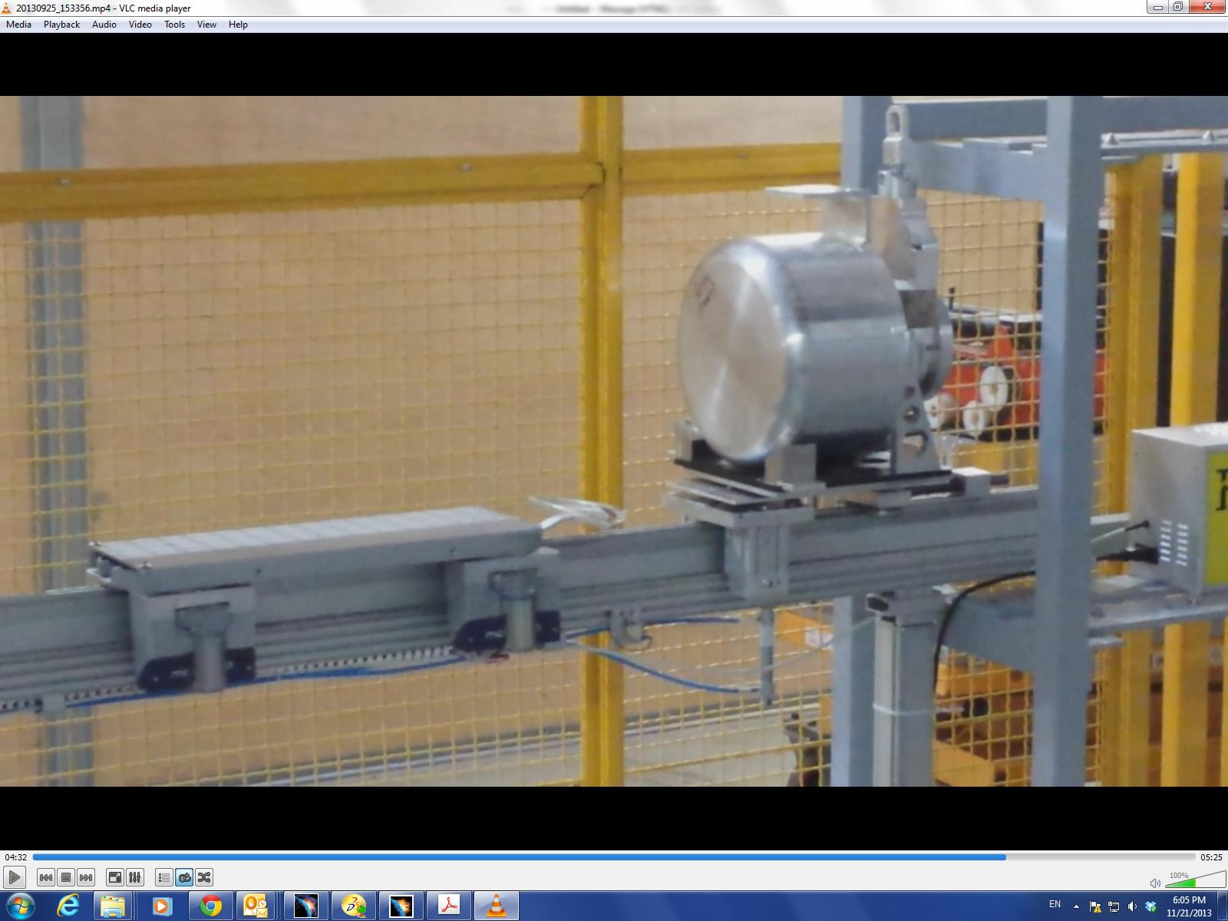
The robotic system
Tested during open days

Slide 24
Other alternatives investigated…

Slide 25
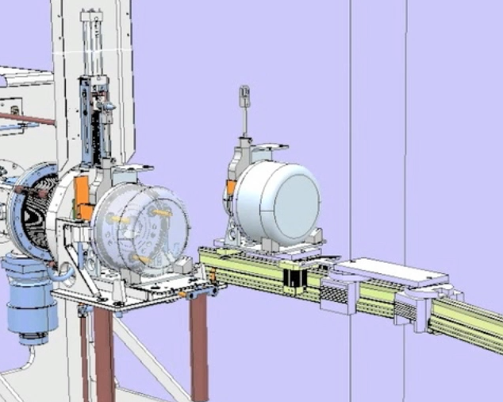
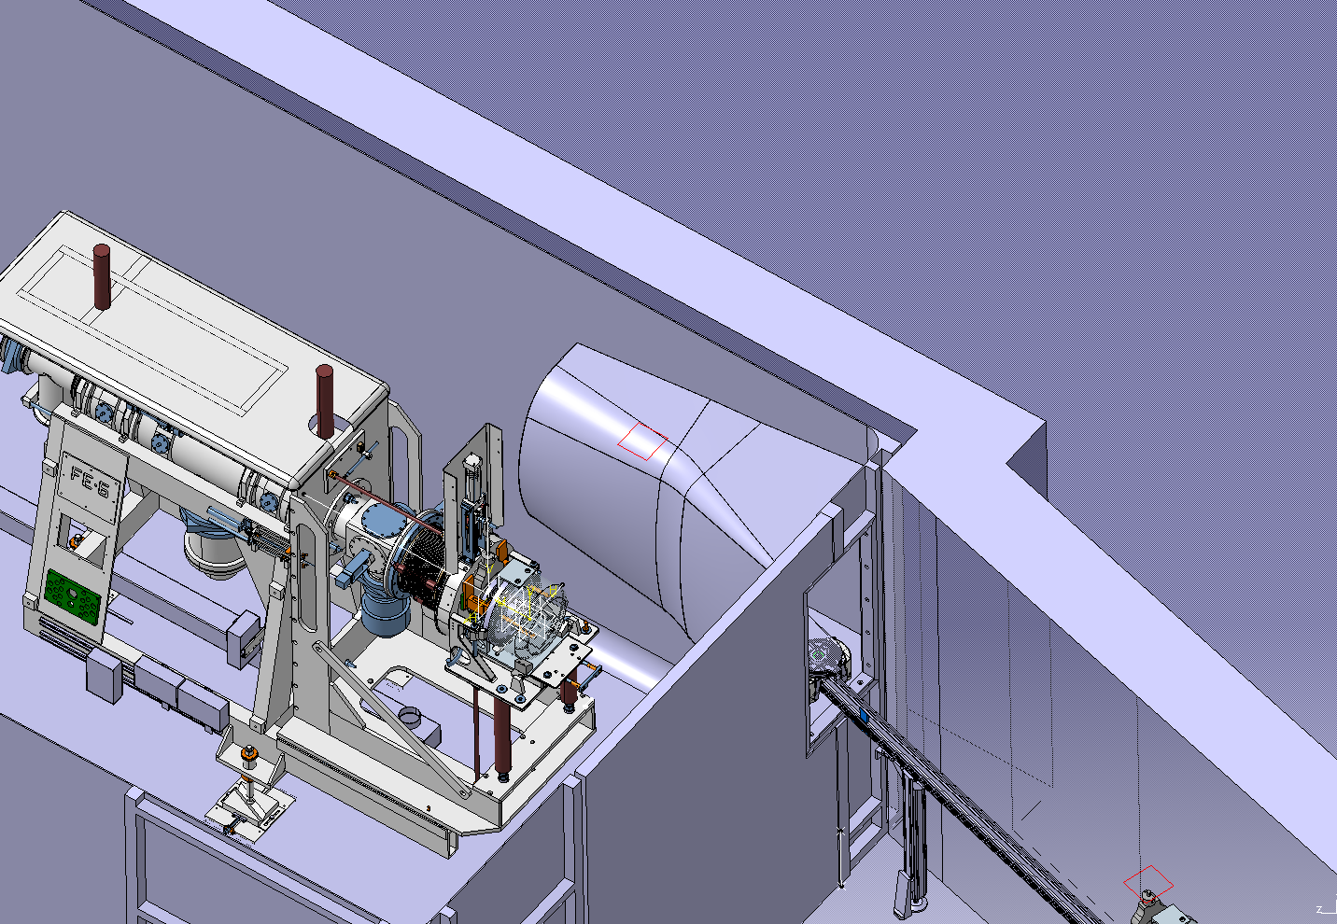
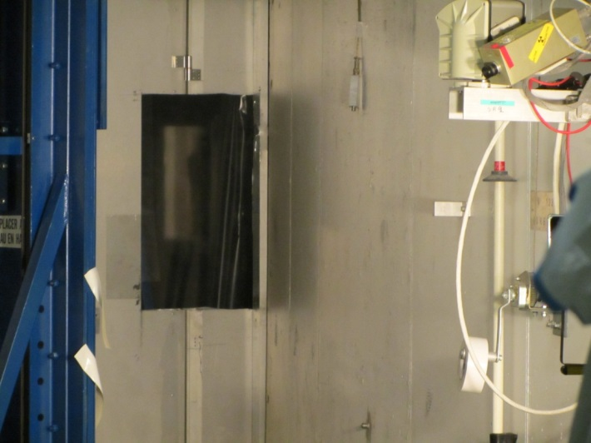
Tests with beam in July

Slide 26
The LISOL separator at KU Leuven

Slide 27
CERN-MEDICIS
What for?

Slide 28

External partners
Dr. Forni (Clin. Carouge, Geneve)
Prof. Morel, Prof. Buehler, Prof. Y. Seimbille, Prof. Ratib (HCUGE, Geneve)
Prof. D. Hanahan (ISREC, EPFL, Lausanne)
Prof. F. Buchegger, Prof. J. Prior (CHUV, Lausanne)
Prof M. Huyse, prof. P. van Duppen (KUL, Univ. Leuven)
Prof. S. Lahiri (SINP, Kolkata)
Prof. I. dos Santos (CT2N, Lisbon)
Prof. E. Piperkova (Nucl. Medicine, Sofia)
Ongoing discussions
S. Buono (AAA)
Prof. K. Wendt (JGU)
Myrrha
ESS
Prof. F. Haddad (ARRONAX)

Slide 29
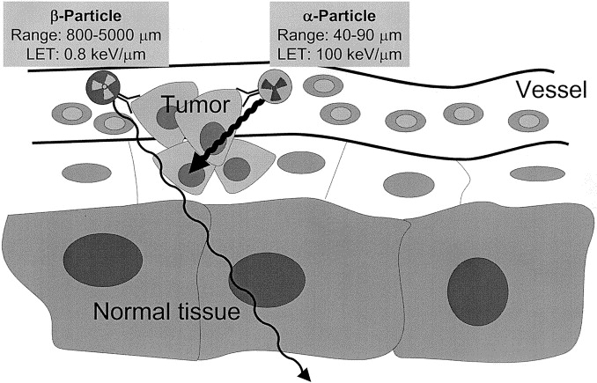
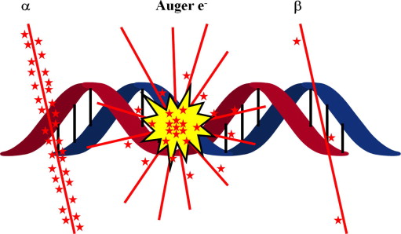
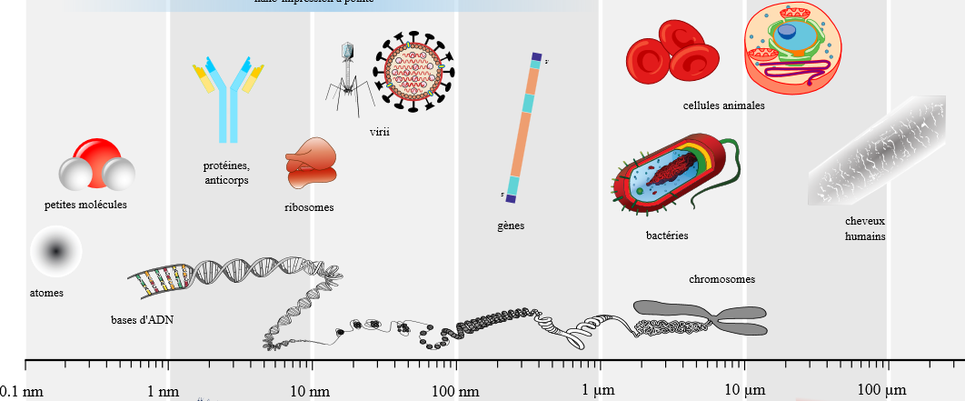
Crossing radioactivity with chemical properties

Slide 30
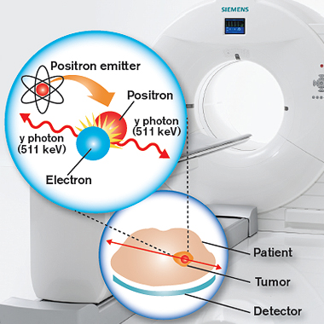
PET scan imaging

Slide 31
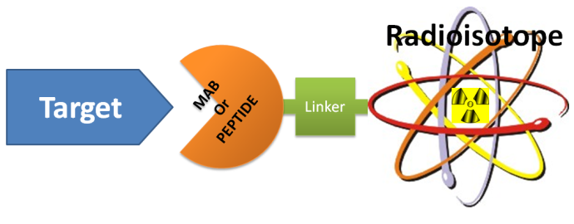
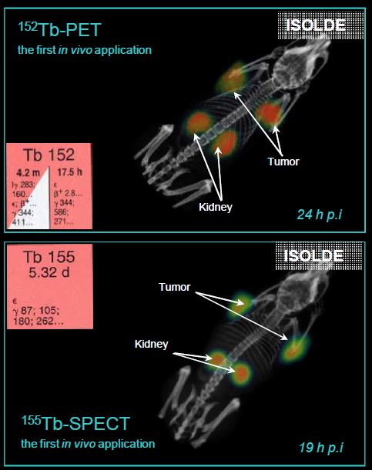
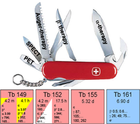
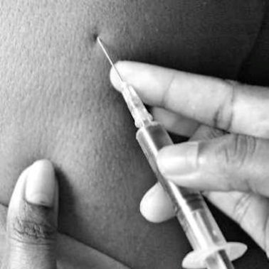
Concept of theranostics pairs
C. Muller et al.
jnumed.112.107540v1

Slide 32
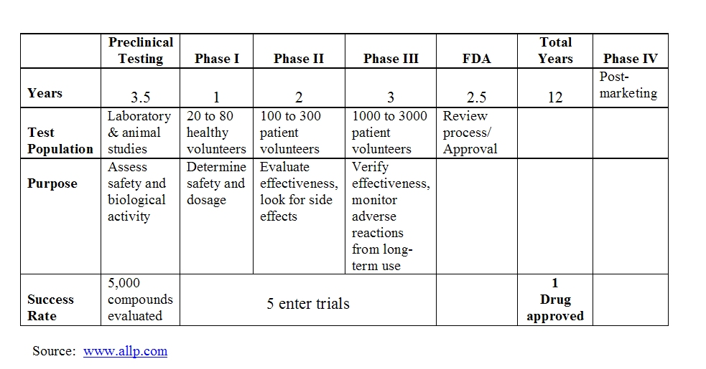
Drug development cycle

Slide 33
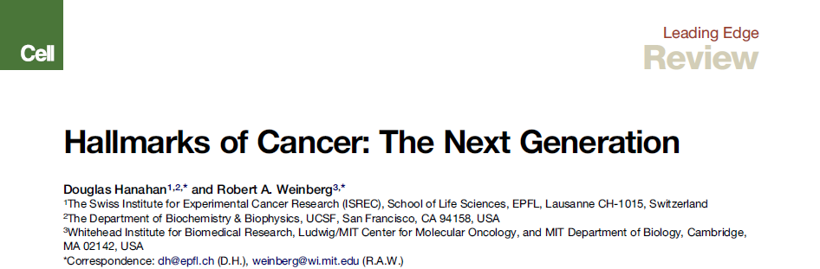


Translational approach
Prof D. Hanahan, Swiss Inst. For Exper. Cancer Research
Lauréat du prix 2014 « Contribution pour l’impact global tout au
Long d’une carrière » assoc. Americaine Rech. Cancer

Slide 34


Cancer regulation pathways: it’s simple

Slide 35

GRPr :
Gastrin Releasing Protein receptor
In the Stomach tissues (Gastric acid)
And also overexpressed in some cancer tissues
I. Dijkgraaf et al., JNM 53, 947 (2012)

Slide 36




Trials in 2012
152Tb
Collected
at ISOLDE
Bombesin analog from
Bombina bombina
Prostate
Cancer
cells

Slide 37





Development of surgical methods
Brachytherapy

Slide 38




New ideas
Critical mass
Unexpected result
1st yearly John Grace/MEDICIS collaboration meeting/public lecture on 15th October, Globe of Innovation

Slide 39













People at CERN
CE
KT
STI
EL
Rail conveyor
RP
HE
MEF
CV
Fluka

