Slide 1

ISOLDE Technical Report
70th Meeting of the ISCC
24th June 2014
Richard Catherall, EN-STI

Slide 2
Outline
Target Area
  Robots and auxiliary equipment
    services
  Modifications for Medicis
    Shielding, Montrac, shroud and FC door modifications
  Hot Cell
  PAD/MAD installation
Targets
RILIS
HRS20
Update and Critical Path

Slide 3
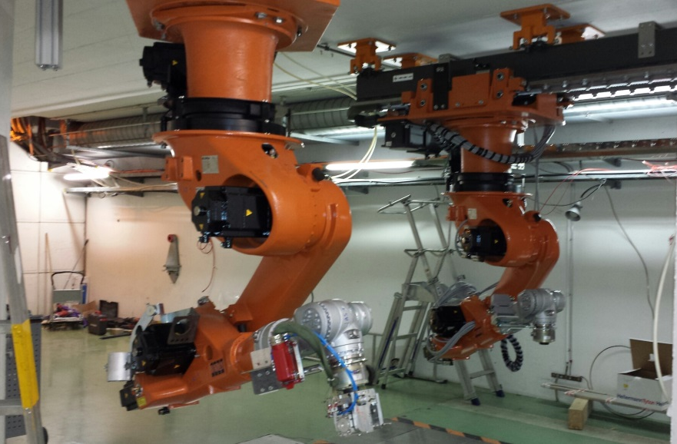
Robots
Robots are in place and commissioning has started this week
Controls and safety interlocks are in place
Need to test, test and test again

Slide 4
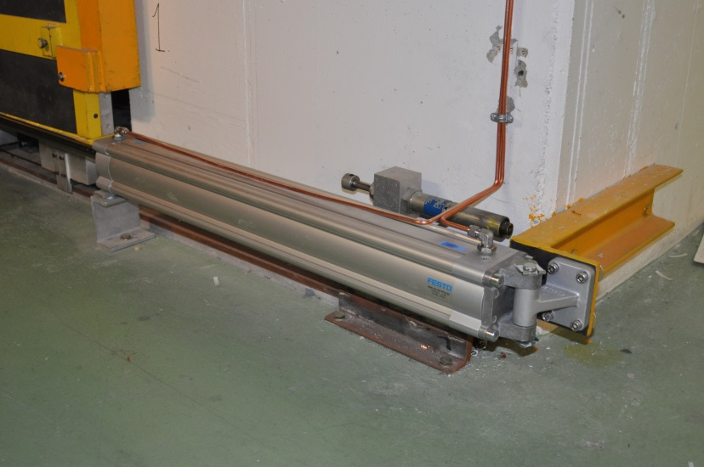
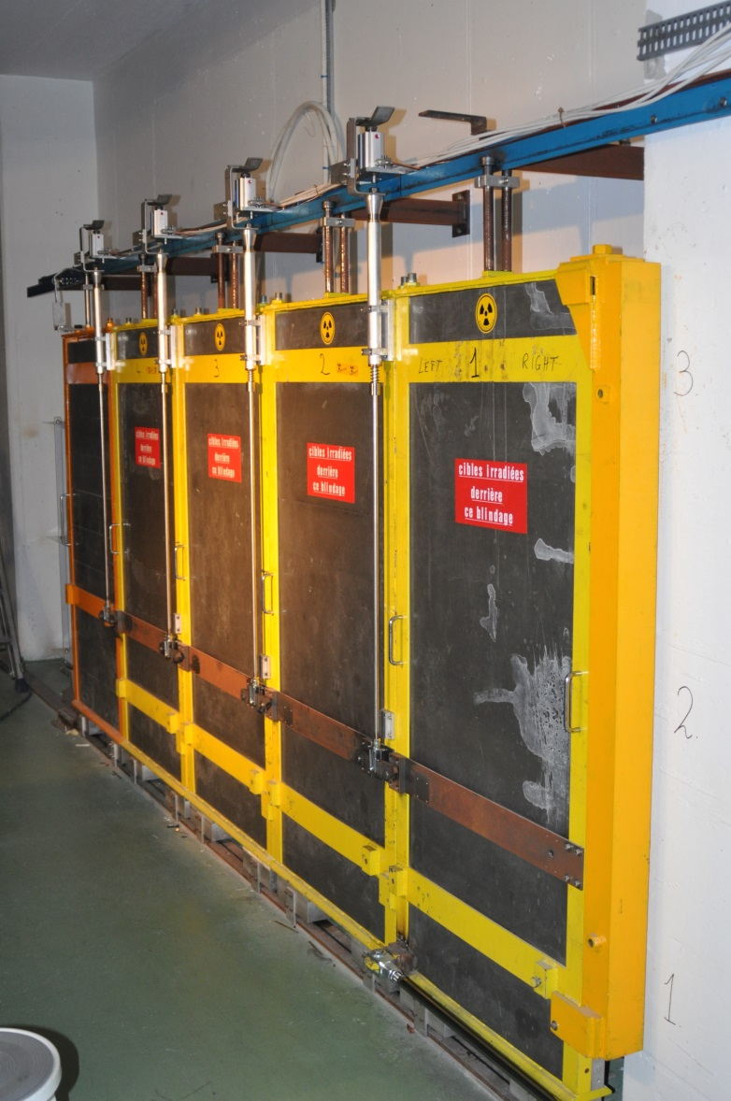
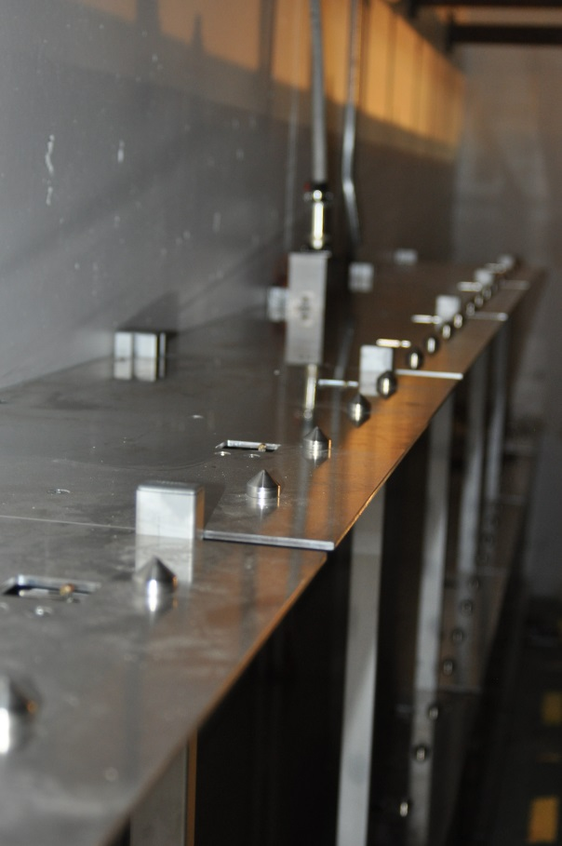
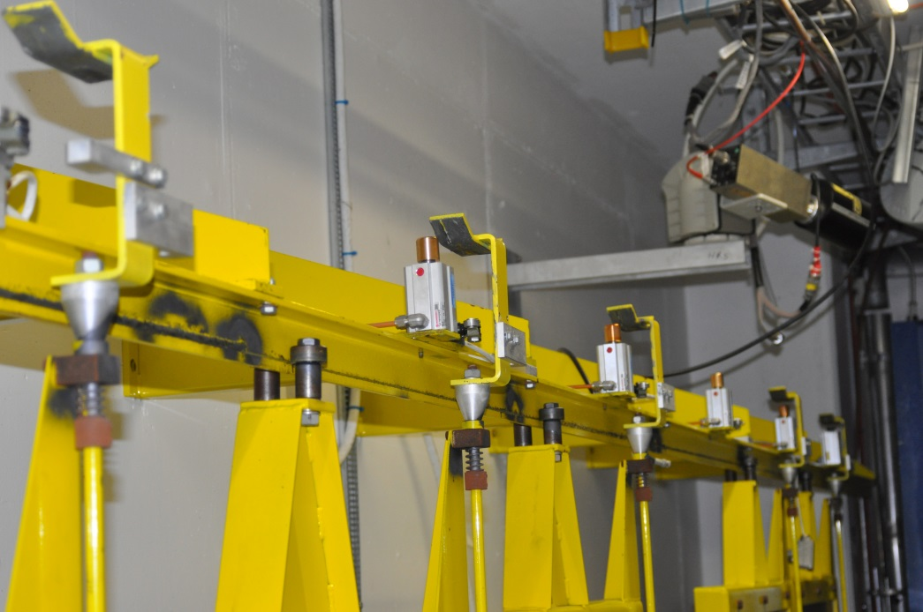
Shelf Modifications
Courtesy of M. Owen

Slide 5
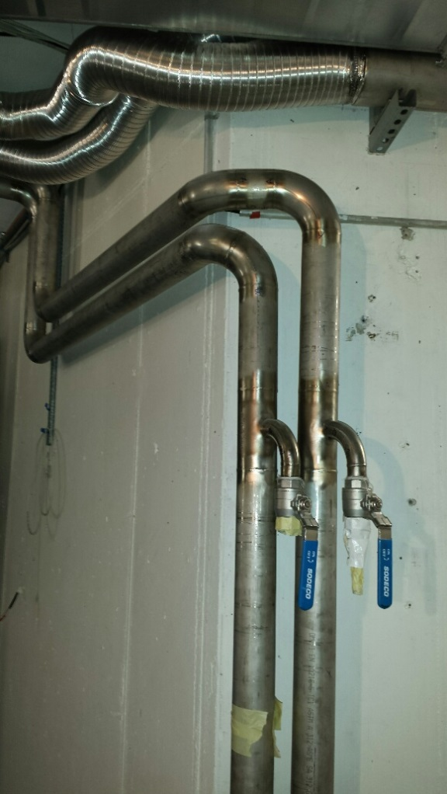
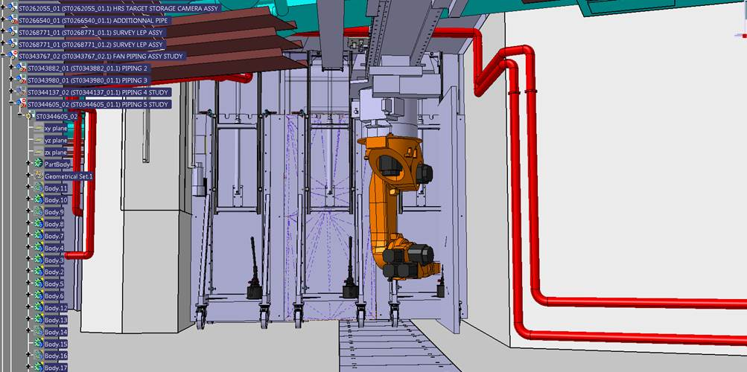
Services
The services to be displaced included:
Electrical cables and cable tray
Flexible tubes to ventilate the HRS FC
Water tubes for the BTY line magnet cooling
Welded for the 4th time last Friday
X-rays to be done this evening
May be a bottle neck for the start up!

Slide 6
Collective dose for robot installation
Phase 1: Installation des blindages
PHASE EN COURS – 91 % de la dose estimée
Dose collective cumulée = 1505 µSv
Dose collective totale estimée = 1648 µSv
Phase 2: Démantèlement des robots
PHASE EN COURS – 39 % de la dose estimée
Dose collective cumulée = 610 µSv
Dose collective totale estimée = 1547 µSv
Phase 3: Modification des services
PHASE EN COURS – 197 % de la dose estimée
Dose collective totale estimée = 2313 µSv
Dose collective cumulée = 4557 µSv
Phase 4 : Installation des robots
PHASE EN COURS – 152 % de la dose estimée
Dose collective totale estimée = 2905 µSv
Dose collective cumulée = 4410 µSv
Phase 5 : Tests des robots
PHASE EN COURS – 6 % de la dose estimée
Dose collective cumulée = 101 µSv
Dose collective totale estimée = 1609 µSv
Courtesy of C. Lemesre

Slide 7
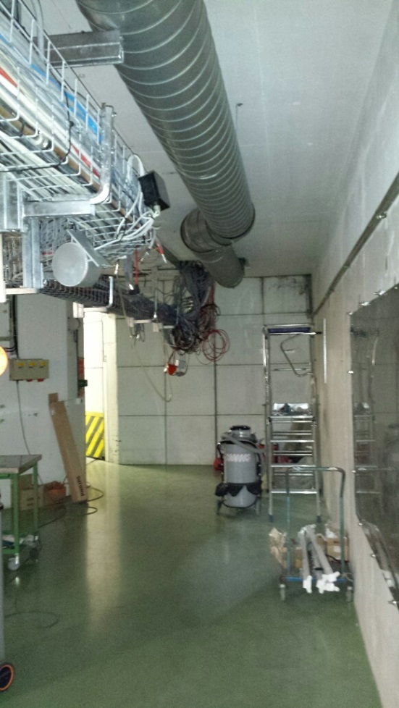
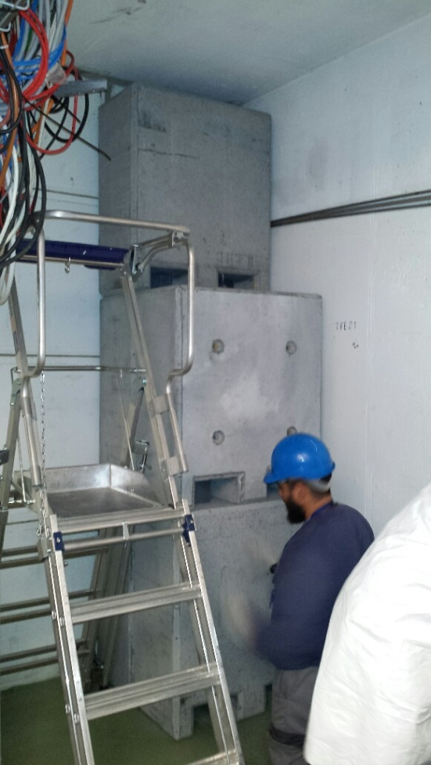
MEDICIS shielding
Displacement of services
Opening of wall for future Montrac installation
Installation of shielding has started and should be finished this week

Slide 8
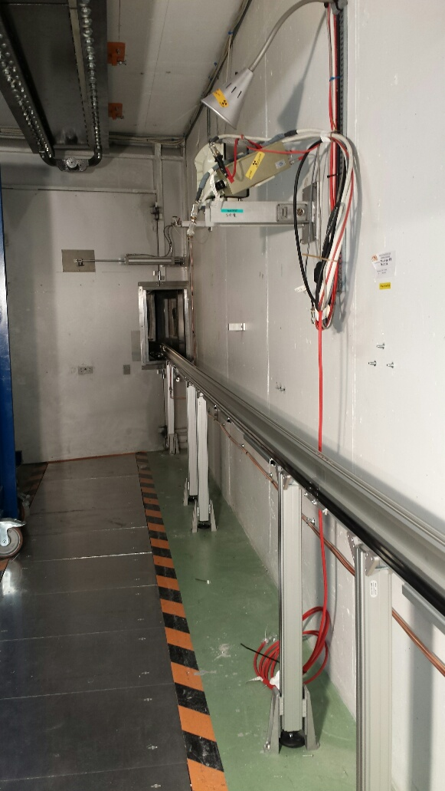
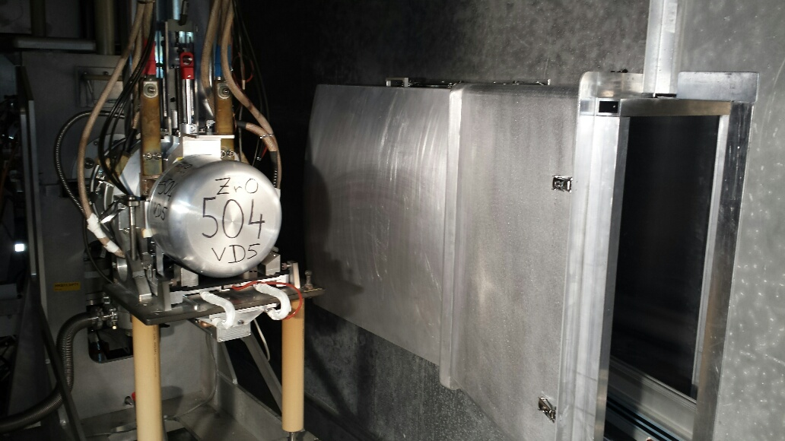
MEDICIS Irradiation Point
Installation of irradiation point and Montrac system including HT protection (shroud)
Faraday cage pistons modified

Slide 9
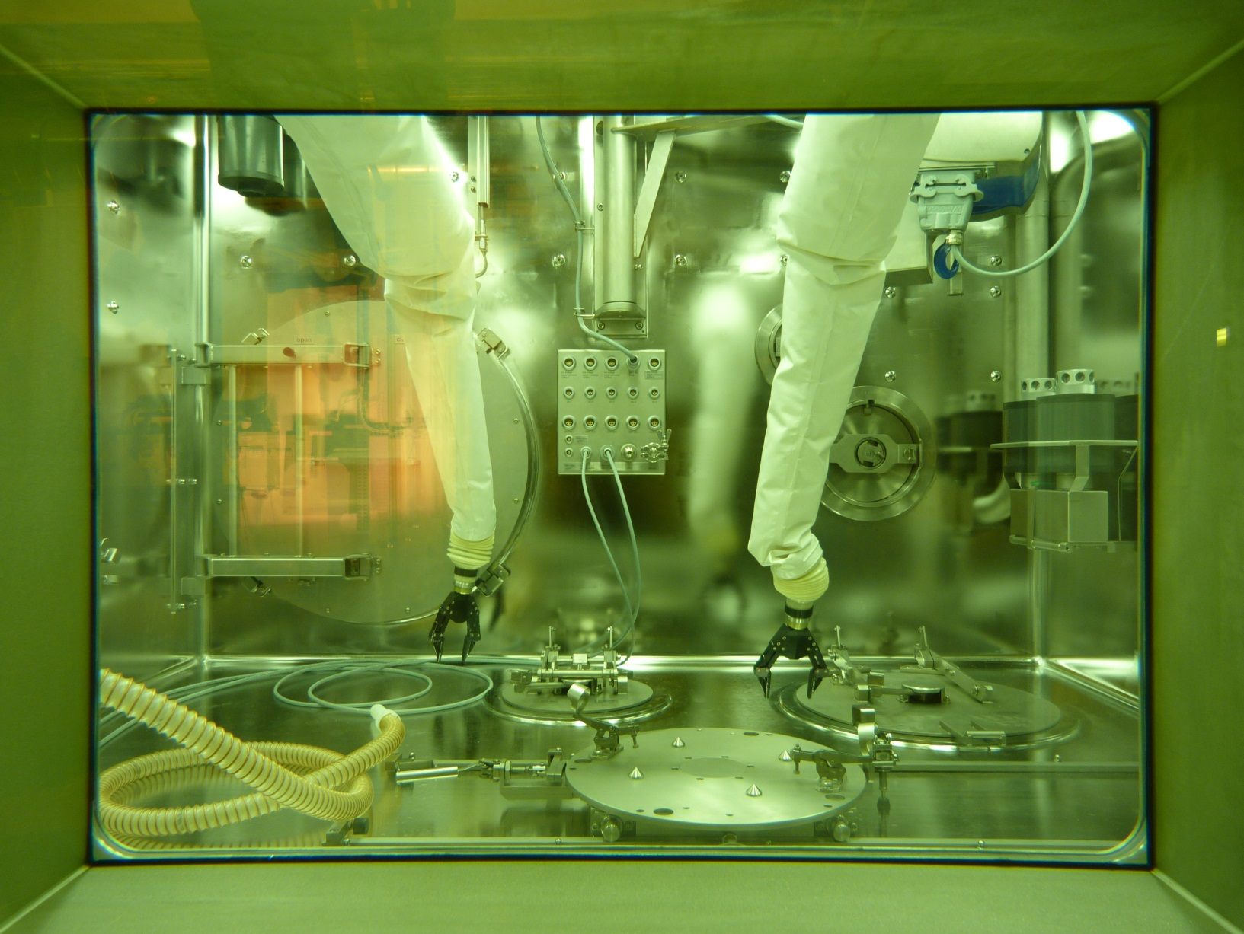
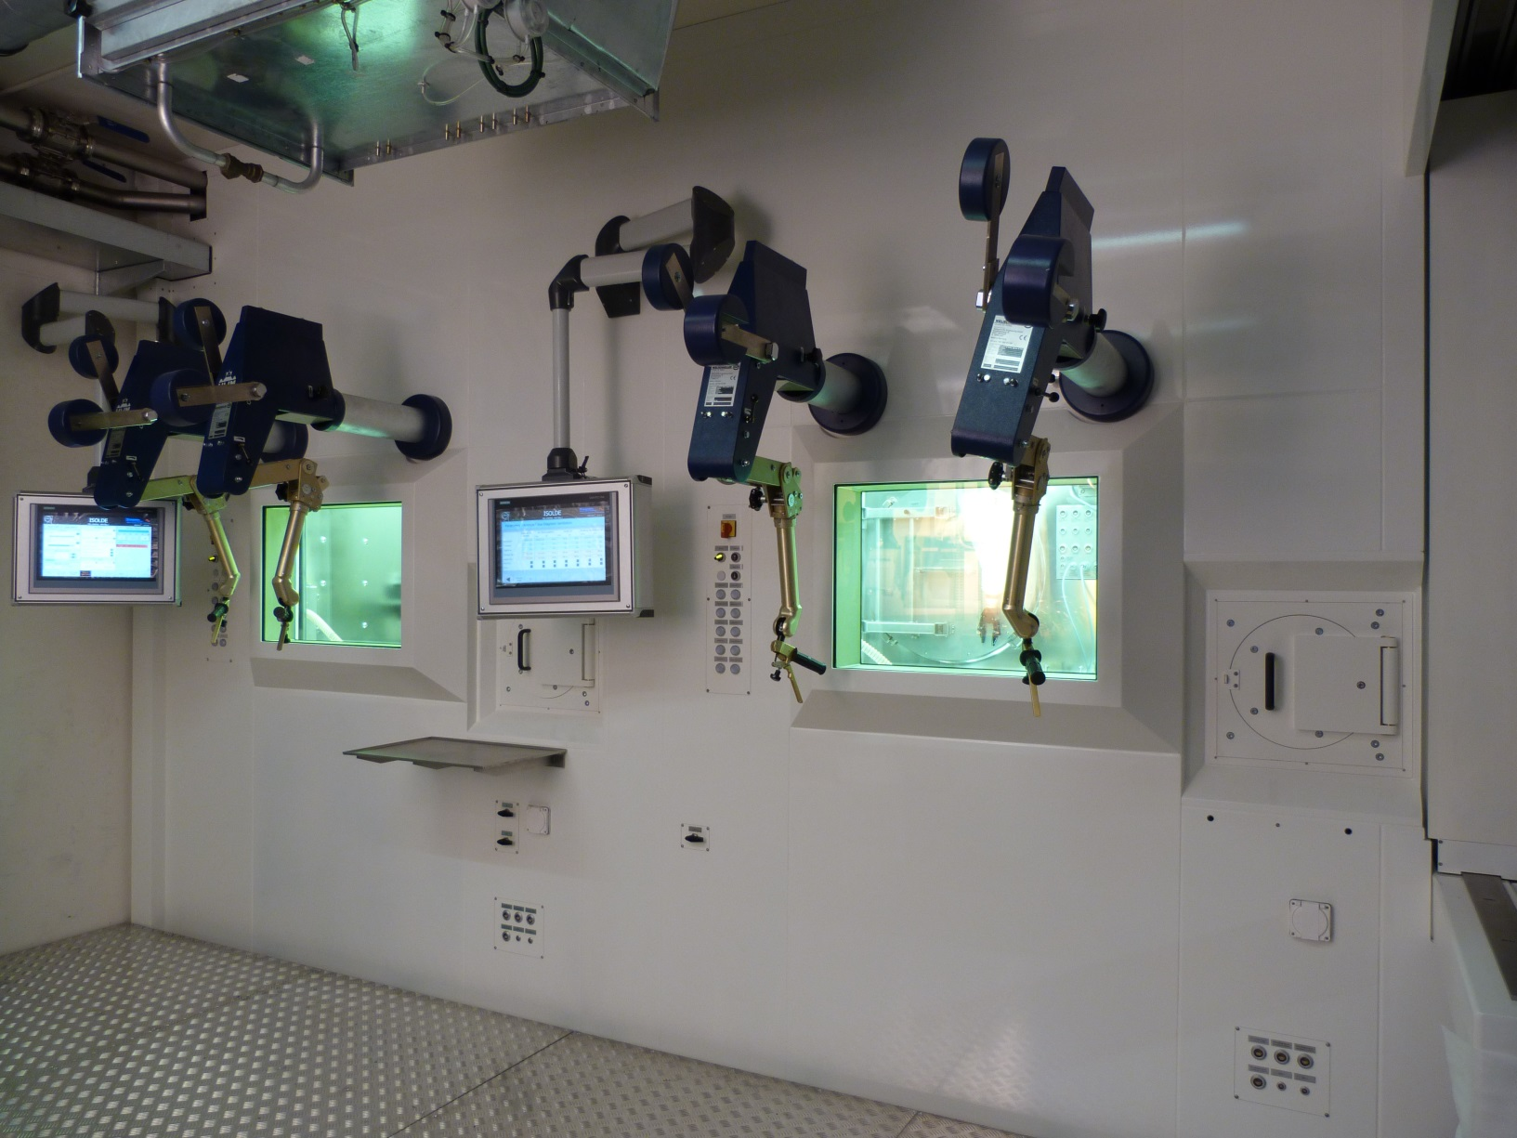
ISOLDE Hot Cell

Slide 10
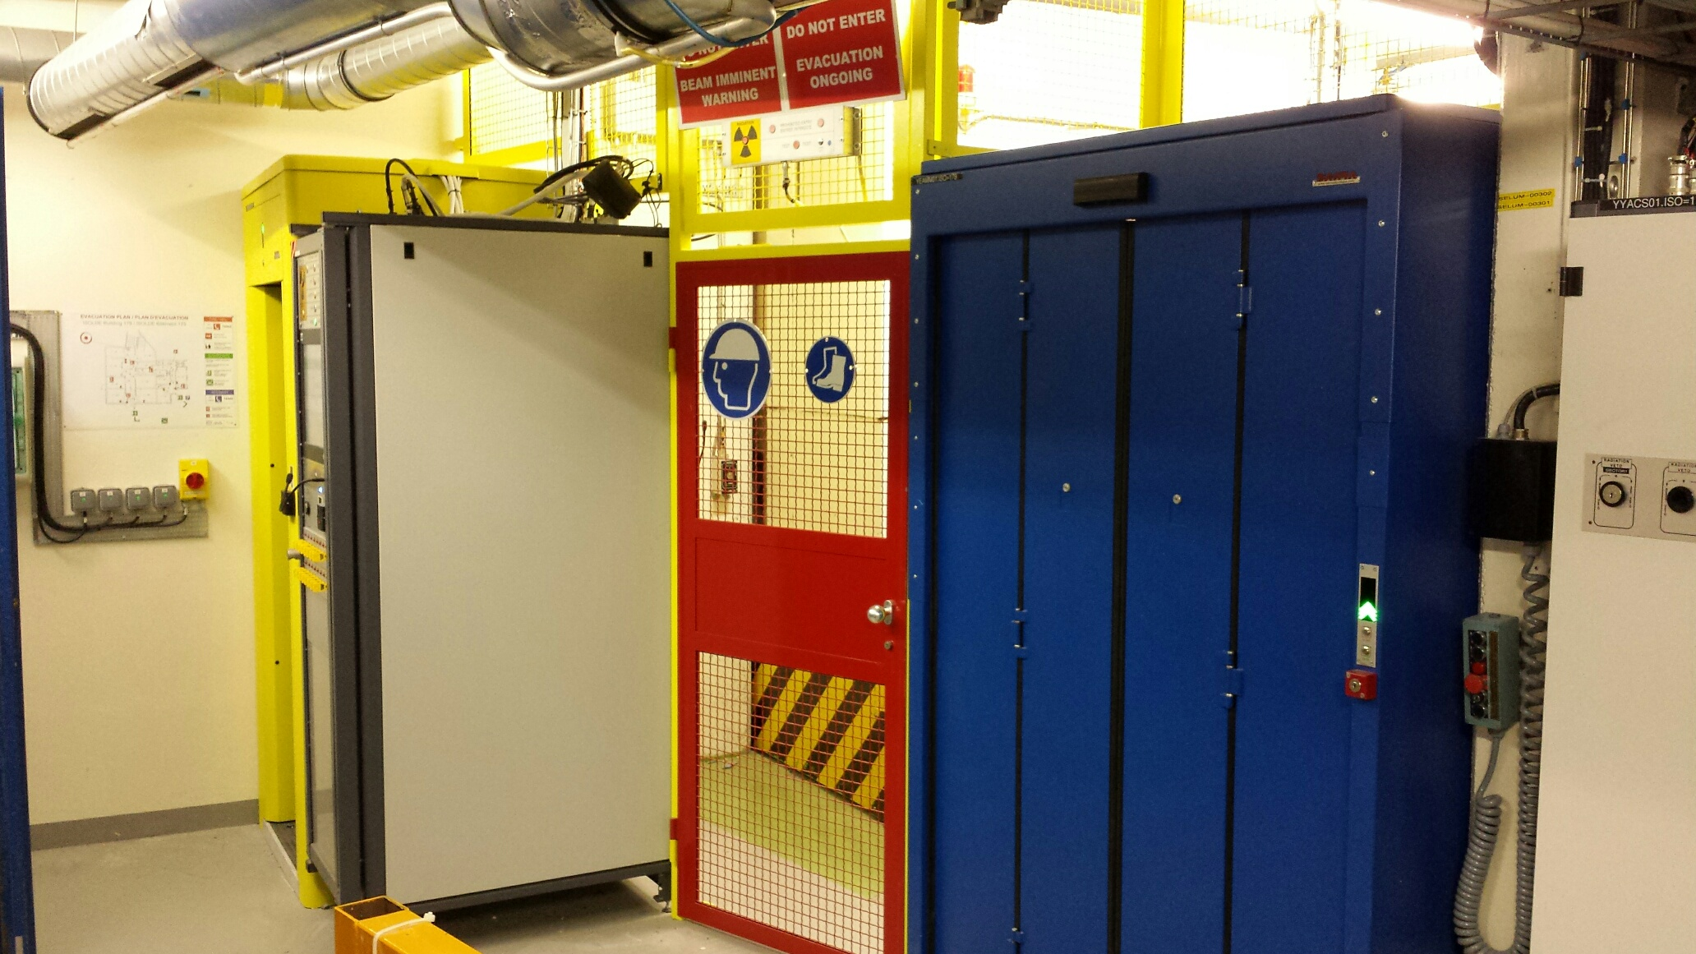
PAD/MAD Access to Target Area
Installed and now operational. A few access delays during implementation
SIR, ISOPRIM access, dosimeter and registered on IMPACT

Slide 11
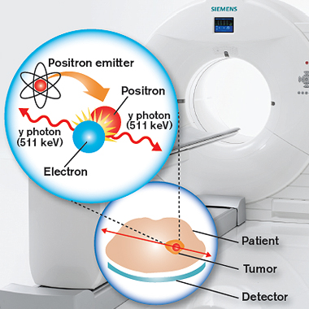
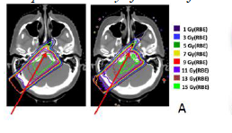
¹¹C Beams for combined PET/Hadrontherapy
Unexpected developments from Molten salt target tests
¹¹C Post accelerated radioactive ion beam possible
for hadrontherapy
Multiple charged
ions
Bunches and cools
ions
Analyzing magnet,
Doublets
Triplet
7-gap
resonator
RFQ
IH
Triplet
HV platform
Accelerator
from
5 -> 300 keV/u
Accelerator
from
0.3 -> 1.2 MeV/u
Accelerator
from
1.2 -> max 2.2 MeV/u
60 kV
Switched
HV platform
60 ↔ 20 kV
Target and
detectors
TRAP
EBIS
Charge
breeding
1⁺ ions
ISOLDE
T. Mendonca et al., CERN-ACC-NOTE-2014-0028

Slide 12
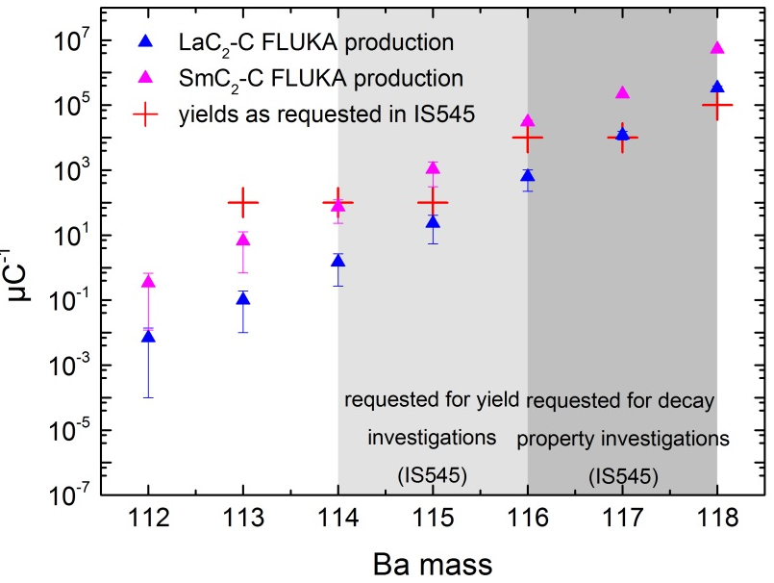
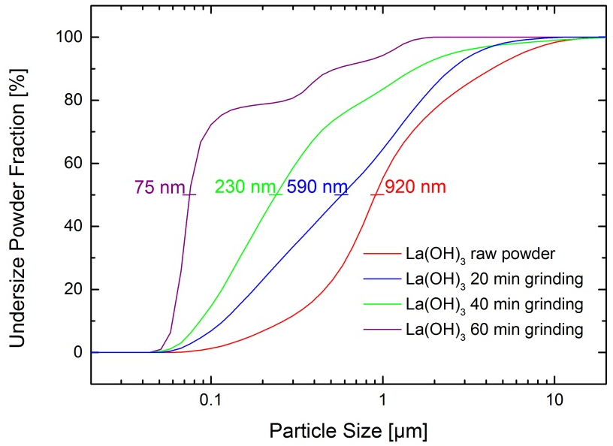
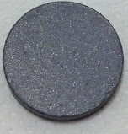
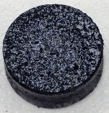
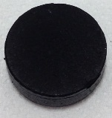
LaC₂–C Spallation Target Material for n-def Ba beams
Adopting procedure as developed for nano-UC_{x} in 2012 towards rare-earth carbides
Theoretical Production Yields
after comparing all possible spallation target nuclei
La(OH)₃ particle size reduction by suspension grinding
Hydroxide instead of oxide as precursor
nanometric carbon for higher homogeneity
MWCNT to increase thermal stability
Developing wet-milling procedure for the production of nanopowders
Ultrasound-assisted nano-incorporation of La(OH)₃ into MWCNT fibers
La(OH)₃ particle
agglomerate of
MWCNT fibres
Result of new nano-incorporation:
micrometric graphite
micrometric La(OH)₃
(as ISOLDE standard)
MWCNT
micrometric La(OH)₃
(dry mixing)
MWCNT
micrometric La(OH)₃
(new suspension mixing)
1 µm
MWCNT fibres
Alexander Gottberg and Julien Guillot

Slide 13
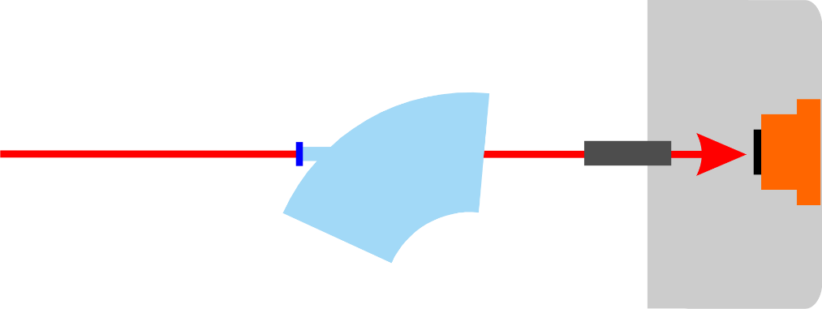
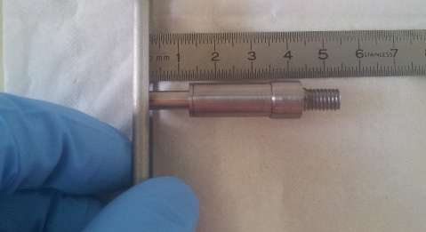
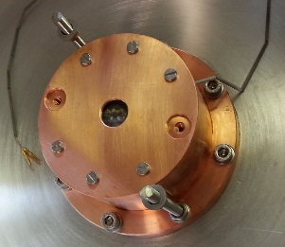
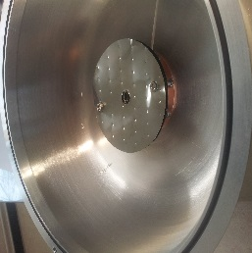
RILIS laser alignment target unit
Target Unit
Mounted as first target on HRS after LS1. Lasers successfully aligned. Unit Functioning as expected.
→ facilitates laser alignment - normally only possible with ion beam
→ helps to clarify laser beam transport issues (thermal lensing)
→ enables remote check of status of magnet windows when in doubt, reducing interventions to separator areas
Thanks to: Bernard, Ermanno, Tim & our 2013 summer student Sasha
Magnet window
RILIS lasers
HRS/GPS
Tungsten ionizer acts as light source for pre-alignment after shutdown
Laser power meter measures power delivered through ion source
readout via existing thermocouple infrastructure
Courtesy of S. Rothe

Slide 14
Status HRS20
Courtesy of Jose A. Ferreira on behalf of TE/VSC

Slide 15
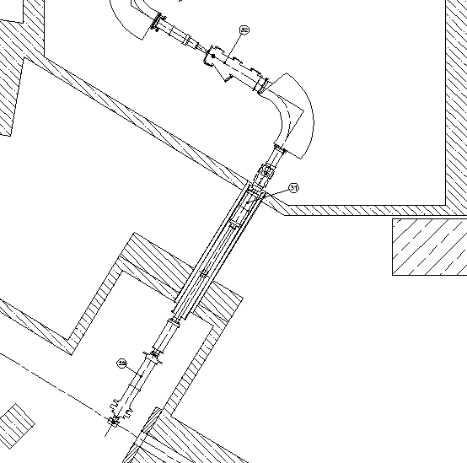
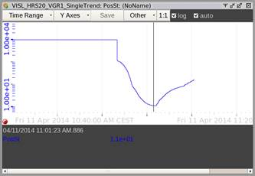
Layout
Laser window
P ~ 10 mbar
Modification laser window
Sector valve
Sector valve

Slide 16
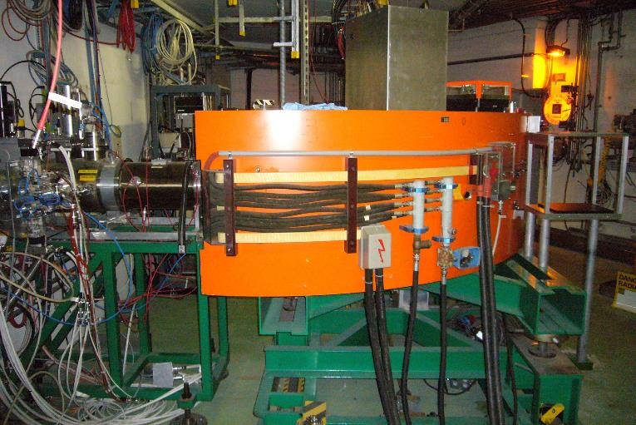
HRS90

Slide 17
Actions
* Sniffer test → Helium pressurization and external detection (non quantitative)
24th April: First leak detection using a sniffer. Leak detected close to the window (1e-4 mbar·L/s)
28th of April: Exchange laser window (old window) and o-ring, pump-down
29th of April: new o-ring installed (pump-down)
30th of April: New sniffer test. All the sector tested, signal from the window (1e-5 mbar·L/s)
7th of May: Sniffer test and shutter mechanism. Again the leak is found on the window. We checked all the sector without any other result.
23th of May: Sniffer test: Clear signal from window (1e-3 mbar·L/s). New plug instead of window.
30th of May, sealing agent, unfortunately pressure was not reduced significantly (always mbar range)

Slide 18
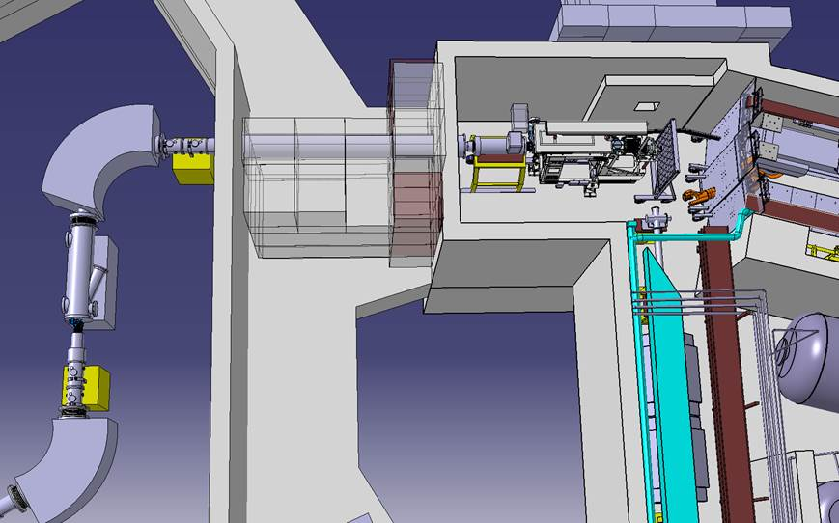
Actions (sector splitted)

Slide 19
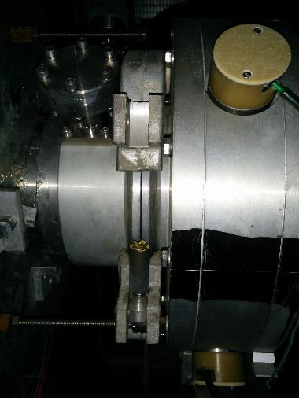
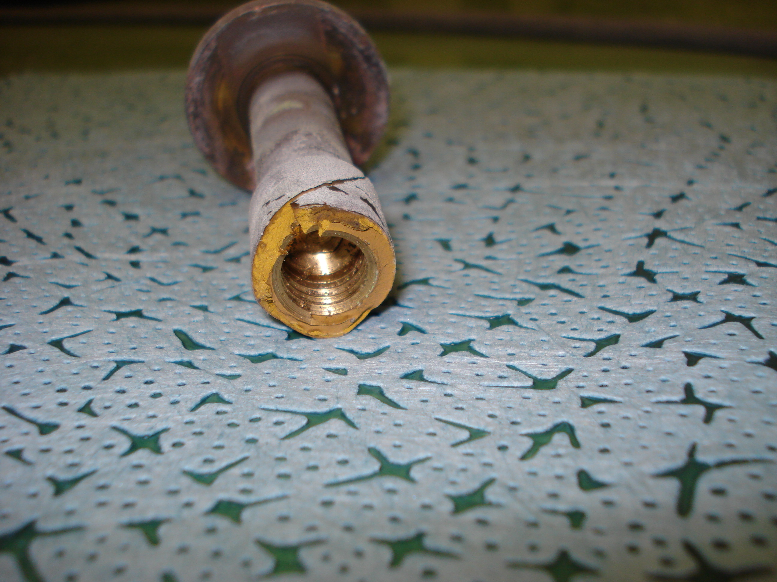
Results
Leak between the magnet and the frontend.
Faraday cage (visual inspection)
The clamp is bigger than the flange!!
O-ring not accessible
Not documented!
Same layout in GPS?

Slide 20
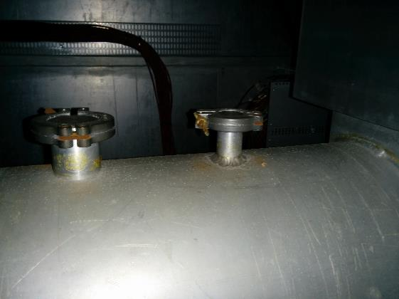
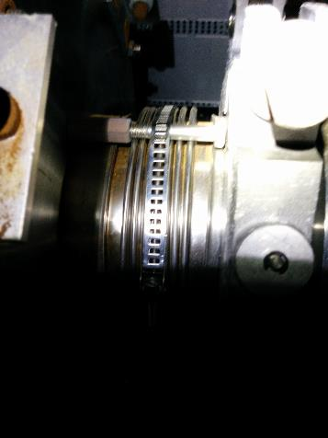
Results

Slide 21
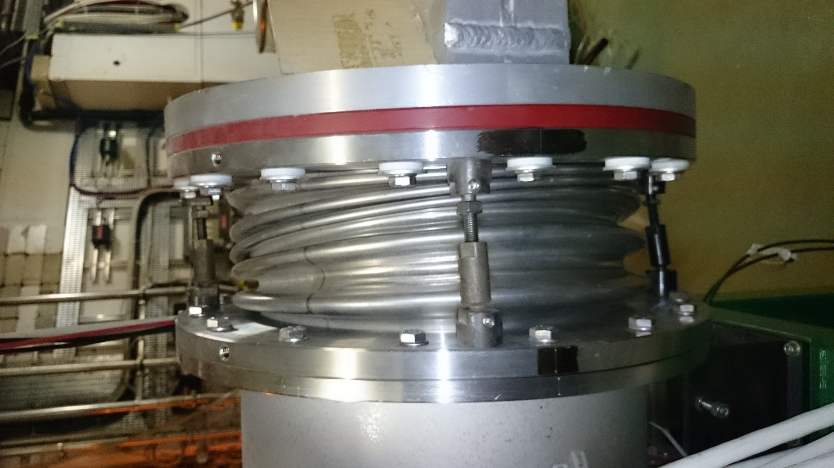
Results

Slide 22
HRS20 Conclusions
Corrosion of non-stainless steel pieces (brass)
Almost all the clamps replaced to prevent further failures:
  BTY3 and HRS20
  1xDN250 in GPS not accessible (NOT DONE)
  2(?)xViton o-ring not accessible to replace.
  Standard clamps on non-standard conical flanges
Leak test of the sector (ongoing). Still leaking → Test (today), installation of Viton seal on the external part of the flange
LS2 consolidation required

Slide 23
Update
GPS extraction electrode repaired
  Ba beams being produced since 3 weeks for RILIS development
Modification of Frontend coupling tables done
Radhard pistons installed on both FC doors
Change of clamps for preventive maintenance
Improved leak tightness of the target area
Change of lighting in part of the target area
New laser window system in HRS.MAG90
RFQ Cooler installed and aligned externally
  Need beam to further check alignment
  New RF amplifier also installed
Change of deflector motors and controls implemented
New HRS magnet controls and FESA class implemented
Most of the software now running

Slide 24
Critical Path
Final commissioning of the robots
Stable beam through the RFQ Cooler
Testing of the repaired tape station
Protons still planned for the 10th July
  SEM grid tests, HT on HRS with protons, RIB from GPS for tape station tests
Request further stable beam on HRS to commission RFQ Cooler…~2 weeks

