Slide 1
Experiments, Schedule & Access to the hall
.
Magdalena Kowalska

Slide 2
Experiments
Activities at existing setups (IDS and VITO – see presentations):
COLLAPS
  DAQ refurbishing and Ca setup prepartions (outside CERN)
  Many activities stopped due to delay in b508
CRIS
  ready to take beam – tests with off-line ion source
  lasers (in ISOLDE hall) almost ready
GLM/ GLM
  Testing new deflector-plate mechanism and controls
  Collection chambers in place (new GHM sample holder, new GLM chamber to come)
ISOLTRAP
  Magnets and setup refurbished
  Stable ions in horizontal line
NICOLE
  June – fridge reinstalled; leak-tight at room temperature

Slide 3
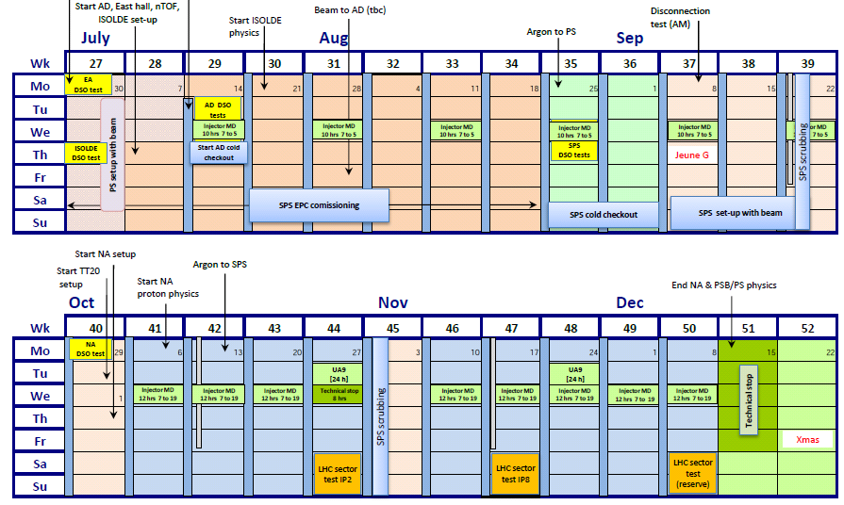
ISOLDE schedule
Protons to ISOLDE: 10 July; 1st beam – wk 29; physics from around July 28 (planned for 21 July before)
Stop: 15 December
20 weeks of physics (21 wks available in principle)

Slide 4
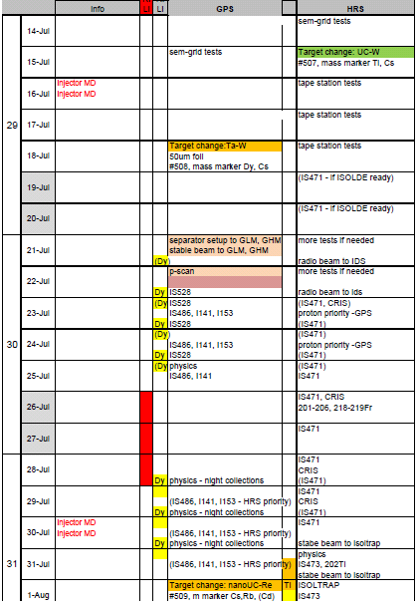
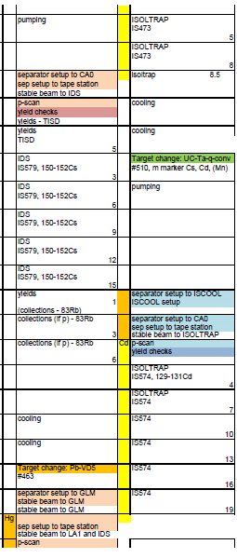

ISOLDE schedule
V1.0-1.1, Apr 25th
HRS delayed by 1-2 wks -> v1.2 in preparation
Each collaboration and setup get some beam
  priority for IS exp waiting long or failed before
530 shifts requested
260 scheduled so far:
  14 wks
  29 IS exp. 5 LOIs
Buffer time on HRS:
Physics not delayed in spite on HRS problems

Slide 5
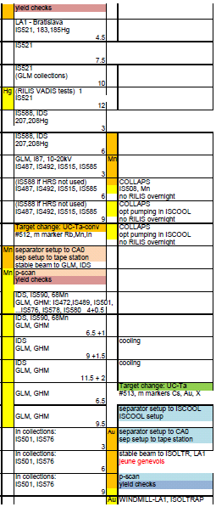
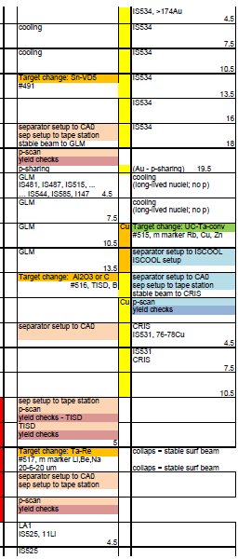
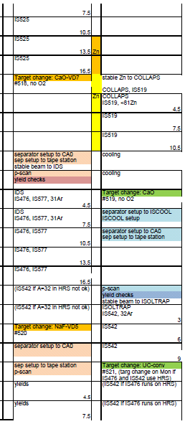
ISOLDE schedule

Slide 6
Access to ISOLDE
Users requesting dosimeter after Jul 1st: (www.cern.ch/isolde/get-access-isolde-facility)
No temporary dosimeters possible
To obtain dosimeter:
  Follow online courses on general safety (as before)
  Follow online RP course on Supervised Areas (as before)
  Follow ISOLDE online RP course – NEW, being finalised
  Present RP form signed by home institute – NEW, available since last week
To access ISOLDE (after July 22nd):
  Follow 2-h RP ISOLDE practical course – NEW (2pm Tue, Fri, 1st course planned for Jul 22nd)
CERN staff requesting dosimeters: as before (online courses + 1-day course)
Users and staff with valid dosimeters:
    After July 1st: Follow ISOLDE online RP course
    Follow new procedure when present medical certificate expires
Access to ISOLDE via dosimeter, not CERN card

Slide 7
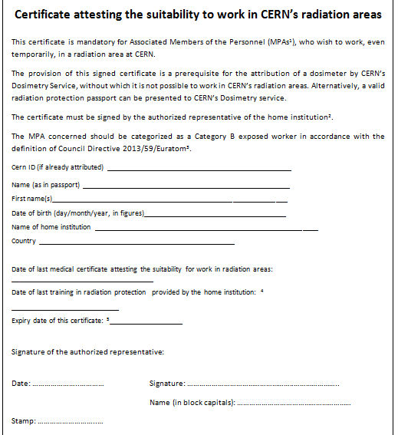
Access to ISOLDE
RP form

Slide 8
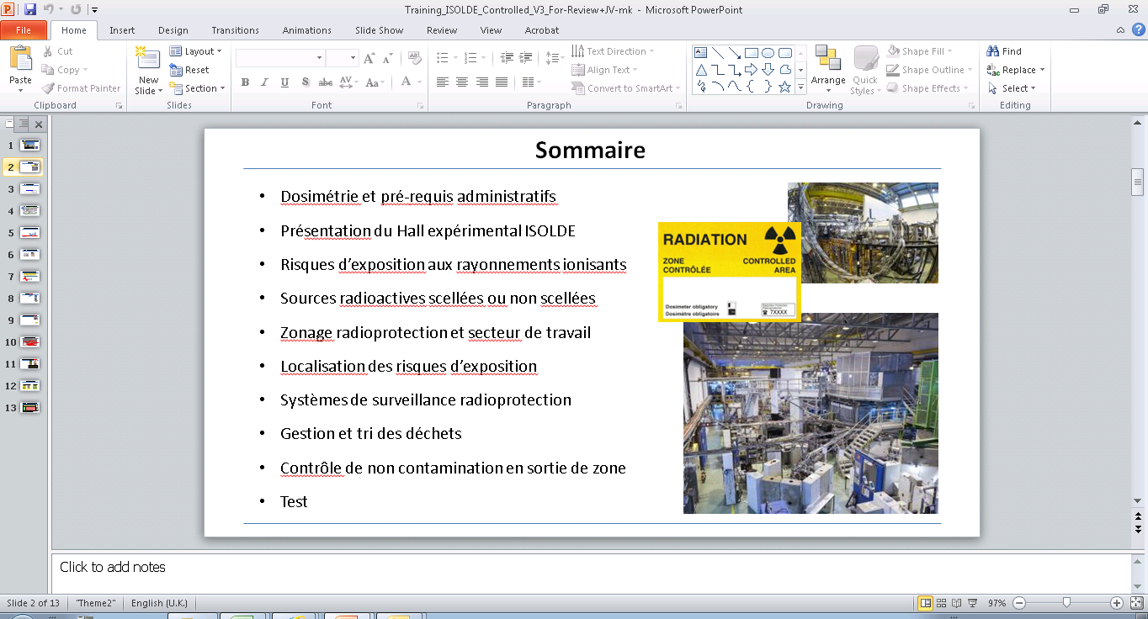
Access to ISOLDE
E-course
Practical course
  S’habiller / se déshabiller (blouse) et/ou gants à définir avec les experts RP
  Utiliser des appareils de détection de contamination / débit de dose
  Lire un système informatique permettant d’obtenir le débit de dose de moniteurs fixes (système nommé GRAMS)
  Savoir se prémunir contre les risques de contamination
  Utiliser un détecteur mains/pieds
  Mieux appréhender les risques d’un mauvais réglage machine (impliquant la collection d’un faisceau hautement radiotoxique par exemple)
  Que faire en cas de contamination suspectée ou avérée (et comment faire la différence) ?
  + autres sujets vus avec nos experts et coordinateurs.

