Slide 1
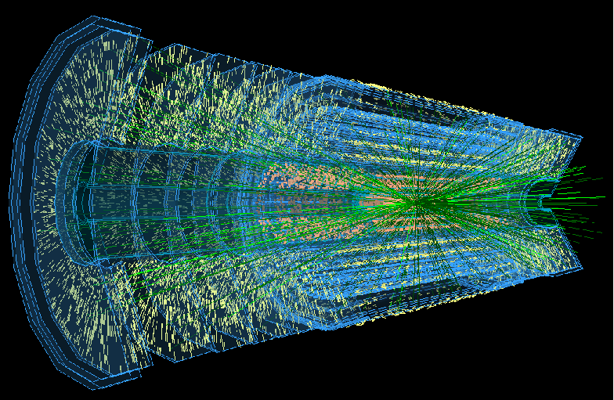
ATLAS Upgrade Overview
Phil Allport
ATLAS Upgrade Coordinator
3/6/14
Brief Overview of Phase-0 Upgrades
Reminder of Phase-I
Phase-II
  New Tracker
    Pixels
    Strips
    HV/HR-CMOS
    Layout and Schedule
  Other Sub-detector Plans
  Revised Cost Profile
Conclusions
1

Slide 2
New LHC schedule beyond LS1
Only EYETS (19 weeks) (no Linac4 connection during Run2)
LS2 starting in 2018 (July) 18 months + 3months BC (Beam Commissioning)
LS3 LHC: starting in 2023 => 30 months + 3 BC
injectors: in 2024 => 13 months + 3 BC
Run 2
LS 2
Run 3
Phase-0 Upgrades (now)
Phase-I Upgrades
LS 3
Run 4
Phase-II Upgrades
LS 4
Run 5
LS 5
LHC schedule approved by CERN management and LHC experiments spokespersons and technical coordinators
Monday 2nd December 2013
2

Slide 3
Current Shutdown
Phase-0
  New insertable pixel b-layer (IBL) + new pixel services (nSQP) + new small Be pipe
  New Aluminum beam pipes to prevent activation problem and reduce muon BG
  New evaporative cooling plant for Pixel and SCT + IBL CO₂ cooling plant
  Replace all calorimeter Low Voltage Power Supplies
  Finish the installation of the EE muon chambers staged in 2003 + additional chambers in the feet and elevators region + RPC gas consolidation
  Upgrade the magnets cryogenics and decouple toroid and solenoid cryogenics
  Add specific neutron shielding where necessary (behind endcap toroid, USA15)
  Revisit the entire electricity supply network (UPS in particular)
  Where possible prepare Phase 1 upgrade (services, AFP, ZDC, FTK, ….)
  Re-align the barrel calorimeter and ID + consolidation of infrastructure and services + general maintenance
  Some early installation of (Phase-I) trigger upgrades which are required for above design luminosity operation are being anticipated for Run 2
    CTP: CTPCore and CTPOut
    Muon endcap trigger with current small wheel (reduce fake rate)
    Tile outer layer trigger (to help L1 muon in transition region)
    nMCM (needed for bunch train correction)
    CMX and L1Topo
    Dual output HOLAs for FTK
3

Slide 4

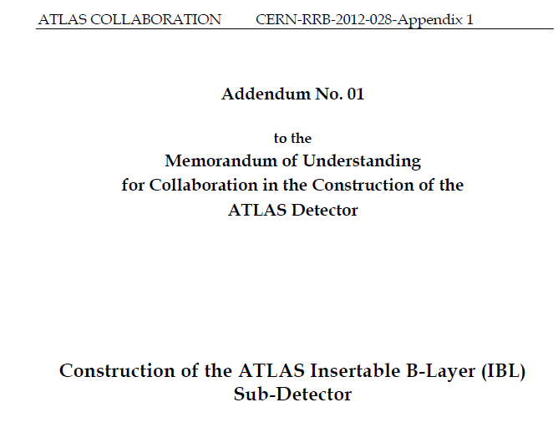
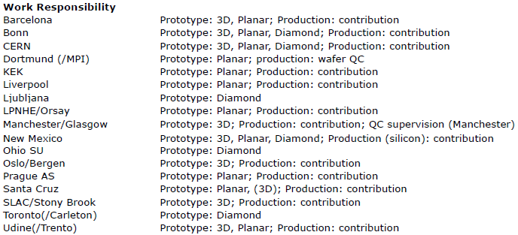
Current Shutdown
Phase-0
  New insertable pixel b-layer (IBL) + new pixel services (nSQP) + new small Be pipe
4

Slide 5

ATLAS: Inner Tracking Detectors
25 m
45 m
5

Slide 6
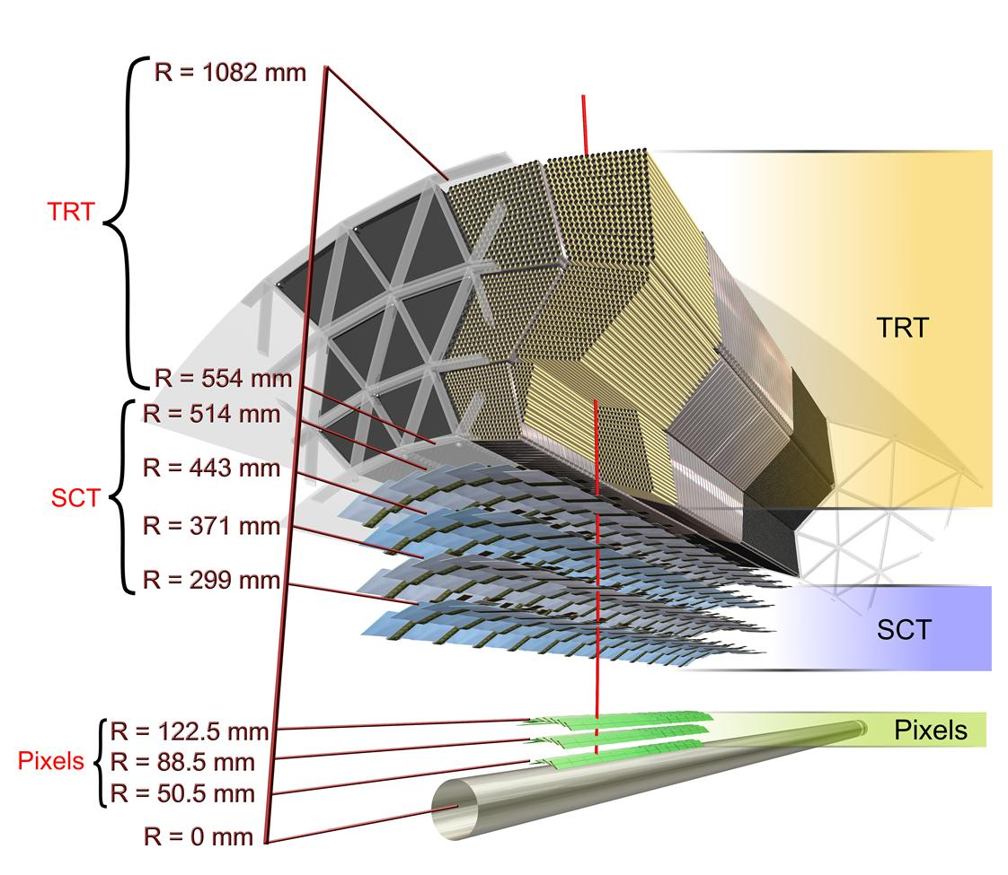
ATLAS Inner Detector
Straw tubes
Silicon strip
Silicon pixel
45 m
6

Slide 7
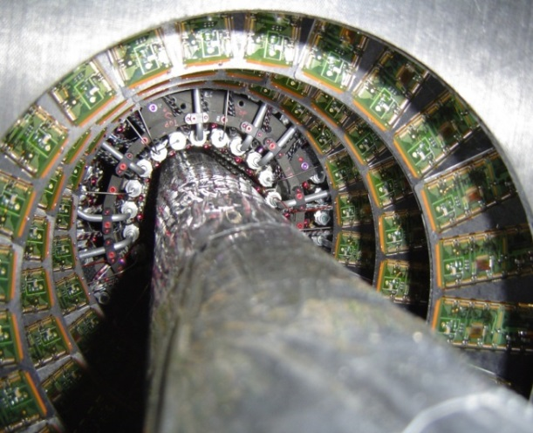
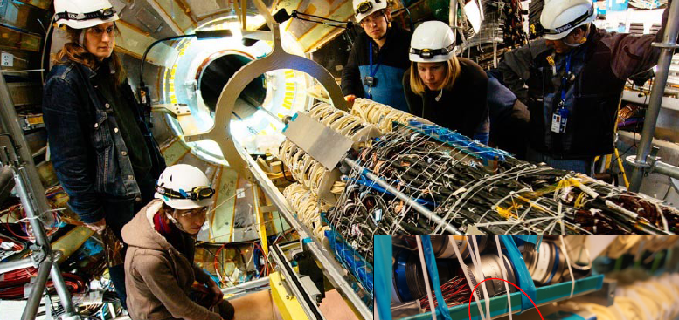
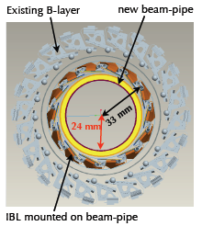
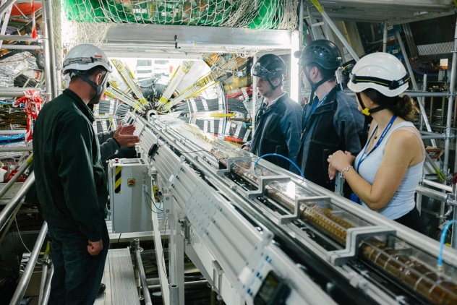
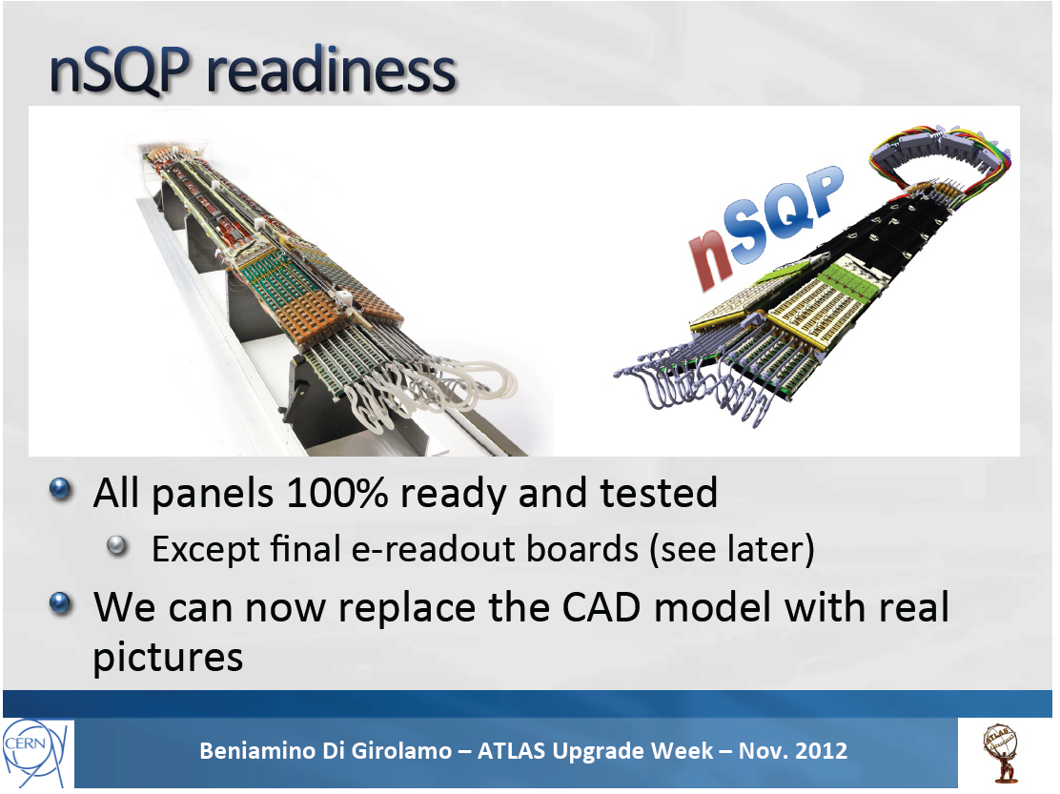
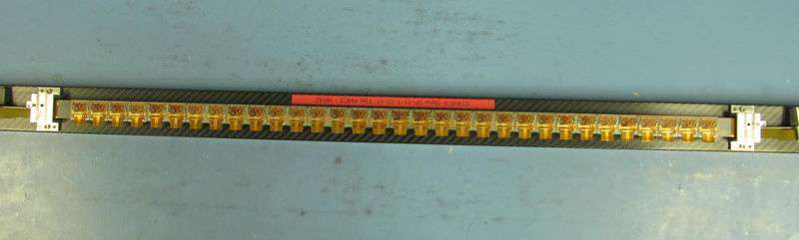
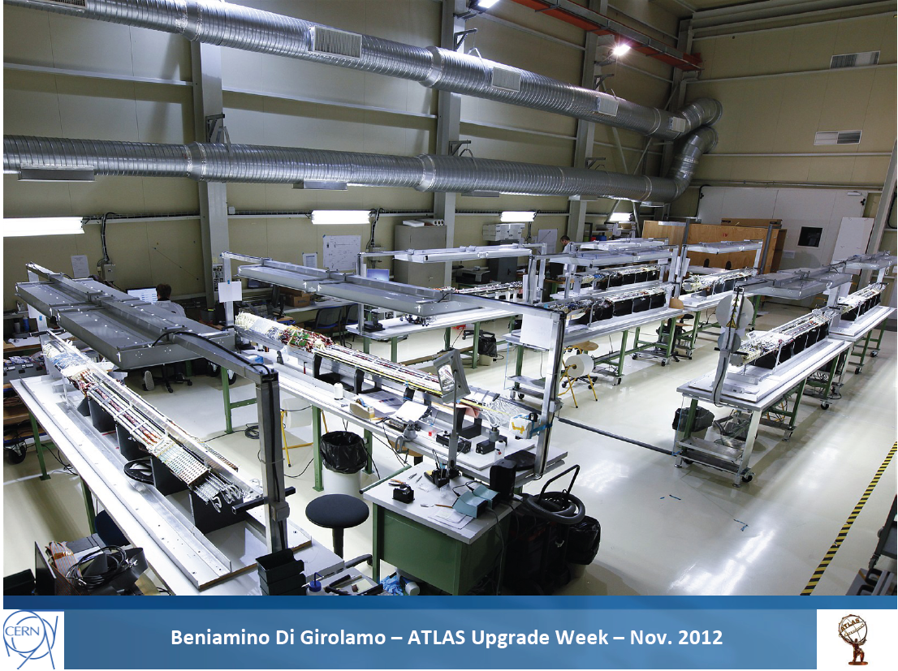
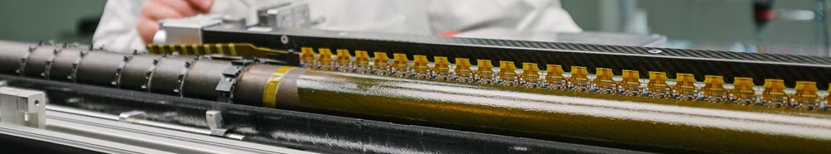
Insertable B-Layer
New pixel layer around new smaller beam pipe
Current pixel package was brought to surface allowing:
  IBL support tube insertion at surface
  New services installed to fix problems and improve R/O bandwidth (nSQP)
  New diamond beam monitors with IBL (FE-I4) ASICs
Reinserted and being reconnected
IBL Inserted into ATLAS on 7th May
  Services being connected and tested
  Preparing for operation and commissioning
Off-detector
  New RODs can read-out 32 FE-I4 ASICs at a rate of 160 Mbit/s using 4 S-Links (also supports the dual output required for FTK)
7

Slide 8
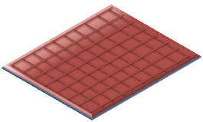
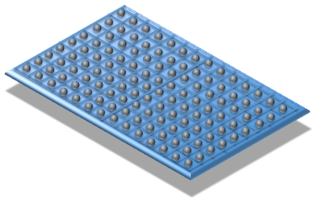

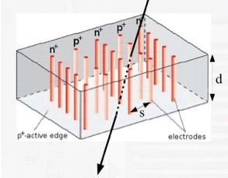
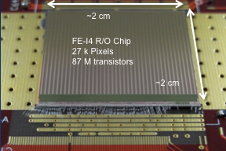
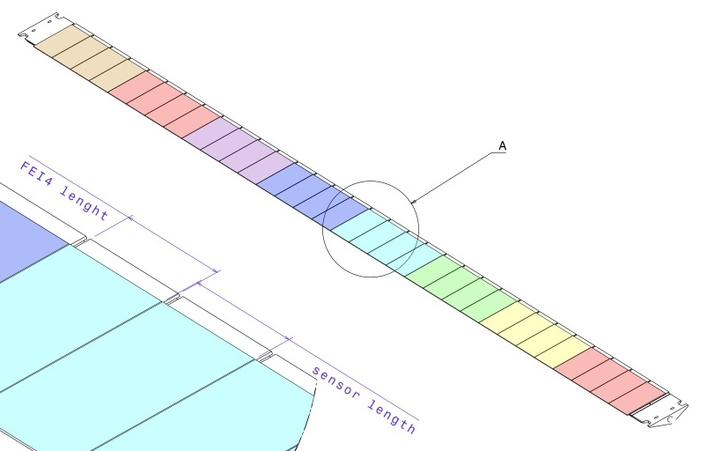
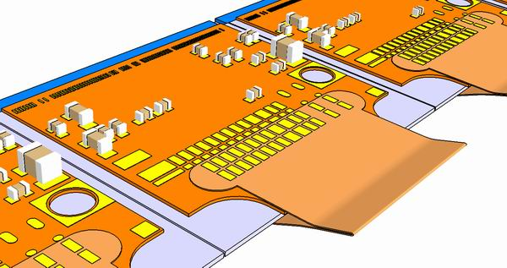
Insertable B-Layer
FE-I4 Pixel Chip (26880 channels)
19 x 20 mm² 130 nm CMOS process, based on an array of 80 by 336 pixels
  (each 50 x 250 μm²)
-
FE chip
3D Sensor
Both electrode types are processed inside the detector bulk
Max. drift and depletion distance set by electrode spacing
Reduced collection time and depletion voltage
sensor
Planar Sensor
“classic” sensor design
oxygenated n-in-n
200μm thick
Minimize inactive edge by shifting guard-ring under pixels (215 μm)
Radiation hardness proven up to 2.4×10¹⁶ p/cm²
12 Double Chip (planar)
8 Single Chip (3D)
12M Pixel/stave
~ 1.9% X₀
3D
Planar
Module:
Sensor + 1x or 2x FEI4
8
3D

Slide 9


Future Upgrade Planning
9

Slide 10
Future Upgrade Planning
Phase-I Upgrade
(LS2)
Starts Middle 2018
10

Slide 11




Future Upgrade Planning
In 2013, 4 TDRs for Phase-I construction projects were prepared within ATLAS, approved by the CB and submitted to the LHCC
As of 5th December 2013 all 4 were endorsed by the LHCC
Upgrade Cost Group approval reported at 4th March LHCC
MoUs, with signatures from the CERN Director of Research and Computing, are now in circulation to Funding Agencies.
11

Slide 12
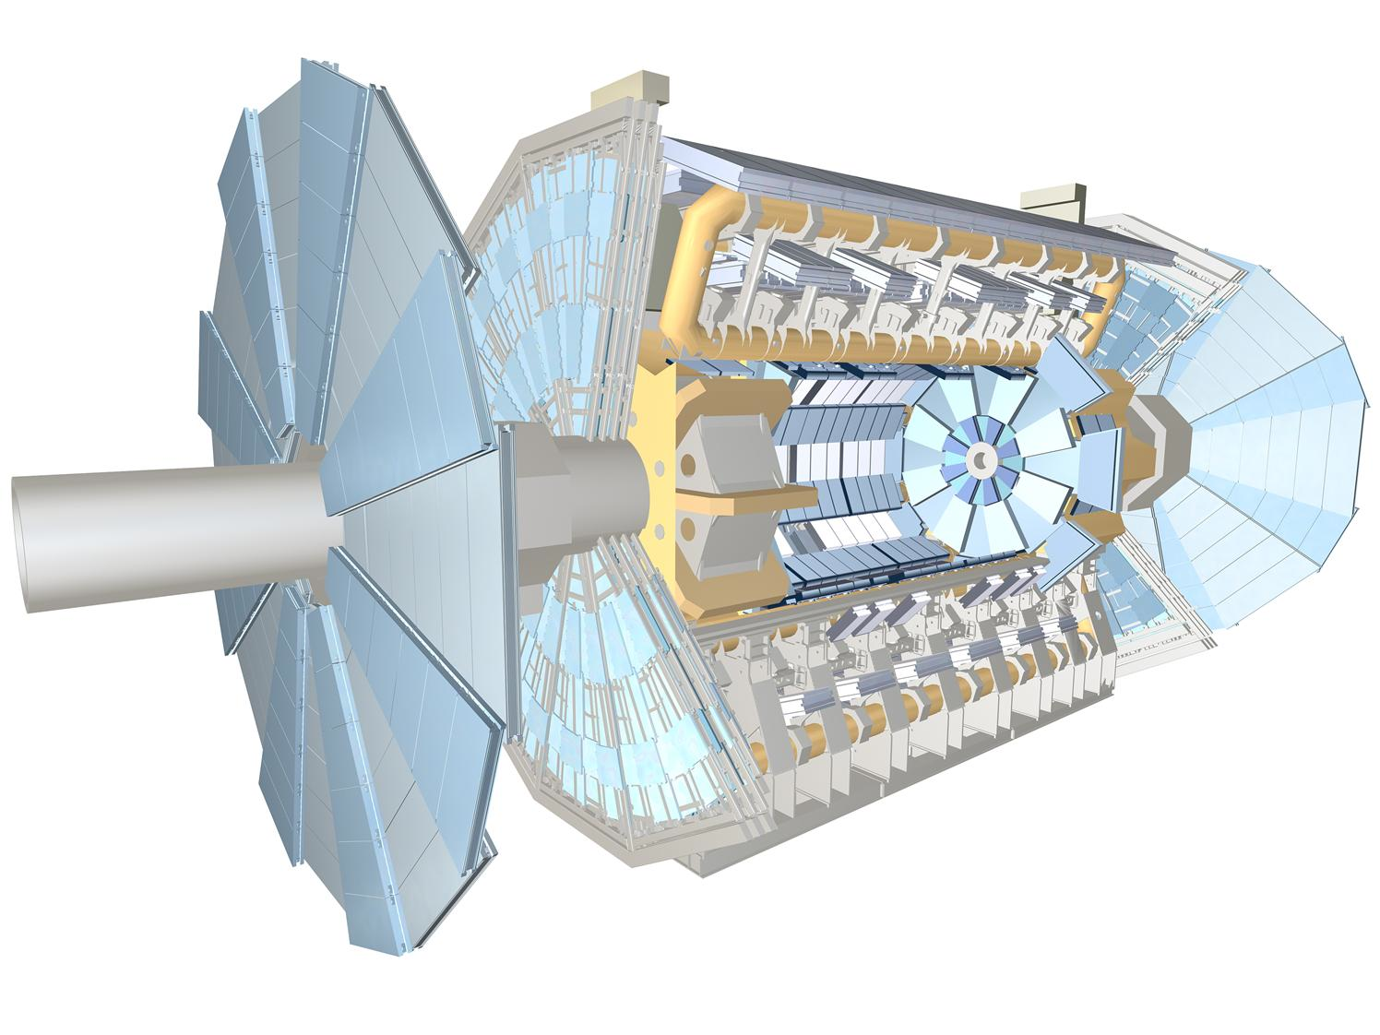

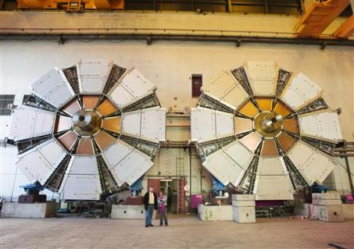
New Small Muon Wheels
(CERN-LHCC-2013-006)
The innermost station of the muon end-cap
Located between end-cap calorimeter and end-cap toroid
L1 trigger
chambers
EI station
small wheel
In furthest forward direction, chamber efficiencies fall with hit rate as luminosity goes well above the design values
Rate of L1 muon triggers exceeds available bandwidth unless thresholds raised
→ Replace “small“ muon wheels
Kill fake muon triggers by requiring high quality (σ_{θ}~ 1mrad) pointing to interaction region
Precision chambers combine sTGC and micromegas technologies for robustness to Phase-II luminosities
12

Slide 13
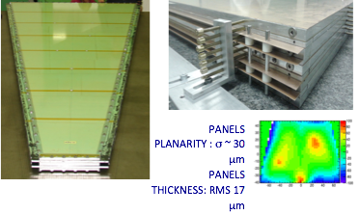
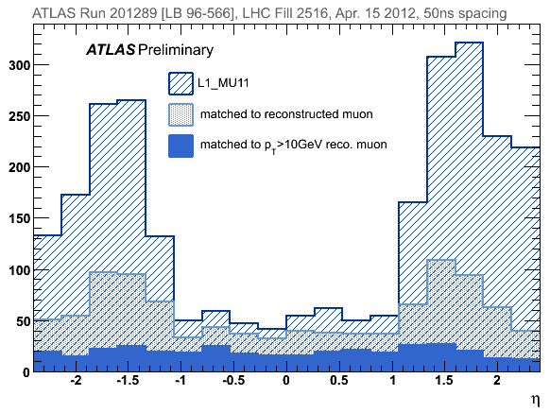
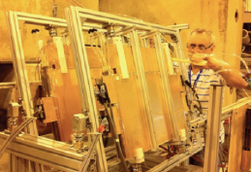
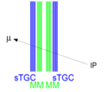
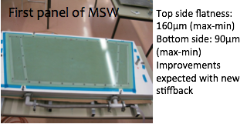
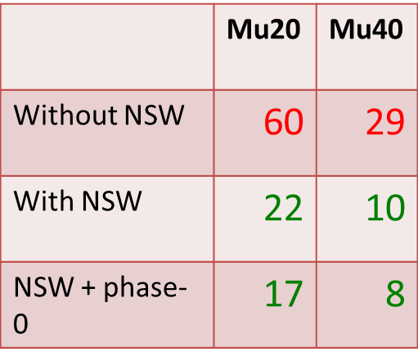
New Small Muon Wheels
(CERN-LHCC-2013-006)
Trigger Chambers
sTGC Prototype
Mechanical Prototype
Tracking Chambers
L1 trigger
chambers
Micromegas Prototype
EI station
small wheel
In furthest forward direction, chamber efficiencies fall with hit rate as luminosity goes well above the design values
Rate of L1 muon triggers exceeds available bandwidth unless thresholds raised
→ Replace “small“ muon wheels
Kill fake muon triggers by requiring high quality (σ_{θ}~ 1mrad) pointing to interaction region
Precision chambers combine sTGC and micromegas technologies for robustness to Phase-II luminosities
13

Slide 14
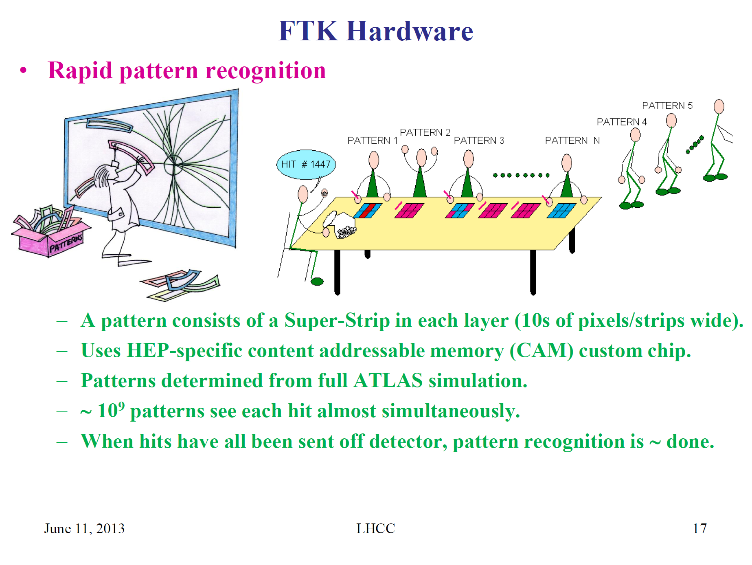
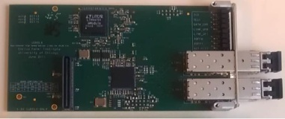
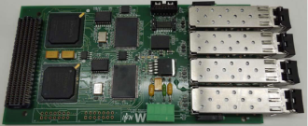

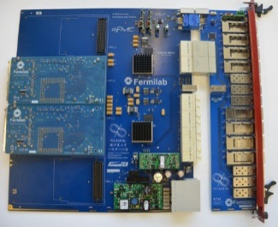
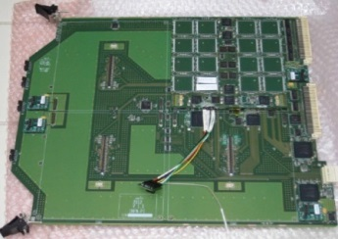
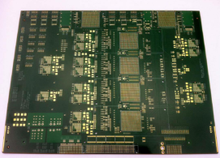
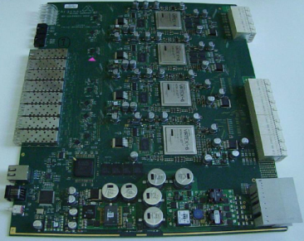
Fast TracKer (FTK)
Fast Tracker (FTK)
(CERN-LHCC-2013-007)
→ This is then followed by FPGA based track fitting (1 fit/ns)
Many boards in pre-production and pre-final CAM chip version submitted
Designed for installation before Phase-I to provide HLT with full tracking at start
(For Phase-II need to speed up to fit tracks in RoI as input to Level-1.)

Slide 15

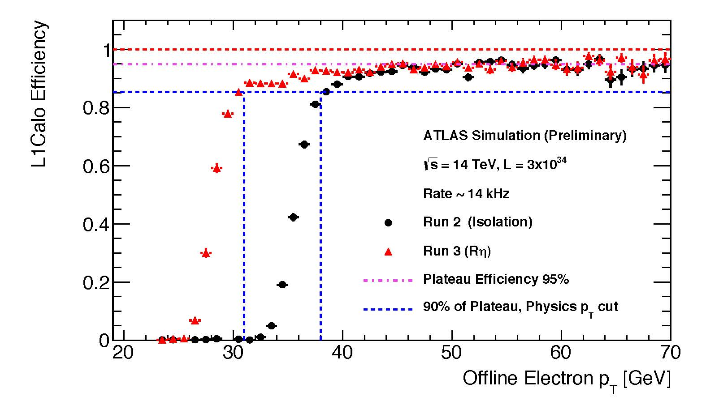
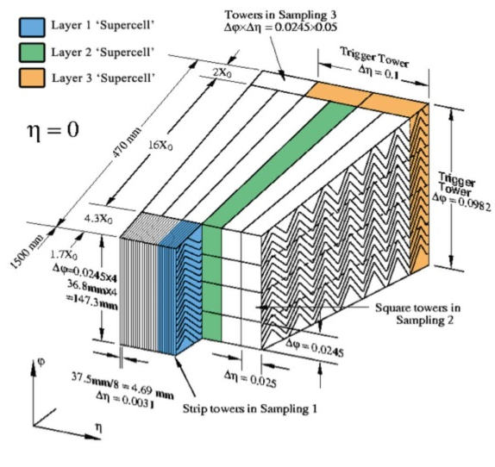
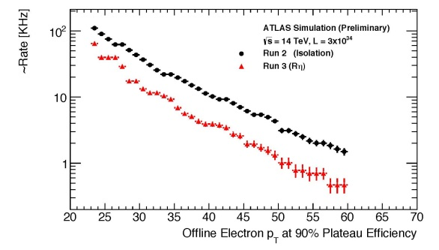
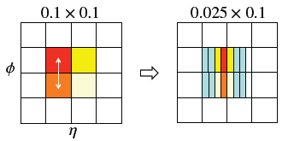
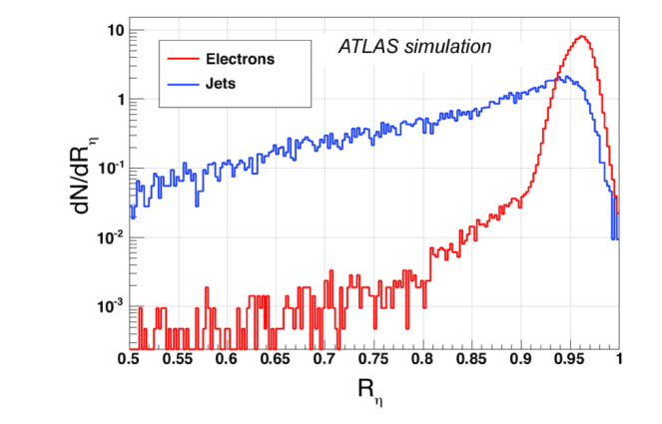
LAr Electronics Upgrades
(CERN-LHCC-2013-0017)
Key target (as for New Small Wheel) is to maintain high efficiency for Level-1 triggering on low P_{T} objects (here electrons and photons)
In the LAr calorimeter this implies changes to the front-end electronics to allow finer granularity to be exploited at Level-1.
Distribution of the R_{η} parameter for electrons and jets, defined as the ratio of the energy in the
3x2 over the energy in the 7x2 clusters of the 2nd layer of the EM calorimeter.
(Phase-I Level-1 designed to be able to become Level-0 at Phase-II.)
15

Slide 16

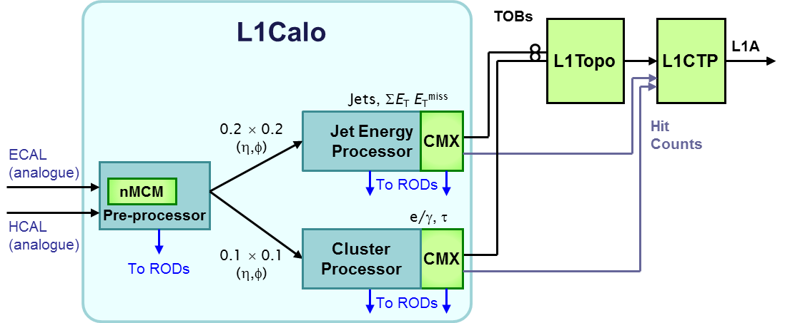
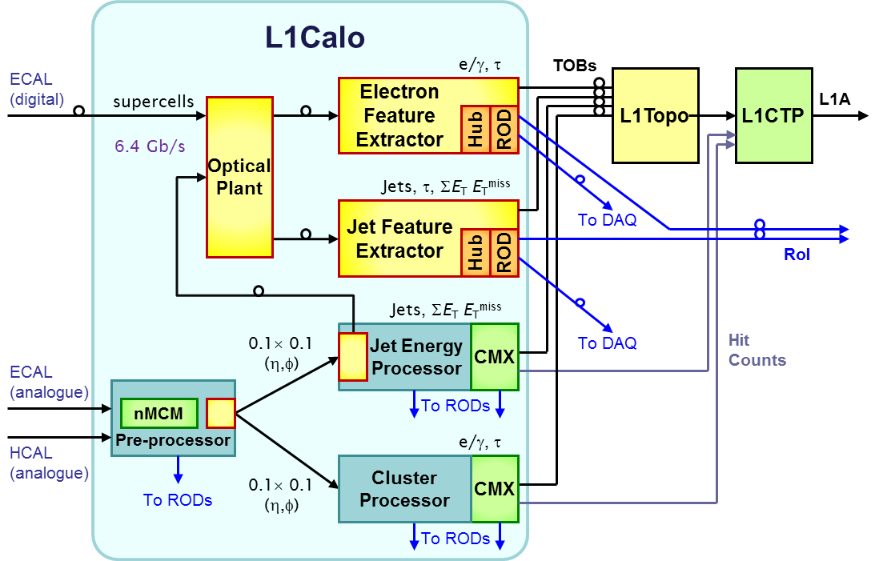
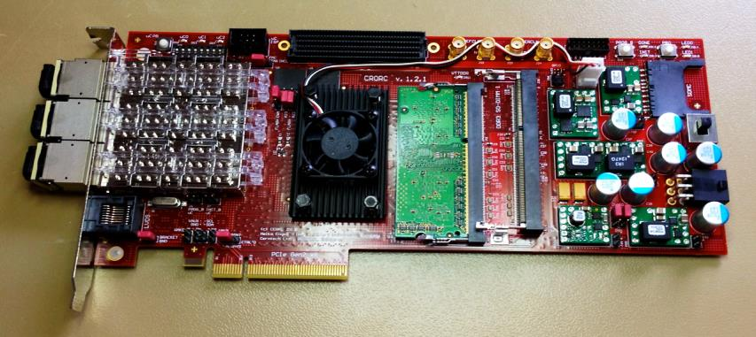
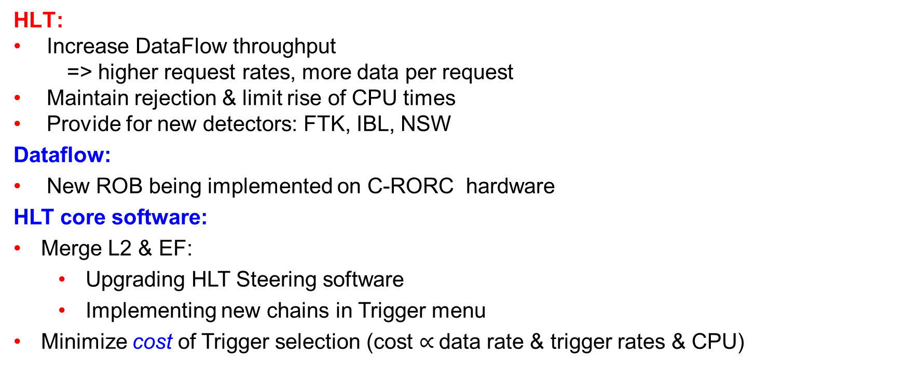
TDAQ Upgrades
Level-1:
Phase I: completely new L1
electron and jet triggers.
Very complex ATCA modules. Requires mastery of 6-10 Gb/s
signal handling. R&D with
demonstrator to check
simulations of distribution on boards
(CERN-LHCC-2013-0018)
HLT:
Increase DataFlow throughput
=> higher request rates, more data per request
Maintain rejection & limit rise of CPU times
Provide for new detectors: FTK, IBL, NSW
Dataflow:
New ROB being implemented on C-RORC hardware
HLT core software:
Merge L2 & EF:
  Upgrading HLT Steering software
  Implementing new chains in Trigger menu
Minimize cost of Trigger selection (cost $∝$data rate & trigger rates & CPU)
C-RORC

Slide 17
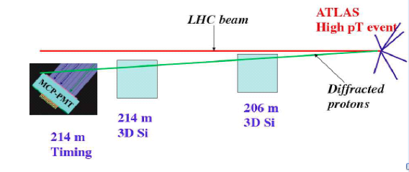
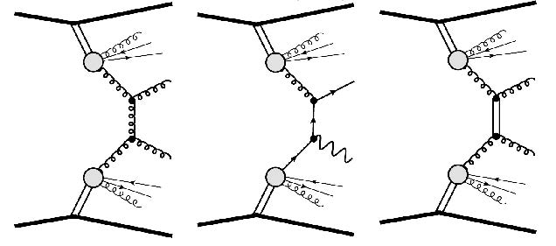

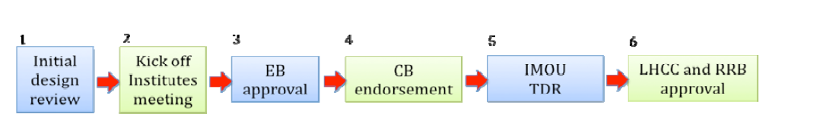
ATLAS Forward Proton (AFP)
IP
IP
IP
IP
IP
ATLAS review process
AFP physics review looked at capabilities in dedicated low <μ> short runs and concluded in January 2014:
The proposed physics programme of AFP special runs to take place between LS1 and LS2 includes some diffractive and QCD physics topics which cannot otherwise be covered by ATLAS and which will be of substantial interest to a sizable external community. These include dijet and W boson production in single diffractive dissociation and Double Pomeron Exchange dijet production with double proton tags.
Technical review report (May 2014) encouraged AFP to proceed to kick-off meeting, request EB approval and to target CB endorsement in near future
17

Slide 18
New LHC schedule beyond LS1
Only EYETS (19 weeks) (no Linac4 connection during Run2)
LS2 starting in 2018 (July) 18 months + 3months BC (Beam Commissioning)
LS3 LHC: starting in 2023 => 30 months + 3 BC
injectors: in 2024 => 13 months + 3 BC
Run 2
LS 2
Run 3
Phase-0 Upgrades (now)
Phase-I Upgrades
LS 3
Run 4
Phase-II Upgrades
LS 4
Run 5
LS 5
LHC schedule approved by CERN management and LHC experiments spokespersons and technical coordinators
Monday 2nd December 2013
18

Slide 19
Future Upgrade Planning
Phase-II Upgrade
(LS3)
Starts End 2022
19

Slide 20
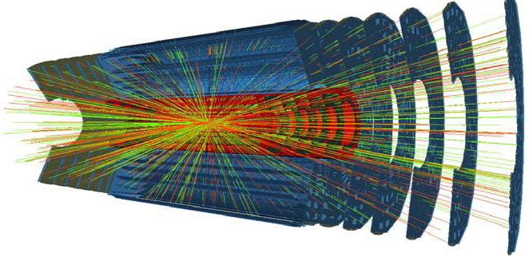
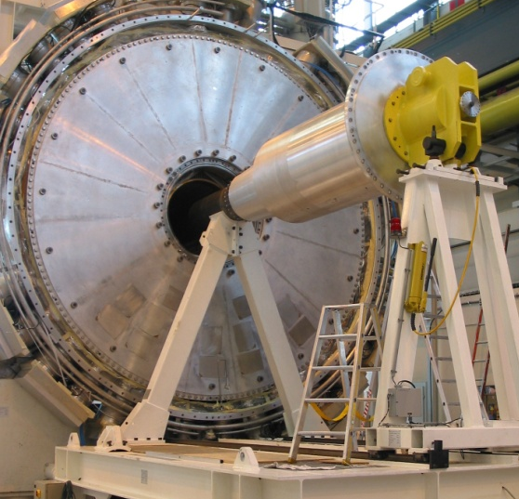
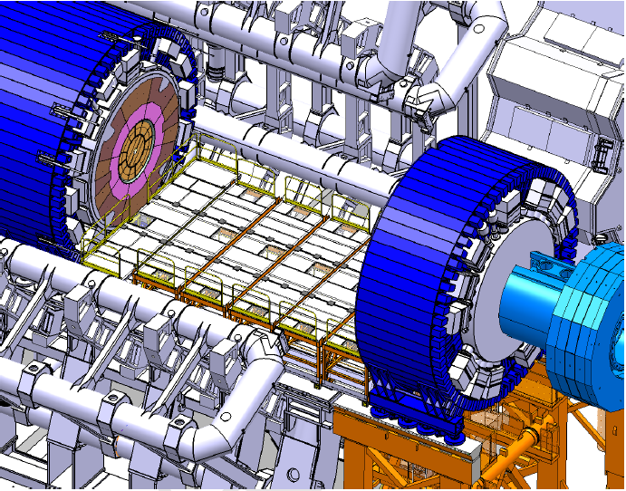
Phase-II Detector Upgrades
  Integrated radiation levels (up to 2-3×10¹⁶n_{eq}/cm²) and plan to cope with up to 200 interactions every 25ns
  Implications of this include:
  New Inner Detector (strips and pixels)
  Trigger and data acquisition upgrades
  L1 Track Trigger
  New LAr front-end and back-end electronics
  Possible upgrades of HEC and FCal
  New Tiles front-end and back-end electronics
  Muon Barrel and Large Wheel trigger electronics
  Possible upgrades of TGCs in Inner Big Wheels
  Forward detector upgrades
  TAS and shielding upgrade
  Various infrastructure upgrades
  Common activities (installation, safety, …)
  Software and Computing
FCal
Cold cover
20

Slide 21
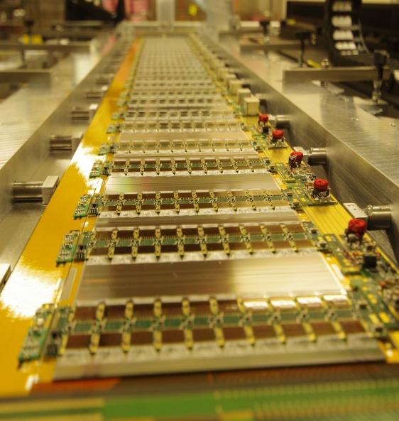
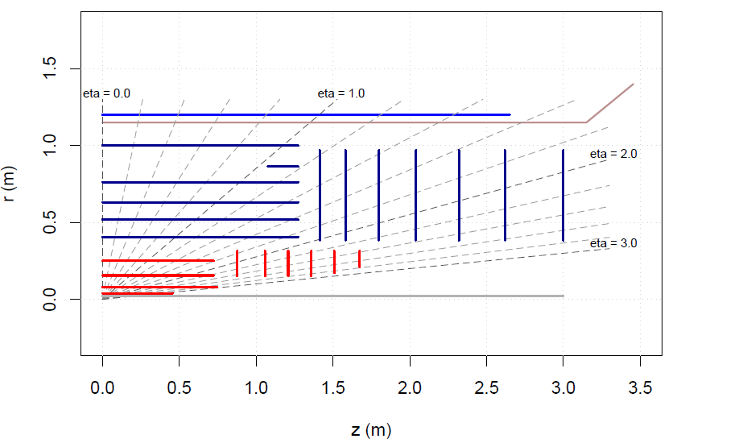







ATLAS: New All-silicon Inner Tracker
Long Barrel Strips
Forward Strips
Short Barrel Strips
Barrel pixel
Microstrip Stave Prototype
RD50
Signal vs dose
(1 MeV n equivalent)
Baseline layout of the new ATLAS inner tracker for HL-LHC Aim to have at least 14 silicon hits everywhere (robust tracking)
Forward pixel
Quad Pixel
Module
Quad Pixel Sensor Wafer
21

Slide 22







New All-silicon Inner Tracker
Pixel Detector
n-in-n, n-in-p planar, 3D and diamond sensors proved to doses up to 2×10¹⁶n_{eq}/cm² and 1Grad
Probably use TSMC 65nm technology which should allow pixel sizes down to 50µm×50µm or 25µm×100µm (RD53)
Test structures in 65nm produced and studied after irradiation
Larger area sensors (n-in-p) quads/sextuplets produced on 150mm diameter wafers with several foundries
Irradiated quad pixel modules studied in test-beam with excellent performance
Prototyping of local supports for various concepts has been carried out
A number of support designs and service routings have been studied
FE-I3
RD50
Quad Sensor
FE-T65-1 – Single Pixel
Forward Pixel Services
Possible Barrel Support Concept
22

Slide 23

IBM announced (Feb 2014) foundries for sale
New CERN contract with TSMC until end 2017
Both 65 nm and 130 nm
Mixed signal design kit available for the 65 nm
2 metal stacks: 6+1 and 9+1
130 nm could be used as an alternative to IBM
Design kit being developed
Radiation hardness tests to be completed

Slide 24










New All-silicon Inner Tracker
Strip Detector
New prototype n-in-p sensors delivered with 4 rows of 2.4cm long strips at 74.5µm pitch
New (256 channel) 130nm CMOS ASIC received (resubmission delivery end June)
Many strip modules (single and double sided) prototyped with 250nm ASICs
Large area stave DC-DC prototype (120cm×10cm) produced and under study
Serial and DC-DC powering studied in detail on short versions of 250nm stave
Several other new chips (HCC, HV multiplex, SP, DC-DC,..)
Hybrid/module designs to use these completed
Local supports extensively prototyped and further material reduction achieved
Progress in Petal and Stave support designs
End-of-stave card for 130nm developed
Fully functional forward module
4 row wire bonds
Module with on-board DC-DC converter
8 double-sided
module 250nm super-module

Slide 25






New All-silicon Inner Tracker
Strip Detector
12 Module full length 250nm ASIC stave with 61440 channels

Slide 26




HV/HR-CMOS R&D
Potential technologies under
study to bring some of the advantages of monolithic
active pixel sensor (MAPS) technology to the ITk.
Already installed at STAR (RHIC)
and proposed for ALICE and ILC
Could also envisage using the “smart diode” approach to propose a single-sided strip replacement with z encoding
Many technologies under investigation for potential use in pixel system at higher radii or allowing less expensive 5th layer
Cost evaluation depends critically on yield estimates for large format detectors
26

Slide 27





New All-silicon Inner Tracker
Integration and Performance
Cooling, services, integration, removal, installation etc all being studied and key is understanding activation issues
Optoelectronics (GBT) being working on in common with other experiments
DAQ/DCS exists for prototype operation but not yet designs for final system
Detailed layout optimisation underway to understand cost/performance trade-offs
Alternative Layouts
5 GeV
100 GeV
27

Slide 28







Baseline Tracker Performance
New Inner Detector Improved granularity
  (Smaller pixels and 2.45cm and 4.9cm strips (74.5μm pitch)
  Improved radiation hardness
  Reduced material
  Extended forward coverage
  Robust tracking (14 layers)
Occupancy for <μ>=200 (in %)
28

Slide 29
ITk: Draft Schedule
2014
2015
2016
2017
2018
2019
2020
2021
2022
2023
CB
Endorse
Pixel TDR
~ 2019
Preproduction
2-3 Years Pixel Production
ITk-IDR
APR-OCT
ITk Ready for Installation
PIXEL
UCG, LHCC,
Pixel-MOU, RRB
Begin
Integration
UCG, LHCC,
Strip-MOU, RRB
STRIP
ITk Commission
on Surface
ITk-Kick off
EB Approval
Strips TDR
~ 2018
Preproduction
3-4 Year Strip Production
YR=1
2
3
4
5
6
7
8
9
10
CB= collaboration board, EB=executive board, IMOU=interim memorandum of understanding, UCG=upgrade cost group, RRB= Resources review board, IDR=initial design review (internal), TDR=technical design report (external)

Slide 30



Phase-II Split TDAQ L1 Scheme
Simulation studies show that including a track trigger complements muon and EM triggers
  Improves muon P_{T} resolution
  Improves EM identification by matching to track
Implemented as 2-level scheme to accommodate legacy electronics and reduce links from strip tracker → reuses Phase-I L1 trigger improvements for new L0
LOA scheme and buffering fully integrated in ABCn130 ASIC
FTK technology could be used to perform fast track fit in L0 defined Region of Interest (RoI)
Note this scheme impacts the electronics in all systems and provides possibilities to exploit the L0/L1 structure to have more extensive information from all sub-detectors at L1
30

Slide 31

Phase-II Split TDAQ L1 Scheme
Front-end chips for different systems (under investigation)
Note latencies, rates and use of R3 read-out are evolving in the light of improved understanding of possible trigger menus for Phase-II and exploration of higher speed data transfer
31

Slide 32



TDAQ and Detector Readout
New TDAQ architecture requires upgrade to readout of detector systems
General comments on need for upgrades of detector readout:
  In addition to the changes in TDAQ architecture. Upgraded readout electronics is required due to ageing and radiation damage.
  More functionality moved to the counting room, taking advantage of large bandwidth optical links to move data off-detector; allows use of FPGAs rather than dedicated ASICs
  Custom low power (lpGBTx) 4.8Gbps rad-hard ASIC can be reasonably assumed available in low mass custom package (or 9.6 Gbps with similar power as current GBTx)
  Detectors are evaluating a common readout architecture based on GBTs and common Front-End interface
32

Slide 33
The ATLAS Experiment
25 m
45 m
33

Slide 34



Phase-II Upgrades to LAr Electronics
Replace all FE boards (warm)
  Gives flexible, free-running architecture sending data off-detector for all bunch-crossings
  Natural evolution of Phase-I new digital trigger boards
  Replacement required due to aging and radiation limits
  Allows implementation of L0/L1 scheme using Phase-I L1 upgrades for Phase-II L0
Replace Hadronic Endcap Calorimeter electronics if required
  Replace HEC cold (GaAs) preamps if significant degradation in performance expected during HL-LHC operation but this requires FCAL removal so new sFCAL would also need to be installed
  (Indications that expected doses are manageable given better dose projections but aging of electronics still needs to be understood)
Replace just the Forward Calorimeter (FCal) if required
  Install new sFCAL in cryostat or miniFCAL in front of cryostat if significant degradation in current FCAL expected at HL-LHC
Old (LoI) dose projections
Performance of cold HEC electronics under irradiation
summing boards and cooling loops (to avoid boiling)
Reduce gap sizes from 269/375/500 μm, new
miniFCAL absorbs energy upstream of current FCAL
Cold Cu/LAr device
[100μm LAr gaps]
34

Slide 35



Tile Calorimeter
No major changes foreseen in the readout or trigger during Phase-I
In Phase-II complete FE&BE electronics replacement.
  Full digitization of data at 40MHz and transmission to off-detector system
  Digital information to L1/L0 trigger
Also significantly improve robustness
  Reduce the complexity and connections inside the front-end drawers. Moving from dependent drawers to independent mini-drawers (readout and power).
  Use a real-complete redundant readout – from cell to back-end
  Redundant Power Supply system introducing Point-of-Load regulators
Present
100 kHz
Phase-II Upgrade
40 MHz
32

Slide 36


Muon Electronics Upgrade
Replace existing electronics to accommodate:
Increased level-1 trigger latency.
Need for sharpening the trigger threshold using MDT precision chamber hits at level 0/1.
Features of the new RPC electronics:
Capable of higher level-1 trigger rate and longer latency.
Time-over-threshold mode to measure charges deposited on the pick-up strips.
→ Centroid of the charge distribution for improved track point resolution.
Features of the new TGC electronics:
Existing on-chamber ASD pre-ampliers will be kept.
New TGC read-out electronics chain compatible with HL-LHC requirements with most of the logic functions moved to radiation free zone (USA15).
→ Use of FPGAs for the first level trigger decision
Features of the new MDT electronics:
Capable of level-1 trigger rate and longer latency in high background regions.
Additional fast read-out chain for MDT level-0/1 trigger.
36

Slide 37



Possible Extensions to Large η
Physics Channels Under Investigation
• Extend tracking to η>4?
SM |  | VBS W+W+ for VBF jet reconstruction Tribosons as multi-lepton measurement reference Inclusive W/Z production Exclusive processes (γγ ->WW)
SUSY |  | VBF production for EWKinos & optimisation for VBF reconstruction JP determinations for observations of SUSY states t-channel processes for stop production
Higgs |  | Di-Higgs reconstruction/acceptance in bbgg and bbττ. VBF Di-Higgs production modes H->WW for fwd jet veto & b-jet veto optimization H->4l for optimization of lepton coverage H->WW; H->tτ for optimization of VBF reconstruction Higgs invisible and MET requirements t-channel mode for single-top associated H production
Exotics |  | JP determinations for Z' versus KK graviton Single-VLQ t-channel production
top |  | Single-top modes like t-channel production with very forward topology for light jet and b-jet reconstruction
Pixel extension in “ring design”
• Segmented timing detectors at MBTS location?
• New FCAL with improved timing and granularity?
• Pixelated muon tagger behind ECAL η = 2.7 – 4.5?
Studies of physics motivations and requirements are proceeding in parallel with studies of possible technical options
• Muon spectrometer with magnetized forward shielding?

Slide 38




LoI Core Costs
Tracker total: 132 MCHF out of 231M CHF
(plus 45 MCHF of total possible additional costs)
Phase-I LoI Costs see:
https://edms.cern.ch/document/1164764
Phase-II LoI Costs see:
https://edms.cern.ch/document/1258343
38

Slide 39
New LHC schedule beyond LS1
Only EYETS (19 weeks) (no Linac4 connection during Run2)
LS2 starting in 2018 (July) 18 months + 3months BC (Beam Commissioning)
LS3 LHC: starting in 2023 => 30 months + 3 BC
injectors: in 2024 => 13 months + 3 BC
Run 2
LS 2
Run 3
LS 3
Run 4
LS 4
Run 5
LS 5
LHC schedule approved by CERN management and LHC experiments spokespersons and technical coordinators
Monday 2nd December 2013
39

Slide 40


Re-profiled Phase-II Core Costs
40

Slide 41
Re-profiled Phase-II Core Costs
LoI Core Costs
New Phase-II Profile
Old LoI Based Profile for Comparison
41

Slide 42


2013 Workshop

Slide 43
Conclusions
  ATLAS has a coherent plan for upgrades through the coming decade to meet the challenges up to and including the HL-LHC era, which are embodied in the two LoIs and four TDRs which have been through full LHCC approval
  The understanding of the full physics potential of the HL-LHC is advancing rapidly, with greatly increased activity on both detector and accelerator preparations following the adoption by CERN Council of the Updated European Strategy for Particle Physics, with the HL-LHC as its highest priority, and the strong endorsement in the recent P5 report
  There are designs for a replacement tracker that should withstand both the pile-up and radiation conditions at the HL-LHC, with performance able to not just fully recover, but also improve on, the current capabilities at low pile-up.
  Major R&D programmes are targeting all the upgrades needed for ATLAS to operate at luminosities far above the initial design requirements.
  However, it is critical for these programmes to proceed rapidly that there be adequate resources now to develop optimized, fully cost-effective solutions.
43

Slide 44
Back-up

Slide 45
HL-LHC Planning
  The stated target of the European strategy set the overall framework “Europe’s top priority should be the exploitation of the full potential of the LHC, including the high-luminosity upgrade of the machine and detectors with a view to collecting ten times more data than in the initial design, by around 2030. This upgrade programme will also provide further exciting opportunities for the study of flavour physics and the quark-gluon plasma.” ( Adopted by CERN Council May 2013, see http://council.web.cern.ch/council/en/EuropeanStrategy/esc-e-106.pdf).
  All 4 experiments, the accelerator and the theory community were represented at the October 2013 ECFA HL-LHC Experiments Workshop at Aix-les-Bains http://indico.cern.ch/conferenceDisplay.py?confId=252045
  The report from this to ECFA can be found at https://cds.cern.ch/record/1631032 which focusses on the detector requirements and physics reach with 3000fb⁻¹
  There were also presentations on accelerator upgrade preparations but these have been to some extent superseded by more recent workshops:
    “The Review of LHC and Injector Upgrade Plans Workshop” from 29th to 31st October at Archamps, France (RLUIP: https://indico.cern.ch/conferenceDisplay.py?ovw=True&confId=260492)
    “The 3rd Joint HiLumi LHC_LARP Annual Workshop” from 11th to 15th November at Daresbury (STFC) Laboratory, UK (https://indico.cern.ch/conferenceDisplay.py?ovw=True&confId=257368)
  The next in the ECFA HL-LHC workshop is planned for 21st-23rd October 2014
45

Slide 46


Slide 47



Snowmass 2013
P5 Report May 2014 at http://science.energy.gov/hep/hepap/reports/ .
Section 2.2 is particularly relevant. "Recommendation 10: Complete the LHC phase-1 upgrades and continue the strong collaboration in the LHC with the phase-2 (HL-LHC) upgrades of the accelerator and both general-purpose experiments (ATLAS and CMS). The LHC upgrades constitute our highest-priority near-term large project."
arxiv.org/pdf/1310.8361v1

Slide 48



Physics Studies
3000 fb⁻¹
B. Murray
Aim to measure as many Higgs couplings to fermions and bosons as possible to really test if this is the SM Higgs or a pointer to the BSM physics we know has to exist
HL-LHC (3000 fb⁻¹): a true Higgs factory:
> 170M Higgs events produced
> 3M useful for precise measurements
(more than or similar to ILC/CLIC/TLEP)
LHC gg→ H (50pb); e⁺e⁻→ ZH (0.2-0.3pb)
Matter
particles
Force
carriers
48

Slide 49



ttH production
with H → γγ
Gives direct access to Higgs-top
coupling (intriguing as top is heavy)
Today’s sensitivity: 6xSM cross-section
With 3000 fb⁻¹ expect 200 signal
events (S/B ~ 0.2) and > 5σ
Higgs-top coupling can be
measured to about 10%
H →μμ
Gives direct access to Higgs couplings
to fermions of the second generation.
Today’s sensitivity: 8xSM cross-section
With 3000 fb⁻¹ expect 17000 signal events
(but: S/B ~ 0.3%) and ~ 7σ significance
Higgs-muon coupling can be
measured to about 10%
49

Slide 50
ttH production
with H → γγ
Gives direct access to Higgs-top
coupling (intriguing as top is heavy)
Today’s sensitivity: 6xSM cross-section
With 3000 fb⁻¹ expect 200 signal
events (S/B ~ 0.2) and > 5σ
Higgs-top coupling can be
measured to about 10%
Rare processes → sensitive studies
only possible with 3000 fb⁻¹
H →μμ
Gives direct access to Higgs couplings
to fermions of the second generation.
Today’s sensitivity: 8xSM cross-section
With 3000 fb⁻¹ expect 17000 signal events
(but: S/B ~ 0.3%) and ~ 7σ significance
Higgs-muon coupling can be
measured to about 10%
50

Slide 51










Physics Studies at Aix-les-Bains
1 TeV
ttH→ZZ
Vector boson anomalous couplings
System mass probed so far
H→Zγ
Improvements in coupling ratios with HL-LHC.
(Range depends on handling of systematics and theoretical uncertainties)
NLO Cross-section calculations
τ Trigger threshold
76 GeV
39 GeV
H→ττ trigger threshold improvements with track trigger at L1
Direct stop
51

Slide 52




Current Detector Radiation Simulation
https://twiki.cern.ch/twiki/bin/view/AtlasPublic/SCTPublicResults#Figures
https://twiki.cern.ch/twiki/bin/view/AtlasPublic/ApprovedPlotsPixel#Radiation_damage_plots
https://twiki.cern.ch/twiki/bin/view/AtlasPublic/InDetTrackingPerformanceApprovedPlots#Alignment
Simulation results fit with data to much better than a factor of 2
(and safety factor of 2 was assumed in dose specifications)
(Temperature history key to fitting I_{leak})
https://cds.cern.ch/record/1516824?ln=en
52

Slide 53





New All-silicon Inner Tracker
Alternative layouts being considered which include either a further pixel layer or inclined pixel sensors attached to the same barrels (Alpine layout)
Extended η coverage needs more detailed physics motivation
53

Slide 54




Current Silicon Microstrip (SCT) Material
Current Silicon Tracker
(4 barrel strip layers)
Module Support
Material Material
Old ATLAS Barrel Module
12 ASIC of 300μm thickness for double-sided module read-out
(ie just 6 read-out chips per side)
New ATLAS sLHC-Tracker Module
will have 80 ASICs in two hybrid fingers for just one-sided read-out
“The barrel modules of the ATLAS semiconductor tracker”.
Nucl.Instrum.Meth.A568:642-671,2006.
Hybrid area per module roughly ×2 at
HL-LHC: much higher R/O granularity
54

Slide 55












Stave: Hybrids glued to Sensors glued to Bus Tape glued to Cooling Substrate
Glue
Glue
Current Prototypes
250nm ASIC Designs
1.2m
1.2m
1.2m

Slide 56




Stave: Hybrids glued to Sensors glued to Bus Tape glued to Cooling Substrate
Module, Stave and Petal concepts with 130nm ASIC: 256 channels so each row of ASICs address two rows of strips
56

Slide 57


The ATLAS Pixel Detector
Three barrel layers:
  R= 5 cm (B-Layer),
  9 cm (Layer-1), 12 cm (Layer-2)
  modules tilted by 20º in the Rφ plane to overcompensate the Lorentz angle.
Two endcaps:
  three disks each
  48 modules/disk
Three precise measurement points up to ⏐η⏐<2.5:
  RΦ resolution:10 μm
  η (R or z) resolution: 115 μm
1456 barrel modules and 288 forward modules, for a total of 80 million channels and a sensitive area of 1.7 m².
  Environmental temperature
  about -10 ºC
  2 T solenoidal magnetic field.
57

Slide 58
Module Overview
Sensor
  47232 n-on-n pixels with moderated p-spray insulation
  250 μm thickness
  50 μm (RΦ) × 400 μm (η)
  328 rows (x_{local}) × 144 columns (y_{local})
16 FE chips
  bump bonded to sensor
Flex Hybrid
  passive components
  Module Controller Chip
  to perform distribution of commands and event building.
Radiation-hard design:
  Dose >500 Gy
  NIEL >10¹⁵ n_{eq}/cm² fluence
60.8 mm
16.4 mm
58

Slide 59






ATLAS Silicon Strip Detectors
4 barrels (2112 modules) and 2×9 disc end-caps (1976 modules)
61m² of silicon micro-strip detectors
~20,000 separate 6cm×6cm sensors
NIKHEF and University of Liverpool
ATLAS
University of Oxford
CERN
59

Slide 60


Current SCT ATLAS Module Designs
ATLAS Tracker Based on
Barrel and Disc Supports
Effectively two styles of double-sided modules (2×6cm long)
each sensor ~6cm wide (768 strips of 80μm pitch per side)
Hybrid cards carrying read- out chips and multilayer interconnect
circuit
Sensor
Sensor
Sensor
Sensor
Barrel Modules Forward Modules
(Hybrid bridge above sensors) (Hybrid at module end)
60

Slide 61

Future Upgrade Planning
Phase-II Upgrade
(LS3)
Starts End 2022
    (https://indico.cern.ch/conferenceDisplay.py?ovw=True&confId=257368)
61

Slide 62

Radiation dose in the present triplet (300 fb⁻¹)
L. Bottura
Two “hot-spots”

Slide 63
Radiation dose in the present triplet (300 fb⁻¹)
L. Bottura
Cold bore insulation
≈ 35 MGy
Q2
27 MGy
MCBX3 20 MGy

Slide 64
RLIUP Summary on LHC Inner Triplets
L. Bottura https://indico.cern.ch/conferenceDisplay.py?ovw=True&confId=260492
Expected dose by LS3 (300 fb⁻¹) with 50 % uncertainty⁽³⁾
  Range of 27 [18…40] MGy in the Q2
  Range of 20 [13…30] MGy in the MCBX
Bonding strength (shear) of epoxies is strongly degraded (80 %) above 20 MGy
Fracture strength of insulating materials degrades by about 50 % in the range of 20 MGy (G11) to 50 MGy (epoxies, kapton)
Insulations (polyimide) become brittle above 50 MGy
Triplet magnets may experience mechanically-induced insulation failure in the range of 300 fb⁻¹ (LS3 ± 1 year)
  Premature quenches (cracks in end spacers)
  Insulation degradation (monitor on line⁽⁴⁾)
  Mechanical failure (nested coils in MCBX)

Slide 65
HL-LHC matrix: equipment, time, cost

Slide 66
Conclusions
The upgrade is robust for 250 (300 ) fb⁻¹/y
    Means to maintain or increase availability are under study
All hardware is more robust for 3000 fb⁻¹ than it is today for 300 fb⁻¹
Design Study finished by 2015 with the TDR
Margins are there and – once established and proved:
  Possible to decrease pile-up density and/or increase to 350 fb⁻¹ (7⋅10³⁴ of L_{level}) thanks to crab kiss (CC in II & ⊥ planes) and β* of 10 cm (large aperture IT & ATS)
  Increase data collection to > 4000 fb⁻¹??

Slide 67


Interface with Accelerator
  In the context of the 3000fb⁻¹ by “around 2030”, given that levelling at 5×10³⁴ cm⁻²s⁻¹ is based on an effective luminosity of 2×10³⁵ cm⁻²s⁻¹, this raises the question of the ultimate acceptable pile-up (average # collisions each 25ns)
  The “crab-kissing” scheme offers an extended interaction region in z with lower pile-up density (better vertex finding)
  The question arises for mean pile-up, <µ>, = 140 (5×10³⁴ cm⁻²s⁻¹, 25ns); if the vertex density could drop from 1.3/mm to 0.7/mm could <µ> be even higher?
H
L
-L
H
C
b
a
s
e
l
i
n
e
a
n
d
b
a
c
k
u
p
(2
5
n
s
):
2
5
0
fb
-1
/y,
μ
=
1
4
0
@
5
E3
4
New Triplets at Interaction Region will have twice present aperture
    Requires modification of absorbers in the interaction region
    appears compatible with small radius beam pipe
    highly desirable to anticipate work in LS2
    (lower activation - time gained for LS3)
Beam loss risks (for new crab cavities and experiments)
    Appear manageable from preliminary studies –
    More (common) work needed
to
(B
B
w
t
i
r
e
.
o
r
.
c
r
a
b
w
/
o
C
K
s
c
h
e
m
e
)
1.
2
“H
L
-L
H
C
+”
(2
5
n
s
):
2
5
0
fb
-1
/y,
μ
=
1
4
0
@
5
E3
4
1.
0
to
(B
B
w
t
i
r
e
.
a
n
d
.
c
r
a
b
s
w
i
th
C
K
s
c
h
e
m
e
)
0.
8
“H
L
-L
H
C
++”
(2
5
n
s
):
2
5
0
fb
-1
/y,
μ
to
=
1
4
0
@
5
E3
4
(B
B
w
t
i
r
e
.
a
n
d
.
c
r
a
b
s
w
i
th
C
K
s
c
h
e
m
e
.
a
n
d
.
8
0
0
MH
z)
0.
6
L
H
C
2
0
1
2
(5
0
n
s
):
2
5
fb
-1
/y
,
μ
=
4
0
@
7
.
5
E3
3
0.
4
to
t
S. Fartoukh
0.
2
z
[m
]
0.
2
0.
1
0.
1
0.
2
67

Slide 68

See Phase-II LoI Section 10 page 134 and https://edms.cern.ch/document/1258343 referenced on page 135
68

Slide 69

69

Slide 70

70

Slide 71
Conclusions and plans
The different alternatives and possibilities to keep or upgrade all the parts of the system being evaluated
  First version of each component ready to be tested
  https://indico.cern.ch/event/311205/
Still more than 8 years for the installation but… some milestones coming really soon
Short term plans
Expert days next week at CERN to test the readout of one minidrawer
Design review in May
Installation of one demonstrator in P1 in August
Long term
2015/2016 – Test beams, performance studies and possible installation of more units.
2020 - Final review of the the demonstrator - LS2
2021 – Components production and set up the FE assembly
2023 – Installation of new electronics

Slide 72

Computing and Software
Resources needed for computing at HL-LHC are large - but not unprecedented.
  However, depending on technology assumptions, flat resources can only provide a factor of 2 to 10 times less CPU power than needed
    Cloud federation may be a way to build the next Grid
      Possible usage of specialized track processing (eg GPUs as used by ALICE HLT)
      Multi-core processors will need major software developments to minimize computing demands
  The use of more specialized hardware to optimize overall costs implies the need for frameworks able to seamlessly adapt and use much more heterogeneous computing resources
  CERN WLCG provides a possible framework for development of future solutions
  All LHC experiments could benefit from better coordinated efforts to develop new programming techniques
Virtualization is the key
technology behind the Cloud
72

Slide 73


CMS: “Long-Barrel” Double-Stack Concept
  Layout optimized for L1 track finding. Geometry helps to keep problem “local”
  Within double-stack, each lower module is combined with two upper modules to form “Tracklets”
  Tracklets in each “super-layer” are extrapolated to the other two super-layers
φ arrangement within double-stack layer
Common supporting mechanics
Self-contained φ sectors.
Each sector needs to be combined with the two neighbouring sectors (left and right) to “contain” ~2.5 GeV tracks.
15 degree sector
Pairs of stubs are combined to form “tracklets”
73

Slide 74



CMS: Phase-II Requirements and Guidelines
Radiation hardness
  Ultimate integrated luminosity considered ~ 3000 fb⁻¹
    To be compared with original ~ 500 fb⁻¹
Resolve up to ~200 collisions per BX, with few % occupancy
    Higher granularity
Improve tracking performance
  Improve performance @ low p_{T} ,reduce particle interaction rates
  Reduce material in the tracking volume
  Improve performance @ high p_{T}
    Reduce average pitch
Tracker input to Level-1 trigger
  μ, e and jet rates would become unacceptably large at high luminosity
    Even considering “phase-1” trigger upgrades
    Performance of selection algorithms degrades with increasing pile-up
  Add tracking information at Level-1
    Move part of HLT reconstruction into Level-1!
  Objective:
    Reconstruct “all” tracks above 2 - 2.5 GeV
    Identify the origin along the beam axis with ~ 1 mm precision
Strip-Strip Module
Pixel-Strip Module
74

