Slide 2
SMACC Twenty-second report
[20 min]
06/06/2014
Jean-Philippe Tock (TE-MSC)
On behalf of the SMACC project

Slide 3
Activities since last LSC (11/04/2014)
  Arc splices installation
    By Activities
    By sectors
  SIT // DFBA
Dashboards
Specials
  DN200 painting
  Overview
Activities for the next 4 weeks
Conclusions

Slide 4
SMACC Main activities for the last 3 weeks
8
Sector 56 :
  Final leak test and reconnection of Q7/DFBAK
Sector 67 :
  Ready for cool-down for SMACC
Sector 78
  Work on NC
  Final leak test
Sector 81
  Purge, ElQA, flushing,…
Sector 12
  Complete insulation vacuum leak test
  Pressure test for 13.05.2014
Sector 23
  Complete reclosure of Ics
  Insulation vacuum leak test
Sector 34
  Repair (hopefully) last splice
  Complete M lines rewelding (except NC)
  M lines leak test
  Start ICs reclosure
Sector 45
  Complete repair of overheated splices
  Start rewelding of M lines
☑
From last LSC (11.04.2014)
DFBAK: All lines reconnected // IC closed // Last subsector to be leak tested
☑
Under cool down
☑
All interconnections reclosed
1 vacuum subsector (Including DFBAO) to be finally leak tested
☑
☑
Interventions after pressure test & before cooldown on-going
☑
All ICs are reclosed
☑
Successful pressure test, to be flushed
☑
Completed
Just pressure tested
☑
Completed
☑
☺ All repaired
☑
Completed
☑
Completed
☑
Completed
≈ 1/2 vac subsectors finally leak tested
☑
Completed
☑
< 60/212 ICs to close
Completed

Slide 5
SEQUENCE AND STATUS
Completed
Install DN200
Completed
Completed
OK to open
Open ICs
Completed
Open M sleeves
Completed
Undo / Redo splices
ElQC (new splices)
Cancelled
Completed
Completed
ElQC (old splices)
Machine Cu
ElQC after Cu mach.
Completed
Completed
Consolidate Q diodes
Completed
Completed
Completed
Completed
Completed
Install shunts
ElQC
after shunt
Insulate splices
Weld M
Leak test M
Close IC
Final LT
≈ 7.7 sectors
≈ 6.4 sectors
Non-conformities (Before P Test)
Non-conformities
(After P Test)
4 completed
≈ 6 sec-eq
Completed in 1st sector (67)… so far
On-going in S81

Slide 6
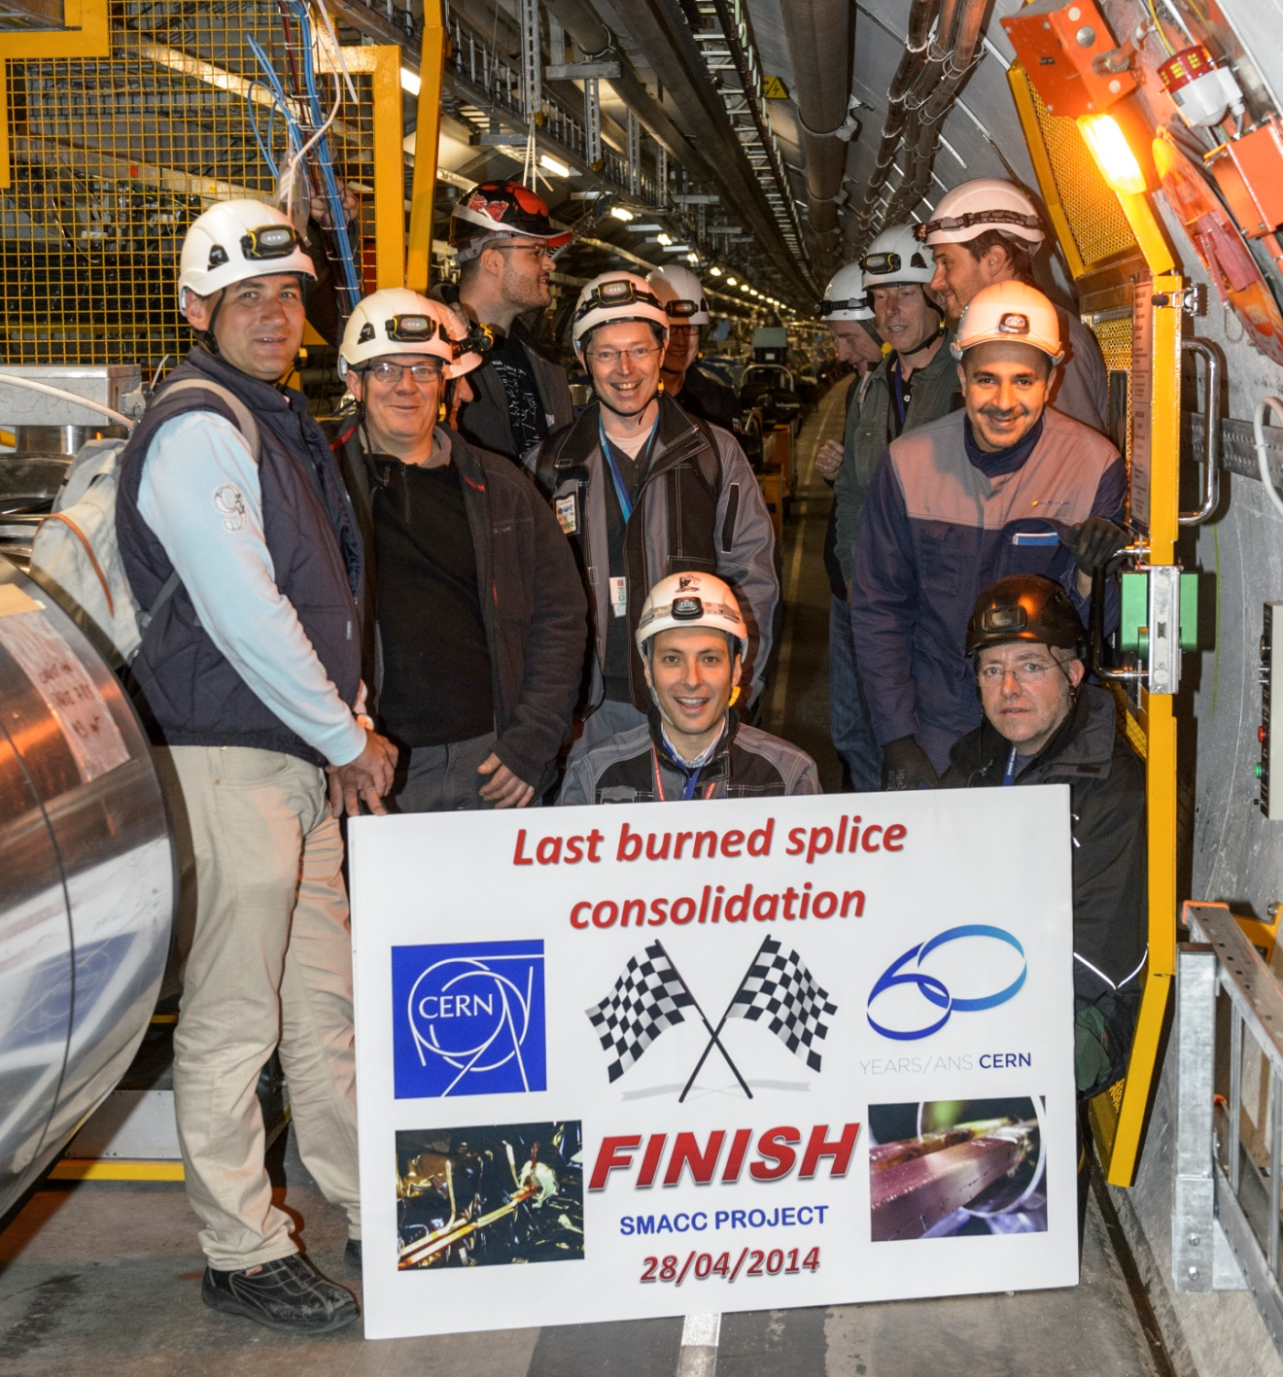
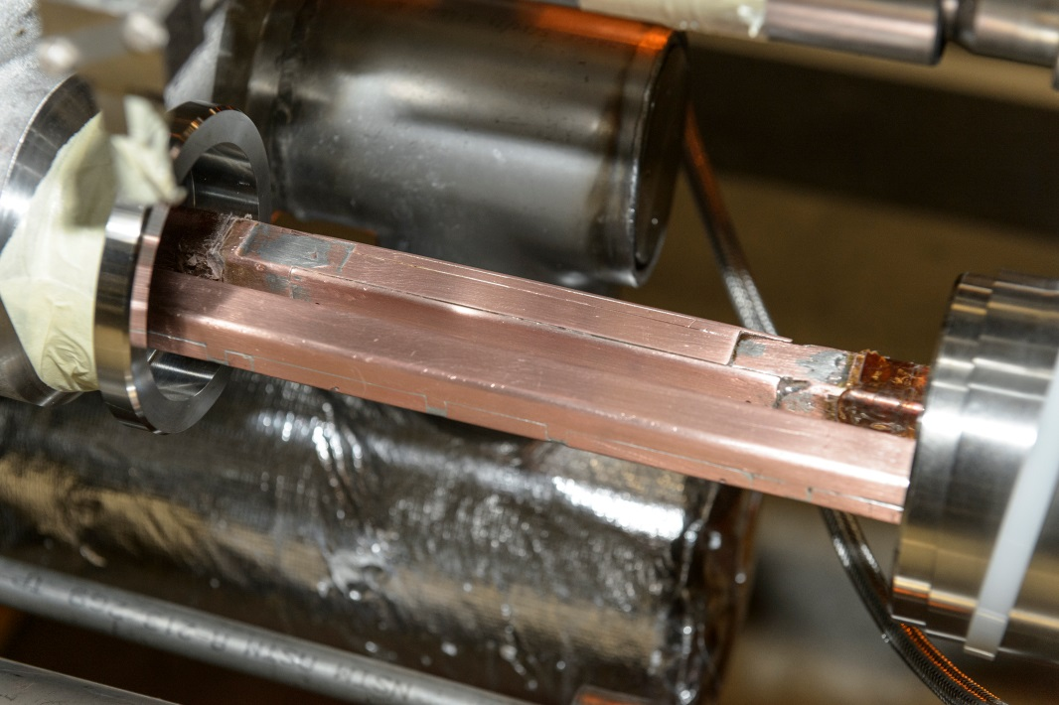
Last overheated splices consolidated
16 were repaired
Courtesy H Prin, N Dalexandro

Slide 7
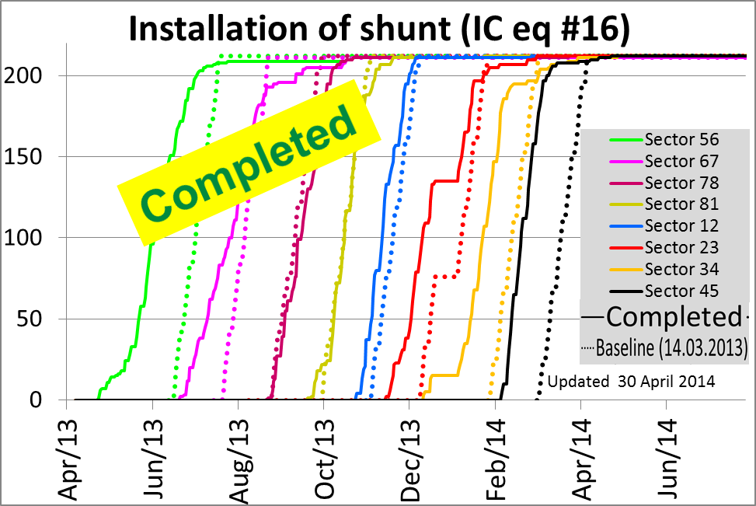
SMACC Progress report by activity
Courtesy H Prin, M Pozzobon

Slide 8
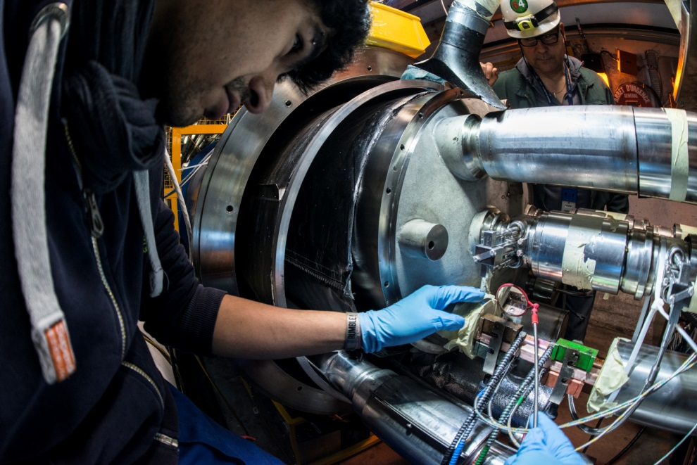
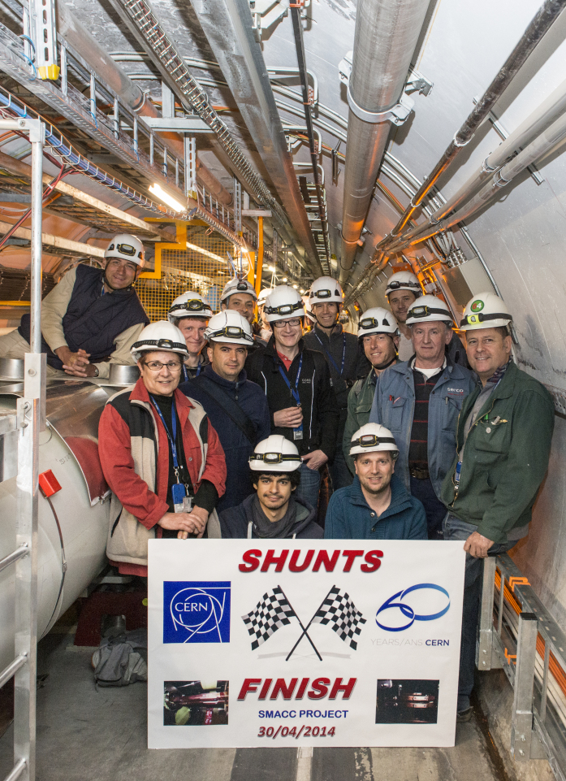
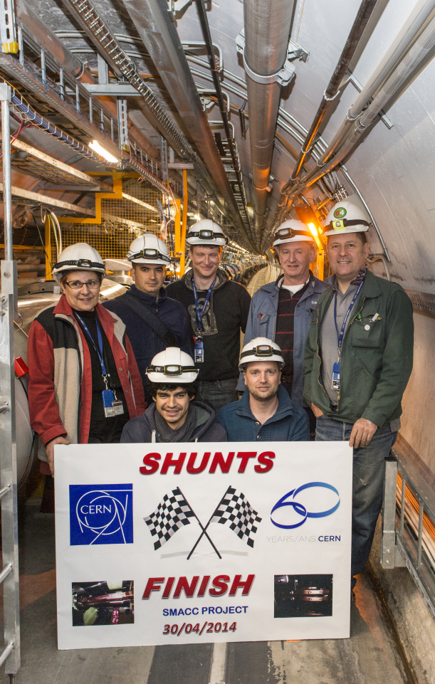
SMACC Progress report by activity
Note the small size of the team …
A lot of work was necessary to give access to splices and reclose

Slide 9
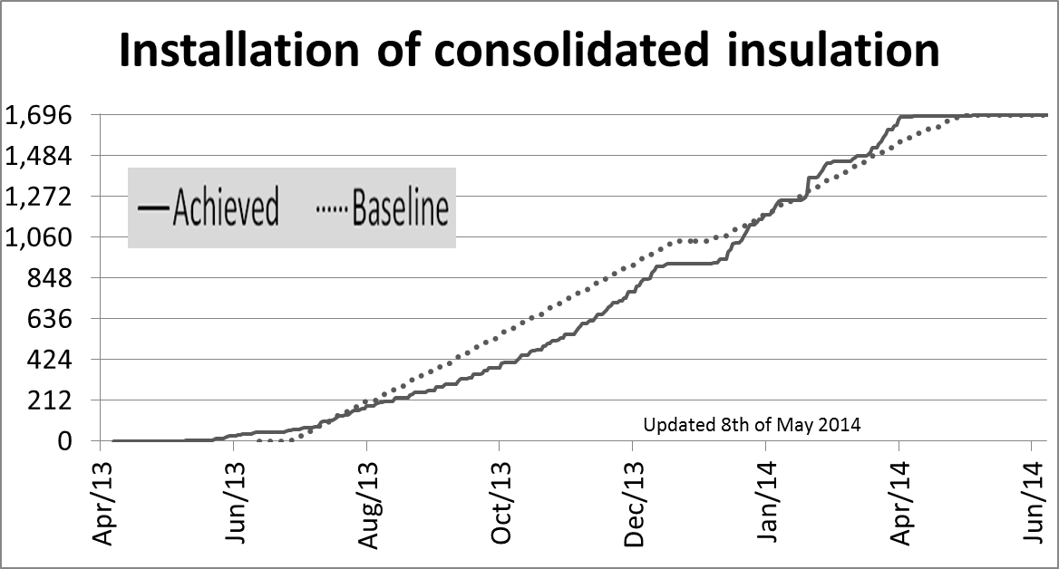

SMACC Progress report by activity
Courtesy H Prin / G Maury

Slide 10
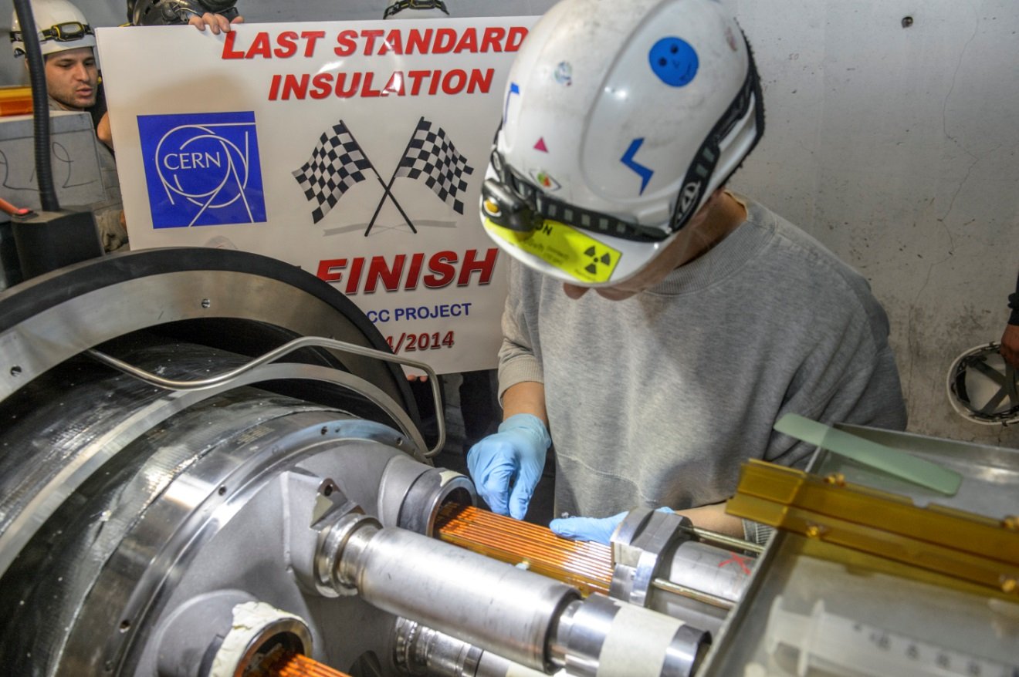
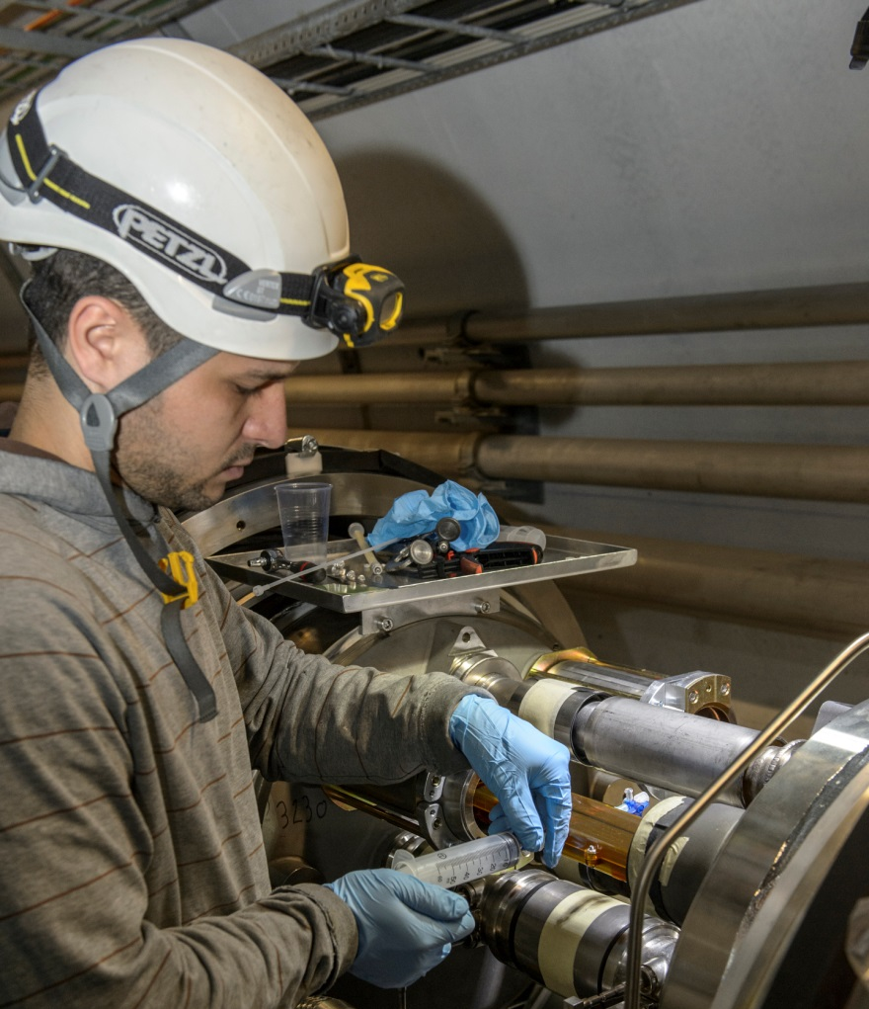
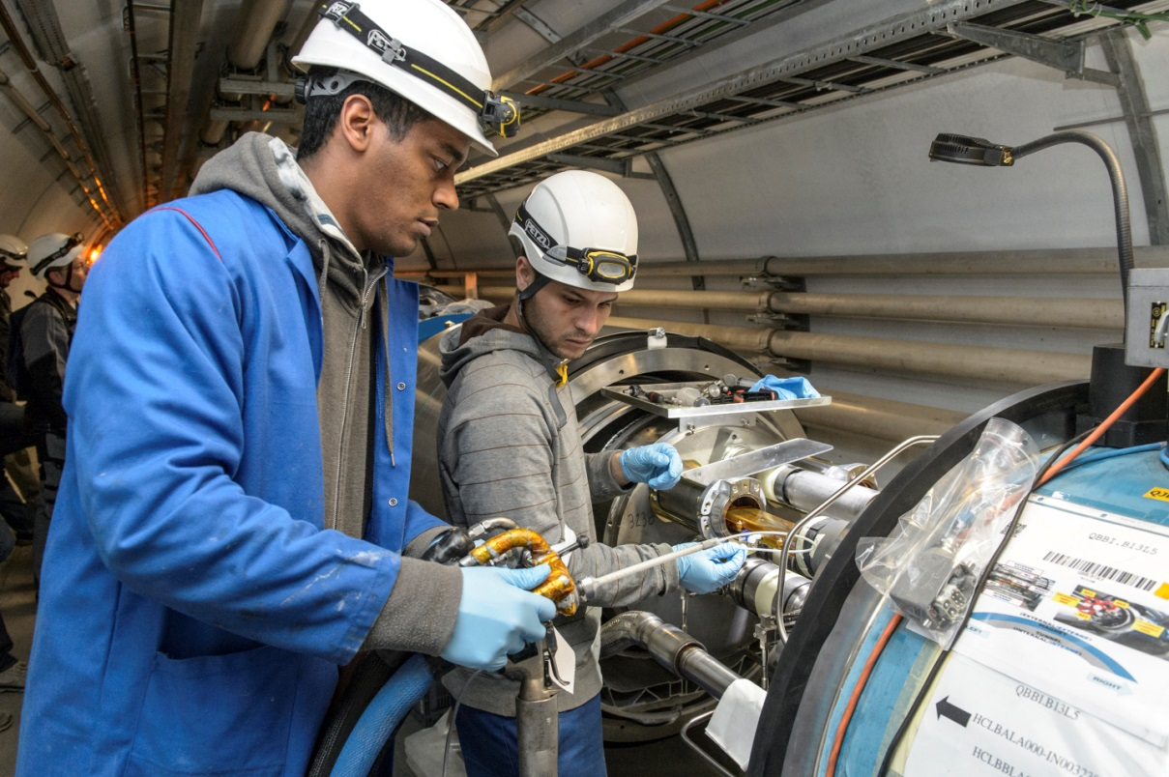
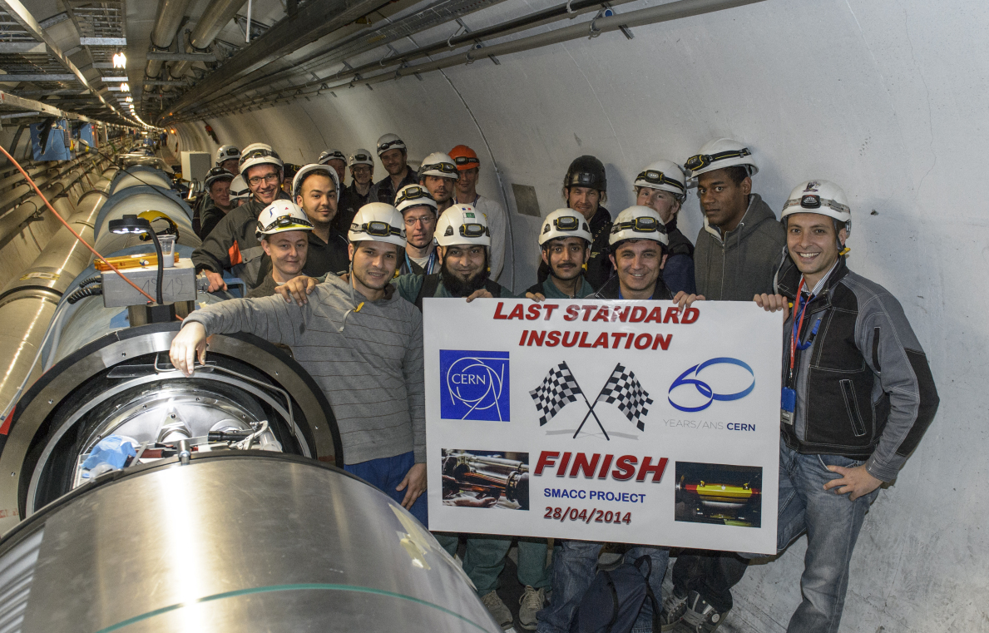
SMACC Progress report by activity
Courtesy H Prin / G Maury

Slide 11

Courtesy F Savary

Slide 12
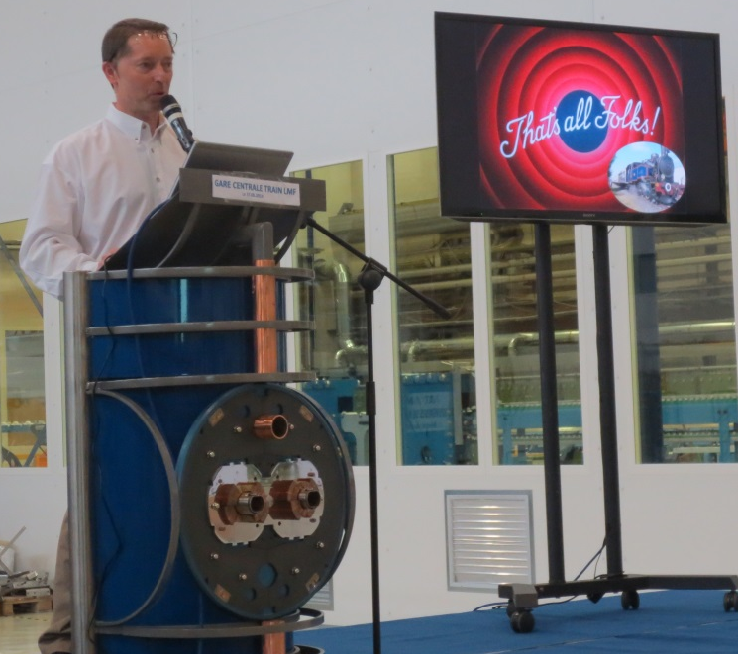
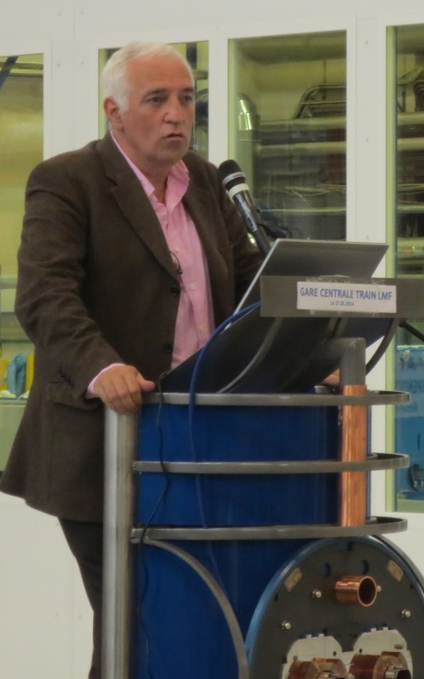
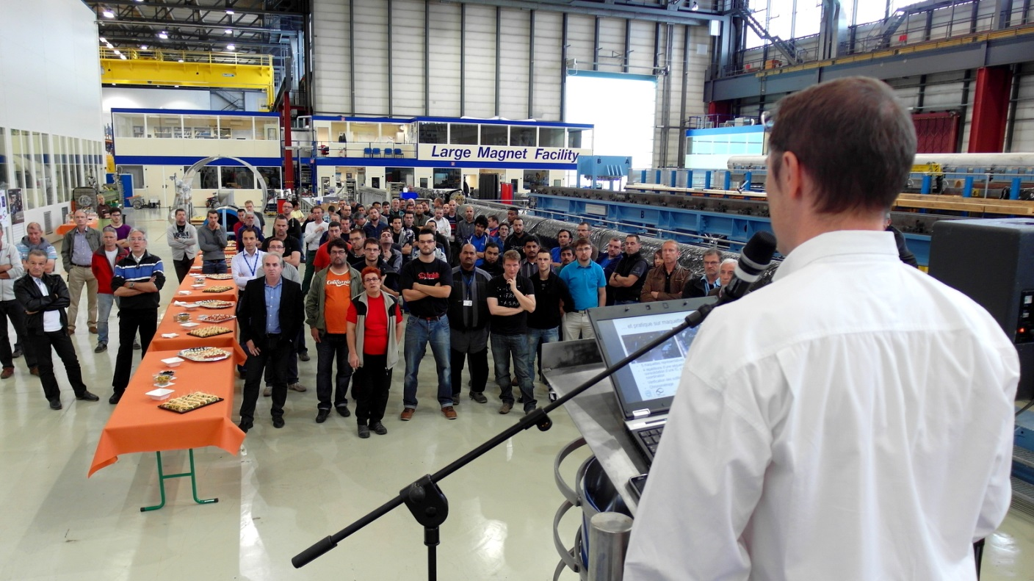
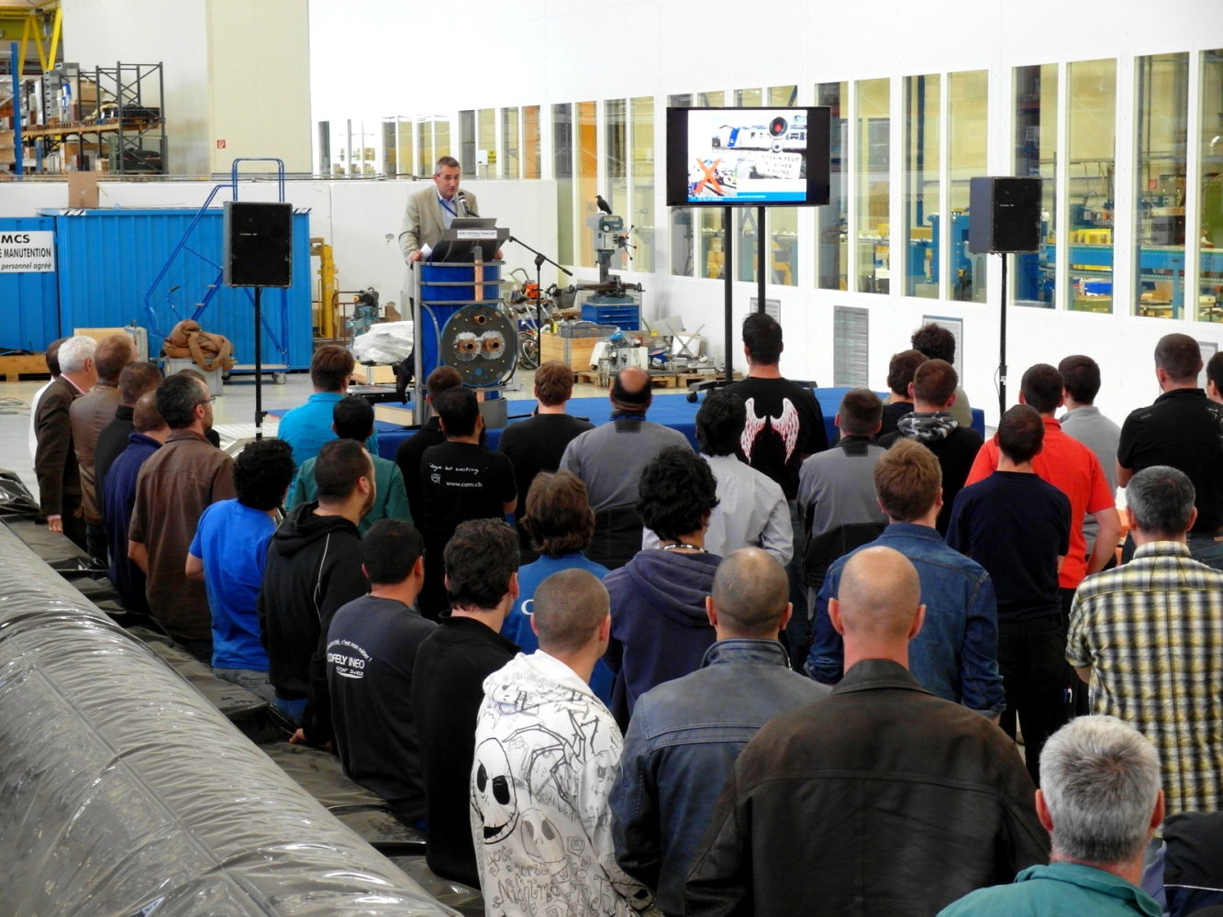
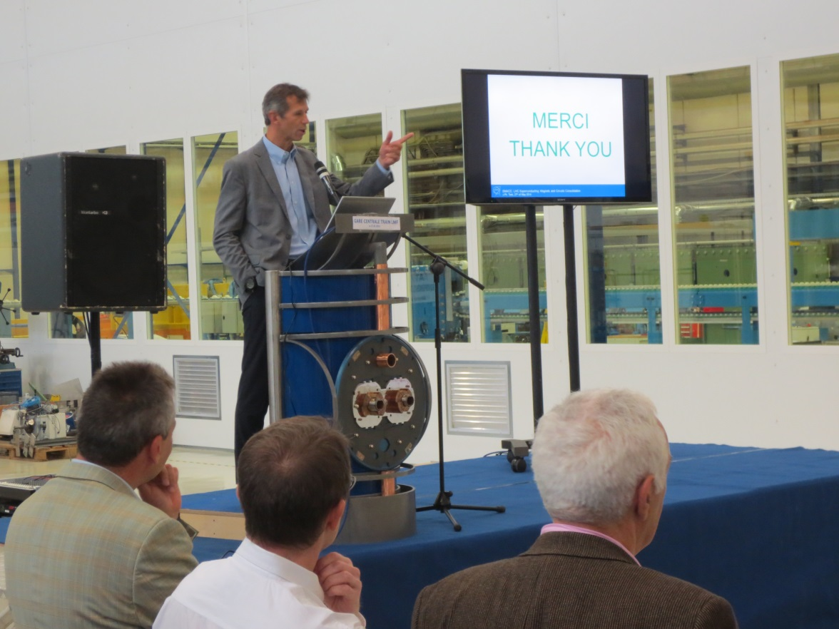

Slide 13
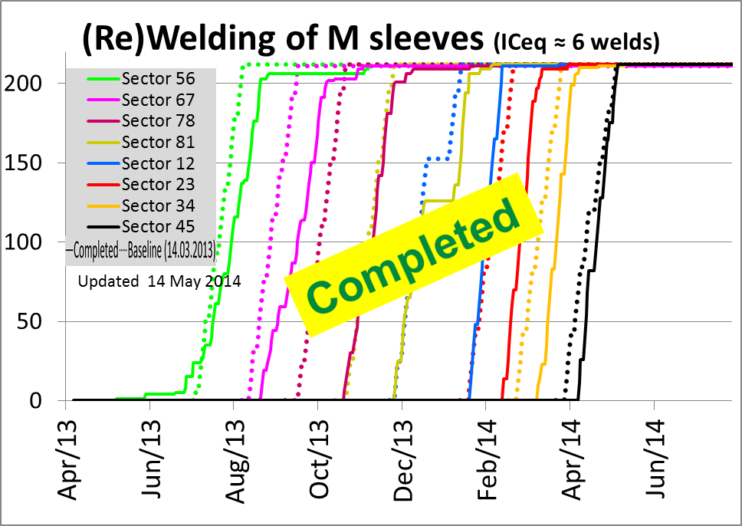
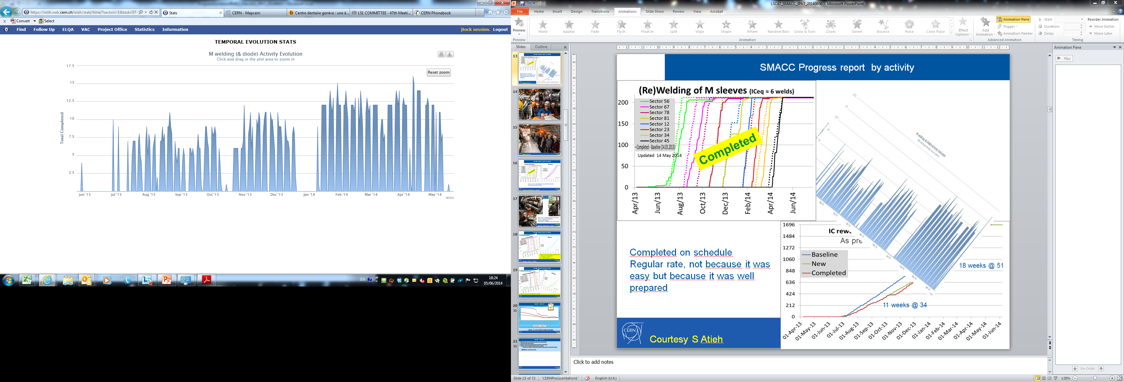
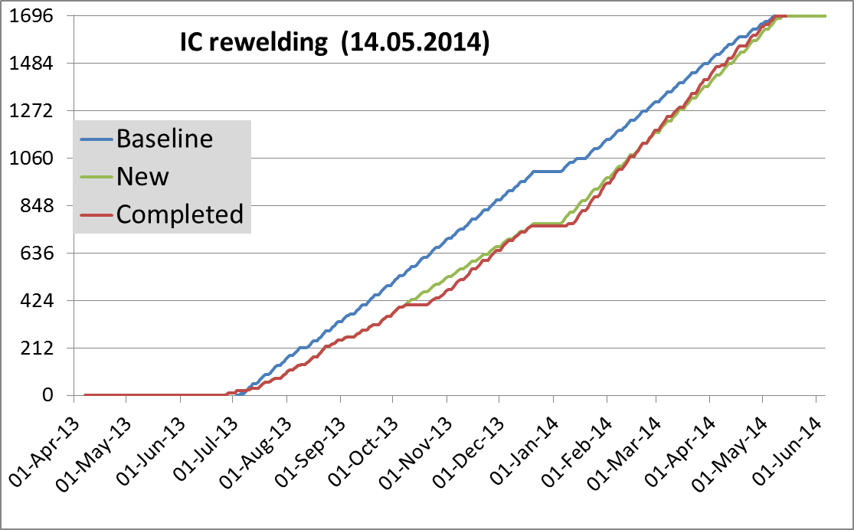
SMACC Progress report by activity
As presented LSC 4.10.2013
Completed on schedule
Regular rate, not because it was easy but because it was well prepared
18 weeks @ 51
11 weeks @ 34
Courtesy S Atieh

Slide 14
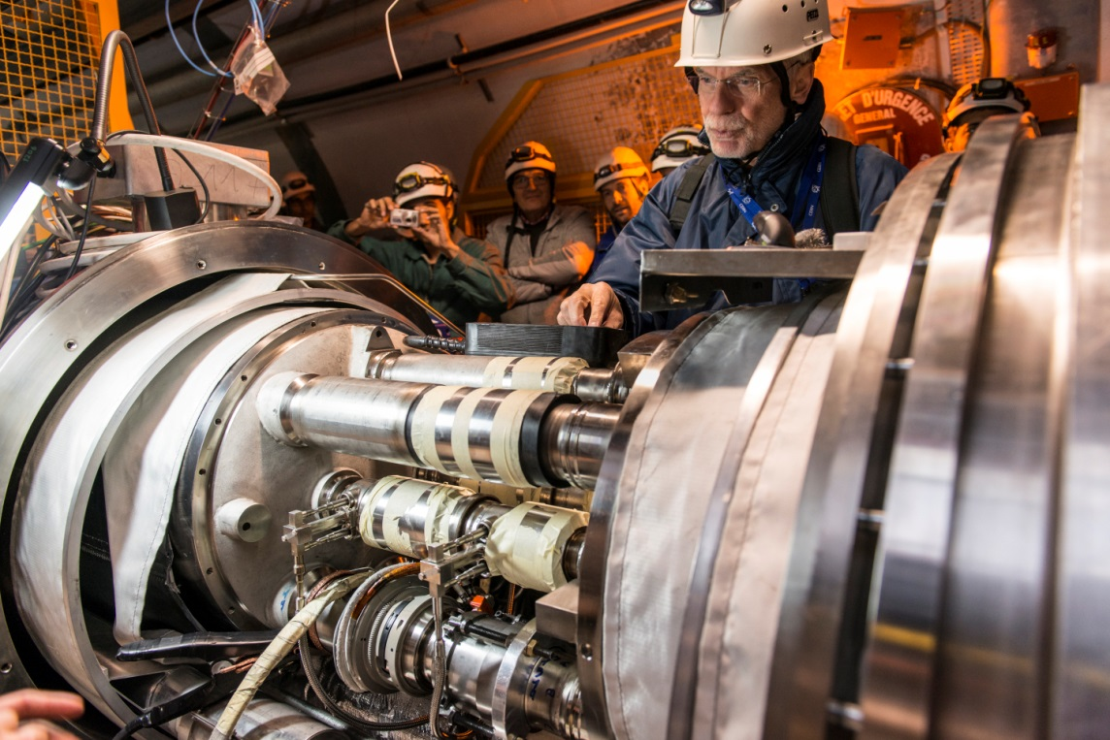
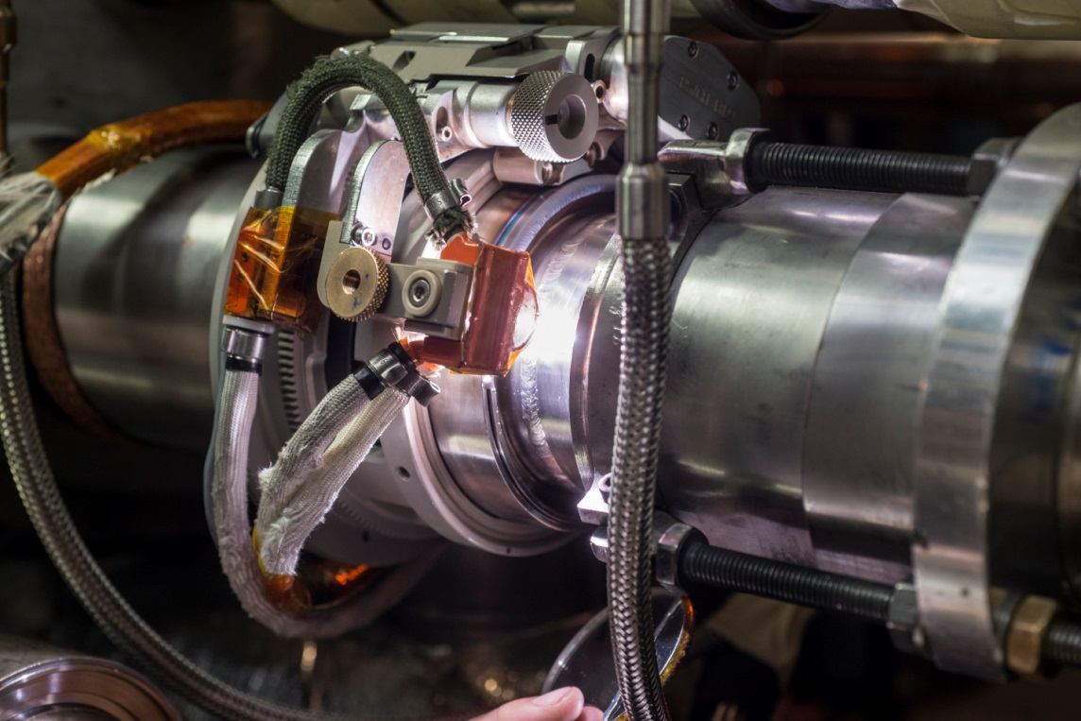
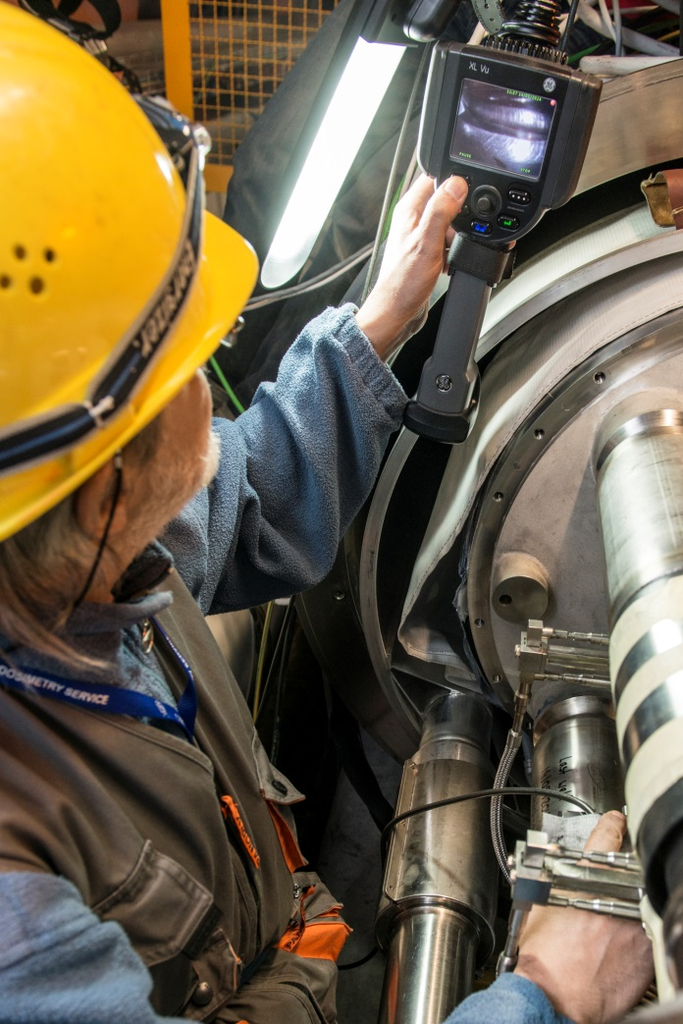
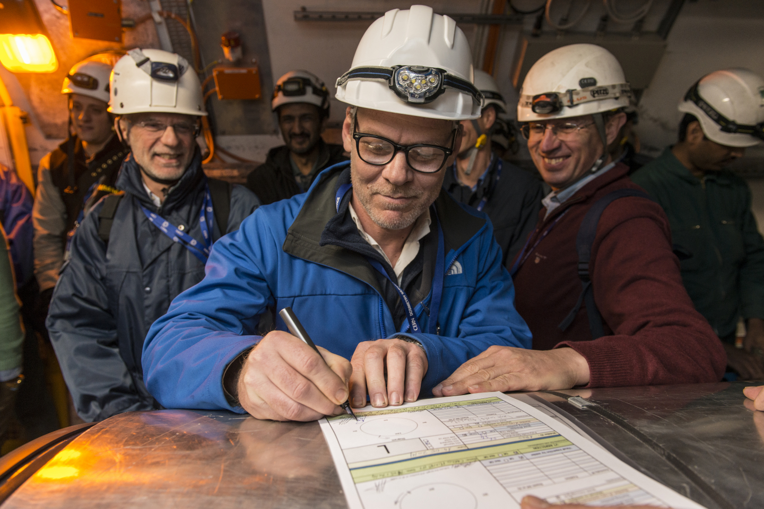
SMACC Progress report by activity
Courtesy S Atieh

Slide 15
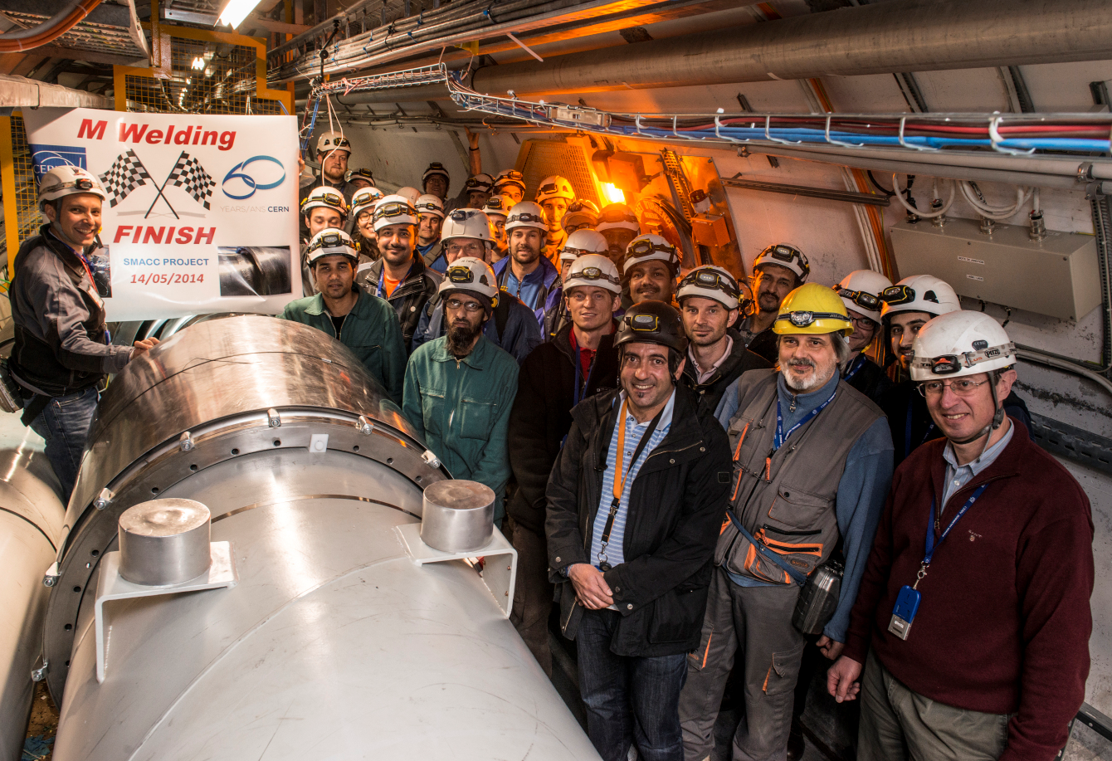
SMACC Progress report by activity
Courtesy S Atieh

Slide 16
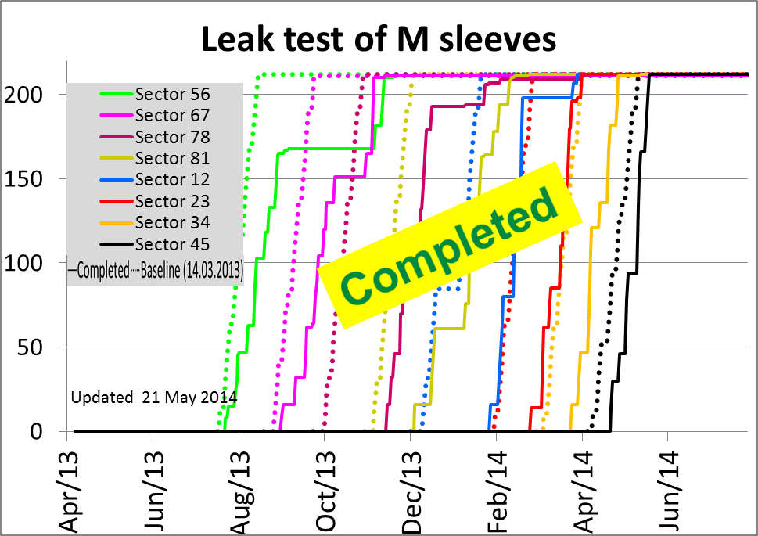
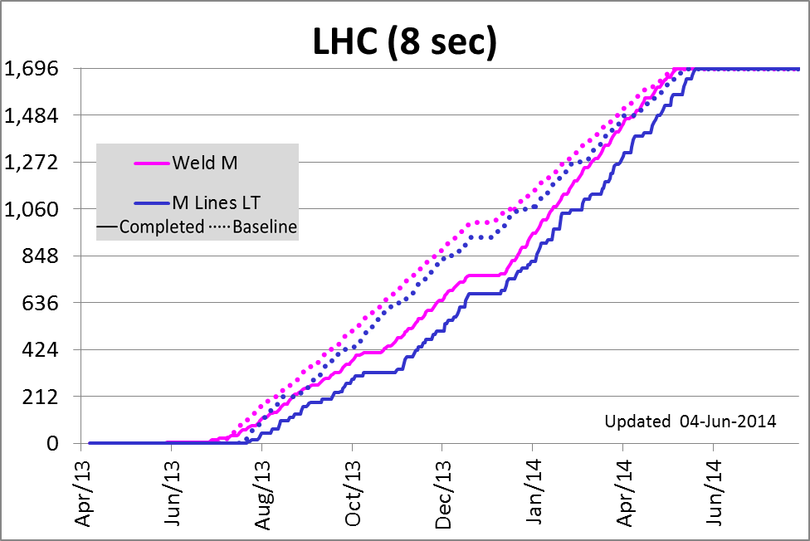
SMACC Progress report by activity
Last M sleeve leak tested one week after the last weld
Followed the rewelding rate
Courtesy P Cruikshank / L Mourier

Slide 17
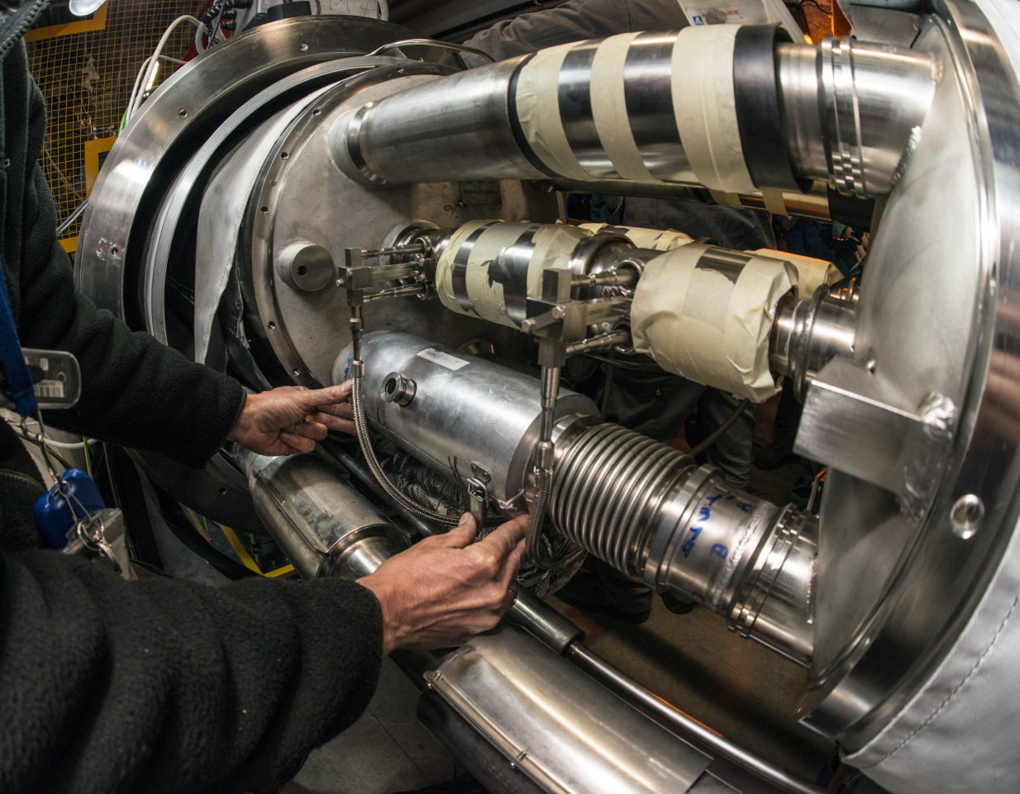
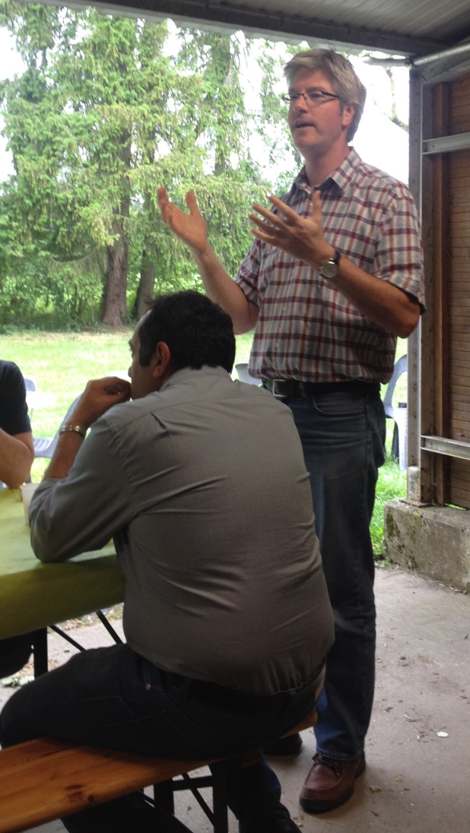
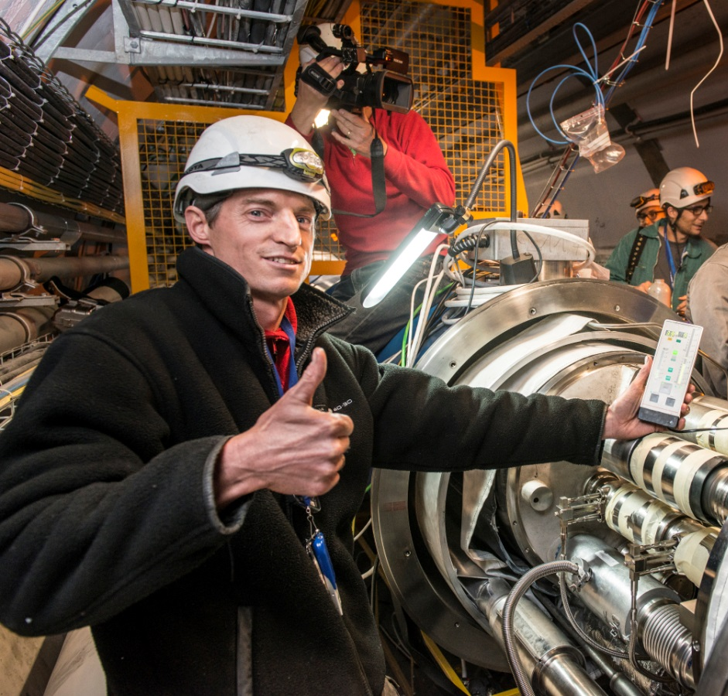
SMACC Progress report by activity
Excellent collaboration between the teams and a very good team spirit
Positive atmosphere
Celebrated in a BBQ co-organised with CSI
Courtesy P Cruikshank / M Pojer

Slide 18
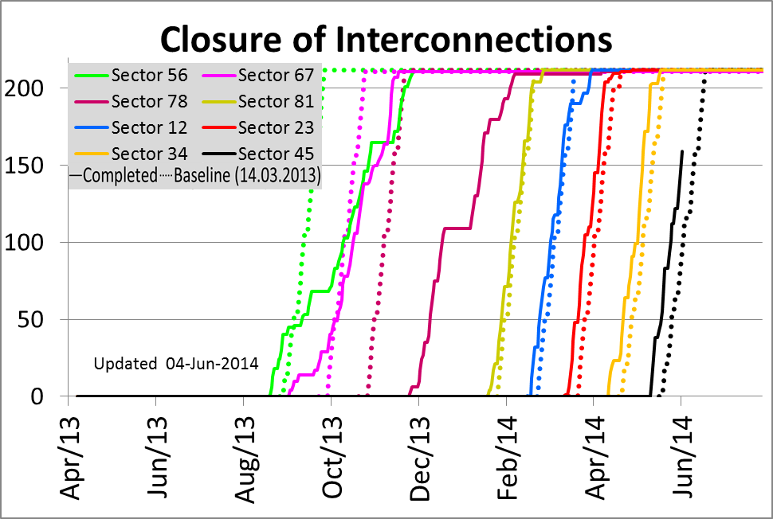
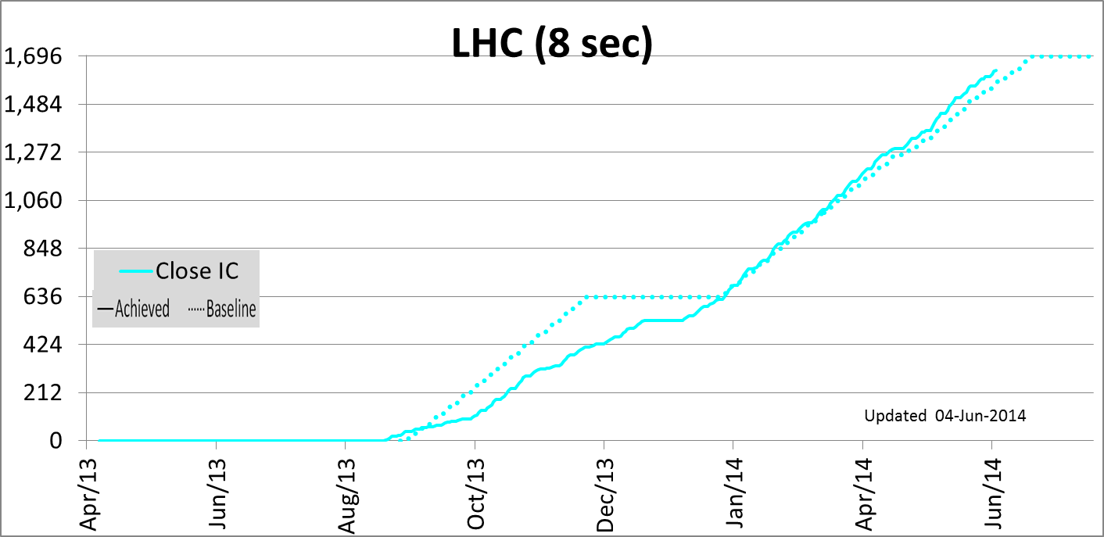
SMACC Progress report by activity
Reclosure of interconnections :
Baseline rate achieved despite openings for special interventions
< 60 ICs to reclose
≈ 1 week ahead of schedule
Last «first» reclosure before the end of June …
other ones will follow after local interventions
Courtesy A Chrul / A Musso

Slide 19
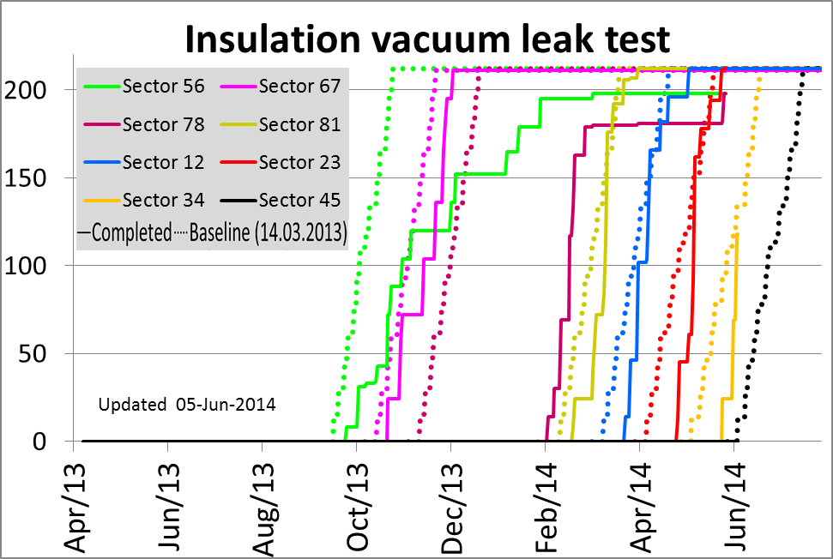
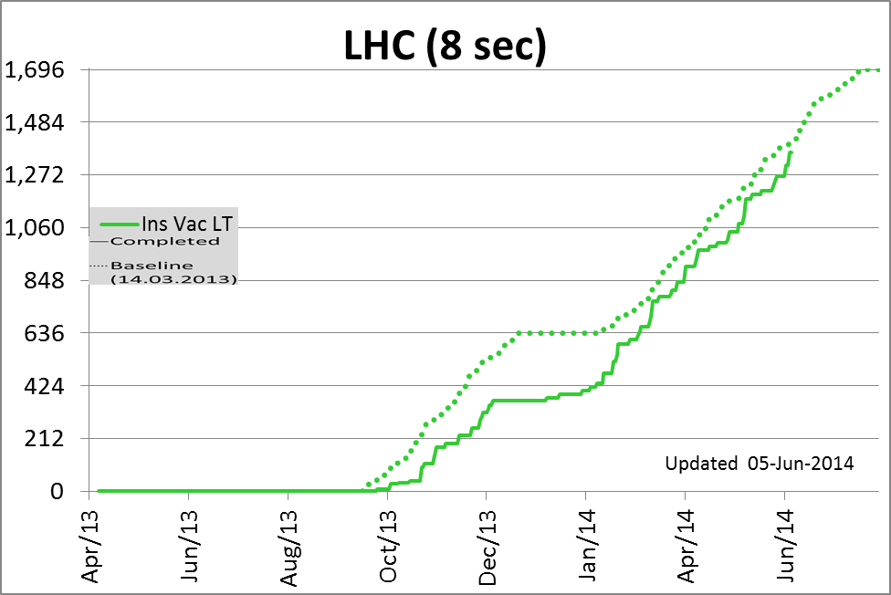
SMACC Progress report by activity
Final leak test: ≈ 6.4 sec equivalent
About 1 week behind schedule, reducing
Subsectors under pumping in last sector (S45)
Recovering the baseline

Slide 20

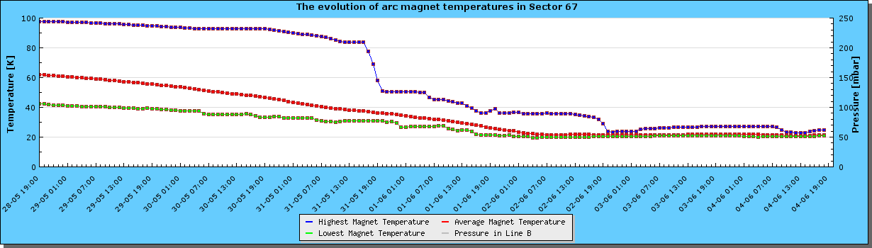
SMACC Sector 67
  Magnet T ≈ 20 K, ElQA at cold to be done

Slide 21
SMACC Sector 81
ElQA after flushing completed, no fault on the cold side
Thermometer issue solved
External leaks repaired and under pumping for validation
Internal leaks solved or accepted «as is» except
  C’K leak in A23R8 : Required IC opening and cutting of cryogenics circuit
  On-going with SIT
  COOLDOWN planned for W26

Slide 22
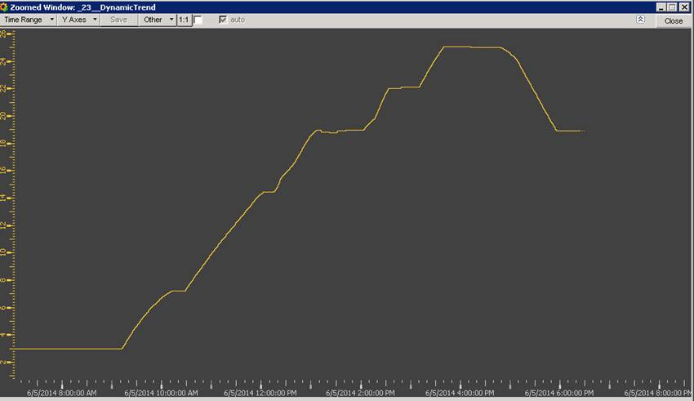
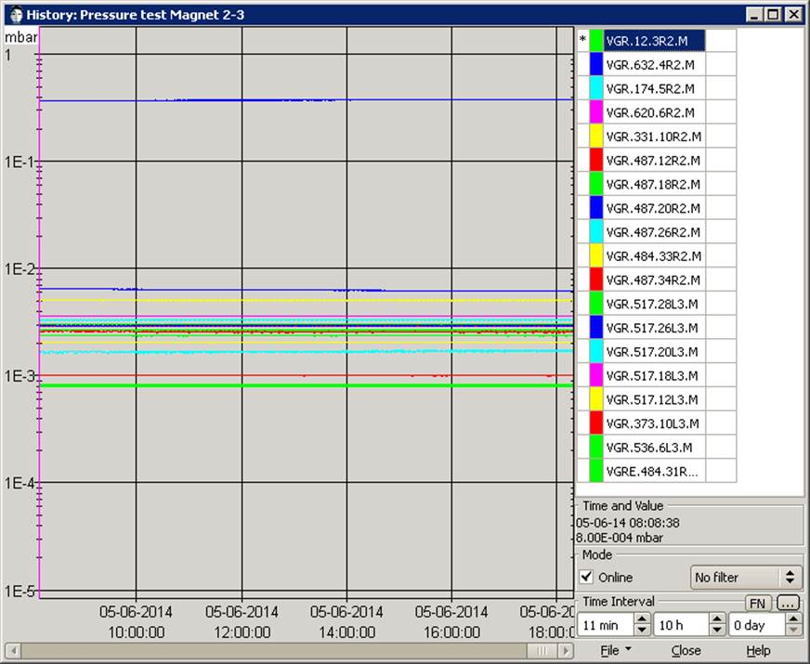
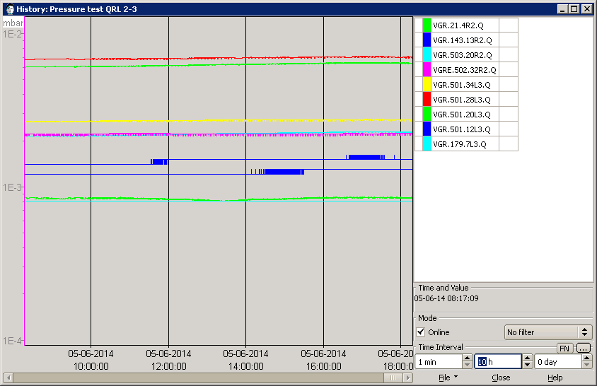
SMACC Sector 23 : Successful pressure test on 5.06.2014
Pressure in lines C&D
(Cold masses)
25 bars during 1 hour
Cryomangnet Insulation Vacuum pressure
QRL Insulation
Vacuum pressure
Courtesy O Pirotte

Slide 23
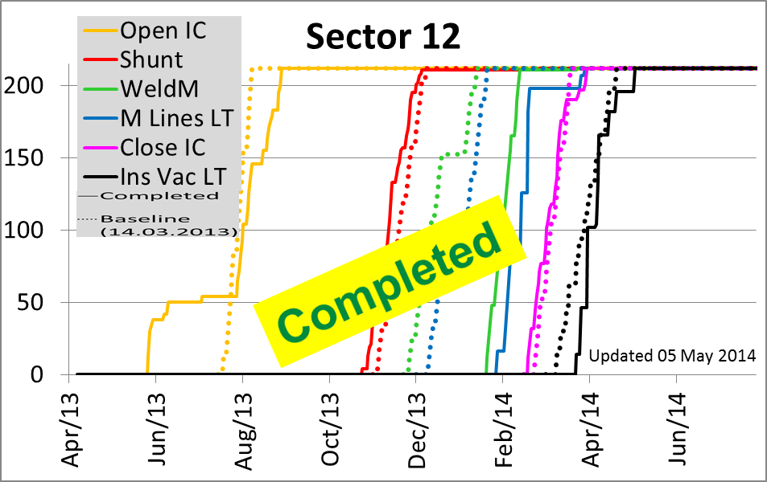
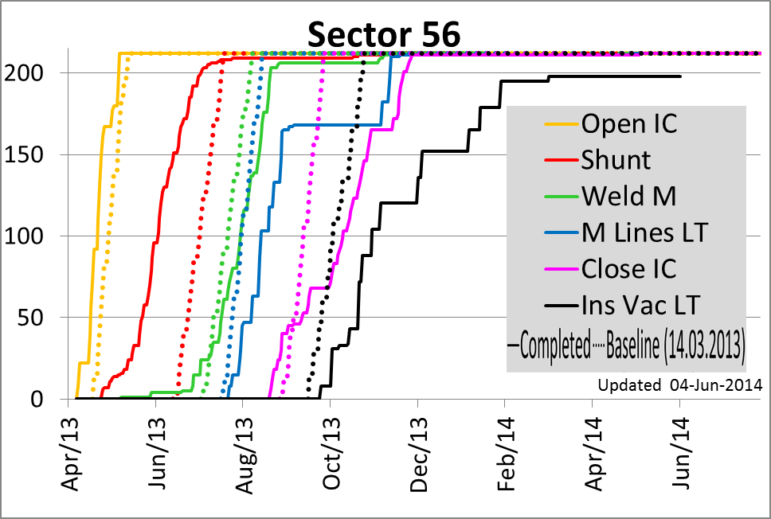
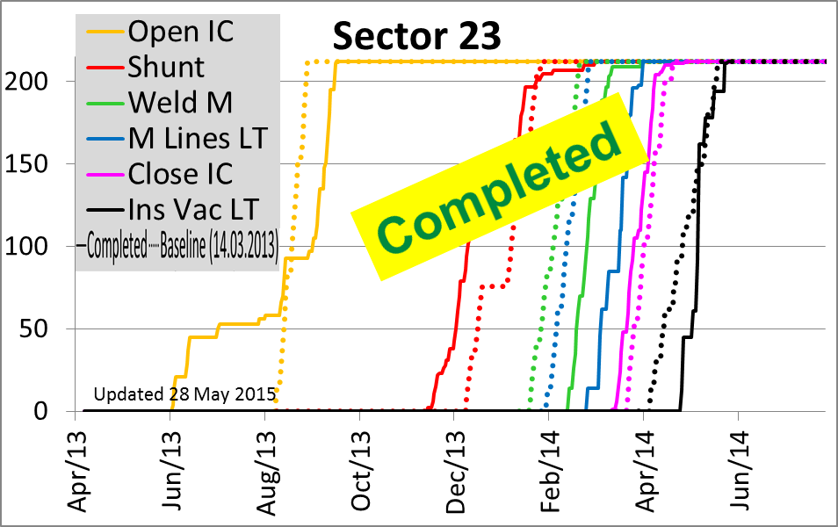
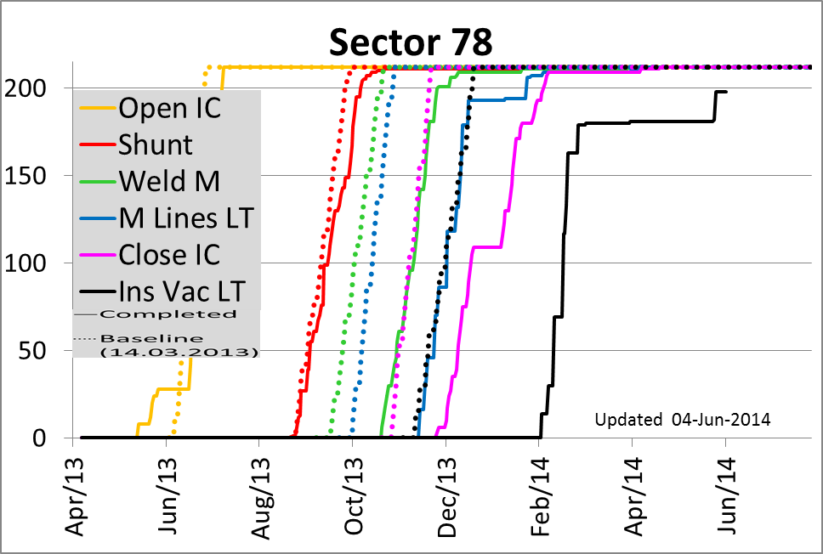
SMACC Progress report by sector
Leak between DFBA HCM/LCM on DFBAK external envelope
Internal leak on LCM header C, presence of a 2nd leak under investigation
VSC clapet to be consolidated in A31L6 after P Test
Internal leak on C-K circuit to be repaired after P Test
Sectors 12 & 23:
  Pressure tested succesfully
  Interventions to be planned before cooldown: (Leaks [internal in A27R1 E line «clapet type»] , [Ext in 25R2 and internal A23R2]
Sectors 56 & 78:
  Only last vac subsector to be leak tested
  Pressure tests before end of June
  Interventions to be done before cooldown

Slide 24
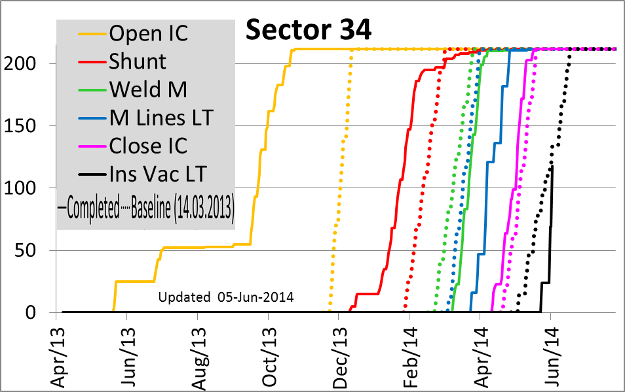
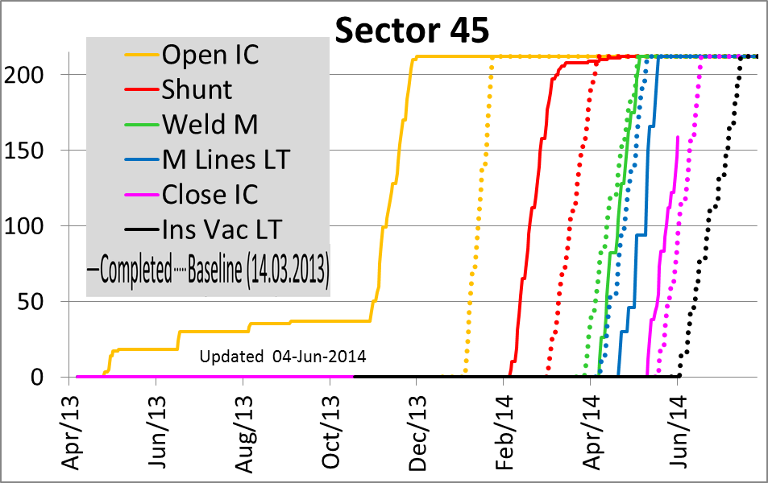
SMACC Progress report by sector
Final leak test on-going
8/14 vac sec tested
3 leaks under invetigation
Main activities are :
  Reclosure of Ics
  Final leak test

Slide 25
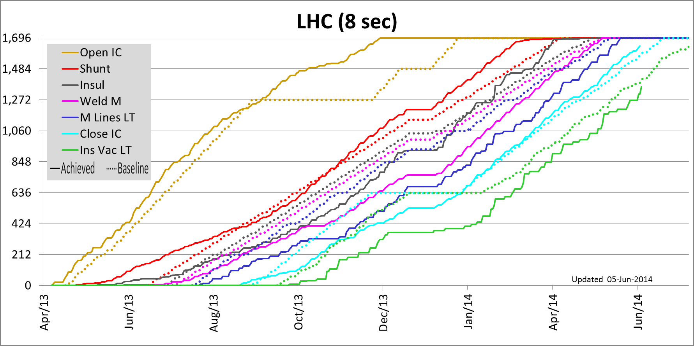
SMACC Dashboards
Everything is completed but:
  Reclosure: Ahead of schedule, < 60 ICs to reclose; priority given to repair interventions
  Insulation vacuum leak test : Recovering, < 2 sectors to test

Slide 26
Two activities are on-going :
* Reclosure in S45
* Ins Vac LT in S56, S78, S34
One activity to start:
* Ins Vac LT in S45
Four sectors are succesfully pressure tested for SMACC (S67, S81, S12, S23) so production activities are completed in these sectors

Slide 27
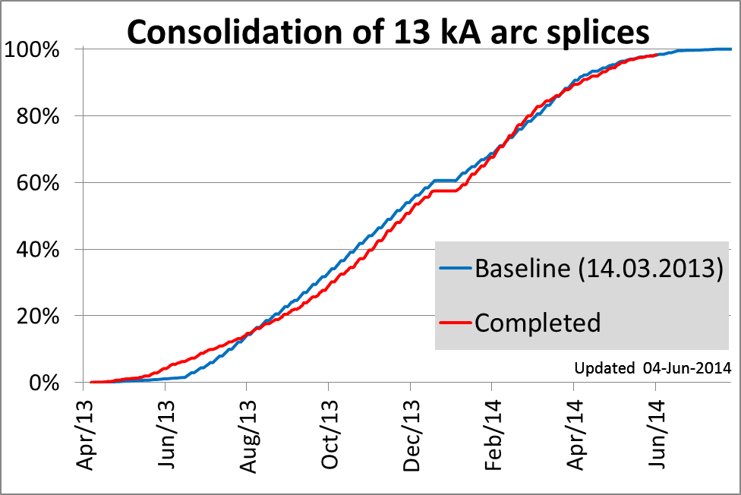
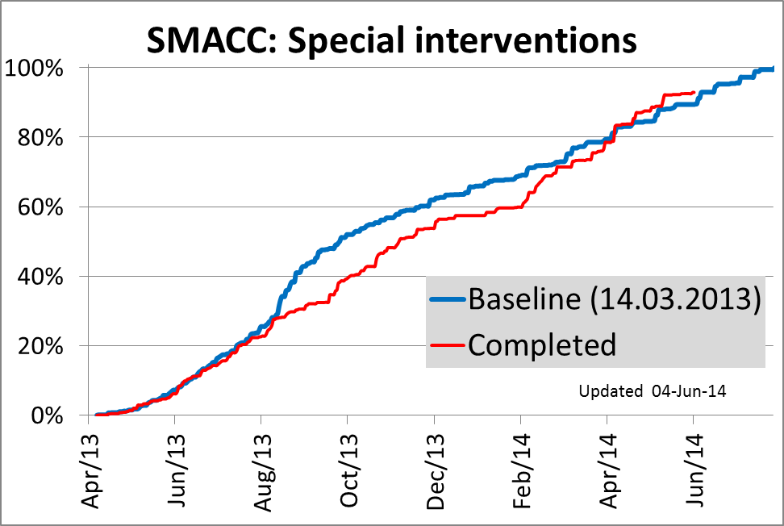
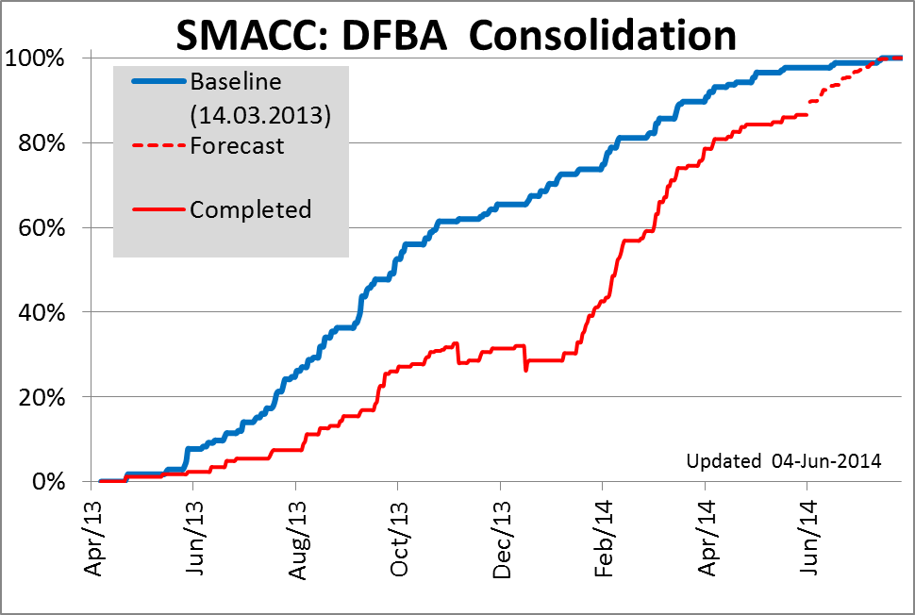
SMACC Dashboards
Baseline: 89.4 % (82.9 %)
Completed: 92.5 % (84.9 %)
Delay -8 (-20) days
Baseline: 98.2 % (92.0 %)
Completed: 98.3 % (90.5 %)
Delay -1 (3) days
😐 On schedule
☺ Ahead of schedule
Arc splices:
On Schedule
SIT
Reactive
Ahead of schedule
DFBA:
Depending on progress on last leak tests
☺ Recovering
Baseline: 97.7 % (93.1 %)
Completed: 92.1 % (87.1 %)
Delay 1.5 (1.5) months

Slide 28
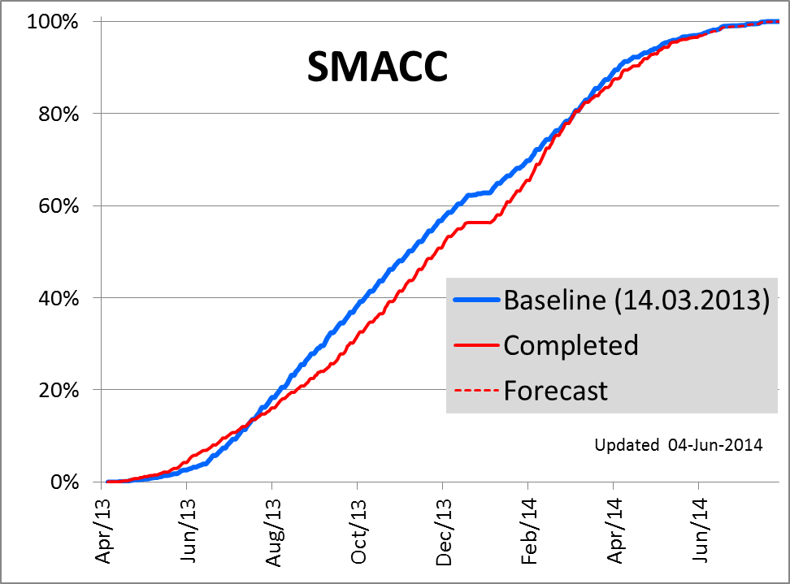
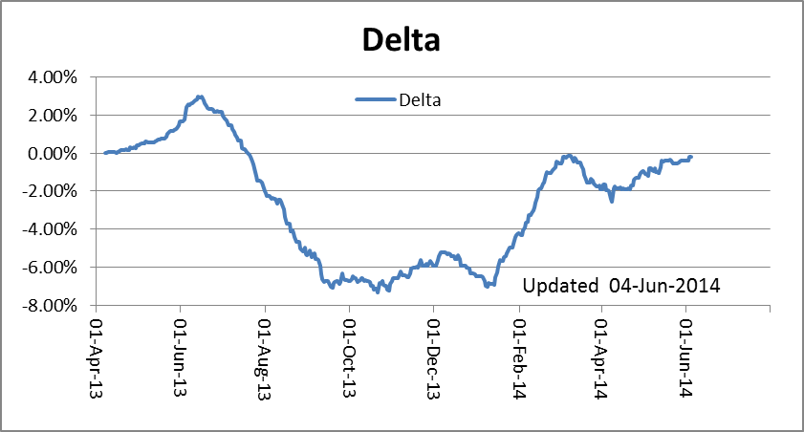
SMACC Dashboards
Progress:
Baseline: 97.1% (91.0 %)
Completed: 96.9% (89.3 %)
Delay 3 (4) days

Slide 29
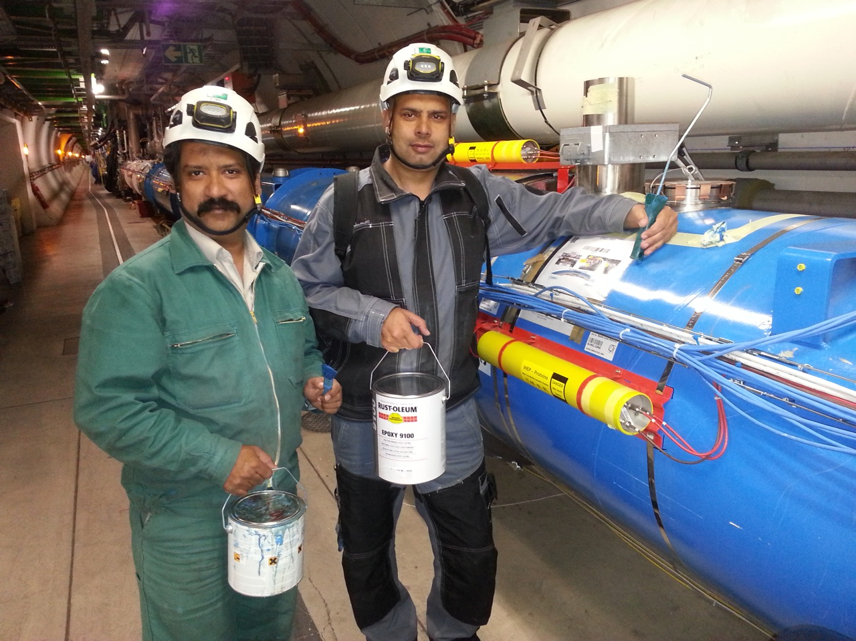

DN200 painting
Done after final leak test
Progress:
  S81 : Completed
  S78 : 85% done,
  waiting OK from LT
  S23 : Just started
  S45 : To start
Collaboration between
PAEC-NCP (Pakistan) and
DUBNA (Russia)
Courtesy A Musso / A Chrul

Slide 30
LHC Overview
(*) Some lines with minor repair are not tested to the test pressure, following derogations asked to and granted by HSE

Slide 31
SMACC Summary on progress
Main 13 kA Splices:
☺ On schedule
☺ Overheated splices : COMPLETED
    Activities still in production mode :
    Inspection before closure, Closure of ICs, Final leak test
    Other activities :
Resolution of NCs (leaks, ….)
Special Interventions & DFBA:
Progress according to final leak test
SMACC:
☺ About 3 days of delay (stable)
wrt schedule defined > one year ago !!

Slide 32
SMACC Main activities for the next 4 weeks
Sector 56 :
  Complete final leak tests
  Pressure test
Sector 67 :
  ElQA @ cold
Sector 78
  Complete final leak tests
  Pressure test
Sector 81
  Comlete interventions on NC
  Start cooldown
Sector 12
  Interventions on NCs
Sector 23
  ElQA, flushing,…
Sector 34
  Complete final leak tests
  Ready for pressure test from SMACC point of view
Sector 45
  Complete reclosure of ICs
  Progress on final leak tests

Slide 33

Conclusions
All ICs will be reclosed for the first time for Mid of June
The good quality and progress (so far) should be attributed to the commitment of the whole team but also to the thorough preparation. Investment pays off.
Working mode has evolved for most of the activities from a production mode towards specific interventions requiring a high reactivity and coordination of all teams
The baseline for insulation vacuum leak tests (last activity) is under recovery

