Slide 1
Anomalies associated with radiation effects and the role of space agencies
Robert Ecoffet, CNES
CERN Seminar, June 10, 2014

Slide 2
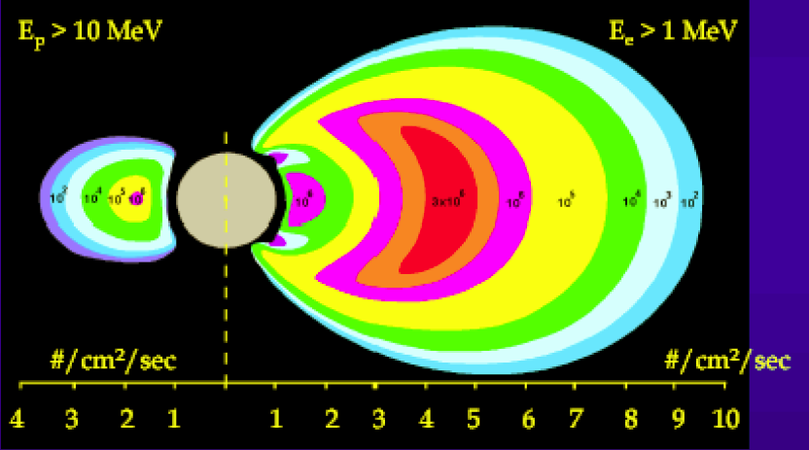
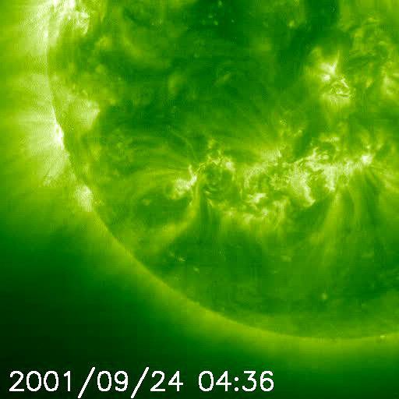
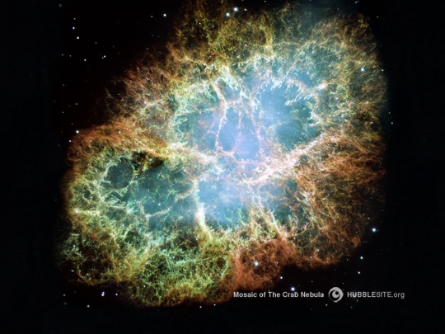
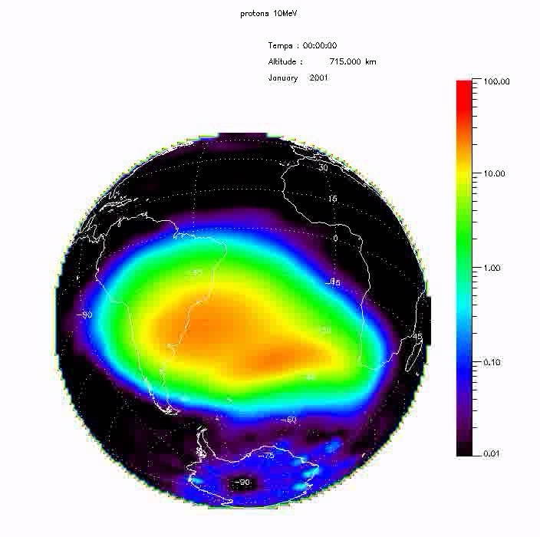
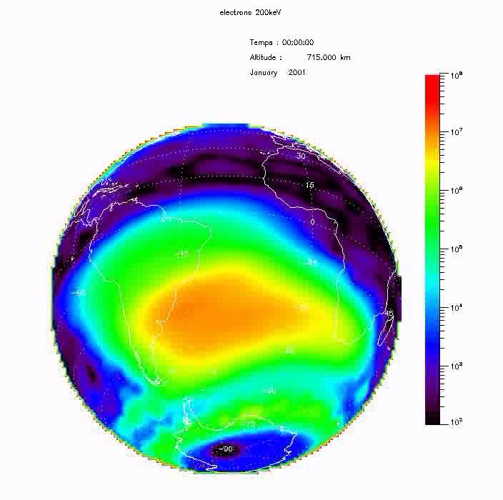
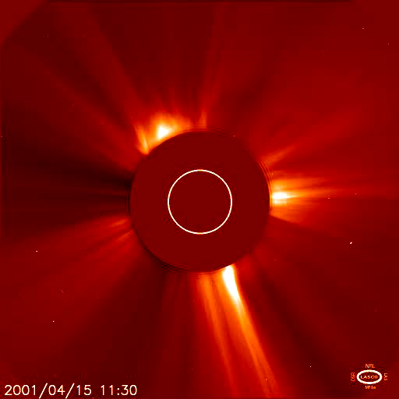
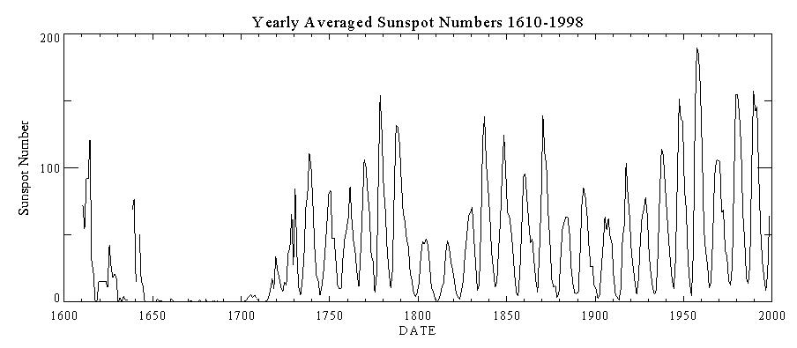
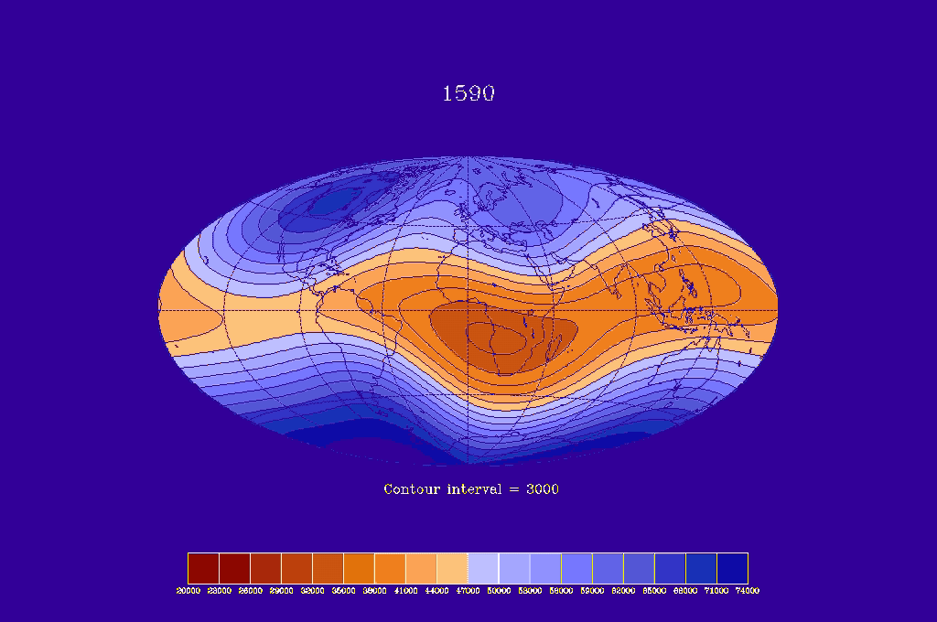
Space environment radiation sources
Radiation belts
Solar flares
Cosmic rays
Protons
Electrons
Protons
Ions
Ions
keV- 500 MeV eV ~ 10 MeV
keV- 500 MeV few 1-10 MeV/n
max ~ 300 MeV/n
CERN Seminar, June 10, 2014

Slide 3
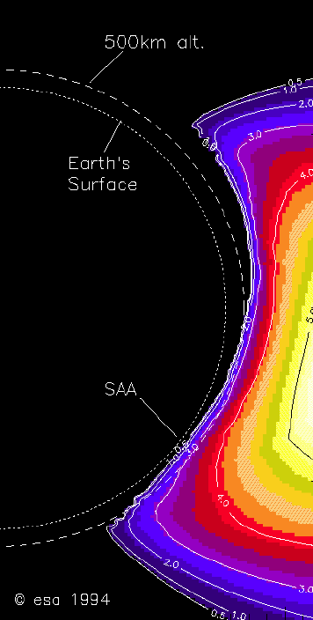
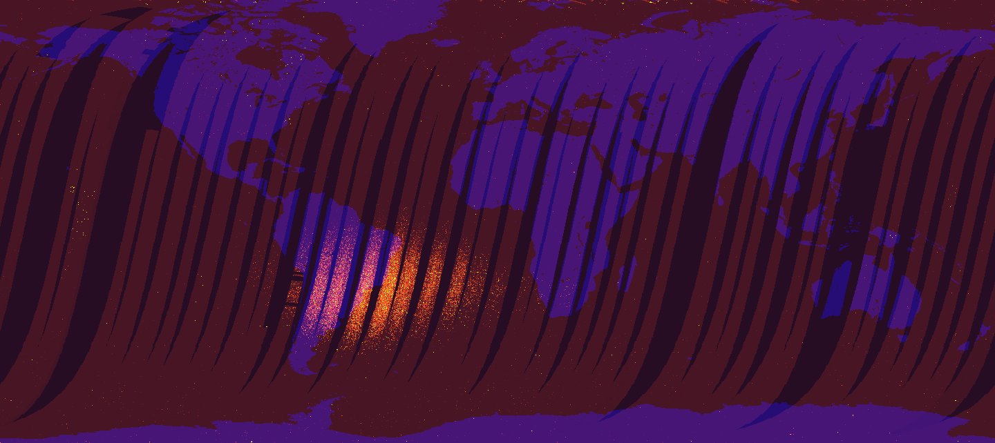
Hazard zones in LEO : SAA and poles
Rotation axis
Radiation belts
Declination
Magnetic dipole axis
Geographic equator
South-Atlantic anomaly
Magnetic equator
Polar LEO orbit
~ 400 km
CERN Seminar, June 10, 2014

Slide 4
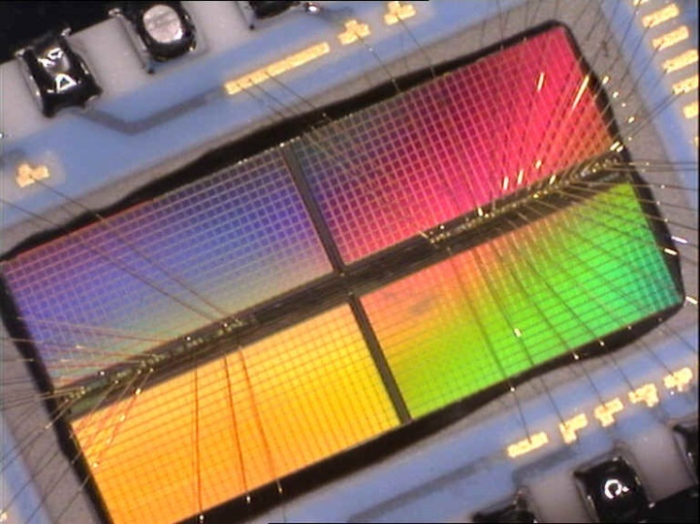
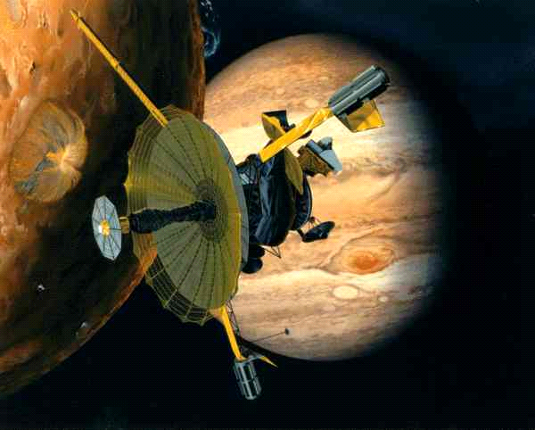
Space environment and components
An environment specific to space applications
A major dimensioning constraint for on-board systems
Very fast evolution of electronic technologies
Performance often leads to cutting edge designs
A strong economic drive toward margin reductions
More exposed missions
Smaller satellites (less shielding)
Today’s components features
Dimensions : 0.1 µm² Time : 1 ps Charge : 1 µV
More transistors now in a single chip than in whole 1980’s spacecraft designs
(GALILEO Jupiter probe for example)
CERN Seminar, June 10, 2014
Notes:
Introduction. Spécificité de l’environnement spatial, impact de la contrainte. Facteurs d’impact internes : évolution techno rapide, performance embarquée, réduction des marges. Facteurs externes : missions, masse.

Slide 5
Main radiation effects
Single event effects
Ionising dose
Atomic displacement
Ion
p+
Trapped charges
e-
p+
p+
(e-)
Oxide
+ + + + + + + + +
+ - - + - + - + - - -
Oxide
Oxide
Interstitials
+ - +
- + + -
+ - - +
+ + +
Interface traps
Ionisation
Silicon
Silicon
Vacancies
Silicon
Ion 2nd
Parametric drift
Function loss
SET : transient
SEU : upset
SEL : latch-up
SEB : burn-out
SEGR : rupture
Lifetime
Hot pixels
RTS
Operating safety
Dependability
Performances
CERN Seminar, June 10, 2014

Slide 6
Single event effects classes
Effects in nominal active structures
Effects in parasitic structures
Exceeding gate oxide breakdown field
SET : transient
Turning on parasitic BJT
Turning on parasitic SCR
Analog
Transient latch
Power MOSFETs
Power MOSFETs
CMOS
SEU : upset
SEGR
SEB
SEL
Digital
CERN Seminar, June 10, 2014

Slide 7
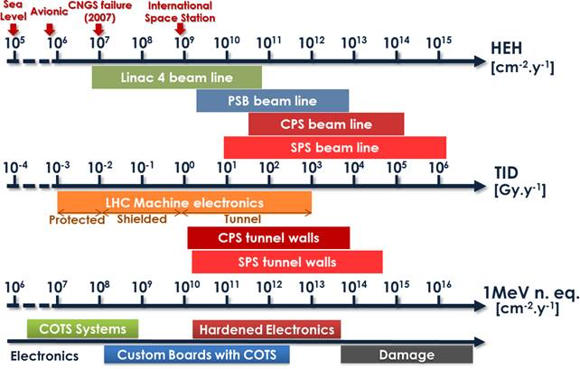
Space environment vs. CERN
> 10 MeV proton yearly proton fluence (outside spacecraft)
50 MeV yearly equivalent fluence (3 mmAl spherical shield)
CERN Seminar, June 10, 2014

Slide 8
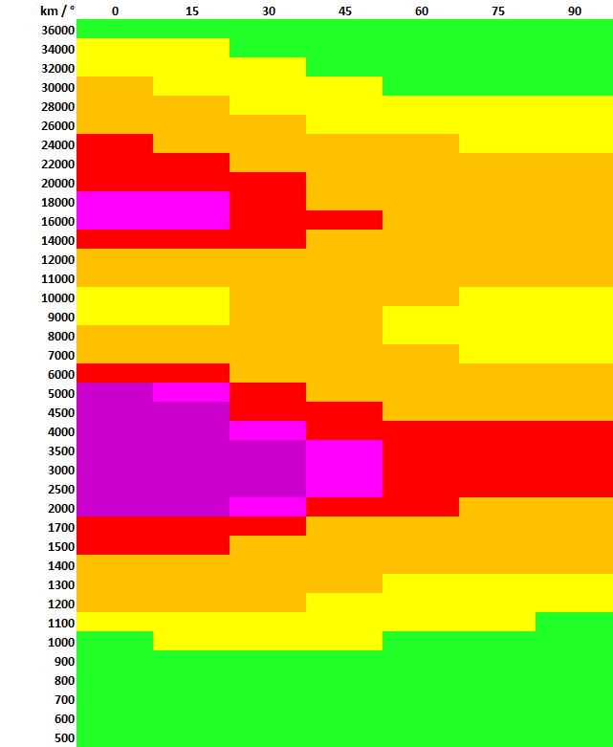
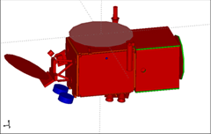
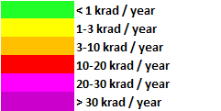
Yearly doses in sample equipment
GEO
MEO Navigation
Outer electron belt
Circular Orbits
Proton belt and inner electron belt
LEO Constellations
LEO Observation Constellations
CERN Seminar, June 10, 2014
Notes:
Cartographie de la dose annuelle sur CARMEN que l’on situe sur diverses orbites circulaires (altitude, inclinaison) dans sa configuration JASON-2. Exemples de doses annuelles typiques sur un équipement.

Slide 9
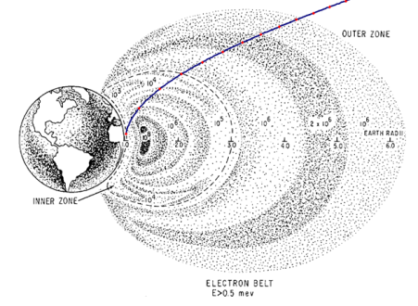
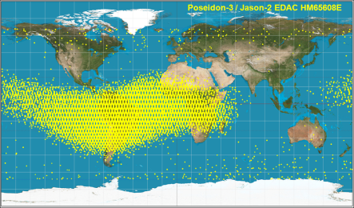
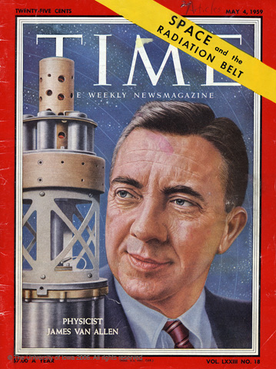
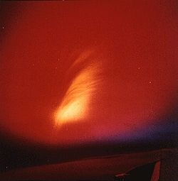
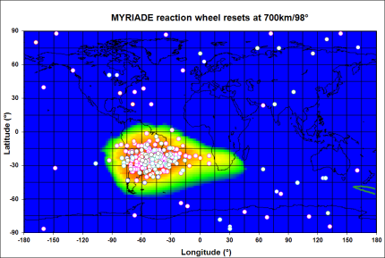
Spacecraft anomalies
Radiation-induced spacecraft anomalies have been observed since the very beginning of the space era
Single event effects now represent the major part of anomalies (60 to 90%)
First satellite failures due to radiation (dose)
First reported SEUs (GCR) in satellites
First proton latch-up in space
Discovery of the radiation belts
Nuclear blasts in space
First proton SEUs
1957
1962
1963
1975
~1978
1991
CERN Seminar, June 10, 2014

Slide 10
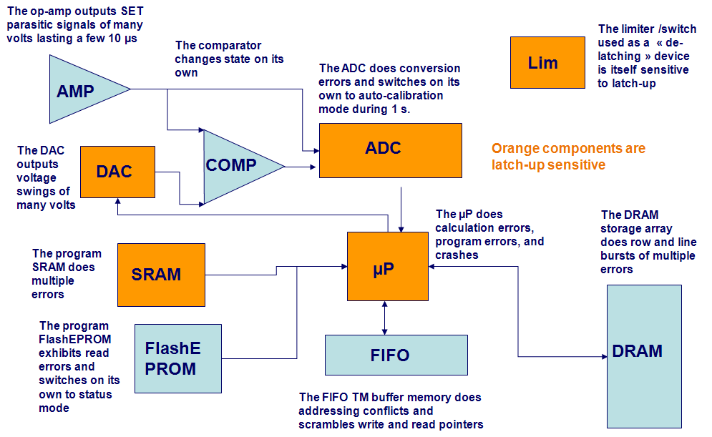
Classical SEE effects
Memory corruption : single errors to error bursts
Processor crash
Mode swapping
Reset
Switch-off
ADC conversion errors
ADC swapping to autocal. mode
Gain change
Reference voltage change
VCO output frequency change
Transient PLL lock loss
False signals
Star pattern loss
Image corruption
…….
Equipment loss
CERN Seminar, June 10, 2014
Notes:
Exemples d’effets classiques SEE

Slide 11
Examples of system effects
Electrical Architecture (Generic) Equipment loss Self switch-off, disjunction, reset, reboot, redundancy swapping | Dose, Latch-up (SEL) SET
On-board energy Solar panel degradation | Dose, Displacements
Attitude and orbit control system Possible attitude loss Star tracker out of AOCS loop Inertia wheels disturbances Self switch-off of ion thruster | SEU Proton transients (SAA, flares) SET SET
On board management On board computer, resets, mode refusal, safe-hold mode Mass memory | SEU – SET SEU
Imaging systems « UFOs » Hot pixels, RTS Dark current, non linearity,… etc | Proton transients Displacements Displacements, dose
Time references Frequency jumps | Dose on SAA passes or flares
CERN Seminar, June 10, 2014

Slide 12
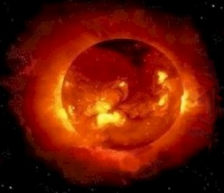

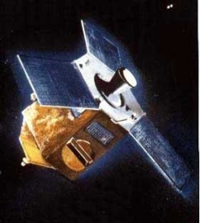
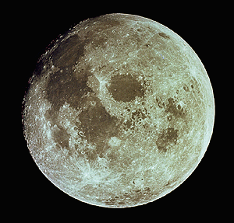

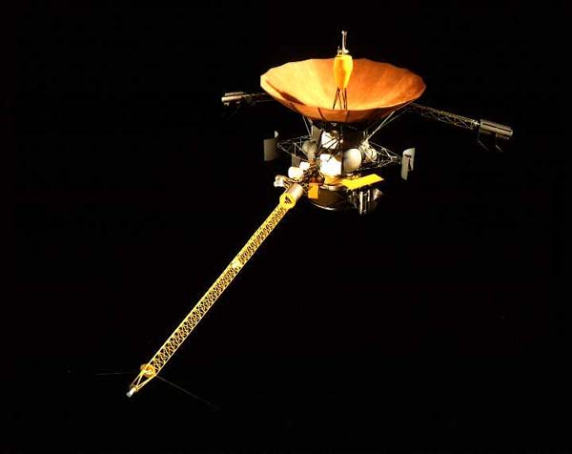
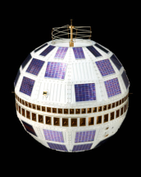
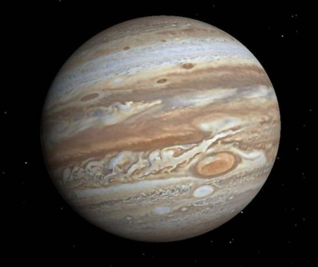
Cumulated effects (published)
Telstar, 1963
Artificial radiation belt
Hipparcos - 1993
Apogee motor failed
Degraded mission
TID degradation of bipolar PROMs and optocouplers
Design lifetime was 5 years in GEO
Actual lifetime was 5 years in GTO
Galileo - 2002
Jupiter radiation belts
Telstar - 1963
Artificial radiation belts
Starfish experiment, 1962
Many systems affected
But outstanding success !
Diode failed in command decoder
7 other satellites failed

Slide 13

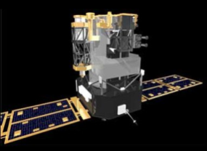
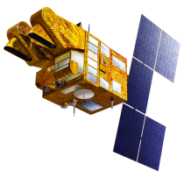
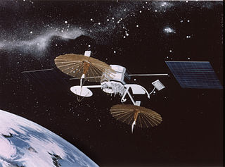
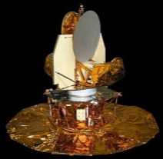
SEE : GCR and SPE (published)
SOHO (L1) – 2001
GCR : self switch-of, reset, reboot, latch-up
SPE : mass memory errors spikes
SPOT-1, 2, 3 (800 km, 98°) - 1995
GCR : SEUs in HEF4736 SRAMs
TDRS-1 (GEO) – 1991
SEUs in 93L422 bipolar RAMs
Possible satellite tumbling
GCR ~ 20 events / week
Oct. 89 flare : 249 events / 7 days
30% p+, 70% ions
MAP (L1) – 2002
5 Nov. 2001, switch to safe-hold condition
SET on PM139 from processor reset circuitry
3-7 November 2001 : large solar event
Attributed to SPE ion

Slide 14
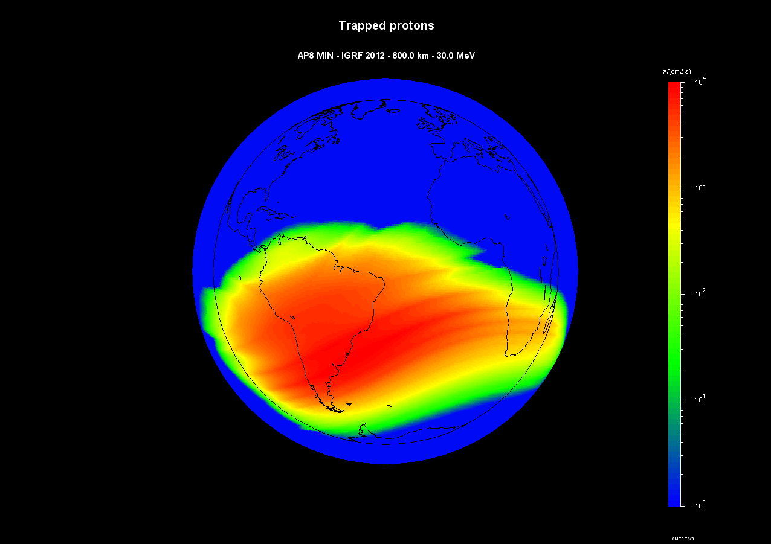
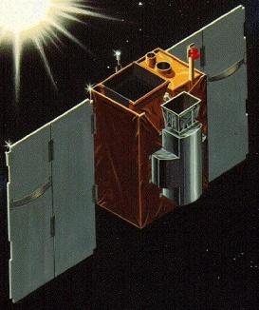
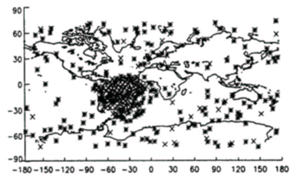
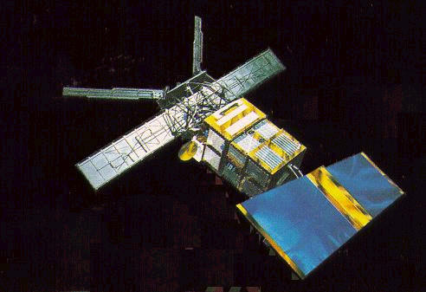
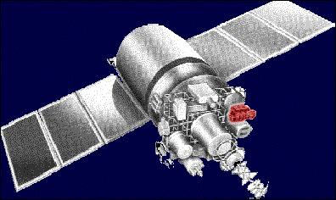
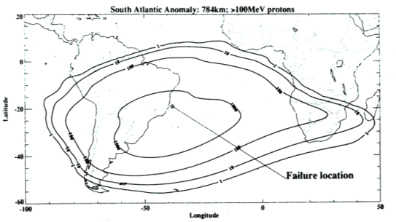
SEE : trapped protons (published)
SAMPEX – 2001
(512 km x 687 km, 81.7°)
ERS-1 (780 km, 98°) - 1991
Solid State Recorder upsets
MIL-1773 fiber optics bus retries
Transients in the photoreceptor
Latch-up on CMOS SRAM
after 5 days Instrument lost
TOMS / METEOR-3 – 2001
(1183 km x 1205 km, 82.6°)
Solid State Recorder upsets
ISS, Space Shuttle, LANDSAT, TERRA, AQUA, AURA, HST, GALEX, GLAST, TRMM, ORBVIEW, ENVISAT, ERS-2, METOP, SMOS, CRYOSAT-2, HERSCHEL, INTEGRAL, XMM, SPOT-4, SPOT-5, JASON-1, JASON-2, CALIPSO, COROT, DEMETER, PARASOL, PICARD, Myriade µSATs,

Slide 15
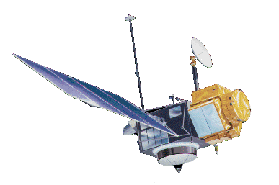
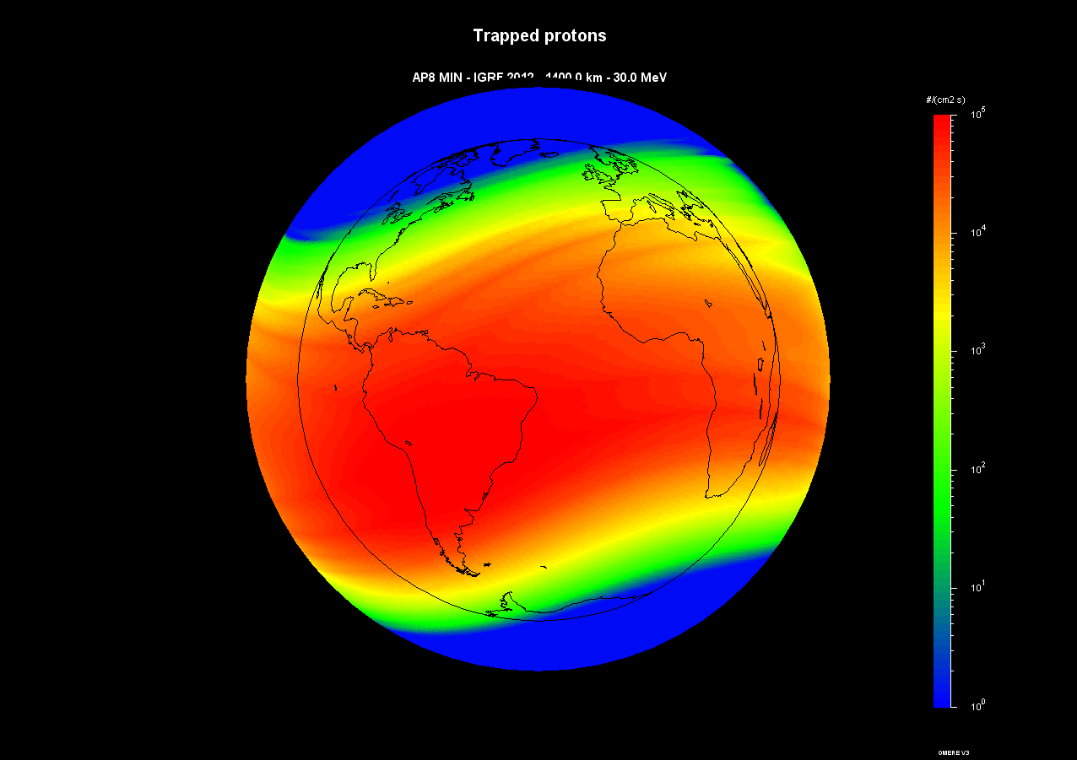
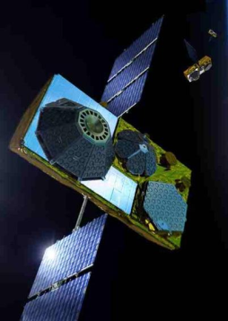
DDD : trapped protons (published – expt *)
TOPEX / POSEIDON – 2002
(1336 km, 66°)
GLOBALSTAR-1 - 2010
(1441 km, 52°)*
4N49 optocouplers
Status circuits
Earlier but not mission-critical
Thruster command circuits
Failures occurred at 8.75 years
Design lifetime was 3 years
48 operational satellites
and 4 spares.
Original constellation deployment in 1998-2000.
In the 2002-2004,
24 receivers
on 21 satellites affected,
3 satellites failed
Radiation design lifetime of individual satellites was 9 years
LT RH1014 bipolar devices

Slide 16
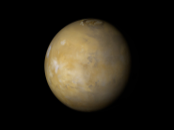
Effects of a major SW event (oct-nov 03)
STARDUST
INTEGRAL CHANDRA CLUSTER
SOHO ACE WIND GENESIS
GOES-9, 10, 12, 8 DMSP-16 KODAMA INMARSAT
AQUA TERRA LANDSAT TOMS
TRMM POLAR FEDSAT ICESAT GALEX MER-1, 2 XTE RHESSI CHIPSAT NOAA-17
MIDORI
SIRTF
SMART-1
MAP
www.sat-index.com
MARS ODYSSEY

Slide 17
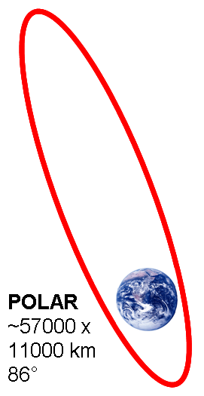
Blurring of VIS camera on NASA / POLAR
NASA image
CERN Seminar, June 10, 2014

Slide 18

Solar protons “filmed” by SOHO
CERN Seminar, June 10, 2014

Slide 19
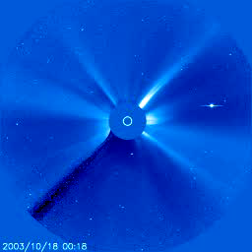
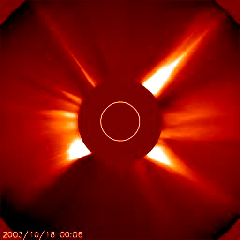
Solar protons “filmed” by SOHO
CERN Seminar, June 10, 2014

Slide 20
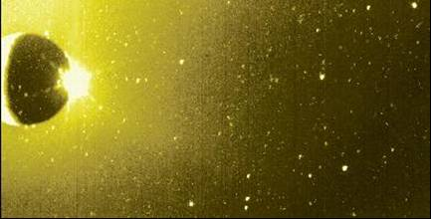
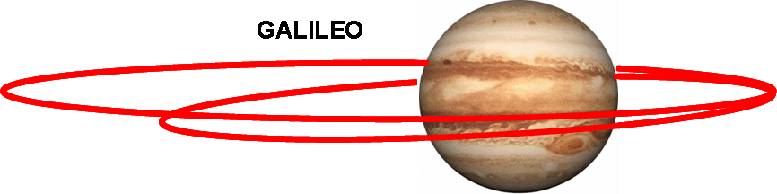
Galileo at Jupiter
Image of a Sodium volcanic plume on the moon Io contaminated by speckles due to Jupiter radiation belts, JPL image
CERN Seminar, June 10, 2014

Slide 21
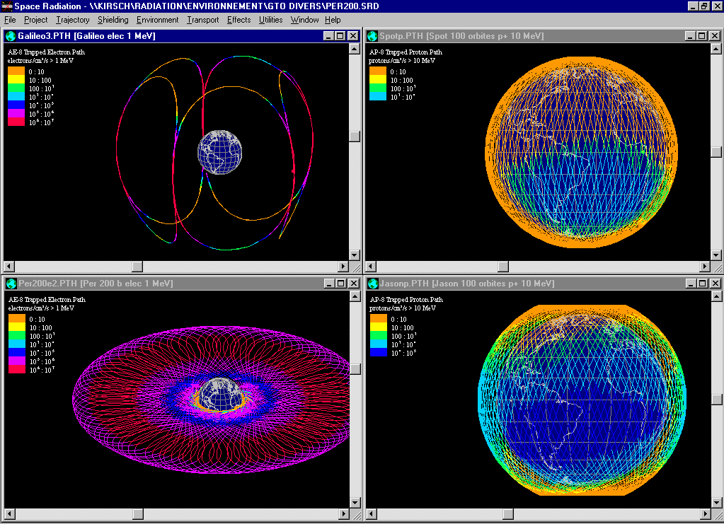
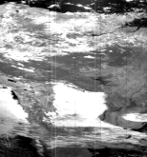
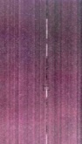


Radiation activities in project phases
Phase 0
Mission analysis
Orbit analysis
Environment specification
Analysis and specification of radiation environment
Phase A
Feasibility
Calculations on simple structures
Generic specification of received dose
Hardness assurance specification
Pre-evaluation of critical components
-
+
-
+
+
+
-
+
-
-
+
-
?
Satellite is a sphere
Simple geometrical simulations
Components are evaluated
Phase B
Preliminary design
Evaluation of component radiation performance
Interaction structural and system design
Risk estimation
Component list analysis
Radiation lot verification testing (RVT)
Application conditions
Radiation levels on actual satellite
Local shielding
Sector analysis
Phase C/D
Detailed design Qualification
Complex structural modelling
T°
ON
OFF
ON
OFF
Flight lots testing
Functions and application conditions
Phase E
Utilisation
Lessons learned
Anomaly analysis
Space weather
CERN Seminar, June 10, 2014

Slide 22
Implementation at CNES
Mission analysis
Mechanical
Thermal
“Radiation engineer” function
Single entry point for radiation issues
Continuity from phase 0 to phase E (design to exploitation)
Leads calculations and tests
Interfaces with component procurement engineers (qualification procedures)
Interfaces with designers (functional, electrical, mechanical, thermal,…)
Iterative and concurrent (2-way) process
Interfaces with satellite operators
Similar implementation for satellite prime contractors and main equipment providers
Function
Reliability - dependability
Electrical
Operations
Radiation engineer
Anomalies - failures
Dose levels
Tests
SEE rates
CERN Seminar, June 10, 2014

Slide 23

Implementation at CNES
Radiation engineer function
set-up after first SPOT-1 on board computer SEUs (1986) : 50% of these SEUs resulted in 24h mission outage
sad to say, new organizations come often as aftermaths of problems
A long run
I started working on SPOT-5 radiation qualification in 1994
20 years after, I’m still recording on-board SEUs !
How many people ?
5 radiation engineers for 2406 employees
(ESA : 2254 employees, 4 radiation engineers, 2 technicians)
(Thales Alenia Space and Airbus Satellites : each 15-20 rad. engineers for 6000-7500 staff)
Most of the tests are now subcontracted to test houses (TRAD, ALTER/HIREX…)
Key words : single point, continuity over project lifetime, interaction with designers
CERN Seminar, June 10, 2014

Slide 24

CNES, ESA, RADECS
CNES
2000 M€
CNES and ESA
CNES manages the French contribution to ESA
For components and radiation
ESCC, ECSS – space standards
CTB : agencies – industry network
Radiation Working Group
Agencies, primes, providers, test houses, component manufacturers
R&D harmonization
Larger networks
IEEE NSREC
NSREC 2014, Paris (merged with RADECS)
RADECS
University, research, agencies, industry
Conferences, thematic workshops
RADECS 2017 at CERN !
755 M€
ESA
4000 M€
Member States
2900 M€
E. U.
1100 M€
CERN Seminar, June 10, 2014

Slide 25



Basic Mechanisms of Radiation Effects in Electronic Materials and Devices
Single-Event Charge Collection Phenomena and Mechanisms
Radiation Transport, Energy Deposition and Dosimetry
Ionizing Radiation Effects
Materials and Device Effects
Displacement Damage
Processing-Induced Radiation Effects
Radiation Effects on Electronic and Photonic Devices and Circuits
Single-Event Effects
MOS, Bipolar and Advanced Technologies
Isolation Technologies, such as SOI and SOS
Optoelectronic and Optical Devices and Systems
Methods for Hardened Design and Manufacturing
Modeling of Devices, Circuits and Systems
Particle Detectors and Associated Electronics for High-Energy Accelerators and Nuclear Power Facilities
Cryogenic or High Temperature Effects
Novel Device Structures, such as MEMs and Nanotechnologies
Space, Atmospheric, and Terrestrial Radiation Effects
Characterization and Modeling of Radiation Environments
Space Weather Events and Effects
Spacecraft Charging
Predicting and Verifying Soft Error Rates (SER)
Hardness Assurance Technology and Testing
New Testing Techniques, Guidelines and Hardness Assurance Methodology
Unique Radiation Exposure Facilities or Novel Instrumentation Methods
Dosimetry
New Developments of Interest to the Radiation Effects Community
www.nsrec.com

Slide 26
Thanks for your attention

Slide 27
Back-up

Slide 28
Compared SEU sensitivities 1 Mbit SRAMs
- No standard behaviour within a technology “generation” - No scaling factor between generations

Slide 29
Example of complex SEU response : DRAM 16M IBM LUNA-C

Slide 30
Example of complex SEU response : DRAM 16M Texas Instruments

Slide 31
A designer’s nightmare
The op-amp outputs SET parasitic signals of many volts lasting a few 10 µs
The limiter /switch used as a « de-latching » device is itself sensitive to latch-up
The comparator changes state on its own
The ADC does conversion errors and switches on its own to auto-calibration mode during 1 s.
Lim
AMP
The DAC outputs voltage swings of many volts
ADC
Orange components are latch-up sensitive
DAC
COMP
The µP does calculation errors, program errors, and crashes
The DRAM storage array does row and line bursts of multiple errors
The program SRAM does multiple errors
SRAM
µP
The program FlashEPROM exhibits read errors and switches on its own to status mode
FlashEPROM
FIFO
DRAM
The FIFO TM buffer memory does addressing conflicts and scrambles write and read pointers

