Slide 1
Beam Losses at HERA and Tevatron extracted by Mariusz Sapinski from publications suggested by Nikolai Mokhov and Kay Wittenburg
Workshop on Beam Induced Quenches, Sept. 15, 2014,

Slide 2
Disclaimer
No one from DESY or FNAL could come to CERN in this period and give the presentations.
Nikolai Mokhov (FNAL) and Kay Wittenburg (DESY) kindly suggested literature on which we based this short presentation, which is does not claim to have any level of completeness.
Just scratching the surface…
M. Sapinski, BIQ workshop, CERN, Sep 15, 2014
2

Slide 3
BLM systems
 | Tevatron | HERA | LHC
detectors | Gas ionization chambers | PIN diodes | Gas ionization chambers
Integration time | 21 µs | 5.2 ms | 40 µs
HERA recovers from quench within 1 hour, no significant loss of lumi
Tevatron – may lead to significant loss of luminosity
In HERA beam is dumped if 4 monitors exceed threshold (lack of sensitivity to localized losses)
M. Sapinski, BIQ workshop, CERN, Sep 15, 2014
3

Slide 4
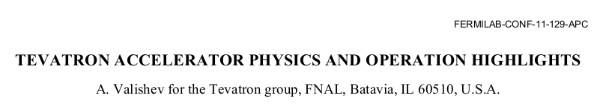
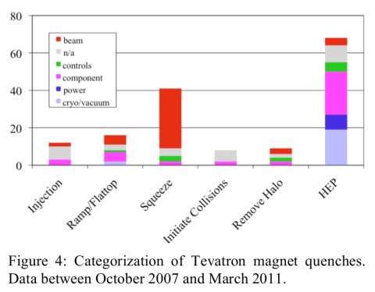
Tevatron
32 quenches during 120s step during β* squeeze from 1.5 m to 0.28 m and change of helical orbits shape – reduction of beams separation from 6 to 2σ
Loss of antiprotons requires lengthy replenishment – significant loss of lumi
2010 – introduction of collimation at top energy (in IRs), reduction of losses to experiments and beam-induced quenches
154 quenches in 4 years
M. Sapinski, BIQ workshop, CERN, Sep 15, 2014
4
Notes:
Situation very different than in LHC
Single vacuum chamber machine
Until 2010 – no collimation at top energy

Slide 5
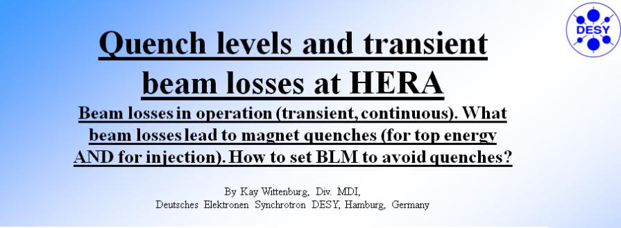
HERA
33rd ICFA ADVANCED BEAM DYNAMICS WORKSHOP ON HIGH INTENSITY & HIGH BRIGHTNESS HADRON BEAMS, 2004, Bensheim, Germany
K. Wittenburg, presentation at CARE AMT workshop on Beam generated heat deposition and quench levels for LHC magnets, CERN, March 2005
M. Sapinski, BIQ workshop, CERN, Sep 15, 2014
5

Slide 6
Slow losses
Very fast losses
(< 5ms)
Σ = 200 Quenches
More about failures:
K. Wittenburg (DESY): Beam loss & machine protection
33rd ICFA ADVANCED BEAM DYNAMICS WORKSHOP on
HIGH INTENSITY & HIGH BRIGHTNESS HADRON BEAMS
Bensheim, Germany
M. Sapinski, BIQ workshop, CERN, Sep 15, 2014
6
Note: A quench in HERA is not a disaster! It takes typ. 1-2 h to recover from cryogenic
Notes:
BTW for LHC we cannot make this kind of pie chart yet…

Slide 7
HERA
64% of beam loss induced quenches due to losses faster than 5.2 ms
  Injection errors
  Power converter and RF trips
35% of beam loss induced quenches due to long losses
  Technical problems with BLM system
  Very localized losses – unwanted local beam bumps or magnets after collimators or longitudinal beam instabilities (high-dispersion zone)
M. Sapinski, BIQ workshop, CERN, Sep 15, 2014
7

Slide 8
Summary
Quench-provoking losses in Tevatron – mainly during squeeze due to:
  Lack of collimation at flat-top
  Beam-beam instabilities
  In LHC we have them as well (up to 4% loss of intensity)
Large amount of beam-induced quenches in HERA occurred in timescale shorter than BLM system resolution – difficult fault analysis!
Longer losses could be very localized and were tracked to technical problem of BLM and Collimation system and longitudinal instabilities.
LHC has learn the lesson and is basically immune to problems specific to Tevatron and HERA, but has its own problems.
M. Sapinski, BIQ workshop, CERN, Sep 15, 2014
8

Slide 9
Extra slides
M. Sapinski, BIQ workshop, CERN, Sep 15, 2014

