Slide 1
Particle Tracking for Orbit-Bump Quench Tests at LHC
V. Chetvertkova, on behalf of B. Auchmann, T. Baer, W. Hofle, A. Lechner, A. Priebe, M. Sapinski, R. Schmidt, N. Shetty, A. Verweij, D. Wollmann.
Workshop on Beam-Induced Quenches, 15-16 September 2014

Slide 2
Quench Test Analysis
What is the energy deposition in the coil at the moment of quench?
Settings: bump
amplitude etc.
Particle tracking:
spatial distribution
P. shower: norm.
space distribution
FCBM: loss rate
BLM: normalized
time distribution
Input
Beam parameter
measurements:
ε, Q, etc.
QPS: moment
of quench
QPS: moment
of quench
Upper bound
or estimate
quench
Analysis
Particle
Tracking
Particle
Shower
Quench
Level
Electro-Thermal
Estimate (MQED)
no quench
Lower bound
Validation
BPM signals
Quench test
BLM normalized
time distribution
BLM signals
Subscale
experiments

Slide 3
Orbit bump quench test
Aperture
Kick
Beam
Bump amplitude
Reference orbit
How to lose the beam:
Increasing the bump amplitude (Dynamic bump test)
Exciting the beam
  Non-coherent excitation (Steady-state orbit bump)
  Coherent excitation (Millisecond timescale test)

Slide 4
Methodology
MADX, thin-lens tracking:
1 cm resolution for further FLUKA simulations
Magnets of interest
Beam
Sliced into ~ 1cm lenses
Aperture: black absorber (no scattered projectiles)
Aperture

Slide 5
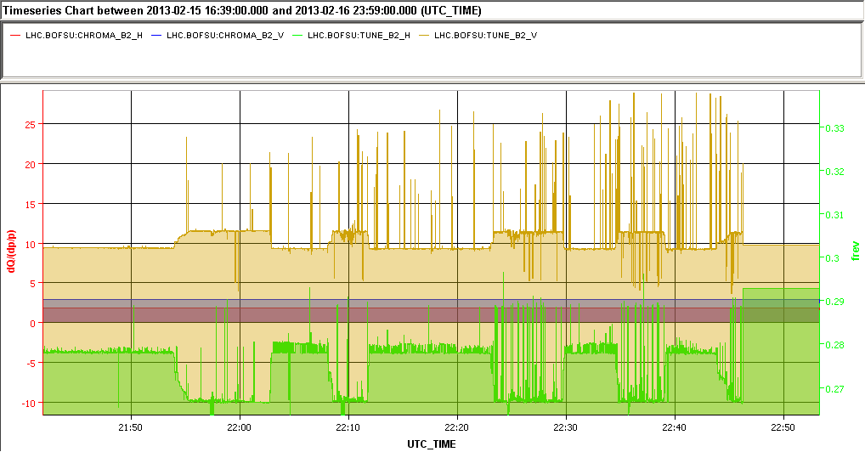
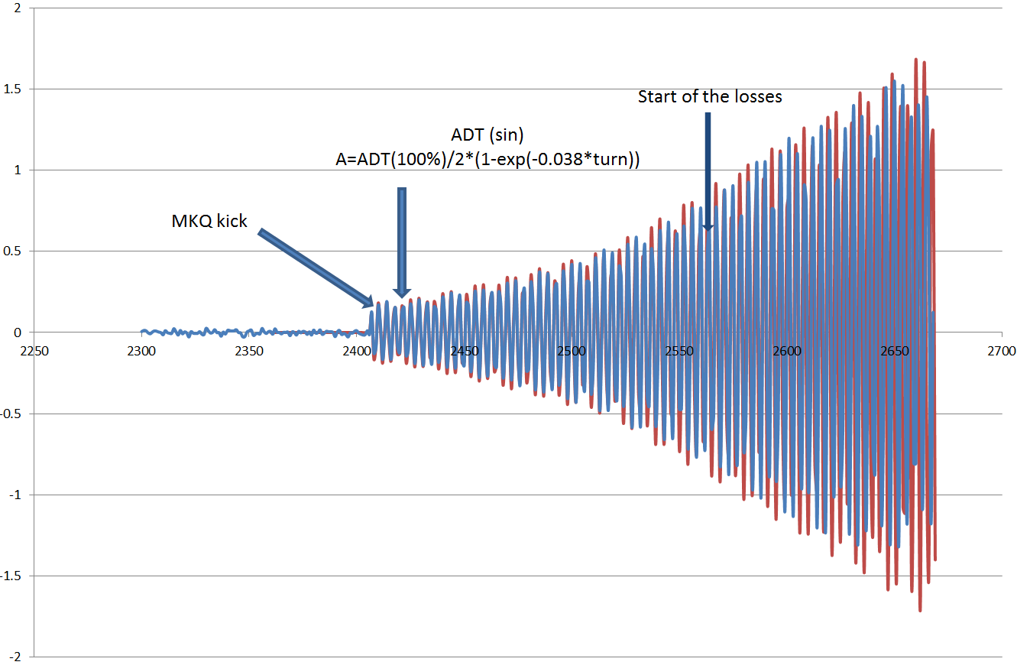
Input parameters / Validation
  Beam parameters
    Energy
    Profile
    Tune, Chromaticity
  Orbit bump amplitude
  Transverse kick
    MKQ kick strength
    ADT kick strength
BPM data

Slide 6
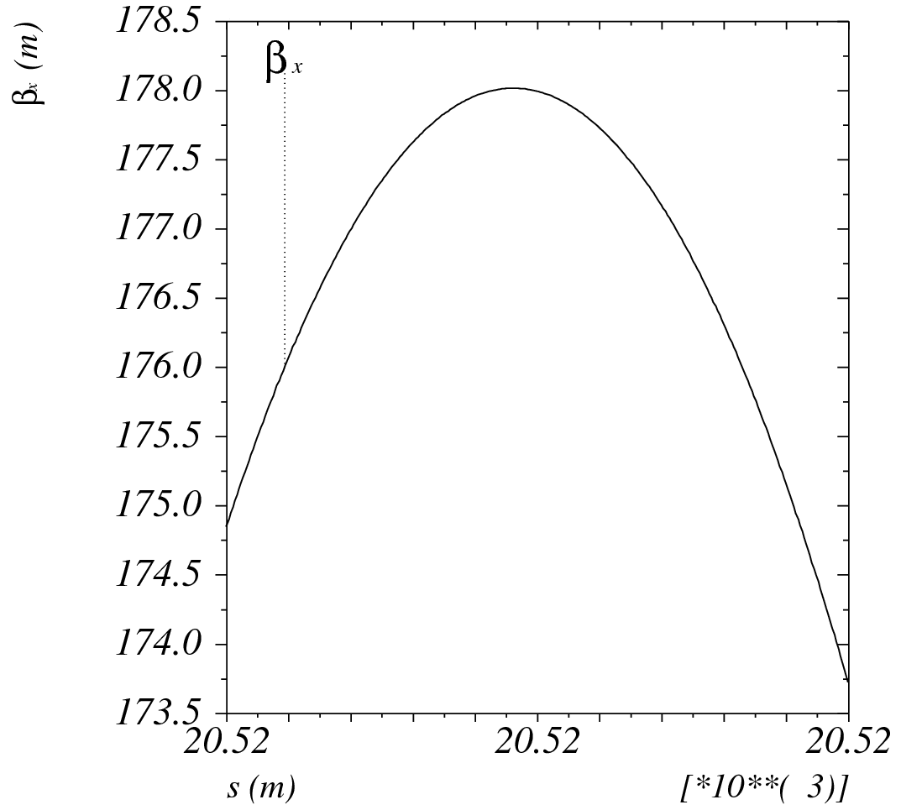
Other parameters influencing loss distribution
  Beam profile:
    Tail population
  β-function in the magnet
    β beat is <10%
  Aperture restrictions
    Surface roughness
    Misalignments
1-2%
Beam
    β-function along the magnet
Aperture
Aperture restriction
Aperture restriction:
Height: 30 μm
Length: 10 ÷ 30 cm

Slide 7
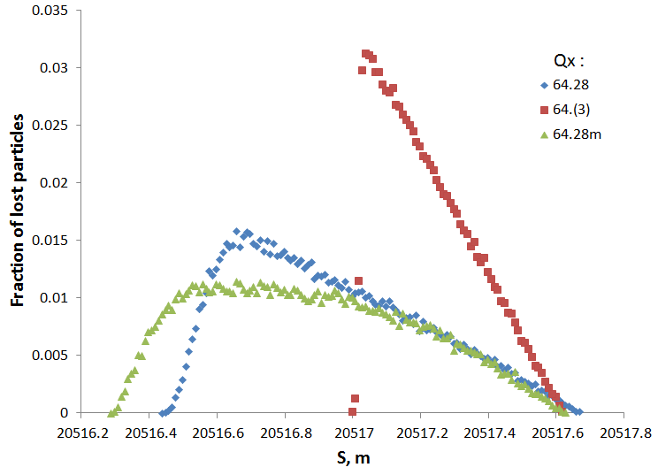
Millisecond timescale test
Dependence on the tune
Nominal tune spread < 1e-3
Beam size:
  ε_{x} = 5.195e-7
  ε_{y} = 1.409e-5
Bump amplitude:
  4.3σnom
Not realistic!!!
Nominal
Tune:
-6e-3
Q_{x} = 64.28
Q_{x} = 64.274
3CB
Q_{x} = 64.28
Q_{x} = 64.268
matching
Conclusion:
Tune variation influences longitudinal loss distribution, however the maximum for realistic cases varies ~ 20%
Q_{x} = 64.(3)
Q_{x} = 64.3330
3CB
Matching – correcting tune
after establishing bump
7

Slide 8
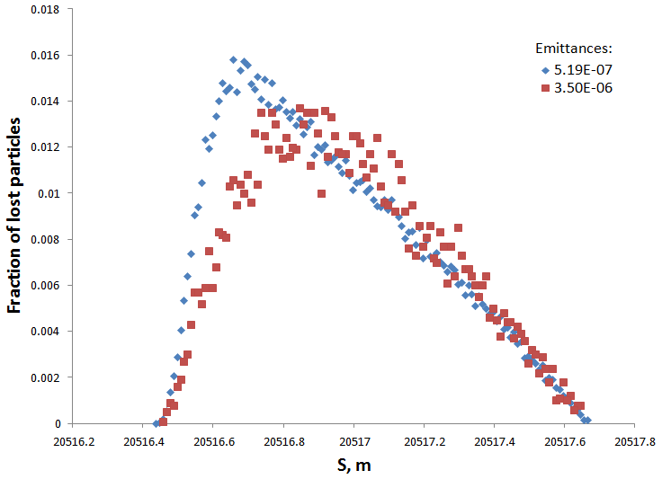
Millisecond timescale test
Dependence on the beam size
Beam size:
  εy = 1.409e-5
Experimental
ε _{n,x} = 5.19e-7
ε _{nom,x} = 3.5e-6
Bump amplitude:
  4.3σnom
Tune:
  Q_{x} = 64.28
  Q_{y} = 59.31
Nominal (extreme case)
Conclusion:
Influence of beam size on longitudinal loss distribution is small in case of fast losses
8

Slide 9
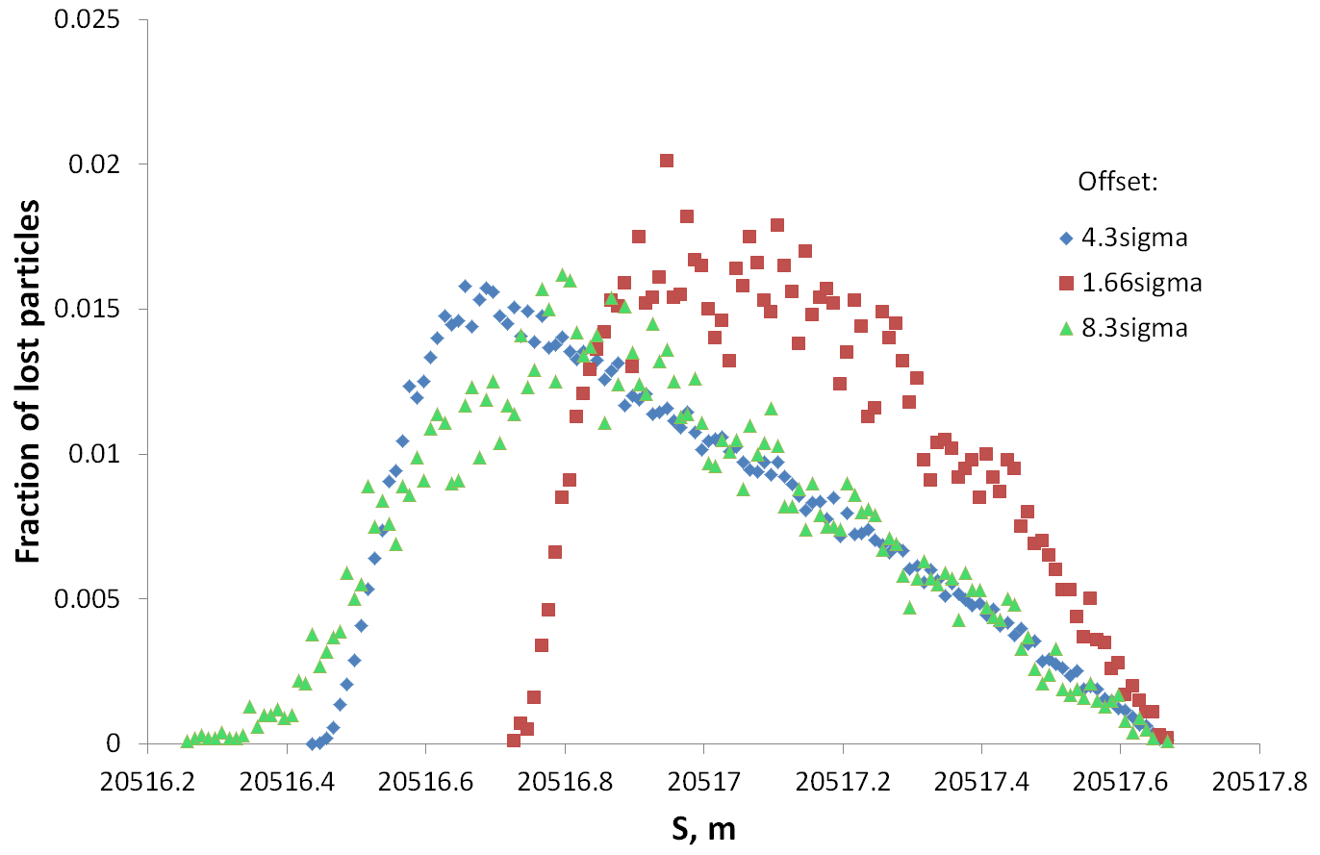
Millisecond timescale test
Dependence on the bump amplitude
Beam size:
  ε_{x}= 5.195e-7
  ε_{y}= 1.409e-5
Extreme case (-)
Experimental
Bump amplitude:
4.3σnom
Extreme case (+)
1.66σnom
8.3σnom
Tune:
  Q_{x} = 64.28
  Q_{y} = 59.31
Conclusion:
Size of orbital bump has only small influence on maximum of lost-particles distribution in case of fast losses
9

Slide 10
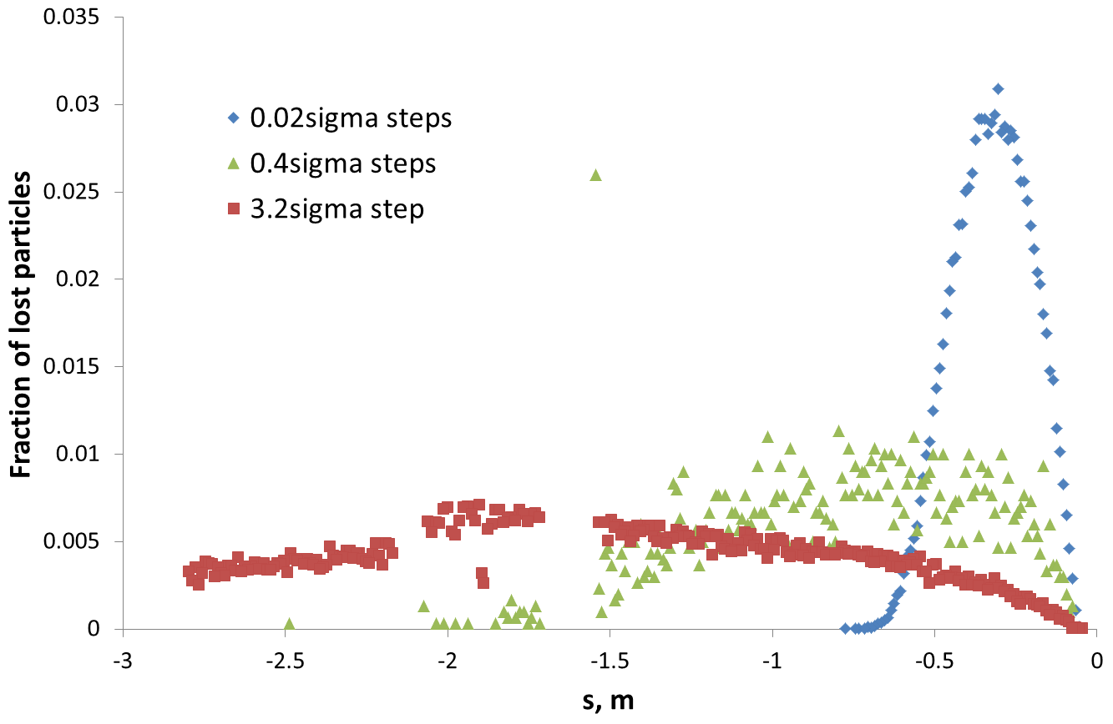
Dynamic orbit bump
Beam size:
  ε_{x}= 6.1e-6
  ε_{y}= 7.1e-6
Initial bump amplitude:
3.5σnom
Step: every 50 turns
Conclusion:
Slow increase of the orbital bump leads to the compression of the lost-particle distribution in case of slow losses

Slide 11
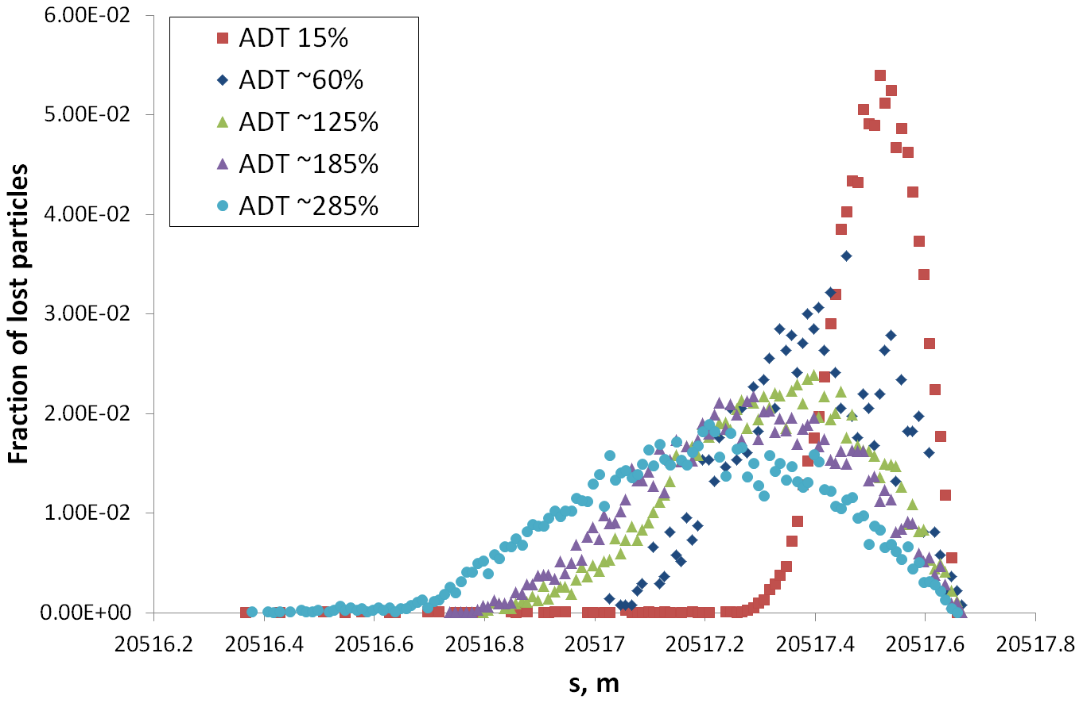
Steady-state orbit bump
Dependence on diffusion rate
Beam size:
  ε_{x}= 1.9e-6
  ε_{y}= 1.4e-5
ADT gain, % | Kick strength, sigma
15 | 1.15E-05
60 | 4.60E-05
125 | 9.58E-05
185 | 1.42E-04
285 | 2.18E-04
Bump amplitude:
2.5σnom
Conclusion:
Decrease of diffusion rate leads to compression of longitudinal distribution
11
11

Slide 12
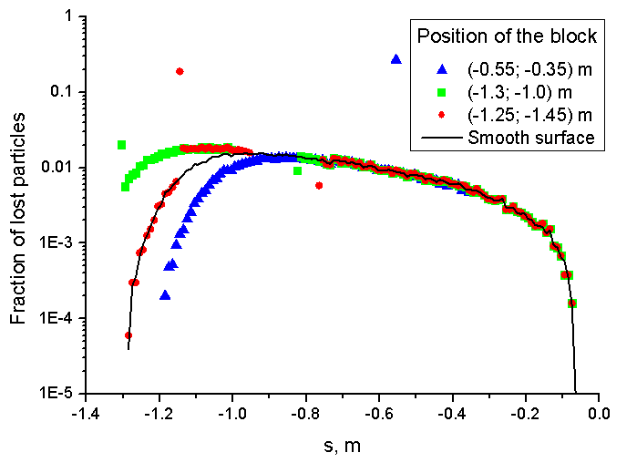
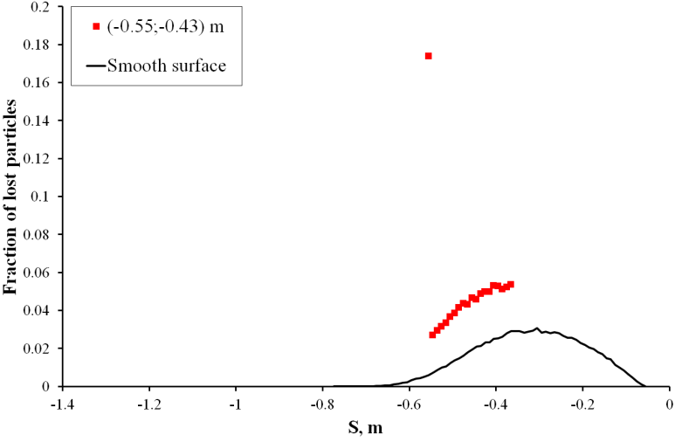
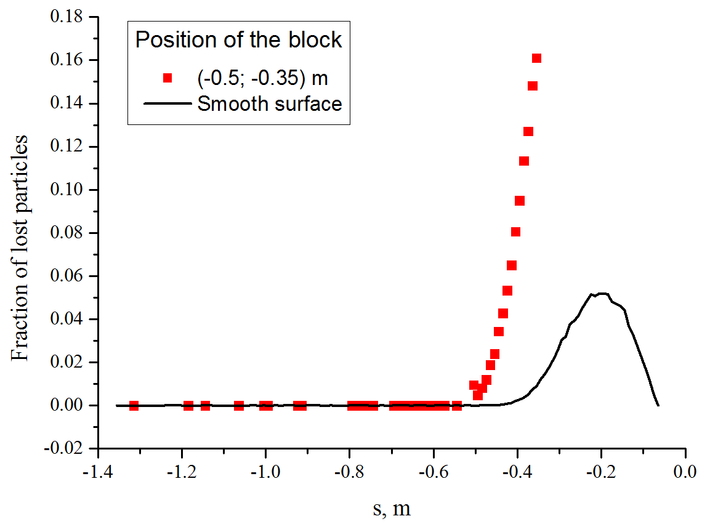
Millisecond timescale test
Dynamic orbit bump
Steady state orbit bump test
Aperture limitations
Conclusion:
Presence of the aperture limitation of 30 μm shifts the longitudinal distribution and therefore changes the average impact angle.
12

Slide 13
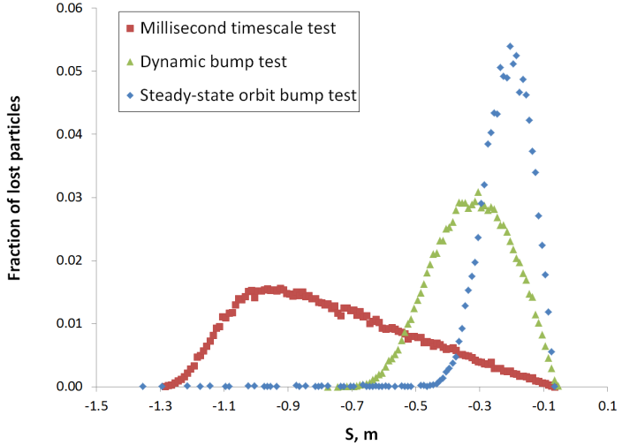
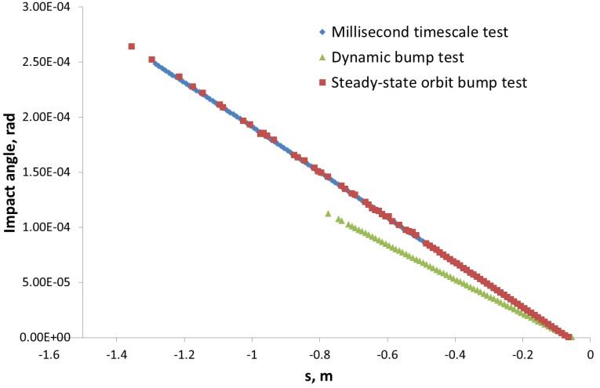
Summary
Aperture
Kick
Beam
Bump amplitude
Reference orbit
Particle
Tracking
Particle
Shower
Spatial loss distribution was calculated for orbit bump quench tests.
Integrated over time this distribution was provided for further particle-shower simulations.

Slide 14


Conclusions
Spatial loss distribution varies depending on the scenario.
Impact angle does not depend on the scenario, but only on the integral magnetic field seen by the particles.
Weighted average angle changes with the spatial distribution.
Results of the FLUKA simulations depend both on the spatial and angular loss distributions (see talks of A. Lechner and B. Auchmann).

Slide 16
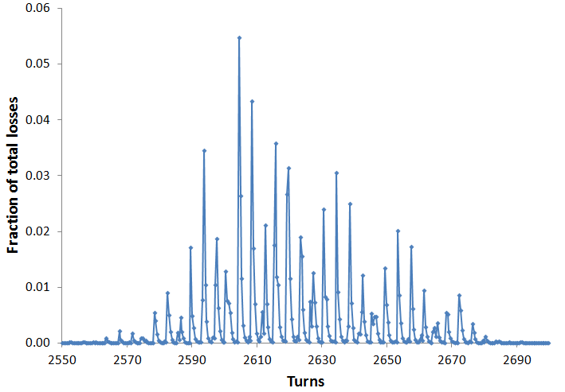
Time structure
Experimental BLM signal
Fast losses
Slow losses

