Slide 1
Conceptual Layout and Integration in High Luminosity Insertions
V. Baglin (TE-VSC)
6th HL-LHC Technical Committee
CERN – 10th June 2014

Slide 2
Outline
Vacuum performances
Layout generalities
Key areas:
  Experiments
  TAS-Q1
  IT
  Q3-D1
  LRBB
  TAN-D2
  D2, Q4, Q5, Q6
  Crab cavities
  Masks
Conclusions

Slide 3
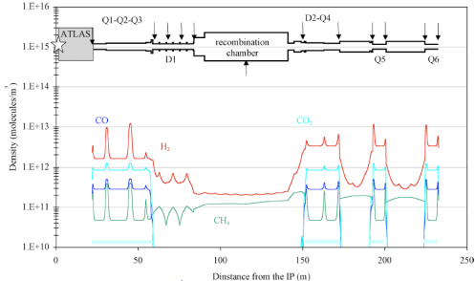
Vacuum Performances
Layout must ensure vacuum performances
Vacuum stability: beam current, ion desorption
Low background to the experiments
 | H2_eq / m3 | mbar
<LSS_{1 or 5}> | ~ 5 10¹² | 10⁻¹⁰
<ATLAS> | ~ 10¹¹ | 10⁻¹¹
<CMS> | ~ 5 10¹² | 10⁻¹⁰
A. Rossi, CERN LHC PR 783, 2004.

Slide 4
Layout Generalities
Sectorisation at each cold to warm transition:
    Lowest unbaked length at RT required
    Decoupling RT and cryogenic systems
Instrumented sector valve assembly
Cryogenic system with perforated beam screen
Room temperature system with NEG coating
    Fully bakeable 200/250 deg, 50 deg/h
    A roughing system every ~ 20 m
    Instrumentation
    Ion pumps every 28 m (to be review for HL-LHC)
    Dedicated pumping for uncoated chambers
    ID 80, 212 are standard aperture (100, 130 )
Integration studies must take into account mobile systems (bakeout, pumping groups) and installation/desinstallation of components.

Slide 5
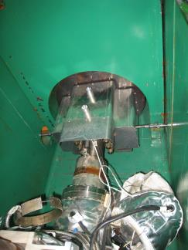
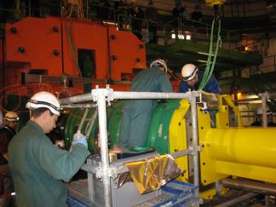

Experiments
Complex and dedicated vacuum chambers: Be, Al (ATLAS) and stainless steel (CMS).
NEG coated
Minimised thickness flanges with helicoflex gaskets
Adapted/dedicated supporting system
Dedicated remote tooling at TAS
TAS remote tooling
Inside FIN (fin iron nose)
RF bridge repair 18-1-2012
Q1R5
IP5
CMS forward chamber
TAS

Slide 6
Experiments for HL-LHC
For HL-LHC:
    Be, Al material
    NEG coated, no RF bridges
    Issue with flange connection, robustness and radiation.
    Impose “quick” flange concept
    Review/redesign TAS remote tooling
    Mechanical supporting system to be compatible with detector maintenance (no personnel intervention must be required)

Slide 7
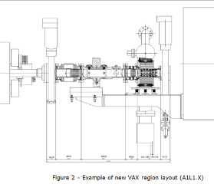
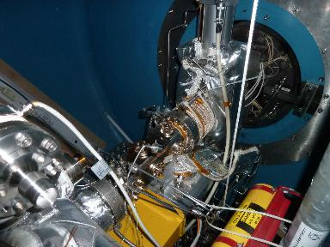
TAS-Q1
2 sectors valves to decouple the experiments and allow pumping, Ne venting
NEG coated
TAS
BPM
IT
VAX area
No room for personal to work !
(even to take a picture !)
To be redesigned for HL-LHC to allow remote tooling

Slide 8
IT
Perforated shielded beam screen
a-C coated beam screen
Active cooling (~ 40-60 K)
Cold/warm transition
Interconnects length to be compatible with vacuum stability
Under study, definition

Slide 9
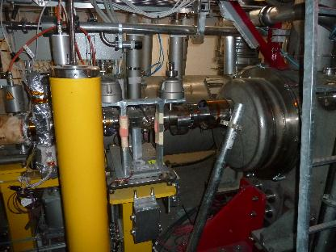
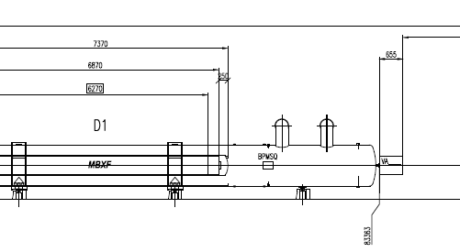
Q3-D1
Longest unbaked length in LHC : ~ 1.3 m !
Weak area
DFBX-Q3
D1
HL-LHC layout
HL-LHC has the sector valve assembly at D1

Slide 10
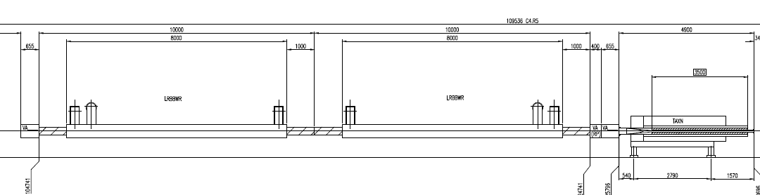
LRBB
Do not exist in LHC.
Already sectorised
Must be bakeable
Material and layout to be studied and designed
Must be compatible with background to experiments

Slide 11
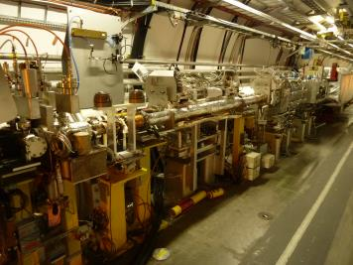
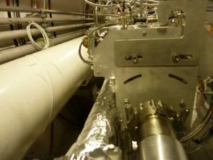
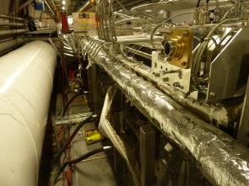
TAN-D2
Short distance between TAN-D2 to accommodate all components (7.43 m)
Integration of all components (collimators, BPM, vacuum system) not properly done during LHC construction
Redesign of collimator’s envelope taking into account mobile equipment : bake out + pumping groups

Slide 12
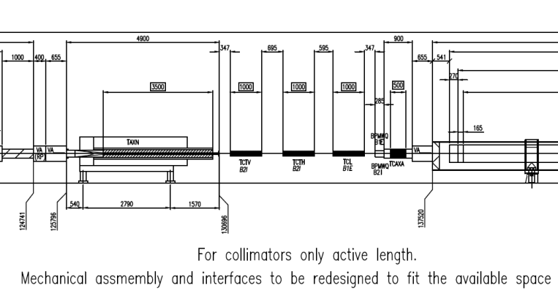
TAN-D2 for HL-LHC
Current layout with added mask (TCA)
This version must allow 5th axis and remote tooling

Slide 13
D2,Q4, Q5,Q6 for HL-LHC
Re-use sector valve assembly
a-C coated beam screen (5 – 20 K ?)
1. 9 K cold mass
R-use Q4_{LHC} cold warm transition for Q5_{HL-LHC}

Slide 14
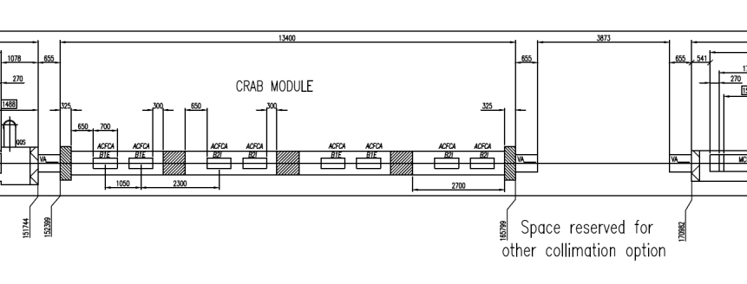
Crab cavities between D2-Q4
Q4 and Q5 sectorised
Collimation sectorised
Module sectorised
Collimation must be in the same sector as the 2nd beam to use it as a cryotrap protecting the cavities

Slide 15
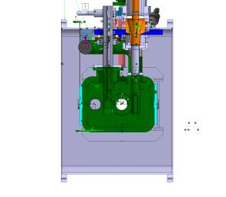
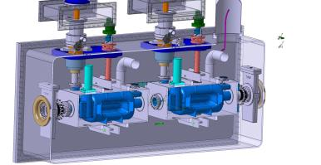
Crab cavities between D2-Q4
Vacuum valves inside insulation vacuum: not inserted into sector valve chain
Interconnects: one sector valve + instrumentation + cavity roughing
2nd non accelerated beam at cryogenic temp (2.0 K) => need beam screen / shadowing
Examples of HL-LHC crab cavities
Layout study and design
Impact of electron cloud and synchrotron radiation on crab modules ?

Slide 16
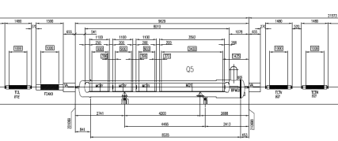
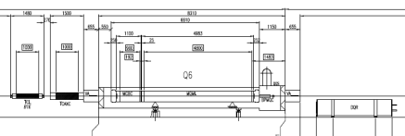
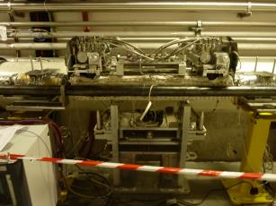
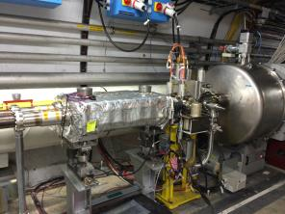
Other Masks and Collimators
Room temperature
Bakeable to 250 deg, 50 deg/h
Room is available
TCL -6L1
TCLIM -6R2
Re-use of standard equipments

Slide 17
Conclusions
Conceptual layout well advanced
Objective to:
    Have vacuum performances compatible with HL-LHC (1.12 A per beam, 2.2 10¹¹ ppb, 2748 b)
        2.24 A in the IP instead of 1.16 A for LHC !
        Above vacuum stability design margin !
    Review/redesign and develop along the LSS the remote tooling
    Re-use vacuum equipments from LHC

Slide 18
Thank you for your attention

