Slide 1
The Radiation Hard
GBTX Link Interface Chip
Paulo Moreira
26 November 2013
CERN, Switzerland

Slide 2
GBTX People
The GBTX is the product of the imagination and work of many people going from the basic ideas through the specifications, design and testing. These people are:
  Sophie Baron
  Sandro Bonacini
  Pedro Cardoso
  Jorgen Christiansen
  Ozgur Cobanoglu
  Xavi Cudie
  Federico Faccio
  Sebastian Feger
  Diego Figueiredo
  Rui Francisco
  Tullio Grassi
  Ping Gui
  Pedro Leitao
  Alessandro Marchioro
  Paulo Moreira
  Christian Paillard
  Karolina Poltorak
  David Porret
  Rafael Sune
  Filip Tavernier
  Guoying Wu
  Ken Wyllie
  (At some point the list must end but, if you feel you should be in it please let me know…)

Slide 3
Outline
Radiation hard optical Link
The GBT system
The GBTX up-link
The GBTX down-link
Phase-shifter
xPLL
ePLL
Controlling the GBTX
Interfacing with the GBLD
Built-in test features
SEU tests
Power consumption
Testing Status
GBTX future

Slide 4
Radiation Hard Optical Link
Development of an high speed bidirectional radiation hard optical link:
GBT project:
  ASIC design
  Verification
  Functionality testing
  Packaging
Versatile link project:
  Opto-electronics
  Radiation hardness
  Functionality testing
  Packaging
GBT
GBT
Versatile Link
FPGA
Timing & Trigger
GBTX
PD
Timing & Trigger
GBTIA
DAQ
DAQ
GBLD
LD
Slow Control
Slow Control
Custom ASICs
On-Detector
Radiation Hard Electronics
Off-Detector
Commercial Off-The-Shelf (COTS)

Slide 5
The GBT System
FE
Module
Clock[7:0]
External clock reference
E – Port
e-Link
GBTX
Phase - Shifter
CLK Reference/xPLL
FE
Module
E – Port
E – Port
ePLLRx
GBTIA
DEC/DSCR
E – Port
CDR
data-down
data-up
Phase – Aligners + Ser/Des for E – Ports
CLK Manager
clock
80, 160 and 320 Mb/s ports
GBLD
SCR/ENC
SER
FE
Module
E – Port
ePLLTx
E – Port
E – Port
One 80 Mb/s port
Control Logic
Configuration
(e-Fuses + reg-Bank)
GBT – SCA
E – Port
JTAG
I2C Slave
I2C Master
I2C (light)
data
JTAG
Port
I2C
Port
control
clocks

Slide 6
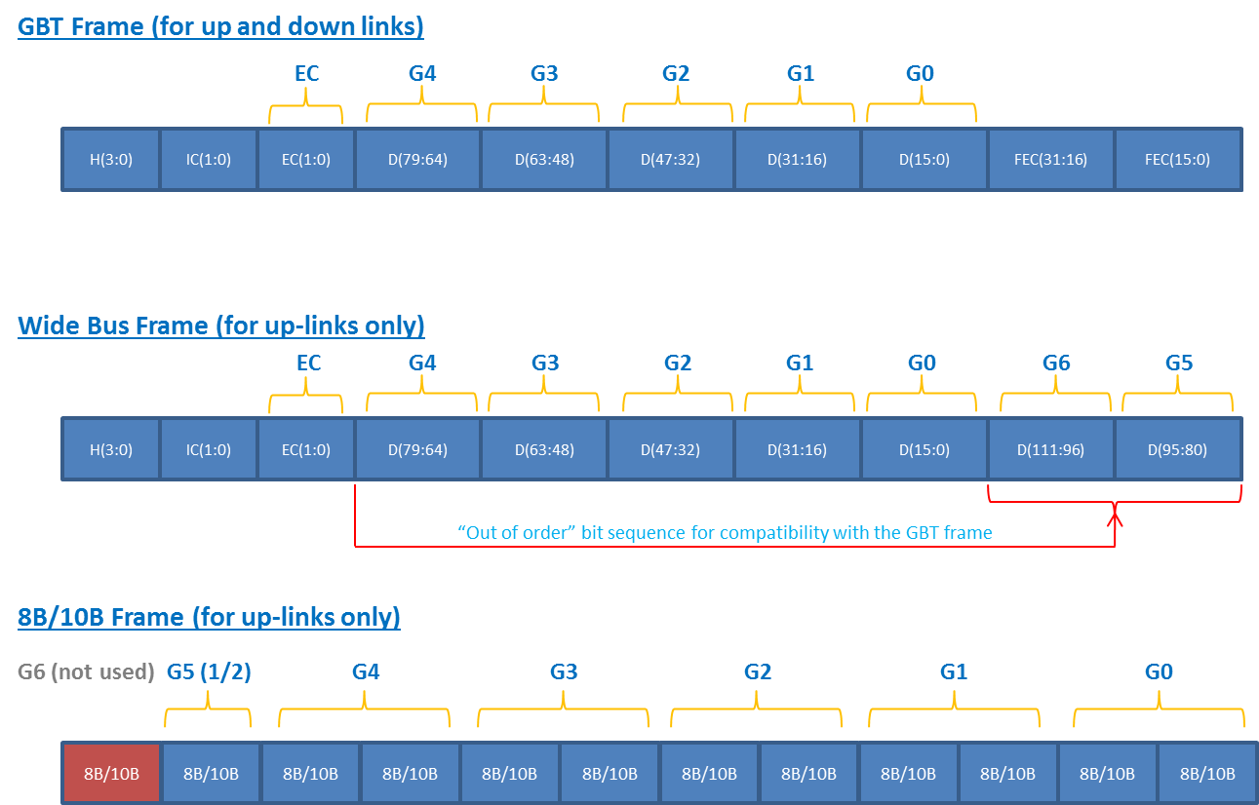
GBTX Data Bandwidth
The GBTX supports three frame types:
  “GBT” Frame
  “Wide Bus” Frame
  “8B/10B” Frame
“GBT” Mode
  User bandwidth: 3.28 Gb/s
    Up/down-links
“Wide Bus” and “8B/10B”frames are only supported for the uplink
  The downlink always uses the “GBT” frame.
“8B/10B” Mode
  Downlink data 8B/10B encoded
  No FEC
  User bandwidth: 3.52 Gb/s
“Wide Bus” Mode:
  Uplink data scrambled
  No FEC
  User bandwidth: 4.48 Gb/s
GBT Frame:
Frame Synchronization:
  DC balanced and “redundant” header
Forward Error Correction:
  Interleaved Reed-Solomon double error correction
  4-bit symbols (RS(15,11))
  Interleaving: 2
  Error correction capability:
    2 Interleaving × 2 RS = 4 symbols = 16-bits
  Code efficiency: 88/120 = 73%

Slide 7
GBTX Functionality (1/4)
e-Links
40 bi-directional e-Links
  Up to 40 @ 80 Mb/s
  Up to 20 @ 160 Mb/s
  Up to 10 @ 320 Mb/s
e-Port data rate can be set independently for:
  each group
  Input / output ports
1 bi-directional e-Link:
  80 Mb/s
40 e-Link clocks (fixed phase) programable in frequency:
  40/80/160/320 MHz (per group)
  (independently of the bit rate)
Automatic, semi-automatic or user controlled phase alignment of the incoming serial data embedded in the e-Ports
  Automatic alignment
    Tracks temperature and voltage variations
    Transparent to the user
    Works on any type of data:
      DC balanced / un-balanced
      A few “occasional” transition enough to ensure correct operation
GBTX
Phase - Shifter
CLK Reference/xPLL
E – Port
ePLLRx
DEC/DSCR
E – Port
CDR
Phase – Aligners + Ser/Des for E – Ports
CLK Manager
SCR/ENC
SER
E – Port
ePLLTx
E – Port
Control Logic
Configuration
(e-Fuses + reg-Bank)
JTAG
I2C Slave
I2C Master

Slide 8
GBTX Functionality (2/4)
e-Links Special cases
8B/10B mode:
  44 input (max @ 80 Mb/s)
  36 output (max @ 80 Mb/s)
    (Four outputs reused as inputs)
Wide-Bus mode:
  56 input (max @ 80 Mb/s)
  24 output (max @ 80 Mb/s)
    (16 “outputs” reused as inputs)
e-Links electrical characteristics
Drivers:
  SLVS signaling
Receivers:
  SLVS/LVDS signaling
GBTX
Phase - Shifter
CLK Reference/xPLL
E – Port
ePLLRx
DEC/DSCR
E – Port
CDR
Phase – Aligners + Ser/Des for E – Ports
CLK Manager
SCR/ENC
SER
E – Port
ePLLTx
E – Port
Control Logic
Configuration
(e-Fuses + reg-Bank)
JTAG
I2C Slave
I2C Master

Slide 9
GBTX Functionality (3/4)
Phase-Shifter
8 independent clocks
Programable in frequency:
  40 / 80 / 160 / 320 MHz
Programable in phase:
  0 to 360◦
  Phase resolution: 50 ps
    (for all frequencies)
Clock driver electrical levels:
  SLVS
Reference clock:
On package crystal
Built-in crystal oscillator
Built-in VCXO based PLL (xPLL)
External reference can used as well
GBTX
Phase - Shifter
CLK Reference/xPLL
E – Port
ePLLRx
DEC/DSCR
E – Port
CDR
Phase – Aligners + Ser/Des for E – Ports
CLK Manager
SCR/ENC
SER
E – Port
ePLLTx
E – Port
Control Logic
Configuration
(e-Fuses + reg-Bank)
JTAG
I2C Slave
I2C Master

Slide 10
GBTX Functionality (4/4)
Chip Control
e-Fuse register bank for burn in configuration
  Standalone operation
  Ready at power up
Dynamic configuration and control
  I2C Slave interface
  IC control channel trough the optical link
Watchdog circuit for chip operation supervision.
GBLD Control
GBLD dedicated I2C master interface
  Copies configuration burned in the GBTX into the GBLD at start-up
  Allows to program the GBLD either through the IC channel or through the I2C slave port
GBTX
Phase - Shifter
CLK Reference/xPLL
E – Port
ePLLRx
DEC/DSCR
E – Port
CDR
Phase – Aligners + Ser/Des for E – Ports
CLK Manager
SCR/ENC
SER
E – Port
ePLLTx
E – Port
Control Logic
Configuration
(e-Fuses + reg-Bank)
JTAG
I2C Slave
I2C Master

Slide 11
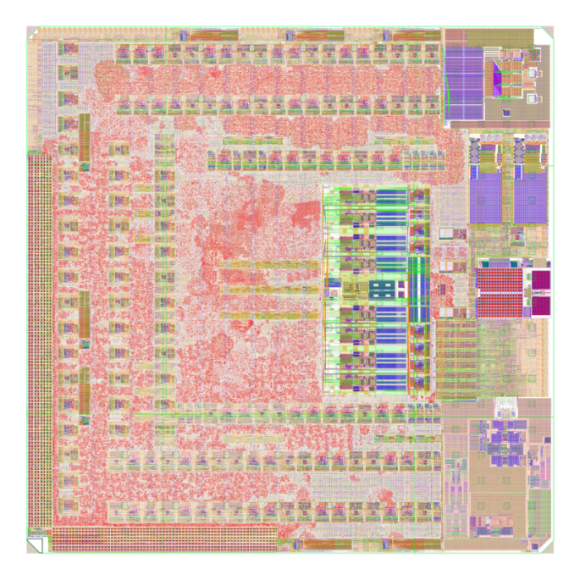
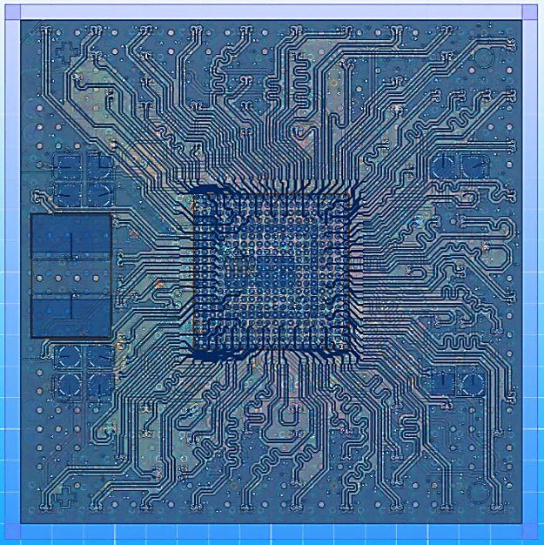
GBTX In Numbers
½ million gates
Approximately:
  300 8-bit programable registers
  (all TMR)
  300 8-bit e-Fuse memory
Clock tree (chip wide):
  9 clock trees (all TMR)
  Frequencies: 40/80/160/320 MHz
7 PLLs:
  RX: CDR PLL + Reference PLL (2.4 GHz)
  Serializer PLL (4.8 GHz)
  Phase-Shifter PLL (1.28 GHz)
  xPLL (VCXO based PLL, 80 MHz)
  (2x) ePLL (320 MHz)
17 master DLLs:
  9 for phase alignment of the e-links
  8 for clock de-skewing
56 replica delay lines:
  For phase alignment of the e-links
7 power domains:
  Serializer (1.5V)
  DESerializer (1.5V)
  Clock Manager (1.5V)
  Phase shifter (1.5V)
  Core digital (1.5V)
  I/O (1.5V)
  Fuses (3.3V)
4.3 mm
4.3 mm
17 mm
Total height including solder balls: ~3 mm
17 mm

Slide 12
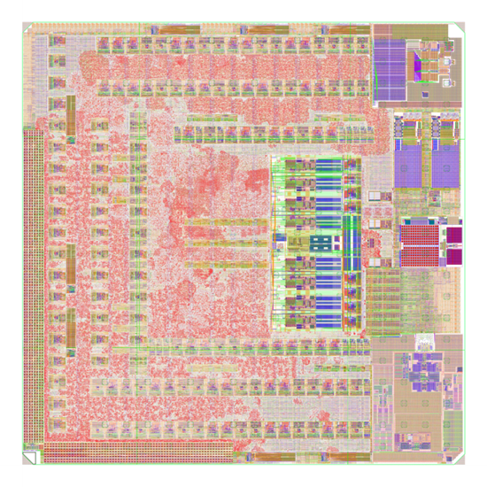
GBTX – Floor Plan and Modelling
10 “Macro-cells”:
Serializer:
  Full custom
  “Analogue-Verilog" modelling
Clock Manager:
  Standard cells
  Verilog modelling
DESerializer
  Full custom
  + “custom” digital
  + standard cells
  “Analogue-Verilog" + Verilog modelling
XPLL
  Full custom
  “Analogue-Verilog" modelling
EPLL (x2)
  Full custom
  “Analogue-Verilog" modelling
Phase-Shifter
  Full custom
Phase Aligners (x8)
  Full custom
  “Analogue-Verilog" modelling
Prompt (x3)
  Full custom
  Verilog modelling
Power on reset
  Full custom
  Verilog modelling
e-Fuses (x300)
  Foundry IP
  Verilog modelling
Standard Cells:
“everywhere”
Phase-Aligners
SER
Phase-Aligners
ePLL
Phase-Shifter
PROMPT
I/O Cells
xPLL
PON-RST
CLK-MAN
E-Fuses
DES
Phase-Aligners

Slide 13
The GBTX up-link
Each eLink is associated with a specific set of bits in the frame
Front-end modules are thus “geographically” addressed:
  By being physically connected to an eLink
  No module address is required
eLinks: 80 /160 / 320 Mbps
Data and clock line (optional)
Frontend
Module
Frontend
Module
Frontend
Module
GBTX
GBT-Frame
4.8 Gbps
optical-fibre link
Frontend
Module
IC Control
GBT-SCA

Slide 14
Transmitter Architecture
40 + 1
Rx eLinks
56 + 1
Phase Aligners
28 + 1 DeSerializers
1/2, 1/4 and 1/8
16
BiDir eLinks
40 + 1
Clocks
Bus Mode
Wide - Bus
Scrambler
Header
Insertion
GBT - Frame
Scrambler
FEC
Interleaver
Header
Insertion
Serializer
/ Driver
8B10B - Frame
Comma
Insertion
8B10B
Encoder
“Conceptual”

Slide 15
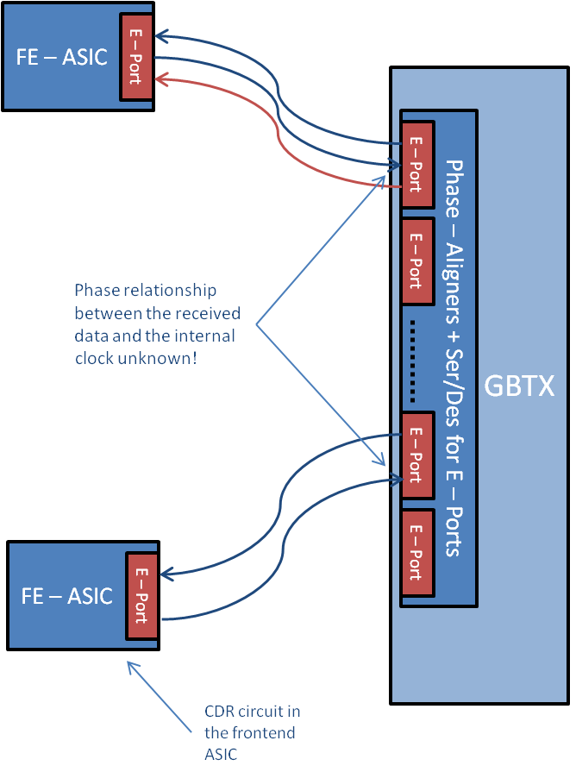
Up eLink – Phase Alignment
Good sampling instants
eLink “i”
GBTX internal clock
Bad sampling instants
eLink “j”
The phase of the incoming data signals is “unknown” in relation to the internal sampling clock!
There are up to 57 eLink inputs (potentially) all with random phase offsets
The solution:
  “Measure” the phase offset of each eLink input
  Delay individually each incoming bit stream to phase align it with the internal sampling clock

Slide 16
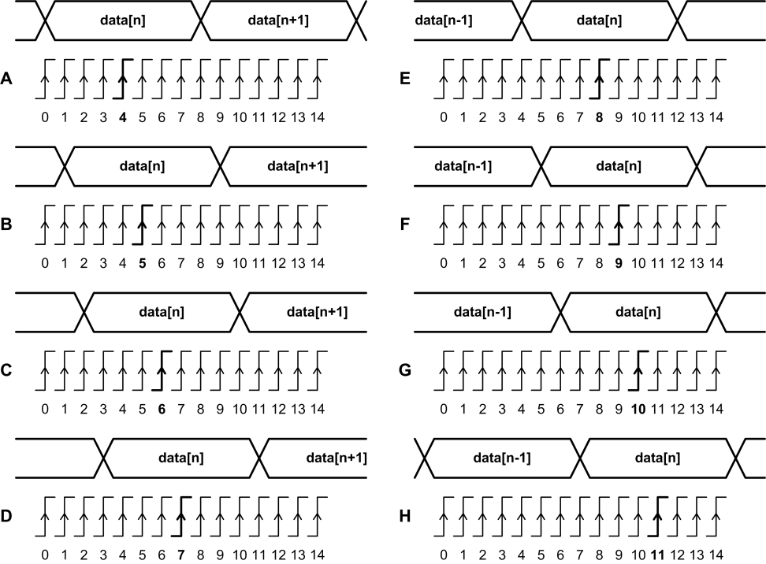
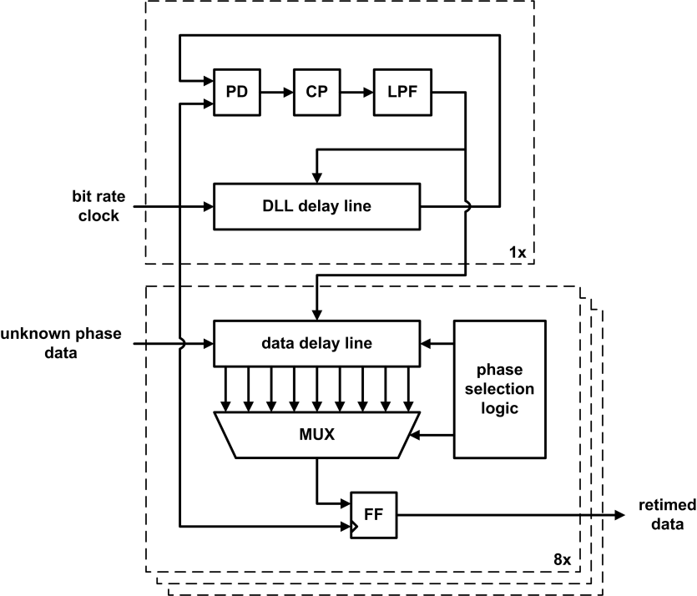
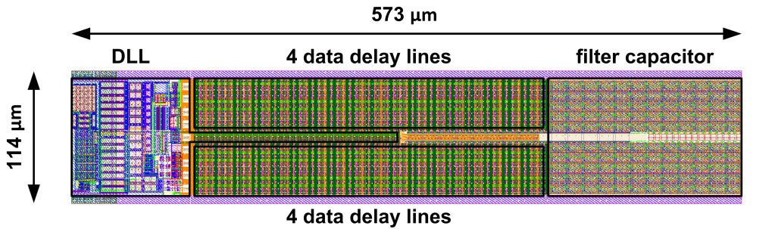
Phase Aligner
(The above picture is just for “easy representation”. In reality
the sampling clock phase is fixed and the data phase is adjusted.)
One master DLL and eight replica delay lines
Three modes of operation:
  Static phase selection:
    A system calibration must be done
  Training with learned static phase:
    1st a training pattern is sent to the GBTX over the e-Link
    2nd after training the phase is fixed:
  Automatic phase tracking:
    No system calibration required
    No need for DC balanced data
Unused channels can be powered Off
Power: 4 mW (for 8 channels)
The total delay line delay is equal to 7/4 T_{bit}
The delay line is divided into 14 equal delay intervals T_{bit} /8
In the automatic mode the circuit can tolerate jitter which is ±3/8 T_{bit}

Slide 17
eLink Data Latency
Phase Aligner Channel:
0
1
0
1
0
Shift CLK = 80 MHz
Shift register:
0
0
1
0
1
1
x2 Mode
CLK 40 MHz
Note1:
In all cases,
the shift clock
(80/40 /160 /320 MHz)
is always “180°”
out of phase
with the 40 MHz
reference clock.
Parallel data:
0
{Data(n-2)[0], Data(n-1)[1]}
{Data(n-1)[0], Data(n)[1] }
Phase Aligner Channel:
1
0
3
2
1
0
3
2
1
0
Shift CLK = 160 MHz
Shift register:
2
1
0
3
2
1
0
3
2
1
x4 Mode
CLK 40 MHz
Note2:
If data “splitting” is
to be avoided this
has to be done either
at the frontend or the
backend. In this case
a latency of 1 LHC clock
cycle has to be accounted
for.
Parallel data:
0
{Data(n-1)[0], Data(n)[3:1]}
{Data(n)[0], Data(n+1)[3:1]}
Phase Aligner Channel:
2
1
0
7
6
5
4
3
2
1
0
7
6
5
4
3
2
1
0
Shift CLK = 320 MHz
Shift register:
3
2
1
0
7
6
5
4
3
2
1
0
7
6
5
4
3
2
1
x8 Mode
CLK 40 MHz
Parallel data:
0
{Data(n-1)[0], Data(n)[7:1]}
{Data(n)[0], Data(n+1)[7:1]}
Important note:
A “word” might (it most likely will) span across a 40 MHz clock cycle boundary! (De-Serializer doesn’t know about the data structure!)
How the words will split depends on the link “return path” delay and on the phase programmed on the phase aligner.

Slide 18
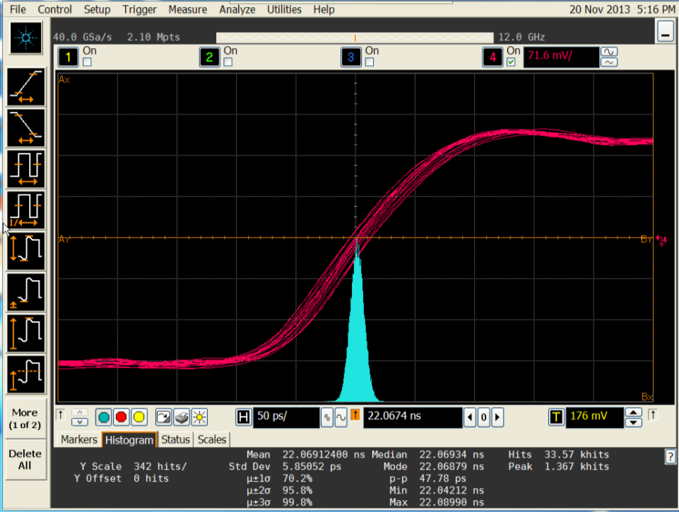
Tx eClock Jitter
“Absolute jitter”
  Scope triggered by the FPGA transmitter reference clock
  SLVDS driver with maximum current settings
320 MHz eClock
(all eLink signals on)
eLink Clocks | Simplex Tx Operation
Frequency | Jitter σ | Jitter P-P
[MHz] | [ps] | [ps]
40 | 6.0 | 47.8
80 | 5.9 | 45.0
160 | 5.6 | 49.4
320 | 5.7 | 44.4

Slide 19
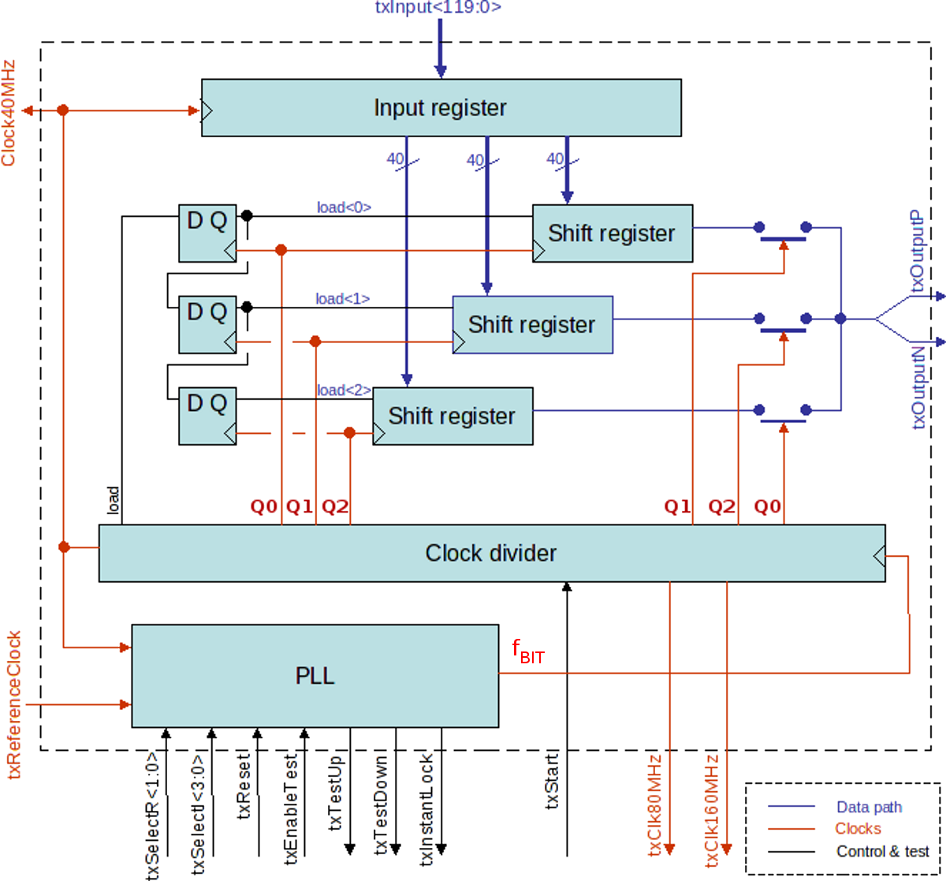
Serializer: Architecture
Serializer:
  4.8 Gb/s
  120-bit shift register
    3 × 40-bit shift register (f=1.6 GHz)
    3-to-1 fast multiplexer (f=4.8 GHz)
Data path:
  No SEU protection
  SEUs handled by the Reed-Solomon CODEC
Clock divider:
  Divide by 120
  f = 4.8 GHz
  Triple voted for SEU robustness
PLL:
  SEU hardened VCO
  SEU hardened Clock Divider
    Based on “custom” dynamic flip-flop
  The PLL clock is used a the transmitter master clock (and not the reference clock)

Slide 20
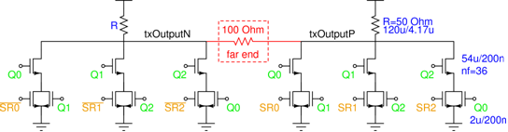
Fast-Mux / Line Driver
Data inputs: 1/3 4.8 Gb/s
Pseudo differential output stage
Pre-discharge switches to minimize pattern-dependent jitter
Three non-overlapping phases:
1/3 of 4.8 GHz

Slide 21
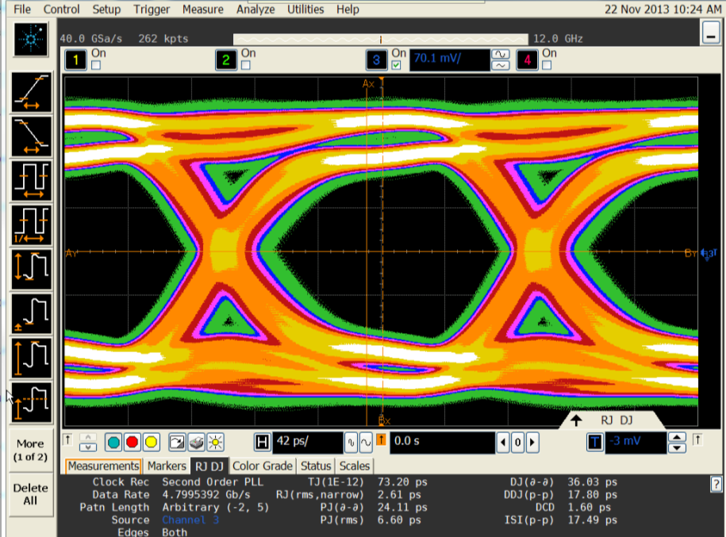
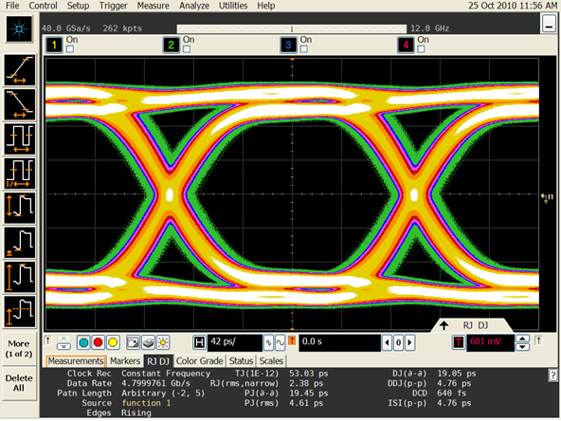
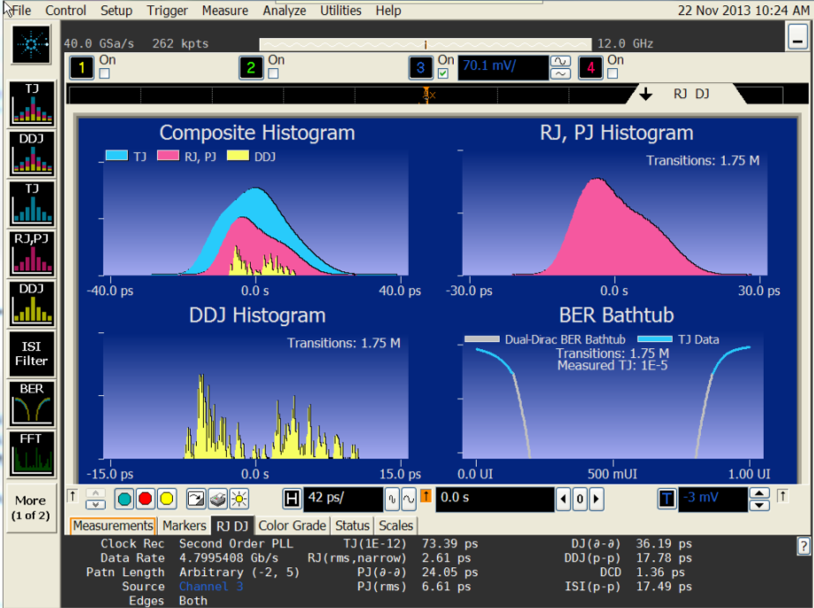
Tx Eye-Diagram
GBTX
GBT-SerDes
The same driver in the GBTX and GBT-SerDes!
However the clock phases were rotated to allow operation at 2.4 Gb/s
Simulations have not yet reveal the cause of the degradation!!!
 | GBTX | GBT-SerDes
TJ (1e-12) | 73.2 ps | 53.8 ps
RJ (rms) | 2.6 ps | 2.4 ps
PJ (d-d) | 24.1 ps | 19.4 ps
PJ (rms) | 6.6 ps | 4.6 ps
DJ (d-d) | 36.0 ps | 19.0 ps
DDJ (p-p) | 17.8 ps | 4.8 ps
DCD | 1.6 ps | 0.64 ps
ISI (p-p) | 17.5 ps | 4.8 ps
tr / tf | 100 ps | 80 ps
Max Data Rate | 5.4 Gb/s | 6.0 Gb/s

Slide 22
The GBTX down-link
As for the up link, each eLink is associated with a specific set of bits in the frame
Front-end modules are thus “geographically” addressed:
  By being physically connected to an eLink
  No module address is required
eLinks: 80 /160 / 320 Mbps
Data and clock line (optional)
Frontend
Module
Frontend
Module
Frontend
Module
GBTX
GBT-Frame
4.8 Gbps
optical-fibre link
Frontend
Module
IC Control
GBT-SCA

Slide 23
Receiver Architecture
GBT - Frame
Line Receiver
DeSerializer
Header
Detection
Interleaver
FEC Decoder
Scrambler
20 + 1 Serializers
x2, 1/4 and 1/8
24 + 1
Tx eLinks
16
BiDir eLinks
40 + 1
Clocks

Slide 24
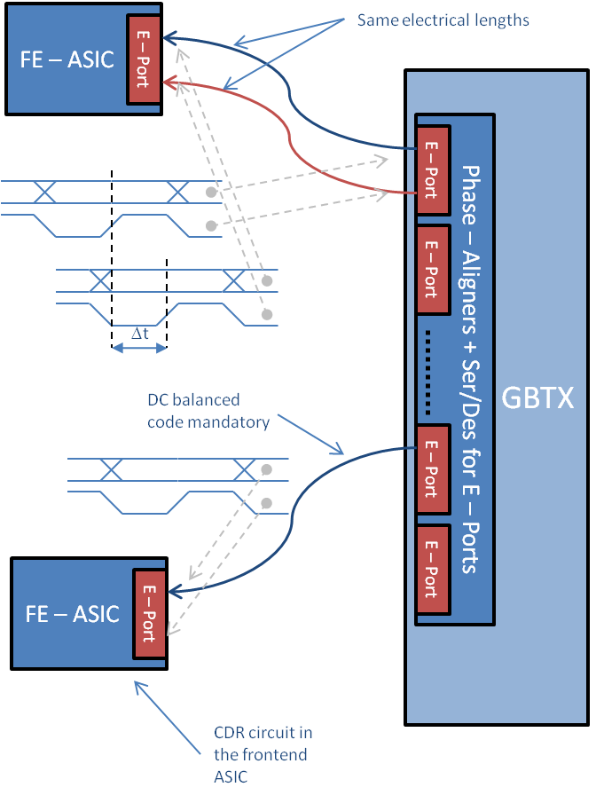
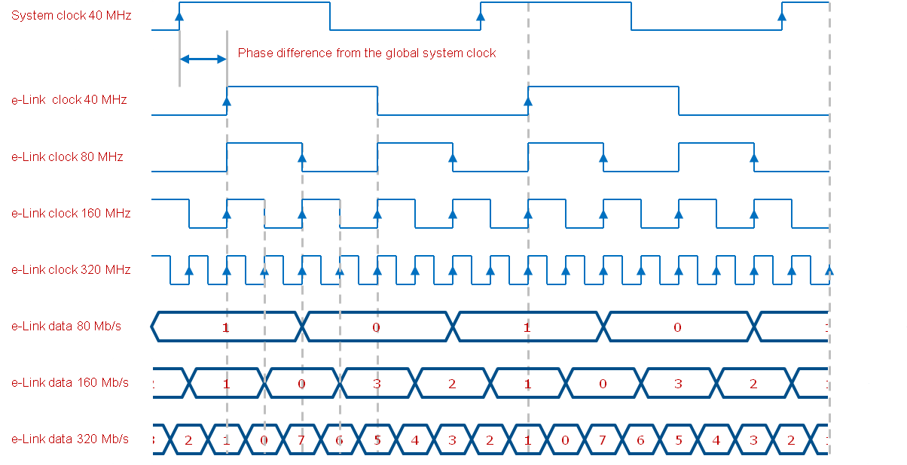
Down eLink – Phase Alignment
Data and clock phases are aligned at the output of the ePort drivers
The system designer must ensure that clock and data phases “track each other” in the frontend modules
eClocks frequency can be programed independently of the eLink data rate
It is possible avoid the eLink clocks but clock recovery must be used in the frontend
  In this case the data transmitted over the eLinks must be DC balanced

Slide 25
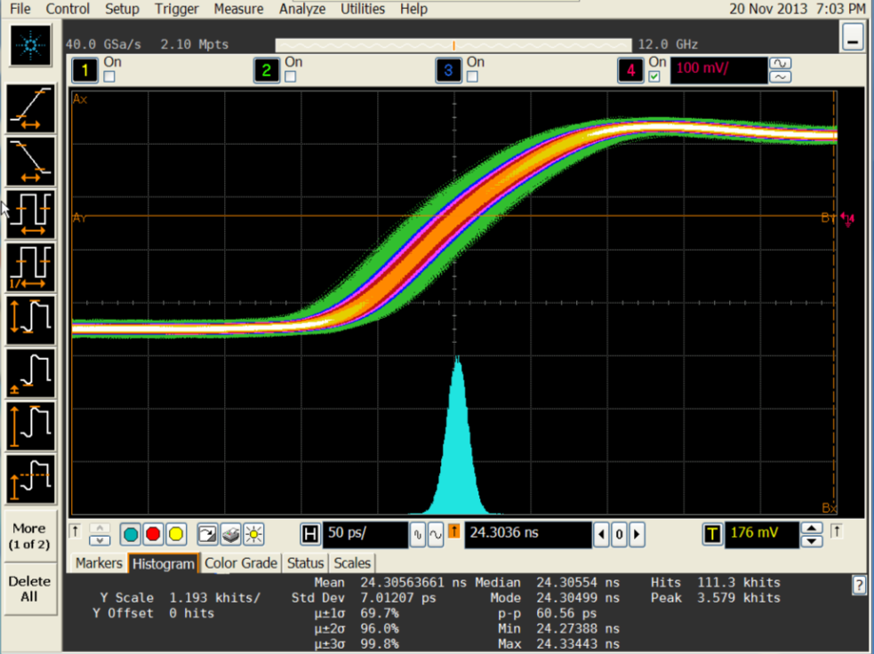
Rx eClock Jitter
“Absolute jitter”
  Scope triggered by the FPGA transmitter reference clock
  SLVDS driver with maximum current settings
eLink Clocks | Simplex Rx Operation
Frequency | Jitter σ | Jitter P-P
[MHz] | [ps] | [ps]
40 | 7.2 | 60.5
80 | 6.8 | 56.7
160 | 5.9 | 45.6
320 | 5.8 | 47.8
80 MHz eClock
(all eLink signals on)
eLink Clocks | Duplex Rx Operation
Frequency | Jitter σ | Jitter P-P
[MHz] | [ps] | [ps]
40 | 7.2 | 58.9
80 | 6.7 | 55.0
160 | 5.9 | 47.2
320 | 5.7 | 43.9

Slide 26
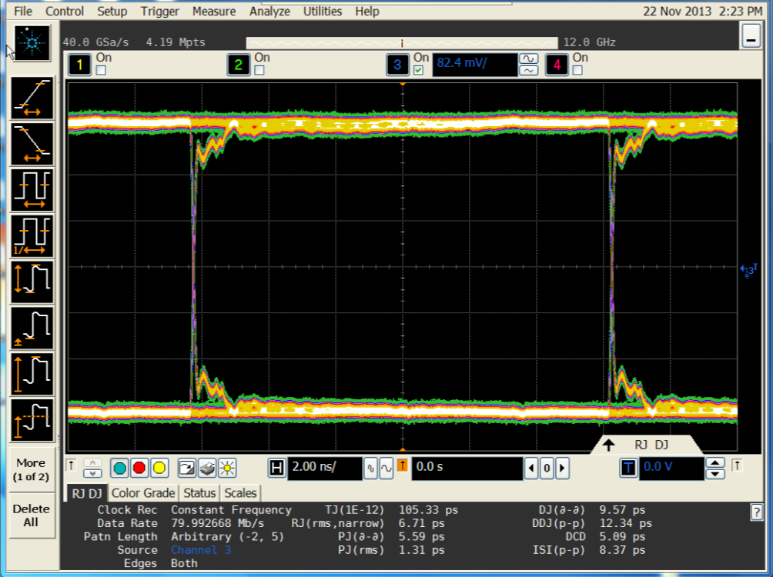
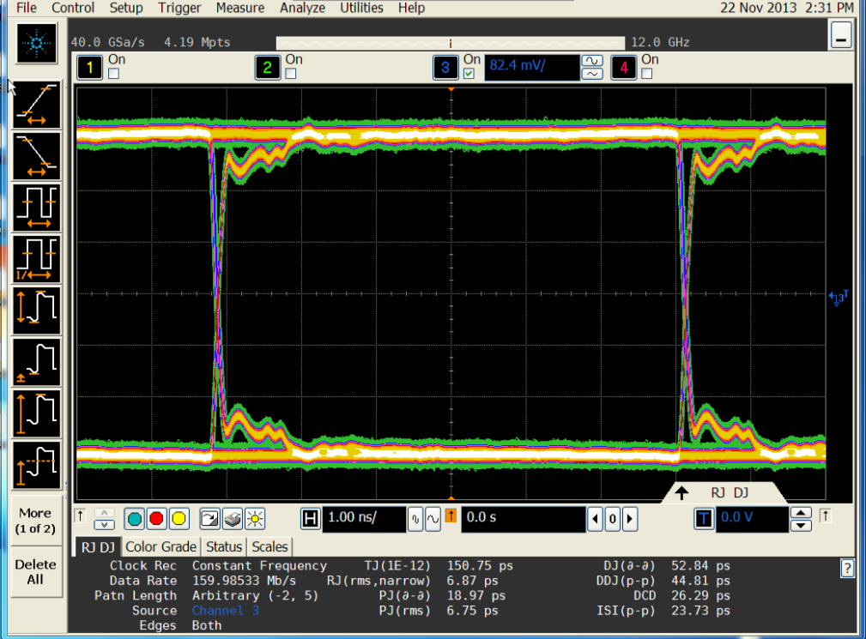
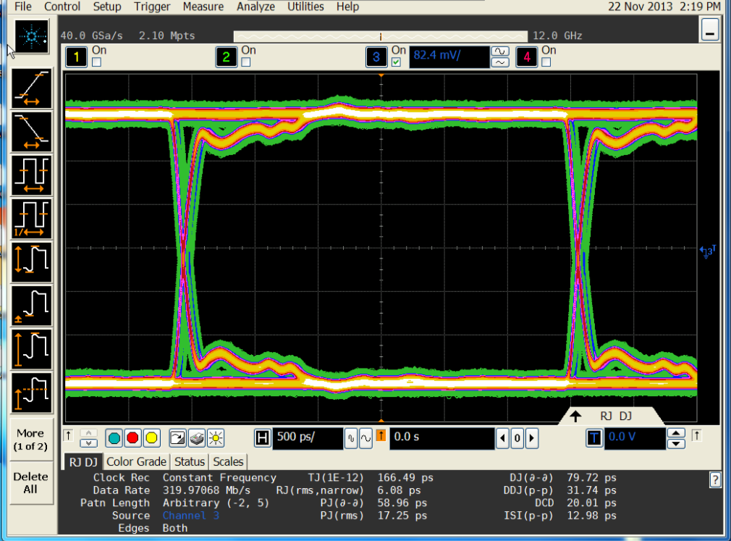
eLink eye-diagrams
80 Mb/s
160 Mb/s
 | 80 Mb/s | 160 Mb/s | 320 Mb/s | Units
TJ (1e-12) | 105.3 | 150.8 | 166.5 | ps
RJ (rms) | 6.7 | 6.9 | 6.9 | ps
PJ (d-d | 5.6 | 19.0 | 59.0 | ps
PJ (rms) | 1.3 | 6.8 | 17.2 | ps
DJ (d-d) | 9.6 | 52.8 | 79.7 | ps
DDJ (p-p) | 12.3 | 44.8 | 31.7 | ps
DCD | 5.1 | 26.3 | 20.0 | ps
ISI (p-p) | 8.4 | 23.7 | 13.0 | ps
320 Mb/s

Slide 27
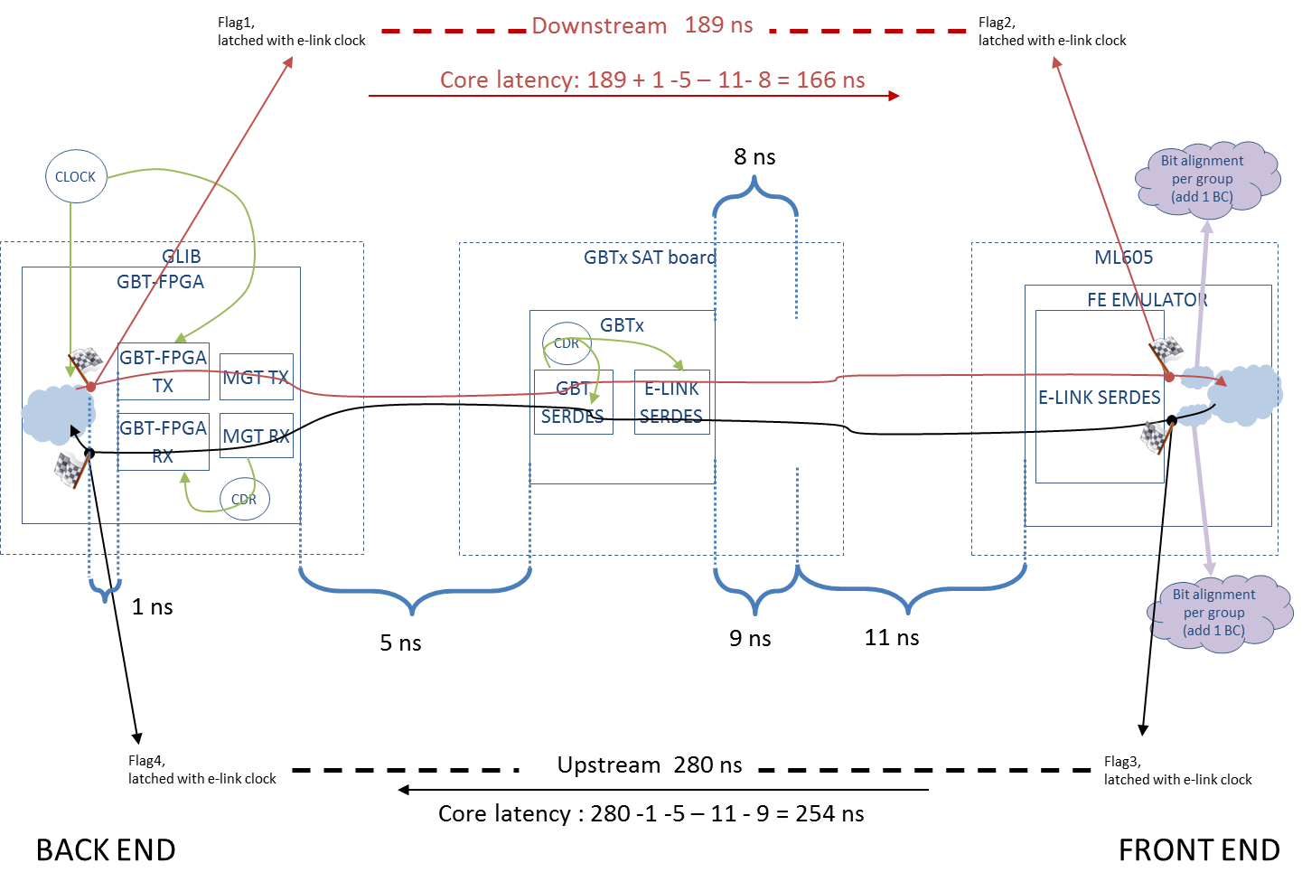
System Latency

Slide 28
DESerializer Architecture
Fast dynamic logic
“Macro Cell”
CDR PLL
rxSelectDataInPhase
DES 2/120
S₀
(240 MHz)
(800 MHz)
(160 MHz)
(40 MHz)
Phase/Freq
Detector
Data Re-Sampler
dataOdd
1-to-3
SREG
3
3-to-15
SREG
15
15-to-60
SREG
60
60
REG
rxOddReg[59:0]
S_{π}
clock40MHz
phCntClock2400MHz
1/3
(SKC)
1/5
1/4
clock80MHz
clock160MHz
dataIn
CK_{1/2}
1-to-3
SREG
3
3-to-15
SREG
15
15-to-60
SREG
60
60
REG
rxEvenReg[59:0]
dataEven
skipCycle
Up
Charge
Pump
Full custom logic: DFF, gates, …
Characterized in ELC
“Hand” net list
Verilog Simulation
P&R in Encounter
Timing extracted
Back annotation
Verilog simulation
Spice simulation
Down
VCO
Loop
Filter

Slide 29
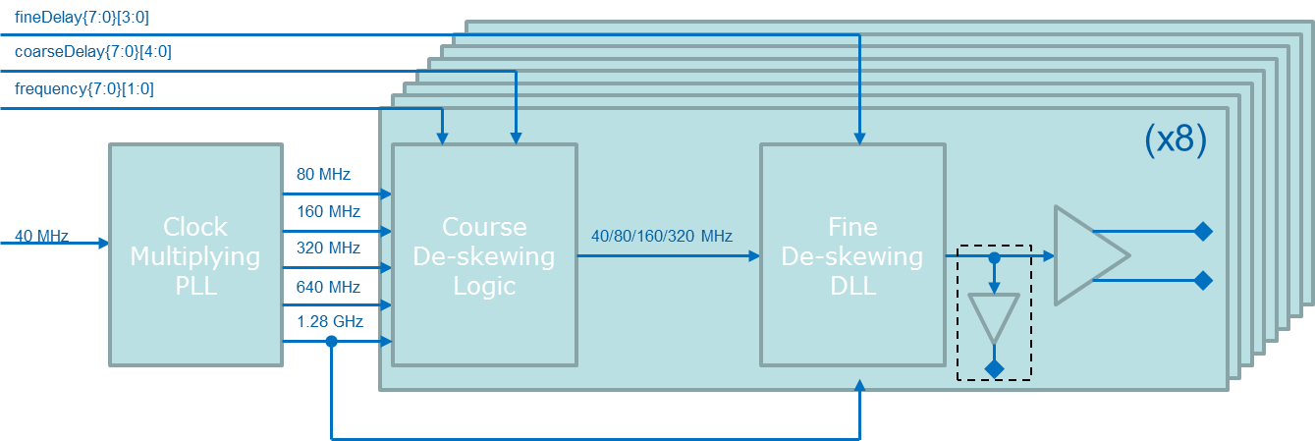
Phase Shifter
Resolution = 1/(16X1.28GHz) = ~49 ps
Main features:
8 – channels
Clock frequencies: 40, 80, 160 and 320 MHz
Phase resolution: 48.8 ps
Phase span: 0 to 2π
1 PLL + Counter generates frequencies: 40, 80, 160, 320, 640 and 1280 MHz
1 DLL per channel
Mixed digital/analogue phase shifting technique:
  Coarse deskewing – Digital
  Fine deskewing – Analogue
Differential non-linearity: < 6.7% LSB
Integral non-linearity: INL < 6.5% LSB
Power consumption: 5.6 mW/channel
Resolution = 1/(1.28GHz) = 781.25 ps

Slide 30
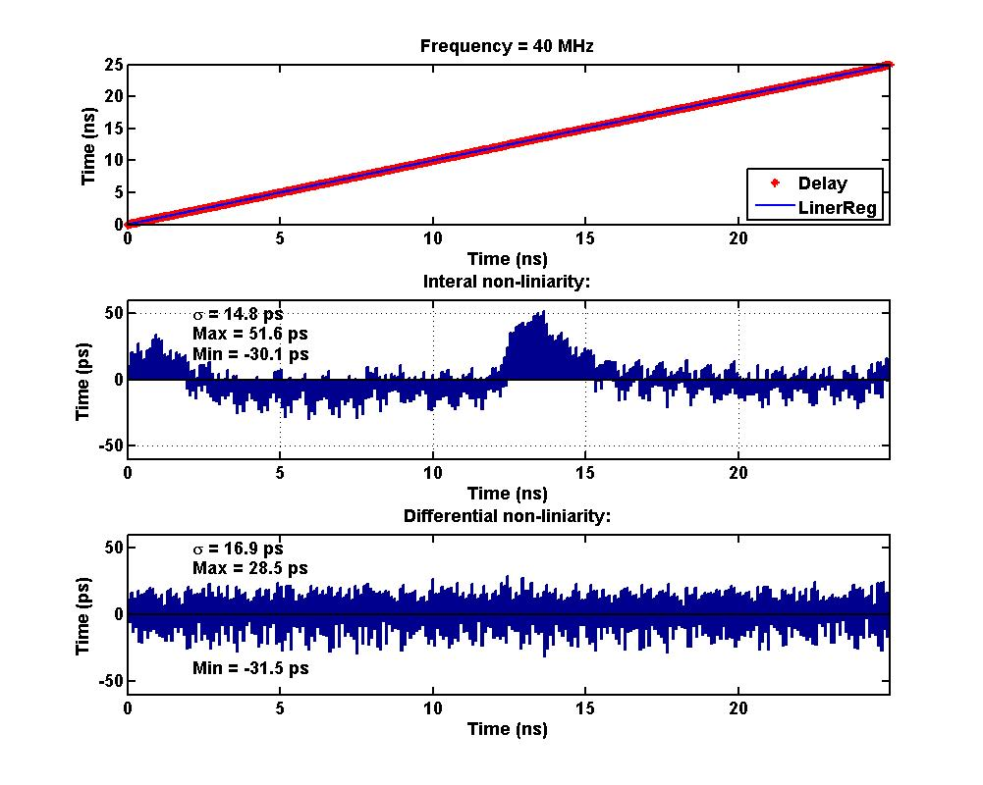
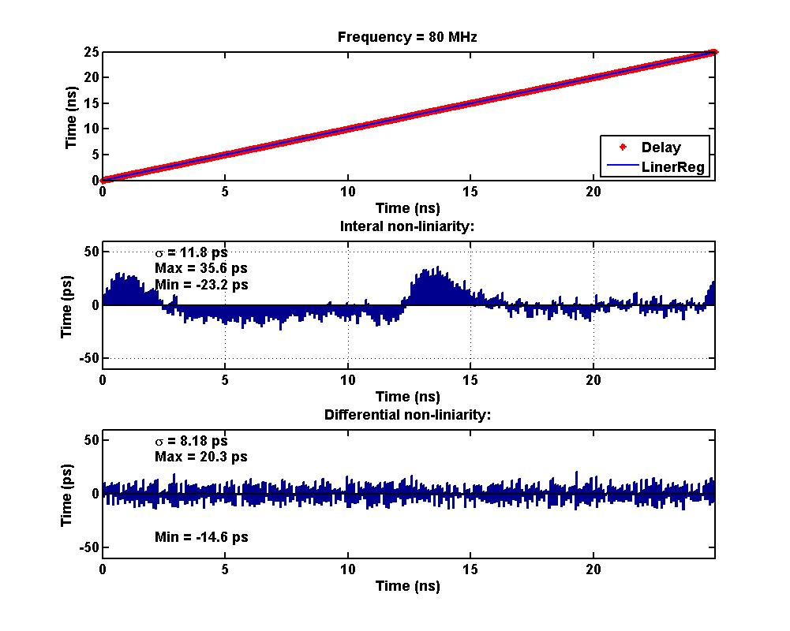
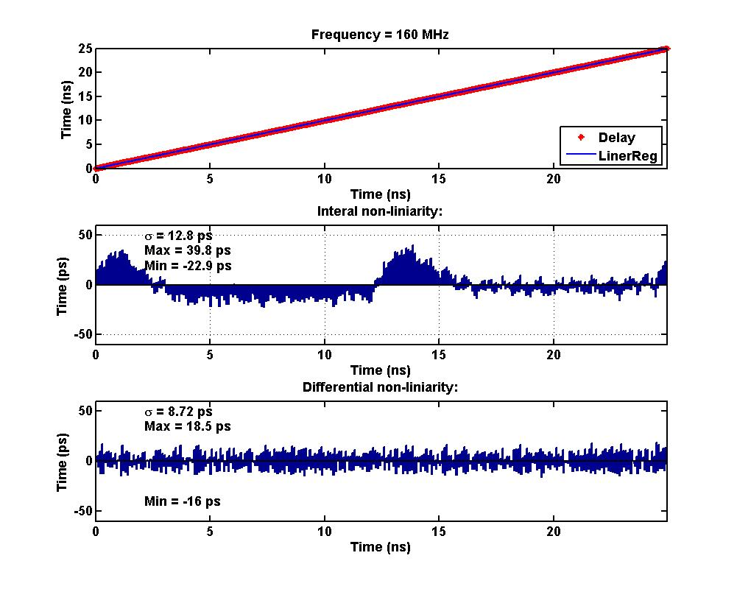
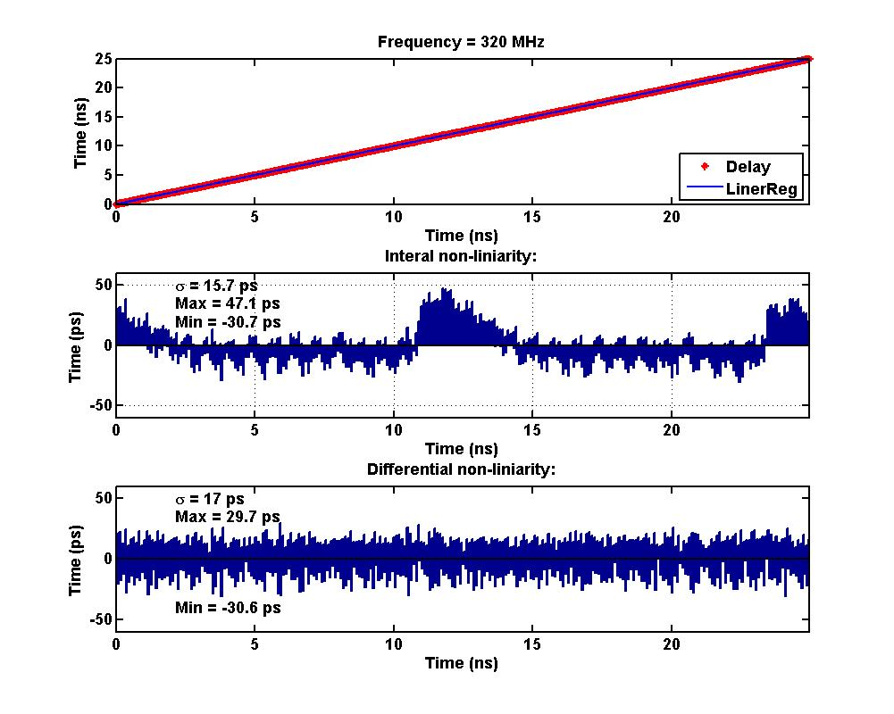
Phase-Shifter Performance (1/3)

Slide 31
Phase-Shifter Performance (2/3)
Non-Linearity |  | Integral |  |  | Differential
Frequency | Δt [ps] | σ [ps] | Max [ps] | Min [ps] | σ [ps] | Max [ps] | Min [ps]
40 MHz | 50 | 14.8 | 51.6 | -30.1 | 16.9 | 28.5 | -31.5
80 MHz | 50 | 11.8 | 35.6 | -23.2 | 8.2 | 20.3 | -14.6
160 MHz | 50 | 12.8 | 39.8 | -22.9 | 8.7 | 18.5 | -16.0
320 MHz | 50 | 15.7 | 47.1 | -30.7 | 17.0 | 29.7 | -30.6

Slide 32
Phase-Shifter Performance (3/3)
Jitter |  | Min Delay (0 ns) |  | Max Delay (25 ns)
Frequency | Mode | σ [ps] | P-P [ps] | σ [ps] | P-P [ps]
40 MHz | Simplex Tx | 3.8 | 37.0 | 4.4 | 40.7
80 MHz | Simplex Tx | 3.4 | 36.7 | 3.8 | 37.5
160 MHz | Simplex Tx | 4.8 | 36.2 | 8.5 | 48.6
320 MHz | Simplex Tx | 13.5 | 63.0 | 15.2 | 67.3
40 MHz | Duplex | 3.9 | 40.9 | 4.4 | 45.0
80 MHz | Duplex | 3.6 | 35.0 | 3.8 | 37.5
160 MHz | Duplex | 5.4 | 42.3 | 8.9 | 49.5
320 MHz | Duplex | 13.4 | 65.7 | 15.3 | 70.6

Slide 33
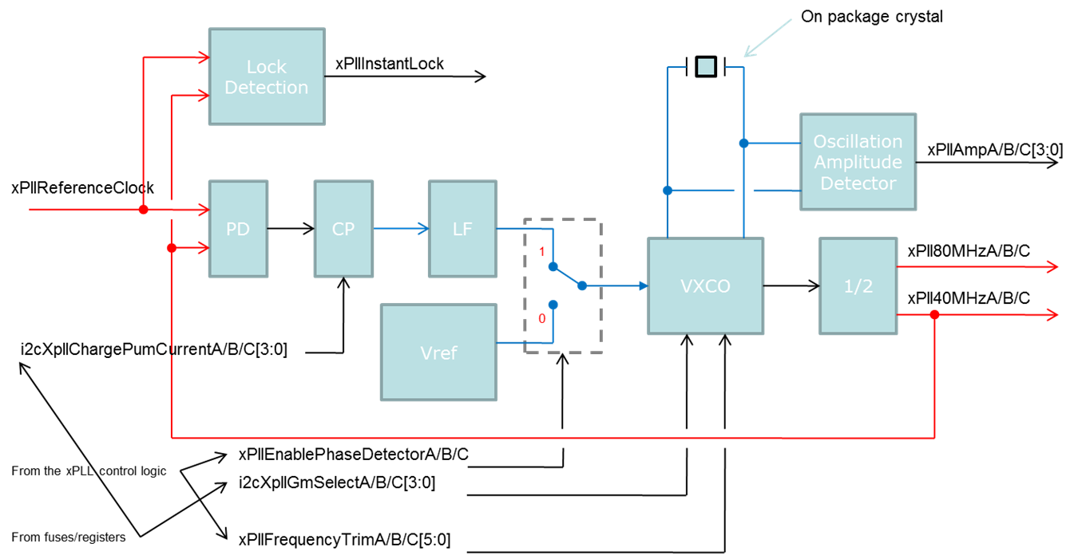
xPLL
Phase-Locked Loop based on a Quartz Crystal Oscillator (VCXO)
On package Quartz Crystal tailored to the LHC frequency
Three main functions:
  Clock reference (for systems without clock reference)
  Jitter cleaning PLL for systems with a “noisy” system clock
  Watchdog clock source

Slide 34
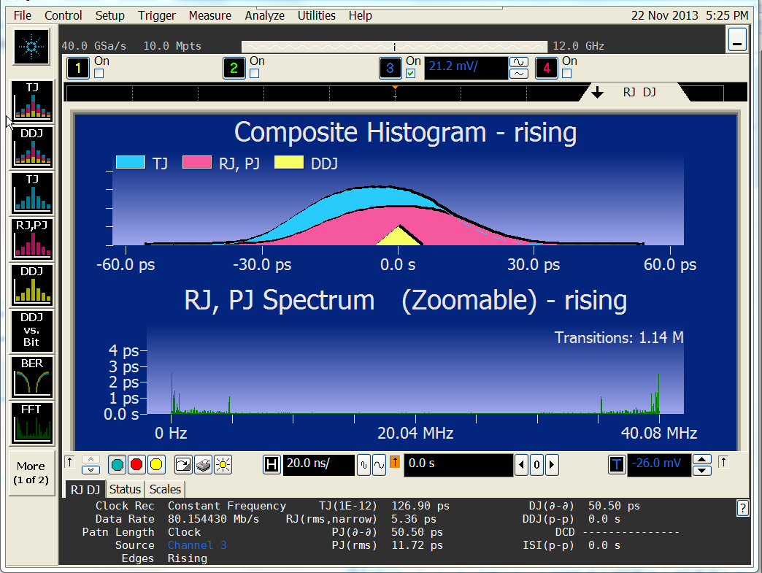
xPLL Performance – VCXO Mode
VCXO Mode | 40 MHz | Units
TJ (1e-12) | 126.9 | ps
RJ (rms) | 5.4 | ps
PJ (d-d | 50.5 | ps
PJ (rms) | 11.7 | ps
DJ (d-d) | 50.5 | ps

Slide 35
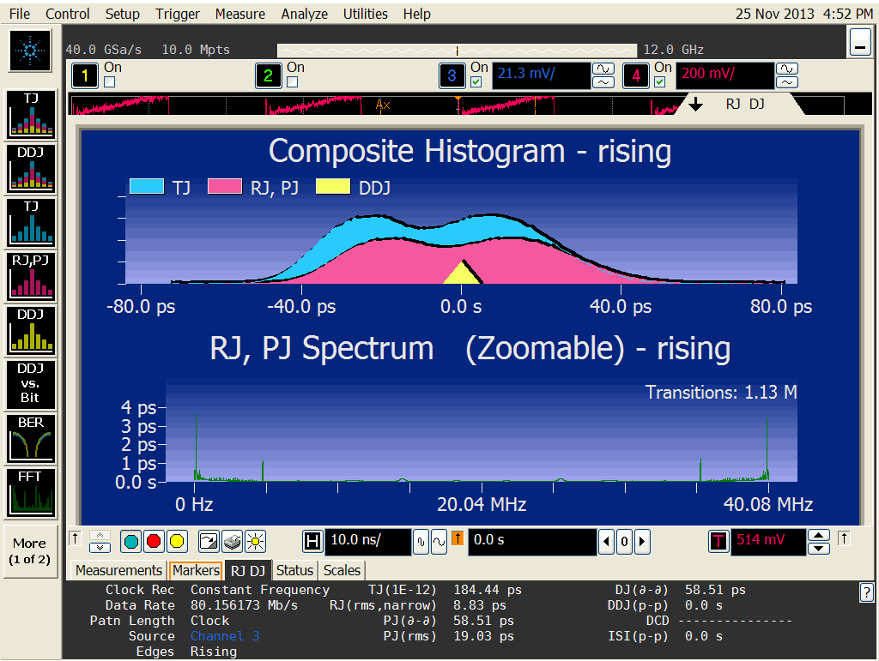
xPLL Performance – PLL Mode
VCXO Mode | 40 MHz | Units
TJ (1e-12) | 184.4 | ps
RJ (rms) | 8.8 | ps
PJ (d-d | 58.5 | ps
PJ (rms) | 19.0 | ps
DJ (d-d) | 58.5 | ps

Slide 36
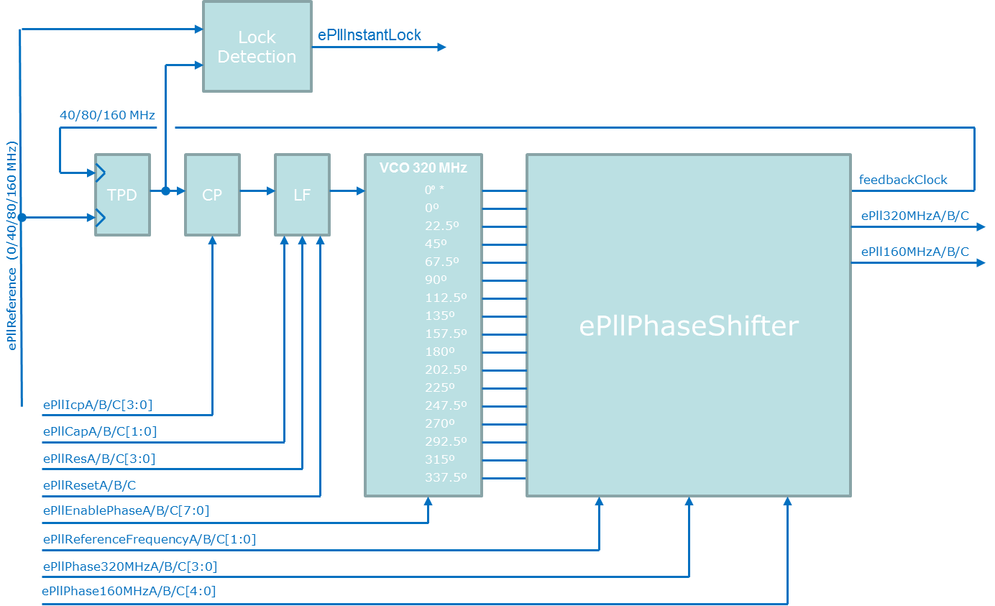
ePLL
Two ePLLs are used to generate the 160 and 320 MHz clocks needed to run the ePorts at 160 and 320 Mb/s respectively
It allows phase shifting the internal clocks with 200 ps resolution
  This is only for internal timing, can’t be used for phase adjust of the eLink clocks
The operation of the ePLLs is transparent to the users.
The performance of the device is reflected on the ePort clocks at 160 and 320 MHz

Slide 37
Controlling the GBTX
Copied into the configuration
registers if the eFuses are enabled
Configuration registers
are TMR protected
eFuse Register Bank
(~300 8-bit words)
Configuration Registers
(~300 8-bit registers)
A “special” eFuse indicates if
the I2C or eFuse bank are in use
I2C Interface
IC Channel
If the eFuses are not
enable then the configuration
registers must be written through
the I2C slave interface
Use of the IC channel to control the
ASIC requires duplex operation

Slide 38
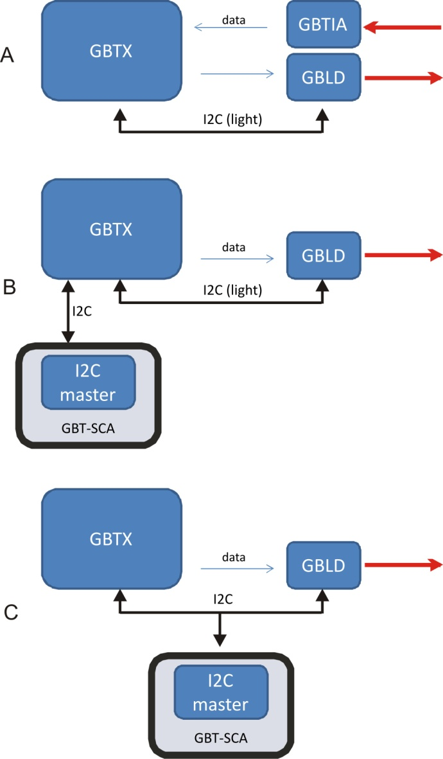
Interfacing with the GBLD

Slide 39
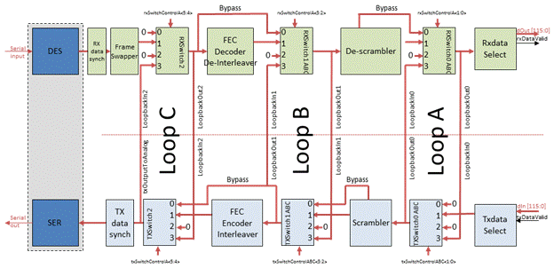
Built-in Test Features
A series of “loopbacks” allow to test the chip with different levels of depths:
  Fast-serial to fast-serial
  ePort to ePort
  ePort – driver to ePort – receiver
Tx high speed test patterns:
  Header + AAA_BBBB_AAAA_BBBB_AAAA_BBBB_AAAA_BB
  Header + counter[25:0] + counter[29:0] + counter[29:0] + counter[29:0]
  Header + 4’h0 + prbs[6:0] x 16
Rx bit error counter:
  Works with the fixed pattern
ePort patterns to validate the GBTX to Frontend timing

Slide 40
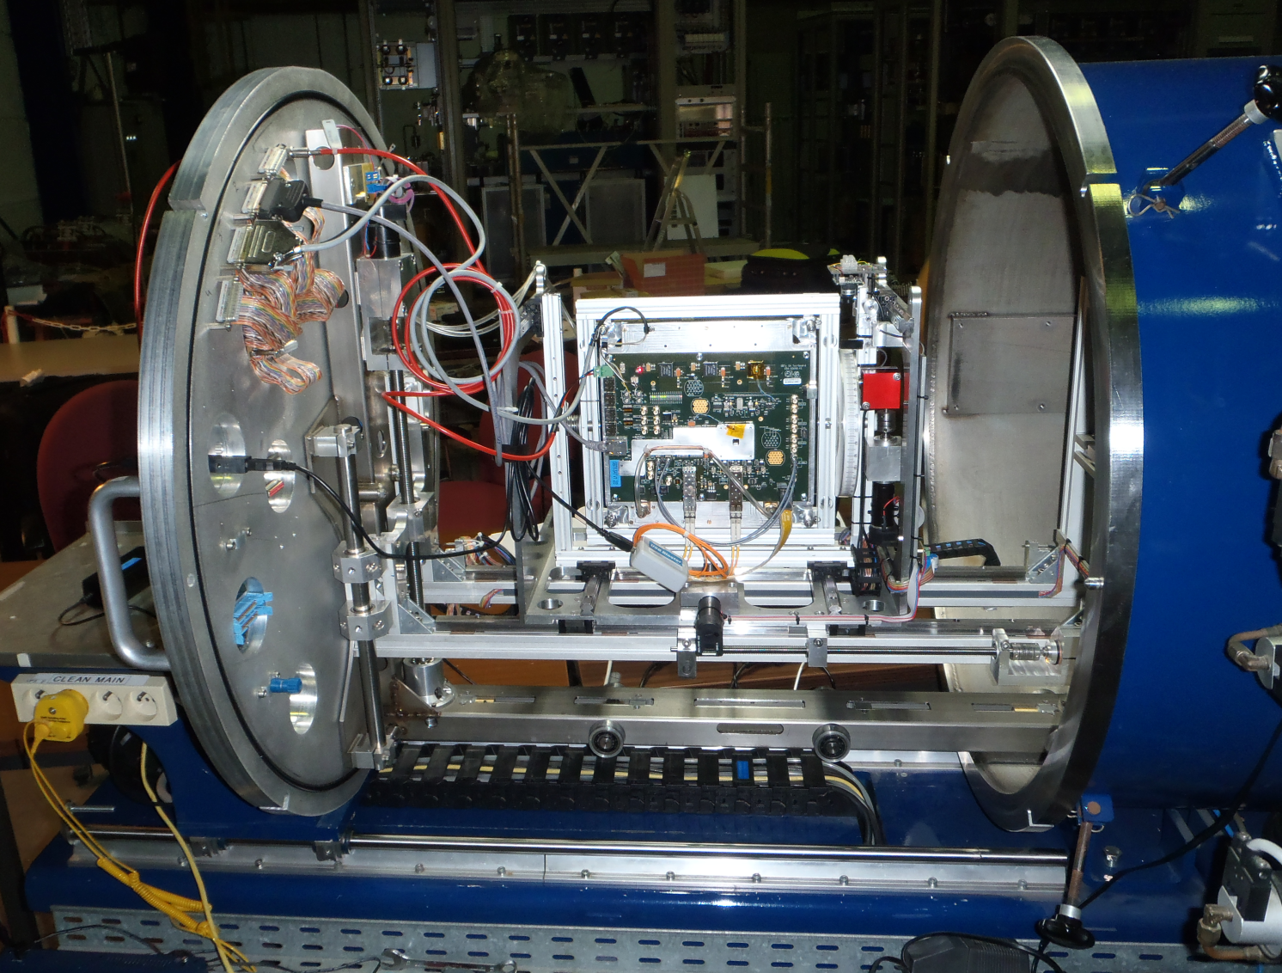
SEU TEST – Louvain-la-Neuve
Heavy Ion Irradiation Facility (HIF)

Slide 41
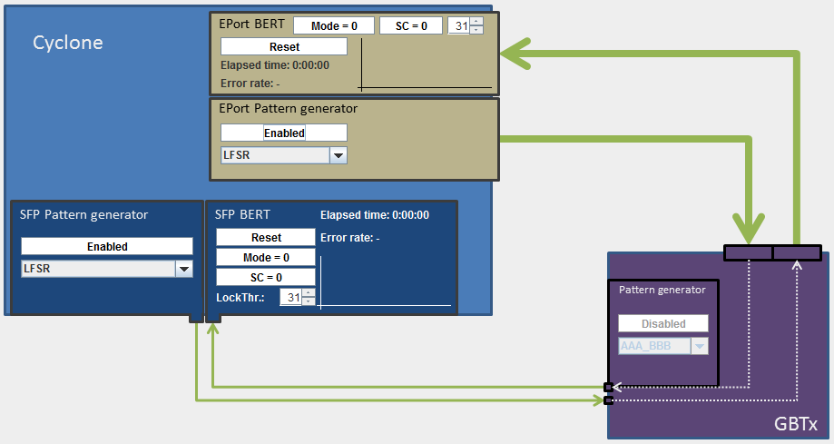
SEU Test Setup
Tested Cases:
  High Speed loopback
  Simplex Tx:
    80 and 160 Mb/s ePorts
    Max and min phase-aligner delay
  Simplex Rx:
    80 Mb/s ePorts
  Duplex:
    80 Mb/s ePorts
  “Special” duplex
    Both Tx and Rx clocked by the reference clock
Ion type:
  Ar – 372
    LETeff = 10.2 MeV/ mg cm2
  Ne – 235
    LETeff = 3 MeV/ mg cm2
8 hour time slot:
  22 “test” runs
Faced some problems with the test setup:
  “Fixed” latency FPGA Rx needs to be used
  Robust lock tracking FPGA Rx must be used

Slide 42
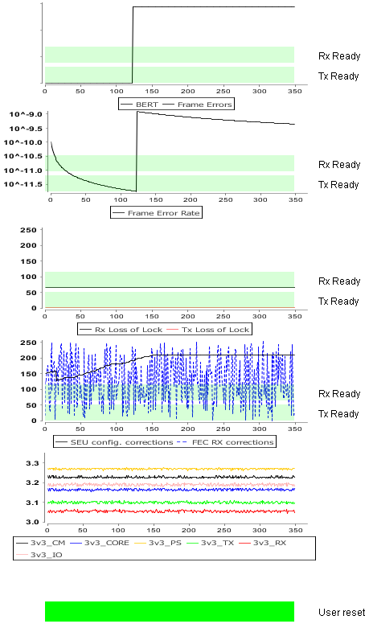
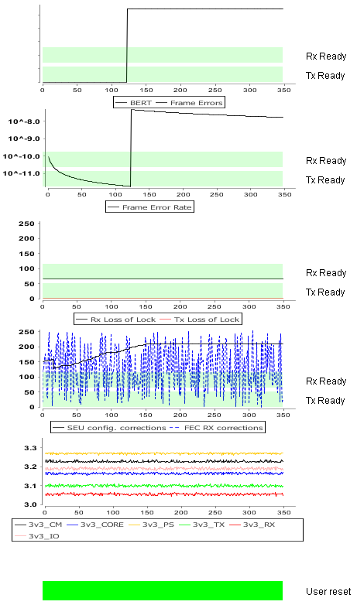
Duplex, ePorts 160 Mb/s , Ne: LETeff = 3 MeV/ mg cm², flux 15.4k i/cm² s
Rx
σ_{event} = 18.6 μm²
Tx
σ_{event} = 18.6 μm²

Slide 43
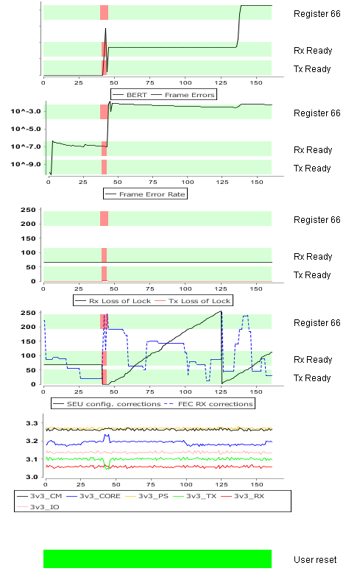
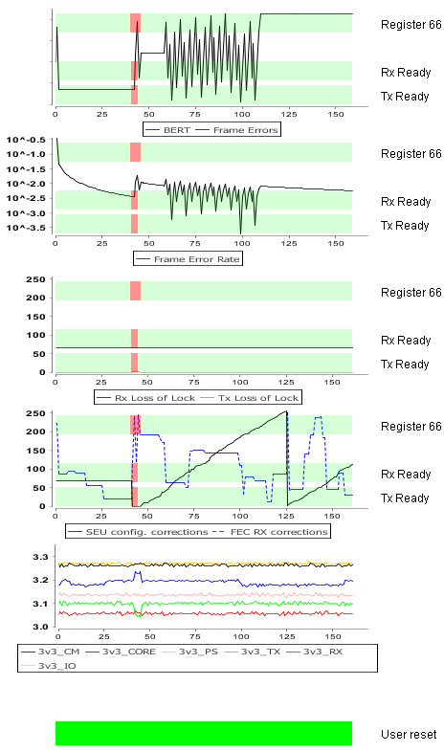
Duplex, ePorts 160 Mb/s , Ar: LETeff = 10.2 MeV/ mg cm², flux 8k i/cm² s
Rx
Tx
FPGA receiver
desynchronized
Shouldn’t have an
only register “A”
Registers errors should be
corrected in a fraction of a second!!!
Tx Reset?

Slide 44
GBTX Power Consumption (1/2)
All power supplies voltages = 1.5V except EfusePower = 3.3V
I/O (gndIO/vddIO):
  P = 41 × 8.2 mW (Data SLVS-Tx) + 41 × 8.2 mW (CLK SLVS-Tx) + 41 × 0.65 mW (SLVS-Rx) = 698 mW, I = 466 mA
TX (gndTx/vddTx):
  P = 456 mW, I = 304 mA
RX (gndRx/vddRx):
  P = 330 mW, I = 220 mA
CORE (GND/VDD):
  P = 305 mW (Standard cells) + 8 × 3.5 mW (Phase-Aligners) = 333 mW, I = 222 mA
PS (gndPS/vddPS):
  P = 42 mW (PLL) + 8 × 16 mW (channel) + 8 × 8.2 mW (SLVS-Tx) = 236 mW, I = 157 mA
CM (gndCm/vddCm):
  P = 2 × 41.5 mW (E-PLL) + 100 mW (XPLL) = 183 mW, I = 122 mA
E-Fuses (EfusePower):
  P = 465 mW , I = 141 mA
  (Only during e-fuse programming. Not added to the
  total power figure below.)
Total:
  P = 2.2 W
  (This is worst case power consumption:
  all functions ON, worst case simulations)

Slide 45
GBTX Power Consumption (2/2)
Case study:
Hypothetical CMS Tracker upgrade configuration:
  E-Links:
    20 × Data-In @ 160 Mb/s
    1 × Clock @ 160 MHz
    2 × Data-Out @ 160 Mb/s
  Phase-Adjustable clocks:
    2 × Clock @ 40 MHz
    2 × Clock @ 160 MHz
Mode: |  |  |  | TRANSCEIVER
E-Links:
 | Data rate [Mb/s]: |  |  | 160
 | # Data outputs: |  |  | 2
 | # Clock outputs: |  |  | 1
 | # Data inputs: |  |  | 20
EC-Channel:
 | State: |  |  | Disabled
Phase-Shifter:
 | State: |  |  | Enabled
 | # Channels |  |  | 4
Circuit: |  |  |  | Power
 |  |  |  | [mW]
 | Transmitter:
 |  |  |  | 456
 | Receiver:
 |  |  |  | 330
 | Clock Manager
 |  | E-PLL: |  | 83
 |  | XPLL: |  | 100
 |  | Total: |  | 183
 | Phase-Shifter:
 |  | PLL: |  | 42
 |  | Channel: |  | 64
 |  | SLVS-TX: |  | 33
 |  | Total: |  | 139
 | I/O:
 |  | Data SLVS-Tx: |  | 16
 |  | CLK SLVS-Tx: |  | 8
 |  | Data SLVS-Rx: |  | 13
 |  | Total: |  | 38
 | CORE:
 |  | Standard Cells: |  | 305
 |  | Phase-Aligners: |  | 14
 |  | Total: |  | 319
Total Power [mW]: |  |  |  | 1464

Slide 46
GBTX Future
Q4 – 2013
  Finalize chip characterization: November– December
  Total dose irradiation tests: December
  Samples available for prototyping: December
    Only small quantities available (< 30)
Q1 – 2014
  Second run of SEU tests: February
  Depending on the SEU test results small changes might be required to improve the robustness of the circuit
  Although the circuit is fully functional a “a few small corners need to be rounded” to make it “plug-and-play” for the users
Q2 – 2014
  Additional 100 GBTX samples available
  Split Engineering Run to produce in quantities:
    GBTX
    GBTIA
    GBLD V4/V5
    GBT-SCA
Q3 – 2014
  Chips available from the foundry
  ASIC Packaging
Q4 – 2014
  ASIC production testing
  First production ASICs distributed to the users

Slide 47
Backup Slides
Additional Slides

Slide 48
GBTx latency measurement
Has to include
  Back end: GBT-FPGA IP core (Rx or Tx)
  Front End: E-links IP core (Serializer or Deserializer)
  To allow pattern detection for flag rising
We used a test system presented at TWEPP, including:
  BE: GLIB
  GBTX: SAT board
  FE: ML605 (virtex6) equipped with an HDMI-FMC
We removed all the system specific delays (cables, PCB, etc)

Slide 49
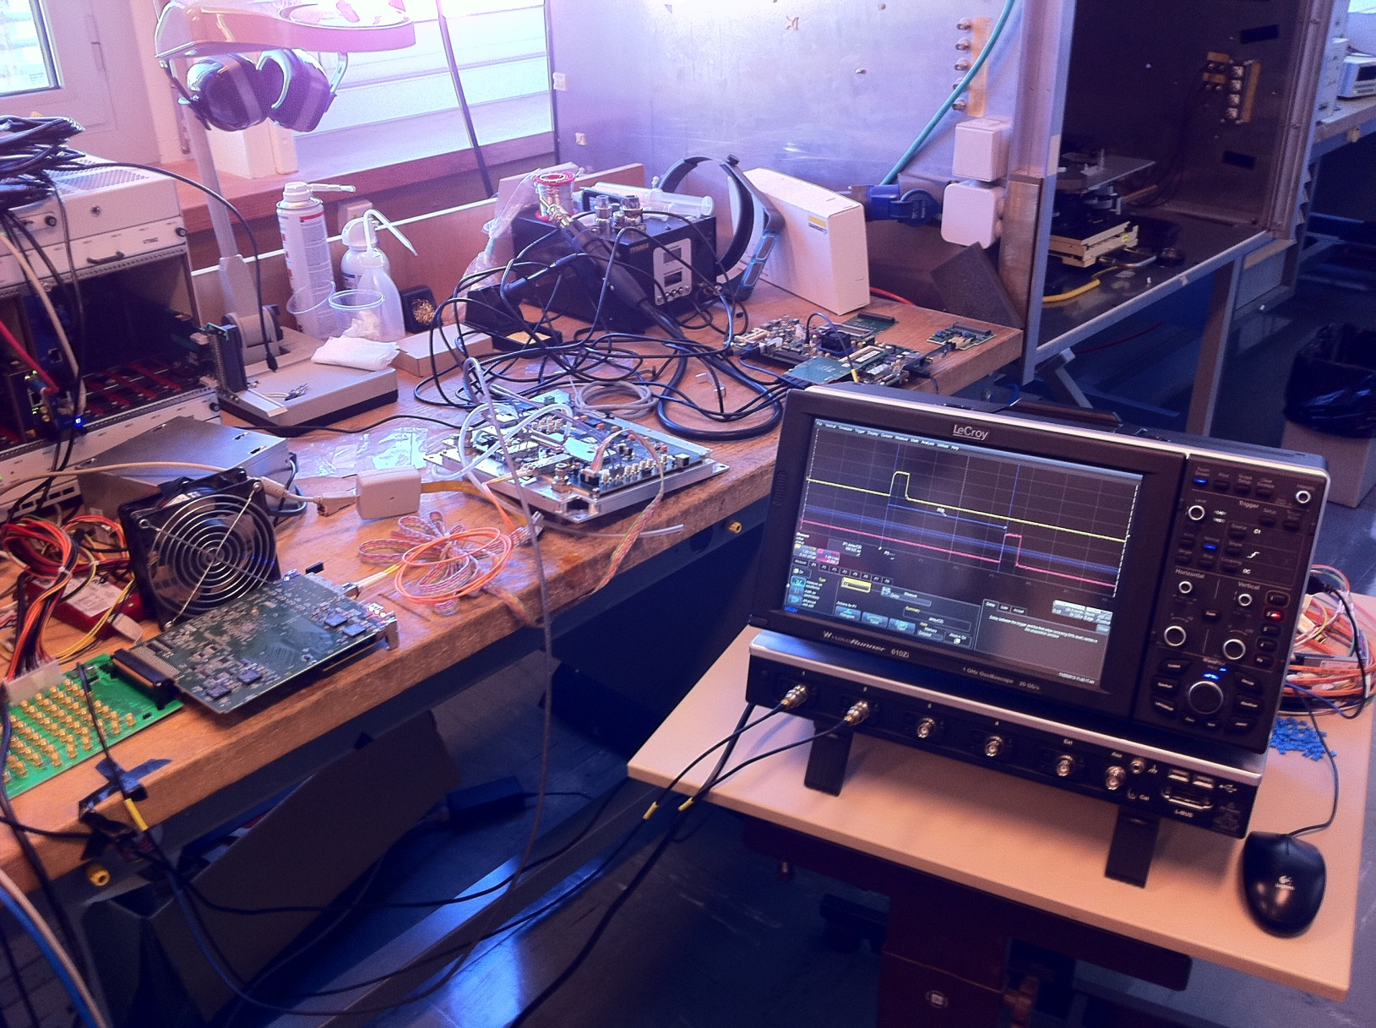

BACK END
(GLIB)
GBTx SAT
board
FRONT END
(ML605 + HDMI FMC)

Slide 50


Flag1,
latched with e-link clock
Downstream
189 ns
Flag2,
latched with e-link clock
CLOCK
Sub-frame alignment (add 1 BC)
GLIB
GBTx SAT board
ML605
GBT-FPGA
FE EMULATOR
GBTx
HDMI
HDMI
E-LINK SERDES
CDR
GBT-FPGA TX
MGT TX
CV
HDMI
HDMI
SFP
SFP
GBT SERDES
E-LINK SERDES
GBT-FPGA RX
MGT RX
HDMI
HDMI
CDR
HDMI
HDMI
Automatic Phase alignment (one value per e-link, transparent to the user)
Sub-frame alignment (add 1 BC)
E-links 0, 2, 4, 6 only
are connected, allowing:
4 e-links of group0 @ 80MHz
Full group0 @ 160MHz
Flag4,
latched with e-link clock
Upstream
280 ns
Flag3,
latched with e-link clock
BACK END
FRONT END

Slide 51
Flag1,
latched with e-link clock
Downstream
189 ns
Flag2,
latched with e-link clock
Core latency: 189 + 1 -5 – 11- 8 = 166 ns
CLOCK
8 ns
Bit alignment per group (add 1 BC)
GLIB
GBTx SAT board
ML605
GBT-FPGA
FE EMULATOR
GBTx
E-LINK SERDES
CDR
GBT-FPGA TX
MGT TX
GBT SERDES
E-LINK SERDES
GBT-FPGA RX
MGT RX
CDR
1 ns
Bit alignment per group (add 1 BC)
5 ns
9 ns
11 ns
Flag4,
latched with e-link clock
Upstream
280 ns
Flag3,
latched with e-link clock
Core latency : 280 -1 -5 – 11 - 9 = 254 ns
BACK END
FRONT END

Slide 52
Total
Architecture: GBT encoding scheme and e-links @ 160 MHz,
Downstream Core Latency:
GBT-FPGA Tx + GBTx + FE GBT deserializer =
166ns = 6.65 BC
Upstream Core Latency:
FE GBT serializer + GBTx + GBT-FPGA Rx (latency optimized) =
254 ns = 10.1 BC
Without the bit alignment (per group), to be done either in the Front End or in the Back End:
=> you should add 1 BC (for bit alignment) to have a realistic value, plus the length of your cables and PCB traces

Slide 53
GBTX Frames
GBT Frame (for up and down links)
EC
G4
G3
G2
G1
G0
H(3:0)
IC(1:0)
EC(1:0)
D(79:64)
D(63:48)
D(47:32)
D(31:16)
D(15:0)
FEC(31:16)
FEC(15:0)
Wide Bus Frame (for up-links only)
EC
G4
G3
G2
G1
G0
G6
G5
H(3:0)
IC(1:0)
EC(1:0)
D(79:64)
D(63:48)
D(47:32)
D(31:16)
D(15:0)
D(111:96)
D(95:80)
“Out of order” bit sequence for compatibility with the GBT frame
8B/10B Frame (for up-links only)
G6 (not used)
G5 (1/2)
G4
G3
G2
G1
G0
8B/10B
8B/10B
8B/10B
8B/10B
8B/10B
8B/10B
8B/10B
8B/10B
8B/10B
8B/10B
8B/10B
8B/10B

