Slide 1
Development of new ps TDC for HEP and other applications
Jorgen Christiansen
CERN/PH-ESE

Slide 2
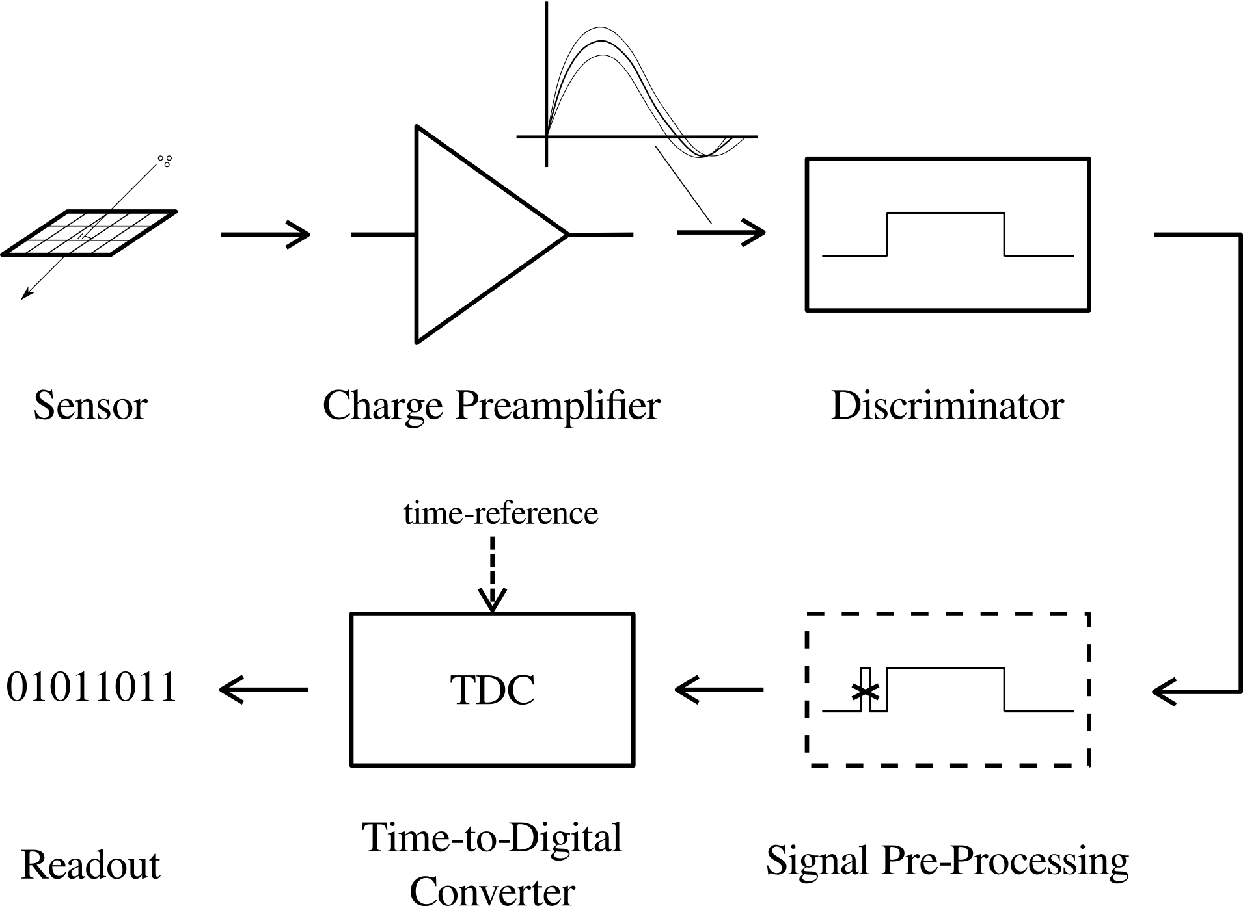
Time Measurement Chain
Detector and discriminator critical
and must be optimized together
Arrival time +
Time over threshold (Amplitude)

Slide 3
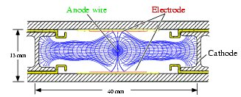
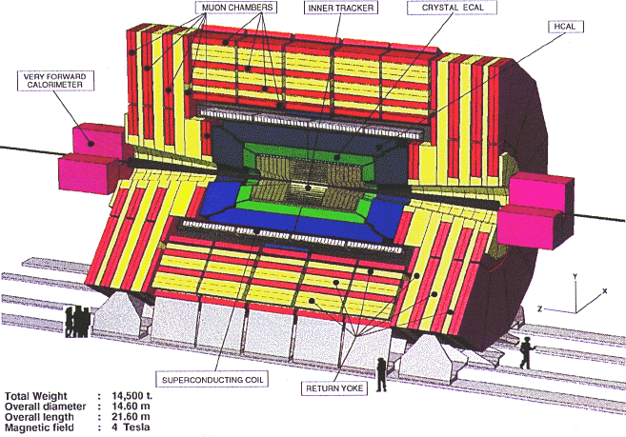
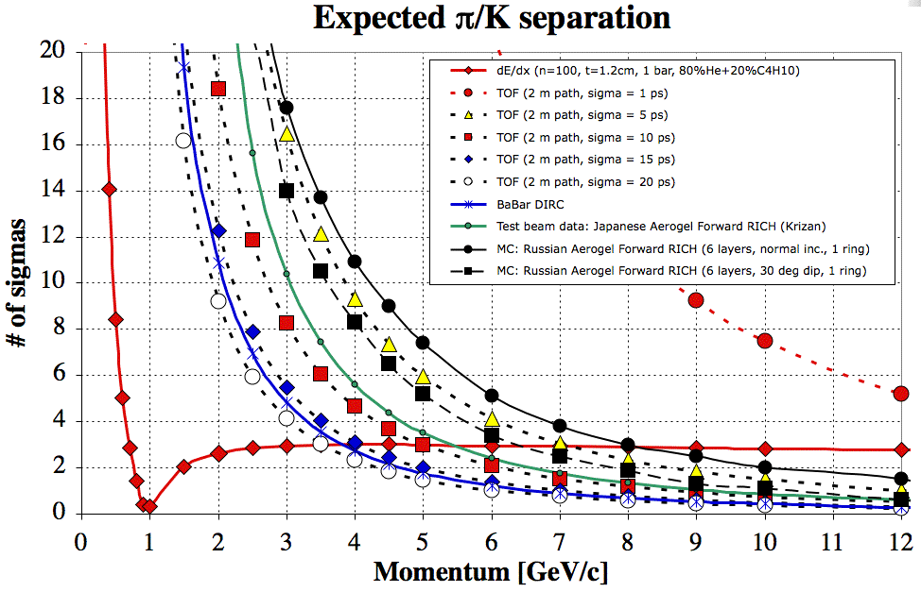
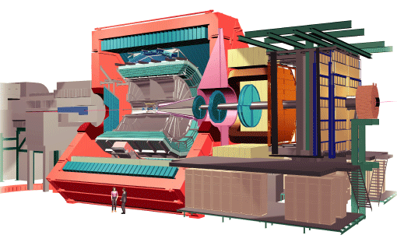
TDC applications in HEP
Drift time in gas based tracking detectors
  Low resolution: ~1ns
  Examples: CMS and ATLAS muon detectors
TOF, RICH
  High resolution: 5ps – 100ps
  Example: ALICE TOF
Background reduction: 5 – 10ps
Signal amplitude measurement: TOT
Make a new TDC with programmable resolution (bin): ~5ps, ~20ps, (~100ps), ~1ns
  Power consumption highly resolution dependent

Slide 4
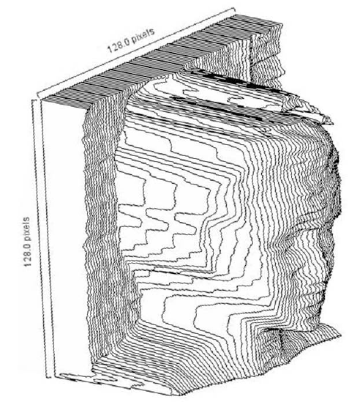
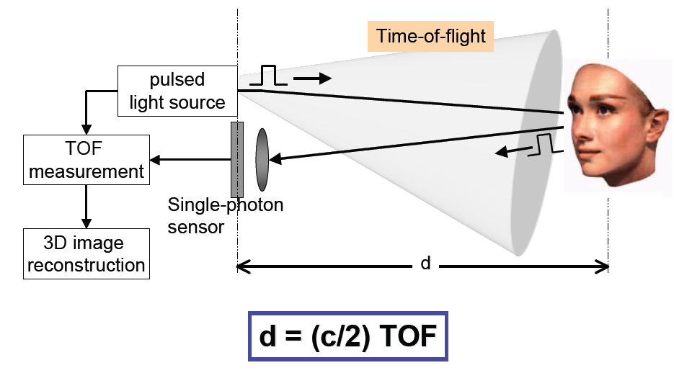
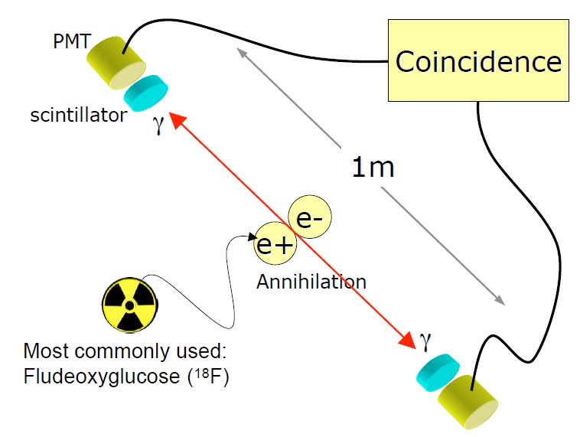
Other TDC applications
  Laser ranging
  3D imaging
  Medical imaging: TOF PET
    Improve signal/noise and have lower radiation dose.
  Fluorescence lifetime imaging
  General instrumentation.
  Differences to HEP systems
    Smaller systems - Fewer channels
    Averaging can in some cases be used to get improved time resolution

Slide 5
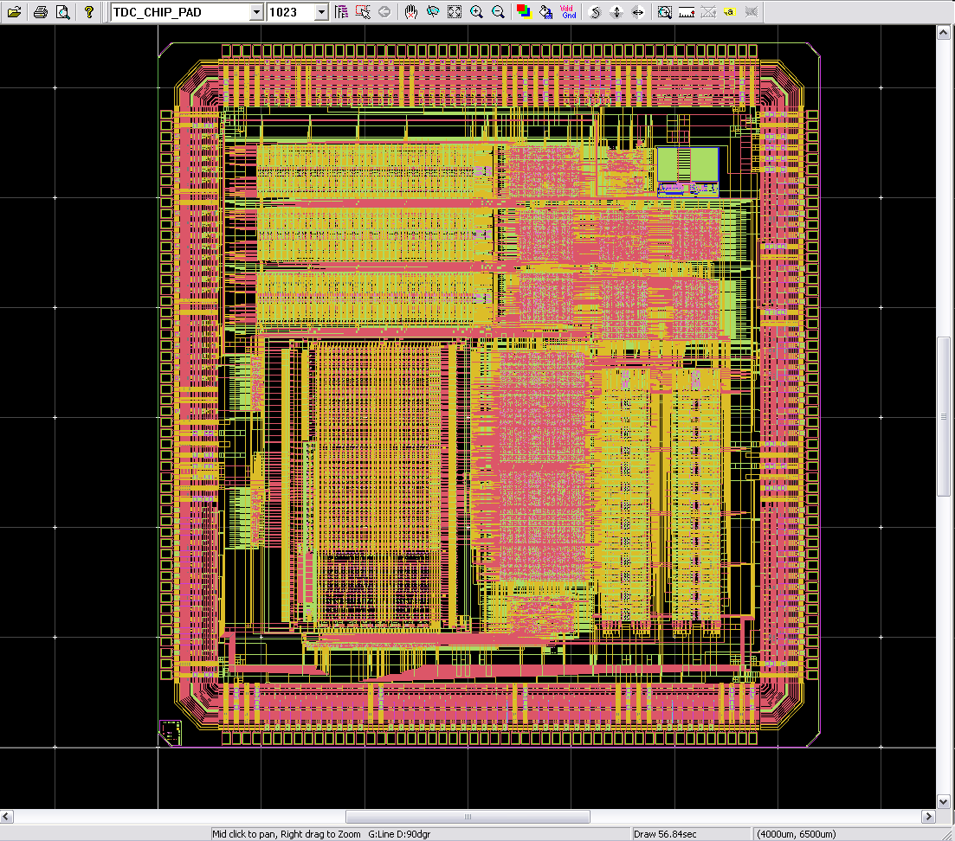
HPTDC
History
  Architecture developed for CERN for ATLAS MDT with final design transferred to Japan
  CMS and ALICE needed similar chip with additional features
Features
  32 channels(100ps binning),
  8 channels (25ps binning)
  40MHz time reference (LHC clock)
  Leading, trailing edge and time over threshold (for leading edge time corrections)
  Triggered or non triggered
  Highly flexible data driven architecture with extensive data buffering and
  different readout interfaces
Used in very large number of applications:
  More than 20 HEP applications: ALICE TOF, CMS muon, STAR, BES, KABES, HADES, NICA, NA62, AMS, Belle, BES, , ,
    We still sell ~1k chips per year from current stock.
  Other research domains: Medical imaging,
  Commercial modules from 3 companies: CAEN, Cronologic, Bluesky
  ~50k chips produced
  ~1MCHF income has enabled to buy new IC tester for CERN microelectronics group
250nm technology (~10 years ago for LHC)
  Total development costs: ~5 man-years + 500kCHF paid by CMS/ALICE.
17ps RMS

Slide 6
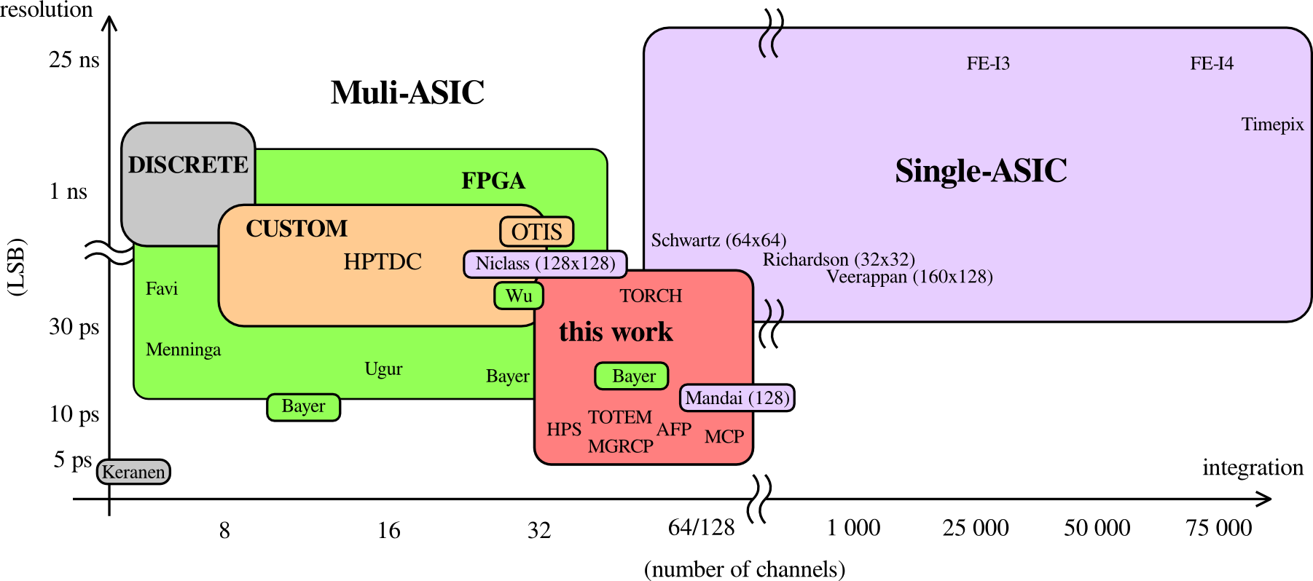
TDC Trends
resolution
integration
~5 ps resolution
High integration
Flexible
New detectors and sensors require new TDC

Slide 7
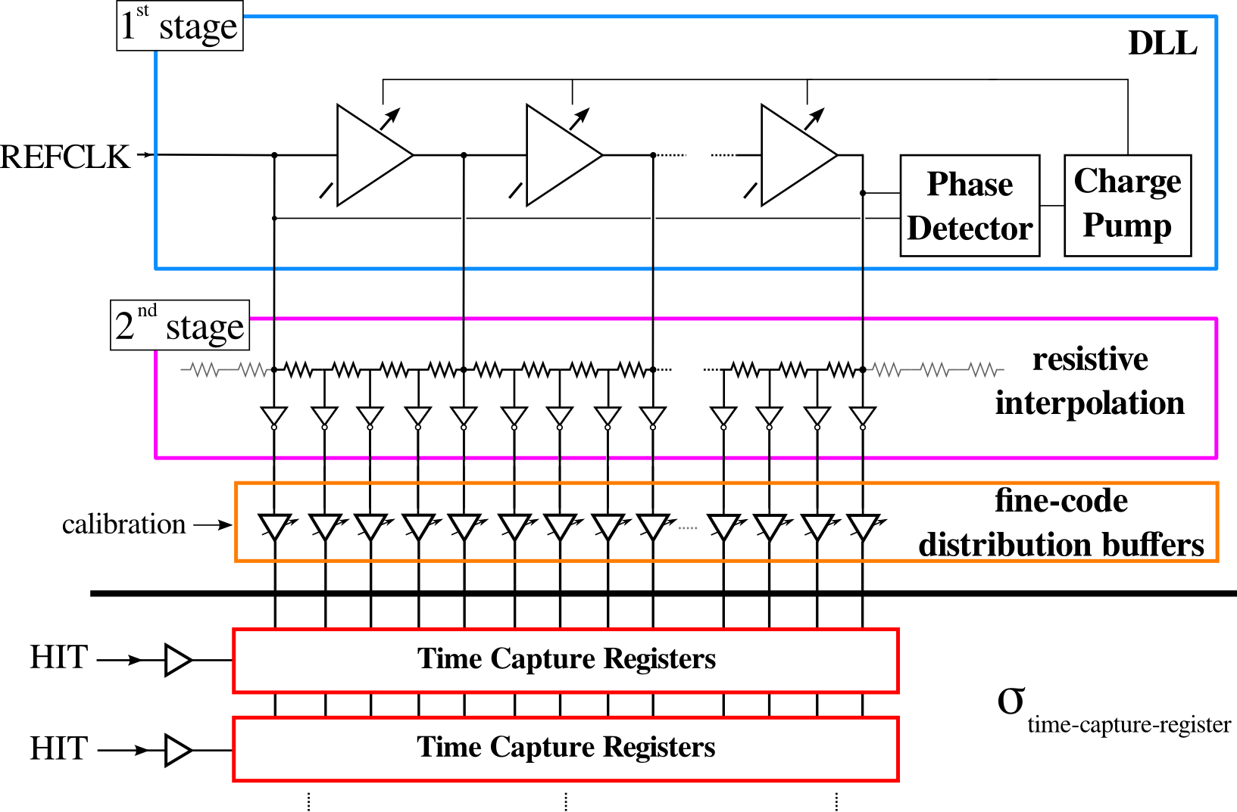
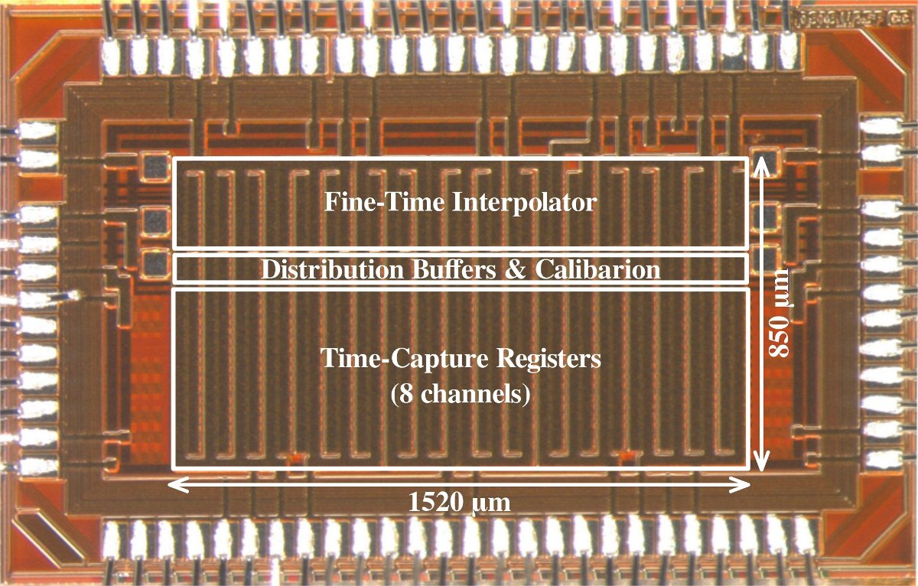
TDC architecture prototyped
Counter
External time reference (clock).
3 stage time measurement:
  Counter: 800ps, Delay locked loop: 25ps, Resistive interpolation: 6.25ps
  Each stage can be enabled/disabled to adopt to needs of each application
Can be scaled to the number of channels required.
Prototyped in 130nm CMOS extensively characterized by PHD student.
Measured time resolution: 2.5ps RMS

Slide 8
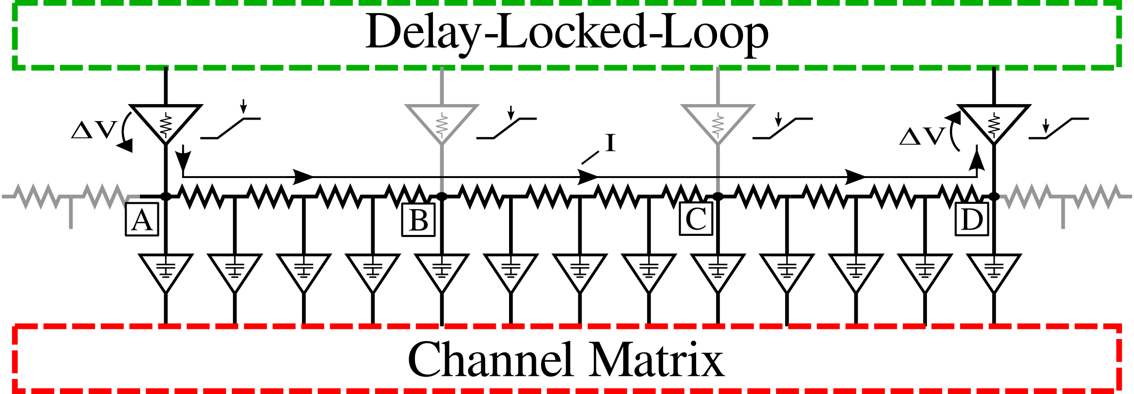
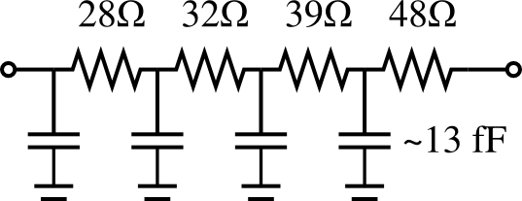
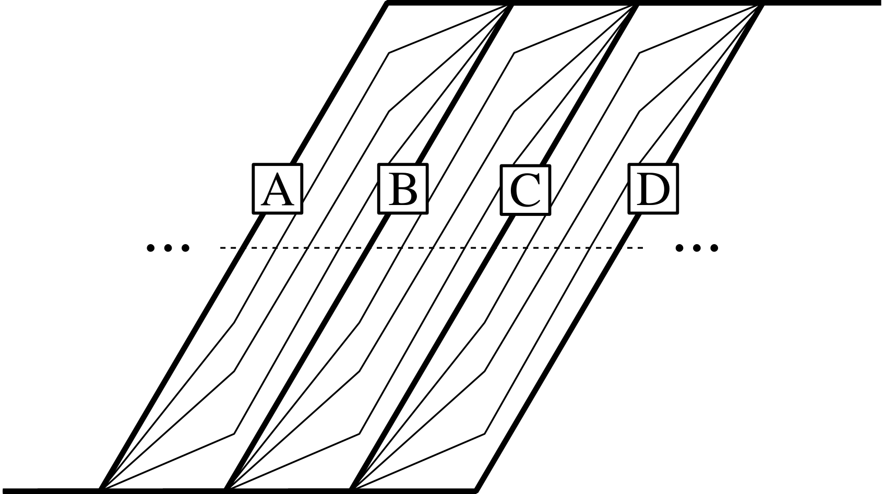
Resistive Interpolation
Resistive voltage divider
-> Signal slopes bigger than delay stabilized by DLL
RC delay (capacitive loading)
- > Small resistances, small loads
- > Simulation based optimization of resistor values

Slide 9
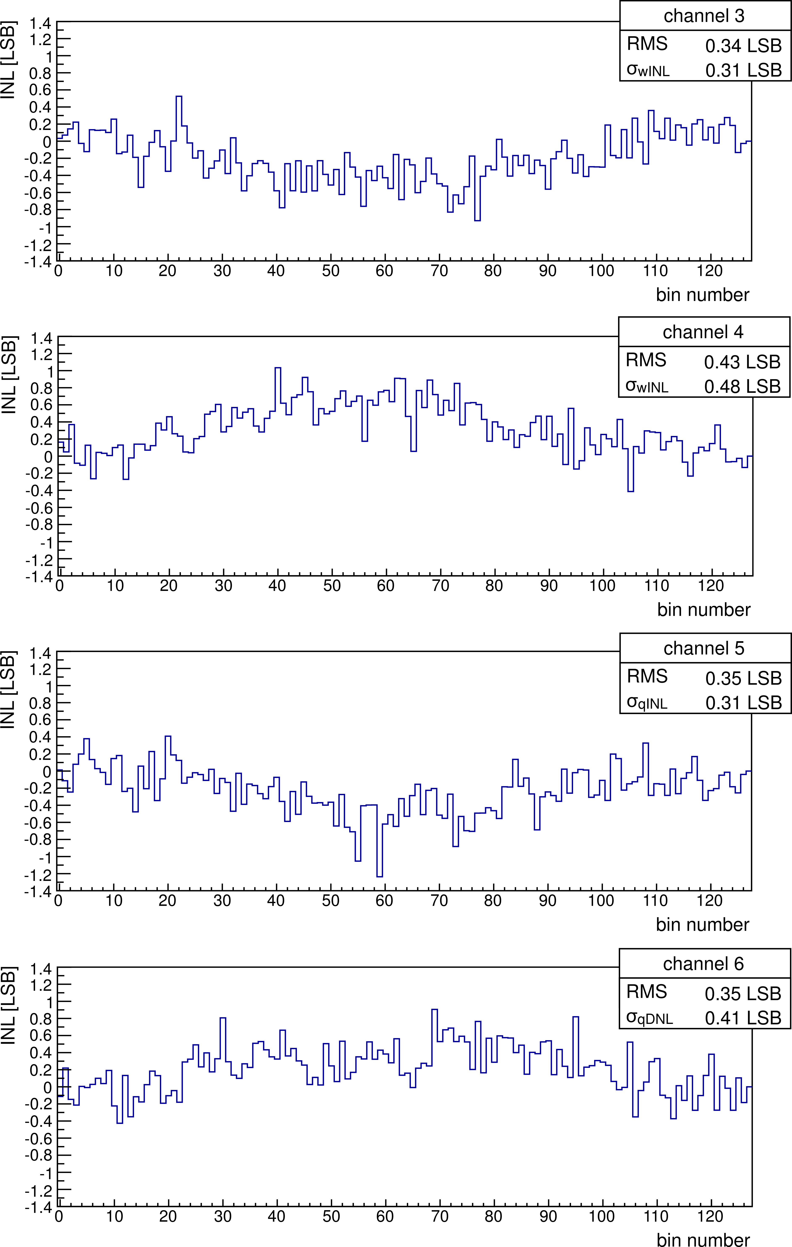
INL after global calibration
INL = ± 1.3 LSB
RMS = < 0.43 LSB (2.2 ps)
Expected rms resolution w/ custom FF:
including quantization noise, INL & DNL
2.3 ps-rms < σ_{qDNL/wINL} < 2.9 ps-rms
Ideal 5 ps LSB TDC: 1.44 ps-rms

Slide 10
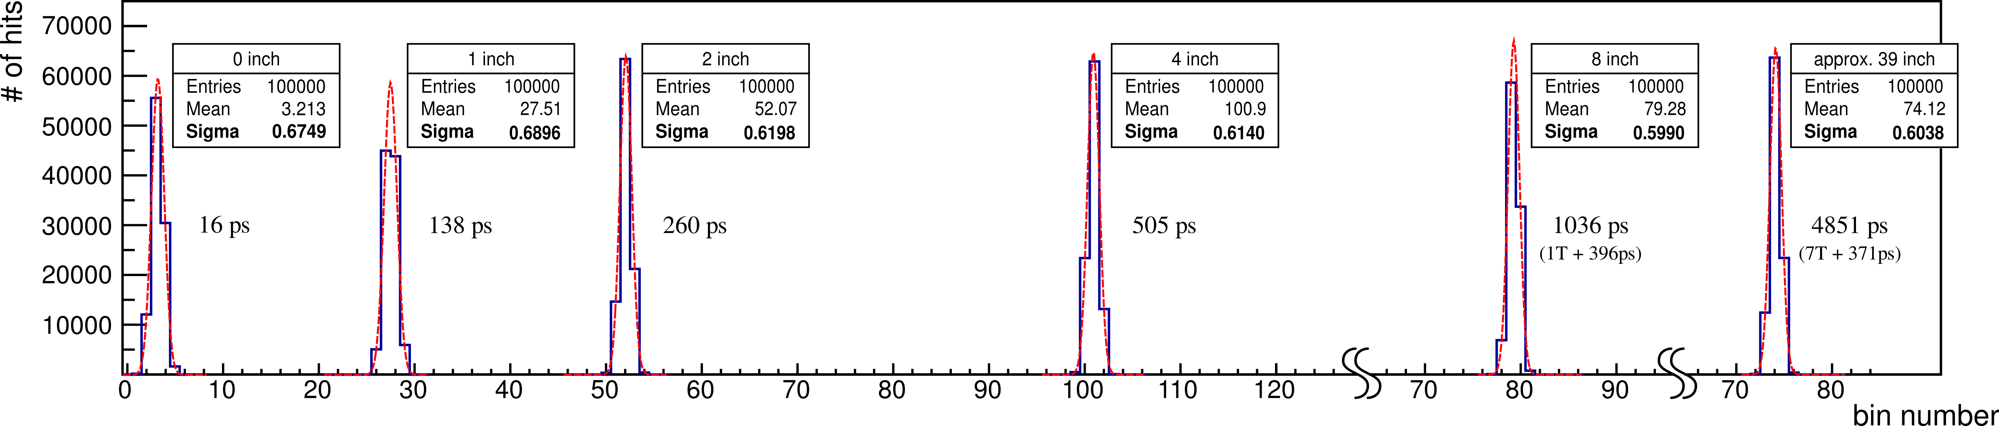
Measured Single Shot Precision
Three measurement series
- Both hits arrive within one reference clock cycle
- Second hit arrives one clock cycle later
- Second hit arrives multiple clock cycles later (~5ns)
bin difference
Limited by non-linearities of TDC
-> Very silent setup
-> Robust architecture
σ_{TDC} < 2.44 ps-rms

Slide 11
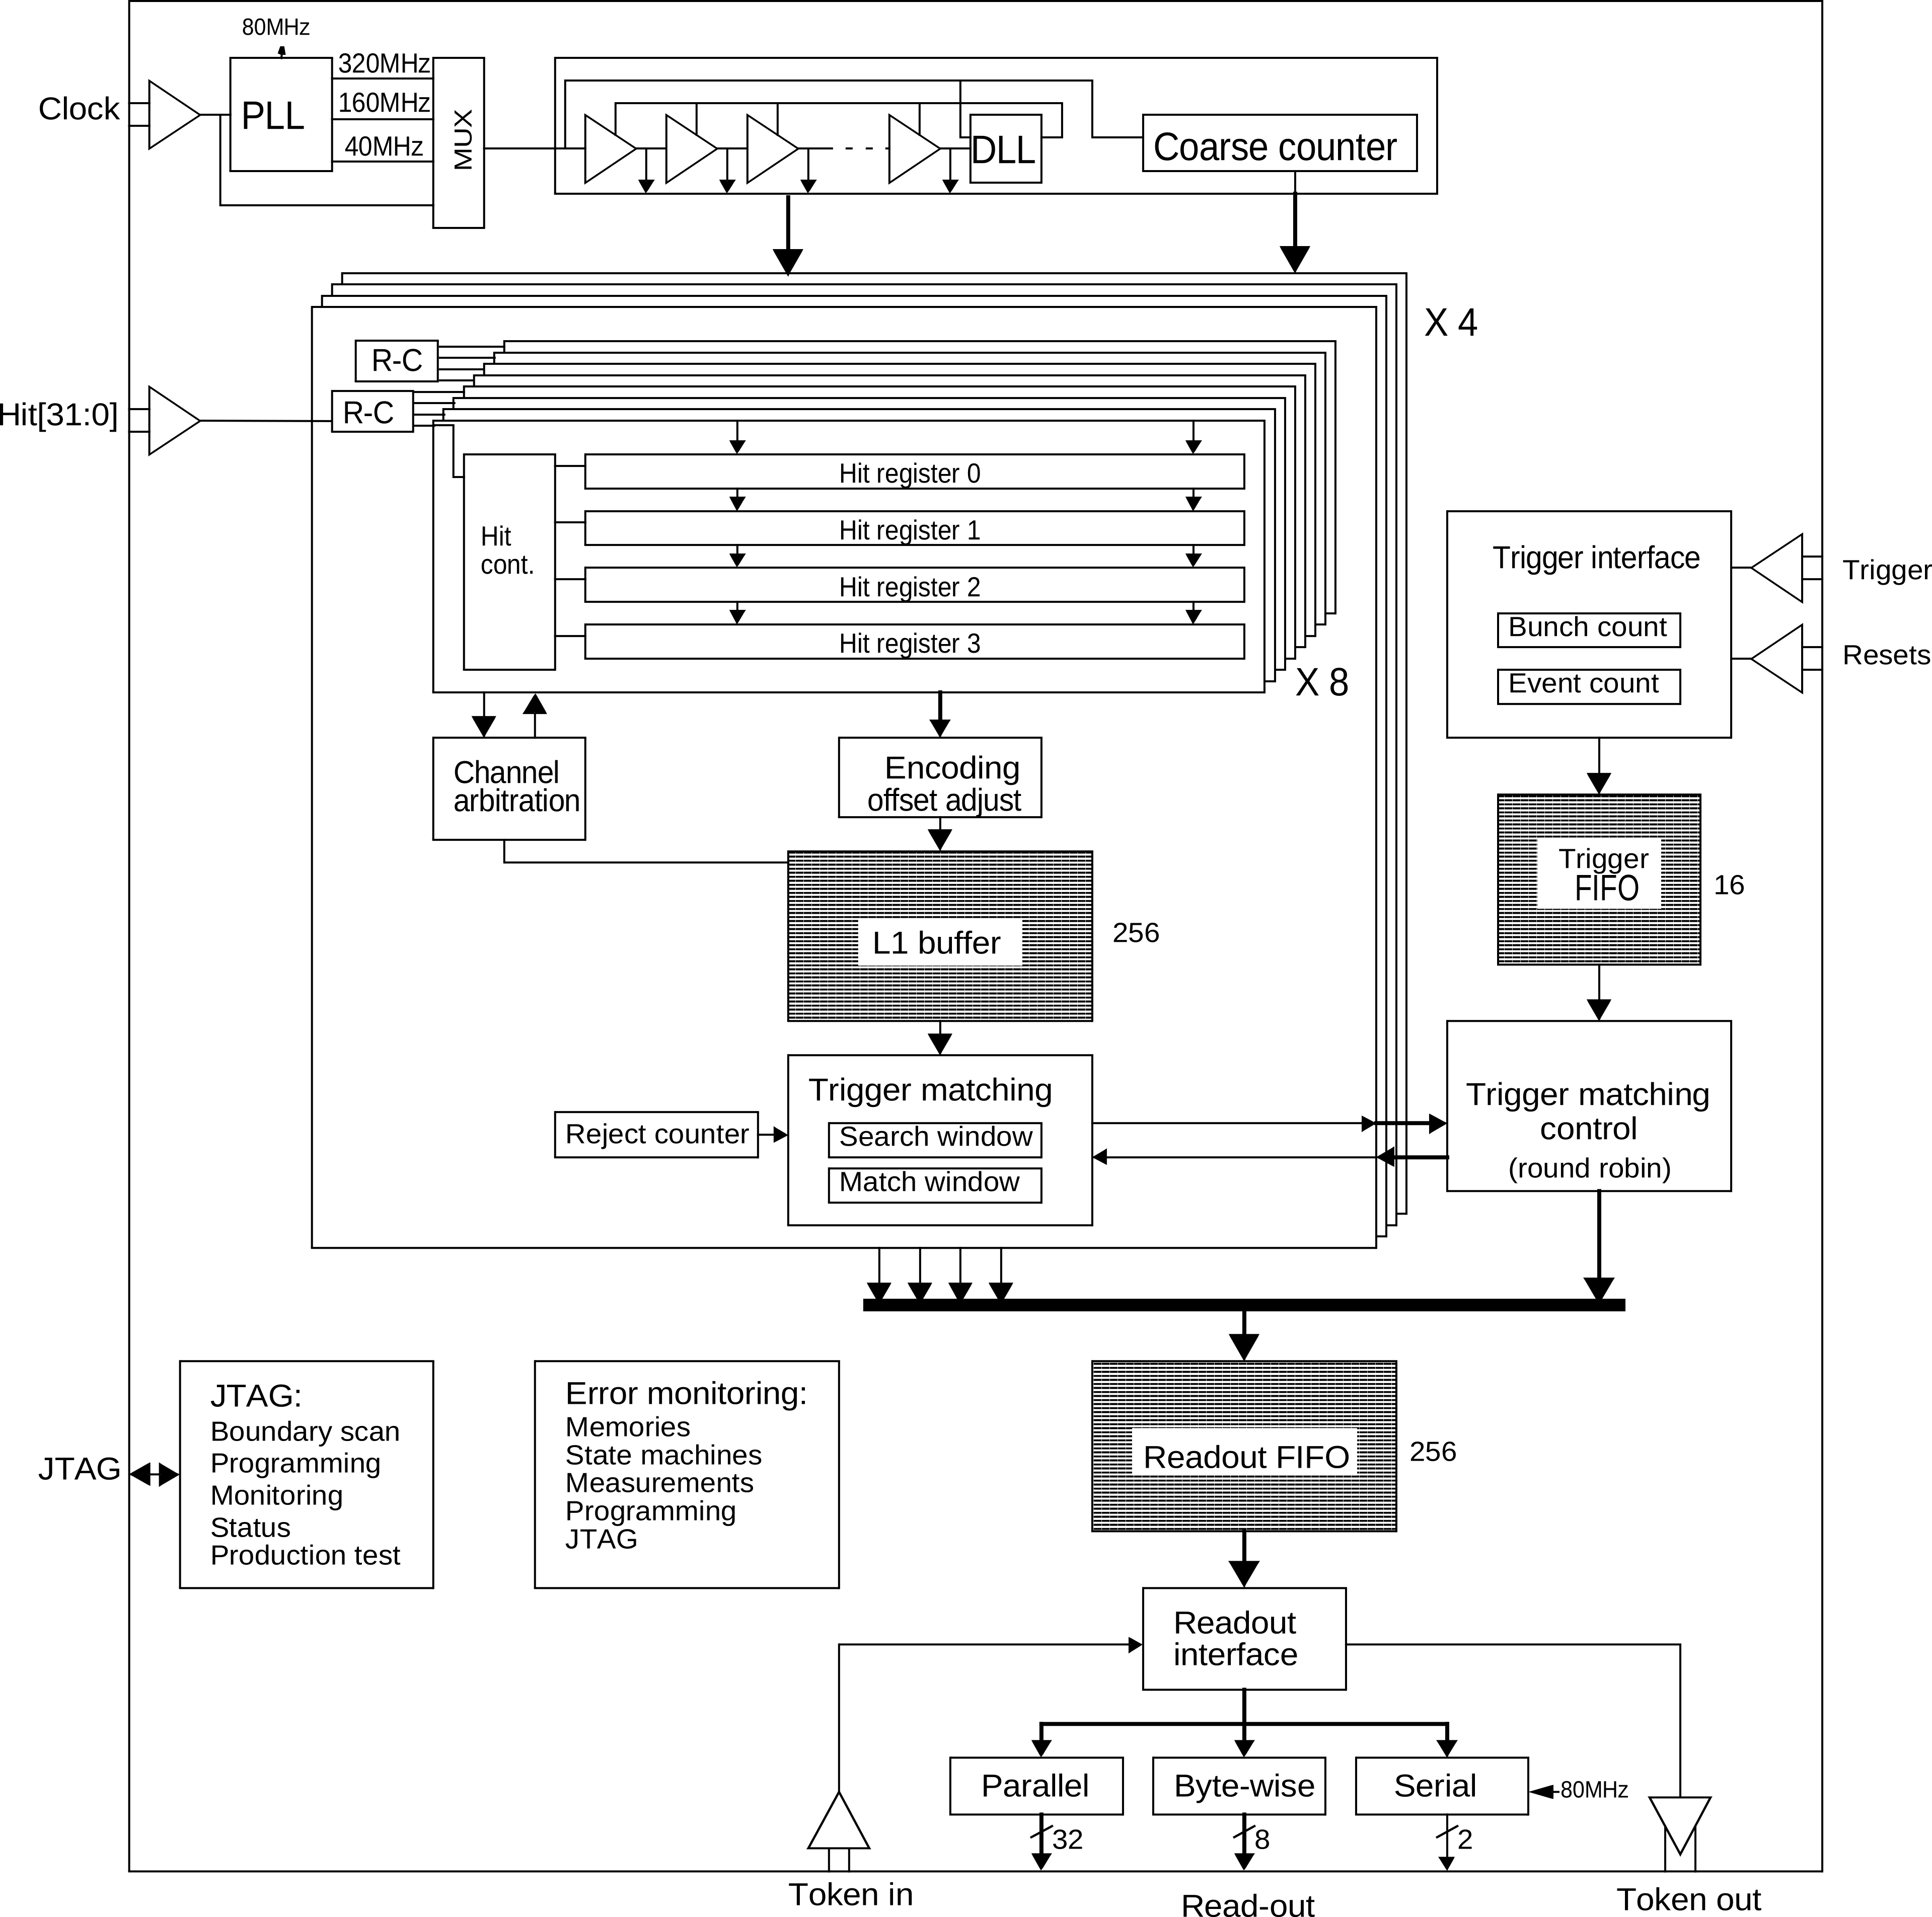
Full TDC ASIC to be made from prototype
PLL
Timing Generator
(5 ps)
Based on New TDC macro and
HPTDC processing/buffering/readout
architecture
32 or 64 channels per ASIC
40 MHz input clock
5 - 800 ps resolution (configurable)
40 MHz
32-64 Channels
To be done:
  Very low jitter PLL,
  Digital design
  Prototyping and test

Slide 12
Users/ clients
No commercial TDC of this type available
  That’s the reason we have sold so many HPTDCs
CERN HEP:
  TOTEM
  ATLAS muon upgrade
  CMS HPS and ATLAS FP420 (very forward detectors)
  LHCb Torch (upgrade option)
  CMS forward Calorimeter with timing
Other HEP
  Many small experiments needs multi channel high resolution TDC
Non HEP research
  Medical imaging: TOF PET
  Florescence imaging
  ?
Commercial:
  CAEN (other companies interested but we can only work with one)
Other clients will show up when device available

Slide 13
Resources (original plan)
Required R&D resources
  ~3 years of chip design:
    Fellow (Lukas -> Moritz)
    PLL from Leuven collaboration/GBT
    (Possible collaboration with Alberta: James Pinfold)
  ~100k CHF prototyping:
    From accumulated HPTDC sales
Putting it in production
  300 - 500k CHF: NRE , Packaging and test
    Request this from clients when full working prototype

Slide 14
Schedule
TDC principle prototyped/tested: Done
Define final technology: ASAP
Final specifications: Q3 2014
Finalize/map TDC macro: Q4 2014
PLL (TDC macro) prototype: Q1 2015
Final RTL model: Q3 2015
Submit full prototype: Q4 2015
Prototype tested: Q2 2016
Final production masks: Q4 2016
First production lot: Q1 2017

Slide 15
Technology: URGENT
Stay with IBM 130nm
  Extend Lukas TDC macro to 64 channels + add counter registers
    Reduce power consumption (will imply some loss in time resolution)
  Add PLL
  Make digital design based on HPTDC
    Simplified and improved performance having individual data buffers per channel
    SEU detection/immunity ? (export restrictions !)
  Risk with IBM availability
TSMC 130nm
  “Simple” technology mapping required
  No design kit yet, Libraries ?
  No performance improvement
  No significant synergy with other projects
TSMC 65nm
  Significant technology mapping required
  Improved performance or architecture simplification and/or lower power
    Simplify getting rid of second order resistive interpolation ?
  Design kit and libraries available
  Synergy with other projects: LPGBT, pixel chips
  More expensive MPW and NRE
Make decision on this during this summer

Slide 16
Backup slides

Slide 17
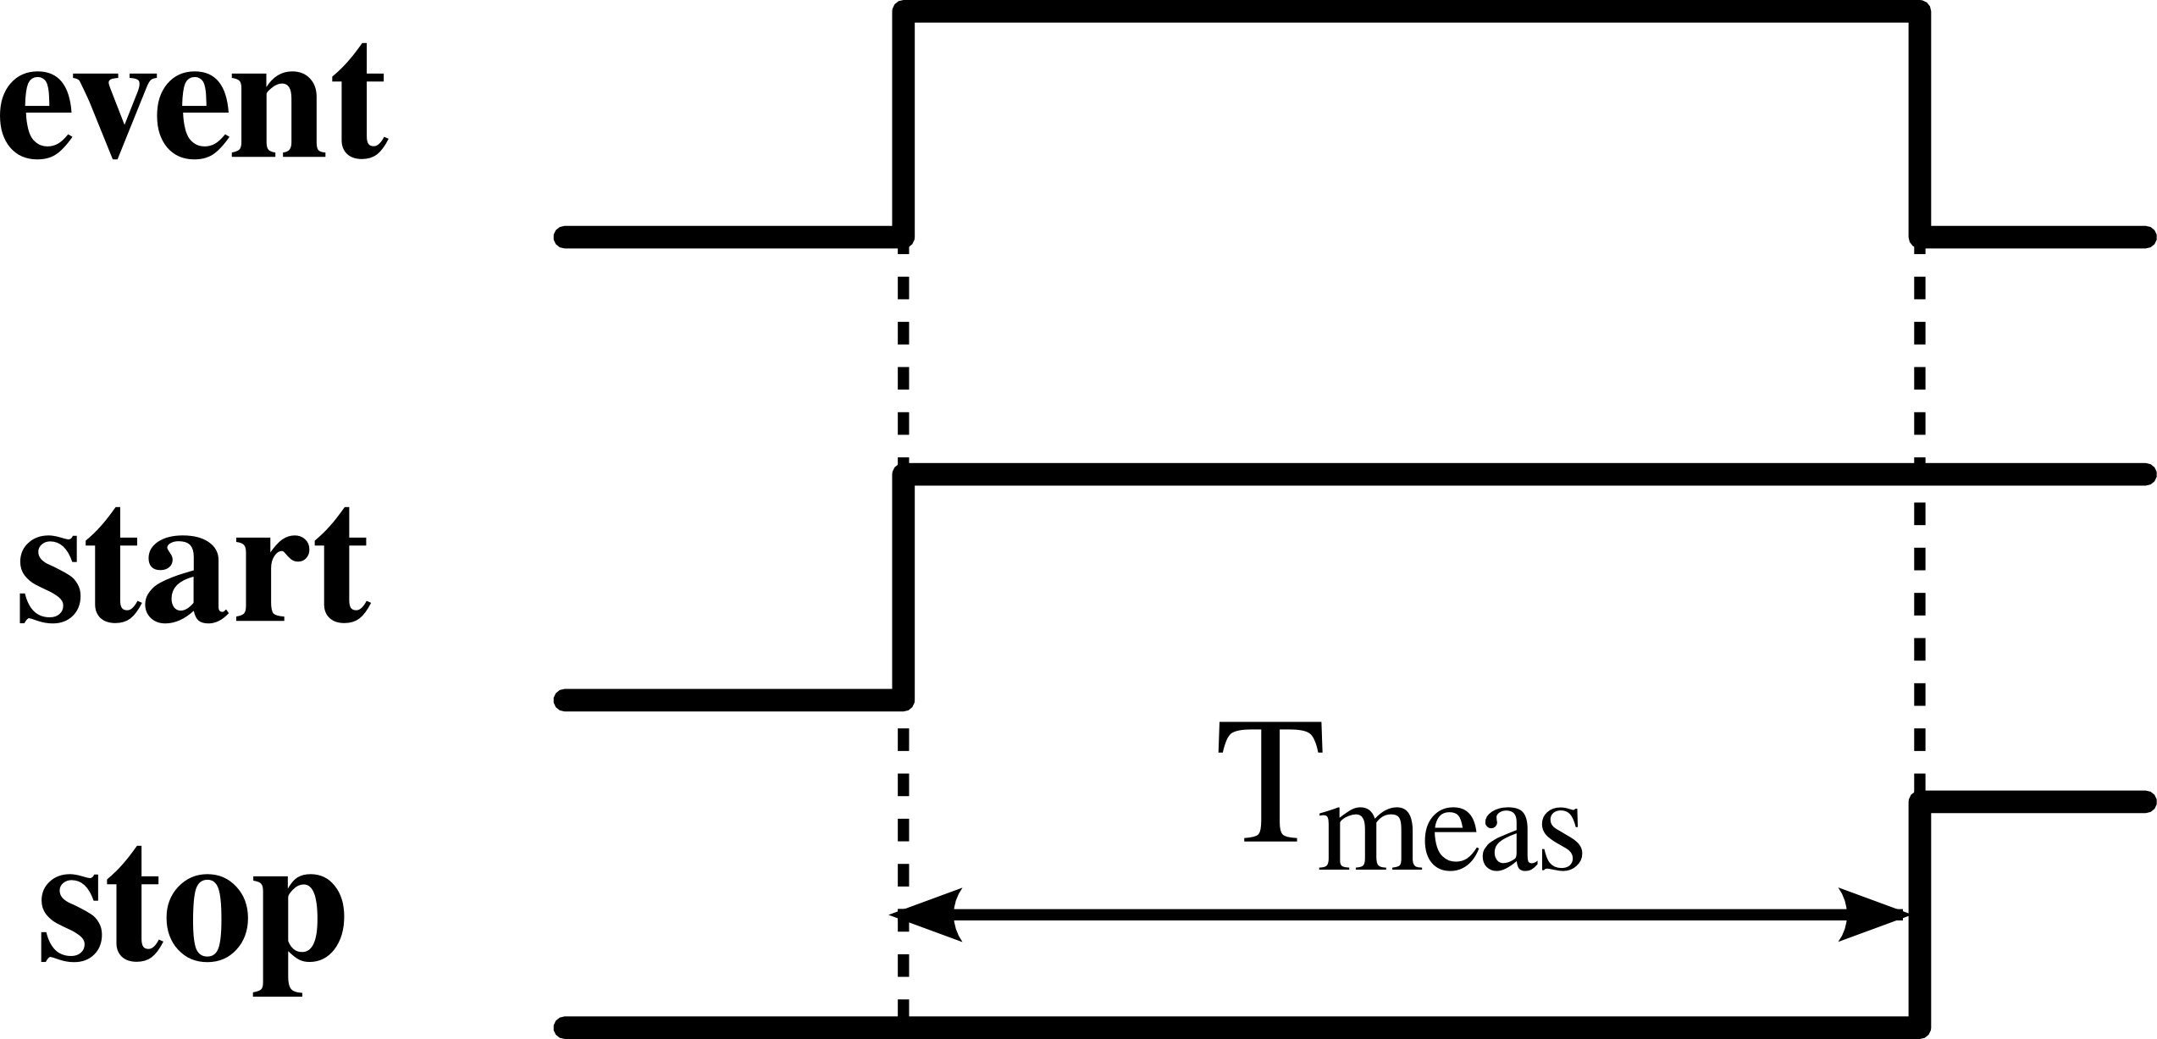
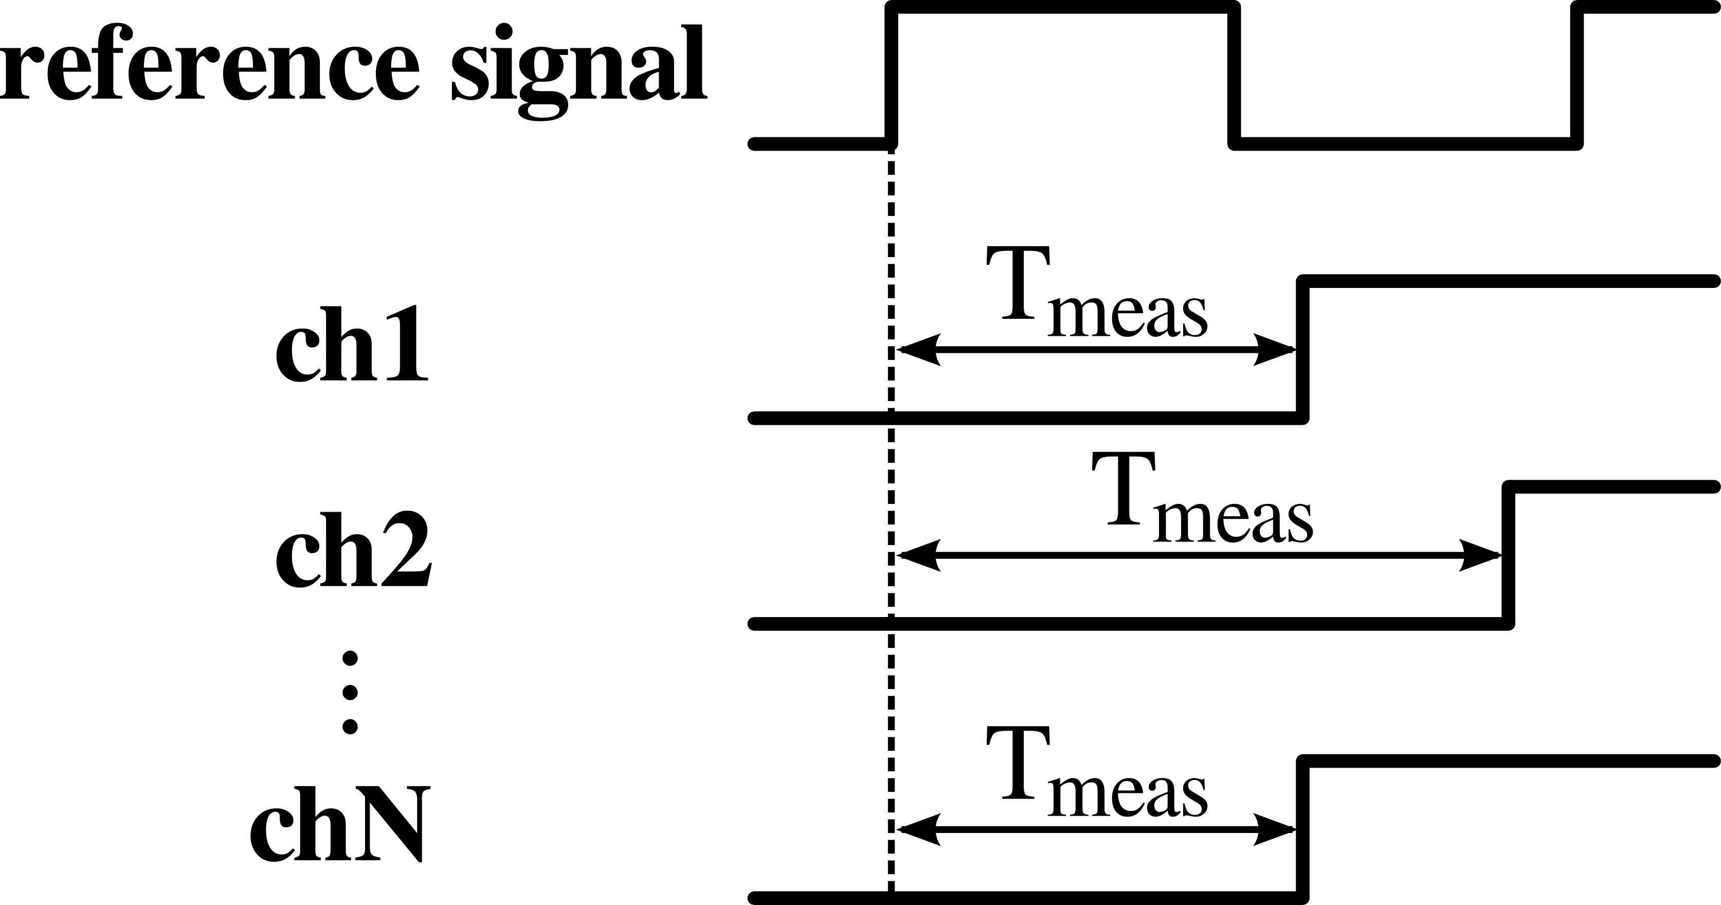
Time Measurements
Start - Stop Measurement
Measure relative time interval between two local events
Small local systems and low power applications
Time Tagging
Measure “absolute” time of an event
(Relative to a time reference: clock)
For large scale systems with many channels
all synchronized to the same reference

Slide 18
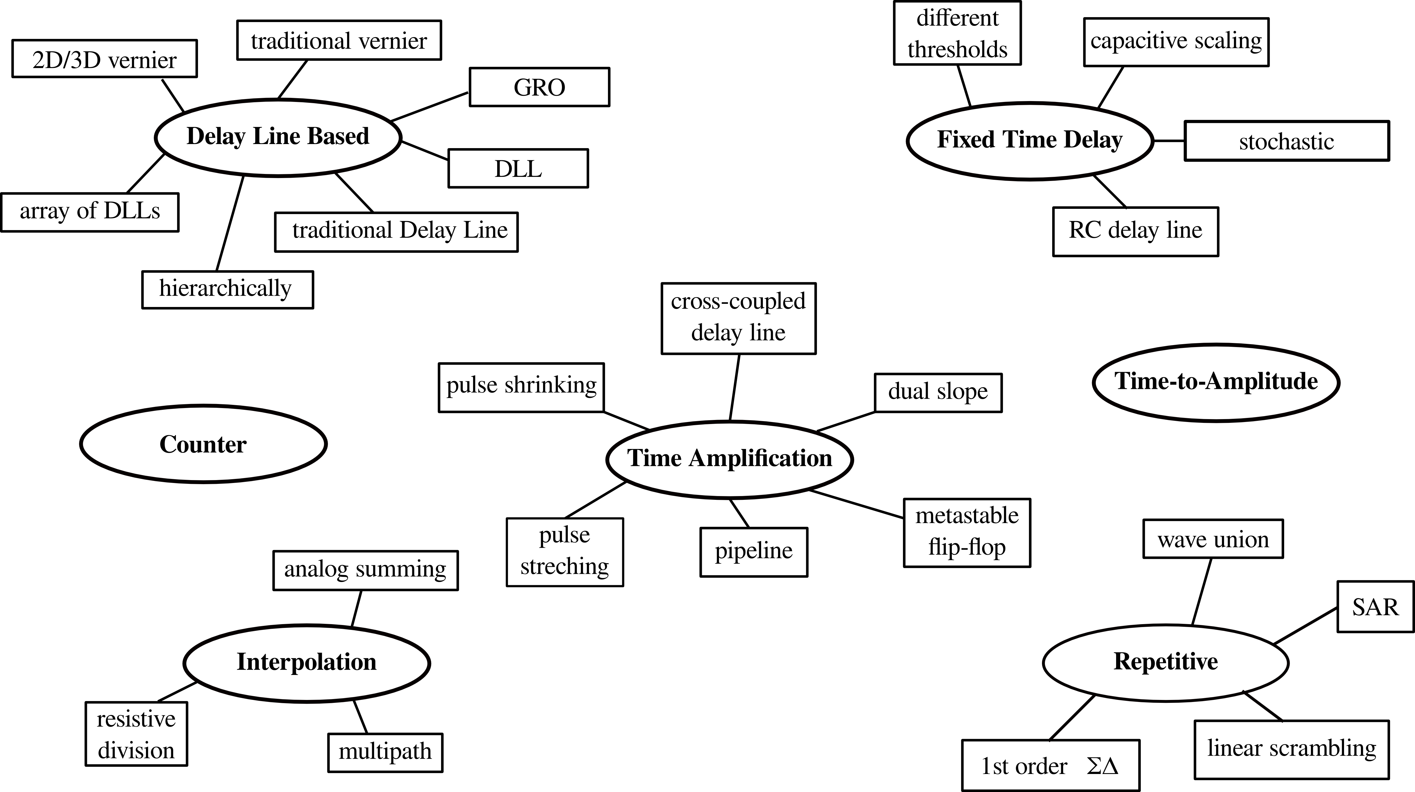
TDC Architectures
1st stage
Counter extension
2nd stage
Multistage concept:
Fine resolution
Large dynamic range

Slide 19
Difficulties in ps range resolution
It is not worth making a fine
binning TDC if resolution is
then lost in imperfections/noise
LSB/sqrt(12) ≠ rms
Device mismatch
-> Careful simulation and optimization
-> Major impact on design and performance
Noise (power supply)
-> Short delays, fast edges
-> Separate power domains
-> Substrate isolation
-> Crosstalk
Signal distribution critical
-> RC delay of wires
-> balanced distribution of timing critical signals
Process-Voltage-Temperature variations
-> LSB auto calibration to compensate for slow VT variations
-> Global offset calibration still required
DNL, INL
Noise, Jitter
single-shot
precision
Offset shifts

Slide 20
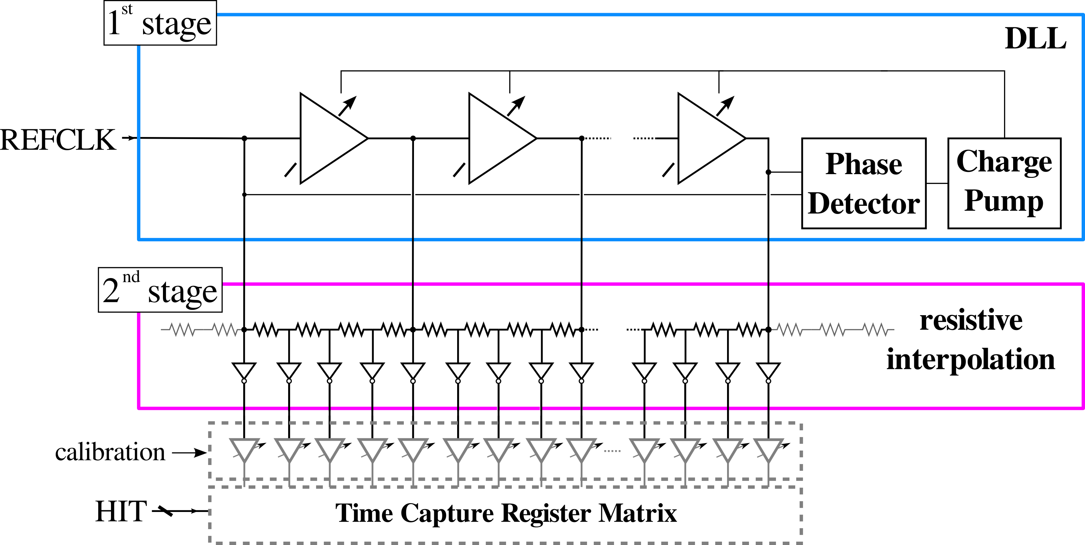
Fine-Time Interpolator
N=32
1.56 GHz
20 ps
delays
5 ps
delays
DLL to control LSB size
-> 32 fast delay elements in first stage - 20 ps
-> Total delay of DLL 640 ps at 1.56 GHz
Resistive Interpolation to achieve sub - gate delay resolutions
-> LSB size of 2nd stage controlled by DLL
(Auto adjusts to DLL delay elements)

Slide 21
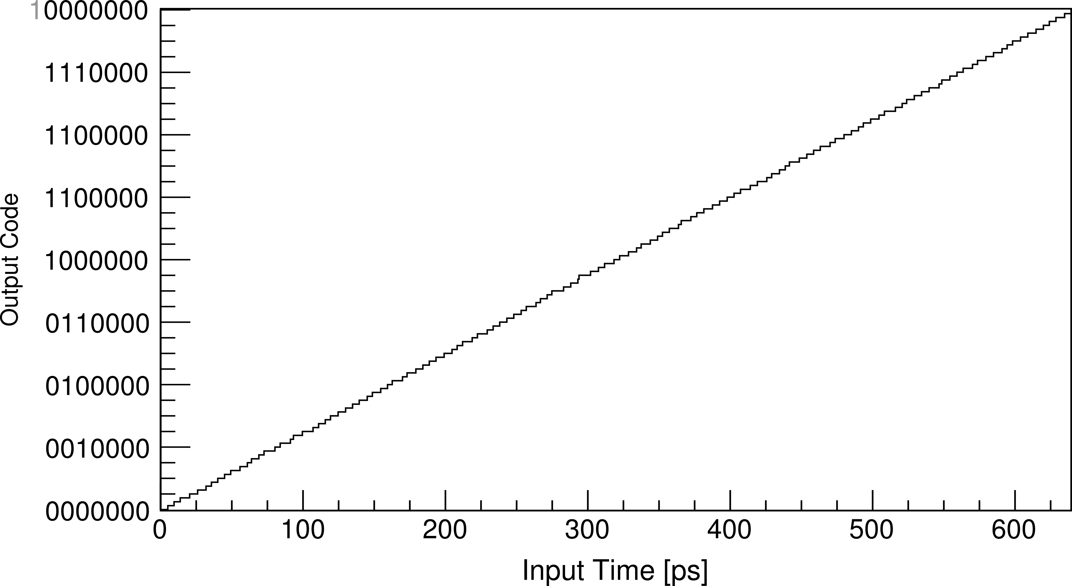
Reconstructed Transfer Function
after global calibration
has been applied
channel 5
DNL
INL

