Slide 1
TDC and PLL work
Jeffrey Prinzie

Slide 2
Previous work
Thesis
  Low jitter clock generator
PhD
  Radiation tolerant TDC

Slide 3
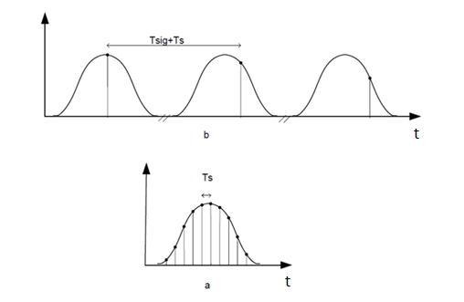
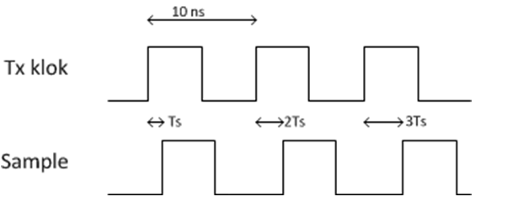
Low jitter clock generator
Concept
Equivalent-time sampling clock
  Tref + Ts
UWB imaging (Tx / Rx)
  Requires accurate clock
Low jitter
51.2 GSa/s eq. time

Slide 4
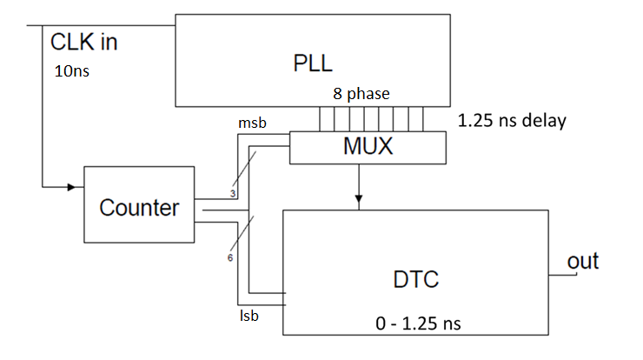
Low jitter clock generator
Architecture

Slide 5
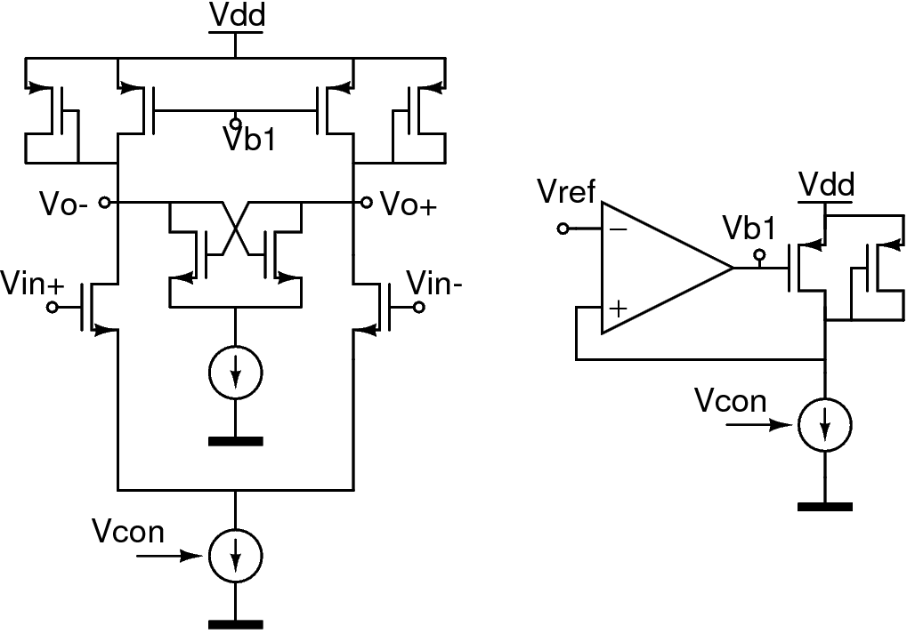
Low jitter clock generator
PLL
3rd order PLL
2.8 ps RMS jitter
8 phase generation
Maneatis load VCO
Charge pump PFD
No multiplier
90nm UMC CMOS

Slide 6
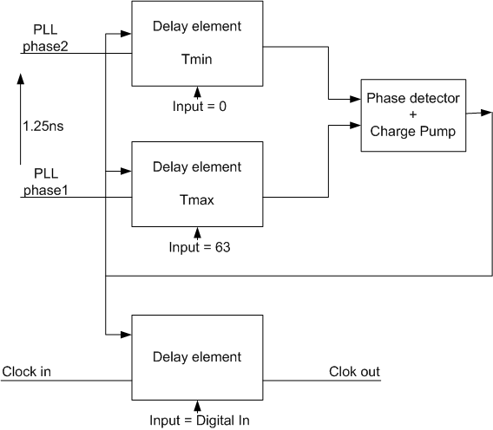
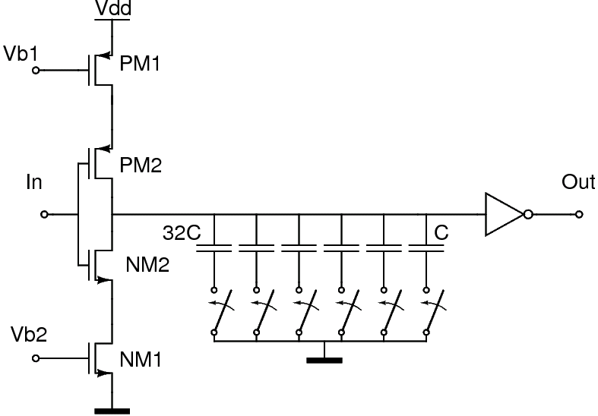
Low jitter clock generator
DTC
0-1.25ns Delay control
6 bit
PVT insensitive
2nd Phase lock

Slide 7
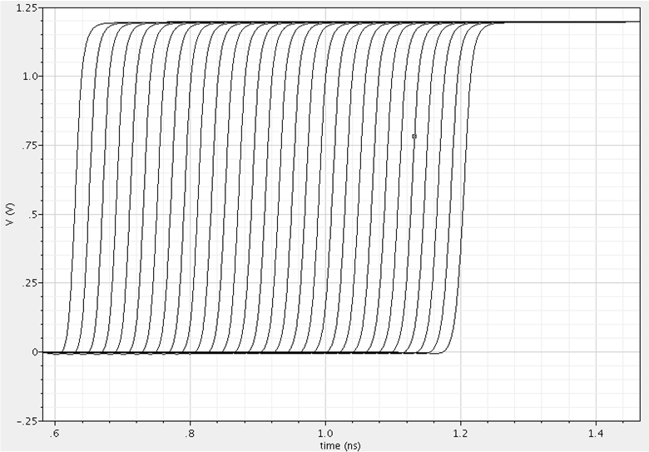
Low jitter clock generator
Results
3.2 ps jitter
(system)
4 mW power consumption
19,5 ps

Slide 8
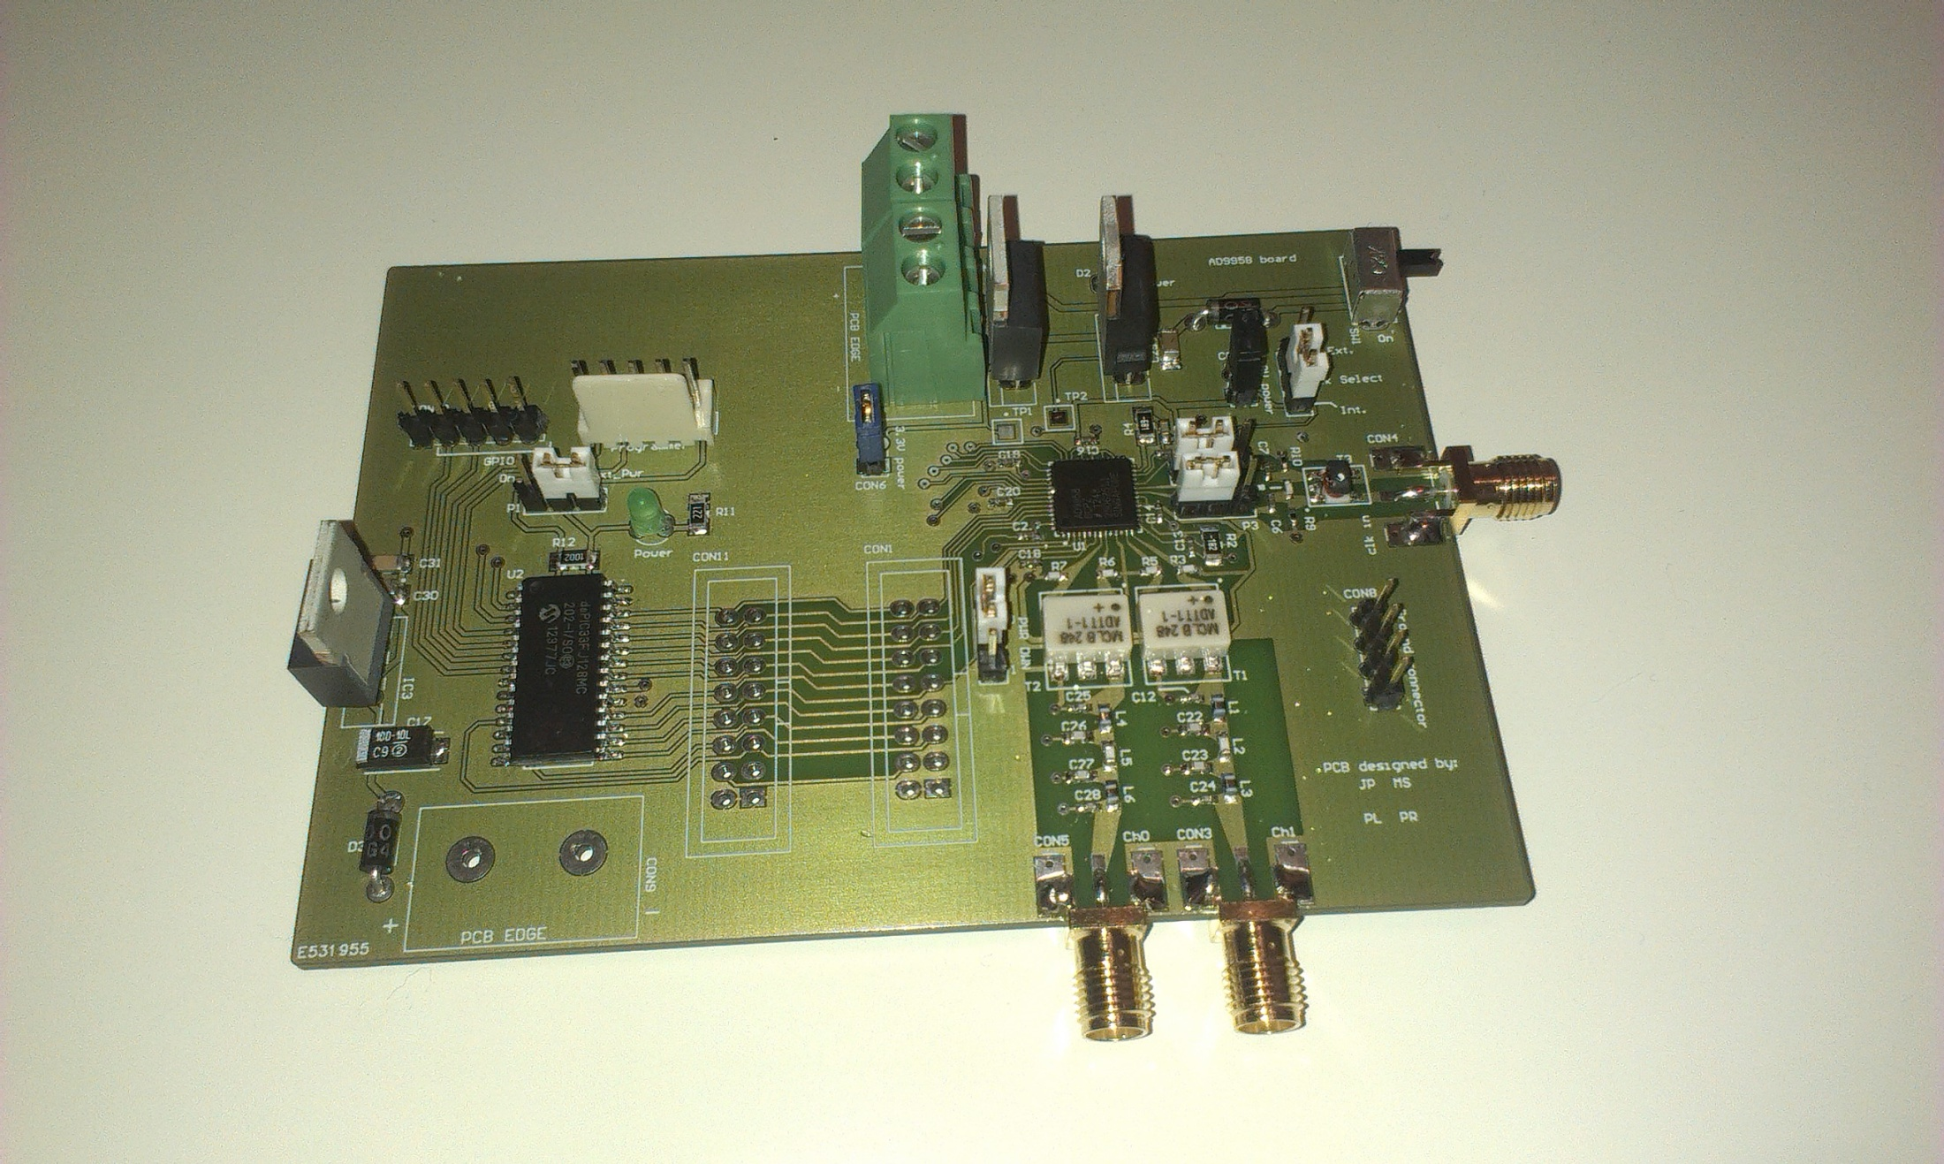
Low jitter clock generator
Discrete component version

Slide 9
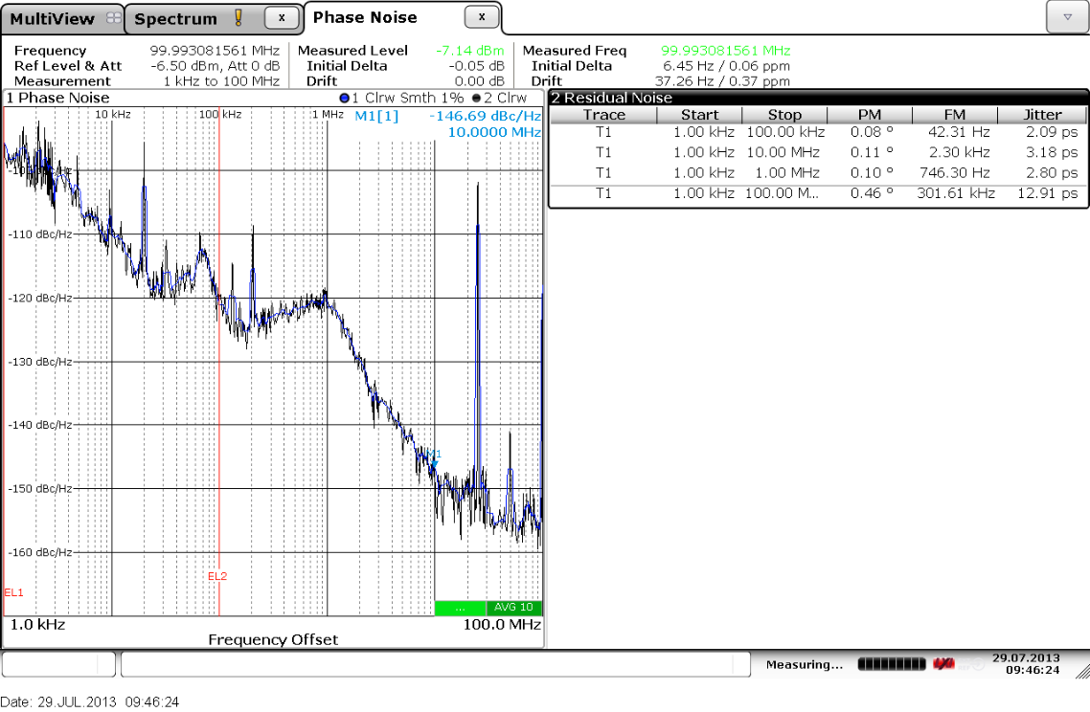
Low jitter clock generator
Discrete component version

Slide 10
Previous work
Thesis
  Low jitter clock generator
PhD
  Radiation tolerant TDC

Slide 11
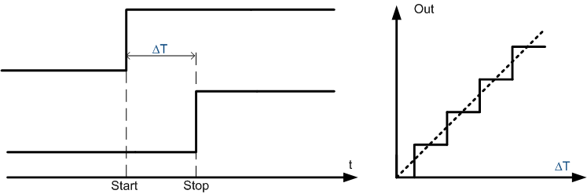
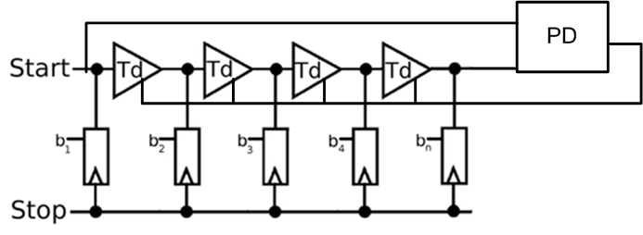
TDC chip 1
DLL based TDC
  DLL → gain/resolution
  Td = Tref/N
  DLL corrects TID radiation
  DLL reduces mismatch effects

Slide 12
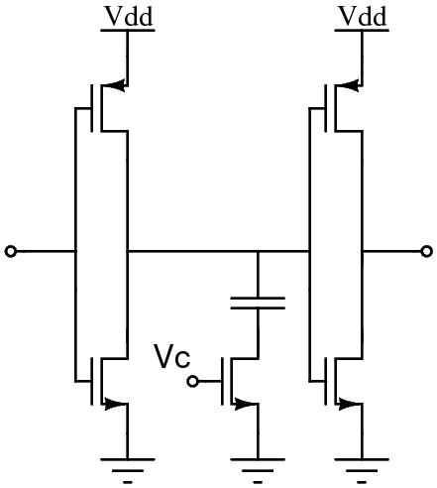
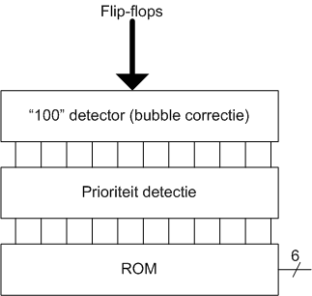
TDC chip 1
Delay line
  Resistive interpolation
  5.8ps resolution
    Tref/5N
  Mismatch
    156 fs/√ps
Coding
  Thermometer code → Binary
    Bubble correction
    Priority detection
    ROM

Slide 13
TDC chip 1
DLL control loop
  Radiation
    TID → offset in PD
    SEE → lock loss
  Combination PFD and Bangbang PD
    Speed/Recovery→ PFD
    Low offset (calibration) → Bangbang PD

Slide 14
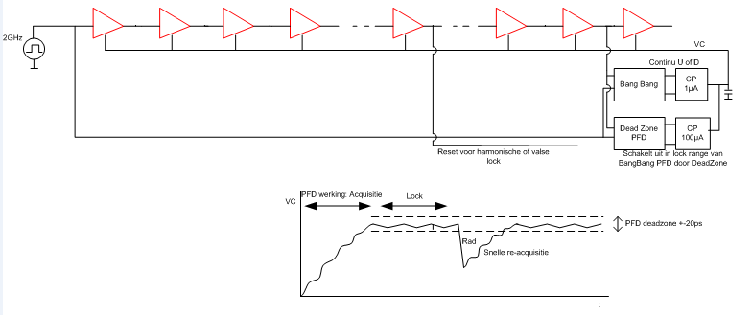
PFD
Deadzone (20ps)
High bandwidth
SEE recovery
Large SPO
Bangbang PD
Low bandwidth (fine adjustment)
Low SPO (1.2 ps 3σ) (TID)
Trade-off: speed vs. ripple (spur)

Slide 15
Progress
Chopped phase detector
Bang-Bang-PD: Chopping
  Minimizes SPO through radiation
  Time domain
Principe
  Inject calibration-clock in both inputs
  Measure phase difference (offset)
  Correct PD
  Effective DLL measurement
Calibration

Slide 16
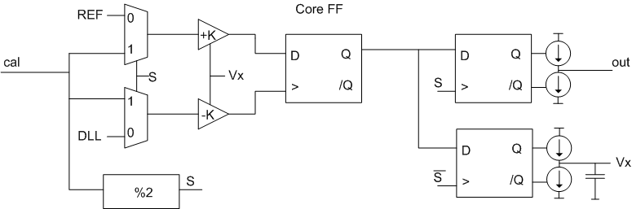
Progress: chip 1
  Inject calibration-clock in both inputs
  Measure phase difference (offset)
  Correct PD
  Effective DLL measurement

Slide 17
Progress: chip 1
  Inject calibration-clock in both inputs
  Measure phase difference (offset)
  Correct PD
  Effective DLL measurement

Slide 18
Progress: chip 1
  Inject calibration-clock in both inputs
  Measure phase difference (offset)
  Correct PD
  Effective DLL measurement

Slide 19
Progress: chip 1
  Inject calibration-clock in both inputs
  Measure phase difference (offset)
  Correct PD
  Effective DLL measurement

Slide 20
Progress: chip 1
Mismatch between 2 Mux
  → SPO ( 1.2ps 3σ including measurement)
Reduction of 1/f noise in PD
  Increases with radiation
Future improvements
  Interleaved BB-PD
  Individual calibration of DLL elements

Slide 21
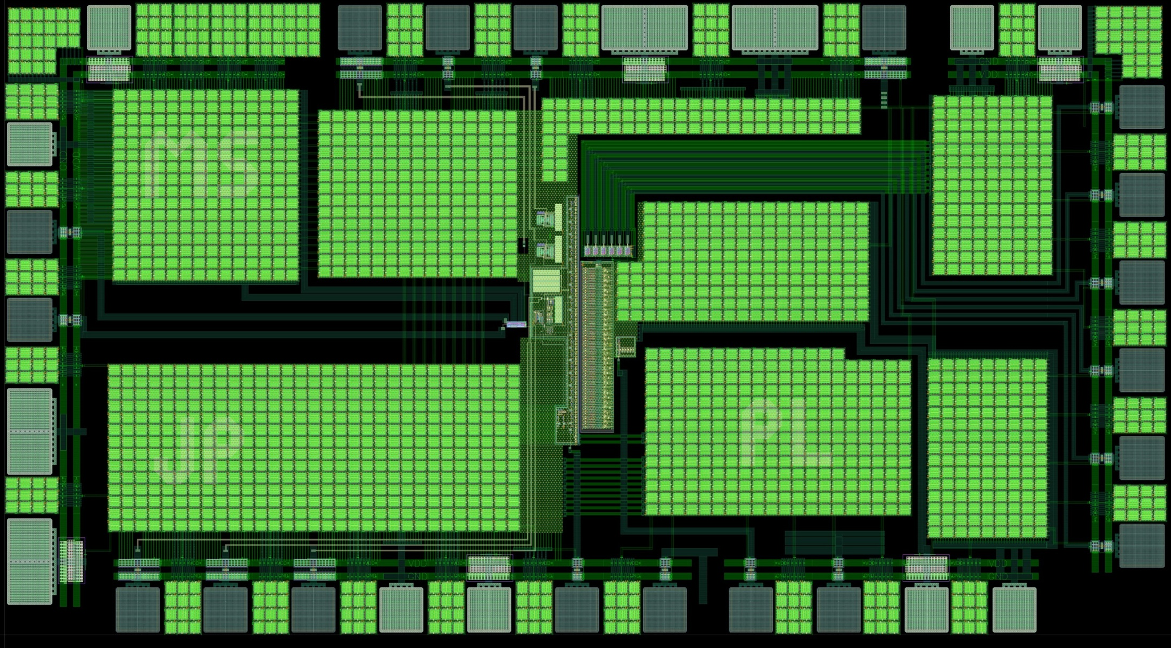
1.75mm
130 µm
0.95mm
370 µm
45 nm TSMC CMOS RF 10 layer

Slide 22
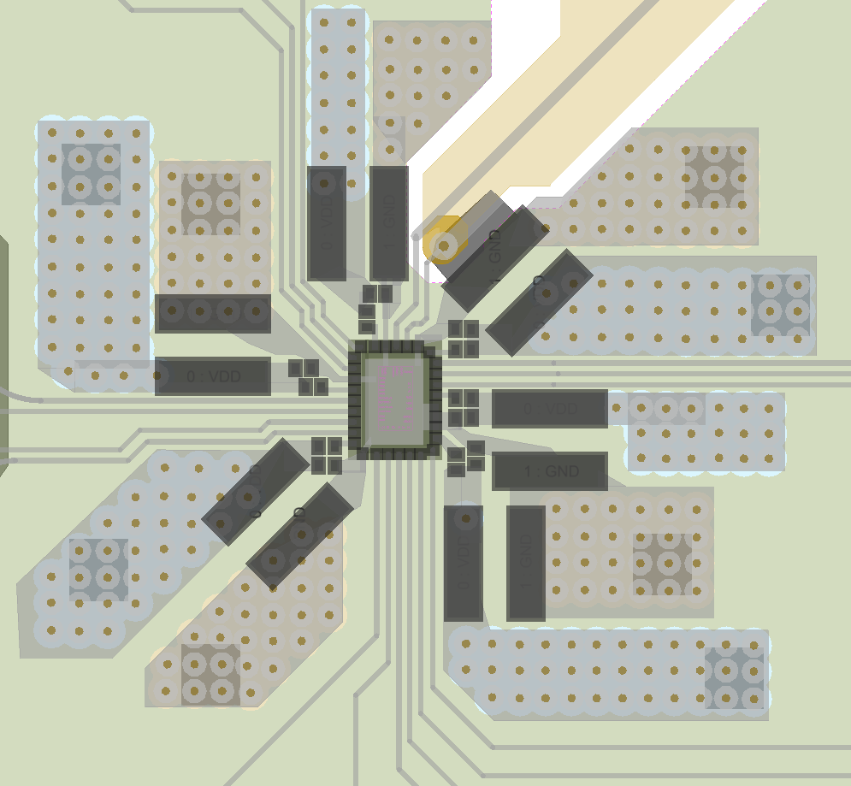
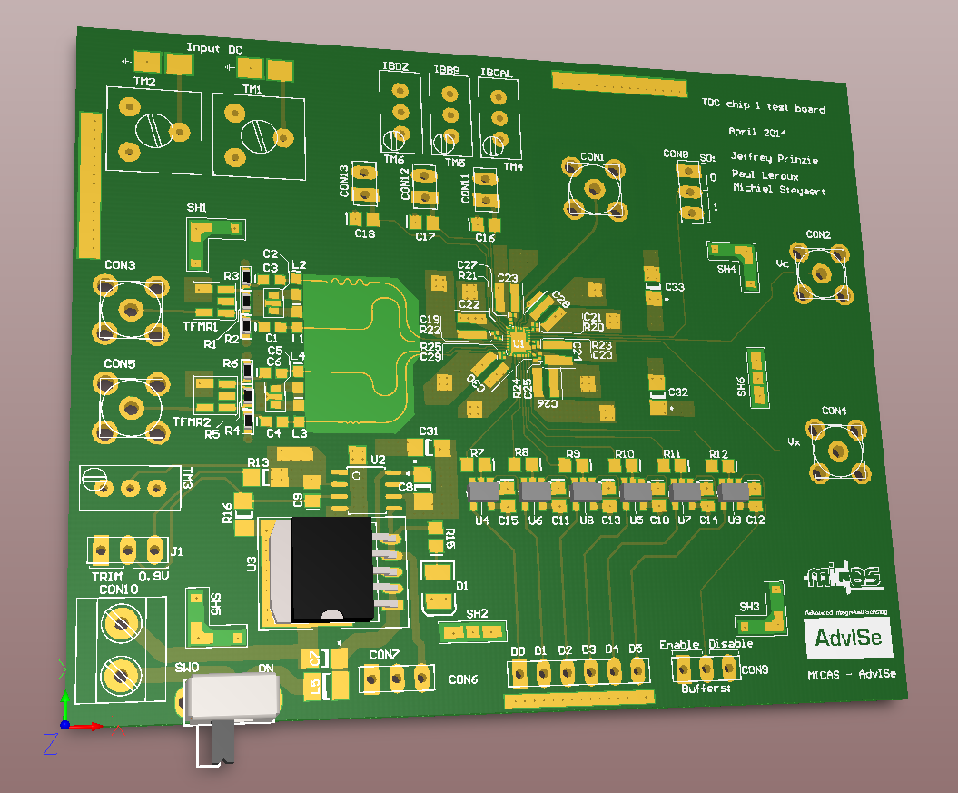

Slide 23
Conclusion
2 year work on
  Time based systems / control loops
    PLL, TDC, DTC …
  nm CMOS implementation
  Jitter / Phase noise optimization
1 year work on
  Radiation effects
Research group
  Multiple PhD on radiation tolerant ICs
    Amplifier , ΣΔ TDC …

Slide 24
Thank you

