Slide 1
Overview of CMS Forward Muon Upgrade
Brian L. Dorney on behalf of the CMS Collaboration

Slide 2
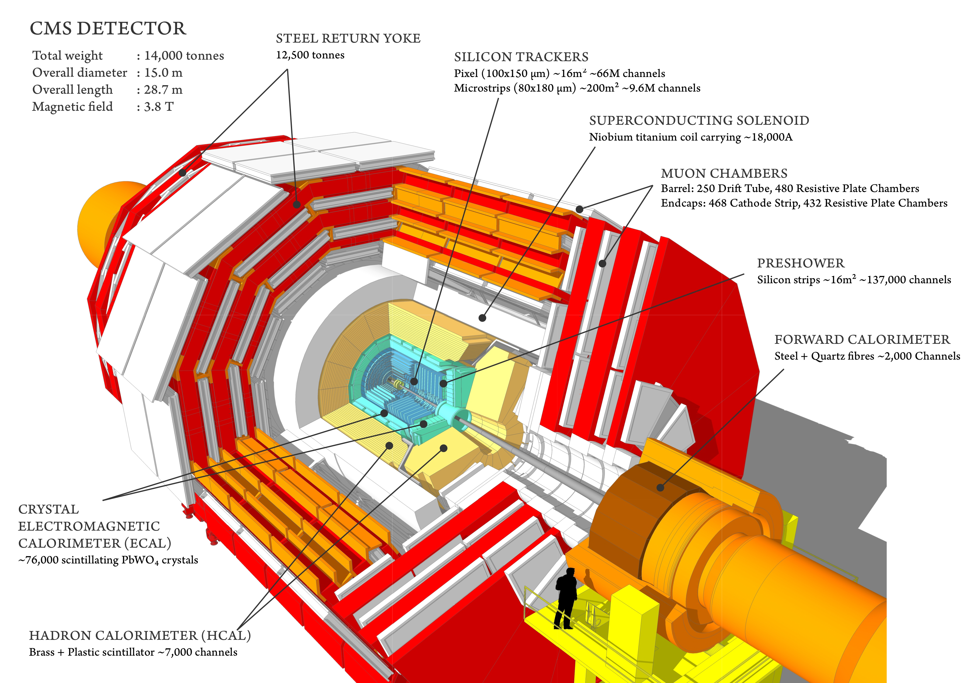
The CMS Detector
CMS Collaboration, Lucas Taylor, “CMS detector design,” http://cms.web.cern.ch/news/cms-detector-design 2011.

Slide 3
The CMS Trigger
Two level system
  Hardware level: on-detector electronics, Level 1 (L1)
  Software level: underground CPU farm, High Level Trigger (HLT)
Significant rate reduction
  LHC collision rate is O(10 MHz)
  L1 trigger readout rate ~100 kHz
  HLT rate ~1 kHz
~400 different trigger paths select pp collision events for offline analysis

Slide 4
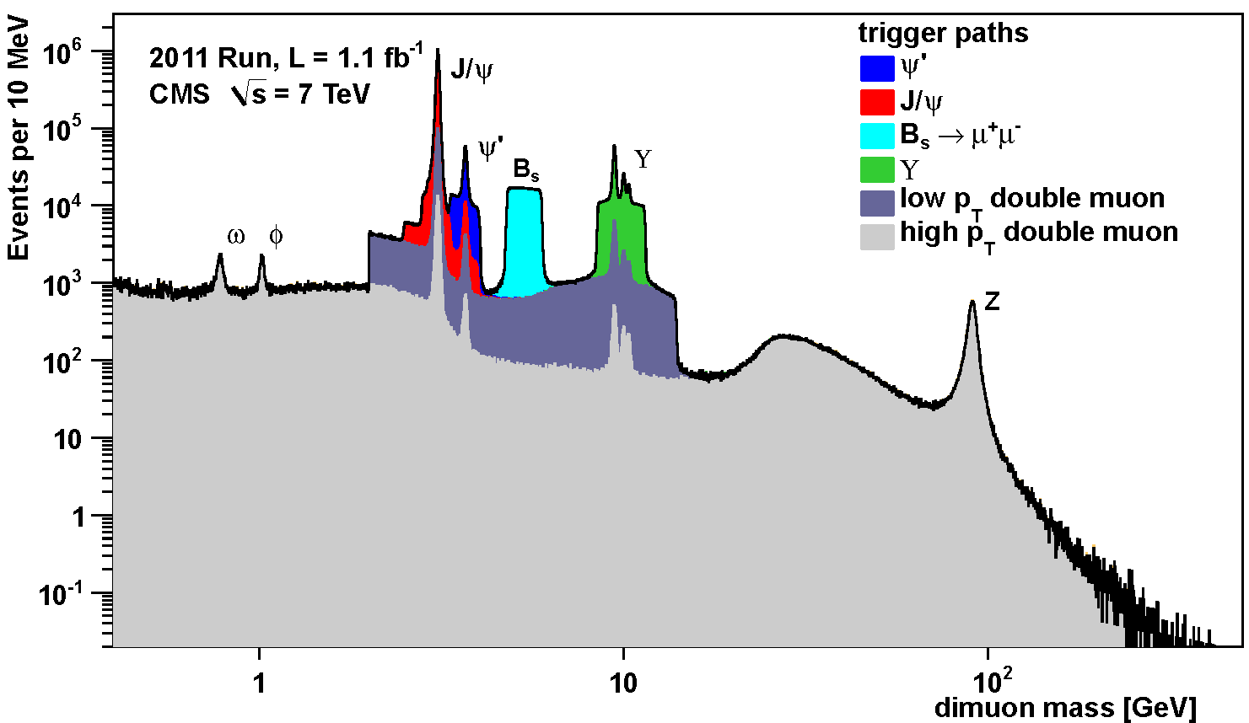
CMS Muon Performance: Run I
Muon-trigger demonstrated superb performance over very wide p_{T} range!
A = {ω, ϕ, J/ψ, ψ*, B_{s}, ϒ(ns), Z⁰}

Slide 5
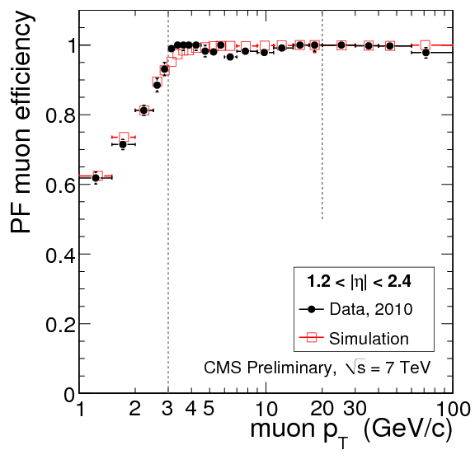
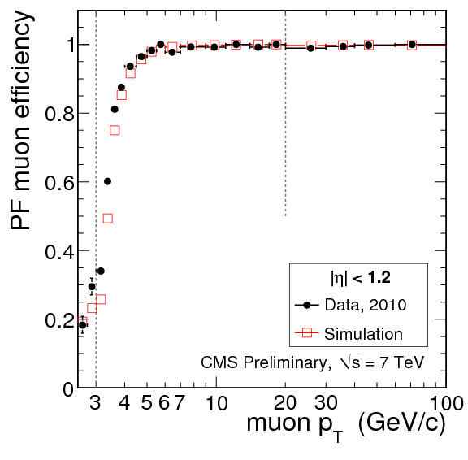
CMS Muon Performance: Run I
Exceptionally high muon-reconstruction and identification efficiency has been demonstrated!!

Slide 6
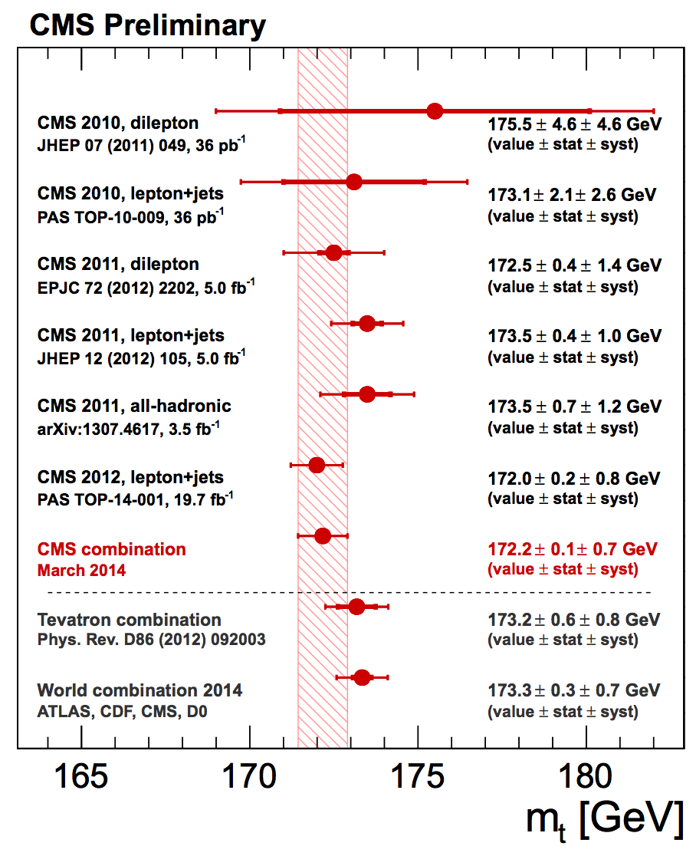
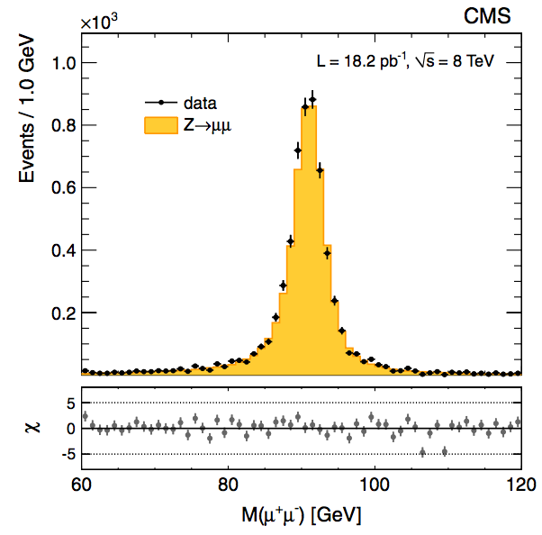
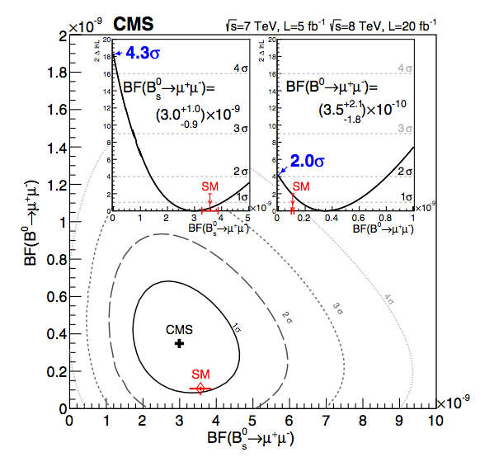
CMS Physics Results: Run I
Fantastic physics results!!!
CMS Collaboration, CMS PAS TOP-14-001, 2014.
Phys. Rev. Letters, 111, 101804 (2013)
Phys. Rev. Letters, 112, 191802 (2014)

Slide 7
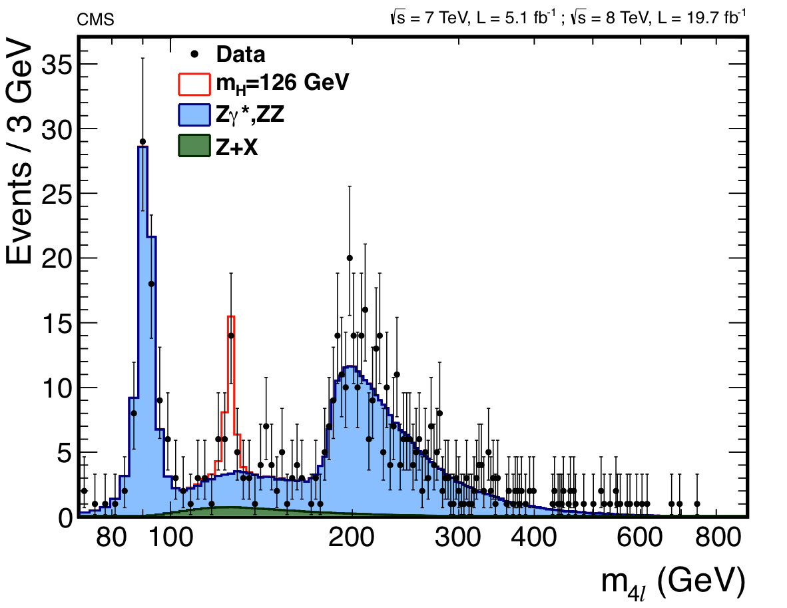
CMS Physics Results: Run I
Producing fantastic physics results
CMS Collaboration, CMS PAS TOP-14-001, 2014.
Phys. Rev. D, 89, 0920077 (2014)
Not possible w/o state-of-the-art muon system
Phys. Rev. Letters, 111, 101804 (2013)
Phys. Rev. Letters, 112, 191802 (2014)

Slide 8
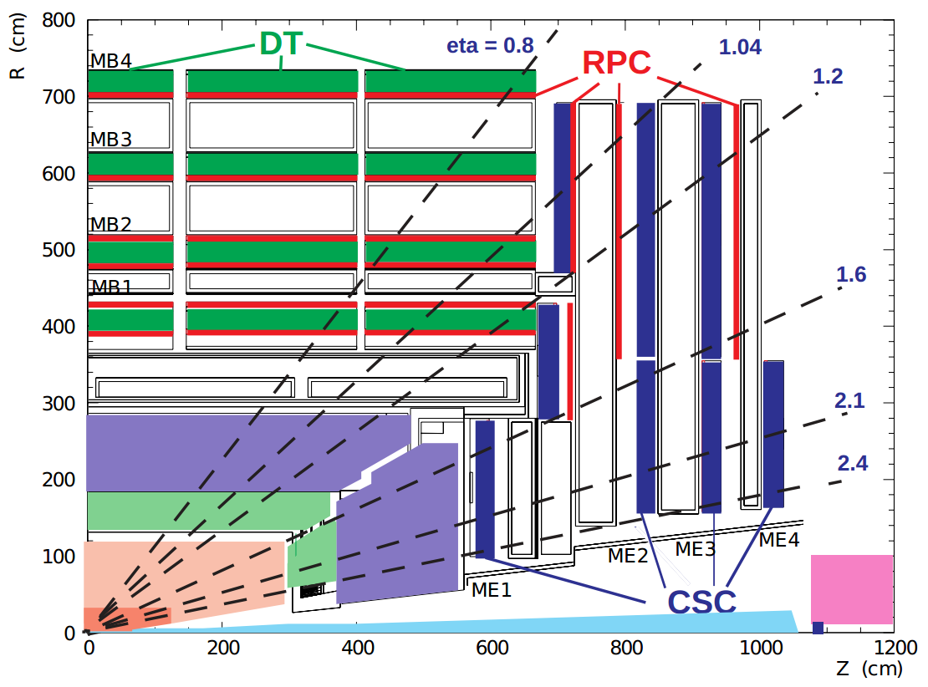
The Future
Muon-triggers in CMS from |η|>1.6 arrive solely from cathode strip chambers (CSC)
CSC system is at the limit of its performance
No redundancy!!!
  Potential problem for physics data taking
Sole System!
No Redundancy!!!

Slide 9
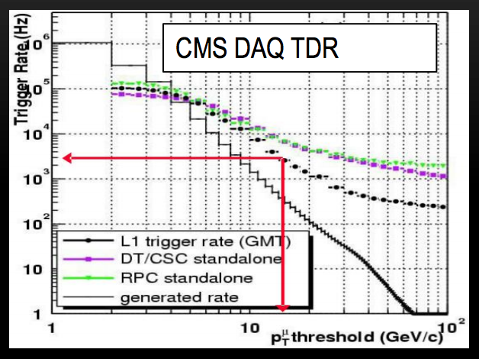
The Future
The rate flattening problem
  Low-p_{T} “soft” muons scatter in the steel return yoke
  Tracks are incorrectly reconstructed as high-p_{T} “hard” muons
Rare occurrence but very high number of soft muons
  Causes large tail in L1 muon-trigger p_{T} resolution
Flattening of L1 trigger rate at high-muon p_{T} values due to this large tail
Rate flattening!!!

Slide 10
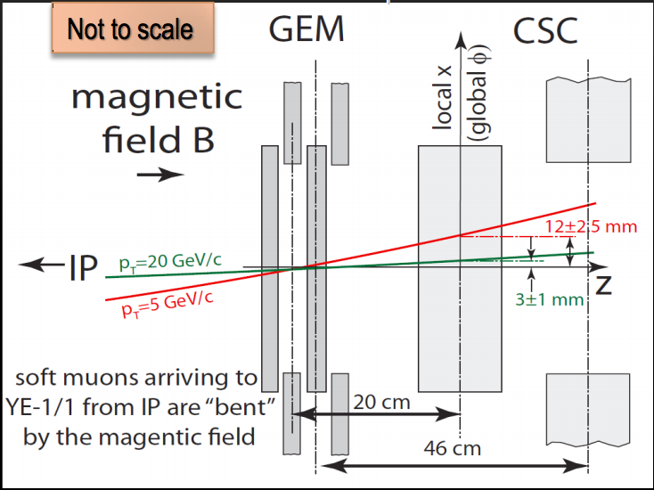
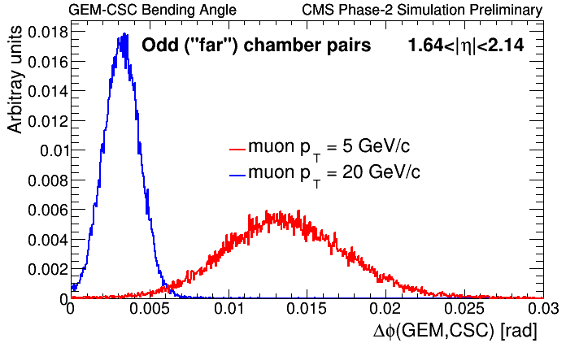
Solution: GEM-CSC Bending Angle
Additional muon chambers before first CSC station offers significant improvement
Bending angle:
acts as powerful discriminator between soft and hard muons

Slide 11
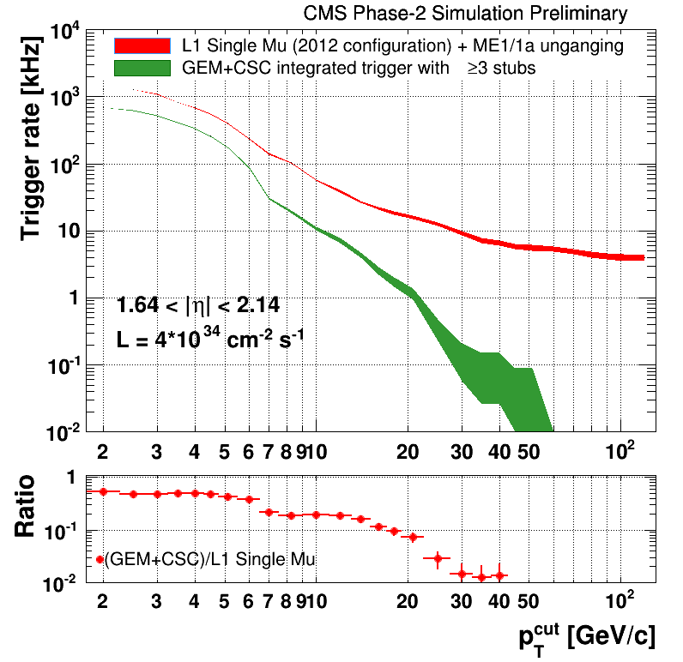
GEMs Solve Rate Flattening
Studies show triple-GEM detectors are the L1 trigger rate savior of CMS
Additional advantages
  Low cost
  High rate capability
  Radiation hard:
    Dose > 9mC, no degradation
    See Jeremie’s talk!!!!
  Good spatial/time resolution:
    ~100μm; ~4-5ns
  High Efficiency (~98%)
  Nonflammable gas mixture
  Rapid manufacturing time
    See Antonio’s talk!!!
Improvement!!!

Slide 12
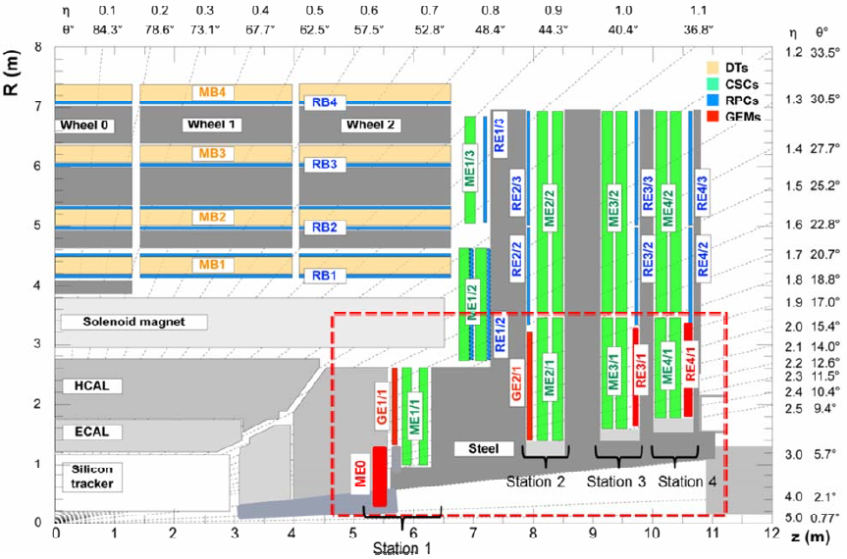
The CMS GEM Project
Create redundancy in muon system
Robust tracking
Reduce L1 muon-trigger and HLT rates by improving muon p_{T} resolution
Ensure ~100% trigger efficiency in post LS2 pp collision environment
  High pile up!
    LS2 (LS3) <PU> = 70(140)
Proposal to install triple-GEM detectors in the forward region of CMS

Slide 13
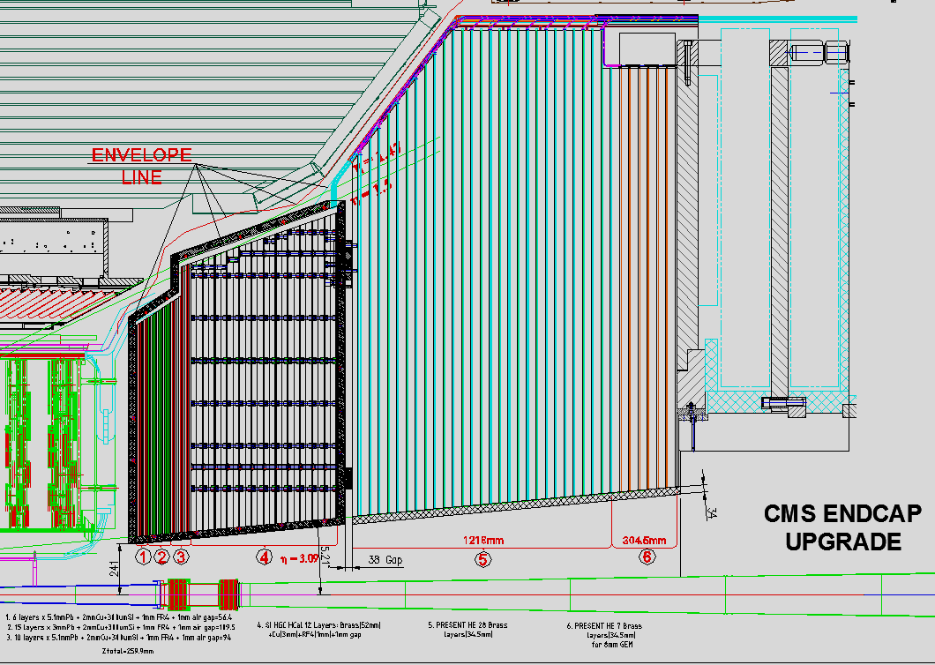
ME0 System
Mechanical
Supports
Sliding Rail
& Services Pocket
For package of 6
2.0 < |η| < 3.5
  20° wedges affixed to back of upgraded CMS HCAL endcap
Six layers of triple-GEM detectors
  Design ongoing
Significantly increases muon acceptance for high profile analyses
  e.g. H->ZZ->4μ
Total foil area ~144m²
1
6
3
2
5
4
Thicknesses cm:
2.5 Borated Poly
1.2 Pb
3.2 Single Chamber 1
3.2 Single Chamber 2
3.2 Single Chamber 3
3.2 Single Chamber 4
3.2 Single Chamber 5
3.2 Single Chamber 6
3.2 Sliding Rail
1.2 Pb
2.5 Borated Poly
------------------------
28.8cm
2.5 borated polyethylene plus 1.2 Pb for n shielding
φ direction →
2.5 borated polyethylene plus 1.2 Pb for n shielding
9
20 degree
Chambers
10
18 degree
Chambers
Δz = 30 cm
Services
& Support
ME0

Slide 14
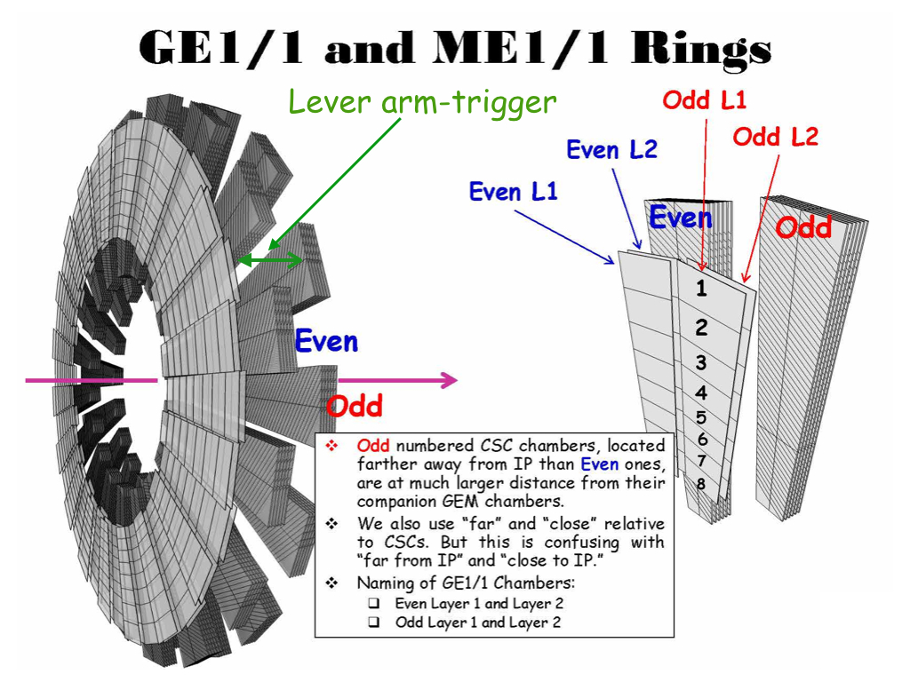
Current Focus: GE1/1 System
1.55 < |η| < 2.18
  Short and long chambers for maximum coverage
36 superchambers (SC) per side of CMS
  Each chamber spans 10° in ϕ
  2 chambers/SC
  144 chambers total
Total foil area ~140m²
Four years of R&D has given us five prototype generations; each an improvement of the last!!!

Slide 15
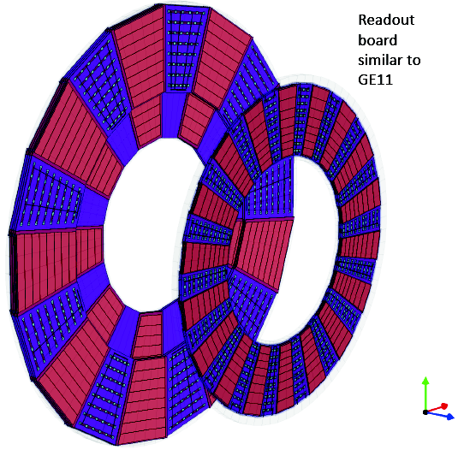
GE2/1 System
GE2/1
1.55 < |η| < 2.45
Each chamber spans 20°
Design on-going
Targeting two rings of double-layered triple-GEM detectors
Total foil area ~145m²
GE1/1

Slide 16
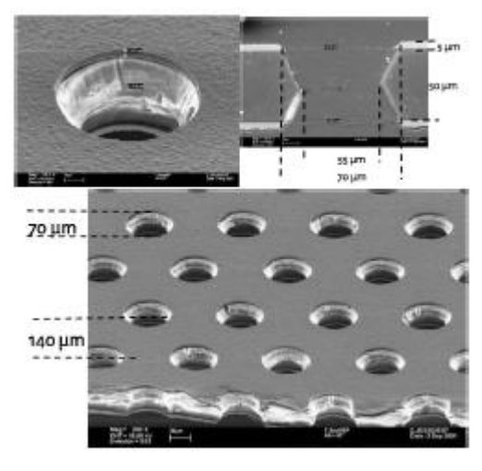
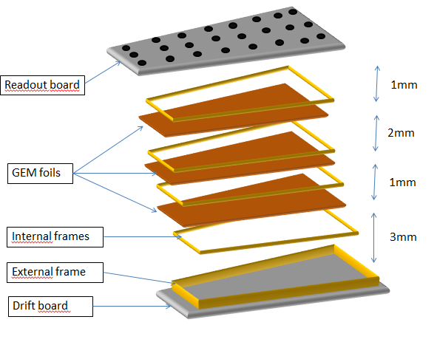
Current Prototype: GE1/1-V5
Triple-GEM foils 5:50:5μm for Cu:Kapton:Cu
  70μm diam.; 140μm pitch
Gap configuration (in mm): 3/1/2/1
NS2 assembly technology; no spacers or glue!
NS2
Gas volume
Readout connector
Washers
Embedded nut
GND
O-rings
Epoxy frame
Free to slide
GND
Drift electrode
Internal screws to adjust stretching
External screws
GEM attaching structure (4 pieces defining gaps)

Slide 17
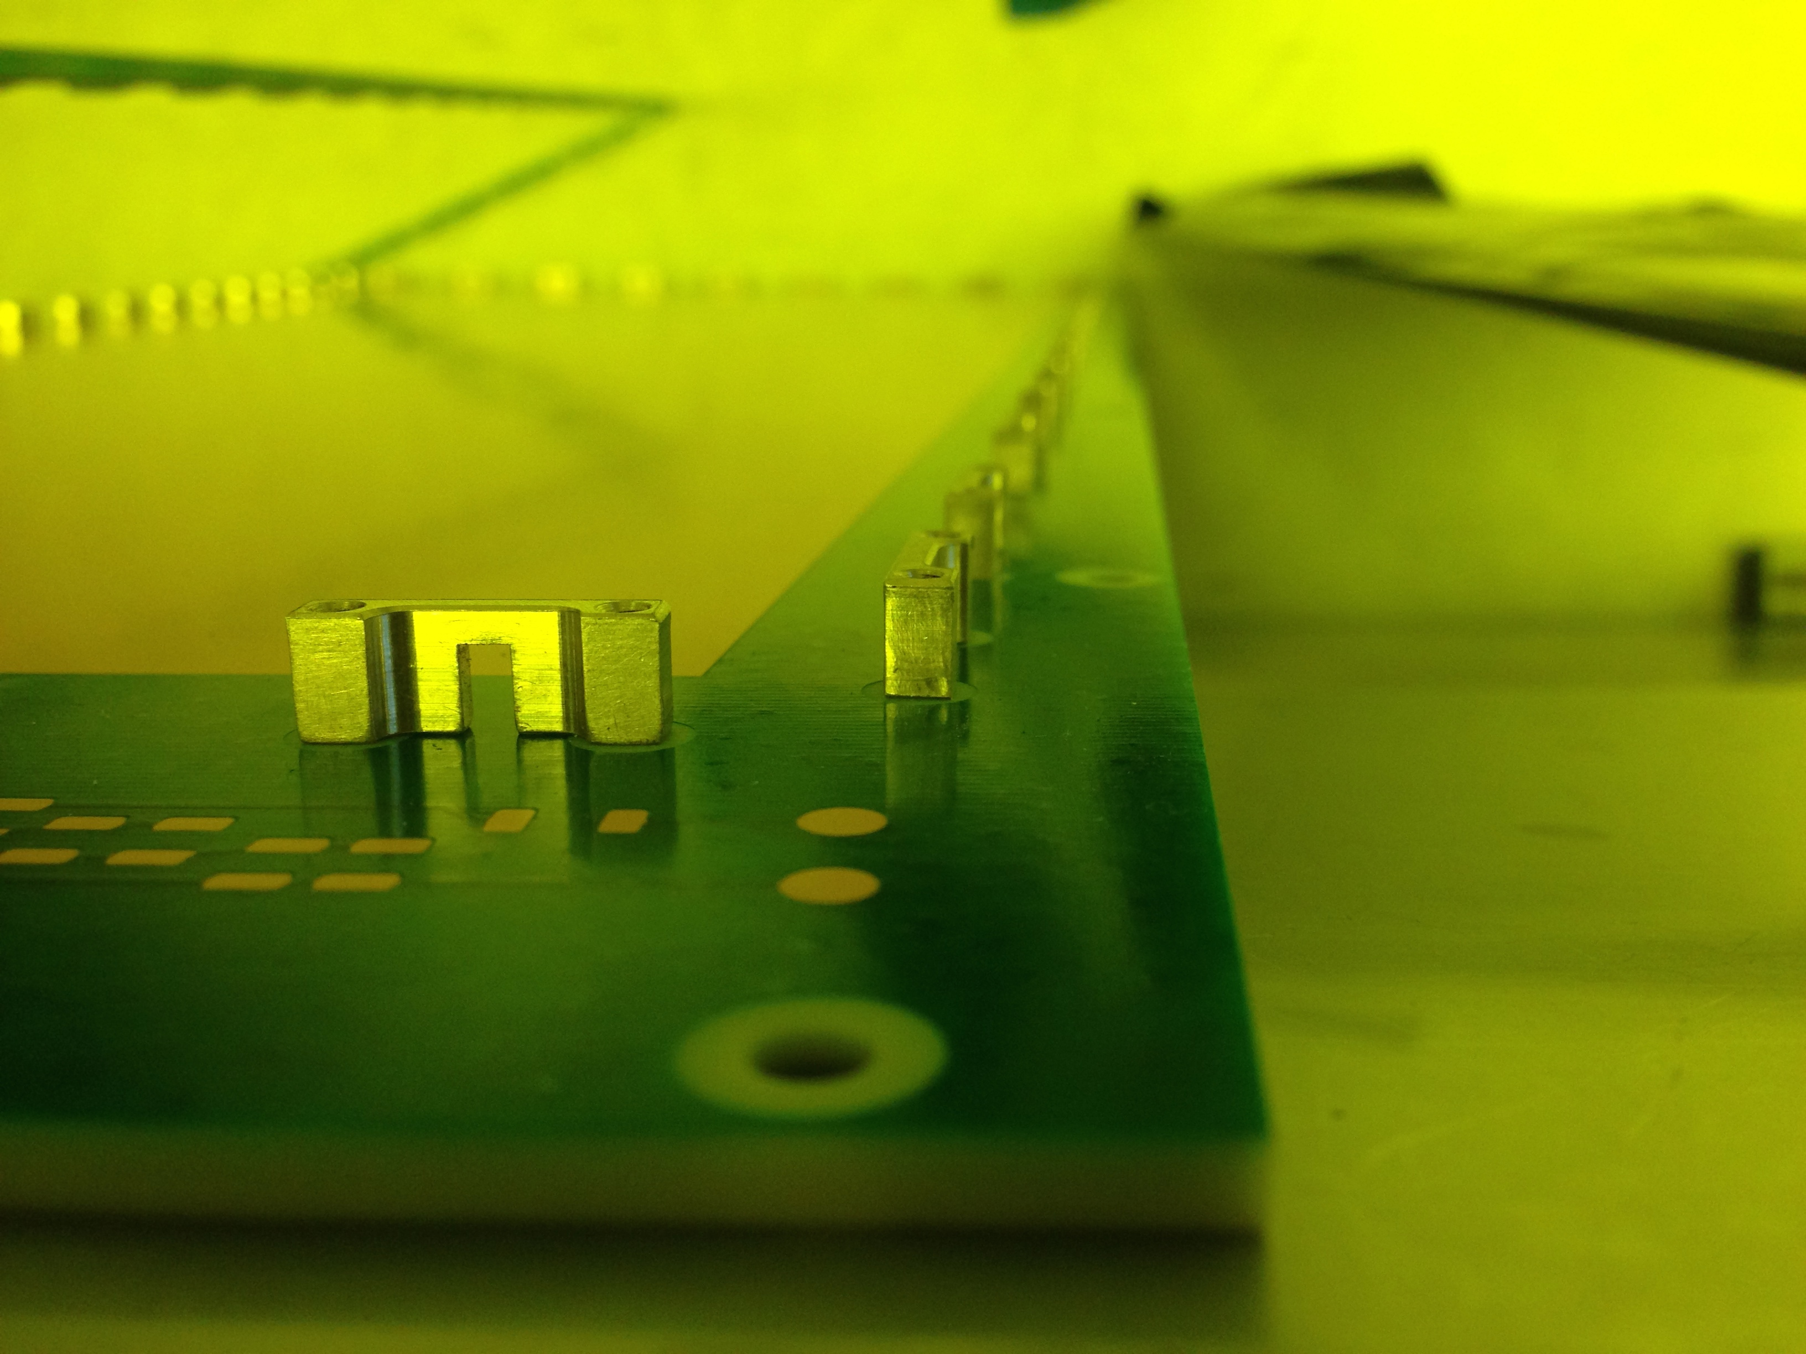
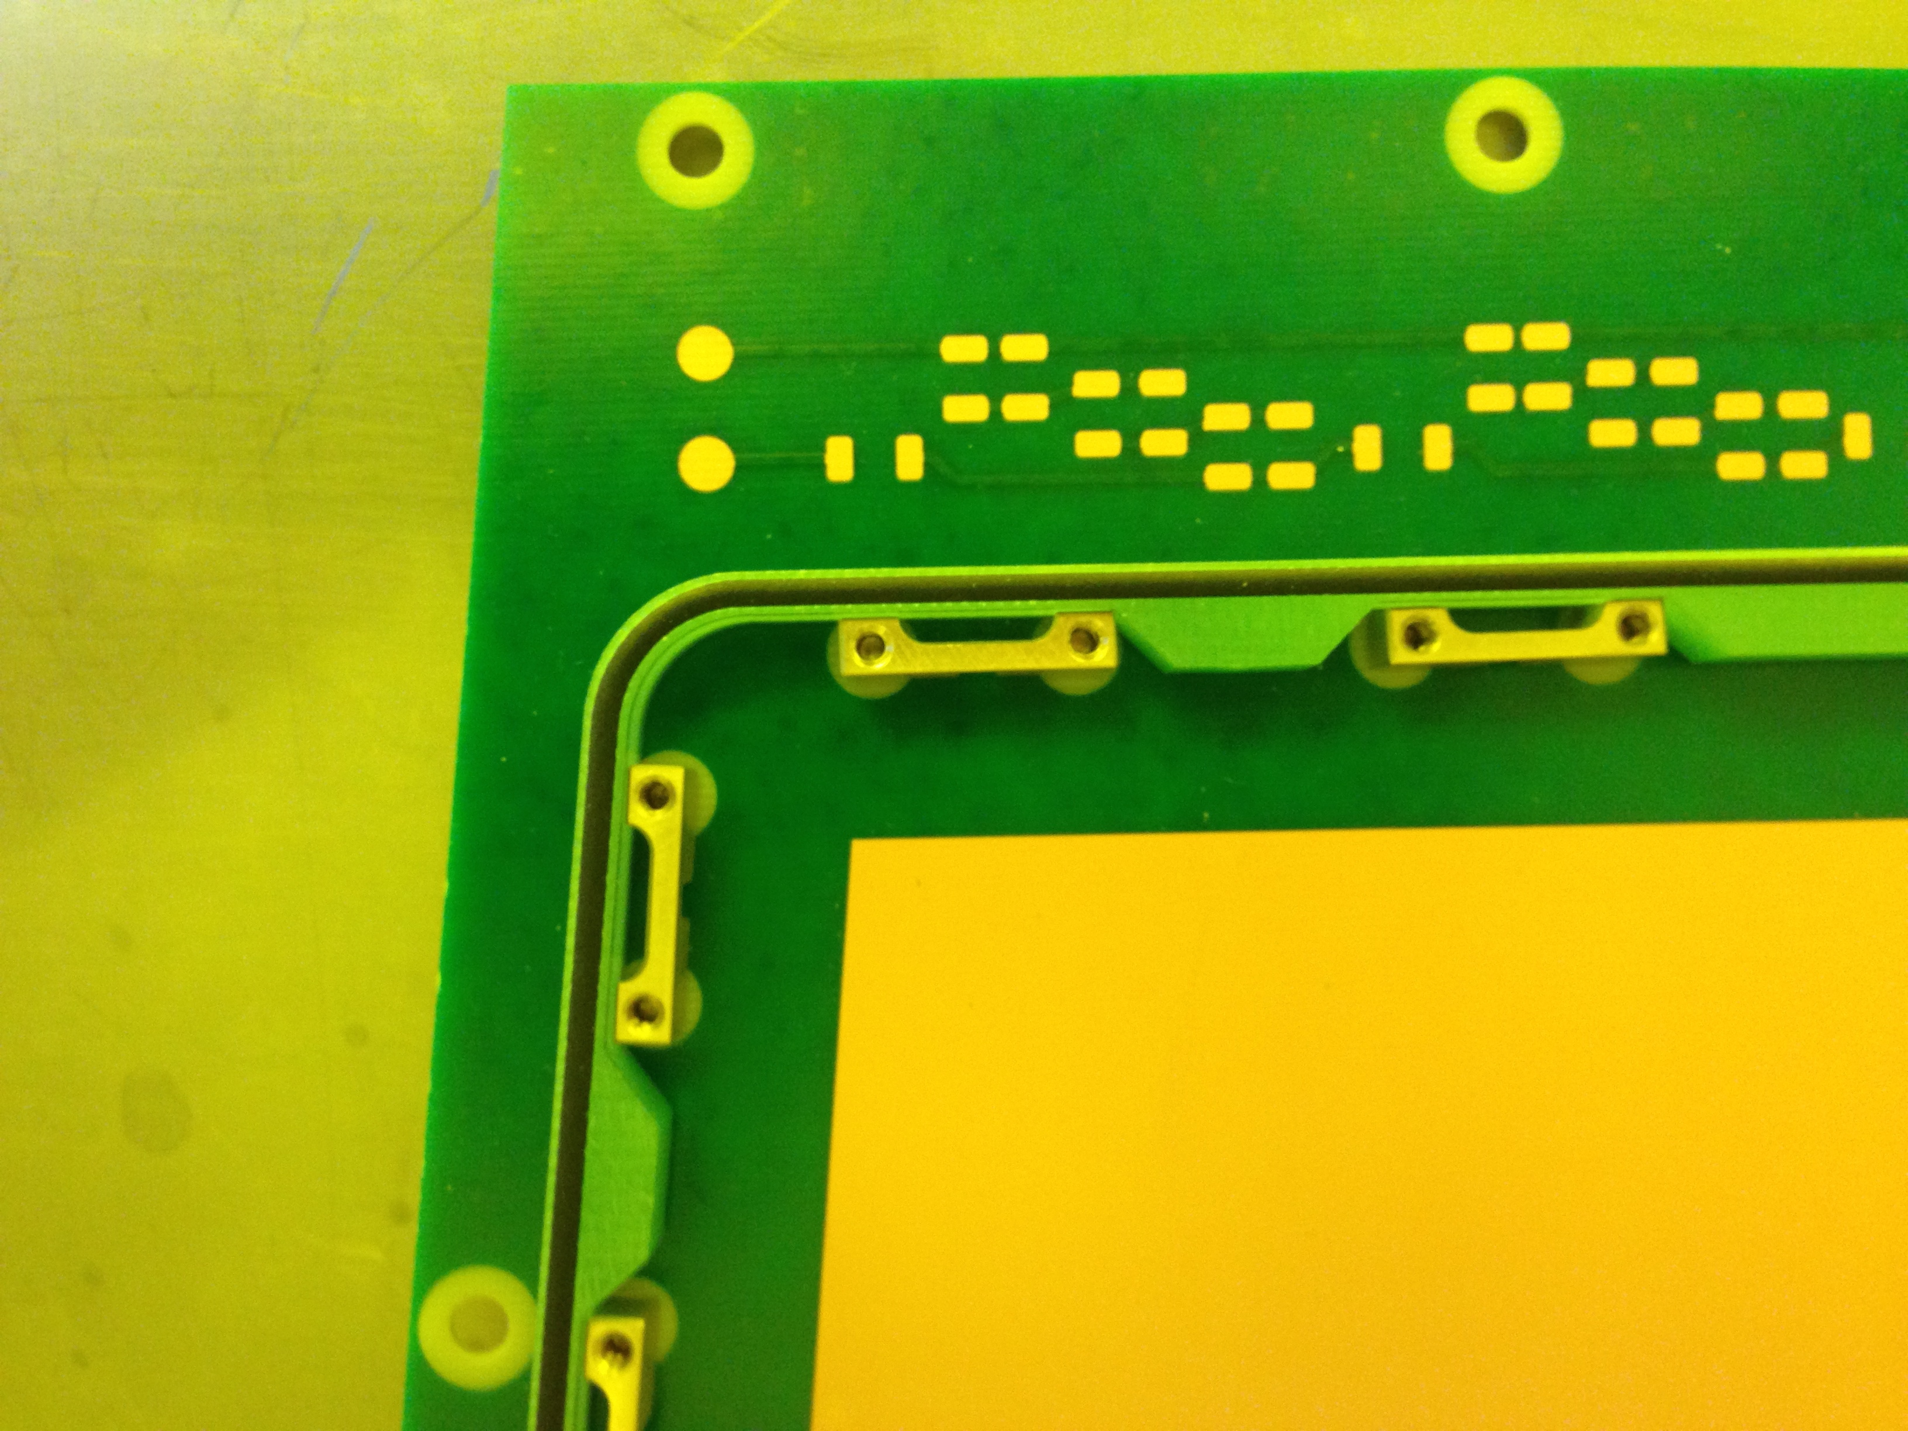
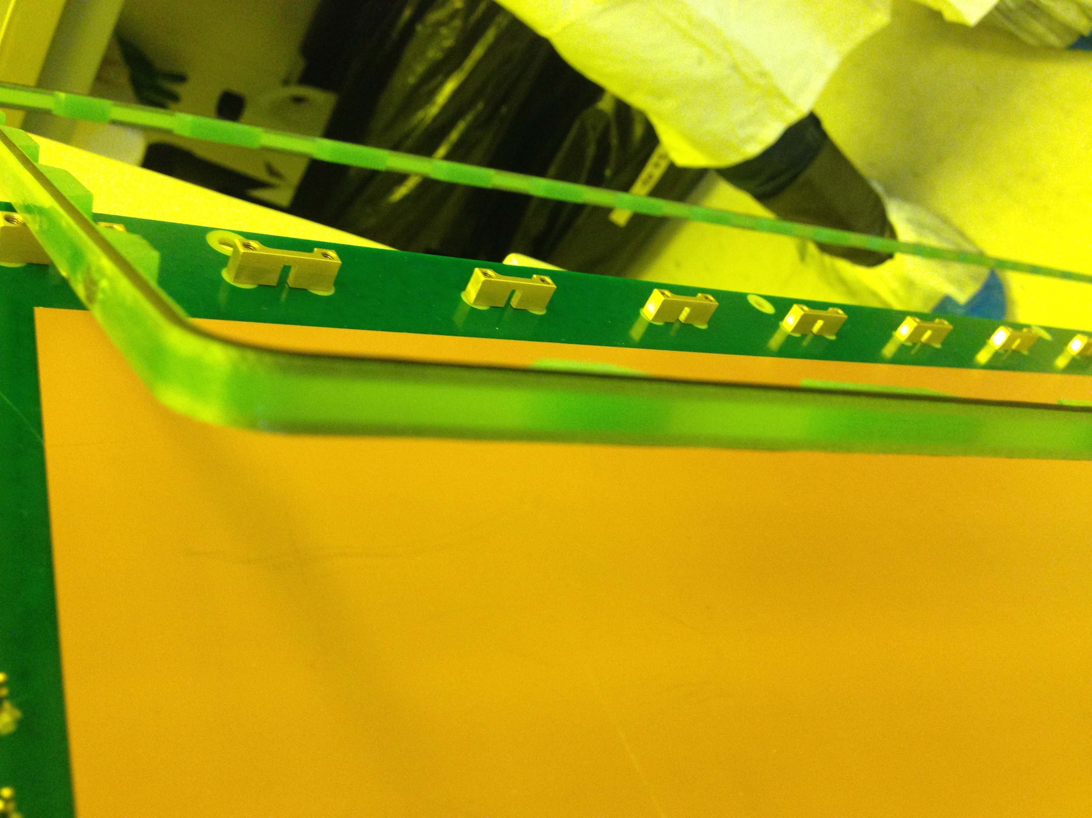
Assembly of GE1/1-V5 Prototype
Brass pullout
New external frame without holes

Slide 18
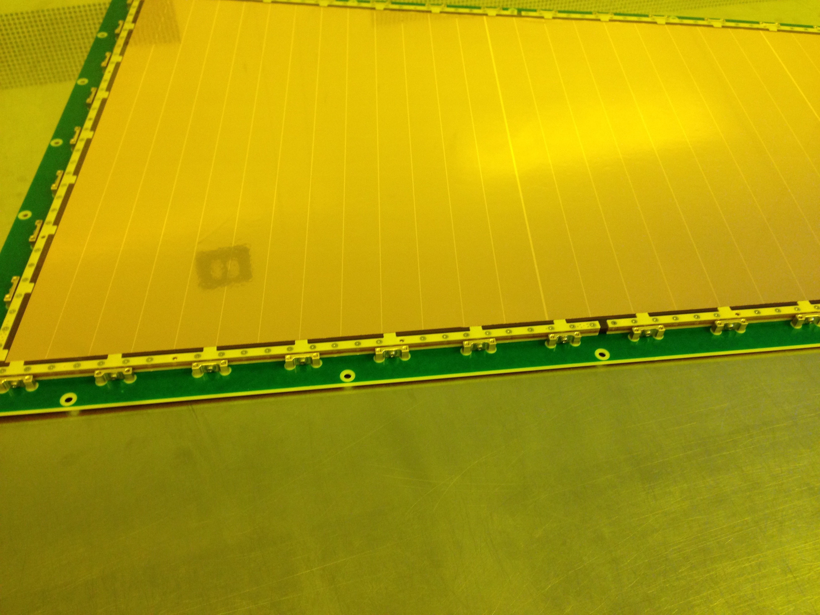
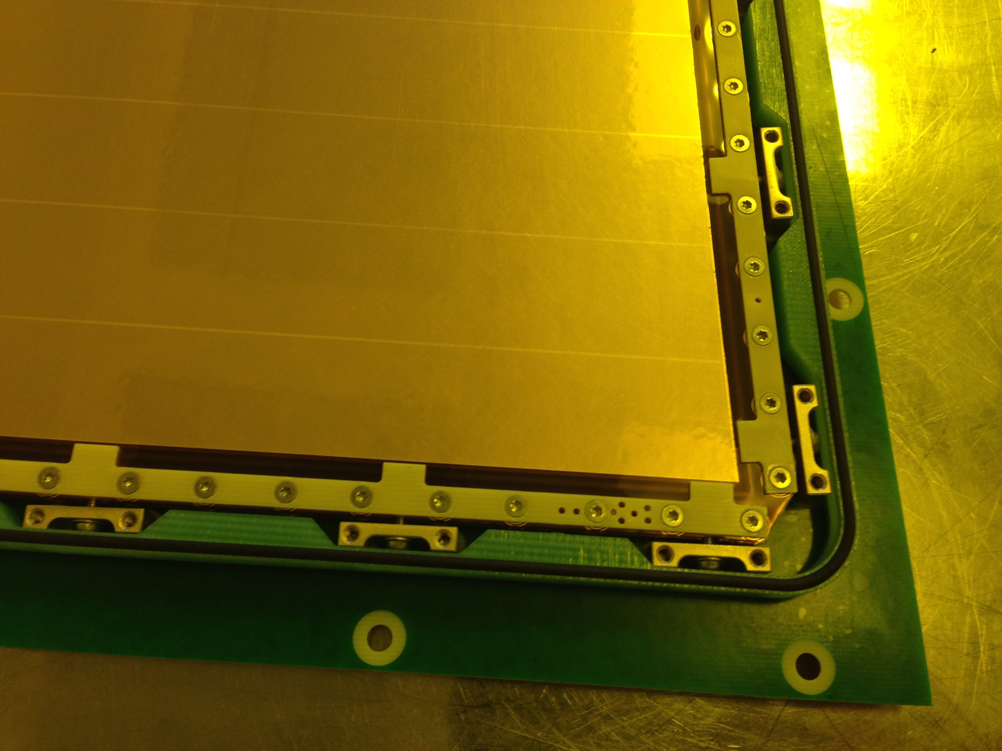
Assembly of GE1/1-V5 Prototype

Slide 19
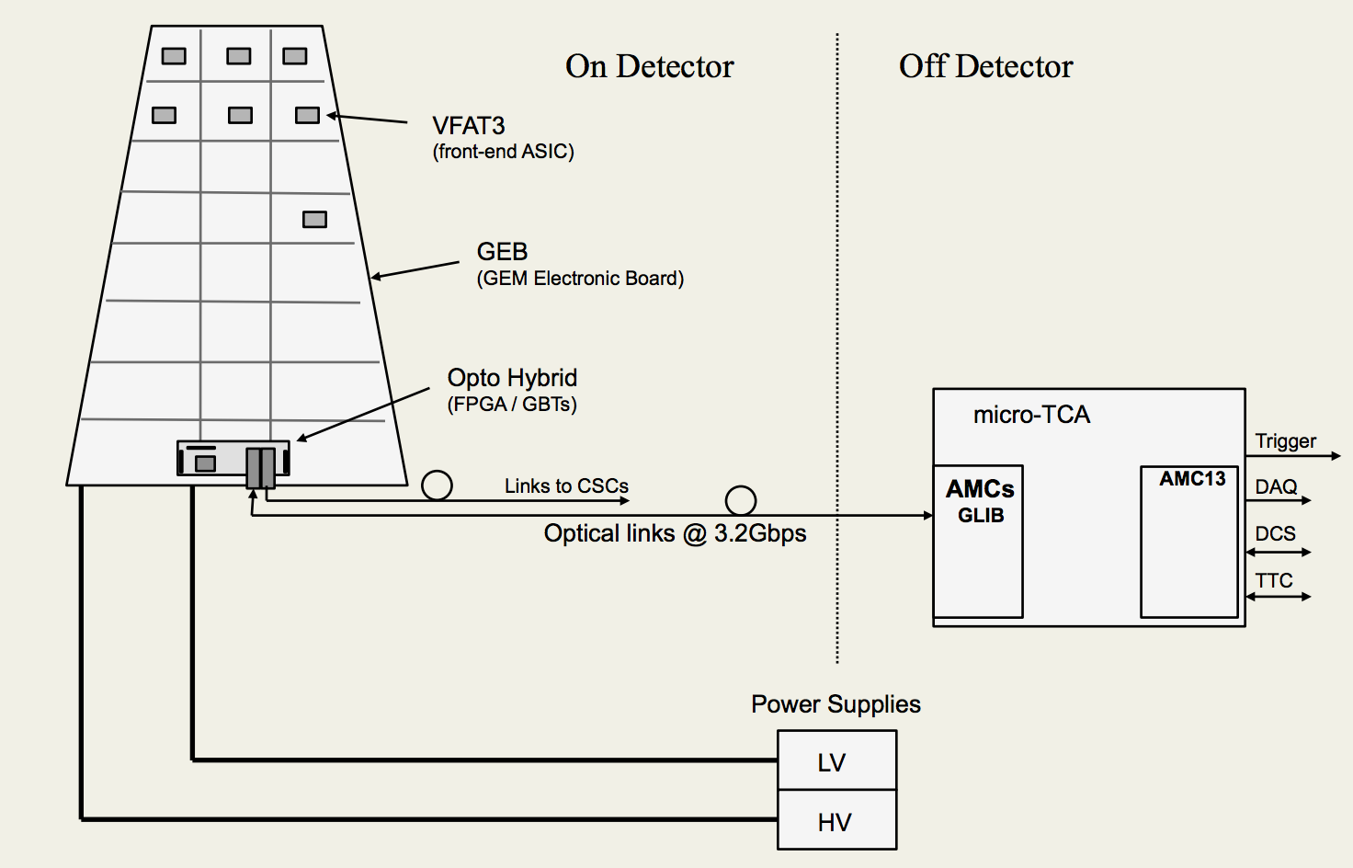
GEM DAQ

Slide 20
GEM DAQ – Status
Version 2 production launched
Firmware development ongoing

Slide 21
GEM DAQ – Status
Switching to MP7
Firmware under development
Being developed by CERN microelectronics group

Slide 22
GEM DAQ – Status
Integration work ongoing at CERN in B904

Slide 23
On-going Activities
Prototype production
X-ray station
CMS GEM Training School
Cosmic stand
CSC-GEM integration stand
Fall 2014 Test Beam
GE1/1 Slice Test in 2016

Slide 24

Prototype Production
See Sinem’s talk regarding status of production sites!!!

Slide 25
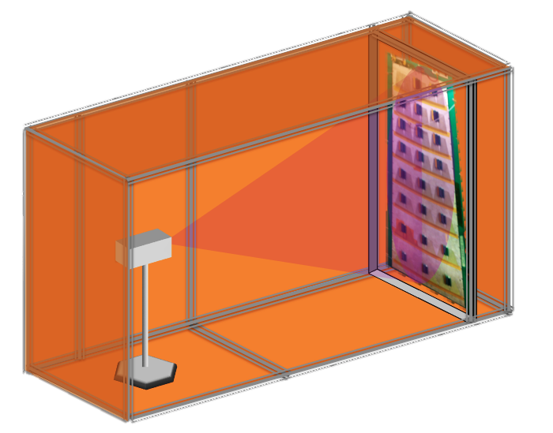
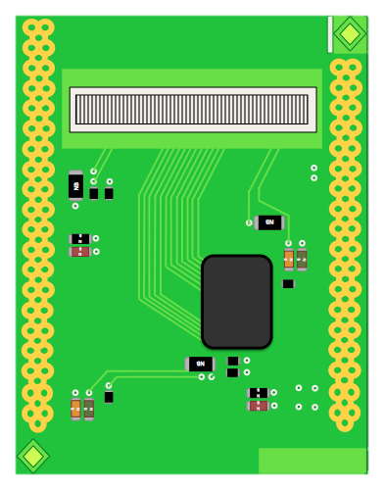
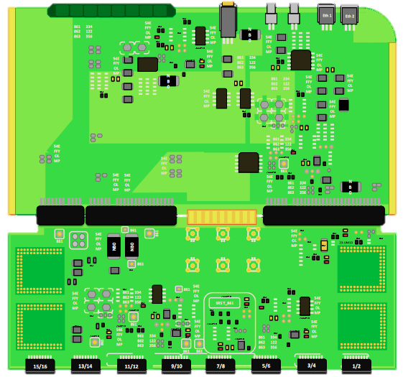

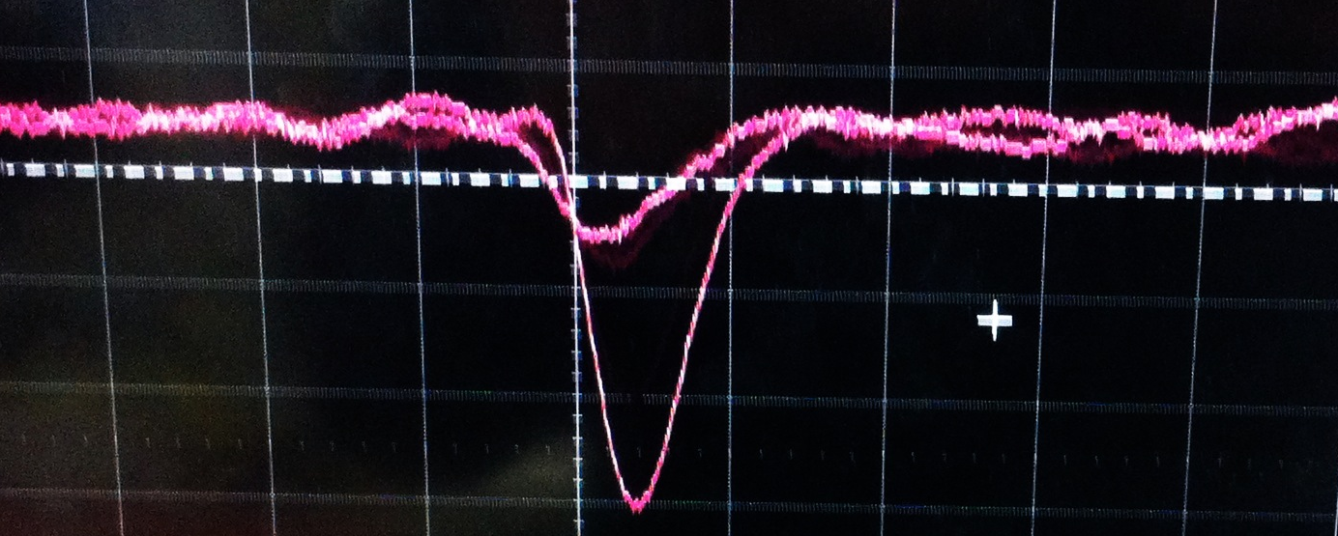
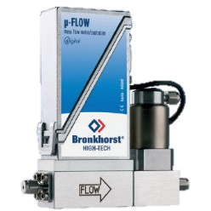
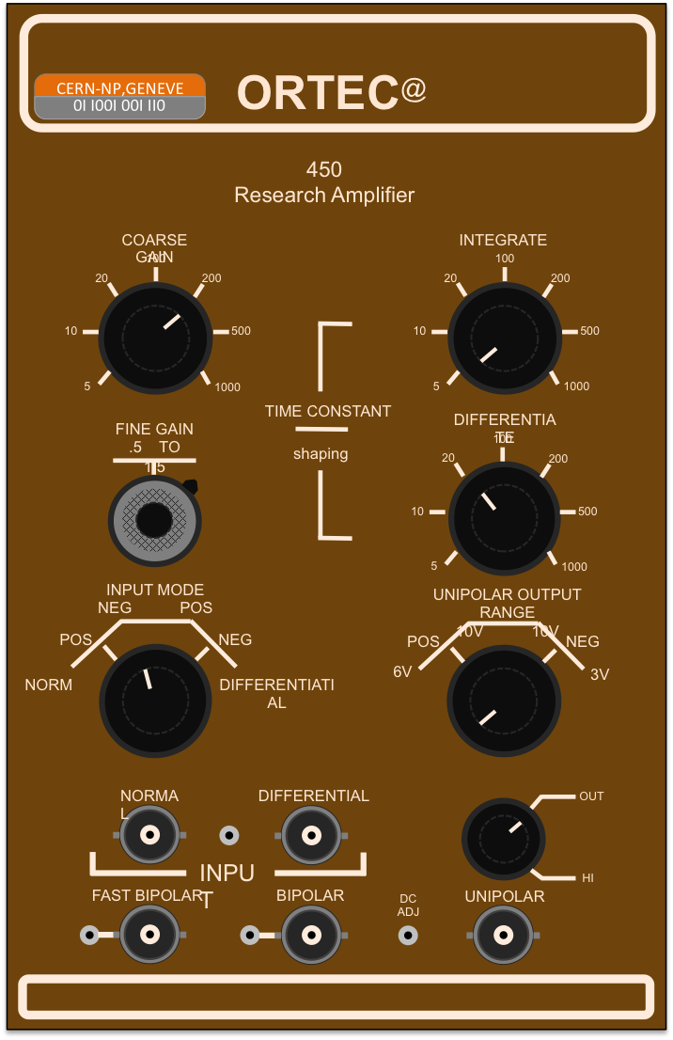
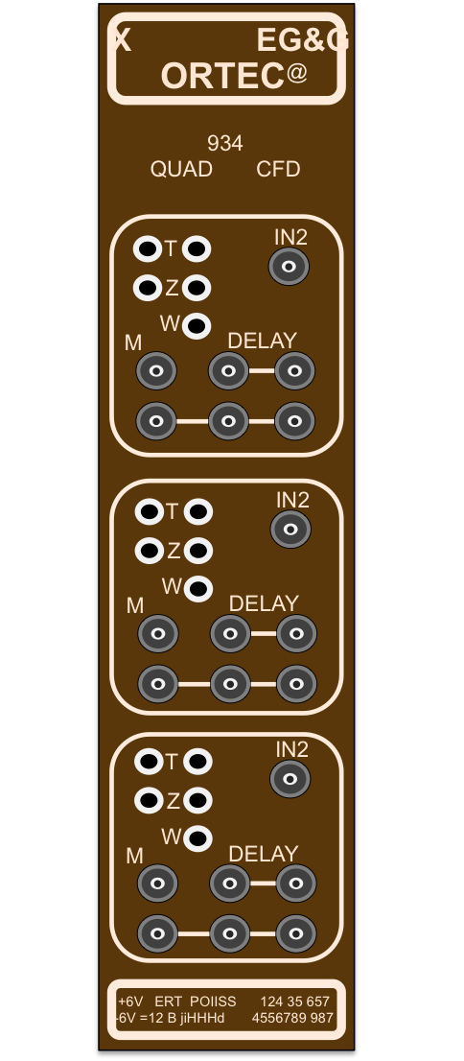

X-Ray Station: Gain Uniformity
APV
SRS
1,20 m
master
Xrays // 8 keV
slave
ON/OFF
Current
Voltage
master
Need two FECs and 24 APVs to scan the entire prototype.
exhaust
slave
Mixture 5l/h
Trigger
Pulse from the bottom of the last GEM
Ar
Latency
Nb of APVs
Internal rate
Veto
Trigger type
CO₂
CF₄
MFC viewer
DATE
MiniX
Amore SRS
DATA
Amplifier
CFD

Slide 26
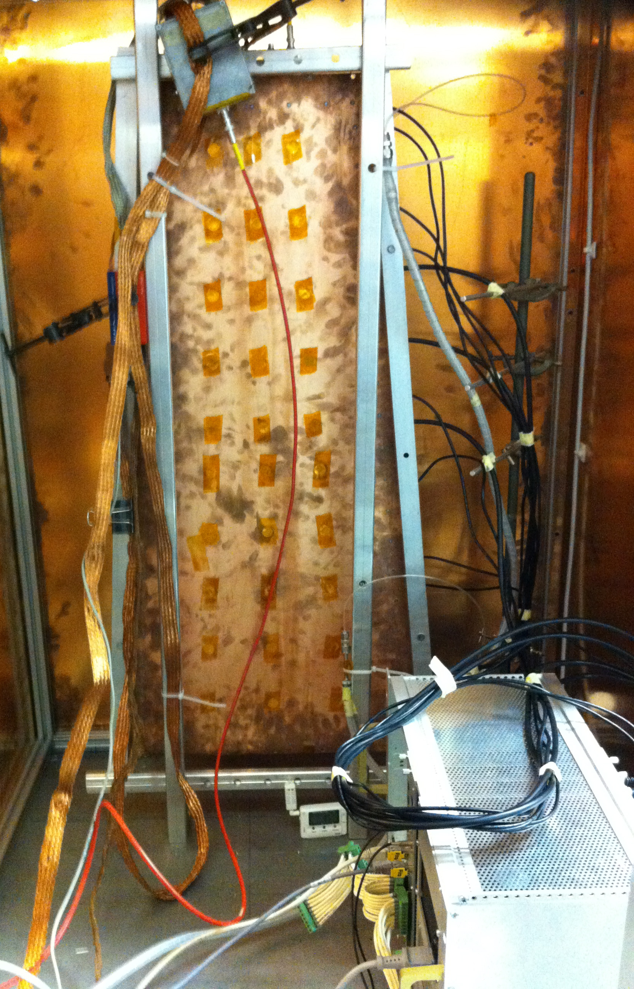
X-Ray Station: Gain Uniformity
APV
SRS
1,20 m
master
Xrays // 8 keV
slave
ON/OFF
Current
Voltage
master
Need two FECs and 24 APVs to scan the entire prototype.
exhaust
slave
Mixture 5l/h
Trigger
Pulse from the bottom of the last GEM
Ar
Latency
Nb of APVs
Internal rate
Veto
Trigger type
CO₂
CF₄
MFC viewer
DATE
MiniX
Amore SRS
DATA
Amplifier
CFD

Slide 27
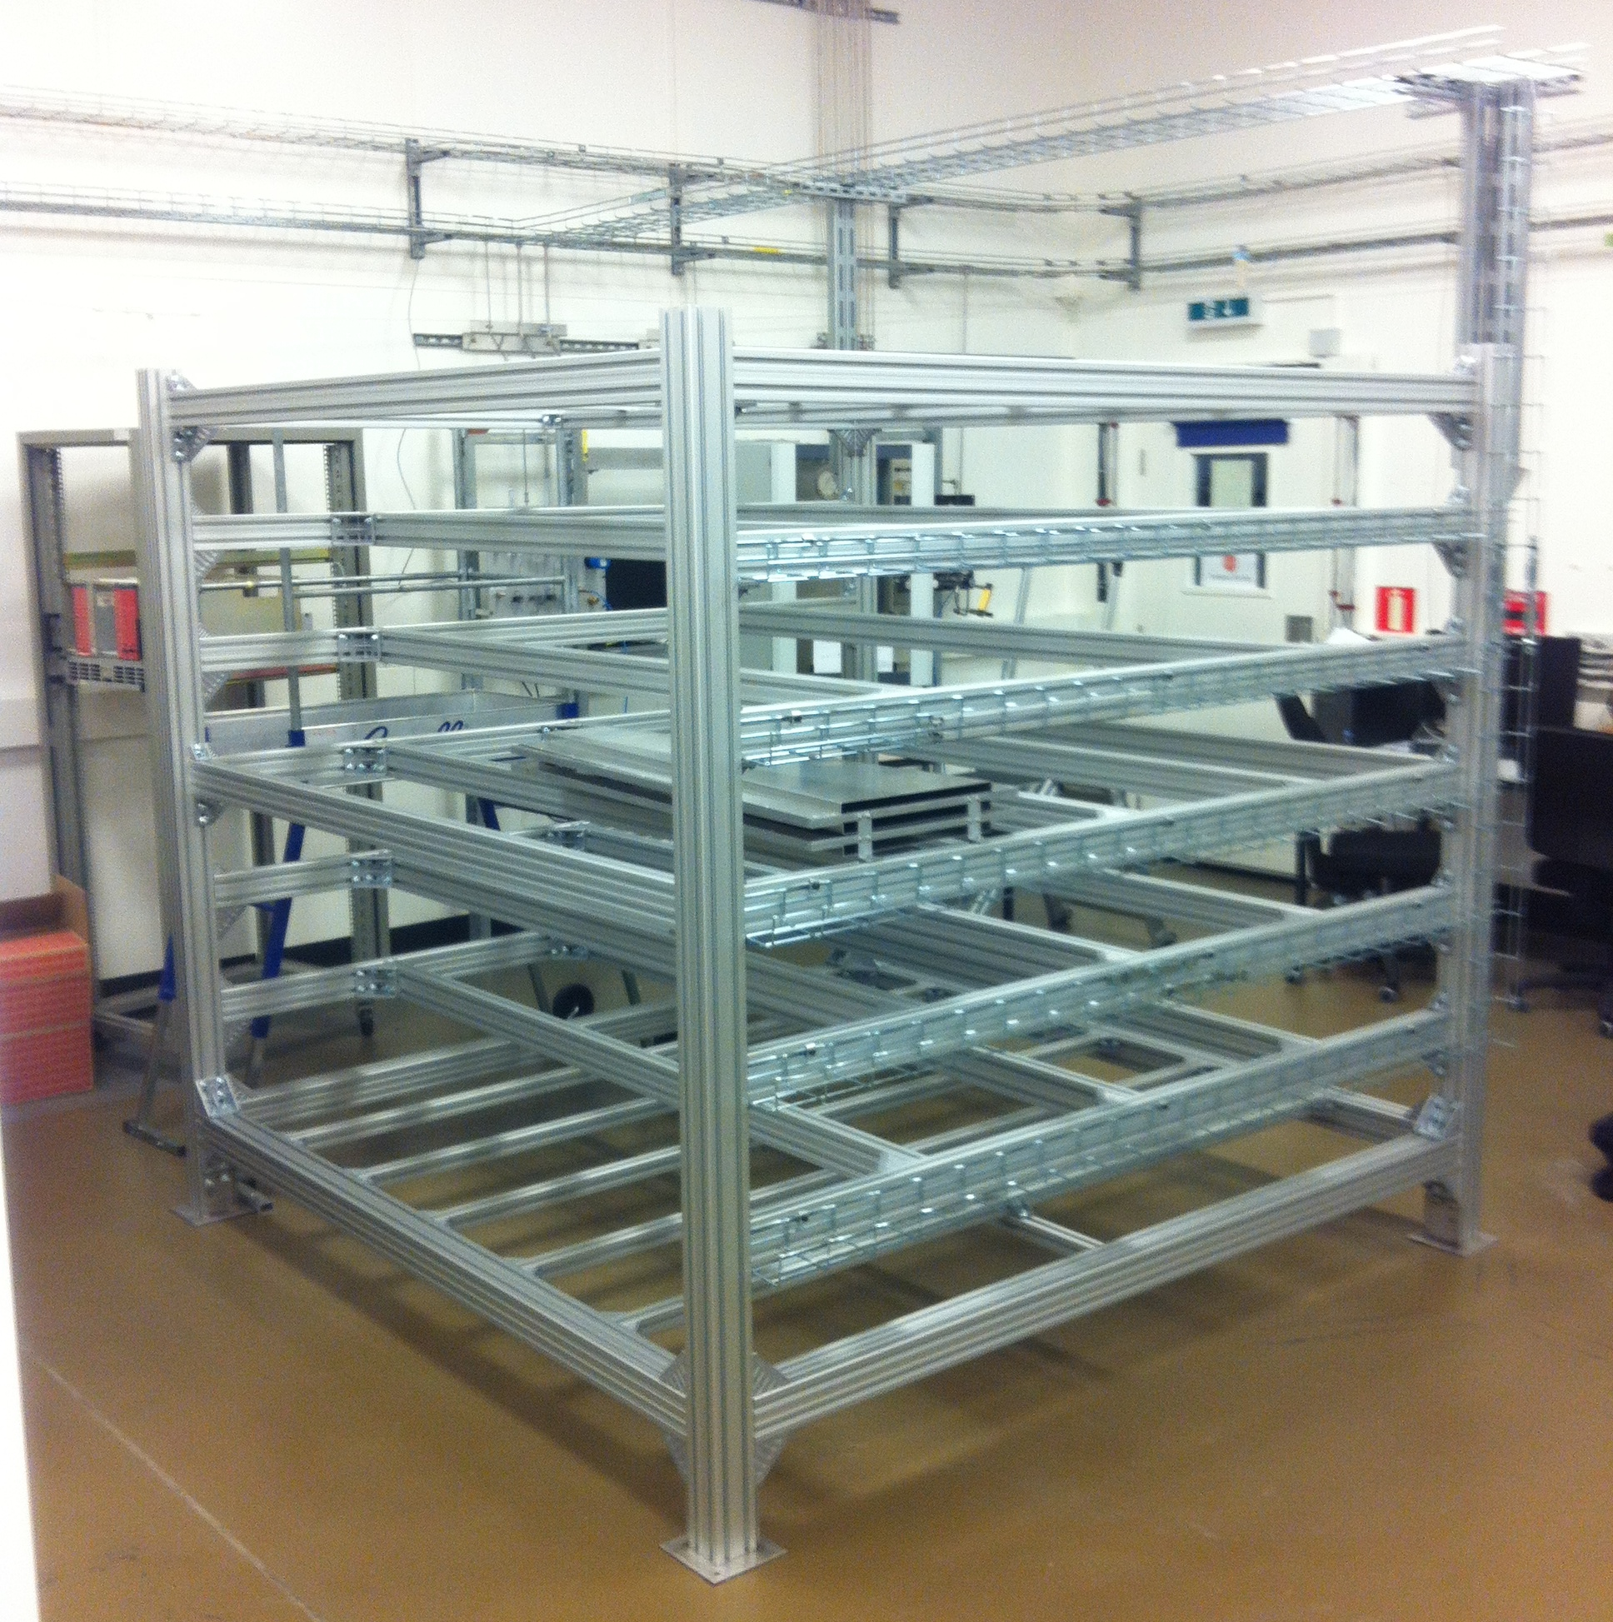
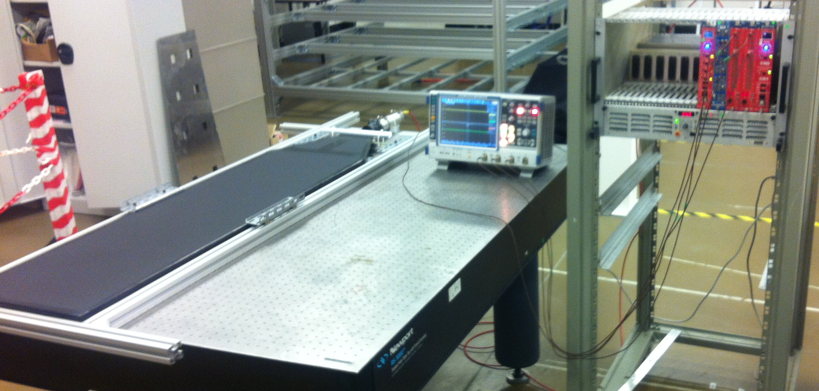
TIF Cosmic Stand
Additional layer of quality control
Construction on going
Aluminum superstructure completed
Assembling scintillators and trigger logic presently

Slide 28
CMS GEM Training School
Introduce new members of the collaboration to principals of triple-GEM detectors
  Leakage current
  Assembly
  HV stability
  Gain calibration
Train expert collaborators in the use of SRS+APV system for gain calibration measurements
  Critical to large scale production of GE1/1 system

Slide 29
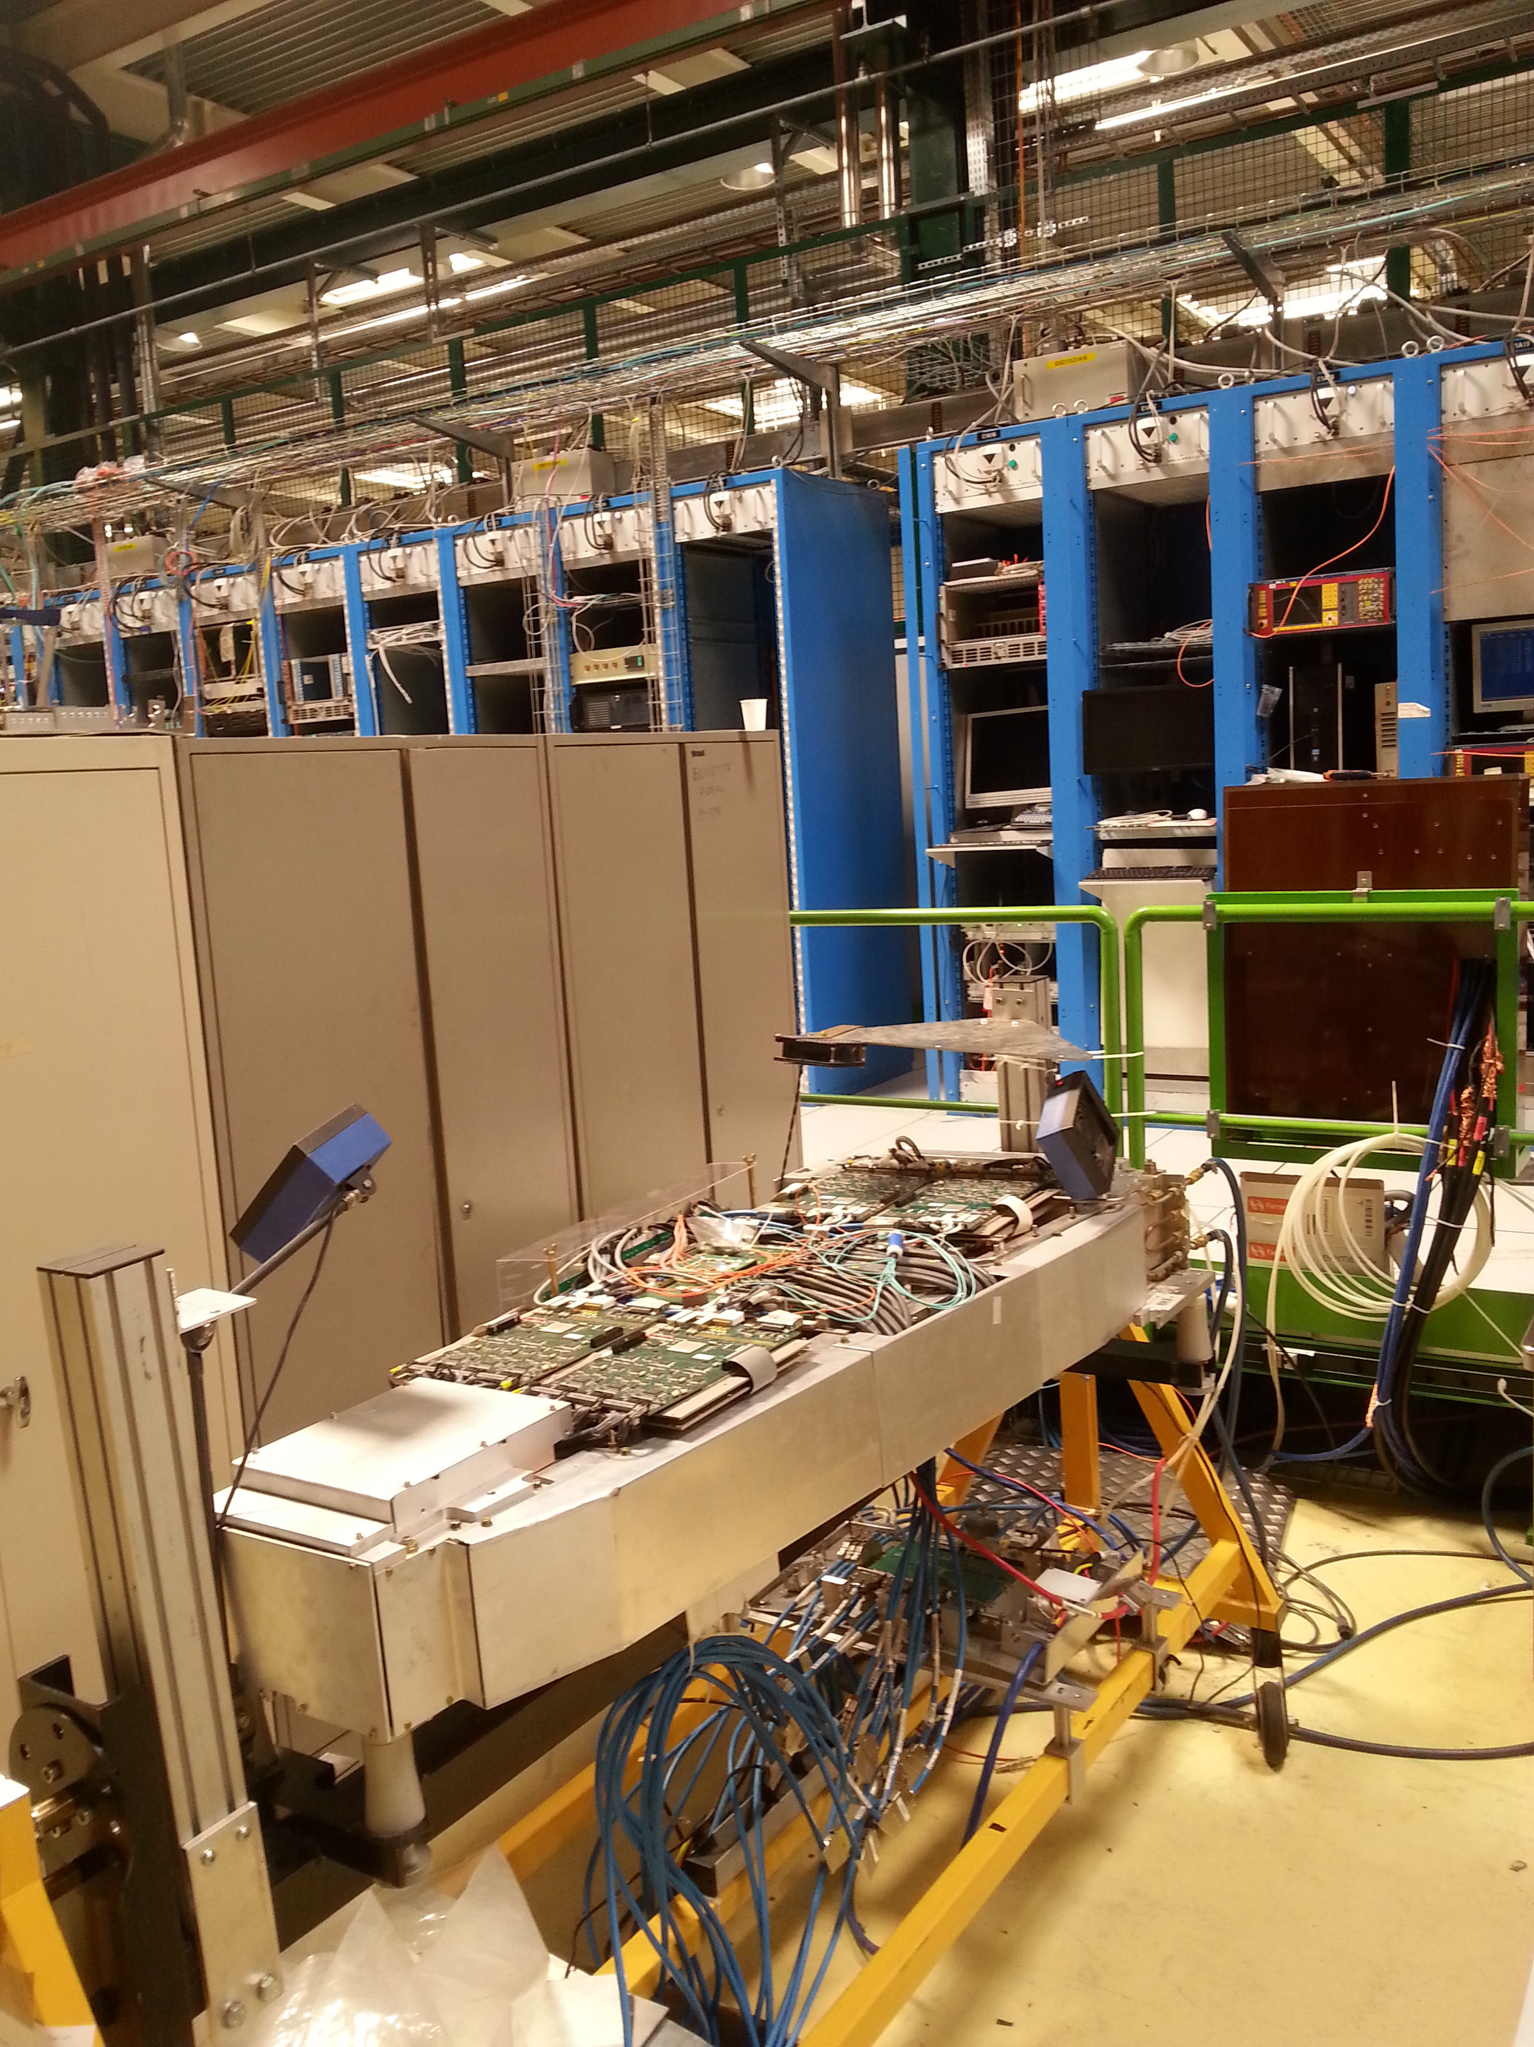
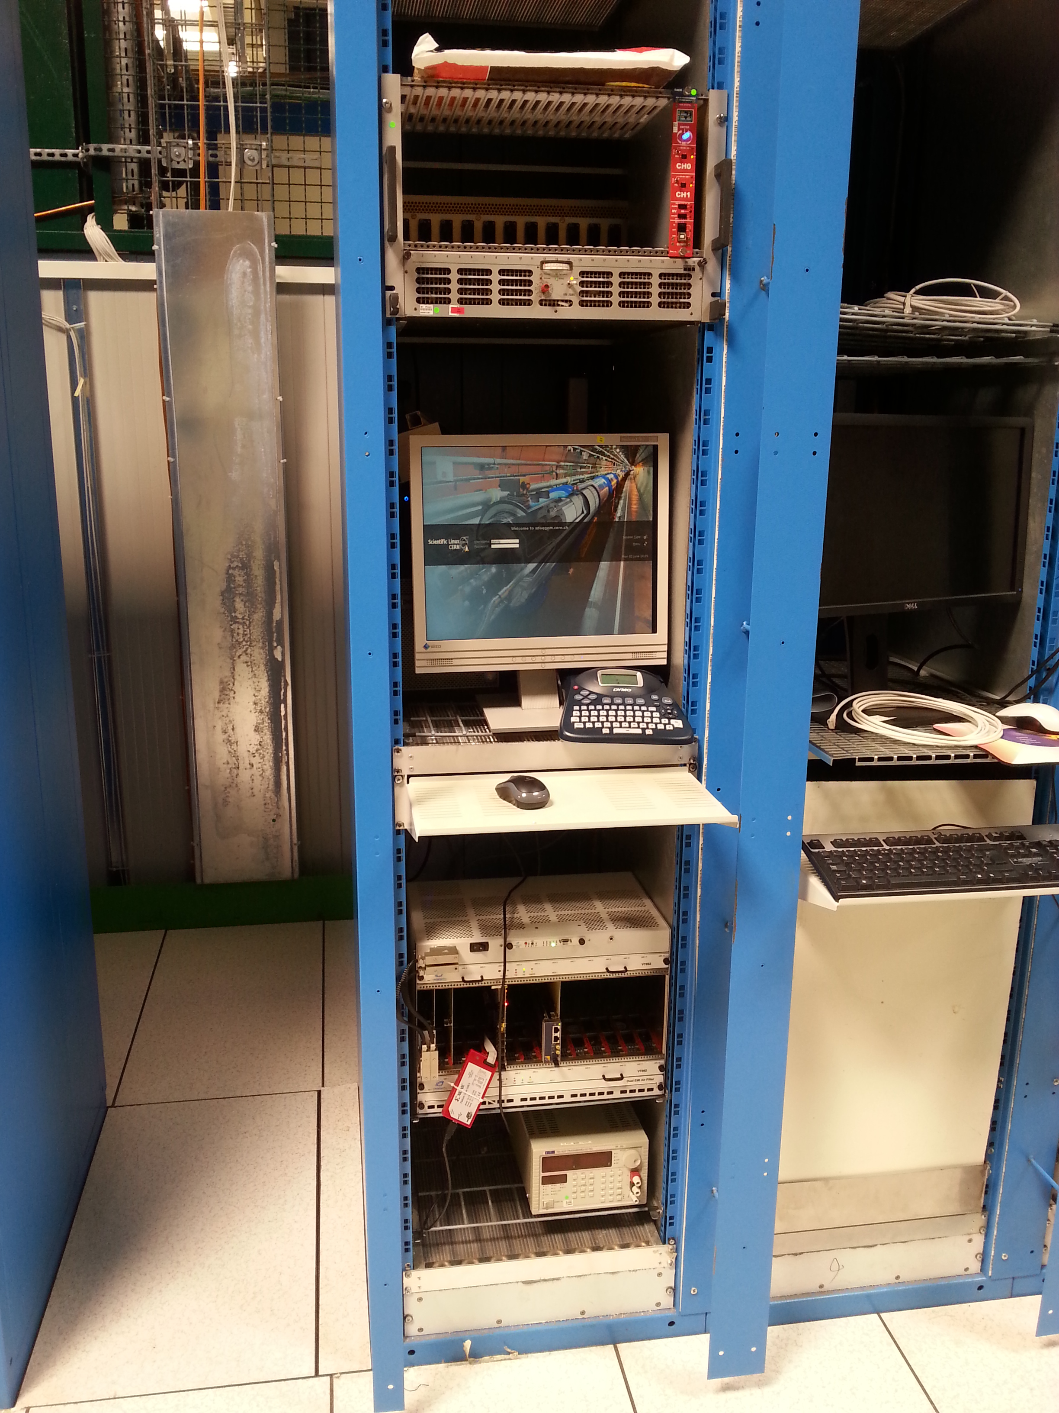
CSC-GEM Integration Stand
Goal: Slice test readiness
  CSC track finding algorithm commissioned before slice test
Full ME1/1 CSC chamber present in B904
Plan to add GE1/1 prototype in tandem
  Position as if they were in CMS
Use cosmics to develop cross chamber communication and trigger logic
HV
Computer for μTCA
CMS GE1/1
μTCA Crate

Slide 30
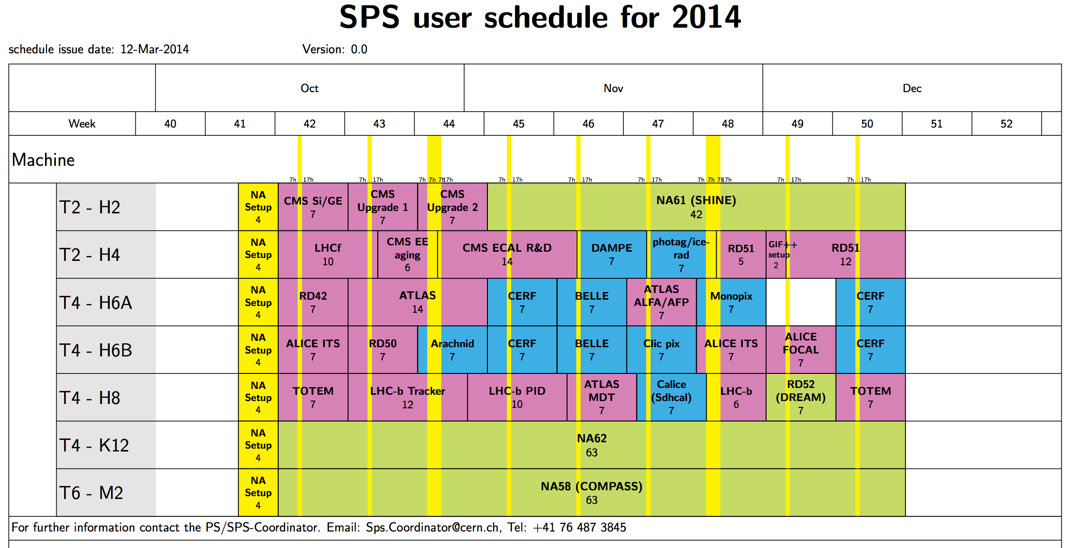
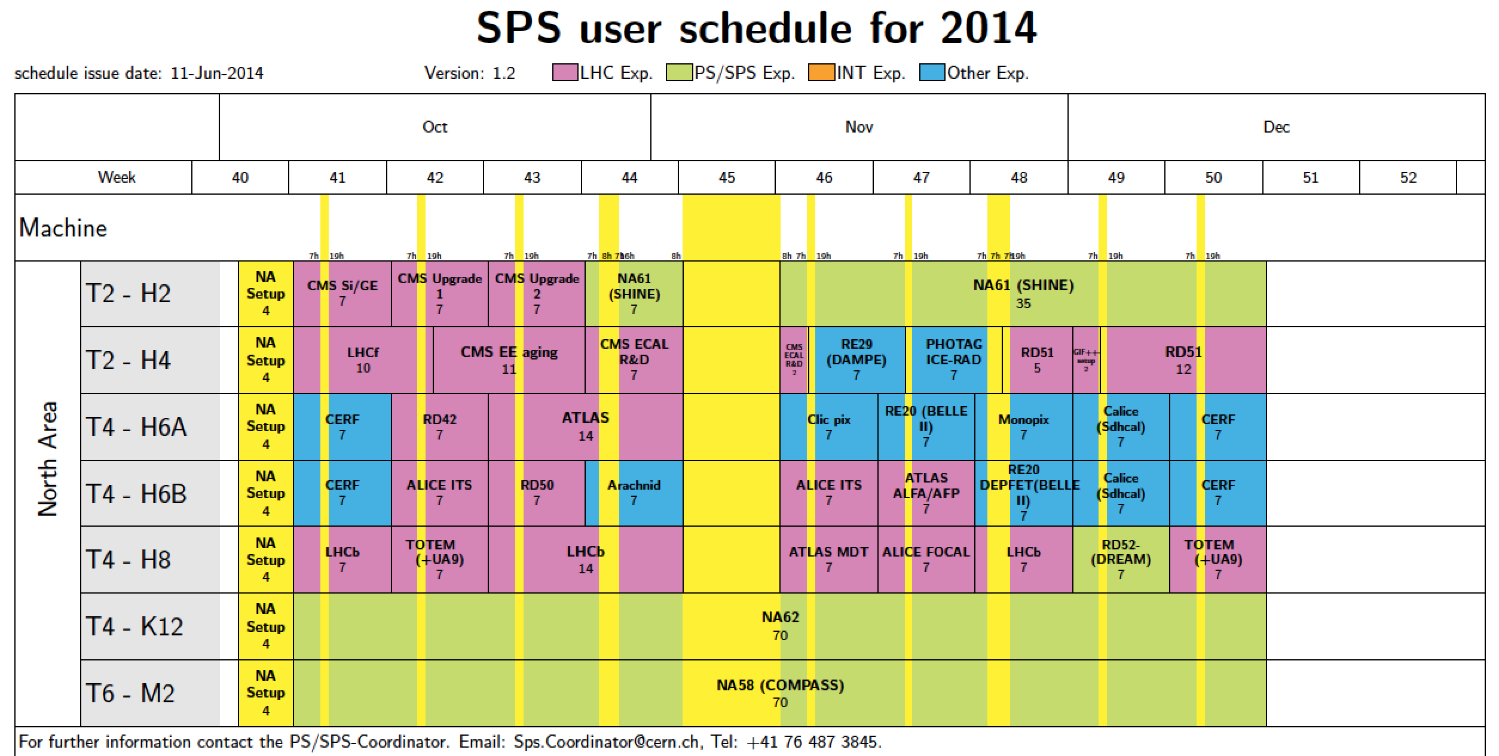
Fall 2014 Test Beam

Slide 31
Fall 2014 Test Beam Setup
H2 Test Beam w/Magnet
H4 Test Beam w/Magnet
October 13th – Nov 2nd
Charge sensitive performance measurements in high B field
Test version one of GEM electronics
Nov 26th – Dec 15th
Timing sensitive performance measurements with B=0
Study impact of radiation dose on performance
Test of version two of GEM electronics
Magnet
RD51 Tracker
GE1/1-V4 GIF
GE1/1-V6-L1
μ
μ
GE1/1-V5
CMS Tracker
GE1/1-V4
No Tracker!!!
1st Tracker
(RD51 Collab.)
GE1/1-V5
GE1/1-V4
2nd Tracker
(CMS GEM Collab.)
Magnet

Slide 32
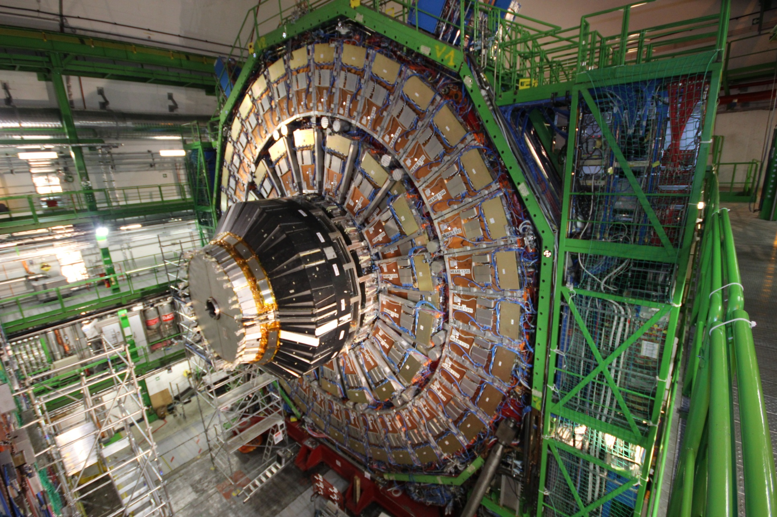
GE1/1 Slice Test
40° wedge
4 superchambers
8 chambers total
GE1/1-Slice TEST
SLOTS 1-2; 35-36
Gas Racks

Slide 33

On-going Activities
X-ray station
CMS GEM Training School
Cosmic stand
CSC-GEM integration stand
Fall 2014 Test Beam
GE1/1 Slice Test in 2016
You can get involved! Ask how!!!
  Discoveries around the corner!!!

Slide 34
Conclusion
Post LS2 presents a challenging pp collision environment
To maintain ability to perform competitive physics measurements CMS must adapt
Muon upgrade based on triple-GEM detectors is an ideal solution for post LS2 operations

Slide 35
Back-up slides

Slide 36
Muon Reconstruction in CMS
Tracks independently reconstructed in:
  Silicon tracker, referred to as tracker tracks
  Muon chambers, referred to as standalone-muon tracks
Global muon reconstruction via outside-in approach
  Attempts to match a standalone-muon track to a tracker track
Tracker muon reconstruction via inside-out approach
  Tracker tracks extrapolated to muon chambers
  Attempt to match to track stub in muon chambers

Slide 37
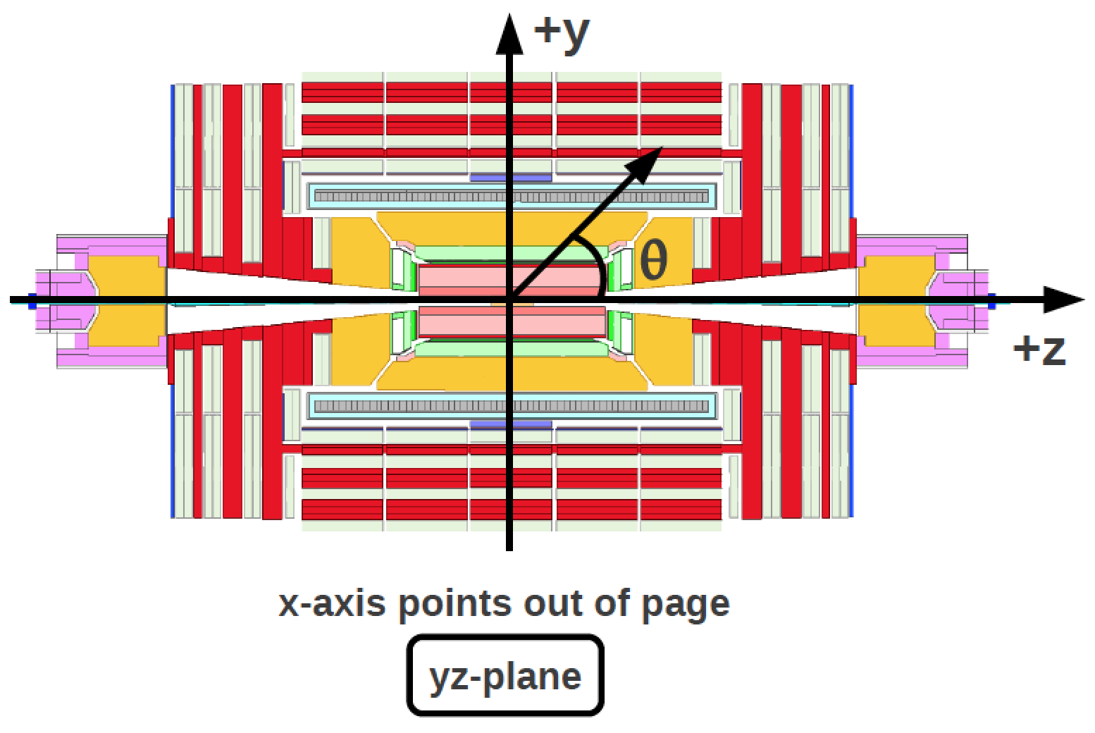
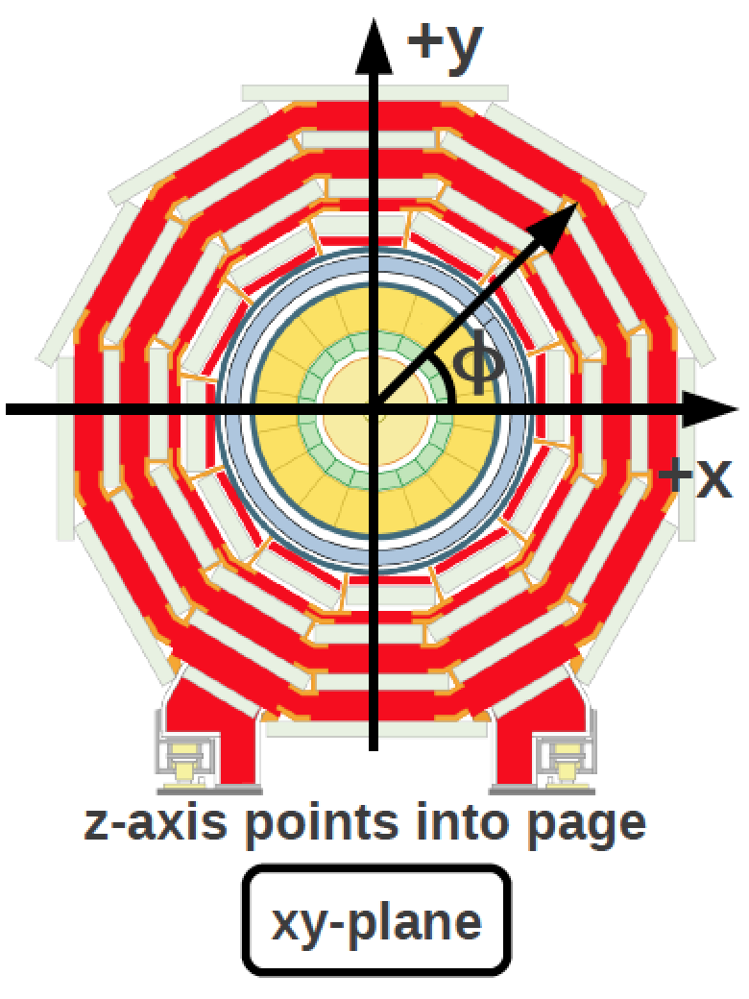
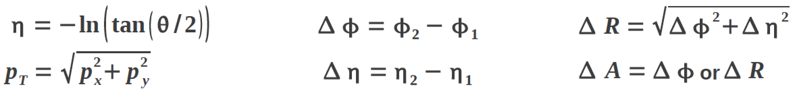
CMS Coordinate System
CMS Collaboration, Detector Drawings, CMS-PHO-GEN-2012-002.

