Slide 1
Update of the
HL-LHC layout and optics
R. De Maria M. Fitterer, with input from G. Arduini, O. Brüning,
R. Bruce, F. Cerutti, L. Esposito, S. Fartoukh, P. Fessia,
M. Giovannozzi, R. Kersevan, M. Korostelev, S. Redaelli, E. Todesco.

Slide 2
Content
Introduction
TAXS aperture
TAXN-TCT-Masks baseline and variants
D2-Q4 correctors usage strengths
Q4 required strength
Q5 IR6 layout
MS in Q10
Conclusion

Slide 3
Introduction
Since HL-LHCV1.0 (see HiLumi meetings, PLC meetings):
  D1,D2 field and length change.
  Dropping MQYL type, no double MQYY for the baseline.
  Corrector package internal lengths changes.
  First review of triplet BPMS.
  Orbit gymnastic and correction studied -> new specs for D2-Q4 orbit correctors.
  Vacuum valves and jumper defined and included.
  Optics implications of Q4 shift studied.
  New TAXS baseline aperture decided now, review planned in one year.
  New D2 beam screen aperture proposed.
  Debris protection and TCT variant discussed.
  LRBB compensator place holder fixed.
  New naming conventions.

Slide 4
TAXS Aperture
Last PLC decision:
  baseline IR 27 mm (instead of 30 mm):
    same aperture in sigma of the triplets
    limits beta* at injection to > 5 m (nominal is 6 m) NB: Injection aperture margins under review.
  WP8 to investigate failure scenarios to justify reduction and in case re-increase the aperture.
  Estimates based on 0.5mm fiducialization and 2 mm of ground motion to be reviewed.

Slide 5
TAN-TCT-Mask: New base line
V1.0
TAN
TCTHV
TCL
MASK
D2
MCBRD
Crab Cavities
MCBYY
Q4
B1
IP
B2
V1.1
TAN
TCTHV
TCL
MASK
D2
MCBRD
Crab Cavities
MCBYY
Q4
B1
IP
B2
New TAN, Mask apertures due to optics and position changes.
Proposed octagonal beam screen for D2.
BB compensator tentatively in front of the TAN.
New position of Q4: .6 MV reduction of crab voltage, additional space for layout variants
(TCT d BB compensator different locations).
TAN – D2 area with added valves and old functional position (no hardware solution yet).

Slide 6
TAN-TCT-Mask: Variants
V1.1
TAN
TCTHV
TCL
MASK
D2
MCBRD
Crab Cavities
MCBYY
Q4
B1
IP
B2
Variants to be studied:
Energy deposition:
  no D2 mask (less effective due to larger distance from the D2),
  thicker TCL jaws ,
  no TCTs and TAN closer to D2.
Collimation:
  TCT protecting Triplet,D2 and Q4 (with possibility to move Q4 to its original position),
  TCT protecting Triplet and D2 (if for phase advance the first option is not feasible).
Vacuum:
  Evaluate feasibility cold masks in D2 (or an orbit corrector if easier) to save longitudinal space and add protection.

Slide 7
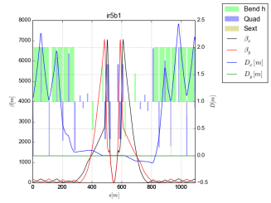
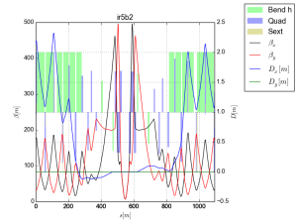
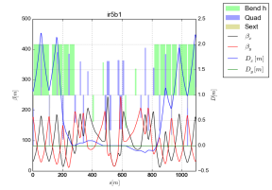
HL-LHC V1.1 optics
Pre-squeeze optics:
Very similar to 1.0
Increase of smallest beta n the crab cavity:
voltage decrease 12.3 MV -> 11.6 MV
If cavities further displaced loss of 0.4 MV every 2m.
Triplet strength: 99.9% (critical magnets)
Q4 strength: 20% (expect 10% during the squeeze)
Q7 strength: 99.9% (critical magnet)
Injection 6m:
Very similar to 1.0
Q4 strength 65% (healthy margin)
Q5 strength 65% (healthy margin)
Injection 15m:
Q4 strength 80% (healthy margin)
Q5 strength 95% (critical magnet)
-> No reduction of Q5 strength acceptable.
-> A possible increase of Q4 length still acceptable.

Slide 8
D2-Q4 Corrector strengths
D2 – Q4 orbit correctors (4.5 Tm each) provides mainly:
  Crossing angle at the IP: Minimum strength 2 Tm, differential B1-B2 0.8 Tm (one plane only).
  Beam alignment for crab cavities: B1/B2 differential +- 0.8 Tm (both planes) for
    for +-0.2 mm between cavities in the same beam line
    For +-0.5 mm between cavities between beam lines
  Separation and offset at the IP, triplet misalignments and external orbit errors: about +- 0.5 Tm.
The correctors are never operated at max strength in both planes. If 3 T for 1.5 is not possible:
  staggered correctors with higher field
  ->nested design seems more efficient if ).

Slide 9
Q5 in IR6
Decision to use and additional MQY in the arc side of Q5.
To be decided if building existing LHC assemblies (two per side) like:
  2xMQY+3xMCBY (same assembly of IR2-IR8 Q4) to replace existing Q5;
  MQY+MCBY (IR6-IR4 assemblies) to be placed close to the existing Q5.
Decision has small impact on the optics, but should be known in advance.

Slide 10
Main Sextupole in Q10
The present ATS optics still needs 4 additional 2-in-1 MS in Q10.
Absence implies at constant collision beta* :
  larger ATS squeeze in the ARCs (longer squeeze, less aperture in the arcs, less optics flexibility in IR8, IR6, IR4, IR2),
  degradation of the dynamic aperture.
They are not hard limits (an easiest location in the missing dipole is 30° apart) but with them there is an additional risks in the performance reach.

Slide 11
Conclusion
HLLHCV1.1 is an incremental step of V1.0 adding realistic constraints but still:
  beam screen and collimator settings needs to be validated
  Protecting hardware in the TAXN – D2 region does not have consistent hardware.
HLLHCV1.1 will be used for:
  evaluating the most effective designs for TAN, TCL and masks,
  evaluate functional positions of TCTs and validate collimation settings for cleaning and failures,
  Validate missing vacuum and cooling elements (valves and beam screen in particular for D2 and Q4),
  Validate aperture at injection with updated criteria.
Timeline: integration study completed this week, new optics, aperture models, tracking tools squeeze are being prepared and published in this order in the following weeks to /afs/cern.ch/eng/lhc/optics/HLLHCV1.1.

