Slide 1

DESIGN OPTIONS FOR ORBIT CORRECTORS IN D2 and Q4
CERN, 2th July 2014
WP3 meeting
E. Todesco
CERN, Geneva Switzerland
Acknowledgements:

Slide 2
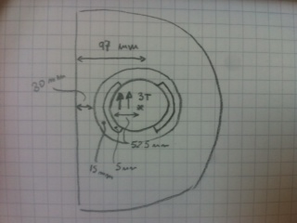
REQUIREMENTS
Integrated force: 4.5 T m
Aperture: 105 mm
  In Q4 could be less be we want to minimize number of different magnets, and spares
Present first guess lay-out:
  3 T field, two units 1.5-m-long (one H and one V)
Cross talk problem:
  Flux of 52.5 mm times 3 T ∼150 T mm
    Needs ∼75 mm of iron for total
    shielding
  Beam inter-distance is 97 mm
    Minus 52.5 mm aperture,
    Minus 5 mm coil
    Minus 15 mm collars
    Only ∼30 mm of iron available

Slide 3
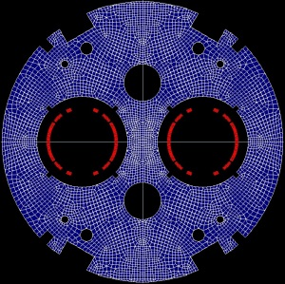
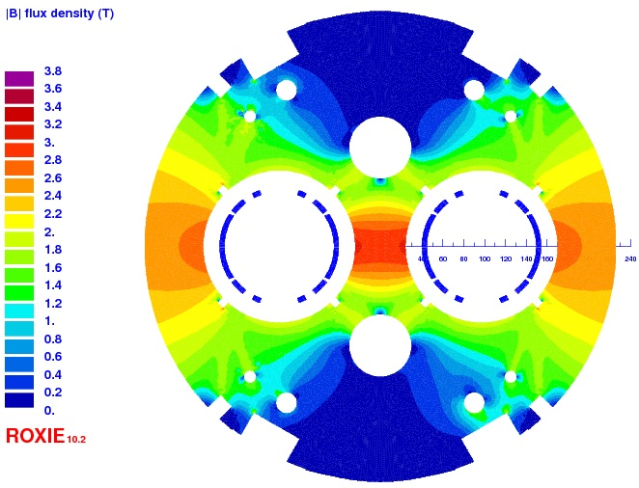
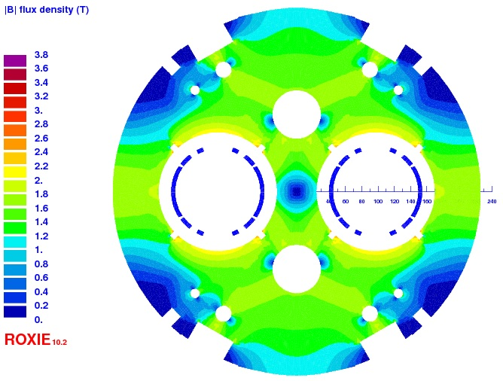
OPTION 1
3 T operational field H/H configuration
  If aperture 1 is changed from + 3 T to – 3 T, aperture 2
  changes (for the same current) from 2.68 to 3.00 T (12%)
  Δb₃=200 units between two configurations
  Same length as baseline
At 3200 A, 2.68 T per aperture
At 3200 A, 3.00 T per aperture

Slide 4
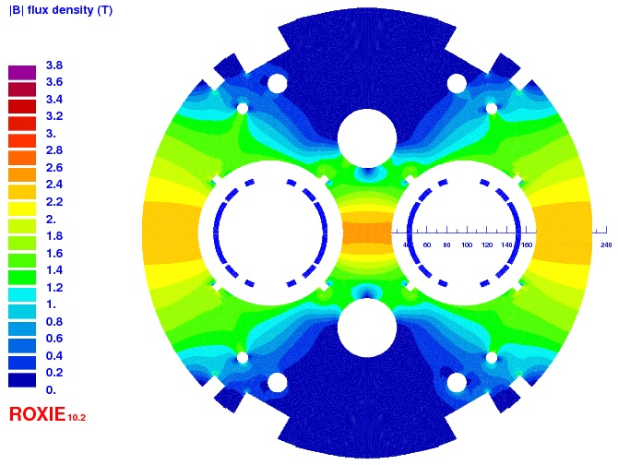
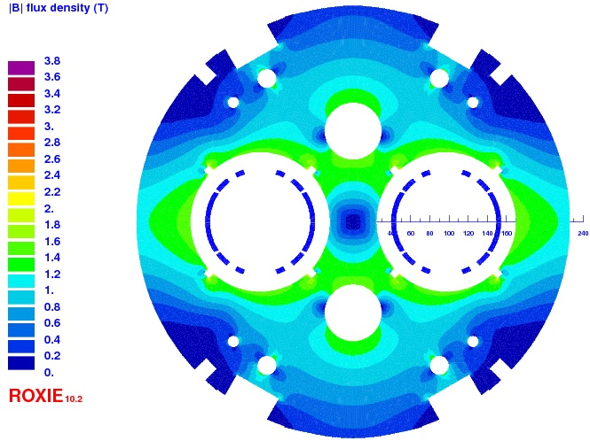
OPTION 2
2.1 T operational field for the H/H configuration
  If aperture 1 is changed from + 2.1 T to – 2.1 T, aperture 2
  changes (for the same current) from 2.1 to 2.0 T (5%)
  Δb₃=100 units between two configurations
  Longer lengths in the baseline of 65 cm per magnet, i.e. 1.3 m more at D2 and 1.3 m more in Q4
At 2230 A, 2.00 T per aperture
At 2230 A, 2.10 T per aperture

Slide 5
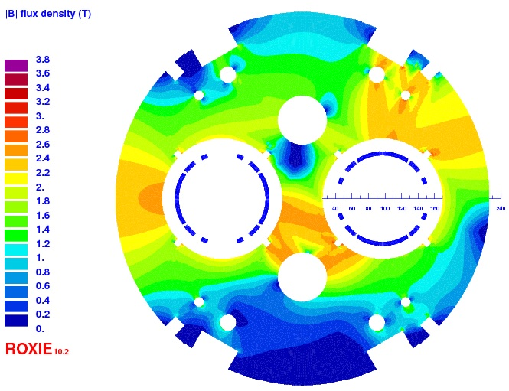
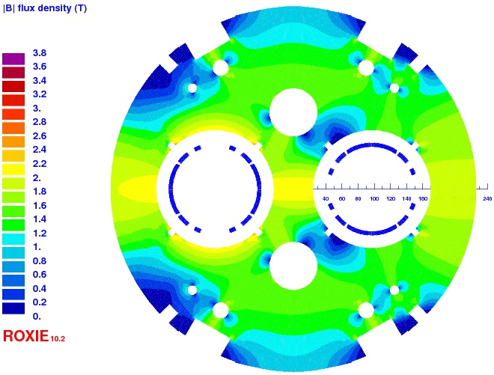
OPTION 3
3 T operational field H and V configuration
  If aperture 1 (H) is changed from + 3 T to 0 T, aperture 2 (V) changes (for the same current) from 3.00 to 3.13 T (4.3%)
  BUT: perpendicular field induced in the other aperture
    3 T B1 in aperture 1 induces 0.08 T A1 in aperture 2
    3 T A1 in aperture 2 induces 0.03 T B1 in aperture 1
  Same length as baseline
At 3350 A, 3.00 T per aperture
At 3350 A only in Ap1 1, 3.13 T in Ap 1

Slide 6
OPTION 4
2.5 T operational field H and V configuration
  If aperture 1 (H) is changed from + 2.5 T to 0 T, aperture 2 (V) changes (for the same current) from 2.52 to 2.57 T (2%)
  BUT: perpendicular field induced in the other aperture
    3 T B1 in aperture 1 induces 0.03 T A1 in aperture 2
    3 T A1 in aperture 2 induces 0.01 T B1 in aperture 1
  30 cm longer magnets, so 60 cm space needed at D2 and 60 cm at Q4

Slide 7
OPTION 5
Have nested correctors
  2.1 T operational field in H and V (over a square)
  No cross-talk
  More challenging magnet
  Longer lengths in the baseline of 65 cm per magnet, i.e. 1.3 m more at D2 and 1.3 m more in Q4

Slide 8
OPTION 6
Have staggered correctors
  Keep 3 T as operational field, but have single aperture magnets
    Iron is enough to shield totally the other aperture
  Easier and simpler solution
  We double the magnets, so 400 cm space needed at D2 and 400 cm at Q4

Slide 9
CONCLUSION
Keeping present baseline
  HH: 12% variation of TF according to the other aperture current
    About ±100 units of b₃, no skew (Option 1)
      Tolerable?
      FiDeL with a matrix of two apertures?
  HV: 4% variation of TF according to the other aperture current
    1% to 2.5% of the max field goes in the other aperture (Option 3)
Lowering field to 2.5 T (plus 0.6 m in D2 and in Q4)
  HV: 2% variation of TF according to the other aperture current
    0.3% to 1% of the max field goes in the other aperture (Option 4)
Lowering field to 2.1 T (plus 1.3 m in D2 and in Q4)
  HH: 5% variation of TF according to the other aperture current
    About ±50 units of b₃, no skew (Option 2)
  Making nested correctors, single aperture (Option 5)
Single aperture correctors, non nested (plus 4 m) (option 6)

