Slide 1
11T Dipoles: Aperture and orbit correction requirements
R. De Maria.
Thanks to L. Bottura, R. Bruce, S. Fartoukh M. Giovannozzi, B. Holzer,
M.Karppinen, S.Redaelli, F. Savary.

Slide 2
Scenarios
11T dipoles (MBH) will allow to introduce collimators in the dispersion suppressor to mitigate diffractive losses originated at the IP or at the collimators and being intercepted by the first dispersive aperture bootlenecks.
WP5 identified the following scenarios
Scenario 1: Post-LS2
  One TCLD/11T dipole unit in the DS's of IR2 (MB.A10)
Scenario 2: Post-LS3 - A
  One TCLD/11T dipole unit in the DS's of IR2 (MB.A10)
  Two TCLD/11T dipole units in the DS's of IR7 (MB.B8, MB.B10)
Scenario 3: Post-LS3 - B
  One TCLD/11T dipole unit in the DS's of IR2 (MB.A10)
  Two TCLD/11T dipole units in the DS's of IR7 (MB.B8, MB.B10)
  Two TCLD/11T dipole units in the DS's of IR1/5 (MB tbc)

Slide 3
Issues
Aperture: MBH are straight therefore less available aperture. Apertures may be made bigger Coil ID 56mm -> 60 mm.
Transfer function: MBH does not have the save field for the same current, therefore:
  A) install a trim power converter or,
  B) implement orbit bumps in the neighborhood of the replaced dipoles :
    Aperture loss for the circulating beam at injection
    Aperture loss or the particle debris in collision
    Orbit corrector strength reduction at top energy
Not for this talk:
Persistent current b3 are large, therefore:
  Add a spool (synergy with MS.10 in IR15 for scenario 3.b).
  Evaluated impact on DA at injection and ATS optics flat if geometric used to mitigate B3 at inj. are still there in a range between 6-7 TeV.
  Feed down effects if orbit is not centered.
Higher order multipoles are present and have similar implication but more difficult to foresee a spool.

Slide 4
Aperture model
MBH
MBH Beam screens parallel on the MBH central reference orbit:
Straight nominal MB type (22 mm radius,17.15 mm gap)
Larger straight beam screen: need beam screen transitions.
Curved nominal MB type by taking advantage of the aperture (sagitta 1.6 mm). Equivalent to MB apertures.
(0.8,0.9,0.5) (r,h,v) mechanical tolerances assumed for all models.
Aperture margin estimates for circulating beam:
At injection the parameters are being reviewed. In this talks n1 standard method is used (20% beta-beat, 4 mm co, 1.5 10⁻³ delta, 27cm arc spurious dispersion, 3.75 µrad emit, 6.7|7 defoc.|foc. target).
At collision energy aperture for the circulating beam is generally available even with ATS, however for scattered particles new bottlenecks may introduced.
B1
B2

Slide 5
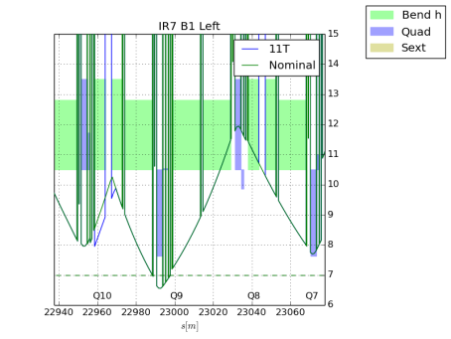
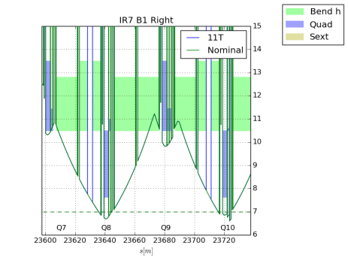
Aperture impact injection

Slide 6
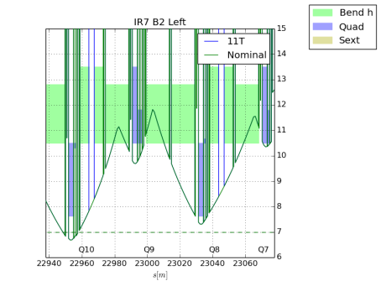
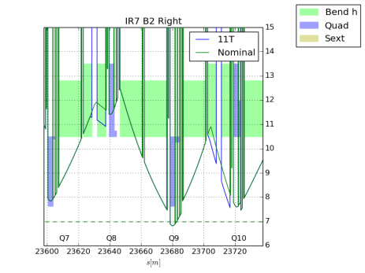
Aperture impact injection

Slide 7
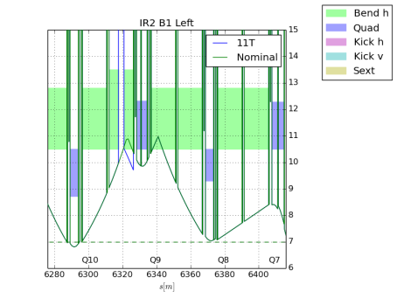
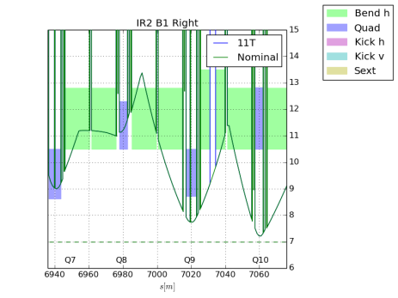
Aperture impact injection

Slide 8
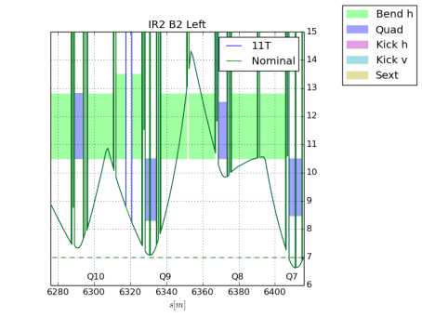
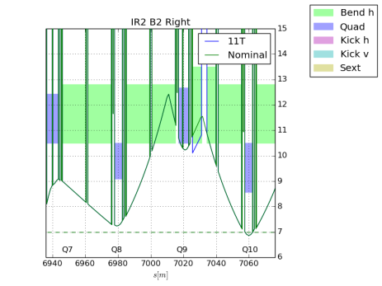
Aperture impact injection

Slide 9
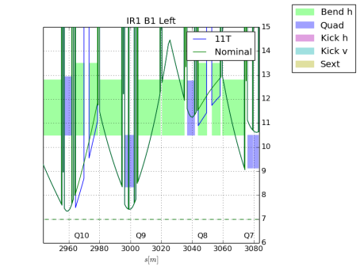
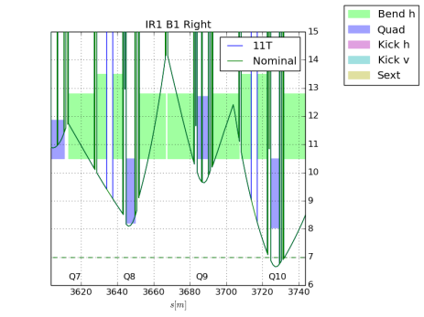
Aperture impact injection

Slide 10
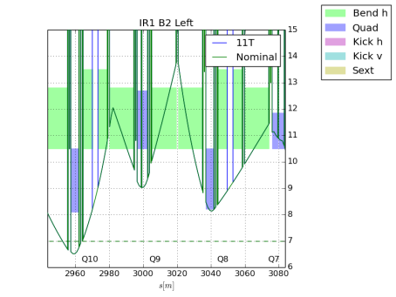
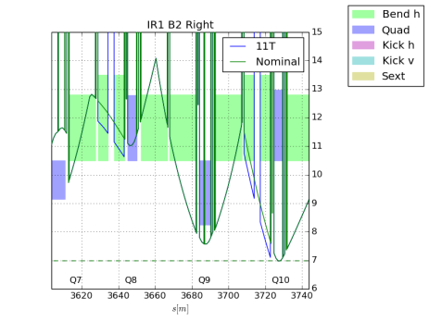
Aperture impact injection

Slide 11

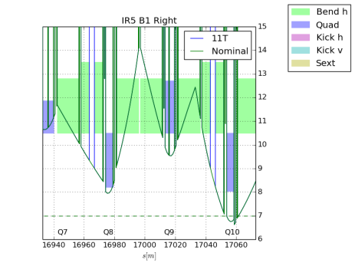
Aperture impact injection

Slide 12
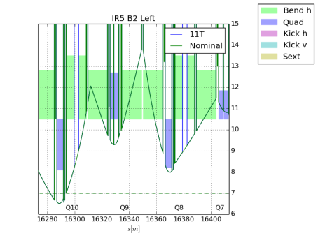
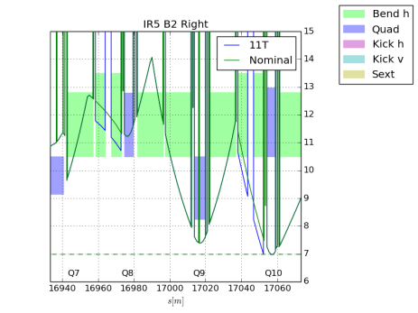
Aperture impact injection

Slide 13
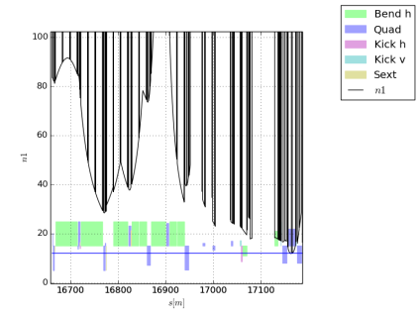
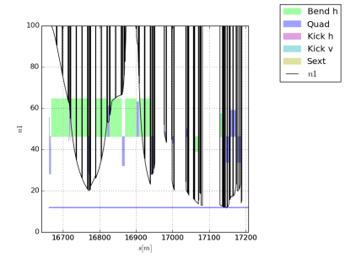
Typical Collision 7TeV Aperture

Slide 14
Aperture impact
Without any orbit bump, a straight nominal beam screen aligned with the reference orbit at the center of the MBH and shifted by half sagitta and fiducialized with the same MB tolerances is just compatible with the present aperture model.
For the HL-LHC similar results holds.
Beam tolerances for aperture margin estimates are under review.
The analysis does not include possible bottlenecks

Slide 15
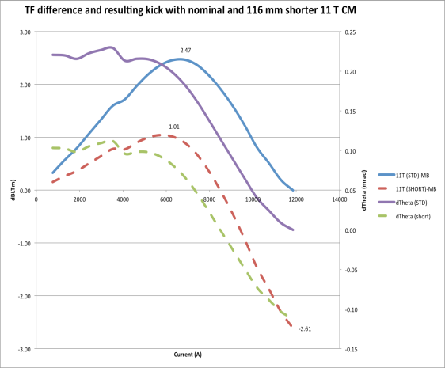
Transfer function scenario
11T dipoles are stronger than MB at low field, e.g. (optimization are still on going).
In this talk I assume per MBH:
~50 µrad at 0.45-3.5TeV
~15 µrad at 6 TeV
~0 µrad at 7 TeV
Orbit bumps needed to correct the effect unless a trim power converter is used.
Orbit bump issues:
Aperture restriction at injection.
Strength limitation at during the ramp.
Residual bumps at flat top may interplay with collimations.
Increase operation complexity.
M. Karppinen

Slide 16
BFPP mitigation by bumps
Proposed in R. Bruce et al, Phys Rev STAB, 12, 071002 (2009)
Apply bump to main beam orbit in loss region, also moves BFPP beam away from impact point, reducing flux, angle of incidence, peak power density.
Tested opportunistically in 2011 Pb-Pb run gained on BLM signals.
If truly effective and reliable, and accepted by Machine Protection, could be an alternative to DS collimators.
May have to rely on this in the period after LS1.

Slide 17
Orbit corrector budget
 | Q12 | Q11 | Q10 | Q10 HL | Q9-7
TYPE | MCB | MCB | MCBC | MCB IR1,5 | MCBC
Max [Tm] | 1.9 | 1.9 | 2.8 | 1.9 | 2.8
Max [µrad@7TeV] | 81 | 81 | 120 | 81 | 120
Used in OP (e.g fill 3375) | 30% | 30% | 50% | 75% | 50%
ATS disp corr. | 30% | 0% | 0% | 0% | 0%
Figure of merit. For a given kick:
Aperture loss at injection due to orbit excursions
Strength margin loss at 3.5 TeV in the orbit corrector
Amplitude of negative orbit in cold dispersion region at 6TeV

Slide 18
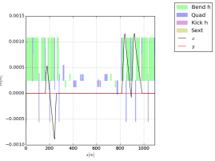
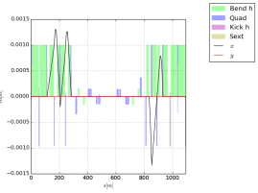
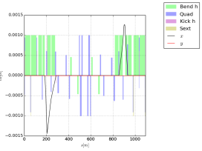
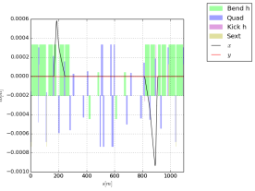
Orbit corrector strengths
 | Q7 | Q8 | Q9 | Q10 | Q11
IR7B1 | 46 r | 83 l | 68 r | 63 l | 22 r
IR7B2 | 45 l | 87 r | 70 l | 60 r | 23 l
IR2B1 | -12 l | 19 r | 70 l | 45 r
IR2B2 | -7 r | 6 l | 65 r | 25 l
% of the maximum kick at 7TeV for a dipole error of 50 µrad per MBH
IR7B1
IR7B2
IR2B1
IR2B2

Slide 19
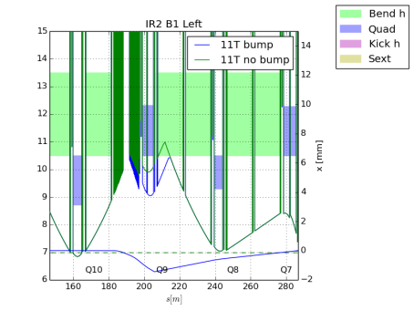
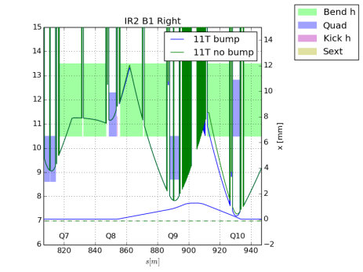
Aperture impact with bumps at inj

Slide 20
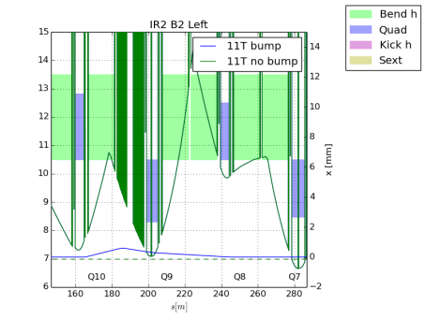
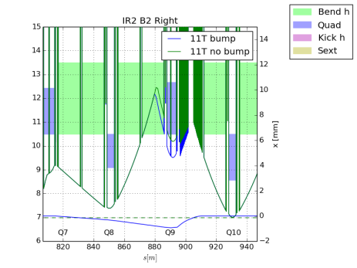
Aperture impact with bumps at inj

Slide 21
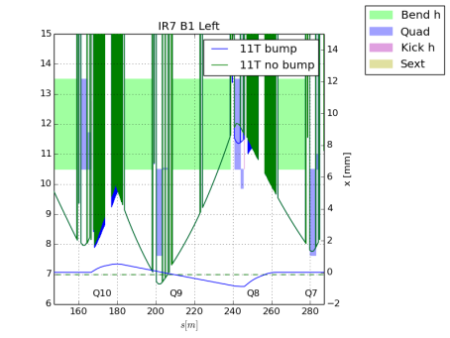
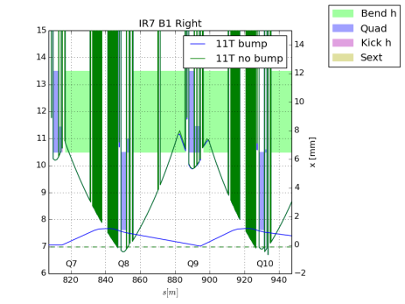
Aperture impact with bumps at inj

Slide 22
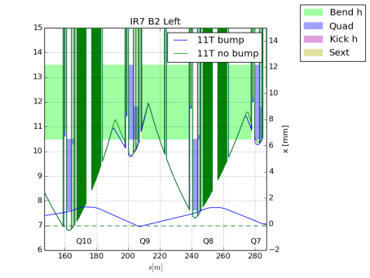
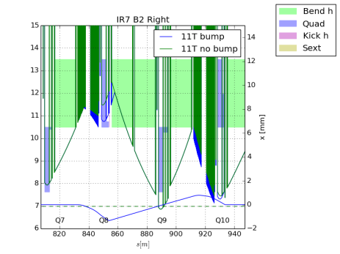
Aperture impact with bumps at inj

Slide 23
Aperture impact with bumps at inj.
An orbit error of 50 µrad starts to degrade aperture at injection in some location (make them potentially critical).
An orbit error of 50 µrad is tolerable up to 3.5 TeV for what concern the orbit strengths. The error has to decrease linearly with the energy to 7 TeV.
Any residual orbit at collision energy <7TeV needs to be evaluated by collimation because may affect the trajectory of diffracted particles.

Slide 24
Conclusion
Straight nominal MB apertures does not degrade aperture margins in critical points for the circulating beam if trim converters are used.
Orbit bump can be acceptable for orbit corrector strengths for the circulating beam for 50 µrad deflection error up to 3.5 TeV.
Collimation studies are needed to validate these conditions for the diffracted particles.
Operation and machine protection studies are needed to validate any operation with bumps.
New upgraded collision optics that will make more use of the DS apertures in collision need to be revaluated.
Recommendation:
  Use trim power converter to avoid additional operational complexity.
  Use a b.s. which is does not degrade apertures with respect to the nominal MB.

