Slide 1
Powering requirements for HL-LHC triplet
M. Fitterer, R. De Maria, M. Giovannozzi
Acknowledgments: A. Ballarino, R. Bruce, J.-P. Burnet, S. Fartoukh, F. Schmidt, H. Thiesen

Slide 2
Outline
Proposed powering scheme
Model of the field ripple
Experiments in the past and theoretical background
Studies:
  Tune modulation amplitude (tune spread)
  Dynamic aperture studies
Conclusion
Further studies

Slide 3
Proposed powering scheme
Proposed powering scheme HL-LHC (Baseline):
Ballarino,
4th LHC Parameter and Layout Committee

Slide 4
Model of the field ripple
Magnetic field seen by the beam (see HSS-meeting 17.02.2014):
with
Voltage ripple (PC specifications, measured by EPC group)
Transfer function of the load (circuit) seen by the PC (measured by EPC
group)
Transfer function from the input current of the magnet to the
magnetic field (assumed constant)
Transfer function cold bore, absorber, beam screen etc.
(input from WP3 needed)
Notes:
dBmuV = Gain references to 1muV, e.g. 20*log10(3.2 mV/(1muV))=70 and 20*log10(10 mV/(1muV))=80

Slide 5
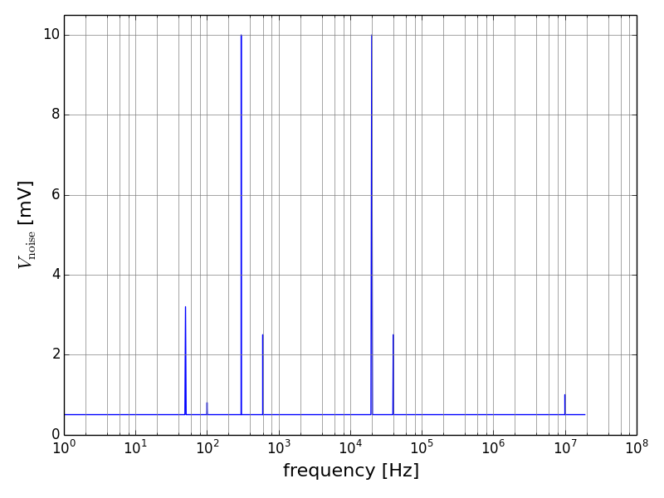
Voltage spectrum
From Hugues Thiesen:
50 Hz harmonics (main grid):
50 Hz: 3.2 mV R.M.S.
100Hz: 0.8 mV R.M.S.
300 Hz harmonics (diode rectifier):
300 Hz (300.4 Hz): 10.0 mV R.M.S.
600 Hz: 2.5 mV R.M.S.
20 kHz harmonics( ITPT converters):
20 kHz: 10.0 mV R.M.S.
40 kHz: 2.5 mV R.M.S.
10 MHz harmonics:
10 MHz: 1.0 mV R.M.S. (0.5 mV)
all other frequencies:
0.5 mV R.M.S
300 Hz
20 kHz
50 Hz
600 Hz
40 kHz
10 MHz
100 Hz
Notes:
dBmuV = Gain references to 1muV, e.g. 20*log10(3.2 mV/(1muV))=70 and 20*log10(10 mV/(1muV))=80
Nominal LHC (peak to peak): Vpk-pk(PC1 (8kA, 8V)) = 5 mV => Vrms=0.707*Vpk-pk =>V [dBmuV) = 20*log10(0.707 Vpk-pk/(1muV))=70

Slide 6
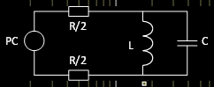
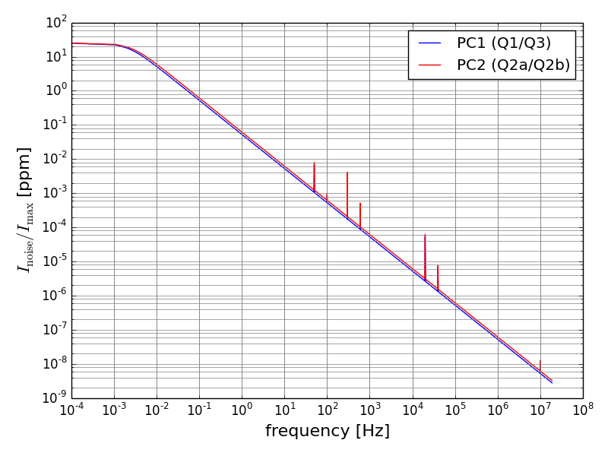
Spectrum of the magnetic field
LHC magnets modeled as RLC circuit (T_{VtoI,load}):
=> the higher the magnet inductance the
stronger the damping of the higher frequencies
and assume B=const.*I (T_{ItoB,load})
=> I_{noise}/I_{max}=k_{noise}/k_{max}
Parameters used for simulations:
length_{Q1,Q3} = 8.0 m, length_{Q2} = 6.8 m
L_{Q1,Q2,Q3} = 10.8 mH/m
R_{PC1,PC2} = 1.144 mΩ
(same as for PC1 of nominal LHC)
I_{max,PC1,PC2} = 17.5 kA
k_{max,Q1,Q2,Q3} = 0.5996 x 10⁻² 1/m²
Note: L_{tot}=L_{Q1/Q2/Q3}= “single” magnet inductance used (not taken into account that Q1/Q3 and Q2a/Q2b are in series)
H. Thiesen
Notes:
parameters from WP3 website 17/02/2014
L(Q1,Q3)=10.8 mH/m*length (Q1,Q3) =86.4 mH, L(Q2)=10.8 mH/m*length (Q2) =73.44 mH,

Slide 7
Experiments
Experiments were done at the SPS [1,2,3] and HERA [4]:
in case of the SPS a tune ripple of 10⁻⁴ is acceptable while experiences at HERA show that for low frequencies even a tune ripple of 10⁻⁵ and for high frequencies 10⁻⁴ can lead to significant particle diffusion.
several ripple frequencies are much more harmful than a single one [1,2]
[1] X. Altuna et al., CERN SL/91-43 (AP)
[2] W. Fischer, M. Giovannozzi, F. Schmidt, Phys. Rev. E 55, Nr. 3 (1996)
[3] P. Burla, D. Cornuet, K. Fischer, P. Leclere, F. Schmidt, CERN SL/94-11 (1996)
[4] O. S. Brüning, F. Willeke, Phys. Rev. Lett. 76, Nr. 20 (1995)
Notes:
[4] SPS: minimization of the power supply ripple => only 50 Hz and higher harmonics => Delta Q<2-3x10^-4, additional ripple with 9 Hz, 40 Hz, 180 Hz => Delta Q=1.1-2.2x10^-3

Slide 8
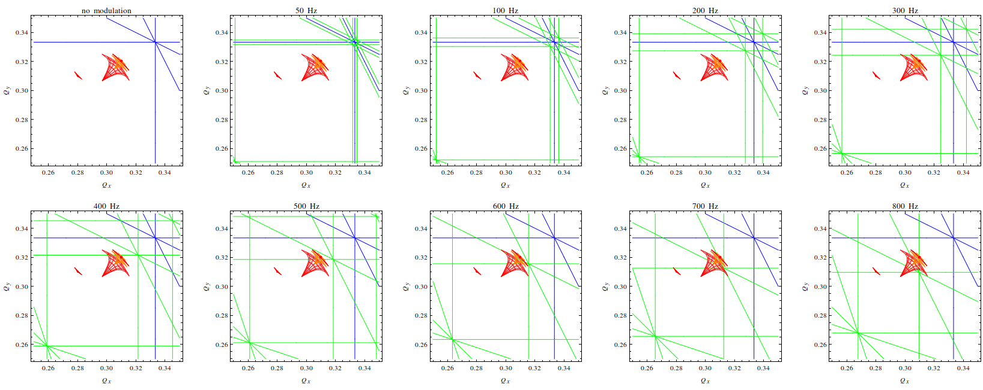
Theoretical background (1)
In addition to the tune shift the tune modulation introduces resonance side bands [5,6]:
  slow modulation (e.g. 50 Hz):
  distances between the sidebands are small but amplitudes decrease only slowly with increasing order
  fast modulation (e.g. 600 Hz):
  distances between the sideband are large and amplitudes decrease rapidly with increasing order
  slow+fast modulation: the sidebands of the fast modulation form the seeds for the sidebands of the slow modulation (“seeding resonances”)
R. Bruce,
LARP/HiLumi Collaboration meeting 2014
[5] O. S. Brüning, F. Willeke, Phys. Rev. Lett. 76, No. 20 (1995), [6] O. S. Brüning, Part. Acc. 41, pp. 133-151 (1993)

Slide 9
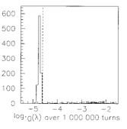
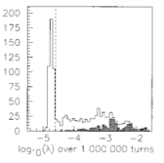
Theoretical background (2)
The influence of non-linearities and the stability and diffusion of particles can be studied analytically or more pragmatic by tracking particles with certain amplitudes and phases in order to obtain:
      dynamic aperture
      survival plots
      frequency map analysis …
no modulation
threshold
one of the most common approaches to determine the dynamic aperture is the Lyapunov exponent, which distinguishes regular from chaotic motion:
In case of tune modulation the particle losses can be extremely slow and chaotic regions can be stable for a sufficiently long time resulting in an underestimate of the DA with the Lyapunov exponent [7].
slow losses can be detected with survival plots. As survival plots are in general very irregular, they are difficult to interpret and extrapolate
with modulation
stable after 10⁷ turns
lost after 10⁷ turns
[7] M. Giovannozzi, W. Scandale, E. Todesco, Phys. Rev. E 57, No. 3 (1998)
Notes:
plots are for the Henon map
sigma(N)=1/N*log(A_lambda * N), all particles with\lambda(N)>sigma_lambda(N) particle is considered to be chaotic, otherwise it is considered stable

Slide 10
Theoretical background (3)
following the approach taken in [8] a more regular pattern can be obtained from the survival plots by averaging over the angles. The dynamic aperture is then defined as a function of the number of turns – “DA vs turns” (“weighted average”):
  and the error can be obtained by using Gaussian sum in quadrature:
  The DA can then be interpolated by:
  An approximated formula for the error can be obtained by using a “simple average” over θ as definition for the DA:
[8] E. Todesco, M. Giovannozzi, Phys. Rev. E 53, No. 4067 (1996)

Slide 11
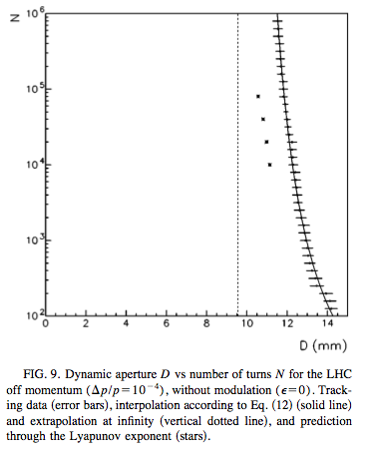
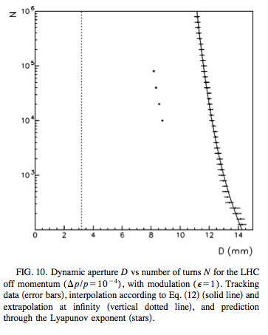
Theoretical background (4)
Example of LHC lattice [8]:
extrapolation to infinity
prediction through Lyapunov exponent
no modulation
with modulation
[8] E. Todesco, M. Giovannozzi, Phys. Rev. E 53, No. 4067 (1996)
Notes:
plots are for the Henon map
sigma(N)=1/N*log(A_lambda * N), all particles with\lambda(N)>sigma_lambda(N) particle is considered to be chaotic, otherwise it is considered stable

Slide 12
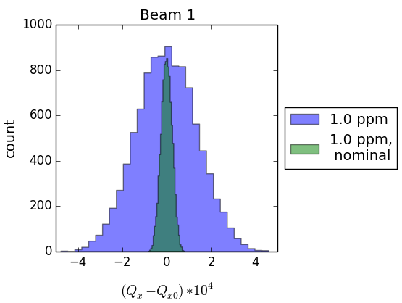
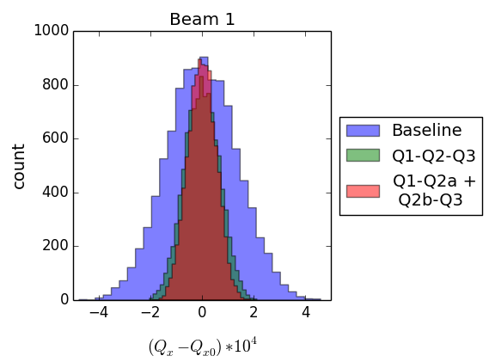
Tune modulation amplitude (1)
First estimate by calculating the tune shift (see LCU Meeting 26.11.2013)
induced by a uniformly distributed error on the current (reference value 1ppm (10⁻⁶))
comparison of nominal LHC (β*=55 cm, V6.5.coll.str) with the HL-LHC (β*=15 cm, HLLHCV1.0)
proposed powering
scheme
estimate of an eventual gain using an alternative powering
scheme (β*=15 cm, HLLHCV1.0)
 | rms((Q_{z}-Q_{z0})x10⁴)
nom. LHC | 0.25
HL-LHC | 1.35 (x5.5)
 | rms((Q_{z}-Q_{z0})x10⁴)
Baseline | 1.35
Q1-Q2-Q3 | 0.67 (x2)
Q1-Q2a + Q2b+Q3 | 0.54 (x2.5)
Notes:
I_max=17.3 kA

Slide 13
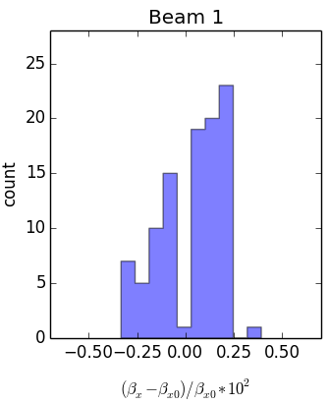
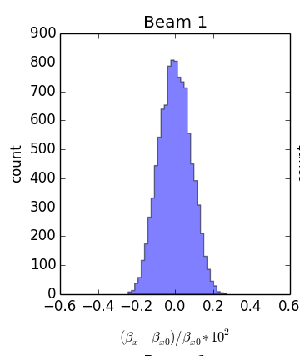
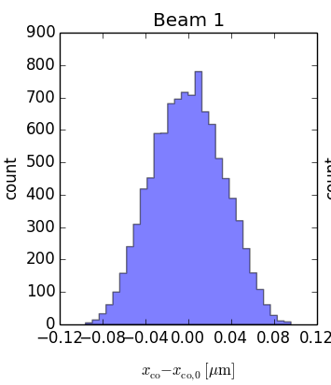
Tune modulation amplitude (2)
Beta-beat and orbit deviation at the IP (β*=15 cm, HLLHCV1.0) for 1 ppm (10⁻⁶) - baseline:
=> around 0.5% maximum beta-beat
(complete ring), around 0.2% at the IP
=> around 0.12 μm maximum orbit deviation
(for ε_{N}=2.5 μm, σ_{IP}=7.1 μm => 1.7% orbit
deviation)
max. over 100 seeds (complete ring)
IP5, 10000 seeds
IP5, 10000 seeds
=> 1 ppm uniformly distributed error on the current results in approx. 10⁻⁴ tune spread, 1% beta-beat and 2% orbit deviation at the IP
Notes:
round optics (β*=15 cm, HLLHCV1.0), /Users/mfittere/HiLumi/Work/HLLHCV1.0/study_power_supply/1e-06round

Slide 14
DA: simulation setup
Powering scheme: baseline without trims
Tracking studies with SixTrack using the following parameters (see backup slide):
with and without beam-beam
optics: sLHCV3.1b, β*=15 cm in IR1/5, β*=10 m in IR2/8
max number of turns: 10⁶
seeds: 60, angles: 59 (steps of 1.5˚), amplitudes: 2-28 (no bb), 2-14 (bb)
no phase shift between ripple frequencies
b2 errors of dipole -> approx. 3% beta-beat
Analysis methods:
calculation of minimum, maximum and average DA over the seeds using the particles lost criterion
calculation of the DA as a function of the number of turns (“DA vs turns”) (see slide 10-11)

Slide 15
DA: studies
Studies (baseline powering scheme, no trims):
determination of the dangerous frequencies:
        50 Hz, 100 Hz (main grid)
        300 Hz, 600 Hz (diode rectifier)
        high frequency 9kHz (representative for 20 kHz (ITPT converters))
  simulation parameters:
        same amplitude (k*l) for all quadrupoles taking the polarity and baseline powering scheme into account
        choose amplitude to obtain dQ_{x/y}= ±10⁻⁴
frequency spectrum provided by Hugues (see slide 5-6) (“real freq. spectrum”) and as a second case adding the 50 Hz harmonics until 1kHz (“real freq. spectrum + 1k”)

Slide 16
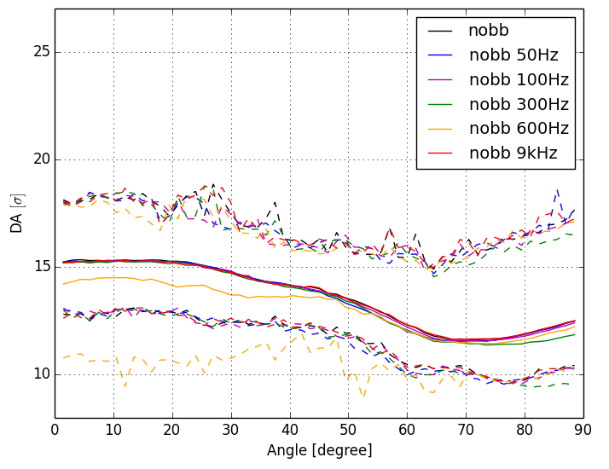
DA: particle lost - without bb (1)
(a) determination of the dangerous frequencies (dQ=10⁻⁴)
relevant difference only for 600 Hz, very slight difference for 300 Hz

Slide 17
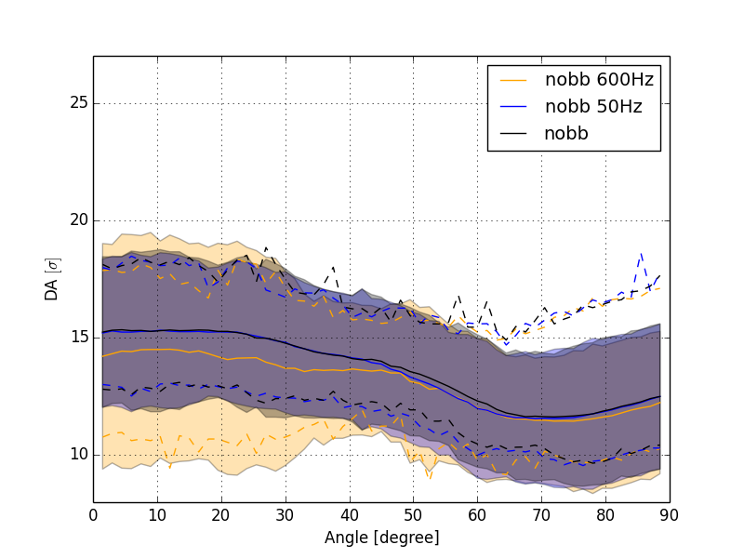
DA: particle lost - without bb (2)
(a) determination of the dangerous frequencies (dQ=10⁻⁴) – 3 σ envelope
minimum within the 3 σ envelope -> minimum DA not just due to a particularly “bad” seed

Slide 18
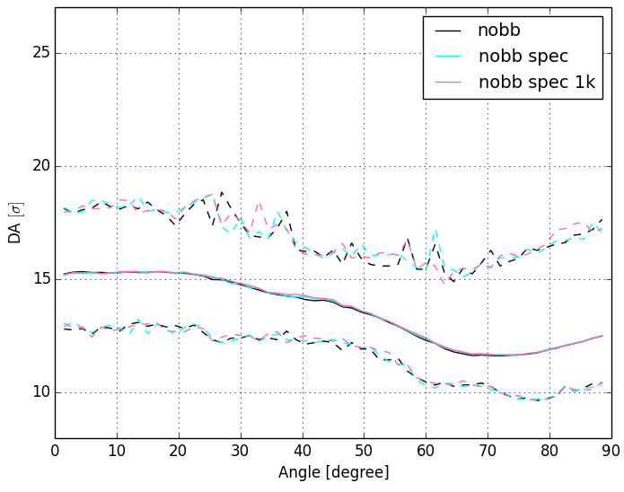
DA: particle lost – without bb (3)
(b) real frequency spectrum and real freq. spectrum + 1k
no relevant difference

Slide 19
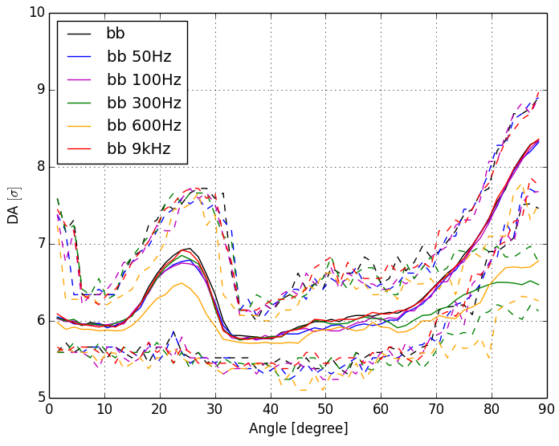
DA: particle lost - with bb (1)
(a) determination of the dangerous frequencies (dQ=10⁻⁴)
relevant difference only for 600 Hz and 300 Hz

Slide 20
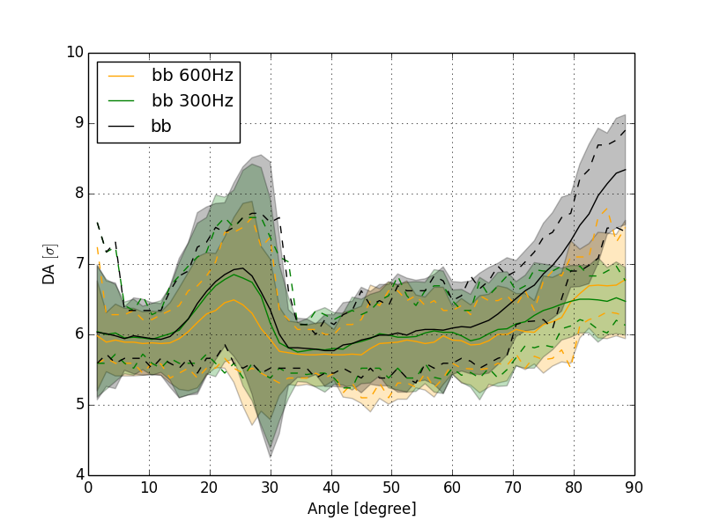
DA: particle lost - with bb (1)
(a) determination of the dangerous frequencies (dQ=10⁻⁴) – 3 σ envelope
minimum within the 3 σ envelope -> minimum DA not just due to a particularly “bad” seed

Slide 21
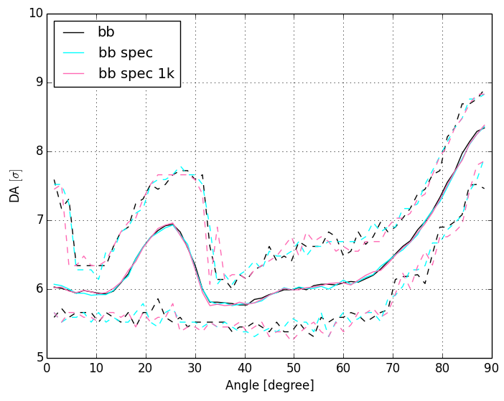
DA: particle lost – with bb (2)
(b) real frequency spectrum and real freq. spectrum + 1k
no relevant difference

Slide 22
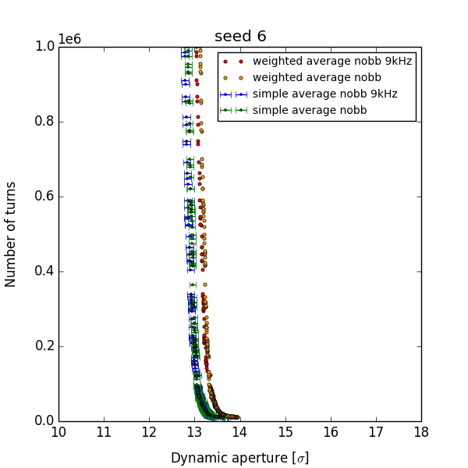
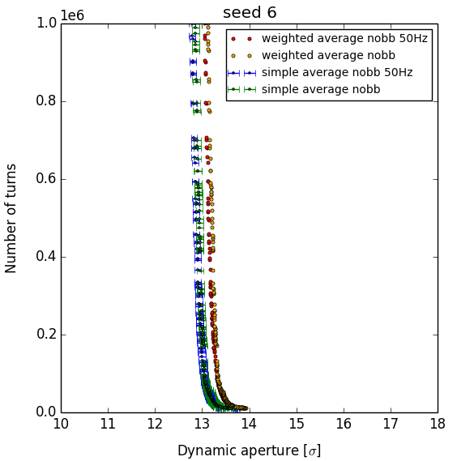
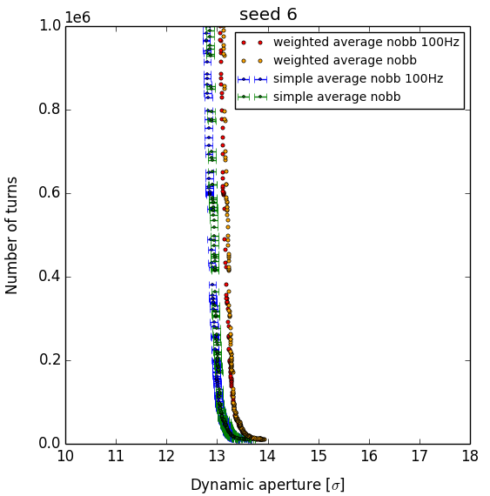
DA: DA vs turns - without bb (1)
(a) determination of the dangerous frequencies (dQ=10⁻⁴) (all plots for seed 6)
50 Hz
100 Hz
9 kHz
no relevant difference for 50 Hz, 100 Hz and 9 kHz

Slide 23
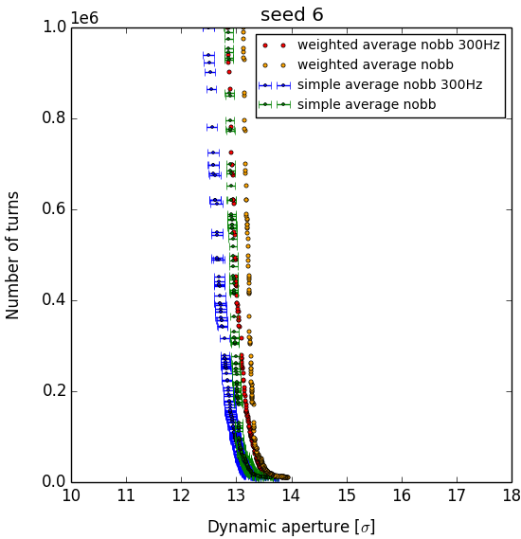
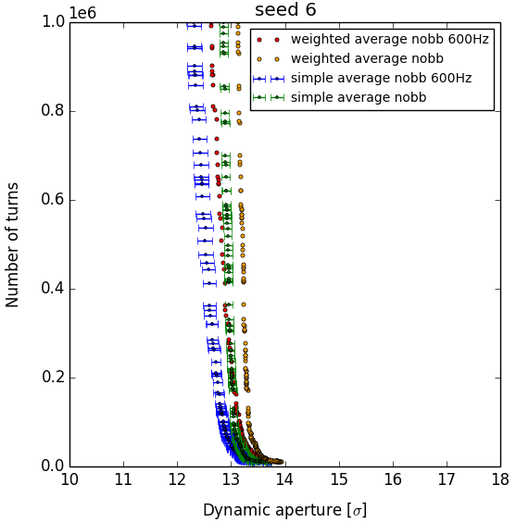
DA: DA vs turns - without bb (2)
(a) determination of the dangerous frequencies (dQ=10⁻⁴) (all plots for seed 6)
300 Hz
600 Hz
visible difference for 300 Hz and 600 Hz!

Slide 24
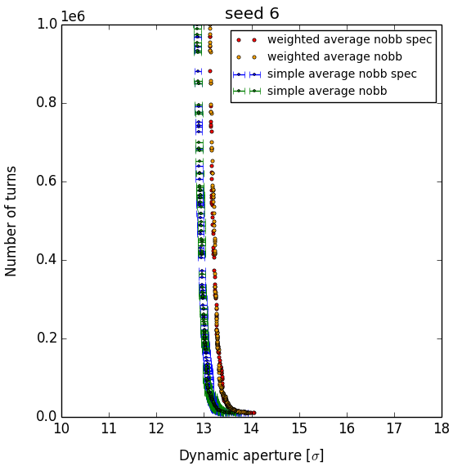
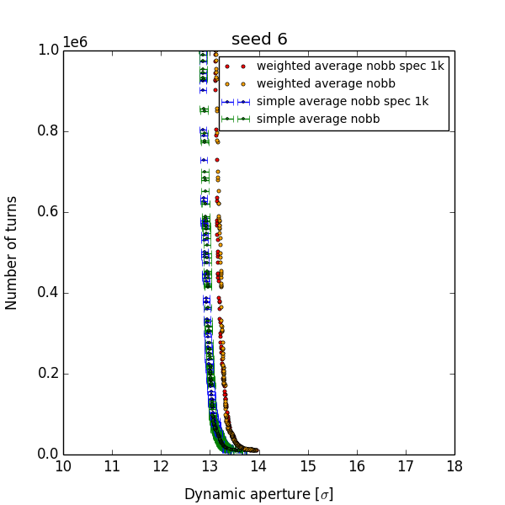
DA: DA vs turns – without bb (3)
(b) real frequency spectrum and real freq. spectrum + 1k (all plots for seed 6)
spectrum
spectrum + 1k
no relevant difference for the real frequency spectrum (+1k)

Slide 25
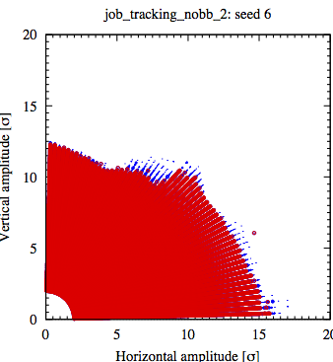
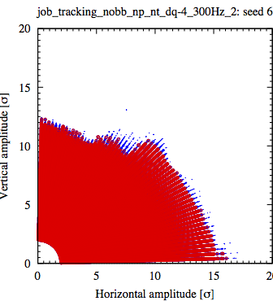

DA: survival plots - without bb (4)
(a) determination of the dangerous frequencies (dQ=10⁻⁴) (all plots for seed 6)
no ripple
300 Hz
600 Hz
•=stable initial conditions, ∘=unstable initial conditions
no real difference visible without post-processing

Slide 26
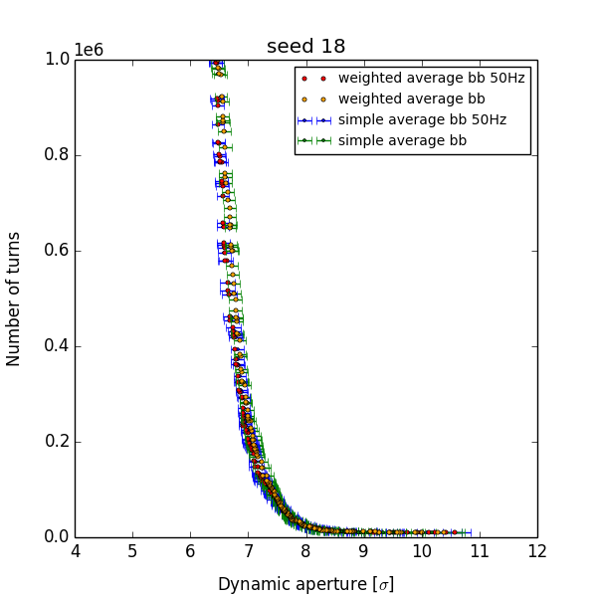
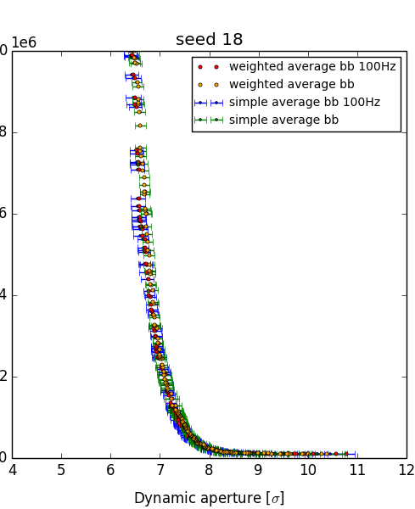
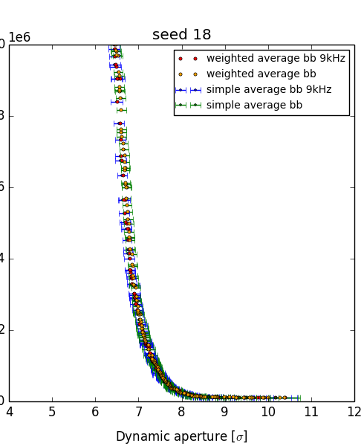
DA: DA vs turns - with bb (1)
(a) determination of the dangerous frequencies (dQ=10⁻⁴) (all plots for seed 18)
50 Hz
100 Hz
9 kHz
no relevant difference for 50 Hz, 100 Hz and 9 kHz

Slide 27
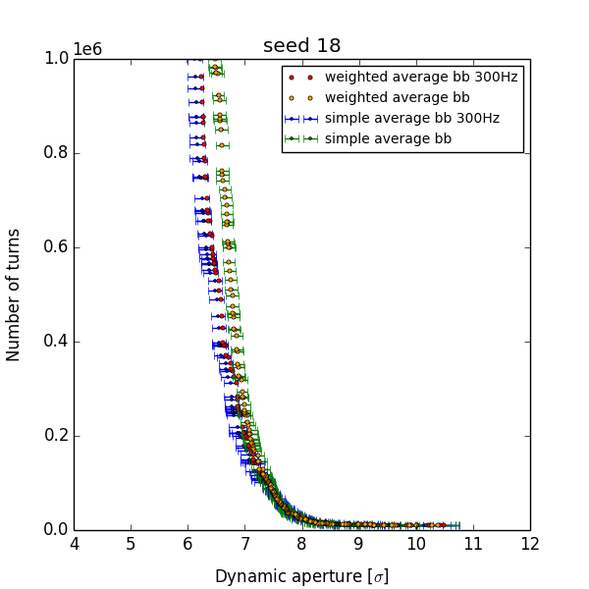
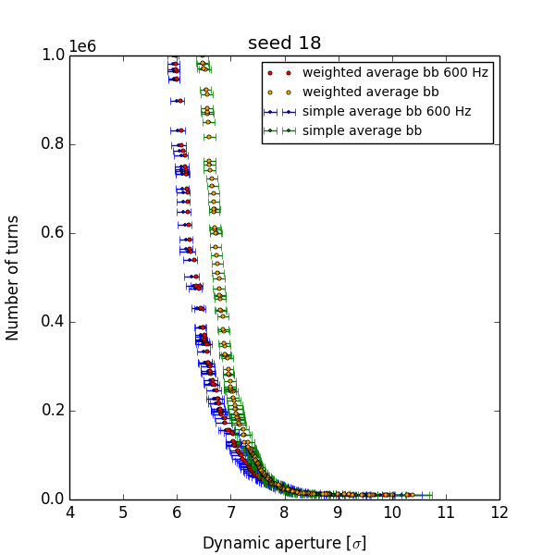
DA: simulation results - with bb (2)
(a) determination of the dangerous frequencies (dQ=10⁻⁴) (all plots for seed 18)
300 Hz
600 Hz
visible difference for 300 Hz and 600 Hz!

Slide 28
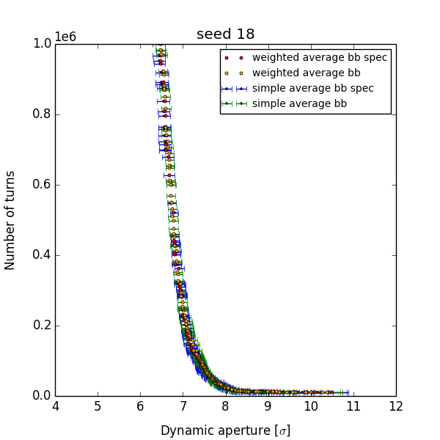
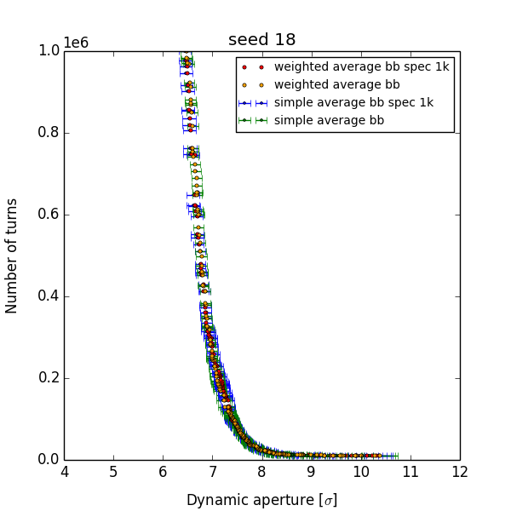
DA: DA vs turns – with bb (2)
(b) real frequency spectrum and real freq. spectrum + 1k (all plots for seed 18)
spectrum
spectrum + 1k
no relevant difference for the real frequency spectrum (+1k)

Slide 29
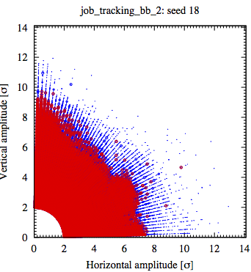
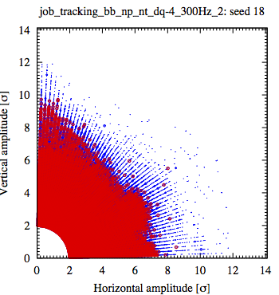
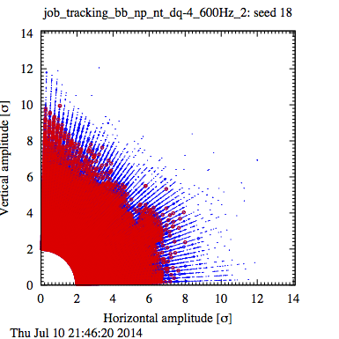
DA: survival plots - with bb (4)
(a) determination of the dangerous frequencies (dQ=10⁻⁴) (all plots for seed 18)
no ripple
300 Hz
600 Hz
•=stable initial conditions, ∘=unstable initial conditions
no real difference visible without post-processing

Slide 30
Conclusions
power supply ripple spectrum: the ripple amplitude is reduced for higher frequencies due to the magnet inductance (approx. 10⁻⁴ for 50 Hz compared to 0 Hz)
=> largest amplitude (50 Hz) for the realistic spectrum is about 10⁻² smaller than the amplitude used for the individual frequencies with dQ=10⁻⁴.
  -> Did we assume too small amplitudes for the ripple spectrum?
  -> Nonlinear components from beam screen (also relevant for case without ripple)?
  -> Can all frequencies below 50 Hz be neglected?
powering schemes:
1 ppm uniformly distributed current ripple translates to approx. 10⁻⁴ tune spread, 1% beta-beat and 2% orbit deviation at the IP
by powering all IT magnets in series (Q1-Q2-Q3) or by powering Q1-Q2a and Q2b-Q3 together the tune shift can be reduced by a factor 2-2.5

Slide 31
Conclusions
DA studies:
no reduction of the DA for 50 Hz, 100 Hz and 9 kHz in all studies
slight reduction of the dynamic aperture (particles lost) for 300 Hz without bb and visible reduction with bb (particle lost). Visible reduction w/o bb for the DA vs turns.
reduction of the DA for 600 Hz (all methods)
no reduction of the DA for real frequency spectrum and real freq. spectrum + 1k using the DA (particles lost) and the DA vs turns method

Slide 32
Further studies
new simulation with 10⁶ turns for corrected real frequency spectrum and real frequency spectrum + 1k, without and with bb: correct 300.4 Hz -> 300 Hz, correct 10 MHz amplitude (no differences expected)
in general only small effect for dQ=10⁻⁴ (except maybe 600 Hz), thus new simulation for single frequencies with 10⁶ turns and dQ=10⁻³ and dQ=10⁻²
no effect for real frequency spectrum (+ 1k): new simulations real frequency spectrum + 1k with 10⁶ turns, with bb increase amplitudes by x10, x100 (range of dQ=10⁻⁴), x1000
quantitative analysis of D(N) -> different fitting methods
FMA for 2x10⁴ turns with and without bb, without ripple, 300 Hz and 600 Hz
tune scans to investigate the dependence of the simulations on the chosen WP
introduce beta-beating (until now only small beta-beating from b2 in dipoles)

Slide 34
SixTrack simulation parameters
lattice: sLHCV3.1b
optics: β*=15 cm in IR1/5, β*=10 m in IR2/8
x-scheme: separation: ±0.75 mm (IR1/5), ±2.0 mm (IR2/8), x-angle: : ±295 μm (IR1/5) , ±240 μm IR2, ±305 μm IR8
tune: Q_{x}/Q_{y}=62.31/60.32
beam parameters: E_{beam} = 7 TeV, bunch spacing: 25 ns, ε_{N,x/y}=2.5 μm (mask), ε_{N,x/y}=3.75 μm (sixtrack), σ_{E}=1.1e-4 (madx),
Δp/p=2.7e-04 (sixtrack), N_{b}=2.2e+11
error tables: LHC measured errors (collision_errors-emfqcs-*.tfs), no a₁/b₁ from all magnets, no b_{2s} from quadrupoles, target error tables for IT (IT_errortable_v66), D1 (D1_errortable_v1), D2 (D2_errortable_v4), and Q4 (Q4_errortable_v1) and Q5 (Q5_errortable_v0) in IR1/5
sixtrack simulation parameters:
60 seeds, 10⁶ turns, 59 angels
corrections:
MB field errors
IT/D1 field errors
coupling
orbit (rematch co at IP and arc for dispersion correction)
spurious dispersion
tune and linear chromaticity
corrections not included:
no correction of residual Q’’ by octupoles
no beam-beam:
no beam-beam, no collision
scan from 2-28σ in steps of 2σ with 30 points per step
beam-beam:
HO and LR in IR1/2/5/8, no crab cavities, one additional LR encounters in D1, 5 slices for HO bb
halo collision in IR2 at 5 sigma
scan from 2-14σ in steps of 2σ with 30 points per step

