Slide 1
Down selection criteria and MDs prior to LS3
G. Arduini
with input from: Ph. Baudrenghien, O. Brüning, R. Calaga, P. Chiggiato, S. Fartoukh, P. Fessia, M. Giovannozzi, G. Iadarola, K. Li, A. MacPherson, E.H. Maclean, E. Métral, Y. Papaphilippou, T. Pieloni, S. Redaelli, G. Rumolo, R. Salemme, B. Salvant, E. Shaposhnikova, M. Taborelli, R. Tomàs, A. Valishev

Slide 2
Outline

Slide 3
Aim
This talk will identify some of the main studies and machine experiments that are required to validate the main choices in terms of operational settings/scenarios or hardware

Slide 4
Nominal Scenario
Some of the challenges:
  25 ns beam operation
  Large crossing angle and Crab crossing to minimize the geometric reduction factor and pile-up density
  β* levelling in the high luminosity experiments at least and possibly in IP8
  Large beam-beam tune spreads (head-on and long range)
  Tail measurement and control particularly in conjunction with possible crab cavities failure scenarios.

Slide 5
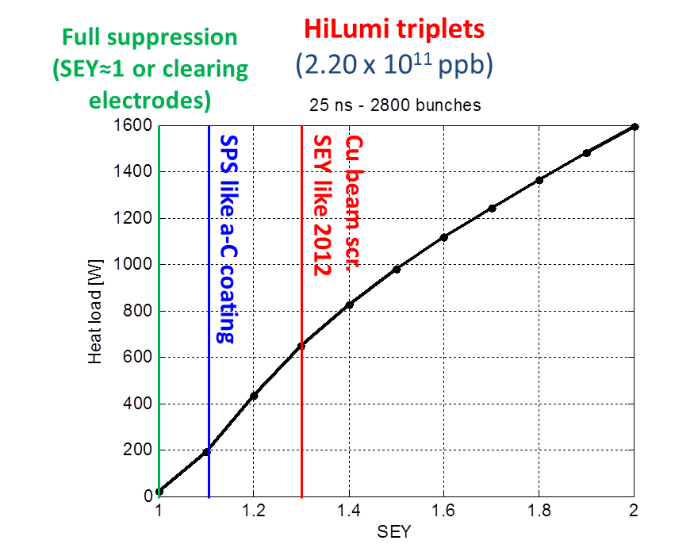
25 ns operation (e-cloud)
Relies on the effectiveness of the scrubbing process to reduce the SEY in dipoles and quadrupoles down to ~1.3.
Expect heat load in the quadrupoles due to the lower threshold SEY (~1.2)
G. Iadarola, G. Rumolo
25 ns scrubbing (2011/12)
HL-LHC triplets/matching section + Triplet/D1 in IP2 and 8: rely on e-cloud countermeasures implemented (a-C coatings and possibly clearing electrodes) to reduce heat load

Slide 6
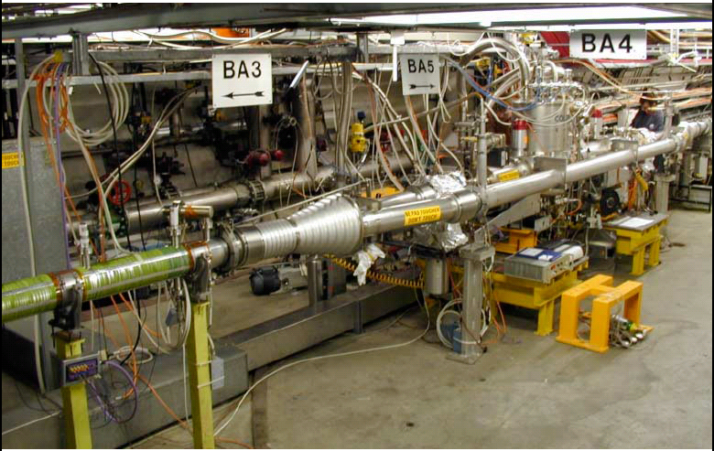
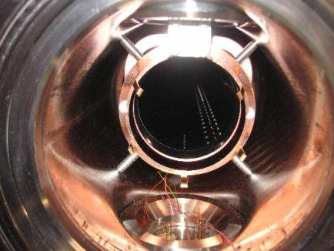
COLDEX
COLDEX tests in SPS in 2015 to validate the effectiveness of a-C coatings at cryogenics temperatures
Irradiation tests to evaluate stability and characteristics as a function of radiation. Some tests done in SPS. PSI?
Total pressures along the vacuum system (BA gauges)
Partial pressures in the RT and cryogenic parts (RGA)
Electron flux in the RT and cryogenic parts (electrodes)
BS and CB temperatures (CERNOX thermocouples)
Heat load on the beam screen (He flow meters)
Effect of gas physisorption/condensation (gas injection)

Slide 7
Large Piwinski angle and crab crossing
Crab crossing to fight the luminosity reduction factor due to the Piwinski angle
First application of crab cavity in hadron high intensity machine:
  Transverse Stability and HOM power
  Cavity control (tight frequency control when detuned to avoid instabilities)
  Validation of the modes of operation of the crab cavity during the operational cycle
  Failure scenarios
  Effect of noise: transverse blow-up?

Slide 8
LLRF Operation
400MHz RF
Global feedback
Cavity Controller
Cavity Controller
Operation:
  RF is ON
  Strong RF feedback + tune controls
  Cavities are on-tune at all time.
Filling, ramping or operation with transparent crab cavities
  Cavities kept on-tune with small voltage (0.5 MV?) + active tuning system
    Effect on beam nullified by counter-phasing the cavities
    RF feedback is used with on-tune cavity to provide stability and keep the beam induced voltage zero if the beam is off-centered.
When crabbing is required (at flat top)
  Drive counter-phasing to zero.
  Degree of local crabbing controlled by synchronously changing voltage or phase in both cavities.
Need to demonstrate “stealth mode” when cavity not operational
TX
TX
Phase PU

Slide 9
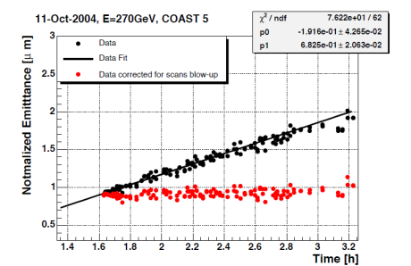
SPS Validation Program: Apr-Nov 2017 (2018)
High Intensity Studies
  Measurement of heat load
  Beam stability for different operating scenarios (counter-phasing, detuned, …)
Test the RF gymnastics:
  Operation with strong RF feedback
  Reproduce filling and ramping conditions, with low cavity voltage, large beam offset and precise counter phasing
  Beam based alignment by using TX power
Validation of failure scenarios and countermeasures
  Propagation of the quench from the expected rise in demanded TX power
  “coupled-feedback” idea. We have 2 CCs in the SPS.
Noise and transverse emittance blow-up ➔ Might be difficult to reach conclusive measurements on that.
  In recent years difficulty to reach good performance in coast
Notes:
2 cavities installed in 1 cryomodule
cavities of same type
3 different cryomodules
should be interchangeable

Slide 10
Halo Control

Slide 11
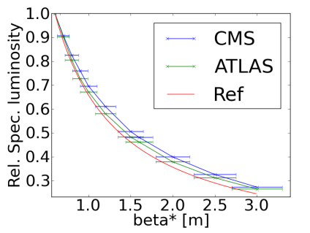
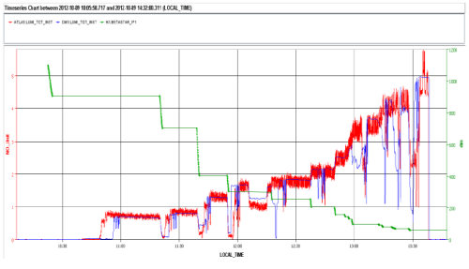
β* levelling
Feasibility demonstrated at low intensity in three dedicated experiments in 2012
Questions to be addressed:
  Reproducibility of the orbit and in particular of the separation
  Beam stability at high intensity ➔ Observations in 2012 revealed instabilities when the beam were separated in IR1 AND 5 by more than ~1 beam sigma
  Development of feedbacks (based on orbit measurements/luminosity?)
  Important also for collide and squeeze that might be required for the stabilization of the beam during the squeeze

Slide 12
β* levelling
This type of studies requires some statistics in order to answer the questions related to reproducibility and possible blow-up during this process:
  Need to test these methods in operation. Possible approaches:
    β* levelling in IP8
    Collide and squeeze in IP1 and 5

Slide 13
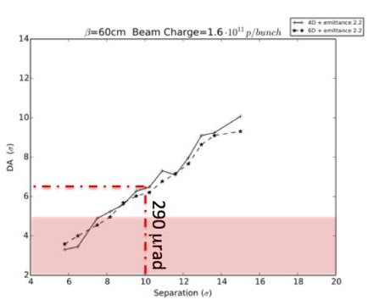
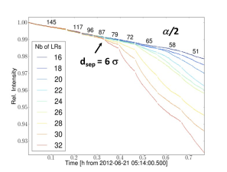
Beam-beam effects
HL-LHC will operate at unprecedented beam-beam parameters (head-on and long range)
Head-on beam-beam tune shifts of ~0.03 have been achieved during dedicated experiments (but with no long range)
  Dynamic aperture and emittance blow-up are critical ingredients for luminosity integrated performance
  Validation of the criteria used for the LHC design is essential
  MDs to be repeated with 25 ns beams with larger number of Long Range Encounters
Notes:
Check maximum value)

Slide 14
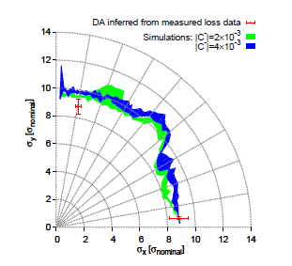
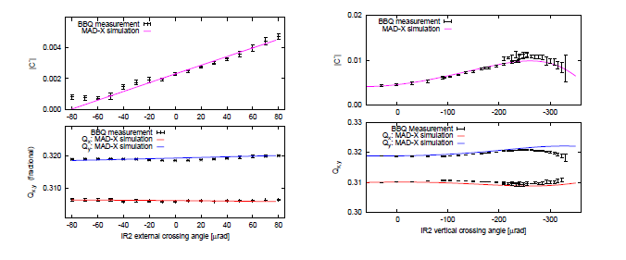
Dynamic aperture
LHC Design assumption factor 2 margin.
Present accuracy 10 to 30%
Correction in experimental IRs will be essential for future LHC scenario
Need to evaluate accuracy of the DA benchmarking simulations with experiments
LHC Design assumption factor 2 margin.
Present accuracy 10 to 30%
Correction in experimental IRs will be essential for future LHC scenario

Slide 15
Alternative Scenarios
  Round vs. flat beams ➔ importance of ATS
  BBLR: what are the measurements that we need to do in the LHC (and SPS)?
  Higher harmonic (800 MHz) system

Slide 16
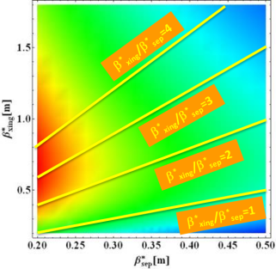
Flat Optics
Flat optics can provide higher luminosities than round ones for β* <35-40 cm): due to geometrical factor
  Initial squeeze with round optics down to min. β* in the crossing plane and then continuing only in the separation plane
  Does Flat Optics require larger normalized long-range separations than Round optics for same DA?
  Scaling laws for DA for flat optics.
  The footprints are larger for flat beams than round for same beam-beam separation

Slide 17
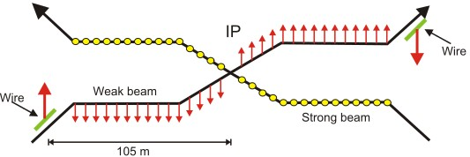
Beam-Beam Long Range Compensator
It offers the possibility of reducing the crossing angle and therefore fight the geometric reduction factor
Could be combined with flat optics to further reduce the crossing angle
Possible scenario to enhance effectiveness of crab cavities:
  To provide margin for crab kissing scenario
  To mitigate performance limitations from crab cavities (e.g. max. achievable voltage, noise, etc.)
On paper wire compensation principle easy to calculate.

Slide 18
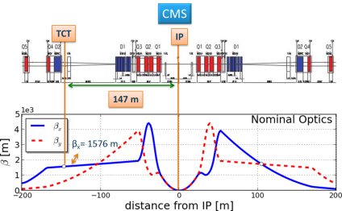
Beam-Beam Long Range Compensator
Ideally at:
  the same normalized distance from the beam as the long range encounters
  Large and similar beta functions (at least for round beams)
Questions:
  Can we find a sufficiently flexible configuration for different possible optics configurations (e.g. during β* levelling)
  Can we go sufficiently close to the beam (in particular if we reduce the normalized long range beam-beam separation)? How can we compensate for that? More current?
  What is the effect on the different PACMAN classes
  Lumped correction vs. distributed sources (with varying aspect ratio)

Slide 19
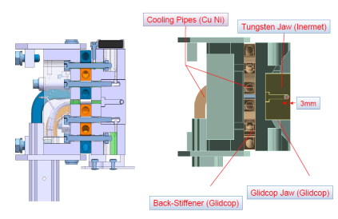
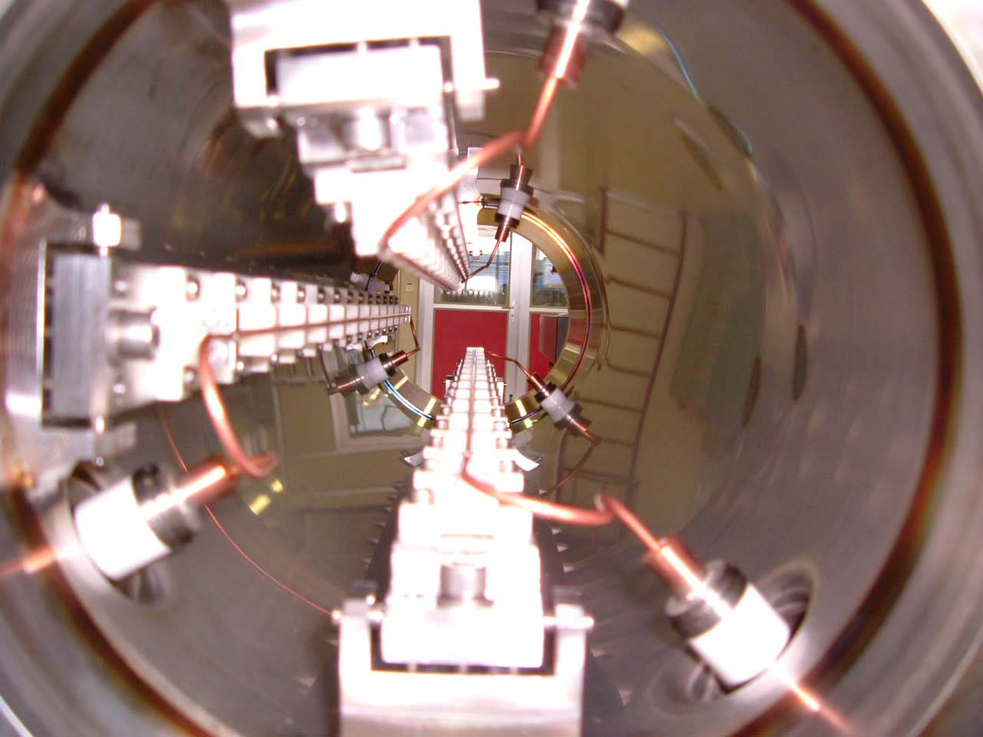
Beam-beam long range compensator
Installation of BBLR concept demonstrator in LHC during winter stop 2015-16
Possibility to revive the SPS installation still available in 2015.
How do we qualify its effectiveness?
    Ideally by demonstrating the possibility of reducing the crossing angle while maintaining good beam intensity/luminosity lifetime
    But we need to benchmark the simulations (the SPS tests could help in that respect at least for some basic observables) in order to validate the predictive power of our simulations

Slide 20
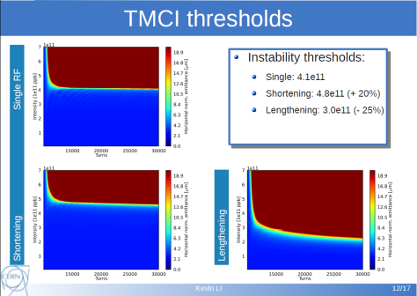
Need for 800 MHz system
Not in baseline. Needed to create bunches with flat longitudinal distribution
  for reduction of the beam induced heating
  for enhancing the effect of the crab-kissing scheme to reduce the peak pile-up density
  Should be used in bunch lengthening mode but this reduces the transverse and longitudinal stability margins

Slide 21
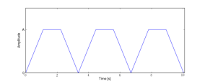
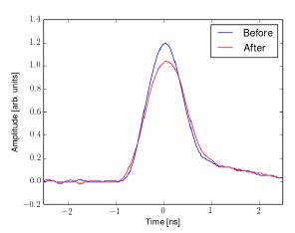
Alternative solution
Longitudinal bunch profile
  Motivated by issues with beam-induced heating
  Flatter bunches obtained by sine-modulation of
  RF phase at f_{mod}=0.97 f_{s}, amp =1 deg, T=10 s
  Issues with many bunches(excitation at f_{rev} + f_{mod}, phase loop on, a=2 deg): bunch length modulation over the whole ring, losses(?)
Bunch length along the ring
nominal 50 ns beam (1374 bunches) @ 4 TeV
Flatter bunches – good for heating issues < 1.2 GHz
Need to verify long term behaviour in the presence of IBS and synchrotron radiation

Slide 22
Summary

Slide 23
Requirements

Slide 25
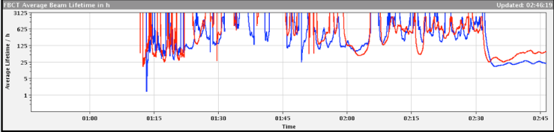
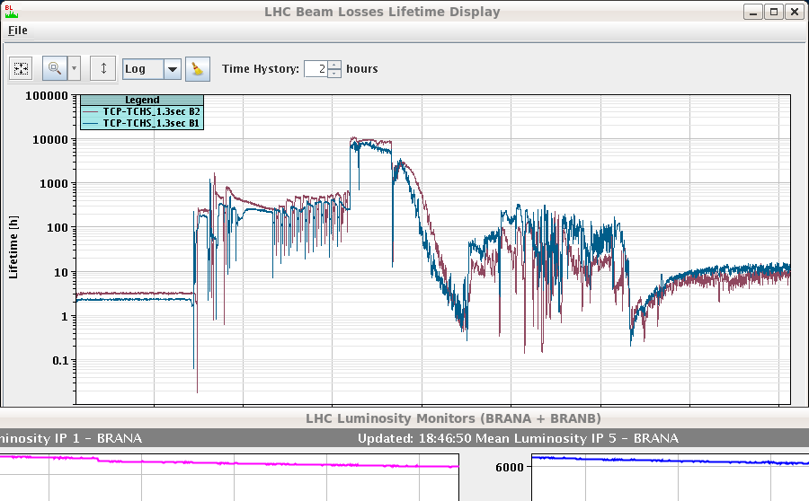
Halo population and control
Goals: Test two active excitation mechanisms:
- Tune ripple to drive resonances
- Narrow-band excitation with ADT
Motivation: behaviour of loss spikes?
Couple of illustrative examples taken randomly from the LHC elogbook...
Physics
25h
Ramp + Squeeze + Adjust
2011
Injection
Ramp
Squeeze
Adjust
10 h
Physics
2012

Slide 26
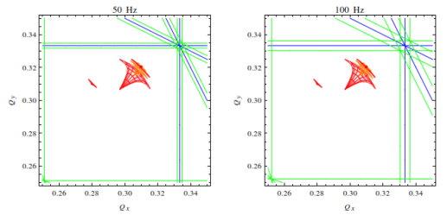
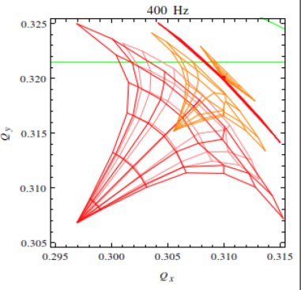

MD plans for halo control
Idea: using de-tuning with amplitude, one can in theory use
- sidebands in tune spectum excited by quadrupole current ripples
- narrow bands excited by the ADT
to resonantly excite the beam halo particles without perturbing the beam core.
There is a general consensus that these methods require a solid validation for the LHC case before being relied upon. Issue: core blow-up, bunch footprints.
Ultimate solution is the hollow e-lenses, but cannot be used before Run 3.
Working with warm magnet and ADT teams to prepared the MDs...

Slide 27
Not discussed
  Effect of noise, vibrations,
  IBS model and validation
  Emittance blow-up during the cycle

