Slide 1


TOTEM Results on Total pp Cross-Section and Diffractive Dissociation
T. Csörgő, for the TOTEM Collaboration
Wigner Research Center for Physics,
Budapest, Hungary
TOTEM physics
LHC Optics Determination
σ_{tot} @ 7 and 8 TeV
Single Diffraction
Double Diffraction
Summary

Slide 2
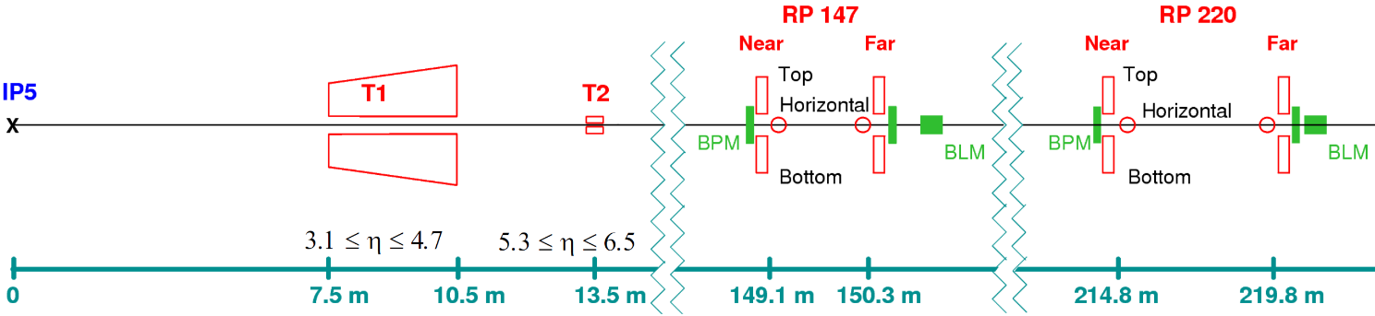
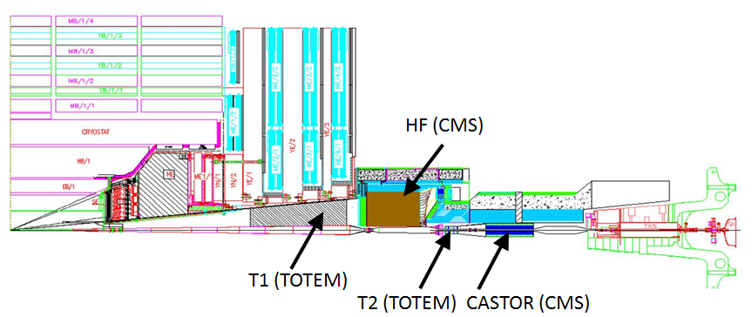
TOTEM – Experimental Setup at IP5
T1, T2: CSC and GEM Inelastic telescopes; RP: Roman Pots
[Details: JINST 3 (2008) S08007 and F. Ferro’s talk at this meeting]

Slide 3
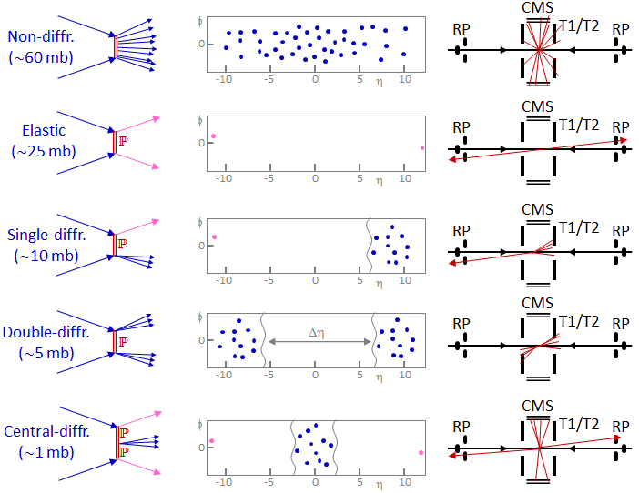
TOTEM physics at LHC
TOTEM TOTEM
TOTEM TOTEM
TOTEM TOTEM
TOTEM TOTEM
TOTEM TOTEM
Elastic and diffractive scattering: colorless exchange

Slide 4
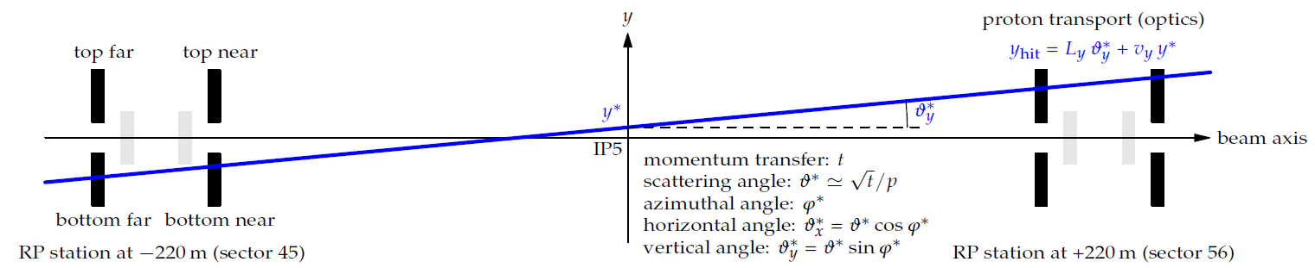
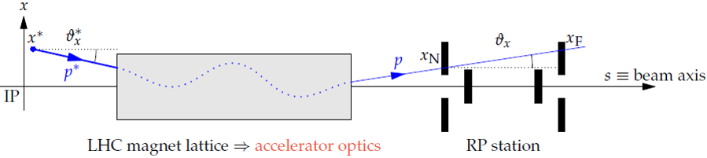
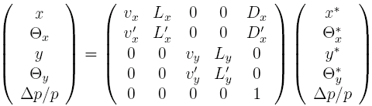
LHC Optics for elastic pp scattering
Precise σ_{tot} determination
needs excellent controll of LHC optics
from TOTEM data

Slide 5
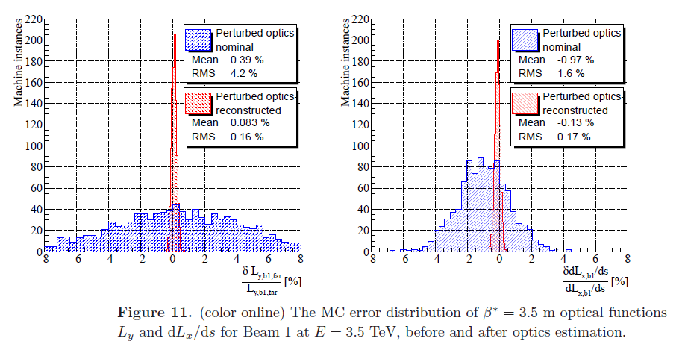
LHC Optics Determination, β*= 3.5 m
Precise control of LHC imperfections with perturbed LHC optics and recalibration from data at IP5 –
optics error reduction by factors of 10 - 20, arXiv:1406.0546

Slide 6
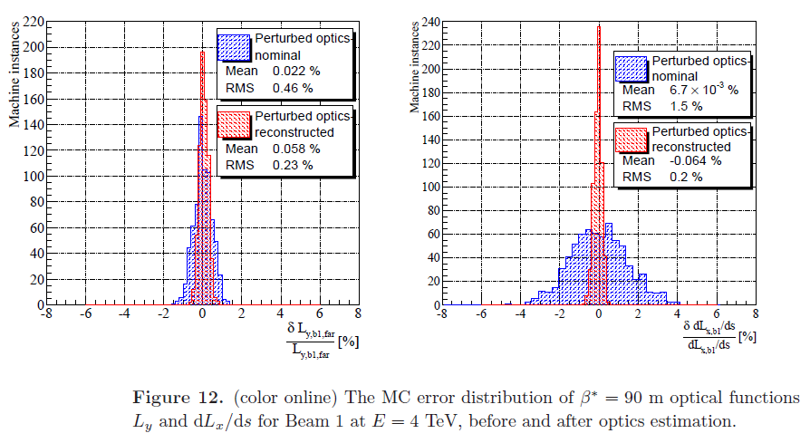
LHC Optics Determination, β*= 90 m
Precise control of LHC imperfections with perturbed LHC optics and recalibration from data at IP5: factors of 2 - 10
arXiv:1406.0546

Slide 7
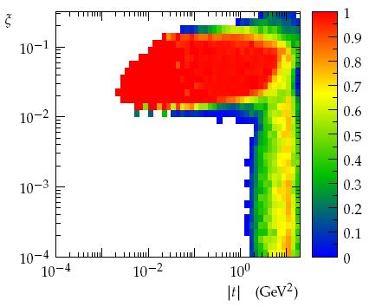
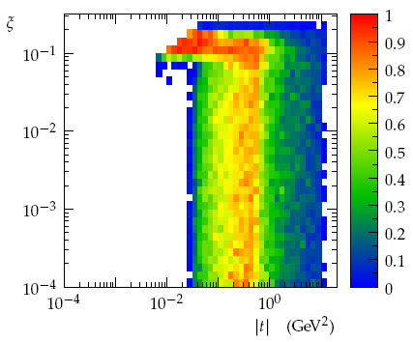
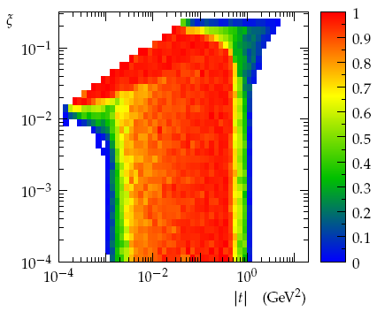
LHC optics and proton acceptance
t = -p² θ*²: four-momentum transfer squared; ξ = Δp/p: fractional momentum loss
β* = 0.55 m
Diffraction:
ξ ≥ 0.03,
low cross-sections,
hard diffraction
Elastic scattering: large |t|
β* = 90 m
Diffraction:
all ξ if |t| ≥ 10⁻² GeV²,
soft & semi-hard diffr.
Elastic: low to mid |t|
Total cross-section
β* = 1000 m
Elastic scattering:
very low |t|,
Coulomb- Nuclear Interference
Total cross-Section

Slide 8
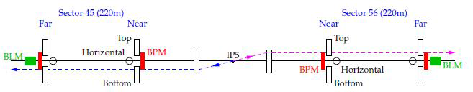
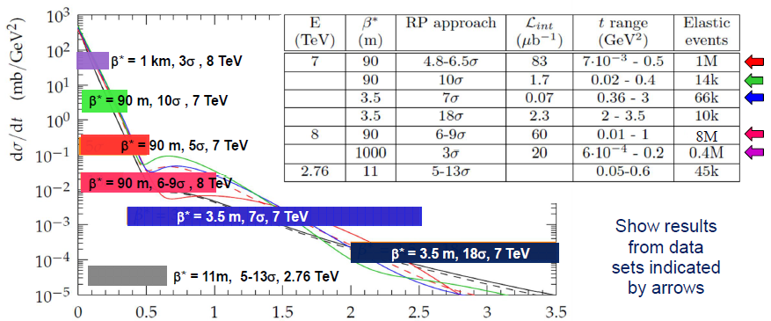
Event selection, data sets
Selected based on topology, low |ξ|, collinearity, & vertex .
Key issues: RP alignment and optics.

Slide 9
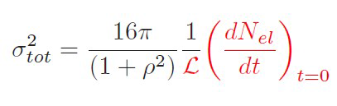
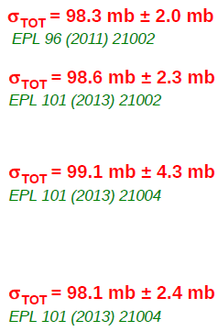

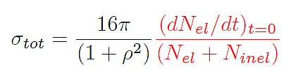
3 methods to measure σ_{tot}
elastic only
(T1,T2 independent)
7 TeV
ρ independent
L independent
8 TeV: PRL 111, 012001

Slide 10
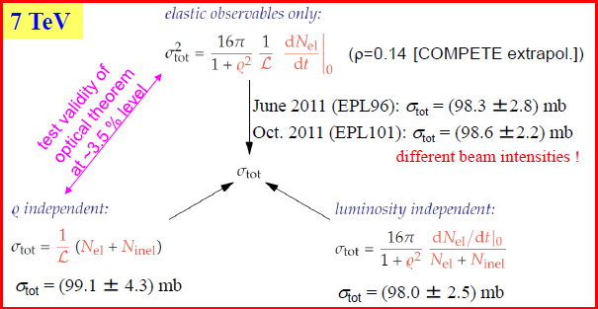
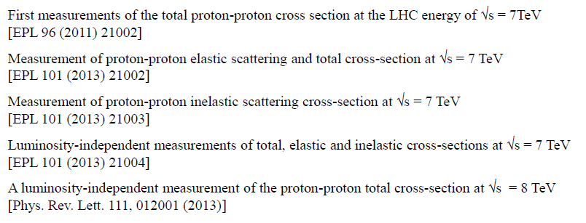
TOTEM total cross-section results

Slide 11
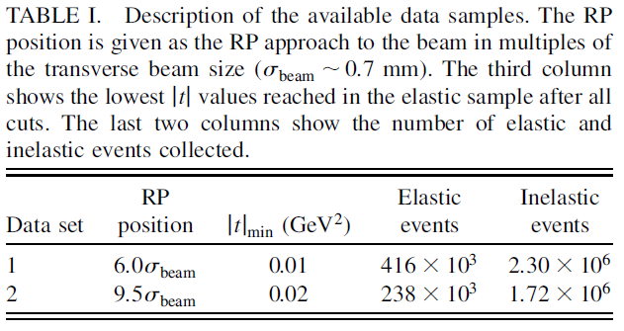
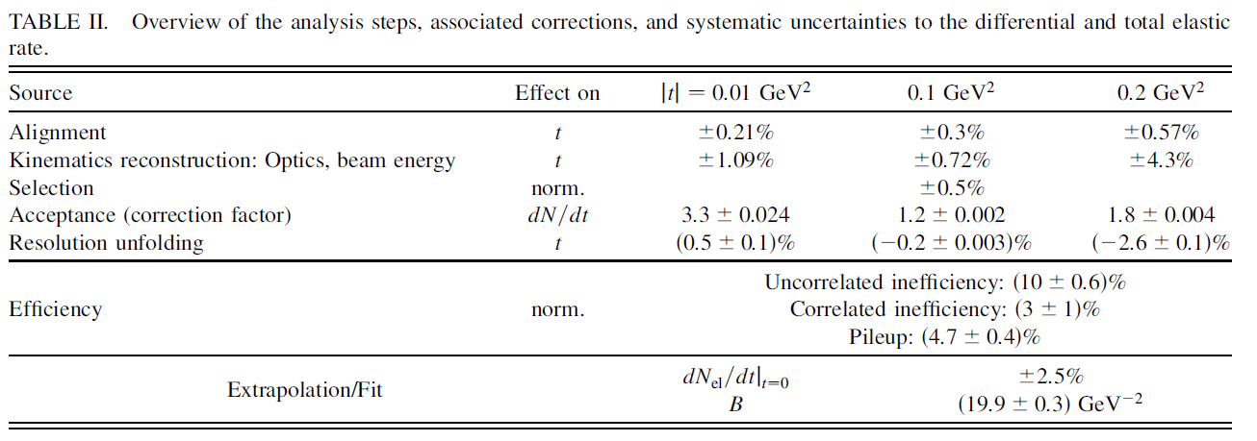
TOTEM total cross-section @ 8TeV
with luminosity-independent method
Needs precise control of LHC imperfections and recalibration from data at IP5:
β*=90m,
optics error reduction by 2-10,
arXiv:1406.0546

Slide 12
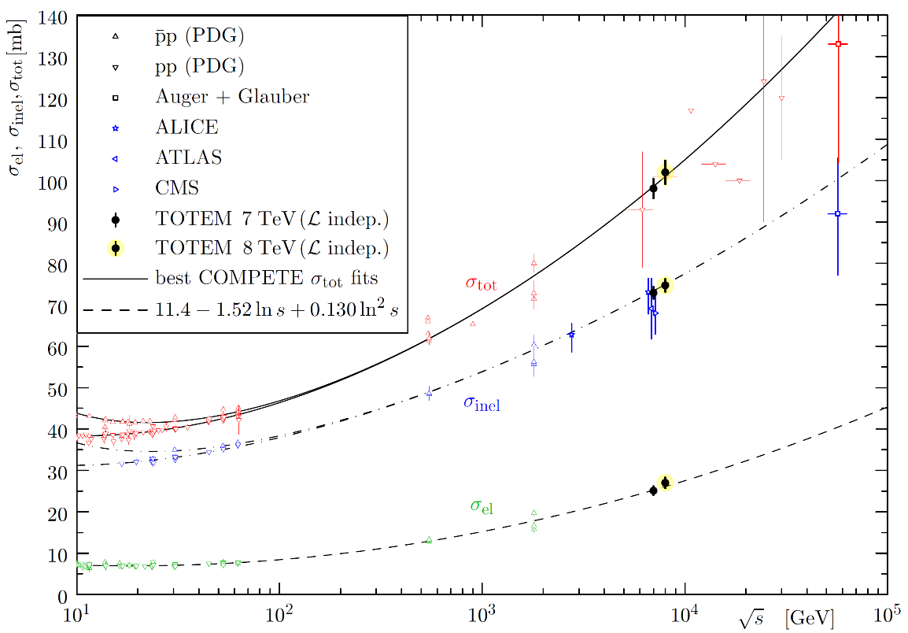
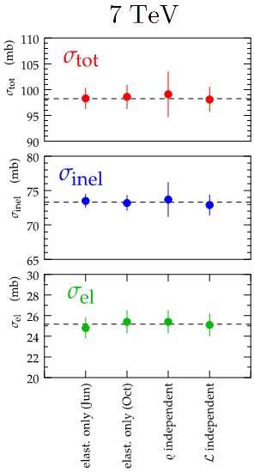
TOTEM: total cross-sections
7 TeV: Excellent agreements between different methods.
Ongoing analysis for 8 and 2.6 TeV with different optics/methods.

Slide 13
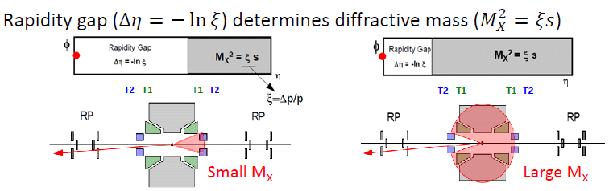
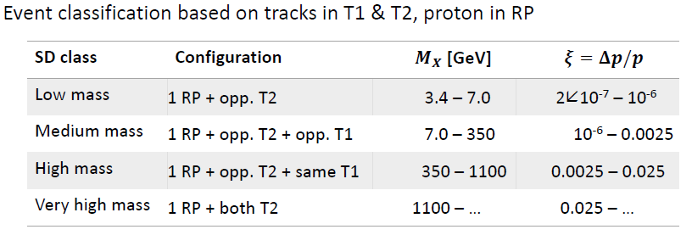
TOTEM for single diffraction
8
2x
8

Slide 14
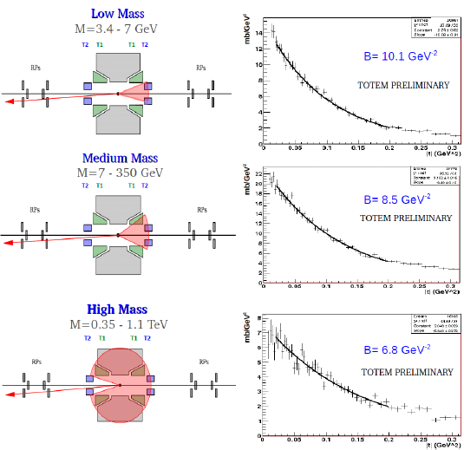
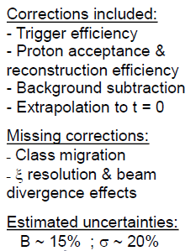
TOTEM on single diffraction, 7 TeV
TOTEM preliminary:
σ_{SD} = 6.5 ± 1.3 mb
3.4 GeV < M_{diff} < 1.1 TeV

Slide 15

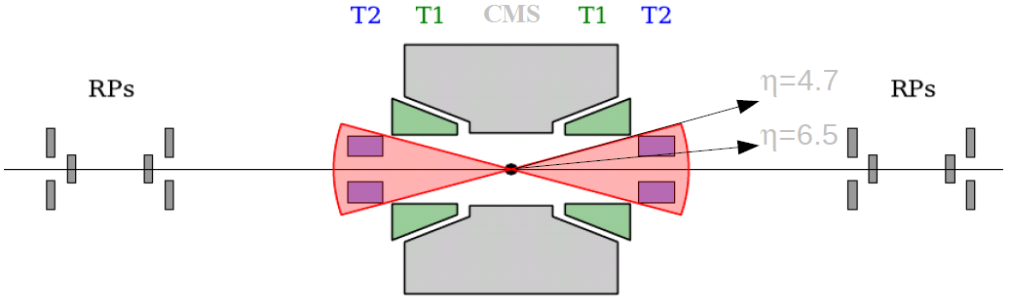
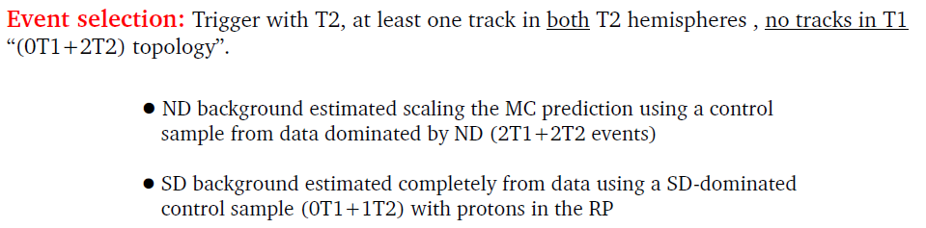
TOTEM for double diffraction

Slide 16
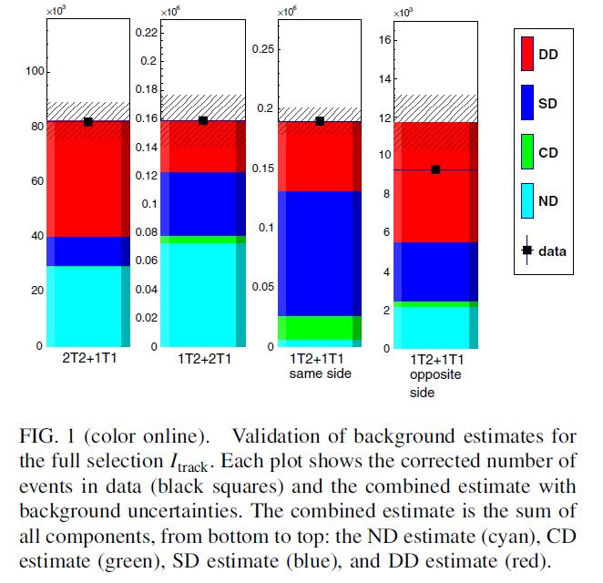

TOTEM results on double diffraction
Phys. Rev. Lett. 111, 262001
E: experimental correction
includes
acceptance,
tracking,
reconstruction efficiencies (T2)
and for only neutrals in T2
E = 0.9 ± 0.1
L = 40.1 ± 1.6 μb⁻¹
TOTEM result:
σ_{DD} = 116 ± 25 μb
4.7 < |η|_{min} < 6.5
for both diffractive systems

Slide 17
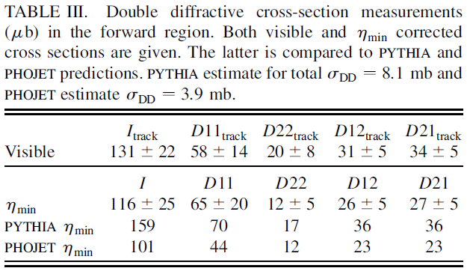
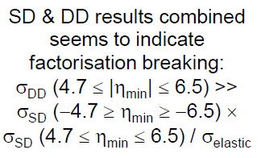
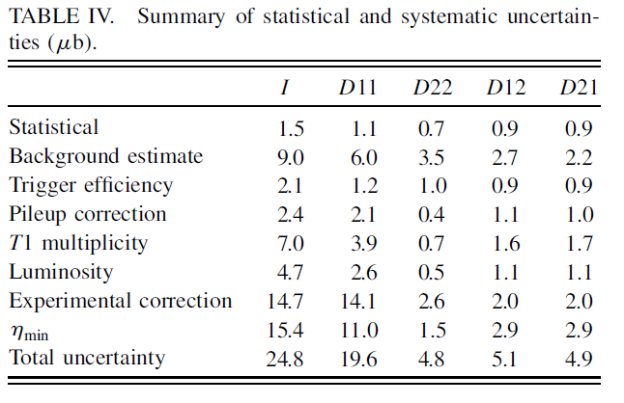
TOTEM for double diffraction
Event cathegories:
I: |η |_{min} corrected
D11:
4.7 < |η± |_{min} < 5.9
D22:
5.9 < |η ± |_{min} < 6.5
D12:
4.7 < |η⁺ |_{min} < 5.9
5.9 < |η⁻ |_{min} < 6.5
D21:
5.9 < |η⁺ |_{min} < 6.5
4.7 < |η⁻ |_{min} < 5.9
Note: |η |_{min} correction:
the dominant source of the uncertaintly

Slide 18
Summary 1
TOTEM has measured
the total pp cross section
using the luminosity independent method
at 7 and 8 TeV
and calibrated the LHC absolute luminosity
At 7 TeV, 3 different methods
of σ_{tot} measurements in excellent agreement.
Work in progress for 2.76 and 8 TeV σ_{tot}
with similar methods.
High precision of these measurements
impossible without the recalibration of LHC optics from TOTEM RP data.

Slide 19
Summary 2
TOTEM has shown
preliminary data
for single diffractive scattering at 7 TeV
and the σ_{SD} cross section at large mass.
The first measurements of
double diffractive cross section
are published.
Common TOTEM-CMS work started
on central diffraction
but this topic is
not reported in this talk.
Stay tuned for Run-2
with a new TOTEM setup

Slide 20
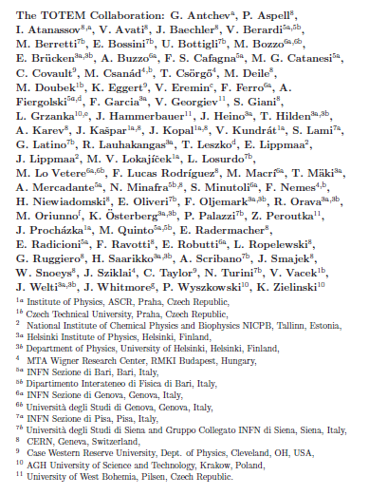
The TOTEM Collaboration
8
countries
11
institutions
78
people
Thank you!

Slide 21
Backup slides – Questions?

