Slide 1
Status of the MOPOS
BI TB – 26th June 2014

Slide 2
Existing MOPOS
MOPOS has been restarting during the last few weeks…no major faults
Repair of 56 BPM Channels
  List of faulty BPM identified by OP, including BPA and BPD
  Replacing mainly analog module
Replacement of BPA, BPD (resonant pick-up) with BPCE striplines

Slide 3
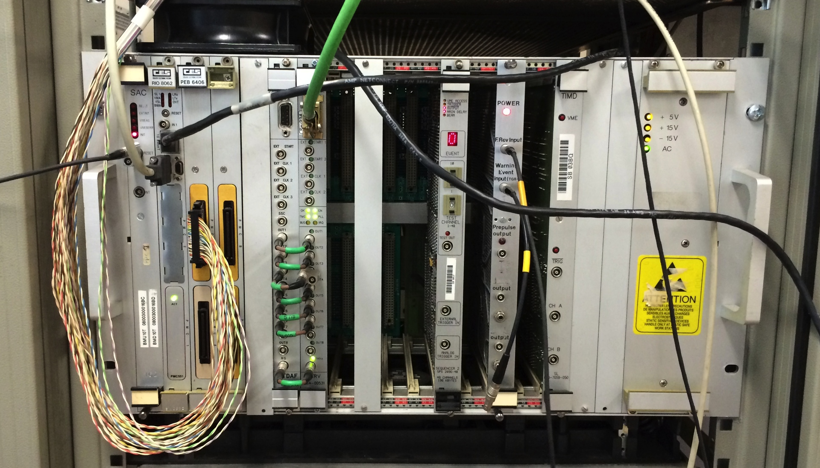
Existing MOPOS - Spares
Item | Installed | Spares | Comments
MOPOS VME Crate with special P2 Bus | 6 | 1
SAC | 6 | 1,Std
PowerPC RIO2 8060 version DA, HA or OA | 6 | 4 | may be more..
1Gb RAM extension | 6 | 1
PCI extension PEB 6406 | 6 | 4 | ‘porte avion’ 1
PCI extension PEB 6407 | 6 | 4 | ‘porte avion’ 2
PMC Acquisition card (MACI) mezzanine | 24 | 19
CTRV | 6 | Std
CTDAF | 6 | 3
SEQ III | 6 | 5 | Recuperated from ttpos
TIMD | 6 | 2
Power Supply | 6 | 3
  Many (>20) spares of analog modules: (pre-amp, filter/calibration, Homodyne receiver, SHAD (digitizer)
  + some modules to be repaired

Slide 4
Existing MOPOS
Situation of Spares
  Having as many ‘hot spare’ as possible (>1 full system)
    Need to test all spares now
  VME system and related components are more critical
    but, we had very little to change over the last 4 years
  Analog modules are not an issue
UPS in Ba’s
  By design VME crate on UPS
    Some system has not been maintained fully operational, i.e. in BA3
  Action to be done to run both analog and digital electronic on UPS electrical network

Slide 5
MOPOS Renovation
Hardware Status
Installation Status
Short and long-term plans

Slide 6
SPS Beam Position Monitors
Monitor Type | Physical Beam Aperture (mm) | Quantity | Mechanical Section | Comments
BPH | 44V x 154H | 103 | rectangular | Electrostatic shoe-box
BPV | 83 x 83 | 94 | square | Electrostatic shoe-box
BPCN | 76 | 7 | circular | Strip-line directional couplers
BPCE | 206 | 12 | circular
Total = 216 BPMs: 6 x 36 slots

Slide 7
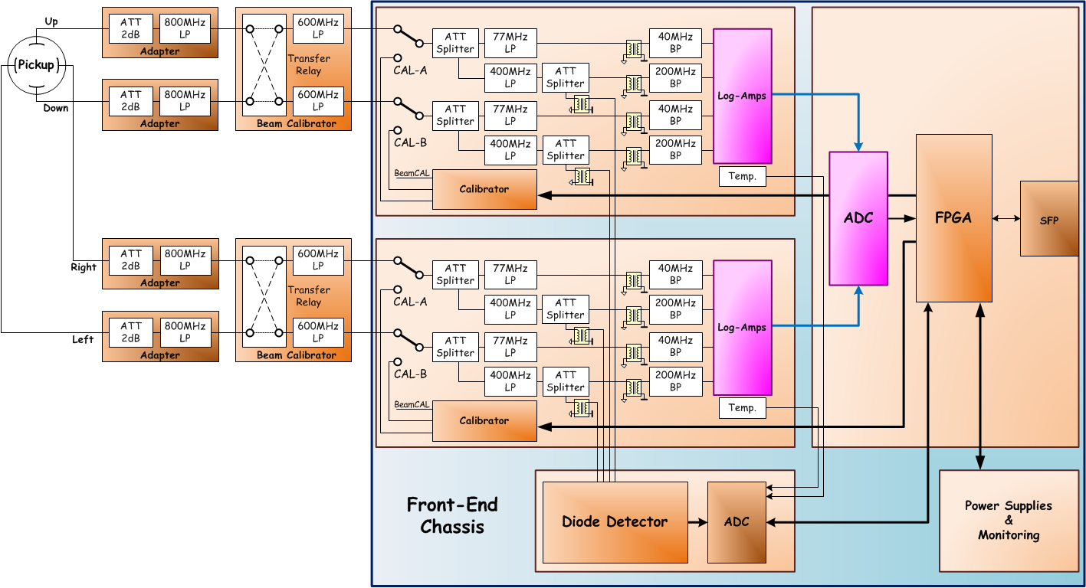
MOPOS Front-End Layout

Slide 8
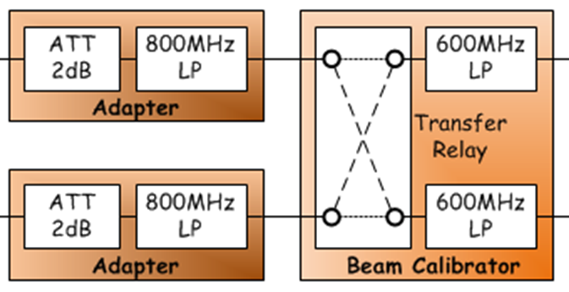
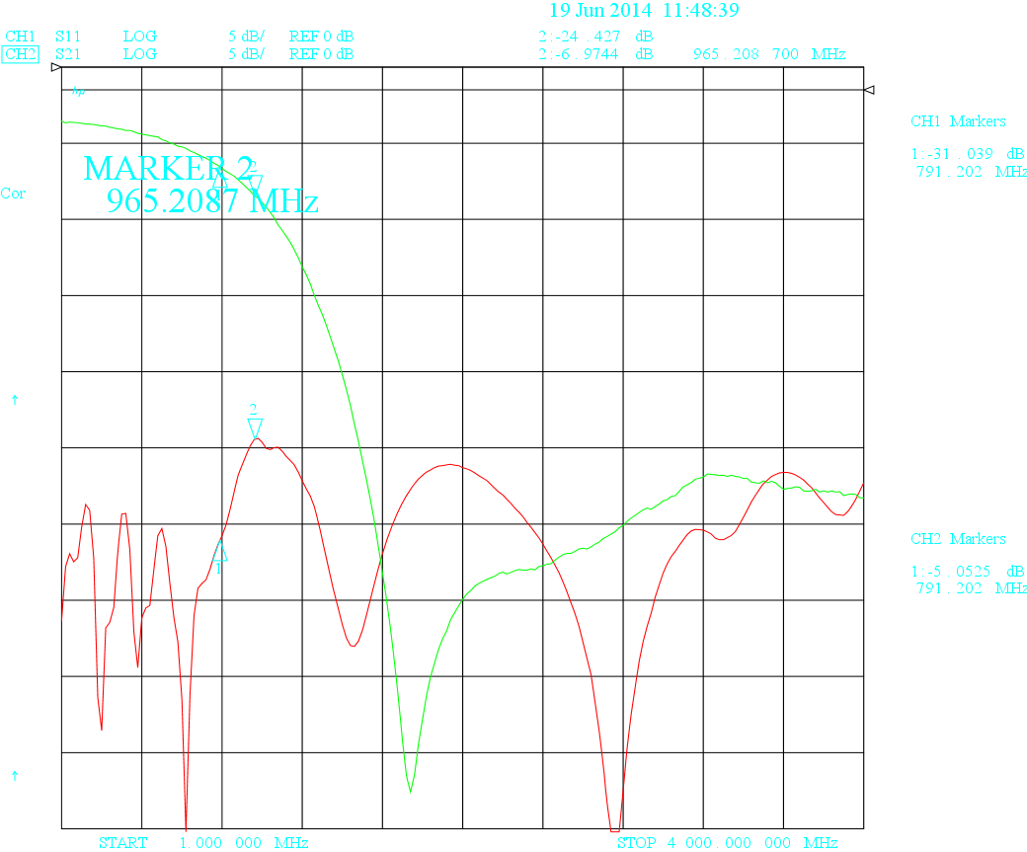
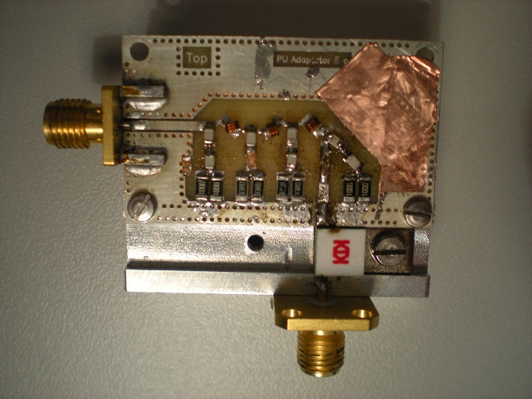
MOPOS Hardware Status
Pick-up Adapter - Development:

Slide 9
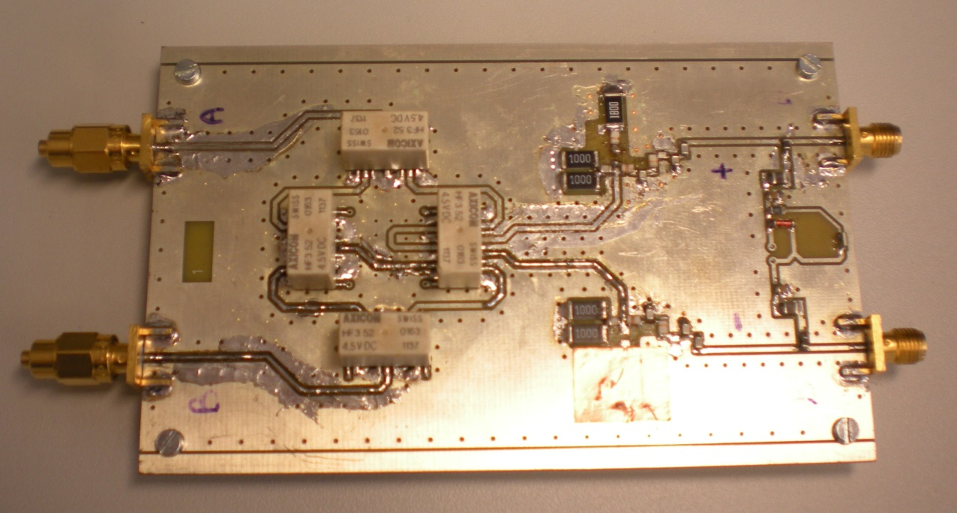
MOPOS Hardware Status
Beam Calibration: “Transfer-Relay” development

Slide 10
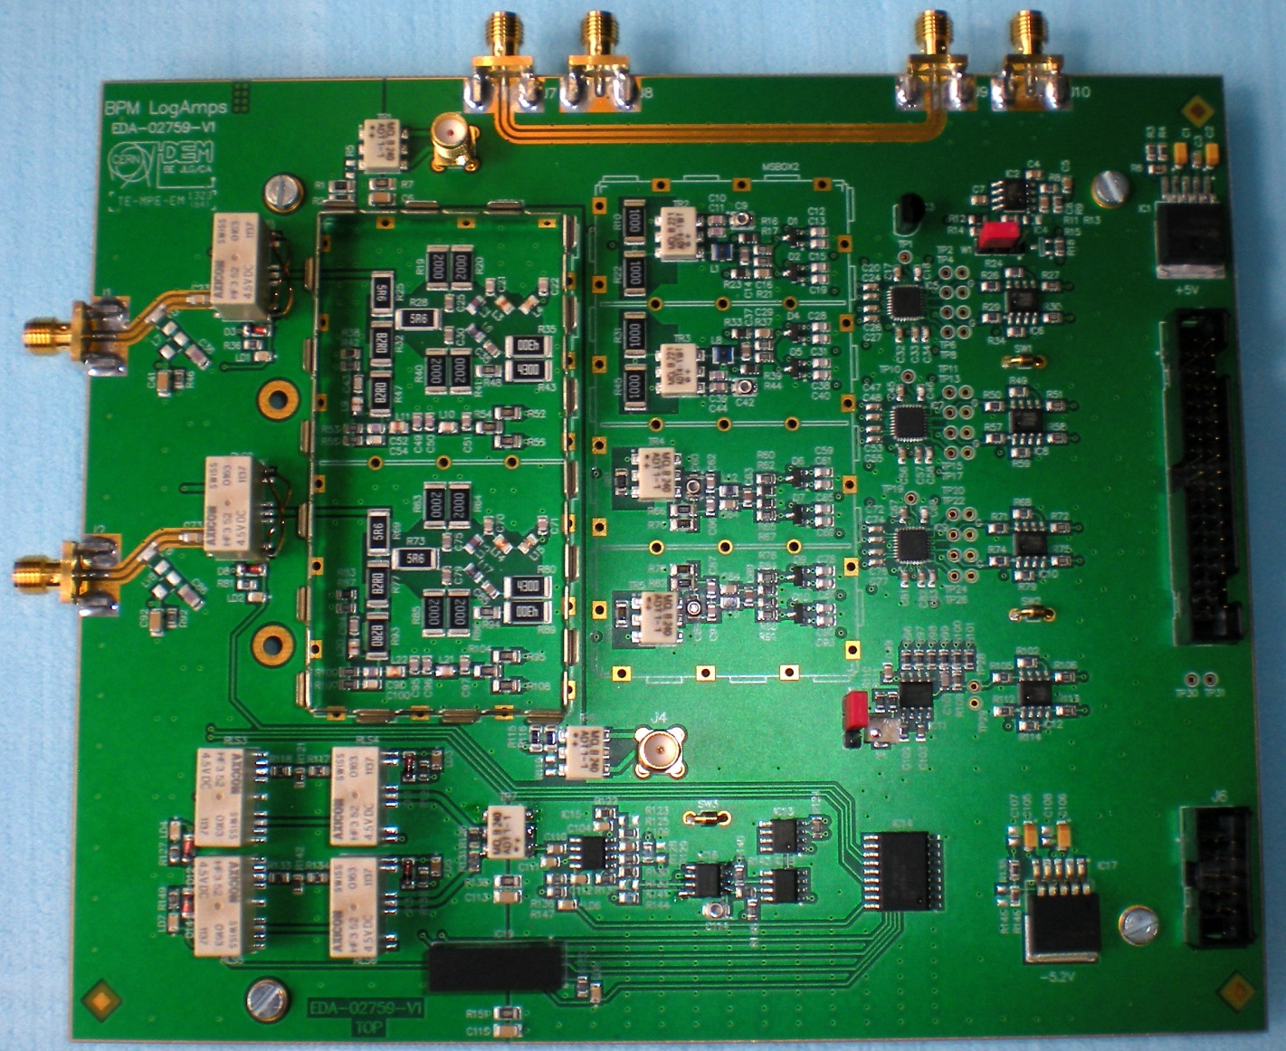
MOPOS Hardware Status
LogAMPS
    Need minor corrections
    2nd prototype under test right now

Slide 11
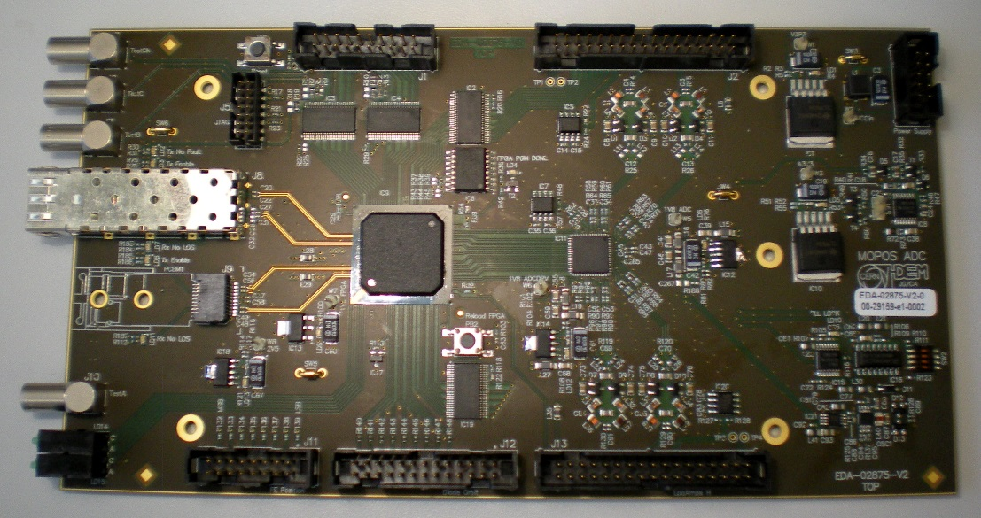
MOPOS Hardware Status
ADC, FPGA & Optical Transmitters
    Octal-14bit-ADC: AD9252
    Xilinx Spartan-6 FPGA (VFC-V2 Compatible)
    Versatile Link (rad-hard) & Commercial SFP module
    Interface for Diode Detector Acquisition (Marek’s development)

Slide 12
MOPOS Installation Status
Mini-Racks
  The SPS tunnel has been equipped with 6U & 16U Mini-Racks.
Cables
  Installation completed in LSS1 & LSS6 (EN/EL)
  Next (LS2): LSS2…LSS5
  Local cabling not done yet
Fiber Installation (LS1)
  Installed: Sextants 1, 5 & 6 and Shaft 4
  Still to be done: Shaft 3

Slide 13
MOPOS Tests in SPS-Sextant 6
Installation of prototype modules (2014/2015)
  Test and validate the performance of the FE electronic LogAmps, Beam-Calibrator
  Pick-up adapters foreseen to run Old & New MOPOS in parallel
  Front-end Electronics modules will be installed both in the tunnel and in surface buildings in order to test their susceptibility to radiation
Installation of a VME crate in BA6
  VFC-V2 modules will be used for the New MOPOS functional tests

Slide 14
MOPOS Installation Plans
Current Plan
  Development of a radiation-hard digital board (2014..)
    Test in SPS tunnel and at CHARM (PS)
  Complete the fibre installation (BA2…BA5) during LS2
  Commissioning of new system post LS2
Option : if major issue with existing MOPOS (2016/2017)
  Use the BPM-cables to transfer the pick-up signals to surface buildings (BA1…6)
  Based on new VFC-HPC

Slide 15
VFC - HPC
SRAM vs DDR3

Slide 16
External memory requirement for the MOPOS: can DDR3 be used?
The Capture mode is the acquisition mode that uses the external memory in the MOPOS
There are 2 “capture modes”:
  The debug mode saves all the data but only for one plane
  The operational mode stores the data only for the selected sensitivity but for both planes
Both modes write 4 32bit words each 100ns into the memory leading to a required transfer rate of 1.24Gb/s that is compatible with the DDR3 (1.33Gb/s) but without much margin
Both modes have data redundancy that could be eliminated and would reduce the required bandwidth to ≈ 800Mb/s

Slide 17
Plans for VFC-HPC
Currently testing the VFC with SRAMs
  Modify the bugs we found
  Produce an operational version with SRAM at least a gerber file (little amount of work/money involved)
New VFC with DDR3
  Outsourcing design and layout
  Testing a first prototype early next year

Slide 18
Specification
SPS Beam Type | Bunch spacing | Bunch number | Bunch charge [10¹⁰] | Bunch length [4σ: ns]
FT / CNGS | 5 ns | 400-4000 | 0.1-2 | 1-4
LHC25NS | 24.96 ns | N_{batch} × 72 | 1-35 | 1-4
LHC50NS | 49.92 ns | N_{batch} × 36 | 1-35 | 1-4
LHC75NS | 74.88 ns | N_{batch} × 24 | 1-35 | 1-4
LHC single bunch | 524.4-2022.6 ns | 1-16 | 0.2-35 | 1-4
LHC ion / Pb82+ | 100 ns | N_{batch} × 4 | 0.05-2 | 1-4
N_{batch}: Protons[1-4]; Ions[1-13] Bunch charge dynamic range: 57dB
Orbit acquisition: averaged over 40 turns [40x23µs=920 ms] (@1kHz up to 100s) 100k turns total
Trajectory acquisition: 50 first turns (automatic) & 10k turns total (on request)
Resolution over ±15mm aperture, for large intensity beams (>2.10¹⁰ p):
  Orbit mode: 0.1 mm ↔ BPH [Na=77mm]: 0.1% BPV [Na=41.5mm]: 0.2%
  Trajectory mode: 0.4 mm ↔ BPH: 0.5% BPV: 1%
Resolution over ±15mm aperture, for single bunches (LHC pilot [2.10⁹ p]):
  Orbit mode: 0.4 mm ↔ BPH: 0.5% BPV: 1%
  Trajectory mode: 1 mm ↔ BPH: 1.3% BPV: 2.4%
Required accuracy (without alignment): 0.5 mm ↔ BPH: 0.6% BPV: 1.2%

