Slide 1



Aims of the Workshop
EuCARD2
WP4: Applications of Accelerators
Past workshops
Future workshops
Plans
Aims of this workshop
EuCARD-2 is co-funded by the partners and the European Commission under Capacities 7th Framework Programme, Grant Agreement 312453

Slide 2
EuCARD2
Third in a series of FP6/7 IAs on Accelerator R&D:
  Coordinated Accelerator Research in Europe (FP6) - 2003 to 2007 - coordinated by CEA - 22 partners
  European Coordination for Accelerator Research and Development - 2008 to 2013 - coordinated by CERN - 37 partners
  Enhanced European Coordination for Accelerator Research and Development - 2013 to 2017 - coordinated by CERN - 40 partners

Slide 3
EuCARD2 Work Packages
13 Work Packages, see http://eucard2.web.cern.ch/ for details
  WP1: Management and Communication (MANCOM)
  Networking Activities: WP2: Catalysing Innovation (INNovation) WP3: Energy Efficiency (EnEfficient) WP4: Accelerator Applications (AccApplic) WP5: Extreme Beams (XBEAM) WP6: Low Emittance Rings (LOW-e-RING) WP7: Novel Accelerators (EuroNNAc2)
  Transnational Access: WP8: ICTF@STFC WP9: HiRadMat@SPS and MagNet@CERN
  Joint Research Activities WP10: Future Magnets (MAG) WP11: Collimator Materials for fast High Density Energy Deposition (COMA-HDED) WP12: Innovative Radio Frequency Technologies (RF) WP13: Novel Acceleration Techniques (ANAC2)

Slide 4
EuCARD2 Work Packages
13 Work Packages, see http://eucard2.web.cern.ch/ for details
  WP1: Management and Communication (MANCOM)
  Networking Activities: WP2: Catalysing Innovation (INNovation) WP3: Energy Efficiency (EnEfficient) WP4: Accelerator Applications (AccApplic) WP5: Extreme Beams (XBEAM) WP6: Low Emittance Rings (LOW-e-RING) WP7: Novel Accelerators (EuroNNAc2)
  Transnational Access: WP8: ICTF@STFC WP9: HiRadMat@SPS and MagNet@CERN
  Joint Research Activities WP10: Future Magnets (MAG) WP11: Collimator Materials for fast High Density Energy Deposition (COMA-HDED) WP12: Innovative Radio Frequency Technologies (RF) WP13: Novel Acceleration Techniques (ANAC2)

Slide 5
Accelerator Applications
>30000 accelerators already in use around the World
Annual sales: >$3.5B
Annual product, etc, sales: >$0.5T
Fit into a few broad categories:
  Energy
  Environment
  Healthcare
  Industry
  Security and defence
  Research
Most of the World’s accelerators

Slide 6
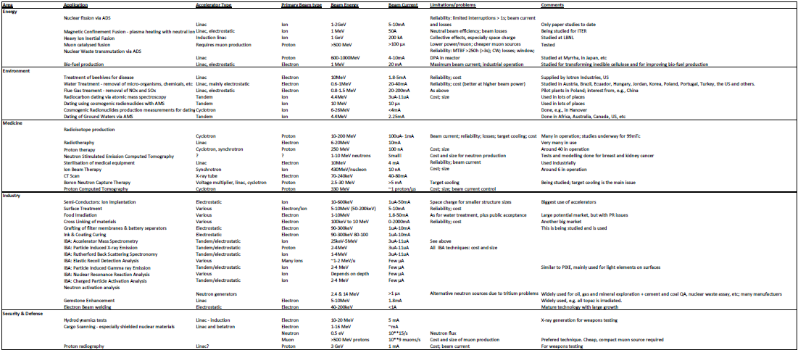
Accelerator Applications
>30000 accelerators already in use around the World
Annual sales: >$3.5B
Annual product, etc, sales: >$0.5T
Fit into a few broad categories:
  Energy
  Environment
  Healthcare
  Industry
  Security and defence
  Research
See: http://eucardapplications.hud.ac.uk/wp-content/uploads/2014/01/Accelerator-applications.xlsx

Slide 7
WP4: Accelerator Applications
Objectives: - look for existing applications that could benefit from accelerators developed for research - look for new applications
First step: review of state of the art – done
Second step: selection of applications to focus on – on-going
Third step – more detailed study via workshops - on-going
Outputs: - Things (limitations, new applications, etc) to be addressed - Collaborations to address them - Funding proposals – H2020, national programmes, etc, etc - Improved or new applications - Policy document
We welcome all input to this work!

Slide 8
Objectives
Task 1: Coordination - Rob Edgecock (Huddersfield & STFC)
Task 2: Low energy accelerators – Marco Cavenago (INFN)
Task 3: Intermediate energy proton and ion accelerators – Marco Schippers (PSI)
Task 4: High beam power proton and ion accelerators – Alessandra Lombardi (CERN)
Task 5: High beam power targets – Hywel Owen (Manchester)
Website at: http://eucardapplications.hud.ac.uk/
53 partners: - 35 not EuCARD2 partners - 19 industry/users

Slide 9
First workshops
Modern hadron therapy gantry developments – UMAN & PSI - 16th-17th January 2014 - Cockcroft, UK - https://eventbooking.stfc.ac.uk/news-events/modern-hadron-therapy-gantry-developments-187
Accelerators for accelerator driven systems - CERN - 20th-21st March 2014 - CERN - organised jointly with MAX - https://indico.cern.ch/event/300409/overview
Accelerator based neutron production (ABNP2014) - INFN - 14th-15th April 2014 - Legnaro - BNCT, radioisotope production, security, etc - https://agenda.infn.it/conferenceDisplay.py?confId=7214

Slide 10
Further planned workshops
Electron beams for industrial and environmental applications – HUD - 6th-7th November 2014 - Institute of Nuclear Chemistry and Technology, Warsaw - see http://indico.cern.ch/event/324518/
Compact muon sources – HUD - 12th-13th January 2015 - Huddersfield - Jointly organised with NMI3 - Muons for muCF, muSR, security screening, etc - http://wwwisis2.isis.rl.ac.uk/useroffice/MuonSources/Register.asp
Compact accelerators for radioisotope production - UMAN - 26th-27th March 2015 - Daresbury, UK

Slide 11
Further planned workshops
Energy applications of accelerators – INFN
Accelerator reliability - CERN
Compact gantries for charged particle therapy - PSI
Young researchers BNCT meeting – HUD
Applications of Particle Accelerators in Europe - HUD
Other suggestions are very welcome!

Slide 12

Policy document
Grew out of a symposium in 2009, sponsored by the U.S. Department of Energy, on the uses and needs of accelerators for the discovery science, energy and environment, defense and security, industrial, and medical communities.
See the website at:
http://www.acceleratorsamerica.org/

Slide 13

Policy document
Plan to do the same for Europe - update US document - European focus - build on other work:
TIARA: Accelerators for Society
See:
http://www.accelerators-for-society.org/
IOP in the UK
CERN document
- focus on policy makers

Slide 14
Policy document
Applications of Particle Accelerators in Europe
International organising committee in place: - Steve Myers - Roy Aleksan - Oliver Boine-Frankenheime - Andrea Pisent - Angeles Faus-Golfe - Phil Burrows - Rob Edgecock (WP4) - Agnes Szeberenyi (Communications)
Conveners for applications areas to be identified: - 3 each for Energy, Environment, Health, Industry and Security
Kick-off meeting; next summer, Royal Society (if possible)

Slide 15
Aims of this workshop
Review the current applications of e-beams
Look at current and possible future technology
Identify limitations, possible improvements, etc
And new applications
Ideally, form collaborations interesting in working in this area
Look at possible funding mechanisms, e.g. through H2020

