Slide 1
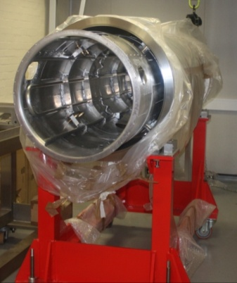
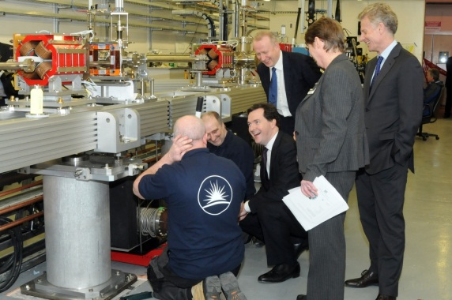
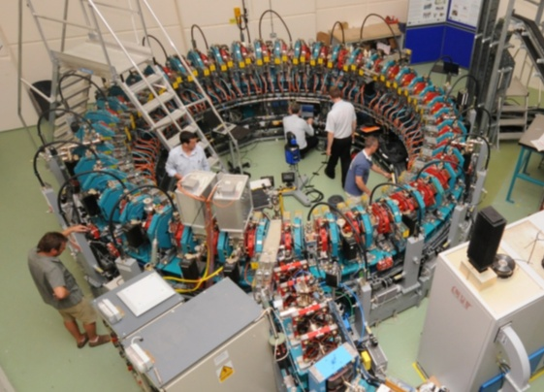
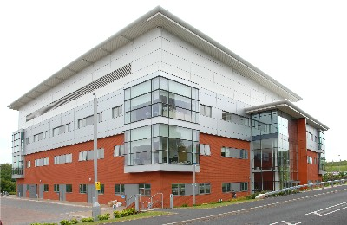
The VELA Accelerator and Compact Electron Sources
6-7 November 2014
Dr Katharine Robertson
ASTeC Business Development Manager

Slide 2
Overview
STFC/ASTeC background
ASTeC Industrial Engagement
The VELA facility
  Background
  Progress
  Technical specifications
  Industrial Access
  Case studies
High frequency compact electron sources
  X-band linac for security applications
  Technology status

Slide 3

Impact on the economy
Growth
Build knowledge economy
Address the big challenges facing us and the world
energy, environment, healthcare and security

Slide 5
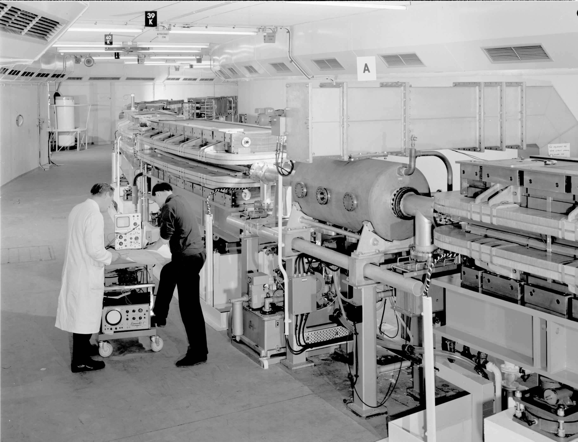
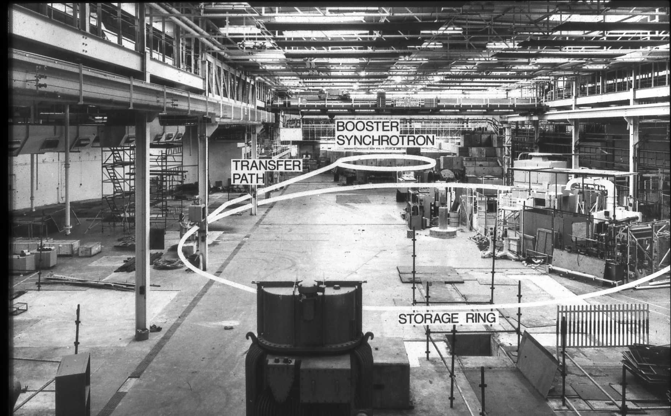
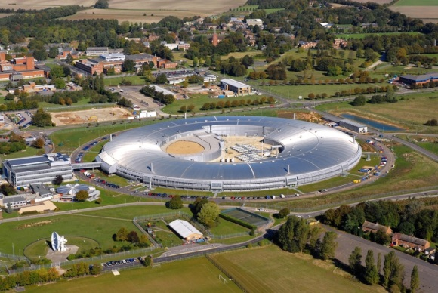
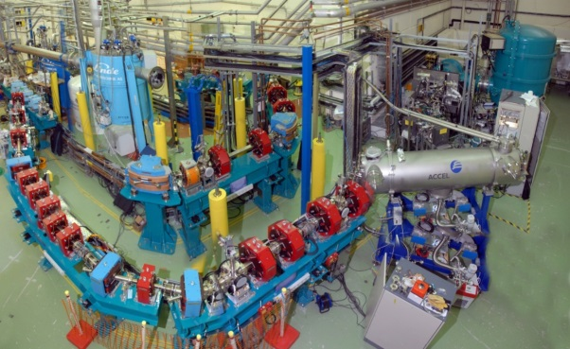
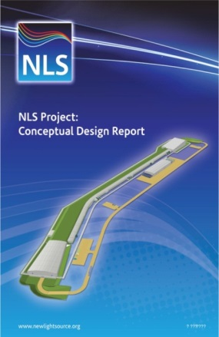
ASTeC Background & Heritage
~55 scientists, engineers and technologists across 2 sites
50 year heritage in world-leading accelerator technology
  Only institute in the world with experience in 4 generations of accelerator technology
1st Generation - NINA – reason for establishment of DL
2nd Generation - SRS – 1981-2008 – world’s first fully dedicated machine using synchrotron radiation for applied & fundamental research
3rd Generation – design of Diamond
4th Generation light source & new accelerator concepts
  EMMA – world first ‘ns-FFAG’ – potential to make accelerators more compact, simpler and cheaper
  ALICE – first accelerator in Europe to operate in ‘energy recovery’ mode

Slide 6
Key Offerings
Access to large, complex and unique research facilities that industry cannot design, procure or operate (e.g. VELA, ALICE)
A vast array of underpinning technology, driven to the cutting-edge by the challenges of particle accelerators. Widely applicable elsewhere (e.g. ultra-high vacuum & coatings).
The knowledge and skills to make these concepts reality

Slide 7
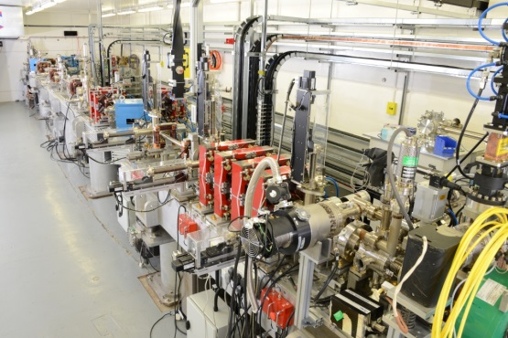
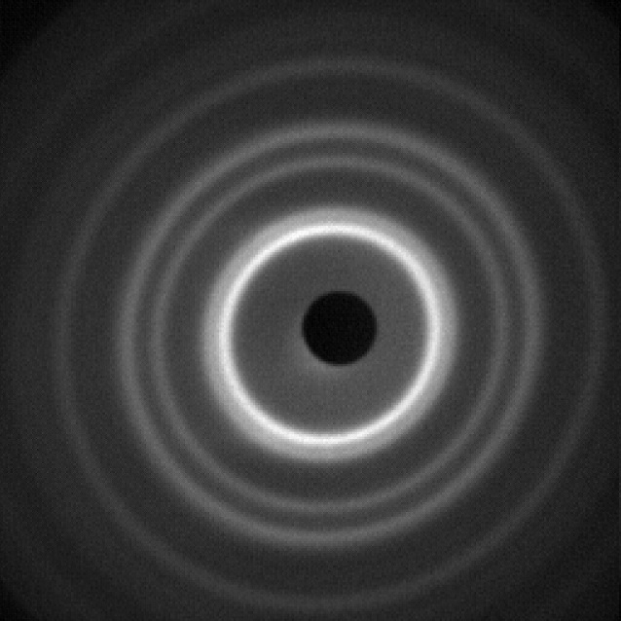
VELA – STFC’s newest accelerator facility
First users Sept 2013
NEW capability in ultrafast electron diffraction demonstrated in Oct 2014
Intend to develop UED capability into full time-resolved pump-probe measurement (‘molecular movies’)

Slide 8
VELA Technical Specifications
Parameter | VELA | Units
Beam Energy | 4-6 | MeV
Bunch Charge | 10 - 250 | pC
Bunch Length (σ_{t,rms}) | 1 - 10 | ps
Normalised Emittance | 1 - 4 | μm
Beam size (σ_{x,y,rms}) | 1 - 5 | mm
Energy Spread (σ_{e,rms}) | 1 - 5 | %
Bunch Repetition Rate | 1 – 10* | Hz
6 MeV electron beam
Very short pulses
Conversion via a target possible for short pulse x-rays
*1 – 400 Hz with high rep. rate gun – future upgrade

Slide 9
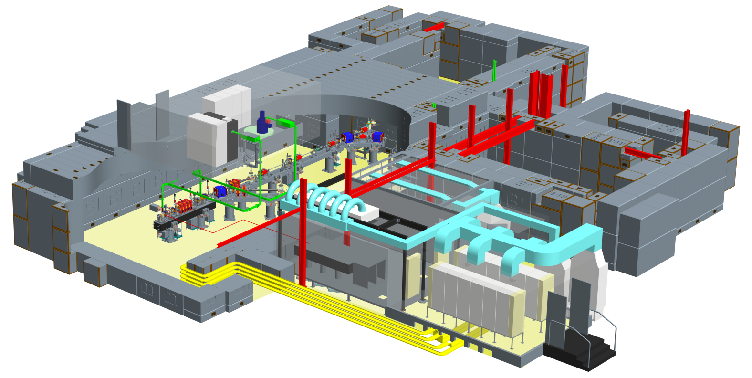
VELA features
Very high quality, pulsed electron beam. Ultra-short pulses, highly stable (position, time, energy etc.), excellent diagnostics, customisable beam.
Two big, flexible, fully shielded experimental areas.
Easy access for industry.
Access “both sides of the wall”.
High performance capability of VELA being developed to explore fundamental delivery capabilities of future compact FEL sources (-> CLARA*)
*Compact Linear Advanced Research Accelerator

Slide 10
VELA – Industrial Access
Available to industry on a highly flexible basis.
  Or via industry/academic collaboration
Access on pay-per-day costing model.
STFC can offer end-to-end support including consultancy, design & build of experimental set-up, facility operation and analysis of results.
  Tailored to customer’s needs
Access can be arranged to other areas of STFC’s vast repository of scientific, engineering & computational expertise/facilities
  E.g. Diamond, ISIS, CLF, HPC facilities, plus wide range of small- and mid-range equipment

Slide 11
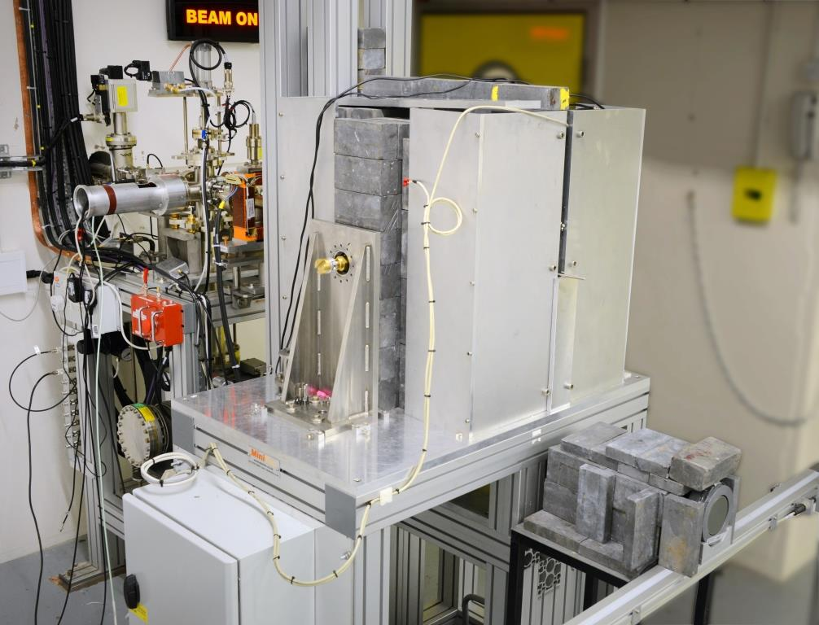
VELA – Case Study 1
Rapiscan, UCL and STFC ASTeC
Proof of concept for new cargo scanning technique
Long term goal – 3D x-ray images for threat detection
High energy and ultra-short pulse widths unavailable elsewhere
Tungsten target used to produce short pulses of x-rays
Encouraging results
Now investing in more extensive strategic R&D programme to move proof of concept towards commercialisable product
Due to return to VELA for follow-up experiments in
early 2015

Slide 12
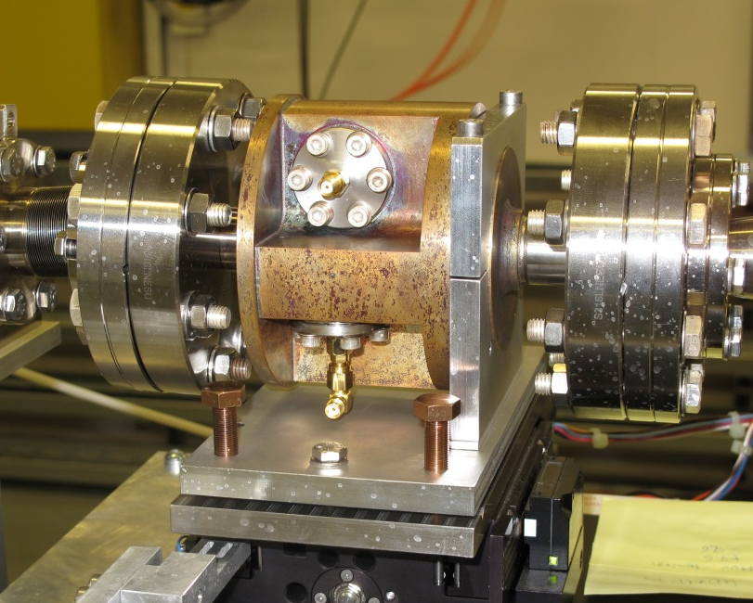
VELA – Case Study 2
FMB Oxford, RHUL and STFC ASTeC
Cavity BPM – specialist diagnostic for high energy linacs, increasing interest due to high-precision accelerator developments (e.g. FEL)
No commercially available product
Existing designs usually very site-specific
The FMB CBPM is being tested in situ on VELA – helping development and demonstrating performance
Aim to develop to stage of readiness for commercialisation

Slide 13
VELA Summary
STFC and ASTeC aim to maximise economic impact of our research, skills and facilities
VELA is a new electron accelerator which is available to industry on a highly flexible basis
Also exploring application areas of underpinning technologies
Contact:
  katharine.robertson@stfc.ac.uk

Slide 14





Compact High Frequency Electron Sources

Slide 15
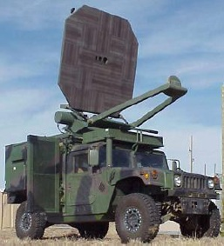

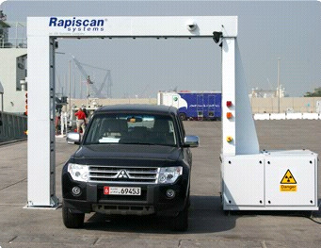
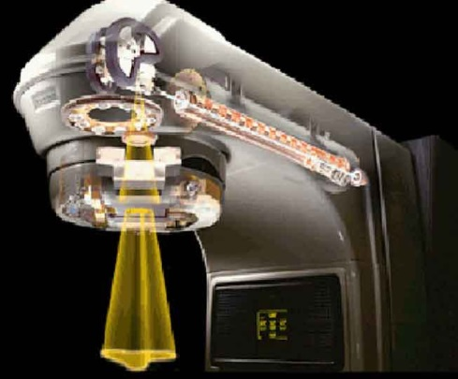
Compact RF Technologies
S-band (2-4 GHz)
  Linacs (medical and security) for x-ray scanning (~10cm)
C-band (4-8 GHz)
  Linac-driven compact FELs (Science) and THz imaging (security) (~5cm)
X-band (8-12 GHz)
  Linacs and RF technology (medical, defence and security) for tumour ablation, x-ray scanning and radar (~2.5cm)
W-band (75-110 GHz)
  Linacs and technology (defence) for radar and active denial systems (mm)
W-Band
C-Band
S-Band
X-Band
X-Band

Slide 16
X-band linac for security scanning applications
Funded by STFC
Collaboration
  Lancaster University
  STFC ASTeC
  Rapiscan
  E2v
Aim – to develop a compact, cost-effective, flexible 1 MeV X-band linac for mobile security scanning, e.g. air cargo

Slide 17
Why X-band?
Higher frequency = Shorter wavelength = higher accelerating gradient
More compact, smaller footprint = more mobile
Less shielding = lighter and requires less infrastructure
Less shielding = cost savings
Drawbacks:
Manufacturing tolerances for the cavities are tighter the higher the frequency
RF sources of sufficient power are not widely available from industry

Slide 18
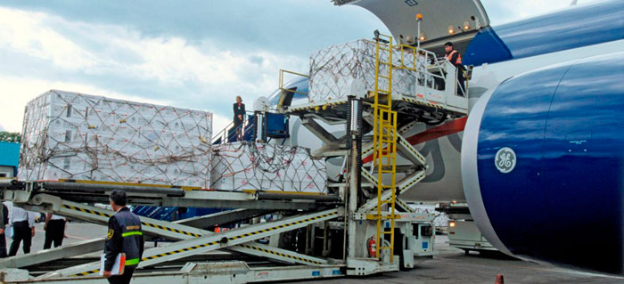
Applications (1)
Low energy, low output
  1 MeV, up to 2cGy/min at 1m @ 100Hz
Air cargo screening = inspect a full ULD
  No system currently exists with required penetration and spatial resolution
  Potential to open up new market sector
Mobile screening with reduced exclusion zone
  Current systems require 40mx40m exclusion zone
  A lower energy/dose rate linac would reduce exclusion zone footprint
  Deploy at e.g. public events, car parks

Slide 19
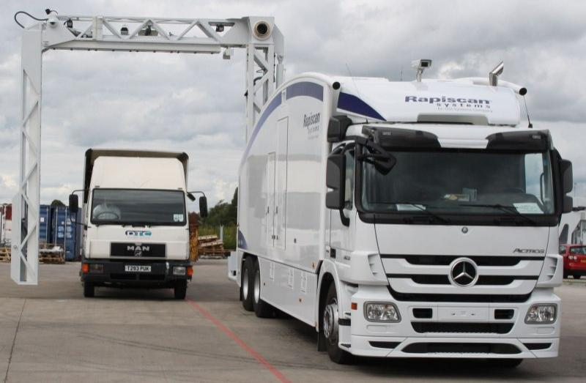
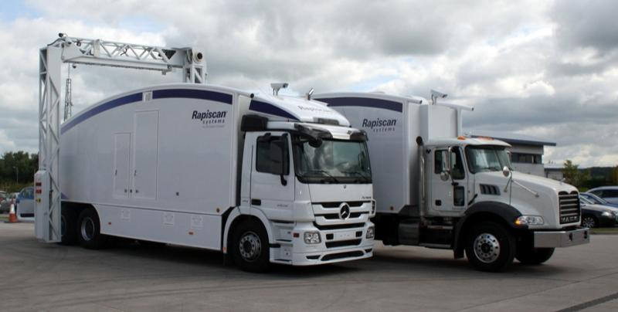
Applications (2)
High energy, medium output
6 MeV, up to 80cGy/min at 1m @ 100Hz
Competing with existing S-band devices
Significant advantage is the weight saving
  Reducing rear axle weight by 500 kg for mobile scanners

Slide 20
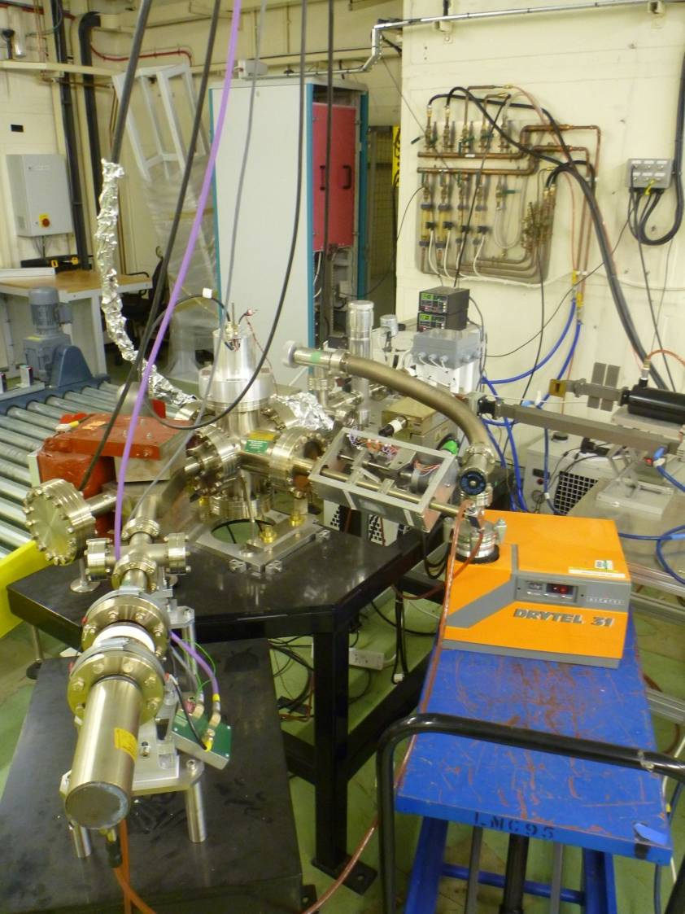
The CLASP project
Designed a new cavity structure with less sensitivity to manufacturing tolerances in the critical areas
Field characteristics closely matched specification – indicated successful manufacturing process
Developing control systems that would not require an accelerator scientist to operate the machine

Slide 21
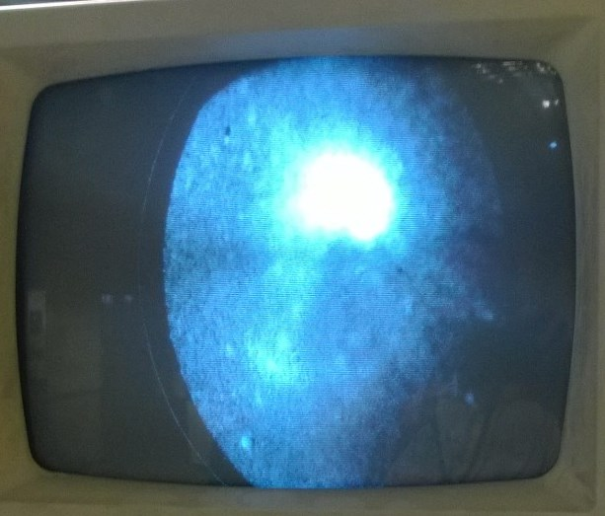
First Beam
Achieved 3/11/14
Preliminary results indicate delivering 1.2MeV
  2μs pulses, 50Hz, 3mA pulse current
Detailed characterisation taking place

Slide 22
Another application: Water
Microbiological
Electron beam
Advanced oxidation processes with nanoscale Fe oxide
Waste water treatment
  In collaboration with the Universities of Oxford and Bristol
Compact linac beam will be used to irradiate waste water samples
  Sequential hybrid treatment

Slide 23
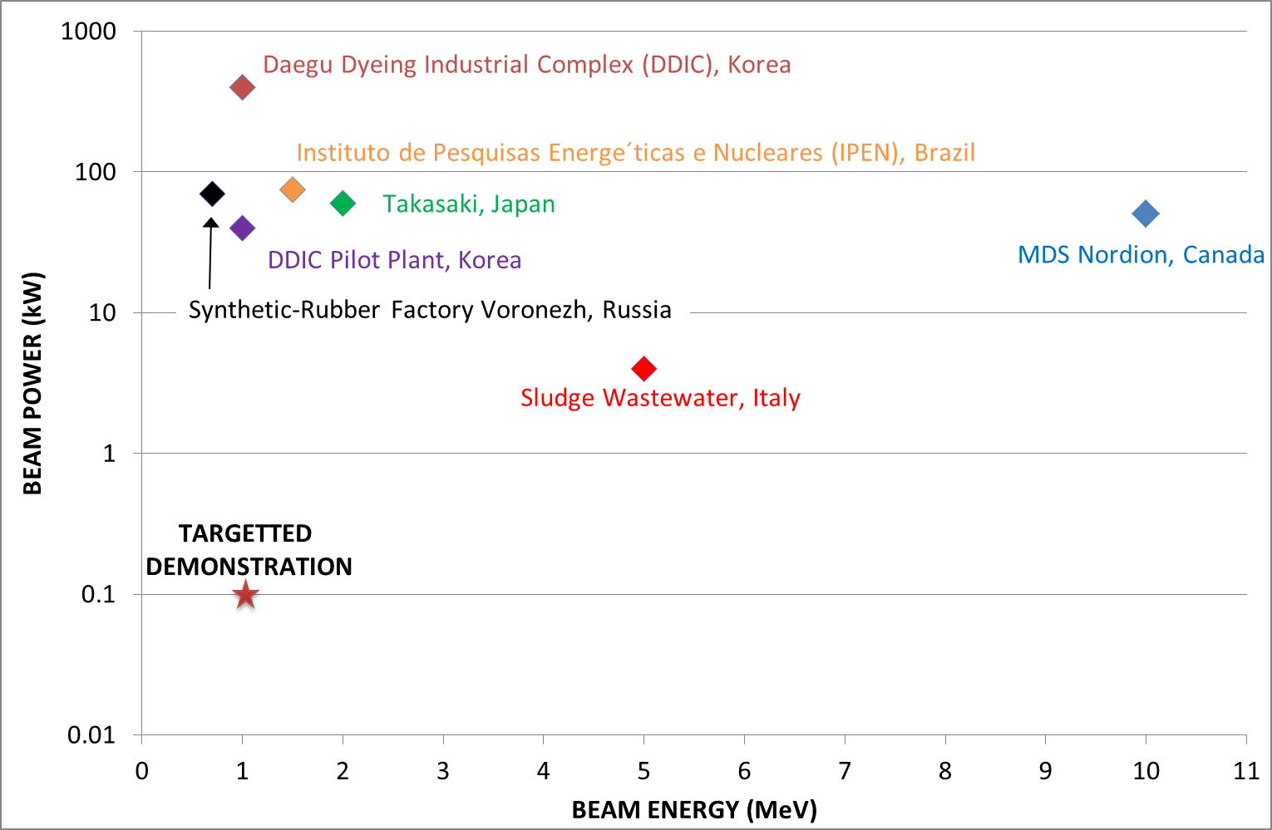
Water treatment
Optimum e-beam parameters to be determined based upon:
  Duration,
  Regime of exposure,
  Energy,
  Beam intensity.
Determine the most effective e-beam exposure that :
enables degradation of
recalcitrant organic contaminants, resistant to other treatment procedures
leads to microbial cell inactivation
assess potential of e-beam to precipitate metals, so enabling their recovery, end-of-pipe.
Determine the key issues that will define the commercial potential of e-beam application for treating problematic contaminated waters.

Slide 24
Summary
X-band accelerators offer great potential for applications where footprint and space for supporting infrastructure is limited, or where mobility is a key requirement
  Security
  Medical
  Environmental
Also offers potential for research accelerators, e.g. in CLARA for demonstration of FEL applications
Limited supply of RF sources is currently a restriction
  Deployment in a research facility may help ‘mainstream’ X-band technology and widen the scope for industrial applications

Slide 25
Thank you
Katharine.Robertson@stfc.ac.uk

