Slide 1

R2E relocation & shielding activities: status report
Anne Laure Perrot EN/MEF- LE
On behalf of the R2E coordination team
LS1 Committee – meeting #48, 27th June 2014

Slide 2
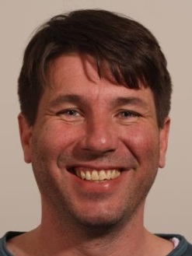
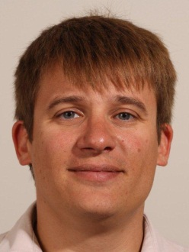
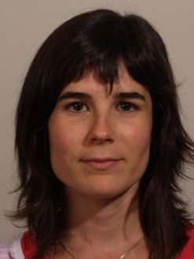
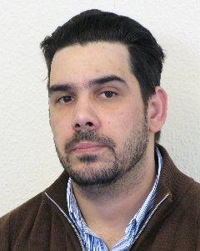
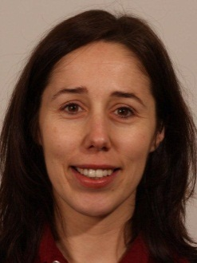
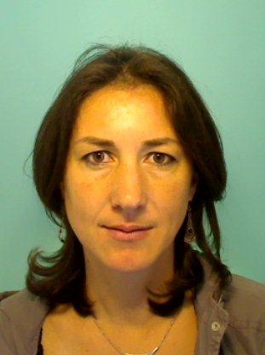
The R2E coordination team
Points 1 & 4
Michael Jeckel (EN/MEF)
Planning &
General coordination (deputy)
Maria Barberan Marin (EN/MEF)
Point 5
Bertrand Lefort (BE/OP)
Point 7
Oscar Andujar (BE/OP)
General coordination
Anne Laure Perrot (EN/MEF)
Point 8
Bettina Mikulec (BE/OP)
A. L. Perrot, EN-MEF/LE
2

Slide 3
Contents
Advancement status of the R2E activities in points 1, 4, 5 & 7
Safety
Summary

Slide 4
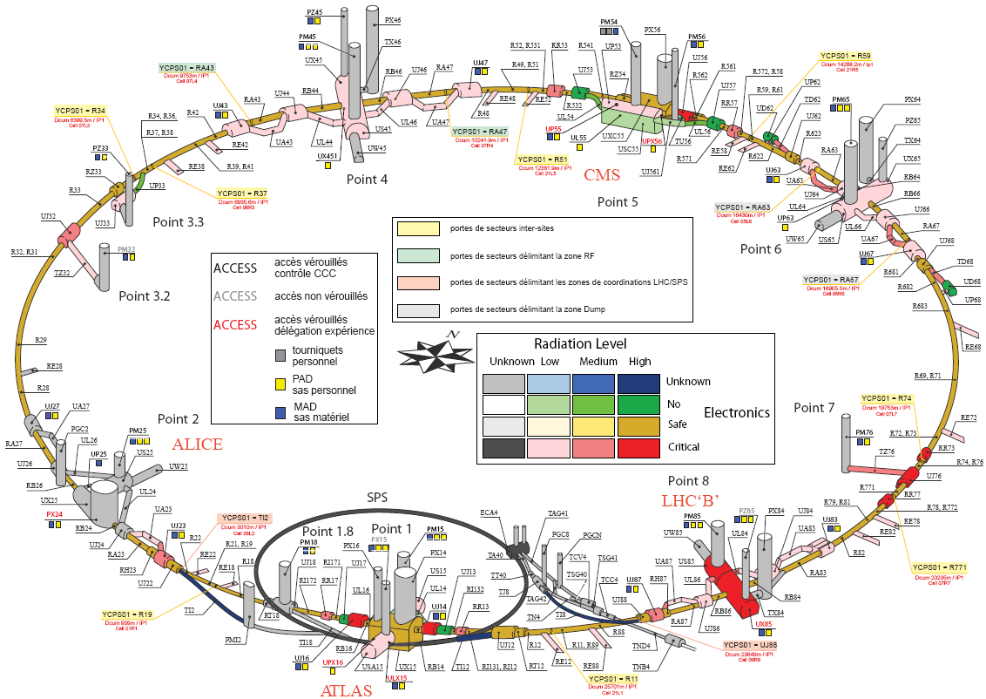
Main critical areas
UX45
UJ56
RR53/57
UJ76
UJ14/16
RR13/17
US85
US85
completed
13rd Dec. 2013

Slide 5

Mitigation activities – general
Phase I: dismantling
- equipment removal/storage (equipment owners, EN/HE),
- services removal (mainly EN/EL, EN/CV)
- civil engineering (GS/SE)
Phase II: infrastructures
- civil engineering (GS/SE)
- services installation (mainly EN/EL, EN/CV, IT/CS)
Phase III: equipment relocation / installation
    (equipment owners, EN/HE)
Phase IV: equipment commissioning
(equipment owners, GS/ASE, EN/EL, EN/CV, IT/CS)
In progress

Slide 6
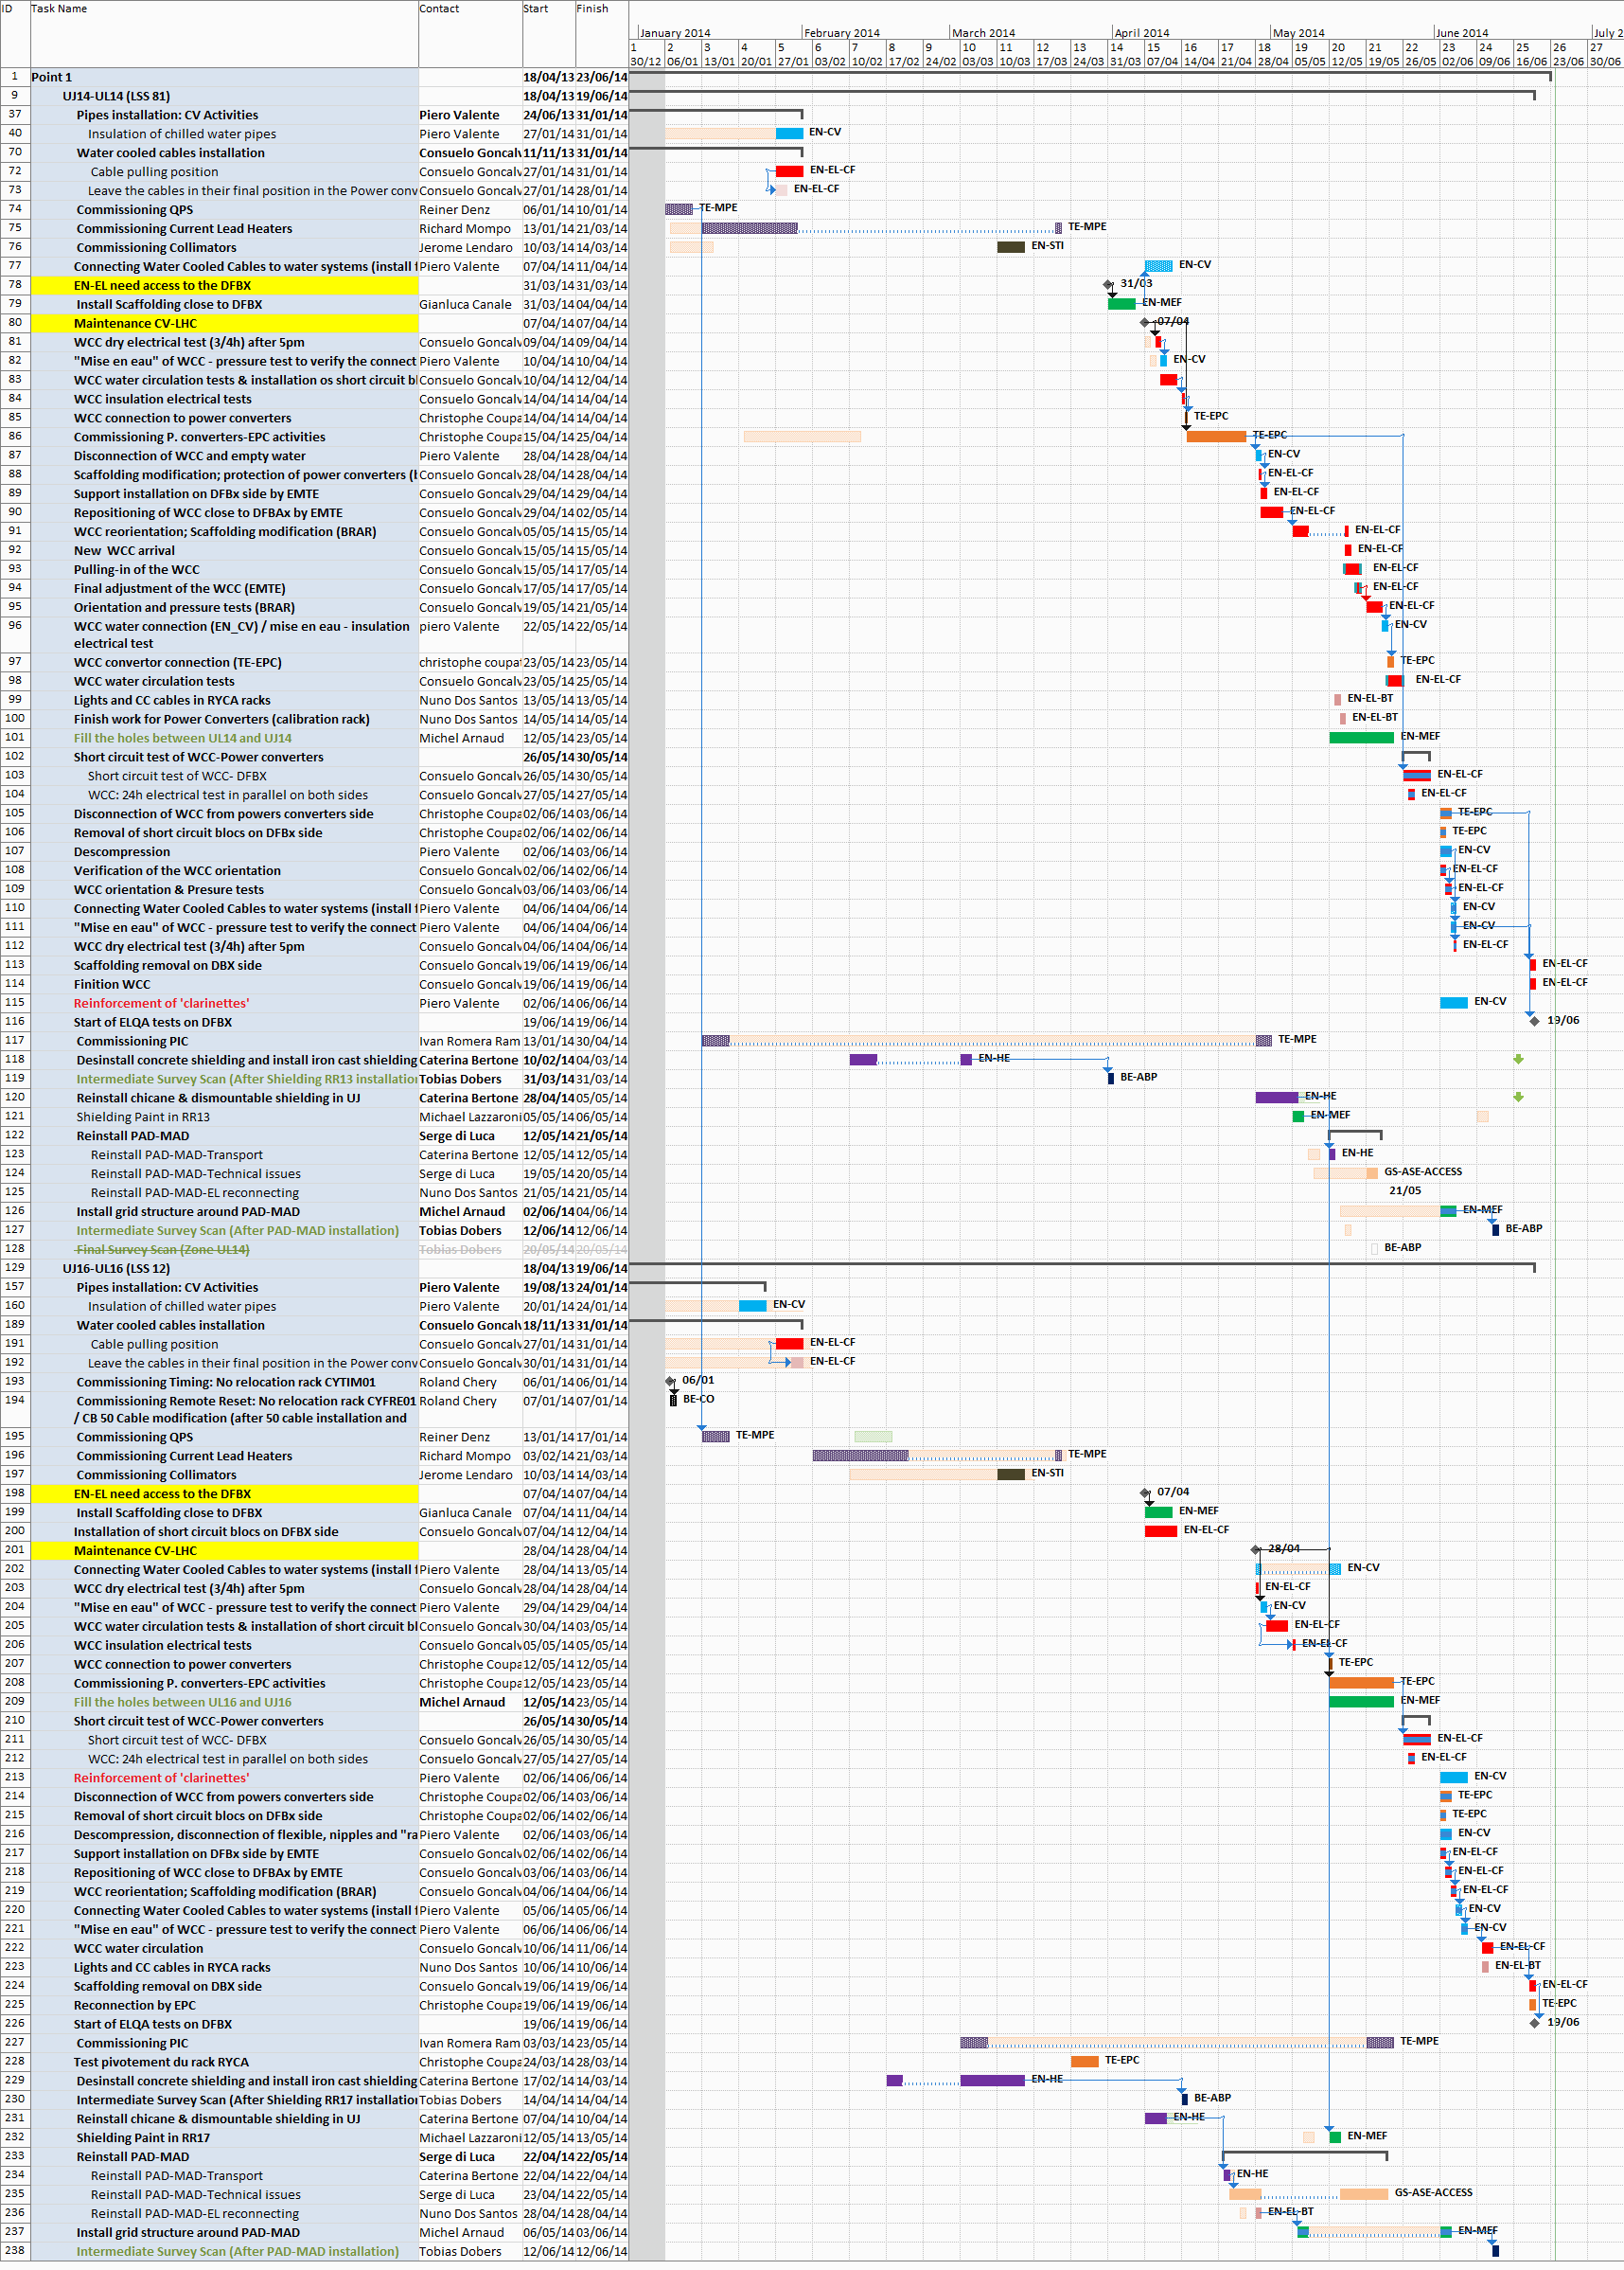
R2E @ Point 1
completed
Point 1 – advancement status
Today
UJ14
Water Cooled Cables (WCCs) installation
Completed with
2 weeks advance
vs baseline
April
Commissioning QPS, current lead heaters, collimators,
WCCs tests and power converters commissioning
(change of one WCC)
EN-MEF survey
in all areas
Short Circuit Tests (SCTs)
WCC orientation and then tests
June
Shielding activities (reinstallation, painting)
PAD/MAD reinstallation
UJ16
WCC installation
Commissioning QPS, current lead heaters, collimators,
May
WCC tests and power converters commissioning
Short Circuit Tests (SCTs)
WCC orientation and then tests
end June
Shielding activities (reinstallation, painting)
PAD/MAD reinstallation
Courtesy M. Barberan

Slide 7
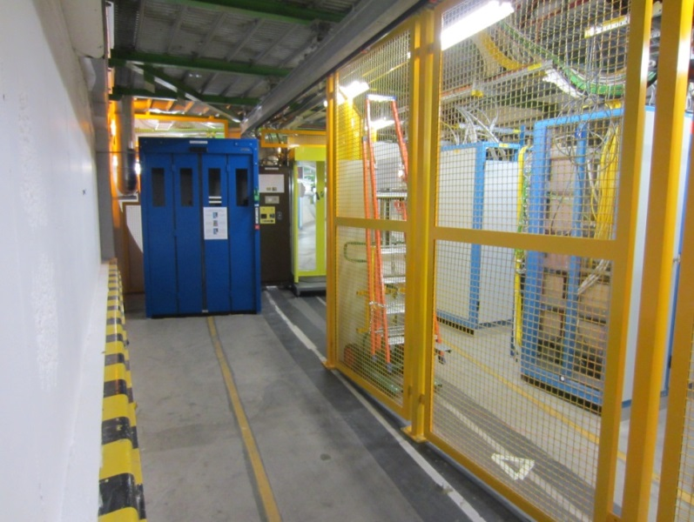
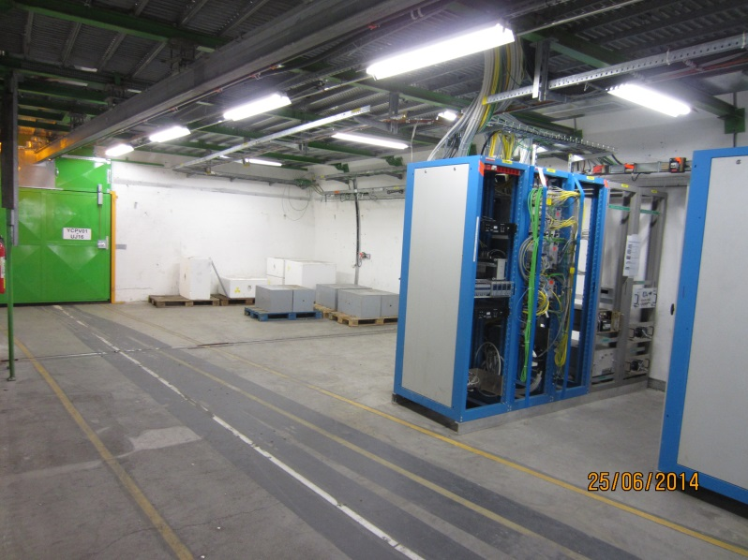
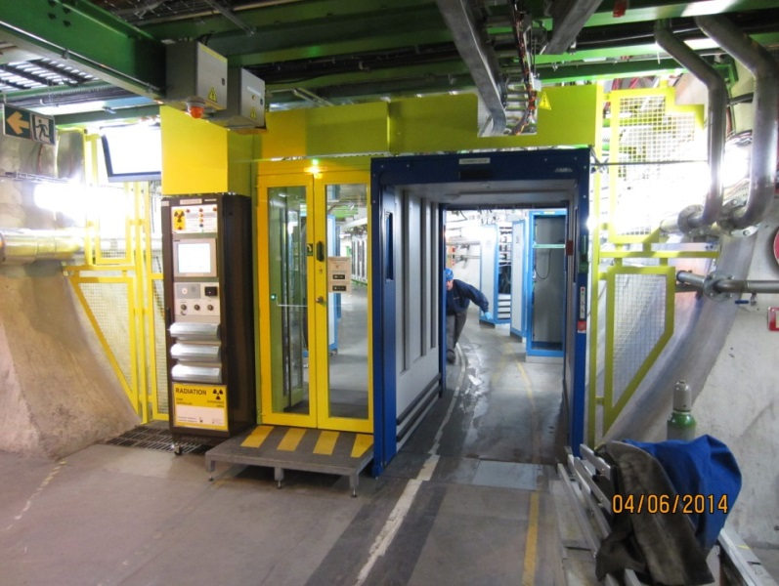
Point 1 – photos
Courtesy M. Jeckel
Before LS1 - UJ16
Today – UJ16
Today - UL16
Today - PAD/MAD in UL16

Slide 8
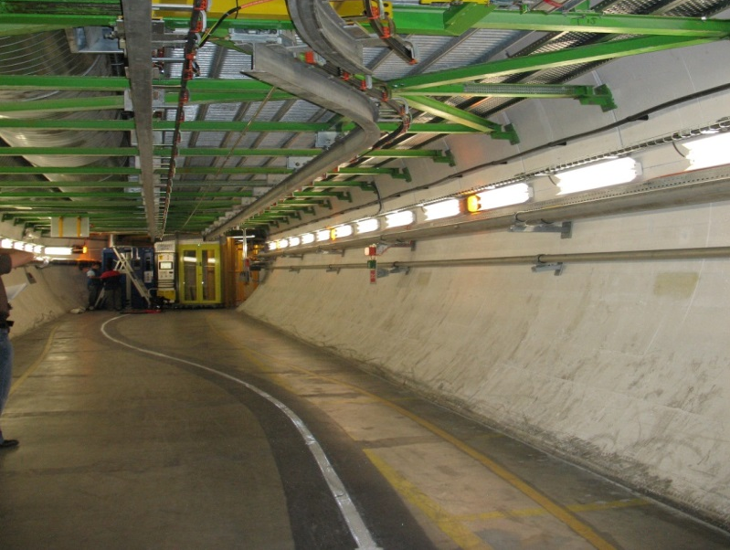
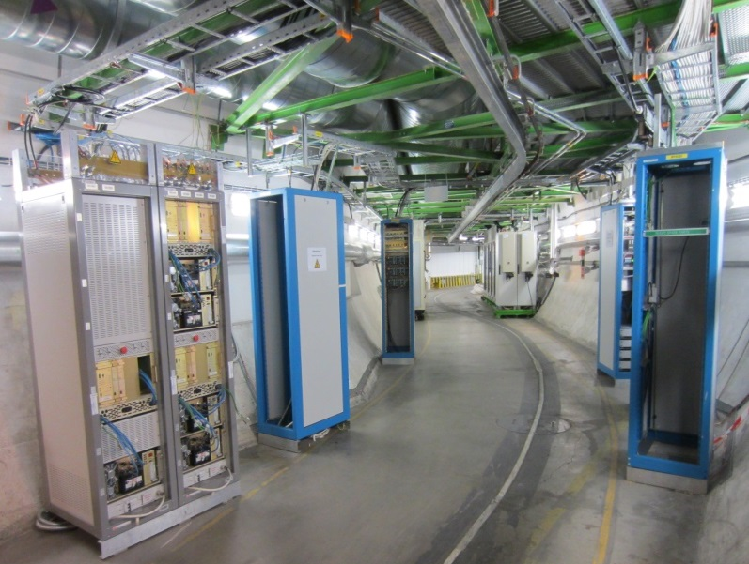
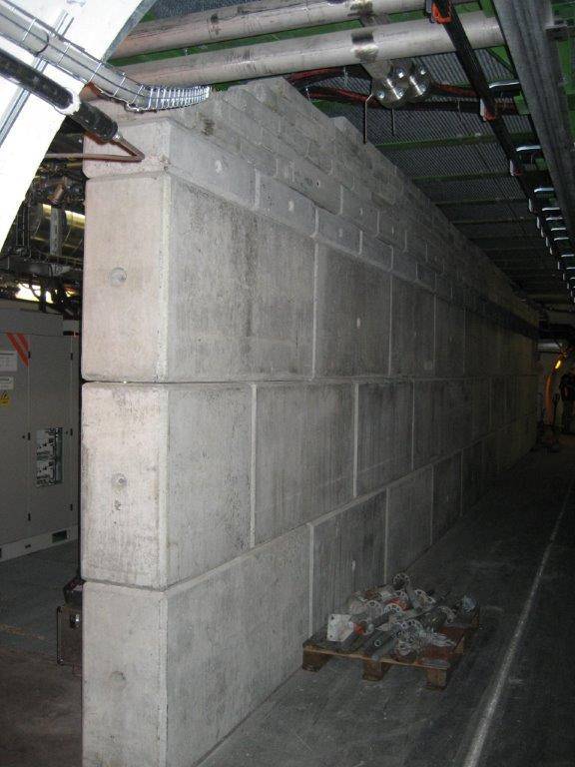
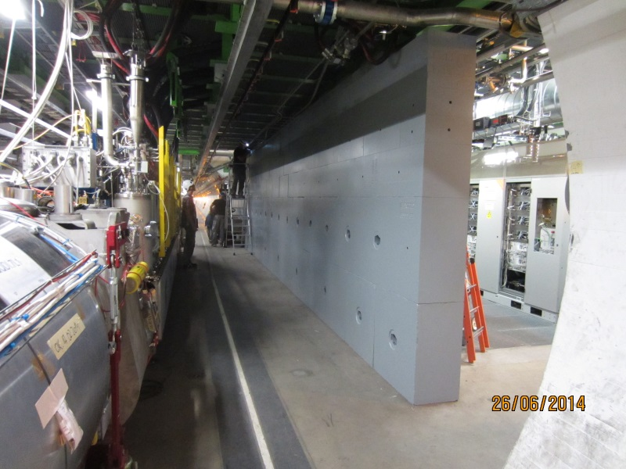
Point 1 – photos
Courtesy M. Jeckel
Before LS1 – UL16
Today – UL16
Before LS1 – RR13
concrete shielding wall
Today – RR13
cast iron shielding wall

Slide 9
Point 4 – advancement status
Start of the relocation activities in January 2014
Main constraints towards completion
First constraint: completion of the QURCA/B for flushing in adjacent sectors scheduled beginning of July (baseline)
Start cabling campaign not before March
Window of 15 weeks for cable campaign
Second constraint: cryogenics special cable delivery
Parallel interventions of TE/CRG and EN/EL
Third constraint: manpower availability for cabling
campaign (327 cables)

Slide 10
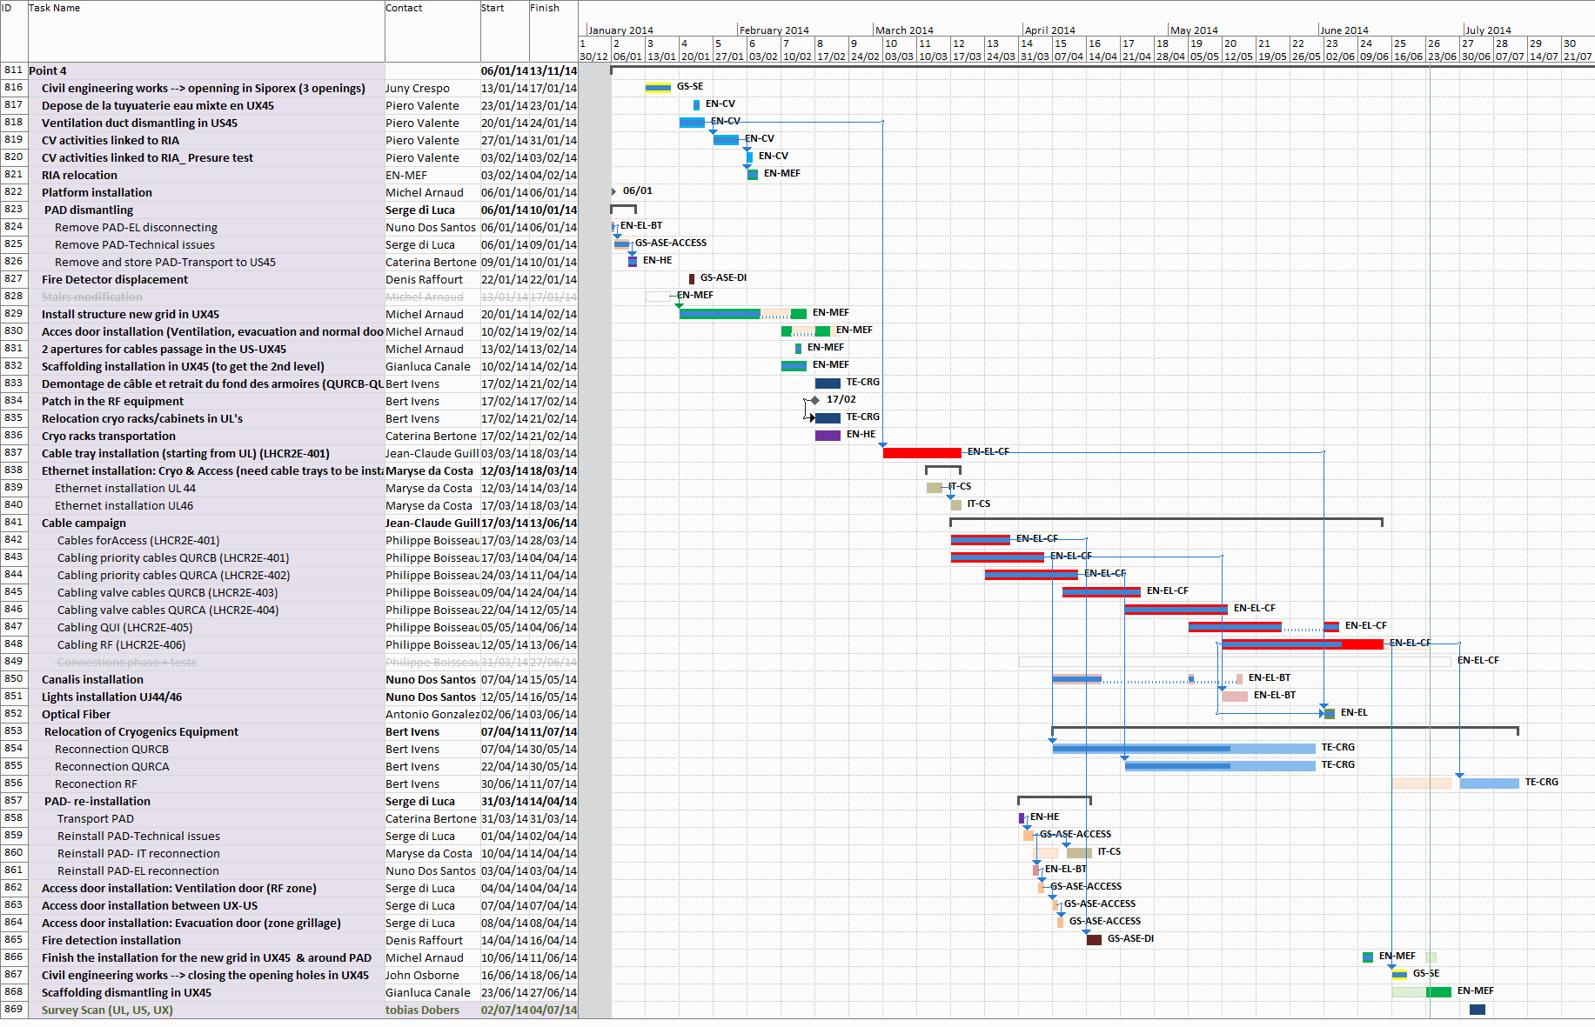
R2E @ Point 4
End foreseen in 2 weeks
Point 4 – advancement status
Today
End: 11st July
with 1 week delay
vs baseline
no impact on other LHC activities
cables campaign: 3 ½ months
TE/CRG:
RF reconnection activities
postponed by 2 weeks due to priority for CD activities
EN/MEF:
Final survey scan
Courtesy M. Barberan
Courtesy M. Barberan
TE/CRG: AMB-MECOS commissioning to be finalised in nominal cryogenic operation condition (week 34 and weeks 40-42 in accordance with the LHC general planning)

Slide 11
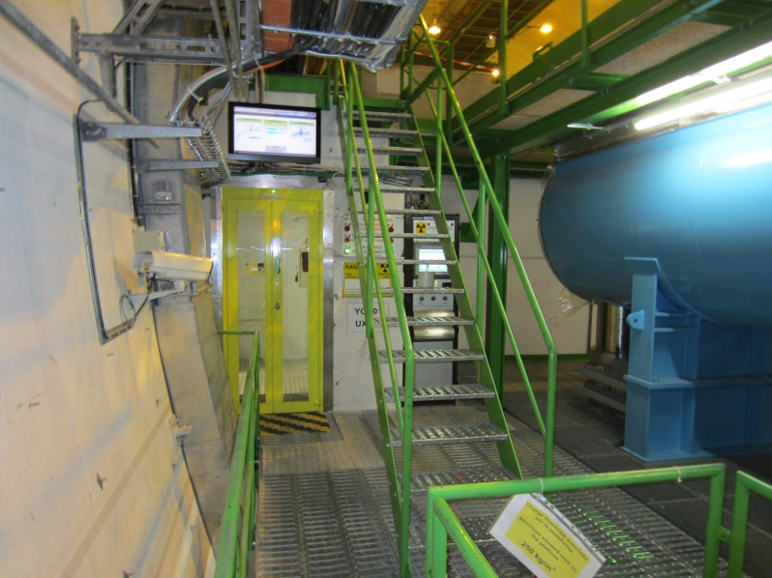
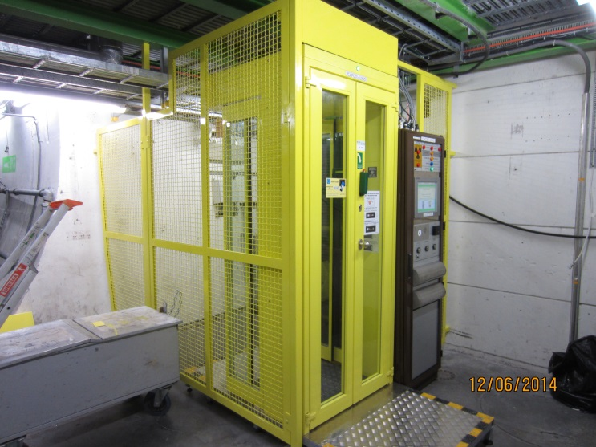
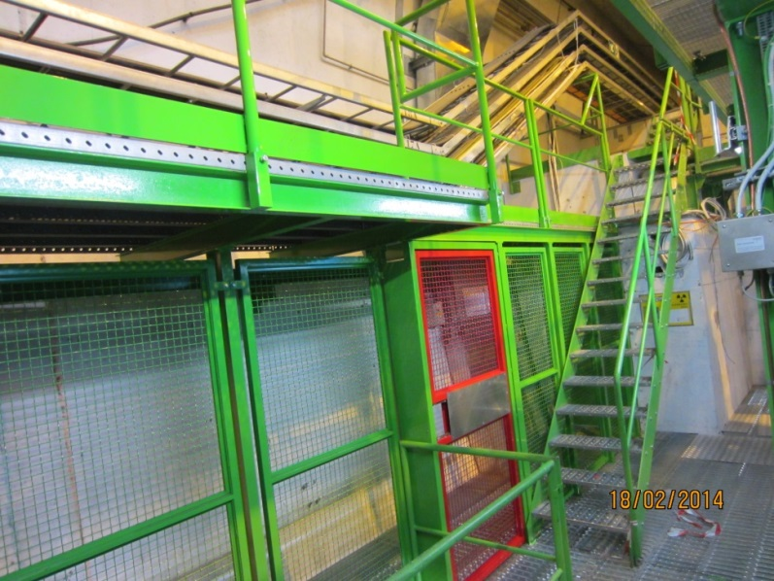
Point 4 – photos
Courtesy M. Jeckel
Before LS1 – UX451
Today – US45 PAD
relocated from US451
Today– UX451

Slide 12
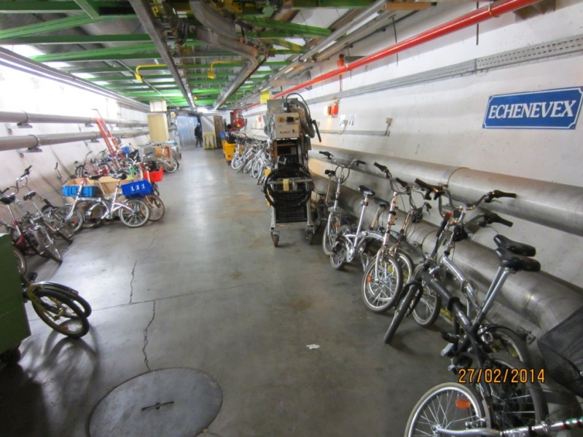
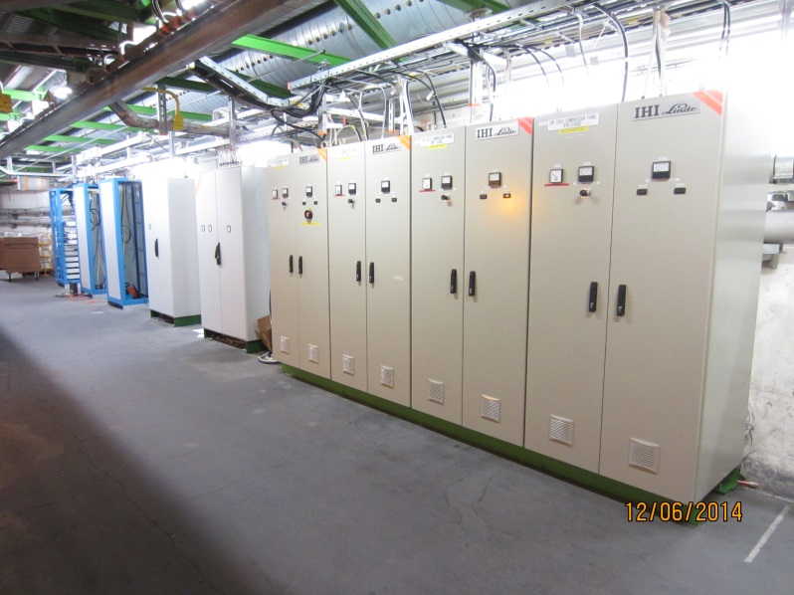
Point 4 – photos
Courtesy M. Jeckel
Before LS1 – ULs 46
Today– ULs 46

Slide 13
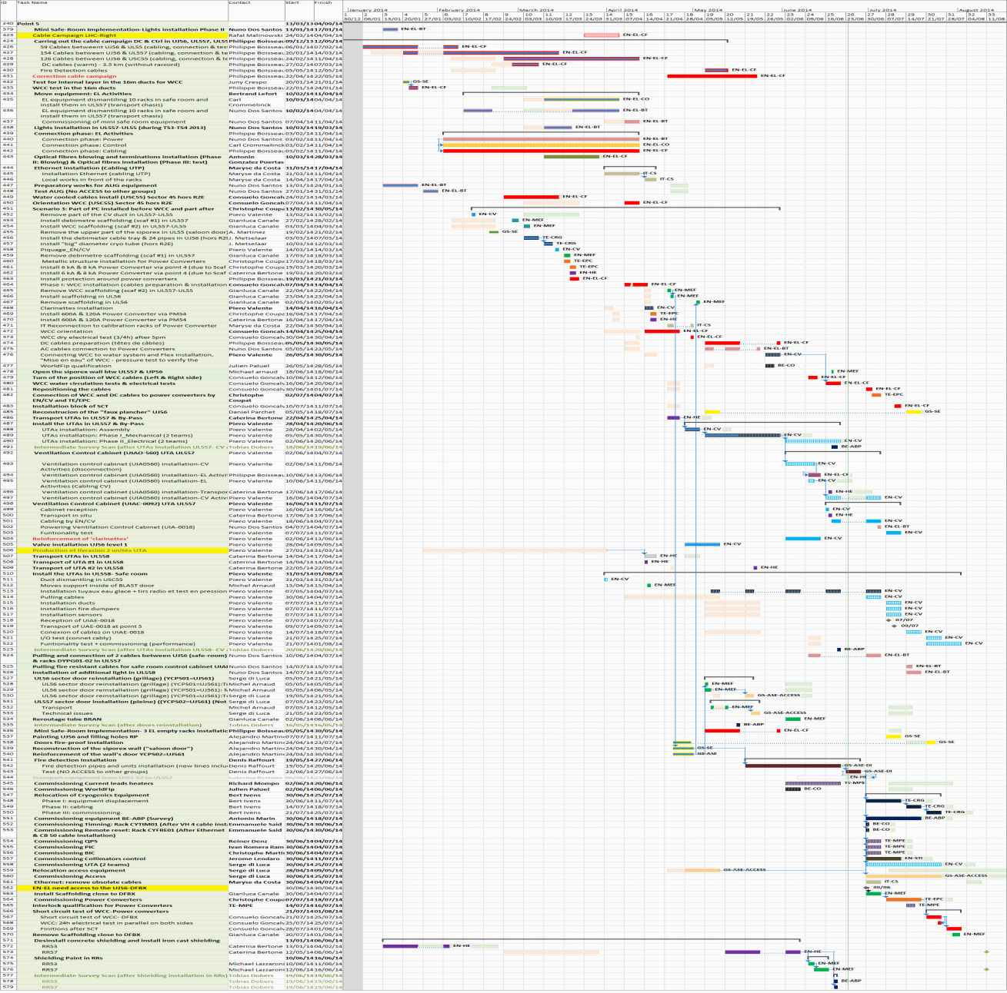
Point 5 – advancement status
Today
cables corrective actions
EN/EL cables campaign
(started in December 2013)
EN-MEF survey
in all areas
WCC & power converters
installation
EN/CV activities
UTAs and control cabinet in UL557
EN/CV activities for Safe room
technical issues/complexity,
material delivery => delay
Safe room activities
GS/ASE - Fire detection relocation
Commissioning activities
by equipment owners
EN/HE shielding activities
Courtesy M. Barberan

Slide 14
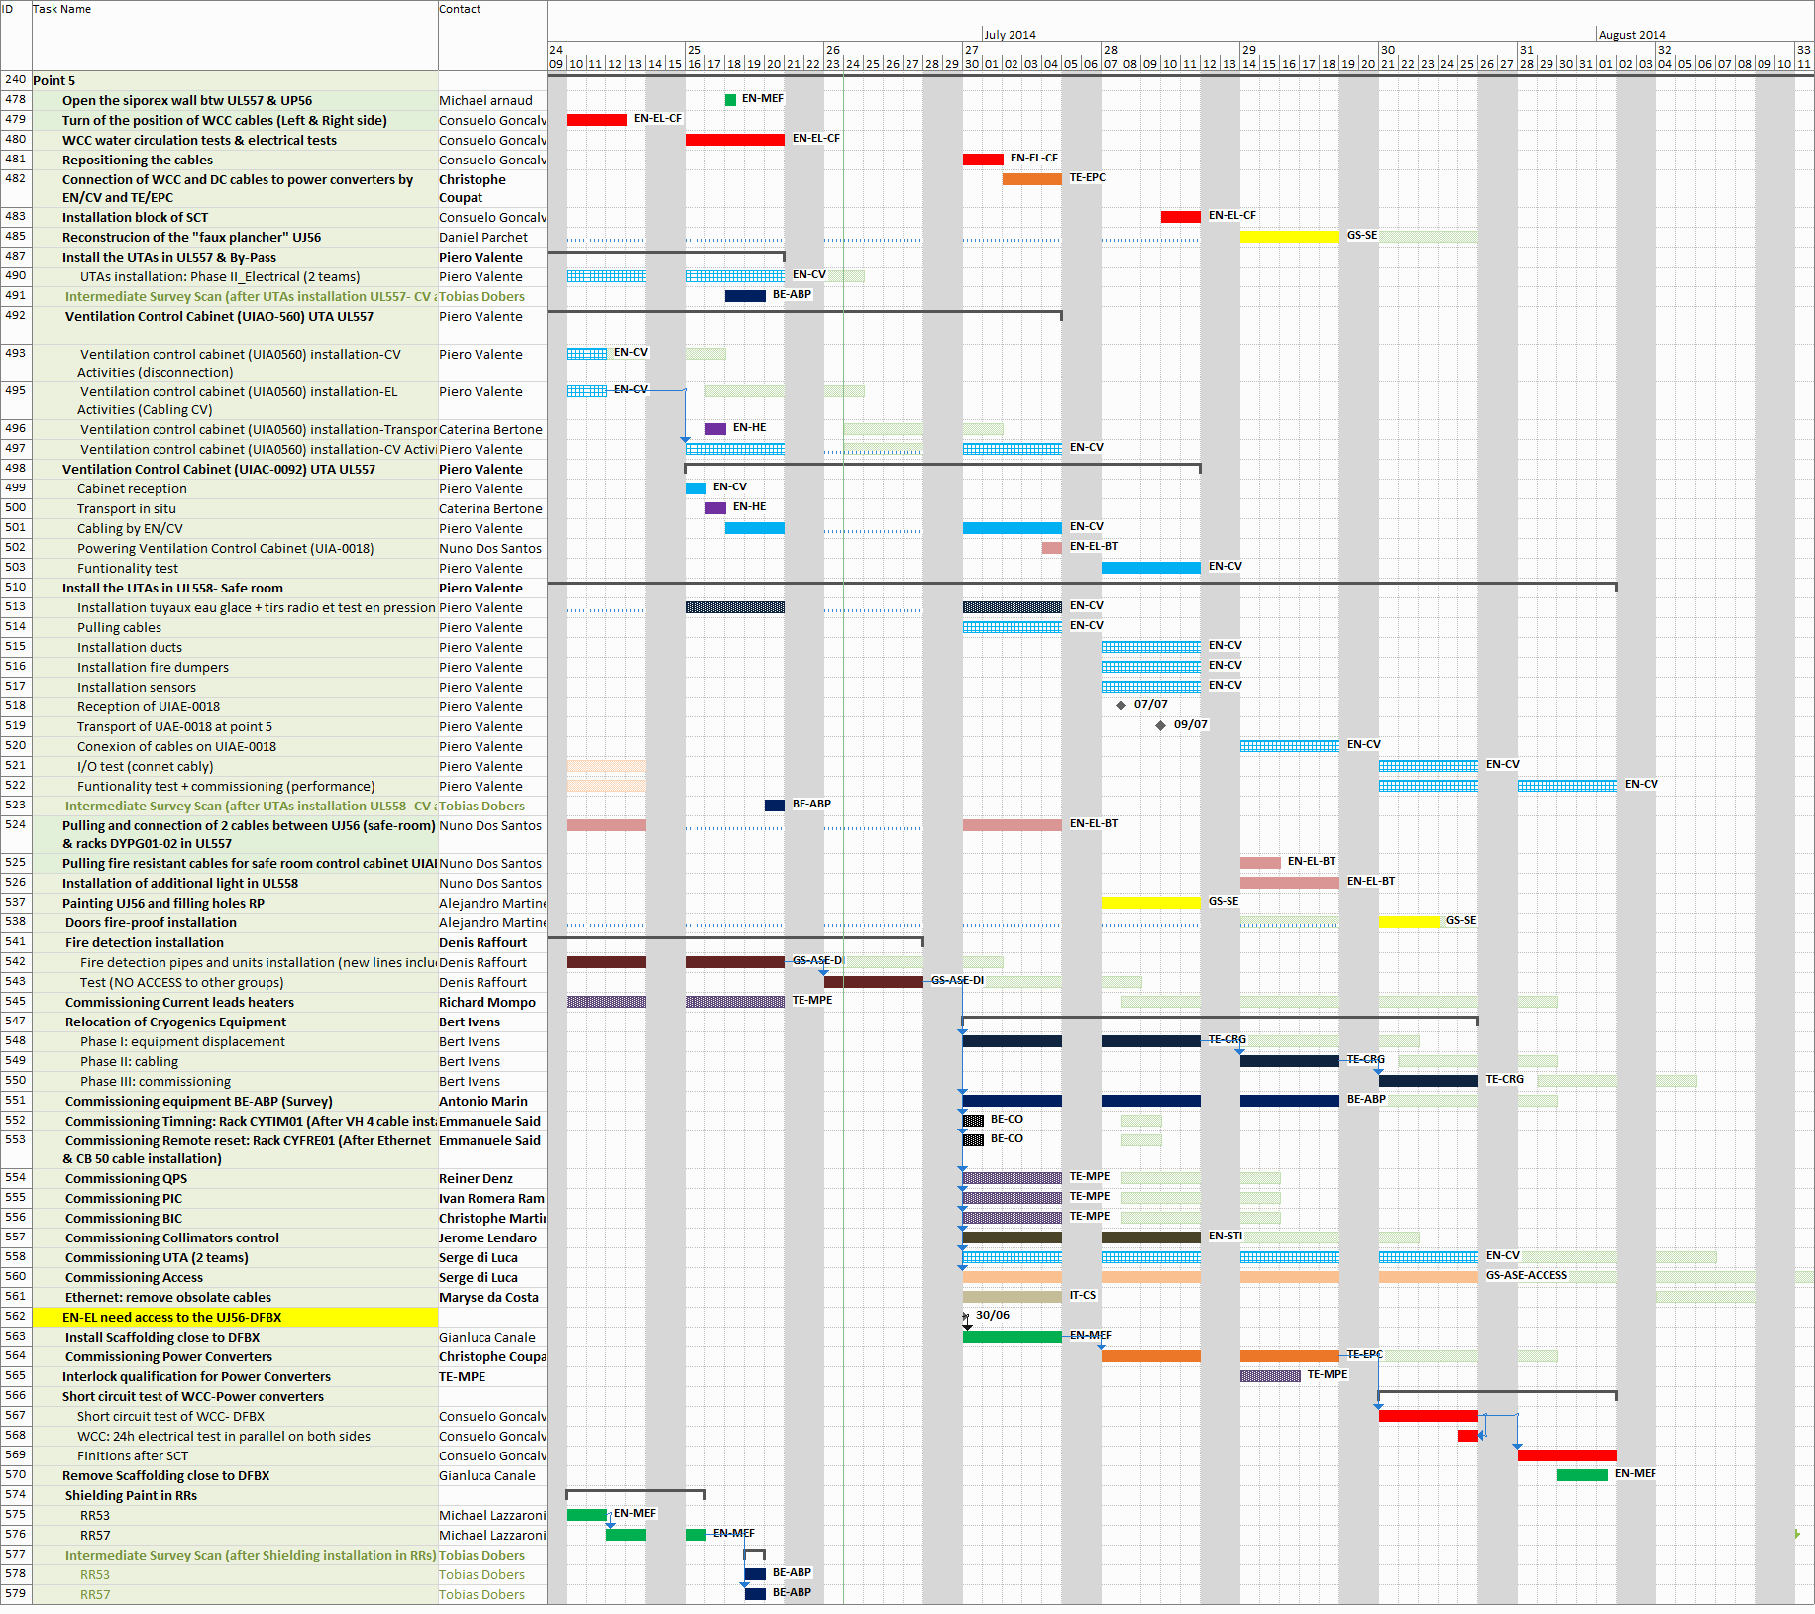
R2E @ Point 5
End foreseen in 5 weeks
Point 5 – advancement status
Today
Forseen end:
1rst August
Cool-down S56
UL557- Safe room
UL557- EYC
on critical path
Safe room CV activities
UL557-
chilled water pipes
UL558 – structure for AHUs (safe room)
Commissioning activities
Short Circuit Tests
under LHC general coordination
Courtesy M. Barberan

Slide 15
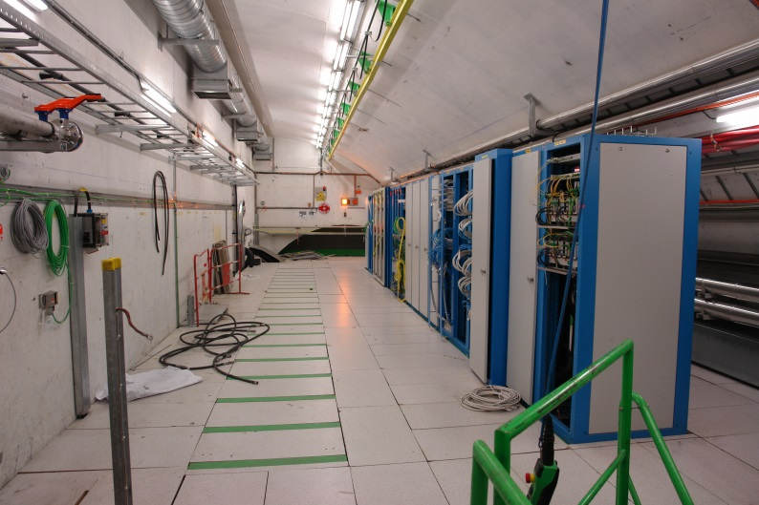
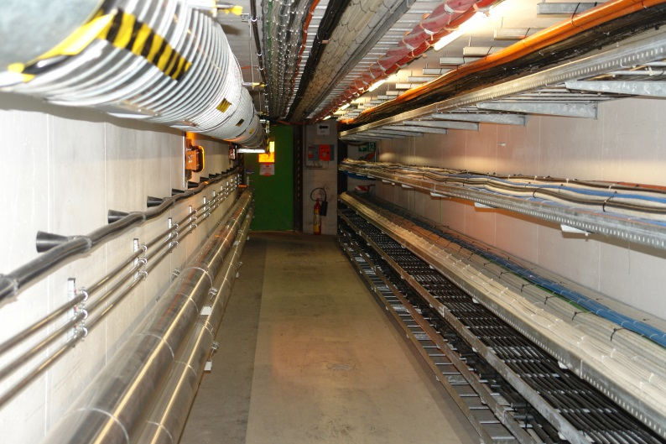
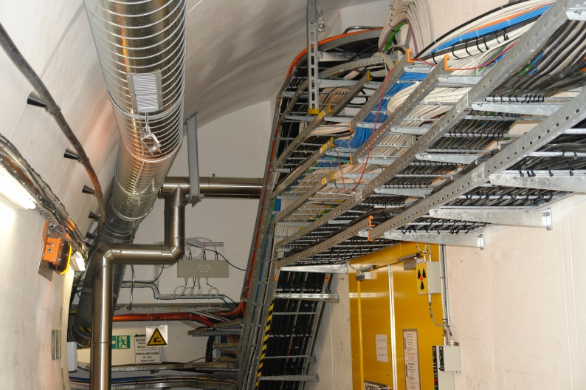
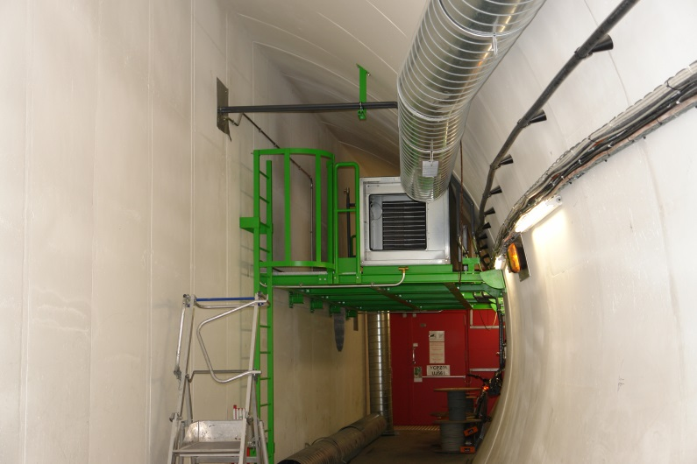
Point 5 – photos
Courtesy R. Bihery, B. Lefort
Today– UJ561
Today– UP56
Today– UP56& UL558
Today– UL558

Slide 16
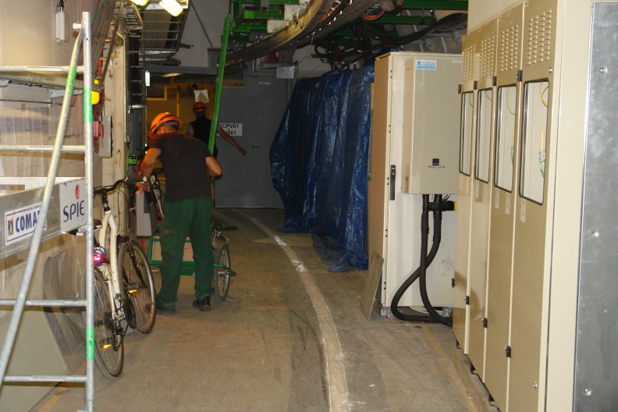
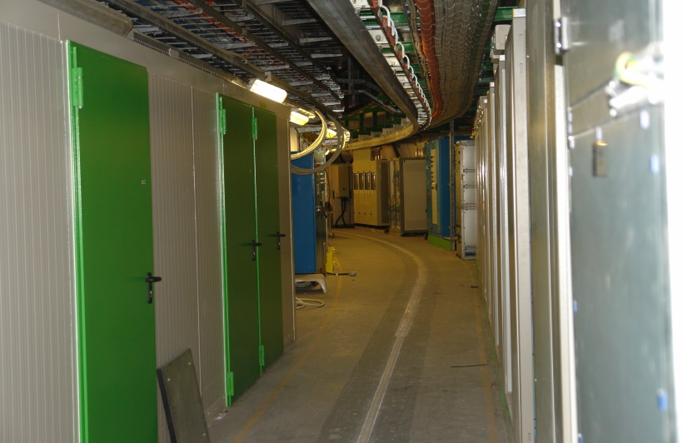
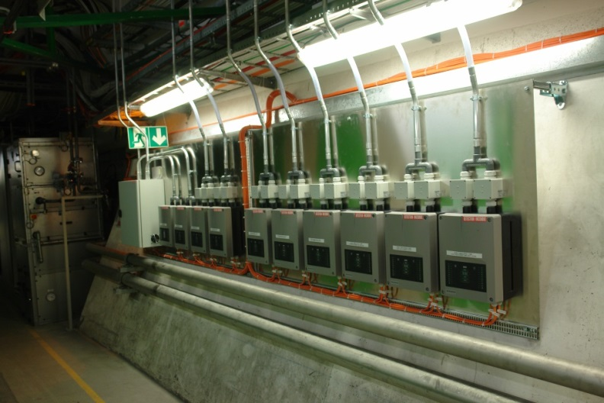
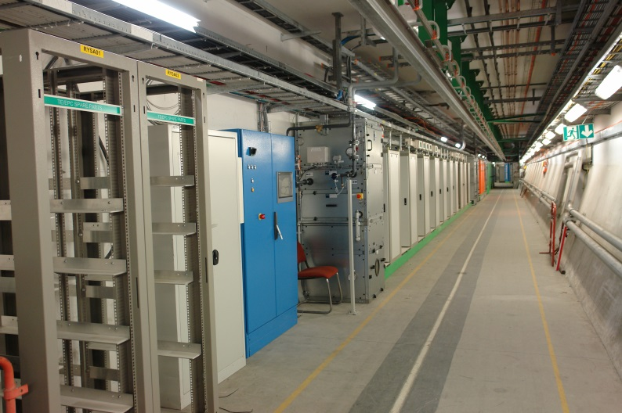
Point 5 – photos
Courtesy R. Bihery, B. Lefort
Today– UL557
Today– UL557
Today– UL557
Today– UL557

Slide 17
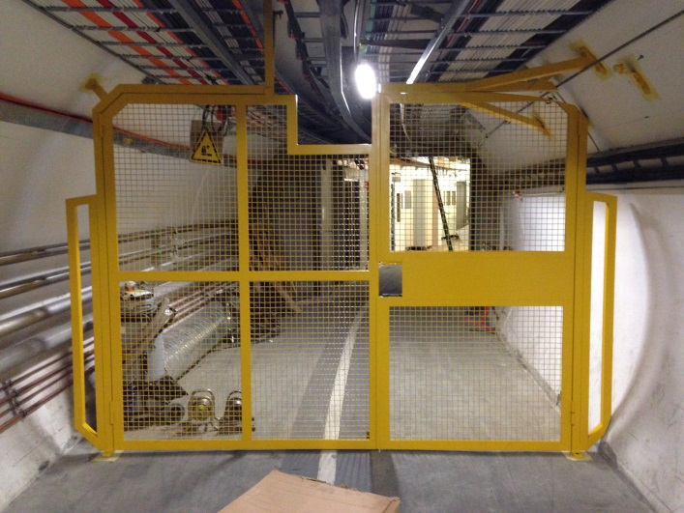
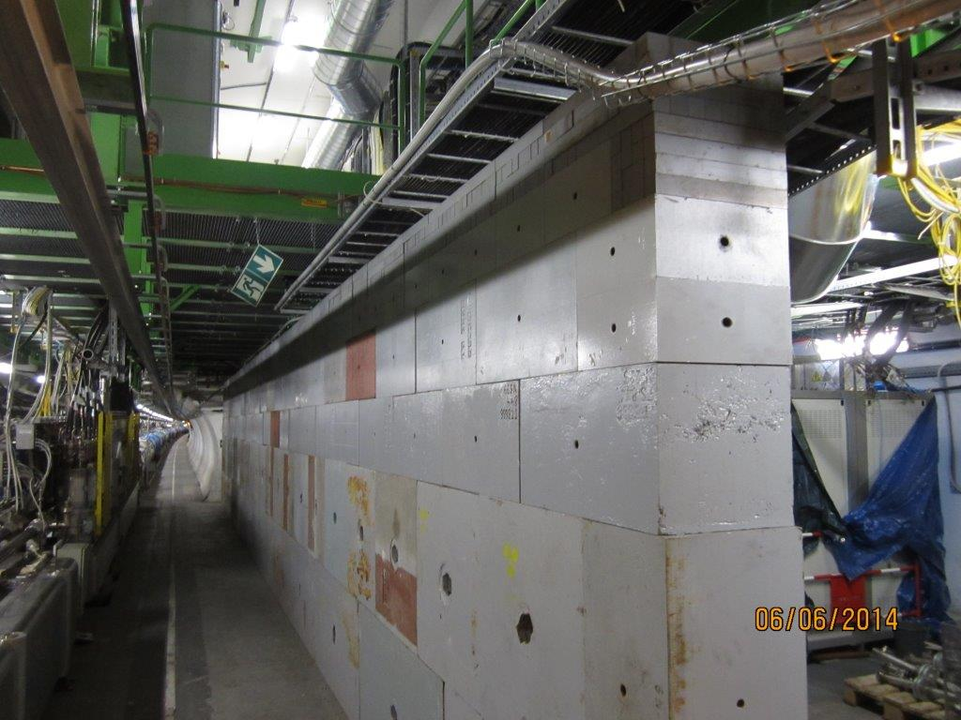
Point 5 – photos
Courtesy R. Bihery, B. Lefort
Today– UJ561
Today– UL56
Today– RRs new shielding wall
(cast iron)

Slide 18
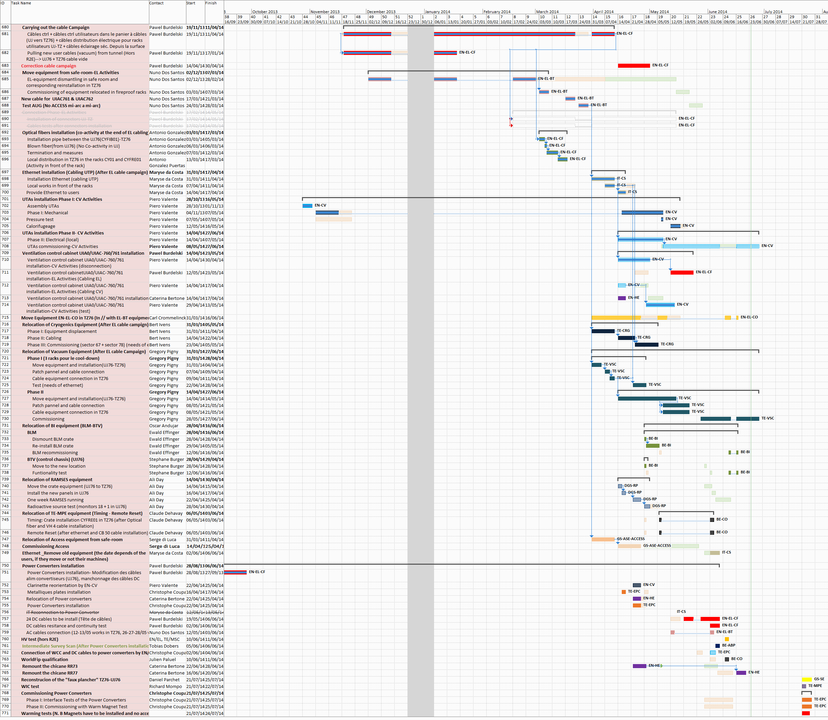
Point 7 – advancement status
Today =
baseline end
EN/EL cables campaign
(started in November 2013)
cables
corrective actions
EN/EL optical fibers
IT/CS Ethernet installation
EN/CV activities
(UTAs, control cabinets)
TE/CRG activities
(t.b. completed to start CD)
TE/VSC activities
(part t be completed to start CD)
Commissioning by equipment owners
TE/EPC
power converters installation
TE/EPC, TE/MPE
power converters, WIC commissioning
Courtesy M. Barberan

Slide 19
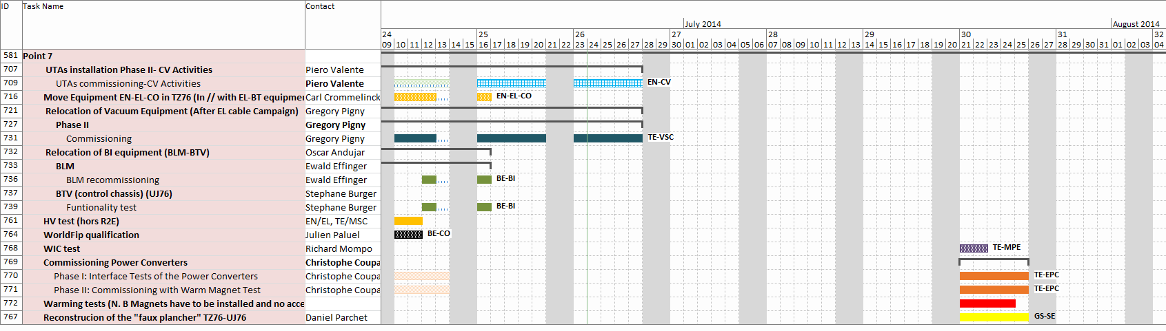
R2E @ Point 7
End foreseen in 4 weeks
Point 7 – advancement status
Today =
baseline end
Forseen end:
25th July
CSCM tests
NO ACCESS
Power converters
commissioning
& warm magnets tests
under LHC general coordination
Courtesy M. Barberan
False floor installation
in UJ76 level 1
(procurement issues)
not included in
the interlock system
BE/BI- BLM
Fast BLMB: relocated beginning of June
Fast BLMED: new readout system ordered in June; installation in October- November; commissioning afterwards.

Slide 20
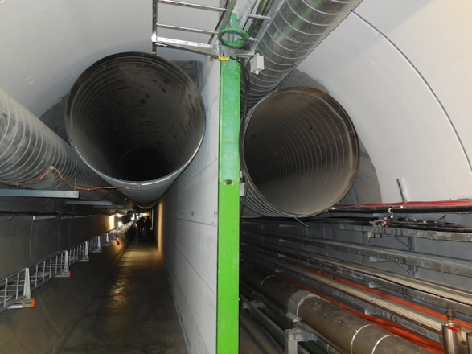
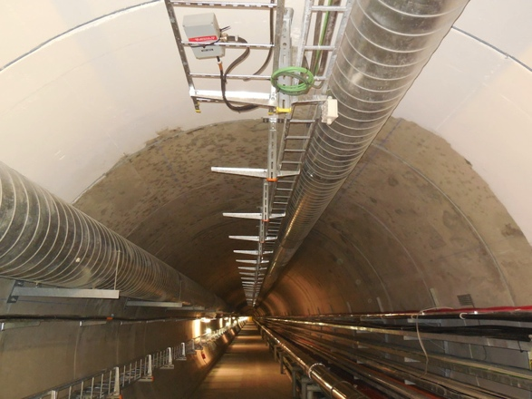
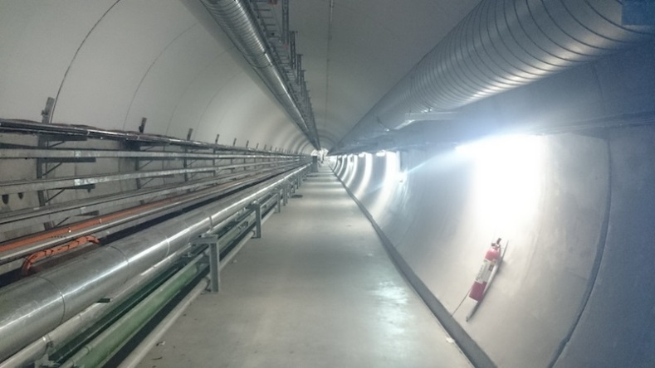
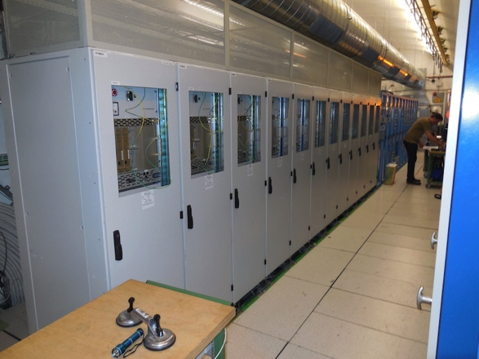
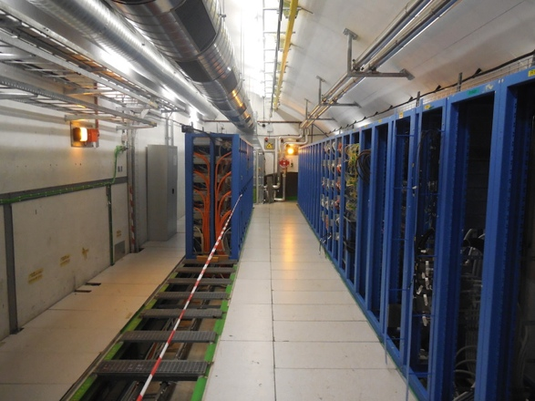
Point 7 – Photos
Courtesy O. Andujar
TZ76 before LS1 and after 235 m wall demolition & 534 m ducts dismantling
UJ76 level 1 before LS1 and today

Slide 21
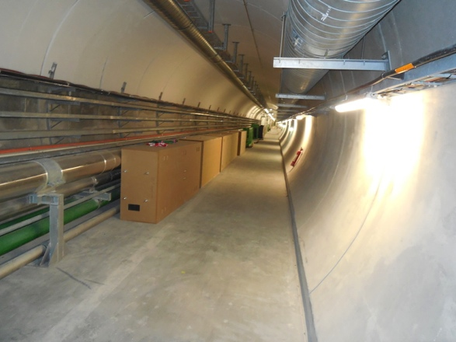
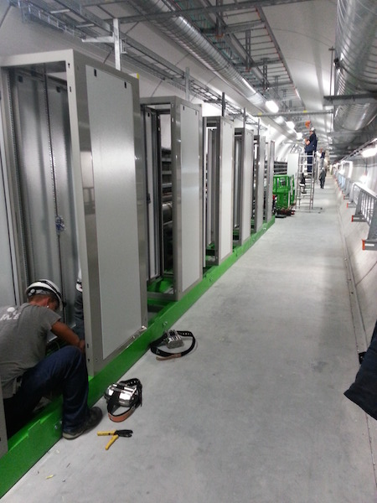
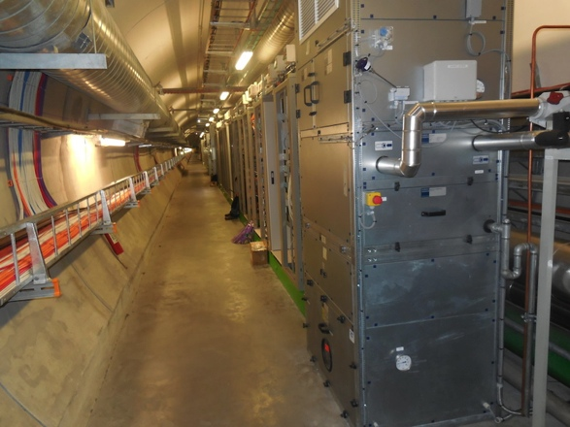
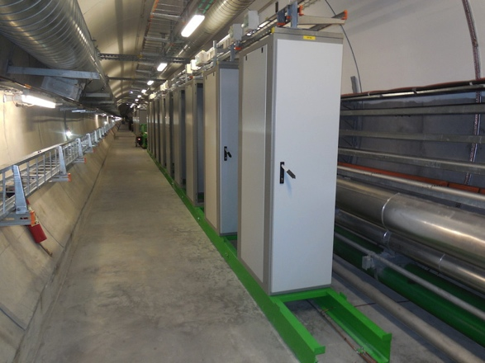
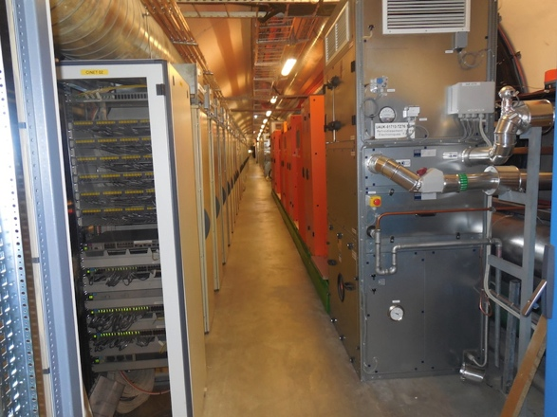
Point 7 – Photos
Courtesy O. Andujar
TZ76 level 1 before LS1 and today

Slide 22
Advancement status - summary
Point
Baseline
Duration
[weeks]
Effective
Duration
[weeks]
Actual / foreseen
end date
Delay (D)
Advance (A) vs baseline end date
[weeks]
Comments
1
61
58
21/06/2014
A:2
-
4
26
26 + 2 =28
11/07/2014
D:1
2 weeks delay linked to change of priority by TE/CRG
5
68
66
01/08/2014
A:2
-
7
57
1+1+57+3+1= 63
27/06/2014
D:6
1 week delay due to French holidays; 1 week ELQA delay, 3 weeks CSCM tests (no access), 1 week delay false floor and postpone of PC commissioning
8
43
43+6=49
13/12/2014
D:6.5
2 weeks delay due to additional cables request, 4 weeks delay linked to change of priority by EN/CV
Very efficient preparatory works by all groups
Very good match between the estimated durations
and the effective durations of R2E activities in situ during LS1

Slide 23
Safety
No safety problem during the R2E activities
Safe room point 5: performance tests mid July
Safety inspections:
Inspection type | Point 1 | Point 4 | Point 5 | Point 7
Electrical security | Done on 03-04/06/2014 Inspector= J-P Julien | Done on 24-25/06 Inspector= J. P. Julien | To be scheduled begining of July Inspector= t.b.c. | To be scheduled after the CSCM (21rst July?) Inspector= t.b.c.
General security | Scheduled on 26/06/2014 Inspector = T. Gilles | Scheduled on 29/07/2014 Inspector= G. Fontana | To be scheduled in July Inspector= M. Renard | To be scheduled after the CSCM (21st July?) Inspector= M. Renard

Slide 24
Safety – point 5
Safe room implementation (ECR/ edms: 1334832)
Safe room performance tests by EN/CV scheduled on weeks 30- 31
Filling the holes (services areas / tunnel and machine / CMS)
under the supervision of C. Gaignant & S. Grillot
R2E provided list /images of holes/ducts performed within the project

Slide 25
R2E Mitigation activities - summary
Still 2 weeks work
towards completion
Still 5 weeks work
towards completion
Safe room by EN/CV
on critical path
UX45
UX45
UJ56
RR53/57
UJ56
RR53/57
UJ76
UJ76
Still 1 week work
towards completion
UJ14/16
RR13/17
UJ14/16
RR13/17
US85
US85
completed
completed

Slide 26
R2E Mitigation activities - summary
R2E activities are within schedule
Safe room implementation at point 5 is very challenging (CV activities are on critical path)
Very good preparation (started in 2010) and efficient work of all groups during the LS1 allow to stay within schedule
Continuous follow-up, weekly Friday’s meetings (#103), carefull preparation/planning and contribution of all teams were crucial for the success
Testing & commissioning: in progress; for the moment only few minors problems detected
Last but not least => safety inspections to be scheduled and carried out by HSE colleagues
Many thanks to all the groups

