Slide 1
Injectors & LHC report
K. Foraz
on behalf of OSS members

Slide 2
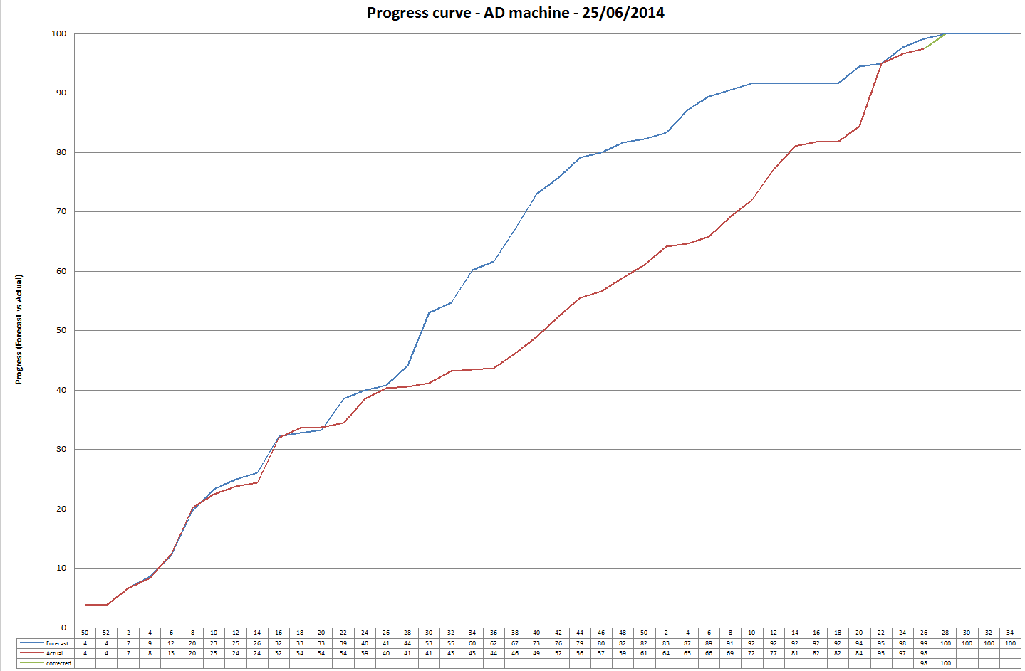
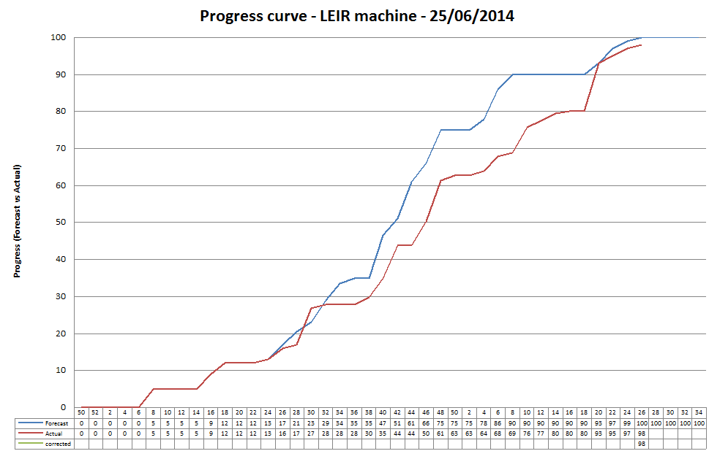
AD & LEIR
AD
Hardware tests in progress
Access wk.28 (ionic pump replacement)
LEIR
Hardware tests complete
Cold check out in progress

Slide 3
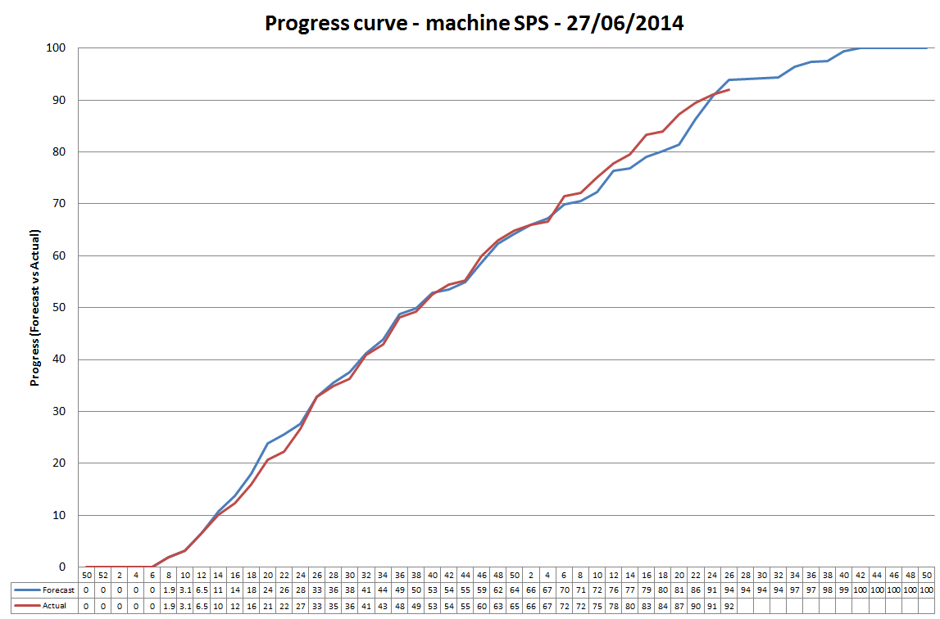
SPS
BA1:
  QDA11910 repaired & re-installed
  TIDGV re-installed, aligned and connected this week
  Few water leaks found -> punctual access next week – agreed with OP
Other Areas:
  LS1 for the SPS will end this evening!!!!!!!
  Control will be handed back to the CCC this evening.
  OP will conduct a patrol of the SPS this evening.
What’s next
  ABT plan to start conditioning of the Kickers next week.
  EPC will start from next week 8 weeks of hardware tests in preparation for start-up.
  informal morning meetings everyday at 09:00 in the CCC
  Impact – new intervention periods :
    LS1-HWT-SPS (valid from 28th June to 31st August)
    LS1-BA80-SPS (valid from now to 30th September)
    TAG41- AWAKE (Valid from now until October 2016)

Slide 4
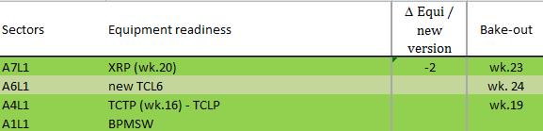
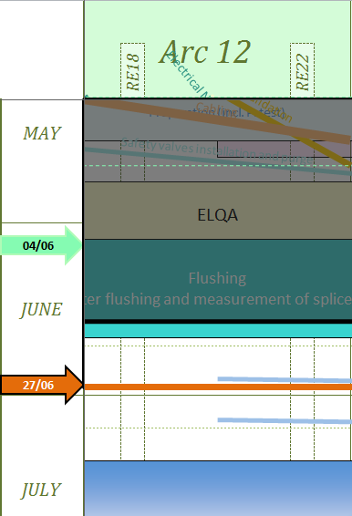
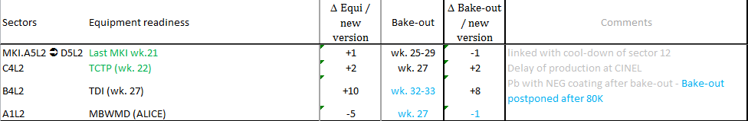
LHC – Sector 12
LSS1R
  Complete: R2E, sealing, bake-out
  What’s next
    Warm magnet tests next week
    Cleaning wk. 28
    IT survey from wk. 28
    ALFA re-installation in Roman Pots: wk. 30
    Safety painting (bis): wk. 35
Arc 12
  Flushing in progress, ELQA after flushing on June 30th and July 1st
  nQPS racks from next week
  Leak status – Repair from July 2nd
    QRL, vacuum subsector B, 1.7* 10-5 mbar l/s @10 bar; leak on header C- localized on 14L2, Spare compensator type C, available and validated by VSC.
    Leak A27R1- line E – 4*10-7 mbar l/s @10bar – 2.5*10-6 @ 19 Bar
  Warm bus bars measurements postponed to July 17th and 18th
LSS2L
  In progress: Short circuit tests, Survey of IT
  What’s next
    Safety painting wk. 27
    Warm magnet tests: wk. 28
    Cleaning wk. 29
  Around Vacuum 

Slide 5
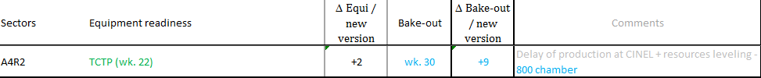
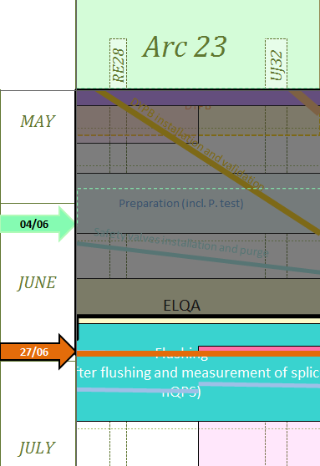
LHC - Sector 23
LSS2R
  In progress: Short circuit tests, Survey of IT
  What’s next
    Safety painting wk. 27
    Warm magnet tests: wk. 28
    Cleaning wk. 29
  Around Vacuum: TCTP installed 
Arc 23
  Leak status
    External leak on jumper 25R2
    Internal leak
      A23R2: residual 3 . 10⁻⁷@ Pa, 3.2*10-4 @ 10bar,now 10-4, suspicion on header E
      11L3 and 19R2 leak on header E
      A7R2: internal leak to be investigated
  ELQA in progress
  Helium spill test in progress
  Flushing from July 3rd
  Painting next week
LSS3
  Raising pump consolidation in progress
  Warm magnet tests wk. 30

Slide 6
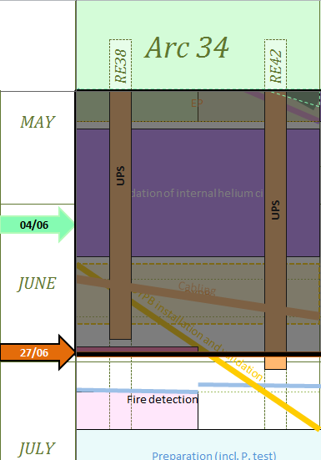
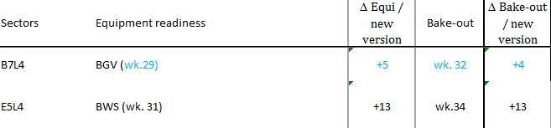
LHC – Sector 34
LSS3
  Raising pump consolidation in progress
  Warm magnet tests wk. 30
Arc 34
  W leak test done
    1 Leak on magnet foot cell 19L4, repair by VSC in progress.
    A11L4: internal leak, 10-7 mbar l/sec, under investigation
  UPS replacement almost finished
  Pressure tests wk. 28 (DFBA) & wk.29 (arc)
LSS4 & P4
  SF and UW, cryogenic, RF maintenance in progress
  R2E: cabling campaign complete, relocation of cryo equipment w. 27-28
  Short Circuit tests wk. 29
  Around vacuum 

Slide 7
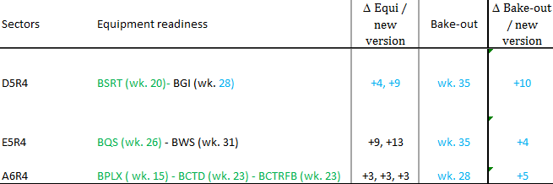
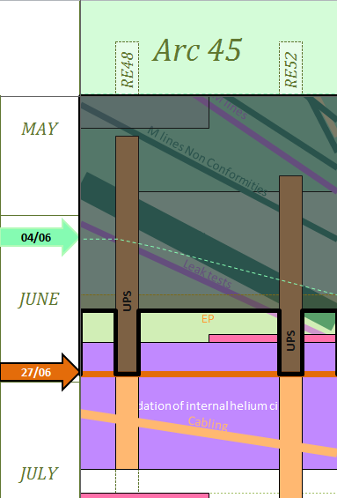

LHC – Sector 45
LSS4R
  Around vacuum:
  BQS, BCTD, BCTRF installed
  Painting next week
  Short Circuit tests wk. 29
Arc 45
  Closure complete
  W leak tests:
    5 sub-sectors validated
    9 sub-sectors being pumped
  UPS replacement in progress
P5 & LSS5L
  R2E
    UTAs installation, Fire detection commissioning in progress
    Cryo relocation & Commissioning from next week
  600A IST done
  Around vacuum: XRP installed
  Short Circuit tests on IT: wk. 29

Slide 8
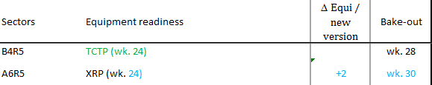
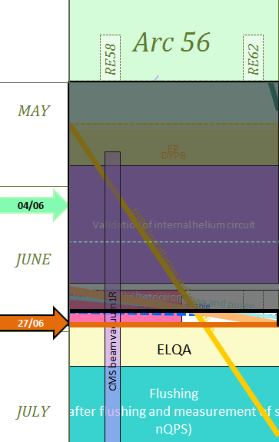

LHC – Sector 56
LSS5R
  600A IST done
  Survey and alignment - Q2 next week
  Around vacuum: XRP installed
  Short Circuit tests on IT: wk. 29
Arc 56
  Pressure test done
  Leak status:
    External leaks: A31L8, A8L6
    Internal leak: A8L6, A1R5, A19R5
  Purge and safety valves installation in progress
  ELQA from July 2nd
LSS6L
  TCDQ IST done
  Safety painting done, but to repeat (wk.38)
  LBDS tests in progress
  Around vacuum

Slide 9
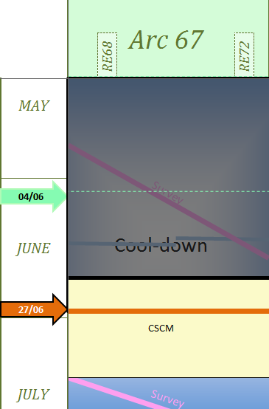
LHC – Sector 67
LSS6R
  LBDS tests
  Around vacuum – complete
  Safety painting done, but to repeat
  Warm magnet tests wk. 31
Arc 67
  Survey measurements complete
  Stabilization at 20K complete
  CSCM will start on Monday
  Cleaning from wk. 30
  Magnets smoothing from wk. 30
LSS7
  Cleaning in progress
  Chilled water pipes removed
  Doors commissioning wk. 31
  Safety painting: wk. 30

Slide 10
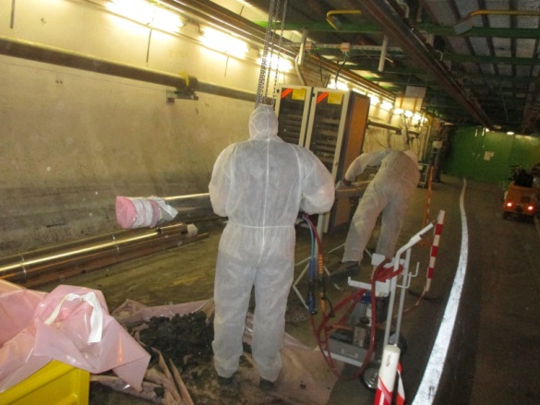
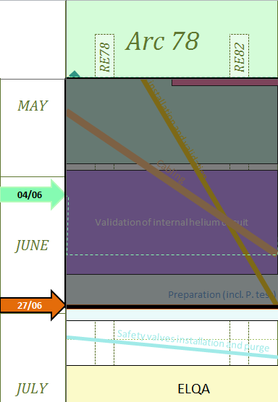
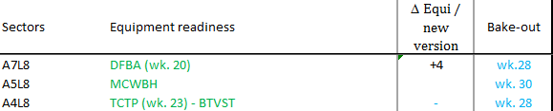
LHC – Sector 78
LSS7R
  Cleaning in progress
  Chilled water pipes removed
  Doors commissioning wk. 31
  Safety painting: wk. 30
Arc 78
  Pressure test in progress
  Cleaning in progress
  Survey alignment
  Leak identification end of next week
    A27L8 (4*10-8 mbar l/s) internal leak on c’k circuit.
    A11L8 internal leak, evolving from 10-7 to 10-8
    DFBAO internal leak repaired, being pumped
    External leaks: the 2 external leaks on the magnet (“pied”) will be repaired
  Purge and safety valves installation from wk.28
LSS8L
  Short circuit tests finished ?
  IT survey, wk. 29
  Around Vacuum

Slide 11
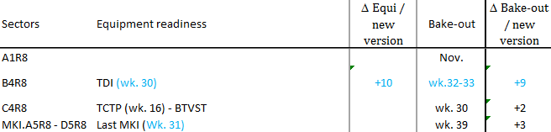
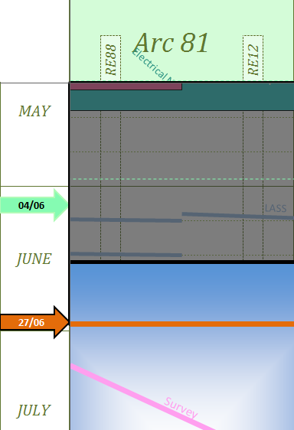

LHC – Sector 81
LSS8R
  Around vacuum
  Warm magnet tests wk. 29
  Clenaning wk. 31
Arc 81
  Cool down starting today
  Leak status
    A15R8 – solved
    A23R8, use as is
    Q4R8 – solved
  Cleaning wk. 30-31
  CSCM wk. 33-35
LSS1L
  Survey IT in progress
  Around vacuum - complete
  What’s next
    Cleaning wk. 30
    ALFA re-installation in Roman Pots: wk. 30
    Safety painting (bis): wk. 35

Slide 12
Conclusions
Injectors
  AD hardware test in progress
  LEIR Cold check out in progress
  SPS: LS1 works finish tonight- Hardware tests from next week (short accesses agreed with OP)
LHC
  SMACC complete !!
  Around vacuum: 22 vacuum sub-sectors to be baked (28%  26%)
  LHC entering in tests phase – Beware of access constraints
SO FAR SO GOOD
See you at LMC for following reports on LHC

Slide 13
Impact of CSCM on schedule
First draft

Slide 14
Schematic V3.1 (the official version)
NC
Flushing, nQPS, ELQA
Cool-down
Pressure test
Pressure test
ELQA
CSCM
Cool-down
Cool-down
NC
Pressure test
Flushing, nQPS, ELQA
ELQA
Cool-down
ELQA
NC
ELQA
Flushing, nQPS, ELQA
CSCM
Flushing, nQPS, ELQA
ELQA
Cool-down
PT Φ 1
NC
ELQA
NC
Flushing, nQPS, ELQA
Cool-down
PT Φ 1
ELQA
Cool-down
NC
PT Φ 2
ELQA
Cool-down
PT Φ 1
PT Φ 2
PT Φ 1
ELQA
ELQA
PT Φ 2
ELQA
PT Φ 1
PT Φ 1
PT Φ 2
PT Φ 1
ELQA
CV maintenance
PT Φ 2
PT Φ 1
PT Φ 2
PT Φ 2
PT Φ 2
CV maintenance
Machine Check-out
Beam Commissioning
Physics

Slide 15
Issues
Leaks = Non Conformities
  Duration depends on type and location of leaks
  Cost: we saw that 2 weeks is a minimum
Sec34 & 45 1 week planned. W.r.t to experience on 3 sectors it seems not enough !!

Slide 16
V3.2 adapted with delays and NC
Flushing, nQPS, ELQA
ELQA
Cool-down
Pressure test
Cool-down
NC
Pressure test
Flushing, nQPS, ELQA
CSCM
ELQA
Cool-down
NC
Pressure test
Flushing, nQPS, ELQA
Cool-down
ELQA
NC
ELQA
Flushing, nQPS, ELQA
ELQA
Cool-down
NC
CSCM
NC
Flushing, nQPS, ELQA
PT Φ 1
Cool-down
ELQA
Cool-down
NC
PT Φ 2
PT Φ 1
ELQA
Cool-down
ELQA
PT Φ 2
PT Φ 1
ELQA
ELQA
PT Φ 1
PT Φ 2
ELQA
PT Φ 1
PT Φ 1
PT Φ 2
PT Φ 1
ELQA
CV maintenance
PT Φ 2
PT Φ 2
PT Φ 1
PT Φ 1
PT Φ 2
PT Φ 2
CV maintenance
Machine Check-out
Beam Commissioning
Physics

Slide 17
V3.2 - cleaning
Flushing, nQPS, ELQA
ELQA
Cool-down
Pressure test
Cool-down
NC
Pressure test
Flushing, nQPS, ELQA
CSCM
ELQA
Cool-down
NC
Pressure test
Flushing, nQPS, ELQA
Cool-down
ELQA
NC
ELQA
Flushing, nQPS, ELQA
ELQA
Cool-down
NC
CSCM
NC
Flushing, nQPS, ELQA
PT Φ 1
Cool-down
ELQA
Cool-down
NC
PT Φ 2
PT Φ 1
ELQA
Cool-down
ELQA
ELQA
PT Φ 2
PT Φ 1
PT Φ 1
ELQA
PT Φ 1
PT Φ 2
ELQA
CV maintenance
PT Φ 1
PT Φ 2
PT Φ 1
ELQA
PT Φ 2
PT Φ 2
PT Φ 1
PT Φ 2
CV maintenance
PT Φ 2
Can’t be done with LHe
Preferably before Cool-down
During NC, but logistics might be an issue
Machine Check-out
Beam Commissioning
Physics

Slide 18
V3.2 – Sector tests
Flushing, nQPS, ELQA
ELQA
Cool-down
Pressure test
Cool-down
NC
Pressure test
Flushing, nQPS, ELQA
CSCM
ELQA
Cool-down
NC
Pressure test
Flushing, nQPS, ELQA
Cool-down
ELQA
NC
ELQA
Flushing, nQPS, ELQA
ELQA
Cool-down
NC
CSCM
NC
Flushing, nQPS, ELQA
PT Φ 1
Cool-down
ELQA
Cool-down
NC
PT Φ 2
PT Φ 1
ELQA
Cool-down
ELQA
ELQA
PT Φ 2
PT Φ 1
PT Φ 1
ELQA
PT Φ 1
PT Φ 2
ELQA
CV maintenance
PT Φ 1
PT Φ 2
PT Φ 1
ELQA
PT Φ 2
PT Φ 2
PT Φ 1
PT Φ 2
CV maintenance
PT Φ 2
Machine Check-out
Beam Commissioning
Physics

Slide 19
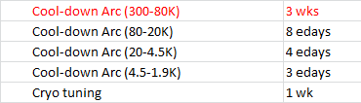
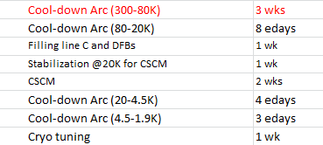
CSCM
CSCM will cost 4 weeks per sector

Slide 20
4.0 : CCSM impact on schedule
Flushing, nQPS, ELQA
ELQA
26
Cool-down
Pressure test
Cool-down
NC
Pressure test
Flushing, nQPS, ELQA
27
CSCM
28
ELQA
NC
Pressure test
29
Cool-down
ELQA
30
Flushing, nQPS, ELQA
NC
31
Cool-down
Flushing, nQPS, ELQA
ELQA
32
ELQA
NC
Cool-down
33
CSCM
Flushing, nQPS, ELQA
34
PT Φ 1
Cool-down
NC
35
CSCM
NC
36
Cool-down
37
PT Φ 2
CSCM
Cool-down
38
ELQA
CSCM
39
ELQA
40
CSCM
PT Φ 1
41
PT Φ 1
ELQA
42
PT Φ 1
CSCM
ELQA
43
PT Φ 2
CSCM
44
ELQA
PT Φ 2
45
CV maintenance
46
PT Φ 1
PT Φ 2
ELQA
PT Φ 1
47
ELQA
48
CV maintenance
PT Φ 1
49
PT Φ 1
PT Φ 2
50
PT Φ 1
51
52
1
2
PT Φ 2
PT Φ 1
PT Φ 2
3
PT Φ 2
4
PT Φ 2
5
6
Machine Check-out
7
8
CSCM & powering tests
PT67 // CSCM in sec.12
PT81 // CSCM in sec. 56 & 78
PT12&23 // CSCM in sec. 34 & 45
9
10
Beam Commissioning
11
12
13
14
15
16
17
18
Physics
19
20
21
22
23
24
25
26

Slide 21
V4.0: CCSM impact on schedule (with survey)
Flushing, nQPS, ELQA
26
ELQA
Cool-down
Pressure test
Cool-down
NC
27
CSCM
Pressure test
Flushing, nQPS, ELQA
28
ELQA
29
NC
Pressure test
Cool-down
ELQA
30
Flushing, nQPS, ELQA
31
NC
Cool-down
Flushing, nQPS, ELQA
32
ELQA
ELQA
NC
33
Cool-down
CSCM
34
Flushing, nQPS, ELQA
PT Φ 1
Cool-down
NC
35
CSCM
36
NC
Cool-down
37
PT Φ 2
CSCM
38
Cool-down
ELQA
39
CSCM
ELQA
40
CSCM
PT Φ 1
41
PT Φ 1
ELQA
42
PT Φ 1
CSCM
43
ELQA
PT Φ 2
44
CSCM
ELQA
PT Φ 2
45
CV maintenance
46
PT Φ 1
PT Φ 2
ELQA
47
PT Φ 1
48
ELQA
CV maintenance
PT Φ 1
49
50
PT Φ 1
PT Φ 2
PT Φ 1
51
52
1
2
PT Φ 2
3
PT Φ 1
PT Φ 2
PT Φ 2
4
5
PT Φ 2
6
Machine Check-out
7
8
9
10
Beam Commissioning
11
12
13
14
15
16
17
18
Physics
19
20
21
22
23
24
25
26

Slide 22
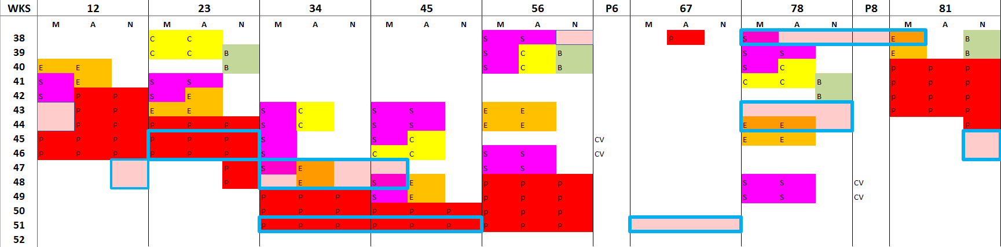
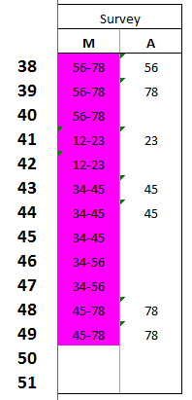
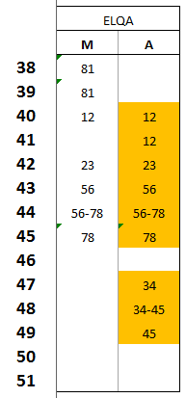
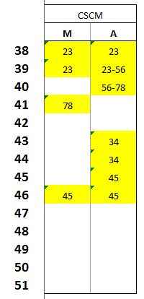
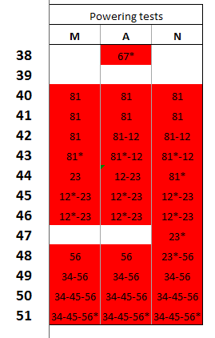
V4.0: shifts
The nightmare of co-activities and access matrix, between ELQA, BLM, Survey and Powering tests
We all know, the program will be different, but just to warn you that Shifts will be needed !!
Already agreed with Survey & ELQA & BLM
Tentative schedule

Slide 23
V4.0: Sector tests
Flushing, nQPS, ELQA
ELQA
Pressure test
Cool-down
NC
Pressure test
Flushing, nQPS, ELQA
CSCM
ELQA
Cool-down
NC
Pressure test
Flushing, nQPS, ELQA
Cool-down
ELQA
NC
ELQA
Flushing, nQPS, ELQA
ELQA
Cool-down
NC
CSCM
NC
Flushing, nQPS, ELQA
PT Φ 1
Cool-down
CSCM
Cool-down
NC
PT Φ 2
CSCM
Cool-down
CSCM
ELQA
ELQA
CSCM
PT Φ 1
PT Φ 1
ELQA
CSCM
ELQA
PT Φ 2
PT Φ 2
PT Φ 1
CSCM
CV maintenance
ELQA
PT Φ 2
ELQA
PT Φ 1
PT Φ 1
CV maintenance
PT Φ 1
ELQA
PT Φ 1
PT Φ 2
PT Φ 1
PT Φ 2
PT Φ 1
PT Φ 2
PT Φ 2
PT Φ 2
Machine Check-out
Beam Commissioning
Physics

Slide 24
CSCM impact on schedule
4 weeks (minimum) impact on beam ON
   Physics Week. 19
nPQS & mQPS to be closely followed
Shifts organization will be challenging !!

