Slide 1
Communication Services projects
During LS1
F. Chapron
IT/CS
26th of June 2014

Slide 2
Agenda
Projects
Technical Network switch replacement
Network for R2E
Experiment updates
TETRA
Mobile services
VDSL Wi-Fi network

Slide 3
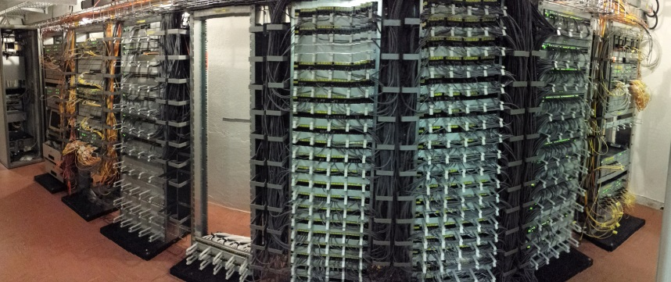
The Technical Network (TN)
Service definition:
  Provide high-speed and reliable fixed network connectivity for the accelerator control, protected from external access
  Provide 10Mbps / 100Mbps / 1Gbps connections
  Dual power supply when available
  Available in LHC (not tunnel) in Experimental caverns and Alcoves where there are UTP plugs…
  Available in injector complex (Booster, PS, SPS, etc.) and Exp. where there are UTP plugs…
Work accomplished (completed since mid-May):
  321 star-points were redone
  376 obsolete 3Com network switches were replaced by HP2910 switches
  371 GPN switches were re-patched
  7729 UTP cables were re-patched
  Network architecture optimisation
Project Leader: Maryse Da Costa
Building 874 (CCC) after TN replacement

Slide 4
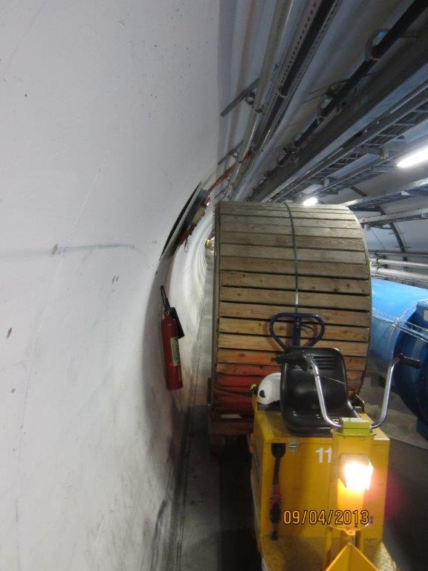
R2E project (network part)
Project definition:
  Move equipment and infrastructure in LHC exposed to radiation
  Three network star-points were concerned
    LHC 5, 6 and 7
  Move of ~100 users in LHC 1 and 4
Work accomplished (completed since end of April):
  400 UTP cables installed
  140m of leaky-feeder cable were installed
  18 Wi-Fi Access Points installed
Project Leader: Maryse Da Costa

Slide 5
Experiment updates during LS1
ALICE:
  Re-cabling and refurbishment of the ALICE Control Room
  Provide network equipment from IT-CS contract for ALICE-HLT
  Exchange 24ports switches with 48ports switches in the CR levels
ATLAS:
  Re-cabling and refurbishment of the USA15 star-point
  Cleaning of the SDX star-point (on-going)
  Replacement and upgrade of 4 core ATCN routers (HP5412 -> HP8212)
  Upgrade of the CDR from 20 to 80 Gbit/s
CMS:
  Re-cabling and refurbishment of the USC55 star-point
  Replacement of HP5412 routers upstairs by Brocade on the CMS control network (Intervention planned for autumn 2014)
  Upgrade of the CDR from 20 to 60 Gbit/s
LHCb:
  Integrate all LHCb IP addresses in CSDB (5043 interfaces, 228 IP services)
  Provide network for the new control room end 2014 (new building SCX8)
NA62:
  Increase the network size from 8 to 40 services on 10 Gbit/s (on-going)
Project leaders : Stephane Casenove and Marc Collignon.

Slide 6
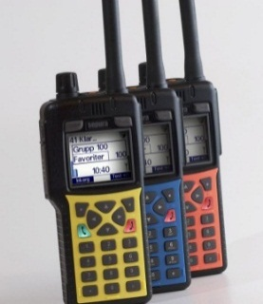
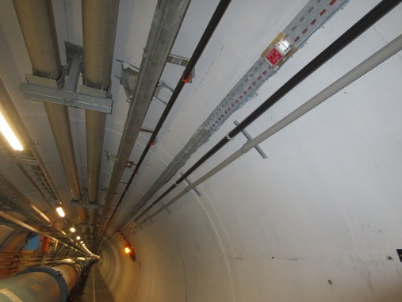
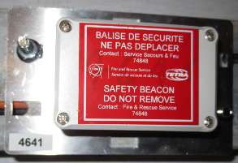
New radio services :TETRA
Service definition
  TETRA (Terrestrial Trunked Radio) is a secured radio network for critical communications (Fire brigade, Guards, etc.)
  Relay French and Swiss fire brigades frequency to allow them intervene in CERN accelerator complex with their own radio device
  Full outdoor/indoor coverage
  High level of reliability and availability (all active equipment are on UPS)
  Lone worker protection!
  Outdoor and Indoor geo-localisation (about 100 meters accuracy)
Situation:
  TETRA network ready since January 2013
  Indoor localisation (1300 beacons)
    Completed in
      PS, Booster, TT2, LINAC II, SPS4/5/6, LHC 1-2/2-3/4-5/7-8
    On-going in
      LINAC4, AD, SPS1/2/3/7, TTxx, LHC 5-6/6-7/8-1
      All will be finished until tunnels’ closure
    LHC Experiments scheduled for 2015
Project leader: Aurélie Pascal
A. Pascal March 2011 Slide 6

Slide 7
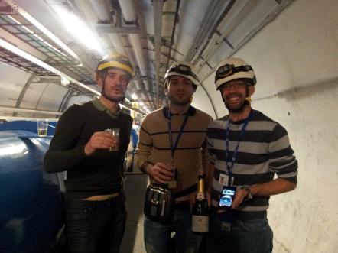

Mobile Services: GSM and 3G
Service definition:
  Permanent availability everywhere at CERN - indoor and outdoor (partially)
  Voice traffic:
    16 + 140 simultaneous calls max between two consecutive REs or RE to adjacent Pit
  Messaging:
    SMS (Short Message Service) : 160 characters maximum
    MMS (Multimedia Messaging Service): allow pictures and voice message attachments
  Data transfer allows access to Internet OR CERN GPN with a mobile device (phone or USB dongle)
    Data transfer (for standard users): 7Mbps DL + 1 Mbps UL Latency: < 50ms
  2 hours’ power autonomy
Situation:
  40 emitters and the entire transmission network were replaced
  New network design with CERN-owned repeaters
Real-time video streaming is enabled everywhere in tunnels !
Test your preferred app with this service
  3G USB dongles at telecom lab
  PDA phones at the CERN stores
Next step: LTE (4G) pilot in LHC RE88 to LCH8 in August
  Theoretical values of 90 Mbps DL & 14 Mbps UL
  To prepare LS2
Project leader: Rodrigo Sierra
First 3G speed tests in LHC!
A. Pascal March 2011 Slide 7

Slide 8
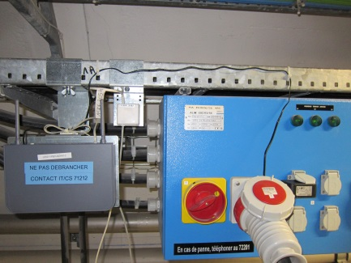
VDSL & Wi-Fi in LHC (& LINAC4)
Service definition:
  VDSL2 : Very high bit rate Digital Subscriber Line version 2.
    High performance version of your ADSL line at Home
    Plugs available every 100m in LHC tunnel connected to GPN
    Up to 100Mbps full-duplex (upload and download) on wire
    Temporary Wi-Fi Access Points in tunnel (with embedded VDSL modem)
      802.11bgn (2.4GHz) up to 80Mbps half-duplex shared
  Wi-Fi Access Points in technical areas (and access pits)
    Permanent service to connect to GPN
    In most UAs, USs, REs and SDs
    802.11bgn (2.4GHz) Max 80Mbps half-duplex shared
    802.11an (5GHz) Max 240Mbps half-duplex shared
Situation :
  26 VDSL switches replaced in April 2013.
  278 temporary Wi-Fi/VDSL modems deployed in tunnel since April 2013
  77 permanent Wi-Fi APs replaced or added
  Wi-Fi coverage map: https://gis.cern.ch/gisportal/IT_Equipment.htm
Project manager: Sebastien Ceuterickx
A Wi-Fi/VDSL modem in LHC

Slide 9
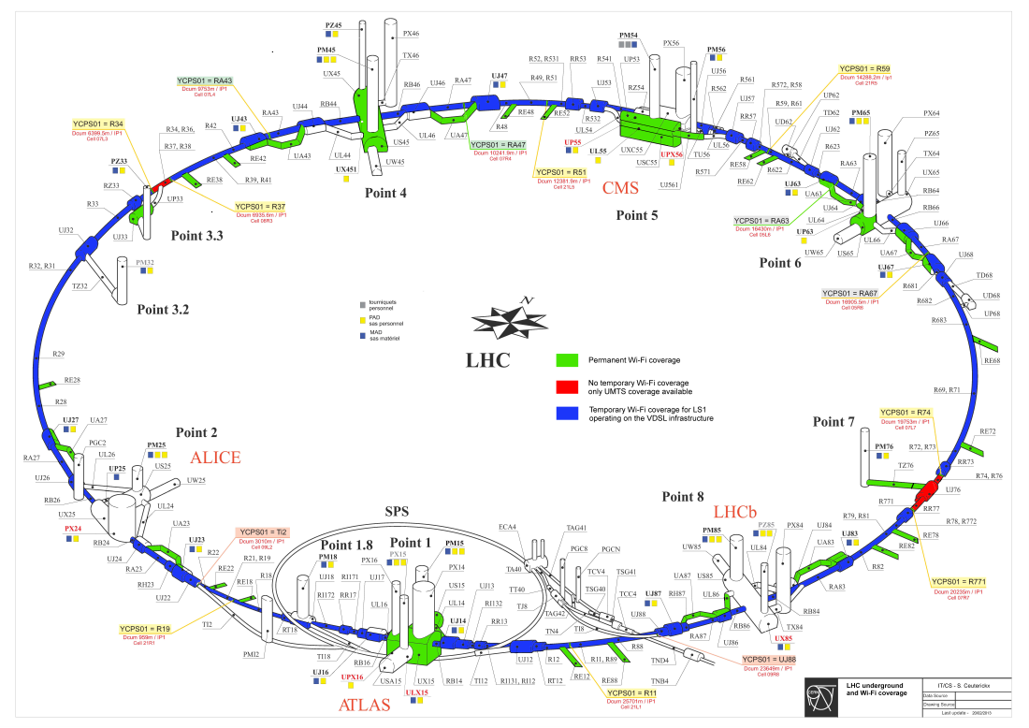
VDSL & Wi-Fi in LHC
Dismantling:
  VDSL/Wi-Fi modem cannot resist LHC operation
  Wi-Fi Kits will be available at the telecom lab
  Shall we keep the mounting brackets in place for future re-use ?
Tentative schedule:
  In LHC Arcs (right after the 80K to 4.5K cool down)
    Arc 67 : 17th of July (to confirm)
    Arc 81 : 14th of July (to confirm)
    Arc 12 : 8th of August
    Arc 23 : 22nd of August
    Arc 56 : 1st of September
    Arc 78 : 12th of September
    Arc 34 : 19th of September
    Arc 45 : 26th of September
  In LHC LSS
    LSS 67 :13th of August
    LSS 12 : 12th of September
    LSS 81 : 22nd of September
    LSS 23 : 29th of September
    LSS 56 : 3rd of October
    LSS 78 : 16th of October
    LSS 34 : 24th of October
    LSS 45 : 31st of October

Slide 10
Conclusion
Projects
Technical network switch replacement = Done!
Network for R2E = Done !
Experiment updates = Finalising it in CMS & Atlas
TETRA = Finalising Indoor localisation
Mobile services = Done !
VDSL Wi-Fi network = Done ! (Dismantling)
Thanks to all those who help us in these projects!

Slide 11
THANKS
Questions ?

Slide 12
Communications services in underground & Exp. after LS1

