Slide 2
Status report of
CRG activities
June 27th, 2014
LS1 Committee (LSC)
L. Tavian TE-CRG

Slide 3
Content
Update on:
  DFBA progress
  Major overhauling and maintenance
  R2E at P4
  Re-commissioning status
  Helium spilling test in S23

Slide 4
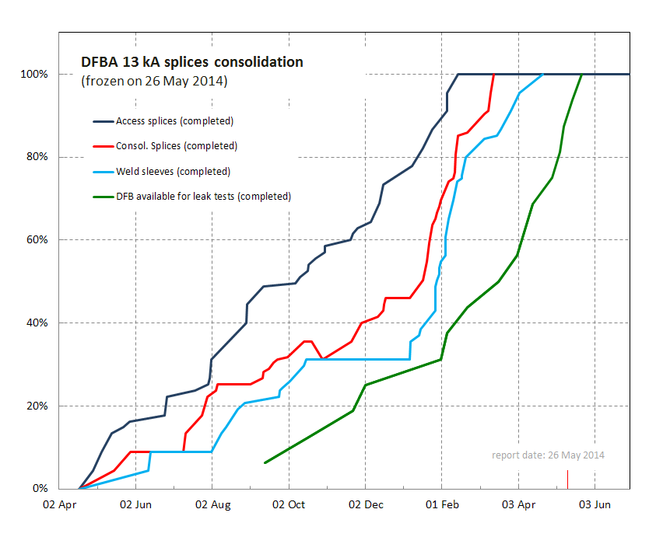
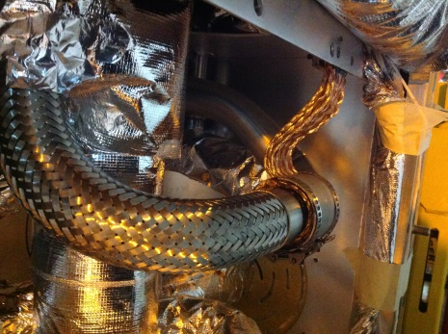
DFBA splices consolidation: completed !
DFBs
100% of splices consolidated, 100% of sleeves welded, 100% DFBAs reclosed (26 May)
Only beam vacuum valves and alignment remaining on 2 DFBAs.
11 DFBAs (sect. 6-7, 8-1, 1-2, 2-3, 5-6, 7R) pressure tested
Active cooling of DFBMB 4R8 screen (11 June)
Other consolidations / maintenance on DFBs
All safety valves re-qualified.
DFBX CL controls: IP 1, 2, 5, 8 (all IPs installation completed)
Several consolidations ongoing (protections, etc.), to be completed by end of July.
2 DFBM with non-nominal behaviour (DFBMB.4R2, DFBMC.5R2) being investigated and consolidated

Slide 5
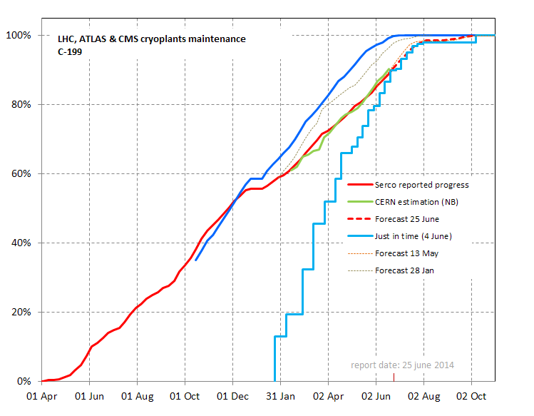
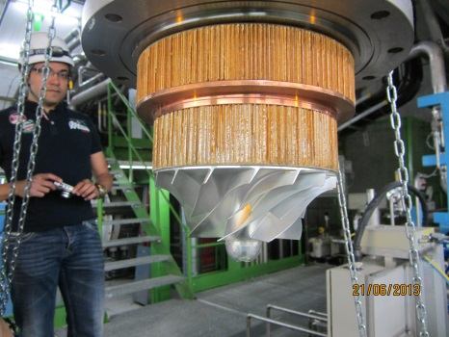
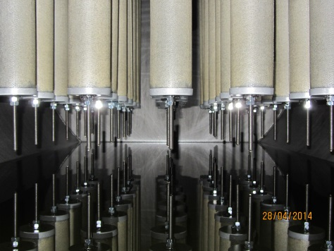
C199 maintenance contract LS1 for cryogenic maintenance activities of LHC, ATLAS & CMS
Demounting a cold compressor
Cartridges of a HP coalescer in Pt2 of LHC
About 90% of work completed
Overall activities ongoing as planned with minor adjustment not affecting the availability of installations for operation (N.B. July still critical but feasible)

Slide 6
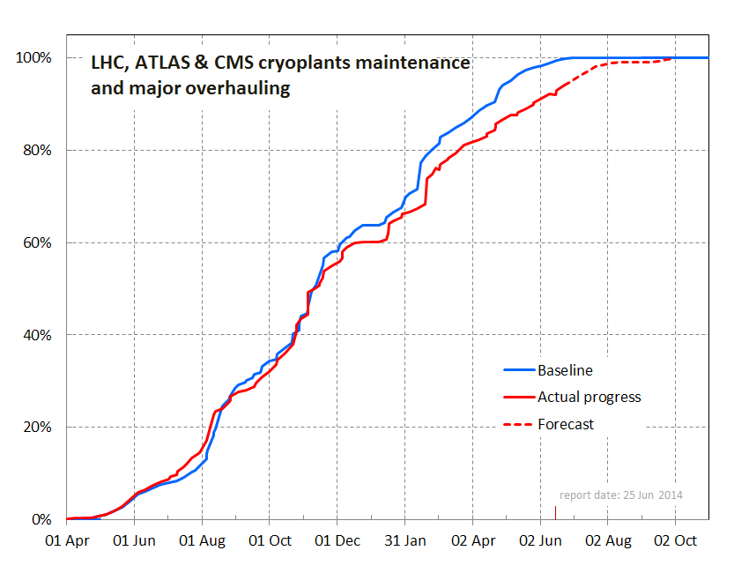
Status of LHC, ATLAS & CMS cryoplants maintenance and major overhauling
About 94% of work completed
C199 90%, Compressors 100%, motors 90%

Slide 7
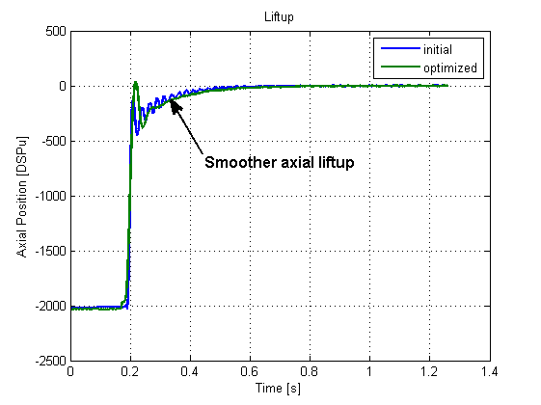
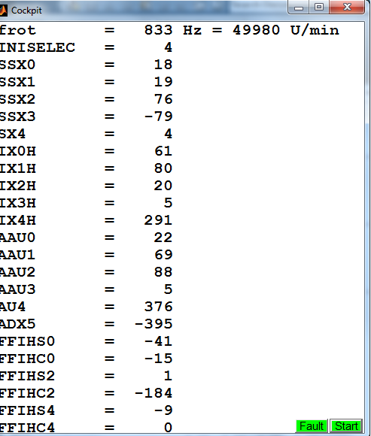
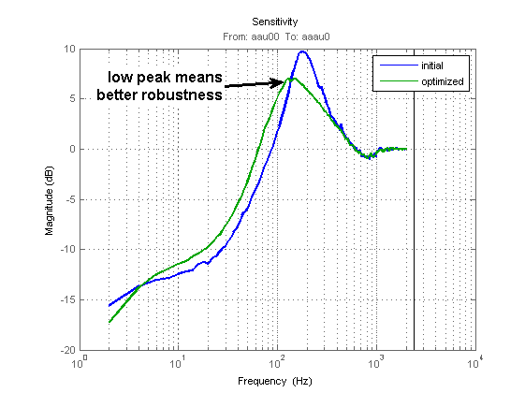
R2E @ P4: new cold compressor electronics
All new systems (Drives and AMB controls) validated at maximum speed and reduced load.
Validation at full load to be done (CW40-42).

Slide 8
Sector flushing & pressure tests
Sector | PT | Flushing | NC after pressure test on QRL
S12 | Done | In progress | 1 leak on Header C: opening of the interconnect from 7th of July
S23 | Done | CW27 | RAS
S34 | CW29 | CW32 | N/A
S45 | CW31 | CW33 | N/A
S56 | Done | CW28 | Under investigation
S67 | Done | Done | RAS
S78 | In progress | CW30 | N/A
S81 | Done | Done | 1 leak on Header D (sub-sector D): Accepted

Slide 9
First sector cool-down (Sector 67)
Week-end slow-down
(LN2 logistics)
Towards readiness for
the 1st CSCM test
Nitrogen precooling

Slide 10
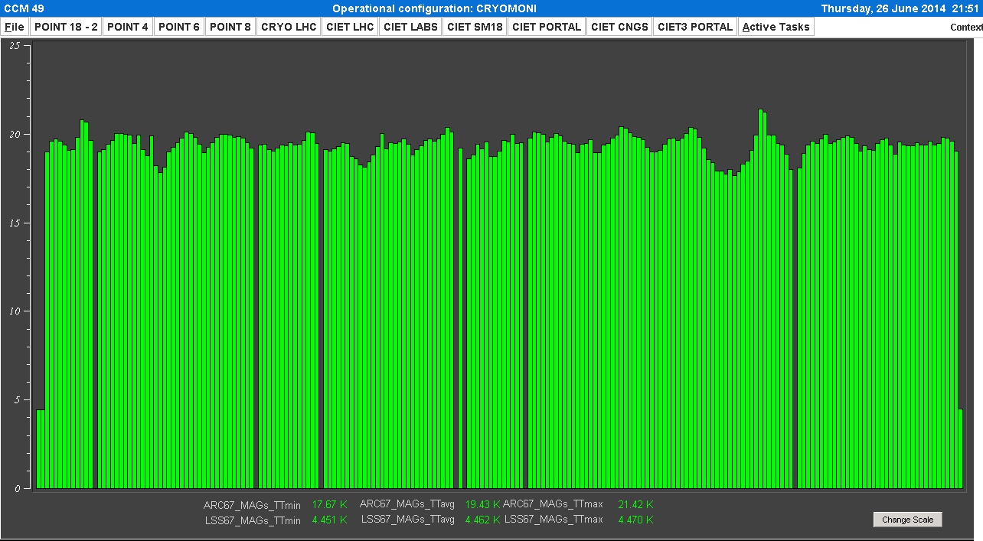
Sector 67 temperature stability

Slide 11
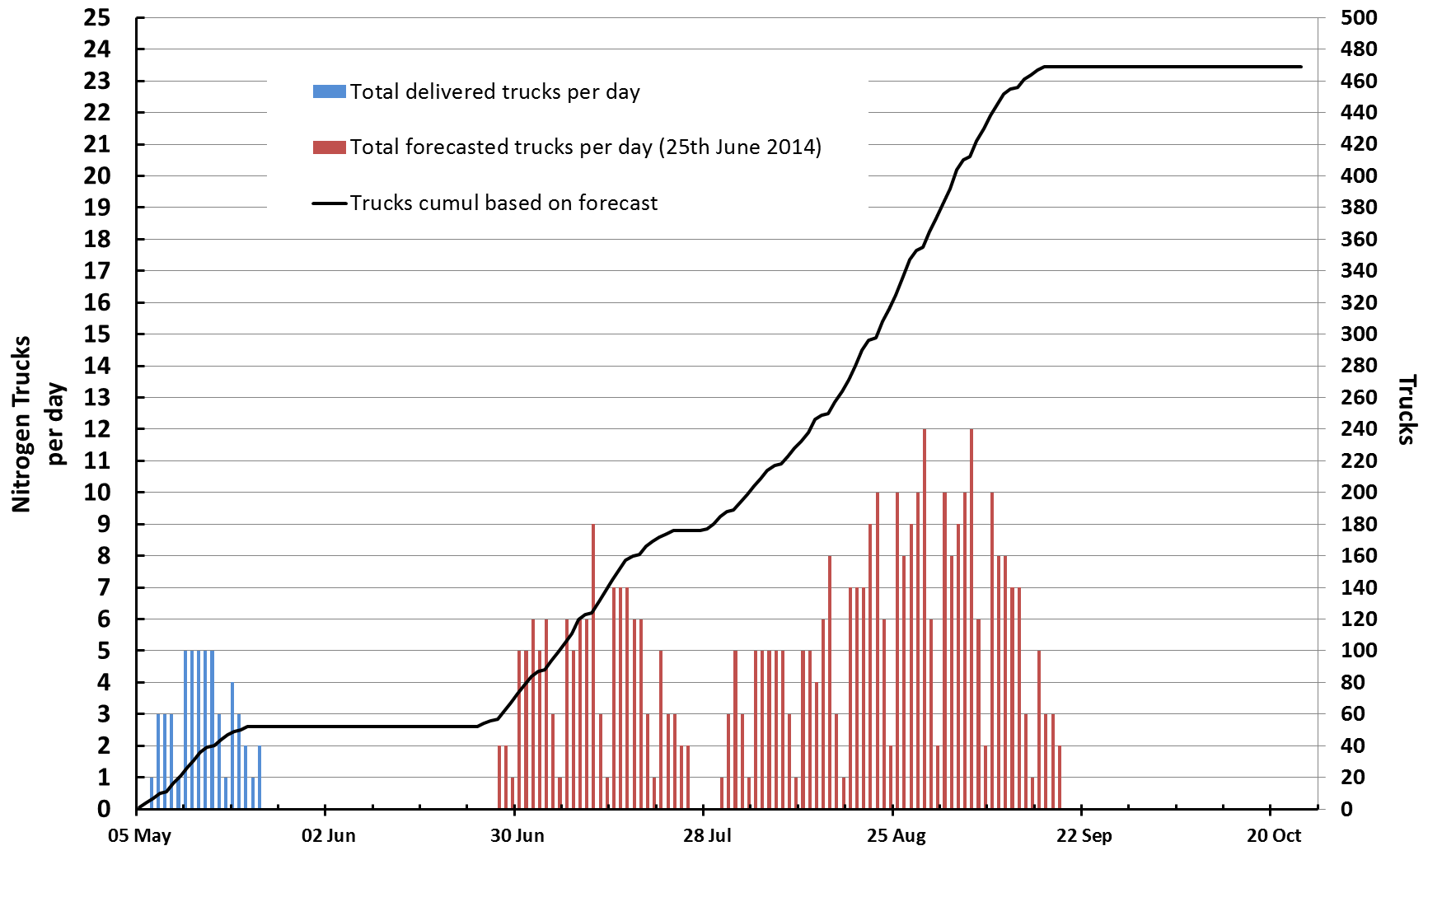
LHC and Detectors cool down, LN2 Planning 2014
About 10’000 tons
Launched for S81 and detectors, organized for 6 remaining LHC sectors
S81
LHC_67

Slide 12
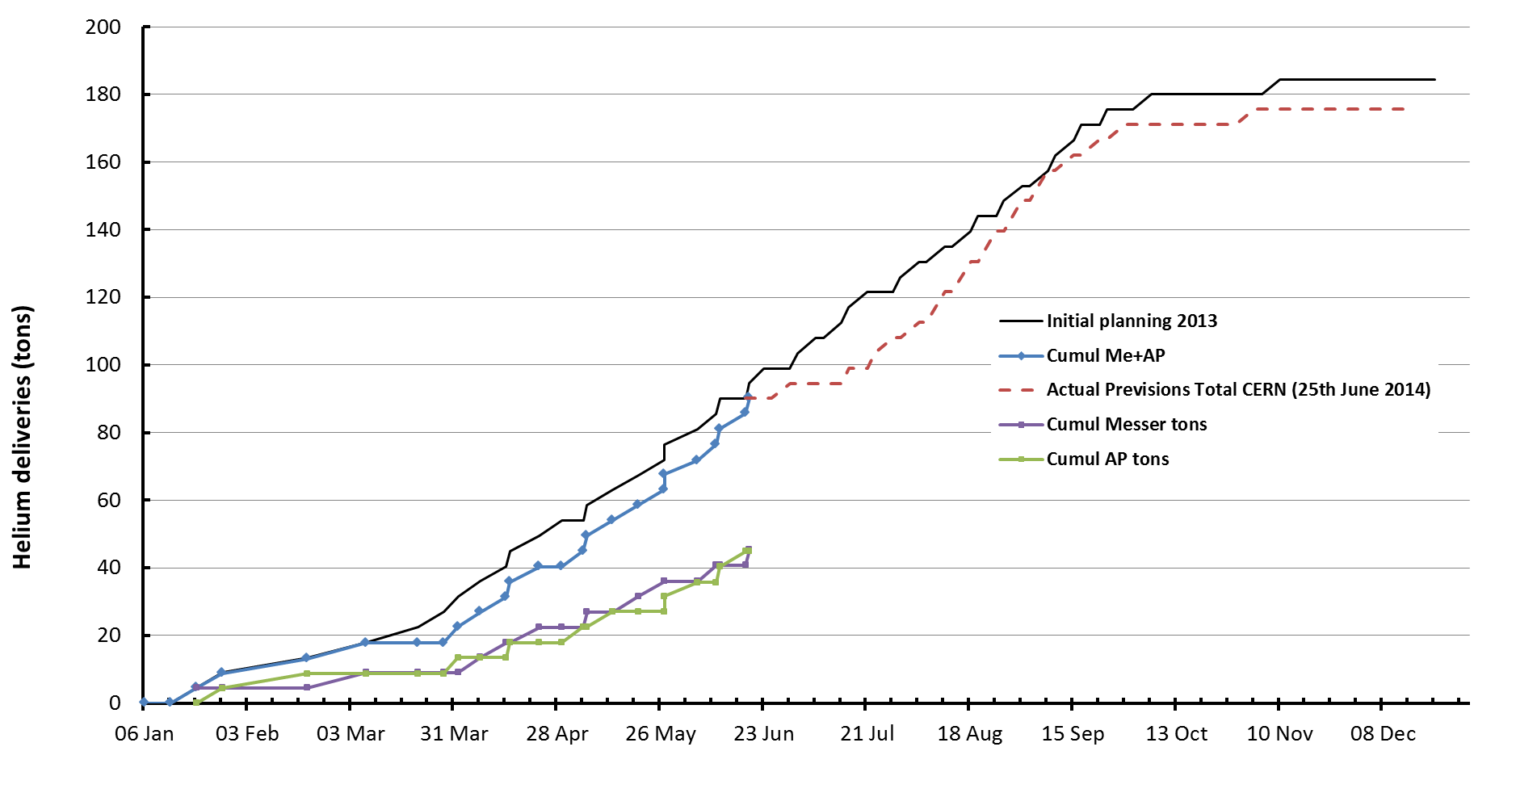
LHe deliveries and forecast 2014 (CERN wide)
Very smooth logistics so far, with 98% of external storage already back at CERN!
Voluntary slow-down of deliveries to match our available capacity at that time
In order to have last LHe storage ready after maintenance AND 1st sector to be filled
In order to have 1st LHe storage ready after maintenance

Slide 13
Status of the Cryogenic Systems of LHC, ATLAS and CMS
P1 - ATLAS
P1.8
P2
P4
P5 - CMS
P6
P8
Argon
Helium
Storage
Storage
Storage
Storage
Storage
Storage
LN2 storage
Storage
MR
SR
QSCB
QSCC
QSCA
QSCC
QSCC
QSCA
QSCB
QSCC
CS
QSCC
QSCB
QSCA
QSCC
QSCC
QSCA
QSCB
QSCC
Surface
N2 CS
MCS
SCS
QSRB
QSRA
QSRA
QSRB
QSRB
QSRA
QSRA
QSRB
Shaft
N2CB
MCB
SCB
CB
QURA
QURA
QURA
QURA
LAr St.
DVB
DVB
QUIB
QUIA
QUIC
DVB
QUIC
QUIC
Cavern
ATLAS Calor.
ATLAS
Toroid
ATLAS
Solenoid
QURC
QURC
QURC
QURC
CMS solenoid
QURC
QURC
QURC
QURC
Sector 1-2
Sector 2-3
Sector 3-4
Sector 4-5
Sector 5-6
Sector 6-7
Sector 7-8
Sector 8-1
Tunnel
Date: 25 June 2014
Legend
LHC
QSC_(A,B,C): Warm Compressor Station
QSR_(A,B): Surface 4.5 K Cold Box
QURA: Underground 4.5 Cold Box
QURC: 1.8 K Unit Cold Box
QUI_(A,B,C): Cryogenic Interconnection Box
Experiments
(M,S,N2)_CS: Warm Compressor Station
(M,S,N2)_CB: Cold Box
MCS: Magnet Compressor Station
DVB: Distribution valve Box
LHC Cryogenic
Distributlion Line (QRL)
Electrical Feed Box (DFBA)
Superconducting Link
Maintenance/consolidation
Pressure tested
Cryo-tuning
Cold standby (experiments)
Maintenance/consolidation finished
Cool down
Operational/ Cryostart
Non conformity / problem
A.P. TE-CRG

Slide 14
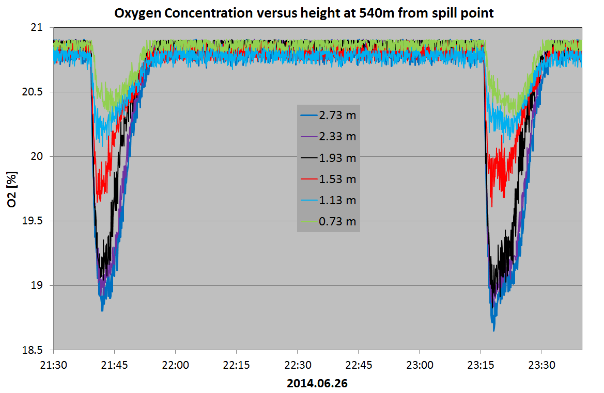
Helium spilling test in S23
m= ~100 g/s

Slide 15
Conclusion
DFBA activities: SMACC activities completed. Reconfiguration in progress.
Site-maintenance and major-overhauling activity: 94 % of progress. Site maintenance at P4 on the critical path.
Re-comminssioning:
  Pressure tests according to the schedule: Some NC to be treated.
  Sector cool-down: S67 completed ready for CSCM tests. S81 Ready for cool-down.
  Fluid logistics (He and LN2) on tracks
  The summer will be hot (large activity load during holidays time)

