Slide 1
Safety Matters !
48th LSC, 27. 6. 2014
- Cool-down Clearance
- Accidents 1st half 2014
Thomas Otto (TE DSO), Safety Officer in Charge of LS1.

Slide 2
Cool-down clearance
Proposed in LHC-CSAP, approved by LMC
Centrally documents the Safety checks performed before cooling a sector below room temperature
Actors
  TE-VSC (flap valves, insulation vacuum)
  TE-CRG (safety release valves)
  GS-ASE (ODH detectors, flashes, evacuation alarms)
  EN-MEF (Safety barriers)
Final clearance by TE-CRG Group Leader

Slide 3
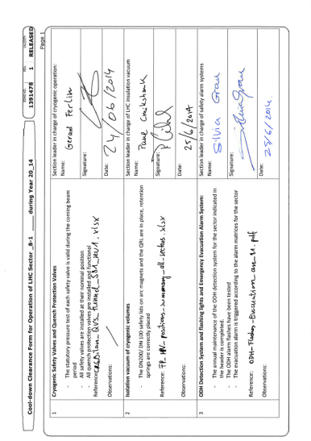
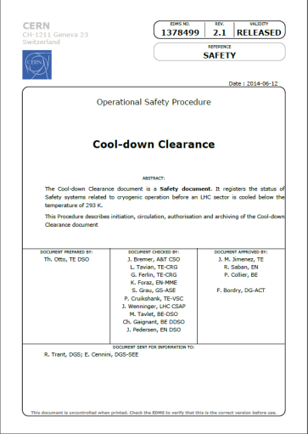
Cool-down clearance
- Approved Procedure
Signed forms archived on EDMS
2nd sector (8-1) just finalised

Slide 4
LS1 Accidents 1st part 2014
Facility | Total | Minor | With days of absence | Total days**
PS | 1 | - | 1 | 6
SPS | 2 | 2 | - | -
LHC | 8 | 5 | 3 | 36
Surface | 15 | 12 | 3 | 11
Experiments* | 2 | 1 | 1 | 6
Total 14 | 28 | 20 | 8 | 59
Total 13/14 | 90 | 61 | 29 | 240
 | ENTC | STAFF | Fell | COAS/ USAS | Total
Minor | 16 | 3 | - | 1 | 20
With absence | 7 | 1 | - | - | 8
Total 14 | 23 | 4 | - | 1 | 28
Total 13/14 | 70 | 13 | 2 | 5 | 90

Slide 5
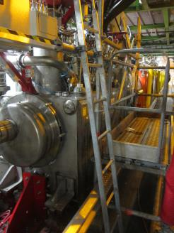
LS1 Accidents 1st part 2014
Description | All | Minor | With days of absence | Days of absence
Falls of persons | 3 | 2 | 1 | 29
Moving objects, manual handling | 9 | 5 | 4 | 20
Struck by moving objects or particles | 5 | 4 | 1 | 6
Handheld tools | 5 | 4 | 1 | 3
Striking against stationary objects, strenuous movements | 4 | 3 | 1 | 1
Fixed tooling machines | 1 | 1 | - | -
Exposure to chemical products | 1 | 1 | - | -
Total 2014 until mid-June | 28 | 20 | 8 | 59
Serious fall from a ladder:
- Ladder was not correctly installed →
- Worker did not wear mandatory safety shoes
- Result: 29 days absence

Slide 6
Statistical Indicators
Until mid-June 104 working days
approximately 10⁶ hours of LS1 work delivered
51 minor accidents (no absence)
8 accidents with 59 days of absence
Frequency rate: 8
Severity rate: 0.06

Slide 7
A word of caution
Safety performance during LS1, in particular in underground areas was very satisfactory
Owing to very thorough preparation of the workers and supervisors
LSC may terminate, but LS1 is not finished yet, remain attentive and stay safe !

Slide 8


