Slide 1



Experimental Particle Physics
at the LHC
Albert De Roeck
CERN, Geneva, Switzerland
Antwerp University Belgium
UC-Davis California USA
IPPP, Durham UK
BUE, Cairo, Egypt
19th January 2015

Slide 2
Lecture Plan
Overview of the 4 lectures in the next days
Lecture 1: Introduction to Experimental Particle Physics at the LHC
Lecture 2: Measurements and test of the Standard Model
Lecture 3: The Higgs Boson
Lecture 4: Searches beyond the Standard Model at the LHC

Slide 3
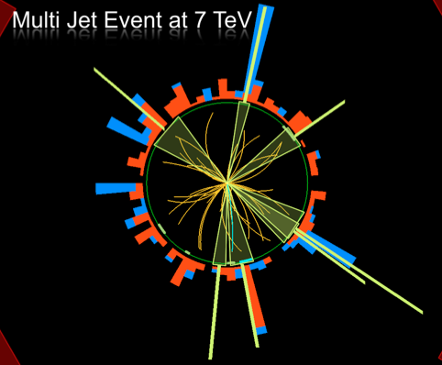
Outline Lecture I
Introduction: Experimental
Particle Physics
The Large Hadron Colider
Experiments at the LHC
Experimental Challenges
Experimental Objects
Summary
Disclaimer:
ATLAS & CMS have very
similar results
Typically one chosen
for illustration

Slide 4
These are “Experimental” Lectures
This is a School on Theoretical and Experiment in HEP
Theory is no doubt extremely important
•The Standard Model, our present Standard Theory is a triumph !!
•The BEH mechanism, through the discovery of the Higgs Boson underlines
the power if theoretical insight!!
•If Supersymmetry will be discovered this will be an unmatched theoretical
triumph!!
But none of the insight/believe in these theories would have happened
without experimental data. No sign of Supersymmetry found yet!!
Moreover experiments have over the past given a lot of ‘surprises’ and new
directions (particle generations, neutrino masses…)
Experimental Particle physics is (mostly) conducted at particle accelerators.
The most recent energy frontier instrument is the Large Hadron Collider LHC

Slide 5
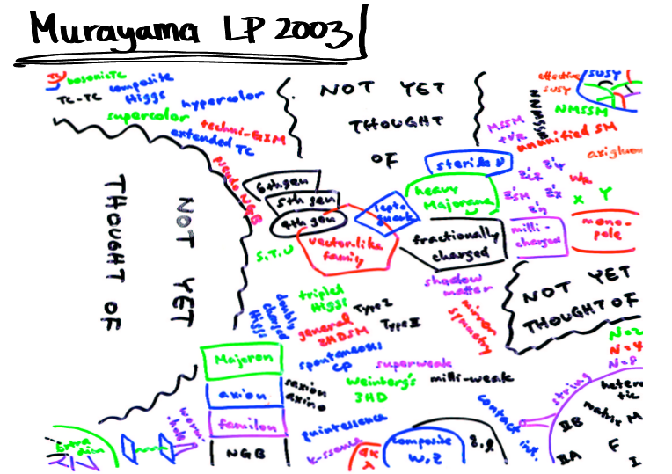
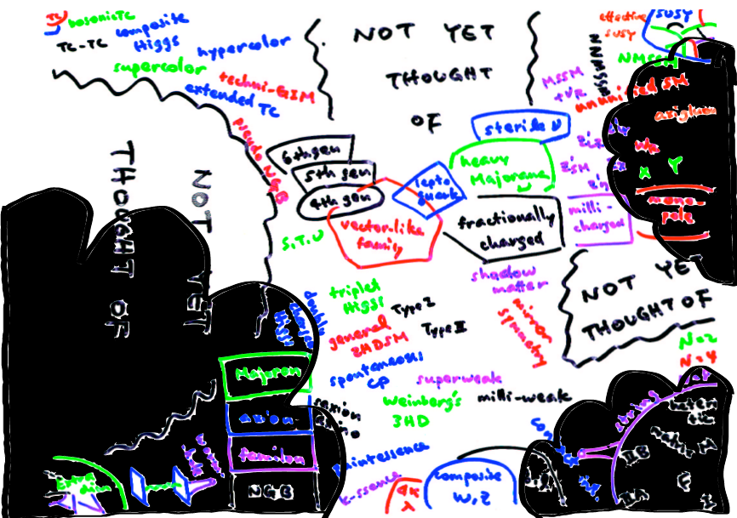

Data and Theories
NOW!
Before LHC
With LHC
March 2010

Slide 6
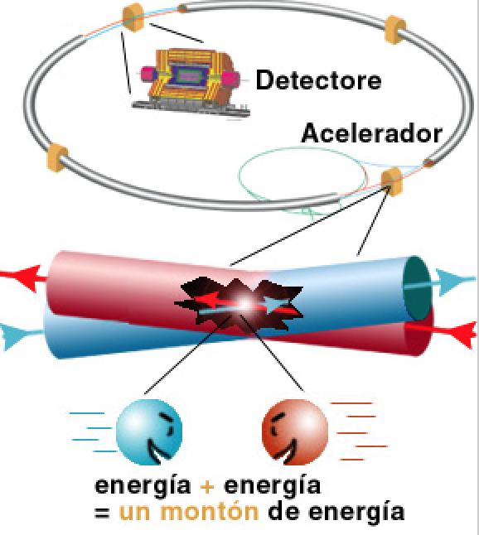
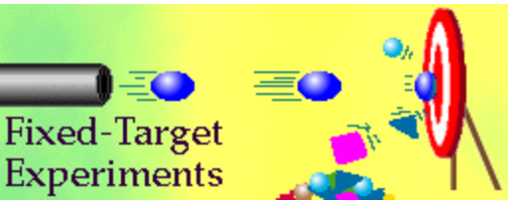
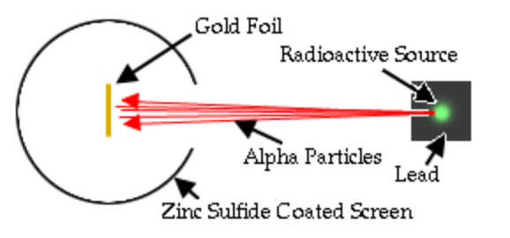
High Energy Physics Experiments
First High Energy Physics
Experiments:
Beam on fixed target!
High Energy Physics
Experiments since mid 70’s:
Colliding beams!
Rutherford experiment (1909)
Centre of mass energy squared s=E₁m₂
Centre of mass energy squared s=4E₁E₂
…plus secondary beams such as neutrinos…

Slide 7
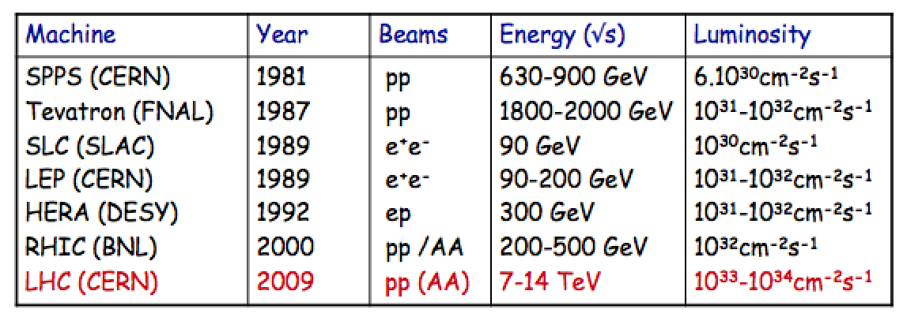
Recent High Energy Colliders
Highest energies can be reached with proton colliders
Luminosity = number of events/cross section/sec
Limits on circular machines
  Proton colliders: Dipole magnet strength →superconducting magnets
  Electron colliders: Synchrotron radiation/RF power

Slide 8
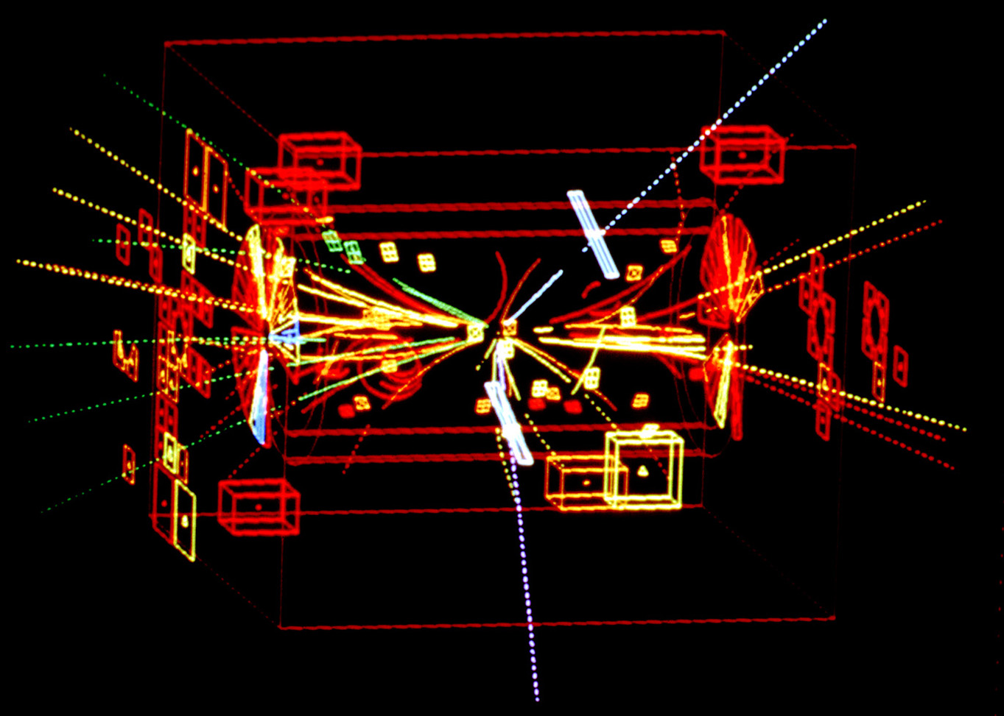
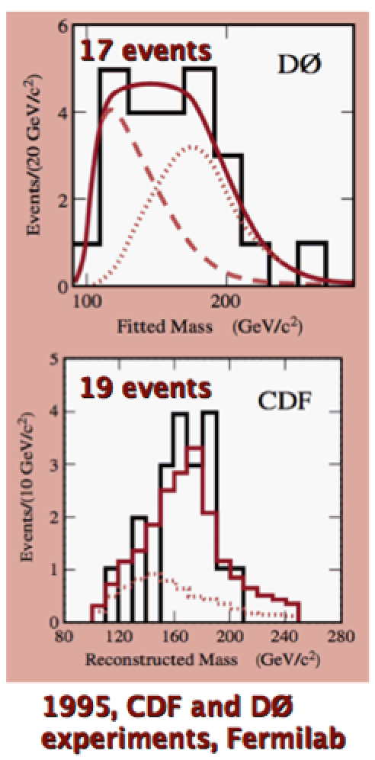
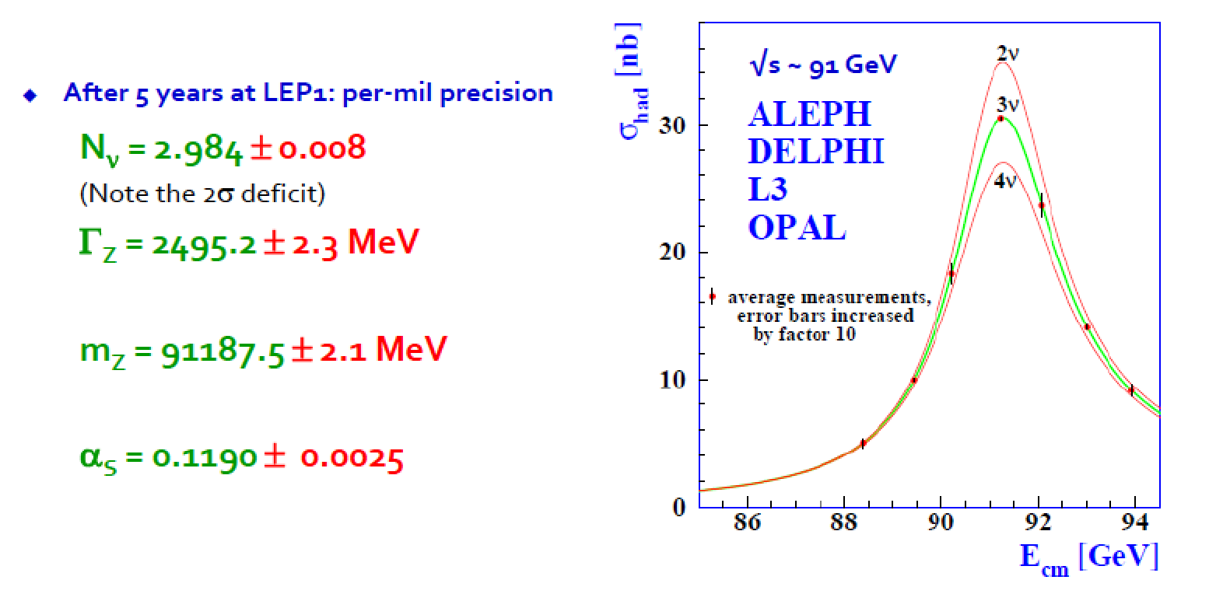
Some Discoveries/Measurements
Discovery of the Z and W
bosons in UA1/UA2 (1983)
pp → Z + X
→ e+e- + X
Discovery of the top
quark in CDF/D0(1995)
Detailed Z-property measurements (1995)

Slide 9
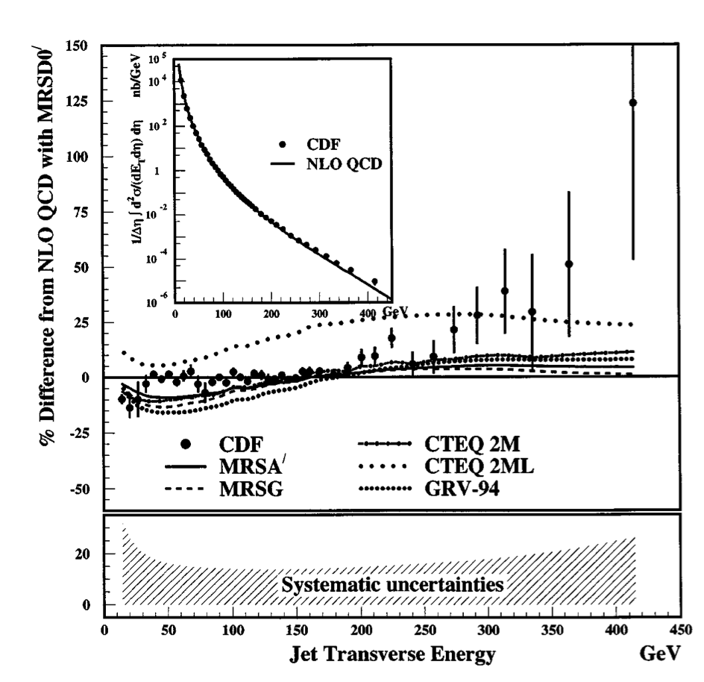
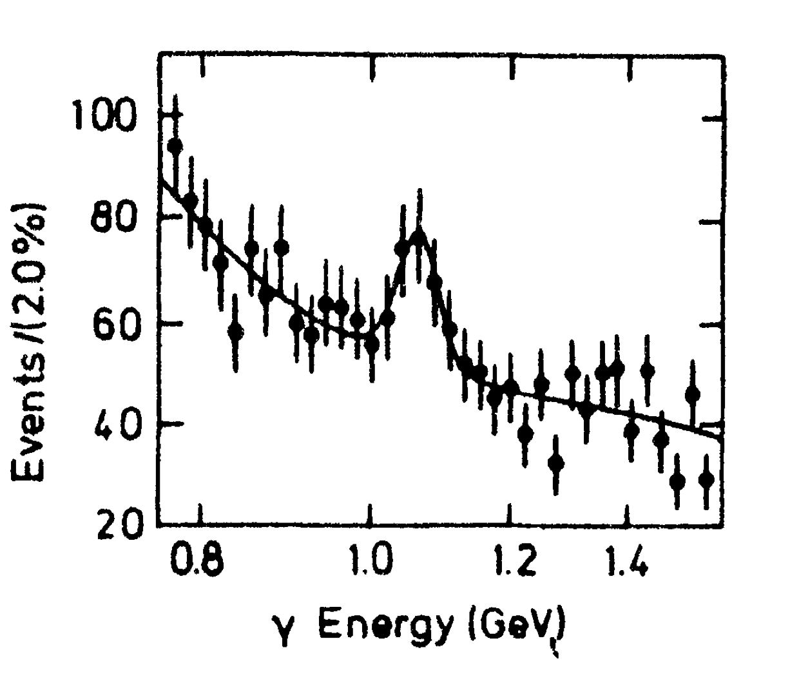
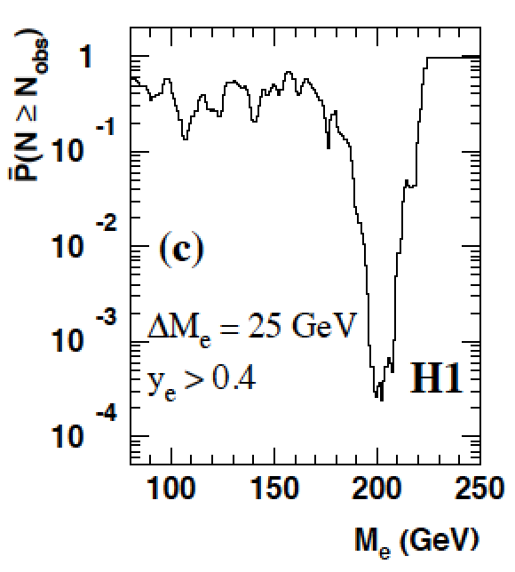
And Some NON-Discoveries
4σ effect
Excess in inclusive jet
analysis
Is the X(8.31 GeV) the
Higgs particle? A lot of
excitement summer 1984
Excess of events at high Q² in ep DIS at HERA, mainly in H1:
•7 events found with an electron-quark mass of ~200 GeV, expected ~1 event
•4 events found with expected 2 events in ZEUS

Slide 10
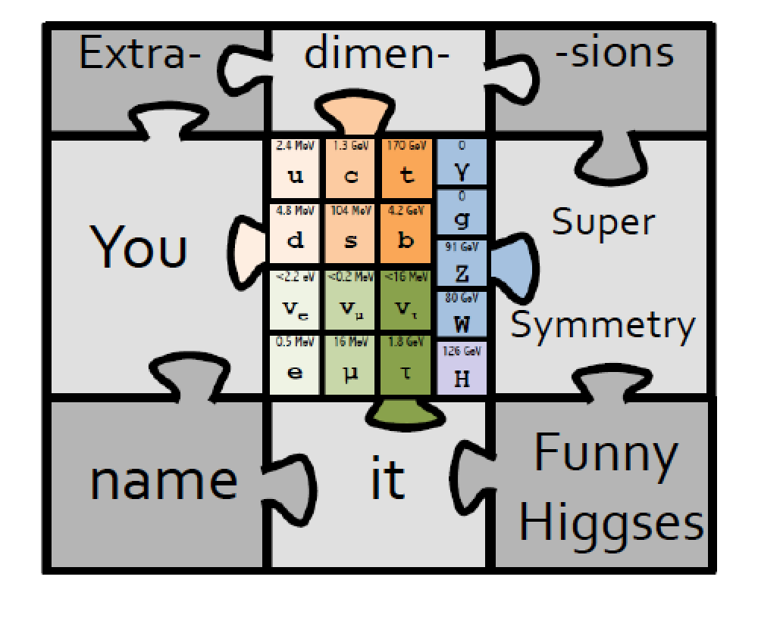
In All: The Standard Model…
And beyond….??? The Experimentalist view ☺

Slide 11
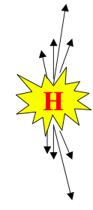
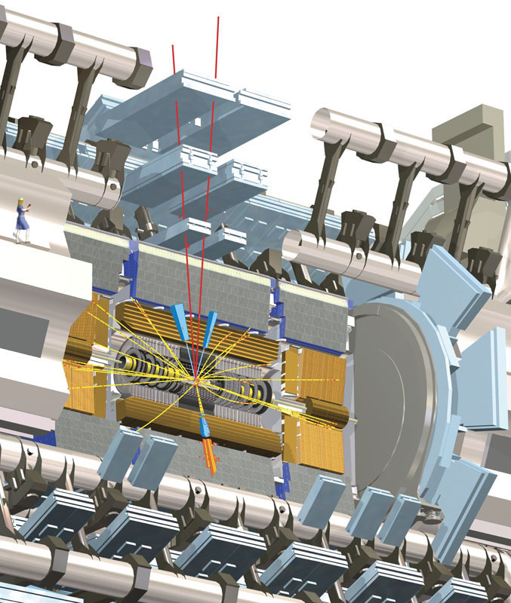
Example: The Higgs Particle
Technique: Produce and detect Higgs Particles at Particle Colliders
E=mc²
proton
proton
Experimental view…

Slide 12
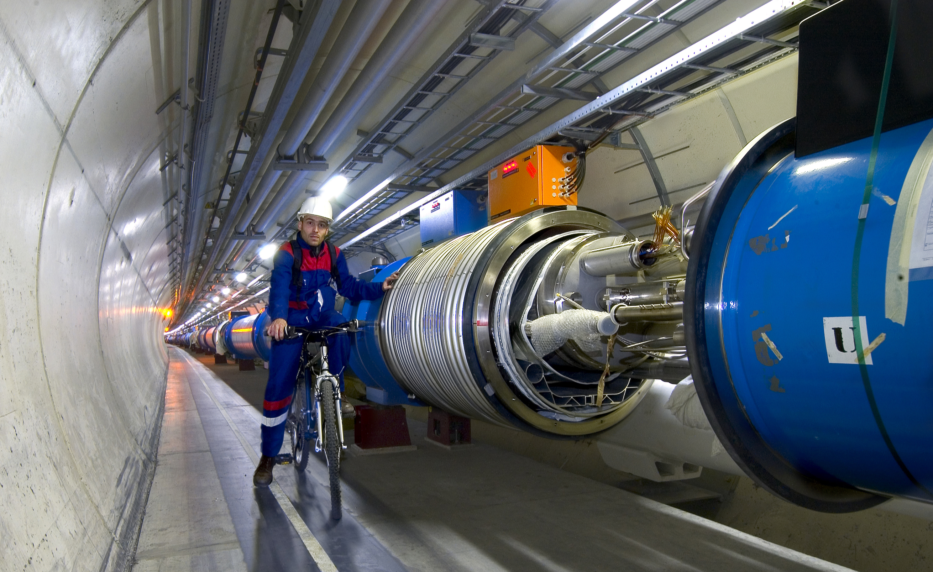
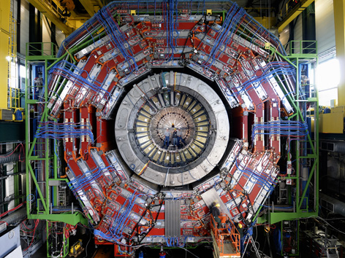

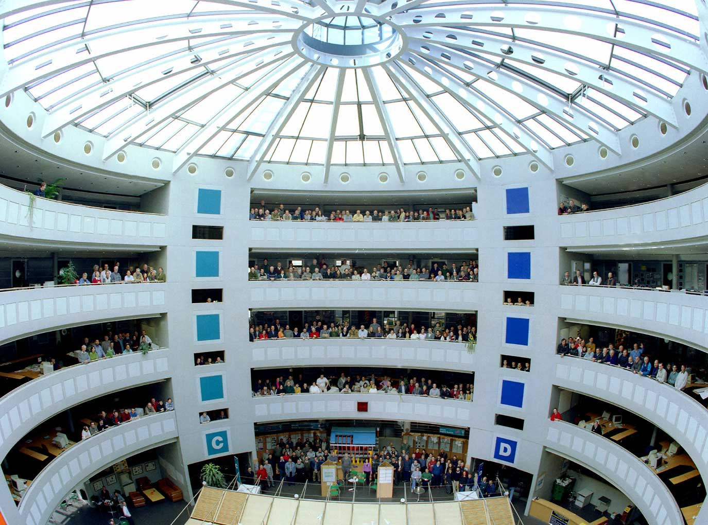
This Search Requires…….
1. Accelerators : powerful machines that accelerate particles to extremely high energies and bring them into collision with other particles
2. Detectors : gigantic instruments that record the resulting particles as they “stream” out from the point of collision.
3. Computing : to collect, store, distribute and analyse the vast amount of data produced by these detectors
4. Collaborative Science on Worldwide scale : thousands of scientists, engineers, technicians and support staff to design, build and operate these complex “machines”.

Slide 13
The Large Hadron Collider

Slide 14
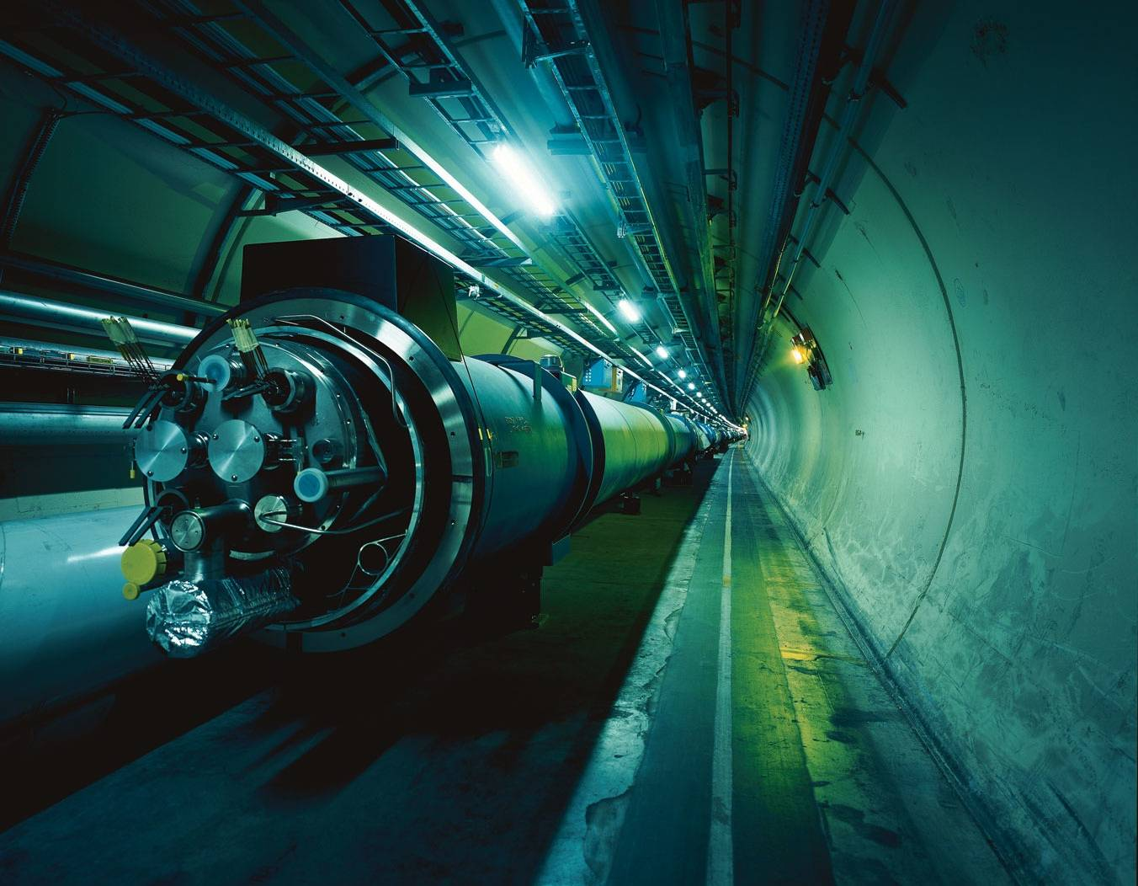

The Large Hadron Collider = a proton proton collider
Can also collide AA
7 TeV + 7 TeV
(3.5/4 TeV + 3.5/4 TeV)
1 TeV = 1 Tera electron volt
= 10¹² electron volt
Primary physics targets
• Origin of mass
• Nature of Dark Matter
• Understanding space time
• Matter versus antimatter
• Primordial plasma
The LHC produced collisions from 2010 till beginning of 2013
LHC will restart in 2015 with collisions at an energy of 13 TeV
Notes:
.999999991 % speed of light
At near light-speed, a proton in a beam will make 11 245 turns per second. A beam might circulate for 10 hours, traveling more than 10 billion kilometers – far enough to get to the planet Neptune and back again.

Slide 15
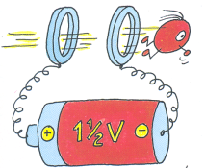
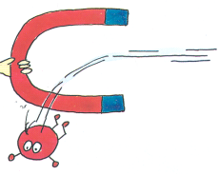
The LHC Machine and Experiments
LHC is 100m underground
LHC is 27 km long
Magnet Temperature is 1.9 Kelvin = -271 Celsius
LHC has ~ 9000 magnets
LHC: 40 million proton-proton collisions per second
LHC: Luminosity 10-100 fb⁻¹/year (after start-up phase)
moedal
LHCf
totem
•High Energy ⇒ factor 7 increase w.r.t. present accelerators
•High Luminosity (# events/cross section/time) ⇒ factor 100 increase

Slide 16
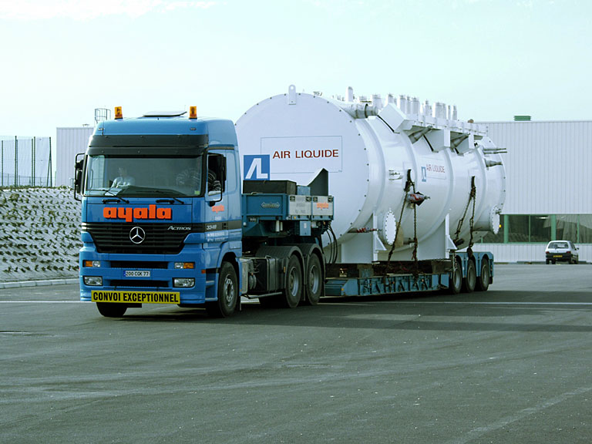
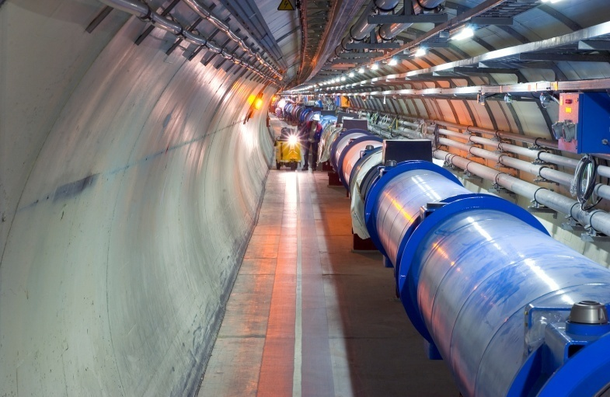
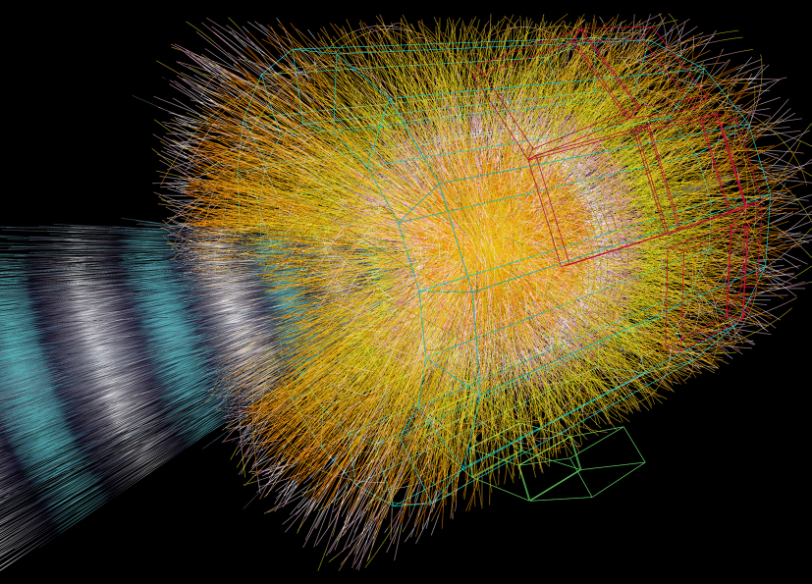
The LHC is an Extraordinary Machine
The LHC is …
LHC facts
Colder than the empty
space in the Universe: 1.9K ie above absolute zero
The emptiest place in our solar
system. The vacuum is better
than on the moon
Hotter than in the sun: temperature
in the collisions is a billion times
the one in the centre of the sun

Slide 17
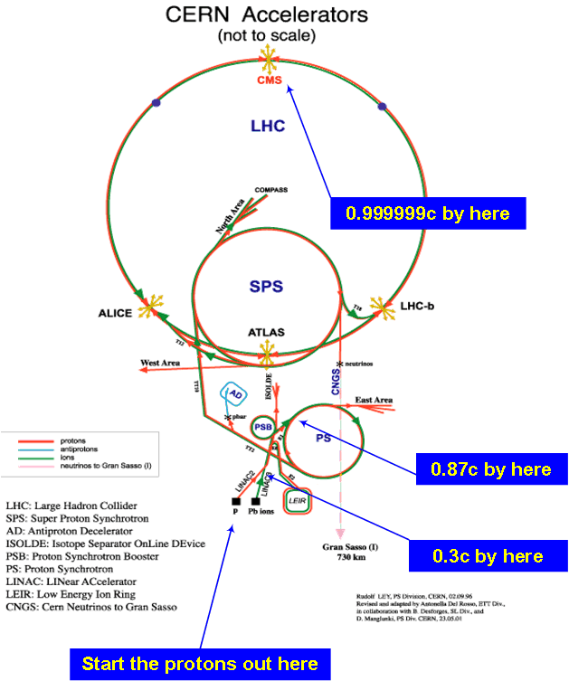
The LHC is an Extraordinary Machine
Linac
Booster
PS
SPS
LHC

Slide 18
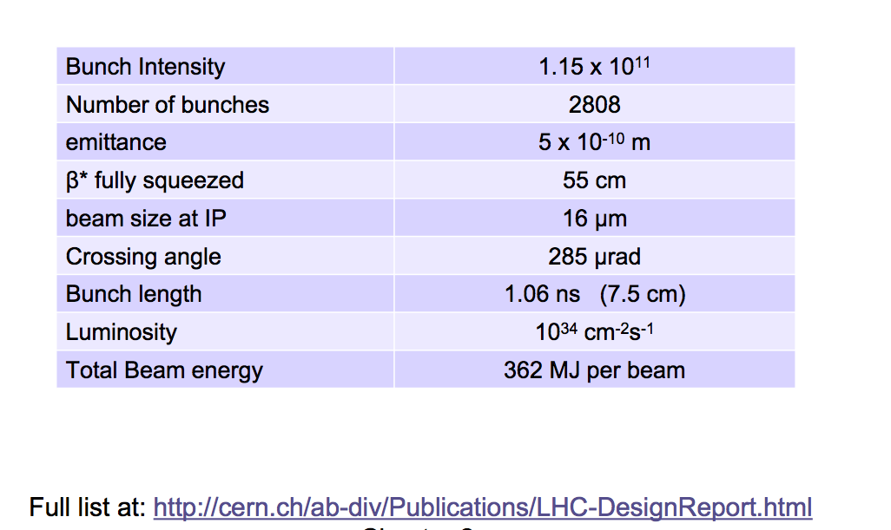
LHC Parameters (Design/14 TeV)
Run-I: 7/8 TeV, less bunches per beam (factor 2),
higher bunch intensity (30%), lumi ~8.10³³cm⁻²s⁻¹

Slide 19
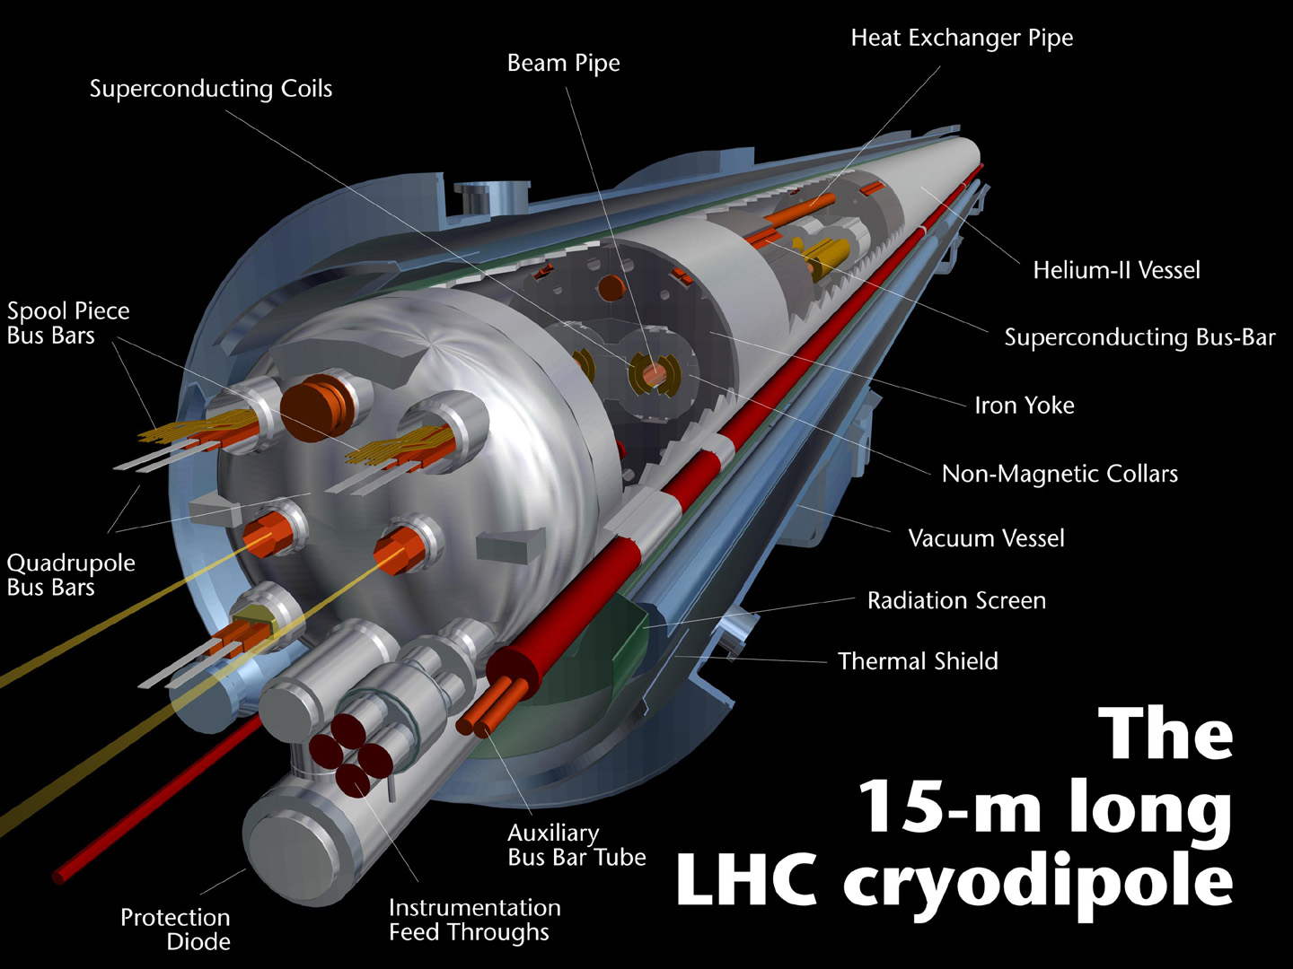
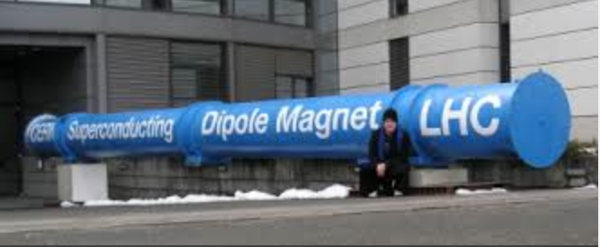
The Cryodipole Magnets
• Superconducting (1.9 K) dipoles producing a field of 8.4 T –
current 11,700A ⇒ 2-in-1 magnet design
Cost: ~ 0.5 million CHF each. LHC has 1232 of them
• Stored magnetic energy up to 1.29 GJ per sector.
• Total stored energy in magnets = 11GJ
• One dipole weighs around 34 tonnes

Slide 20
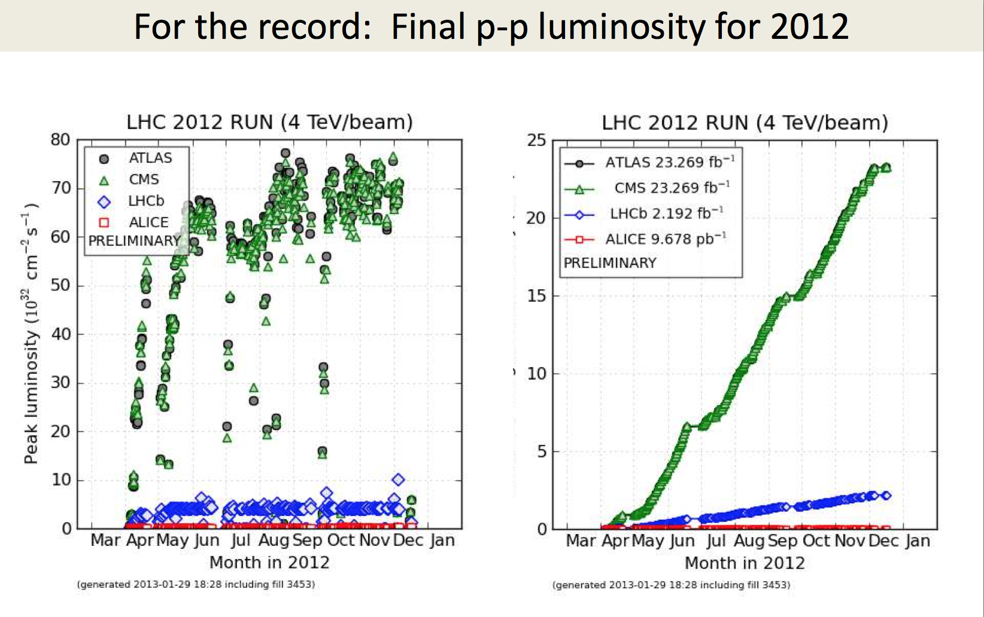
LHC Performance (2012)

Slide 21
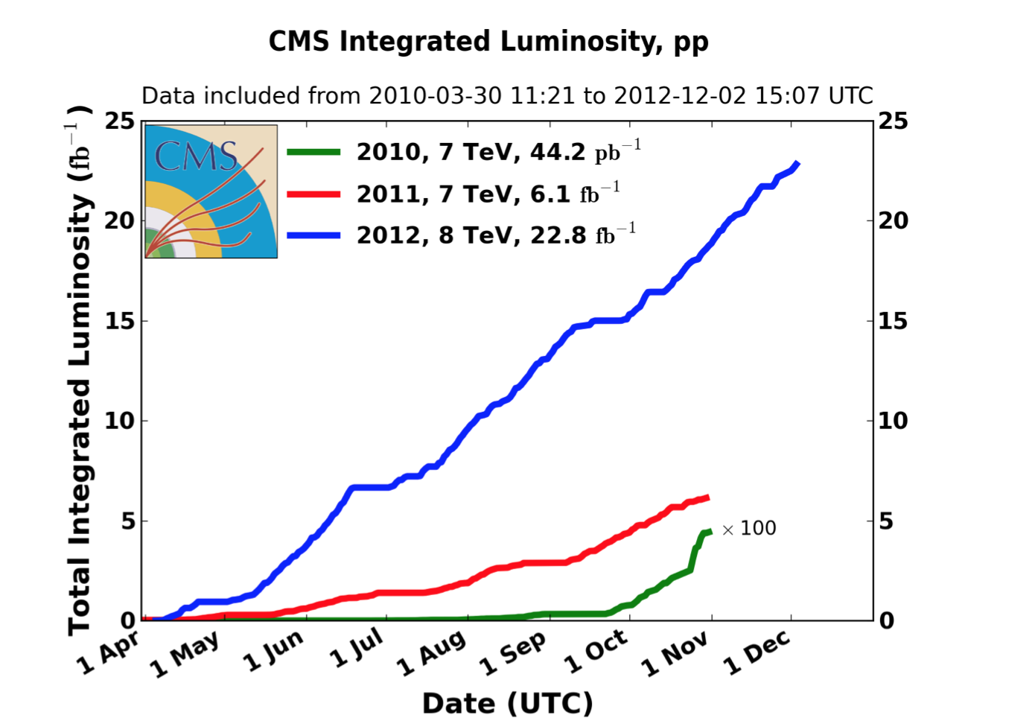
LHC Performance (2010-2012)

Slide 22
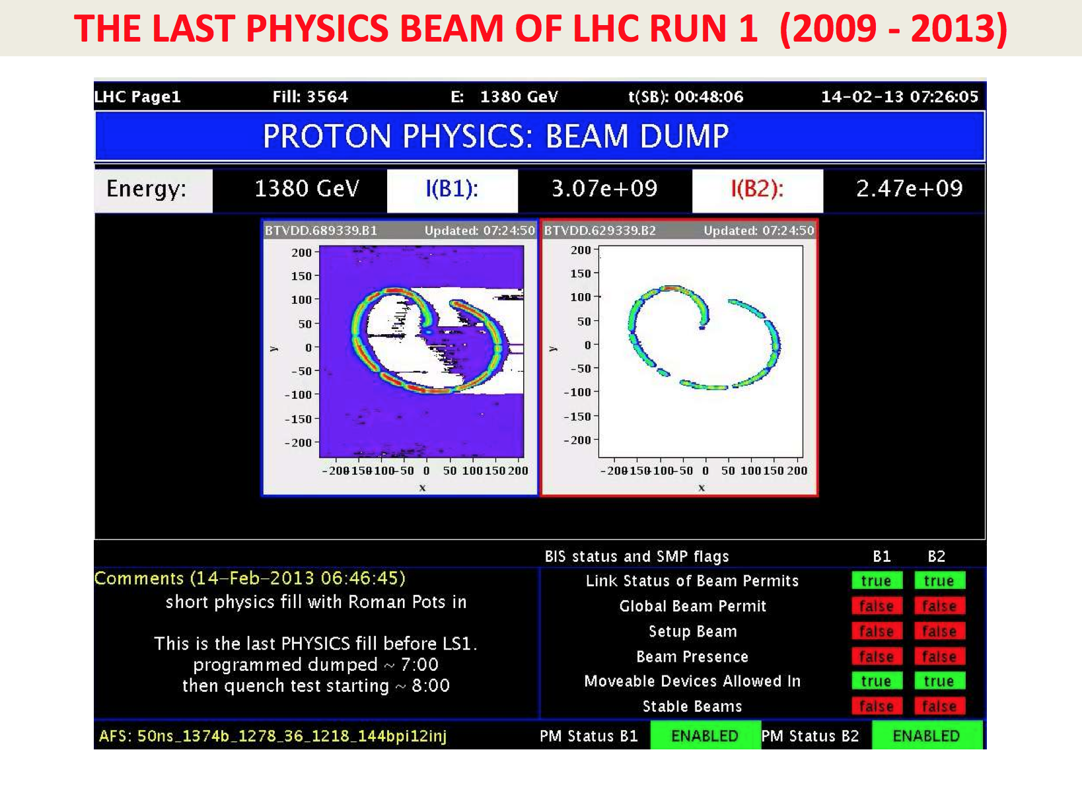
This Search Requires…….
LHC being ‘upgraded’ and awakening as we speak… more in Lecture 3

Slide 23








Experiments at the LHC

Slide 24
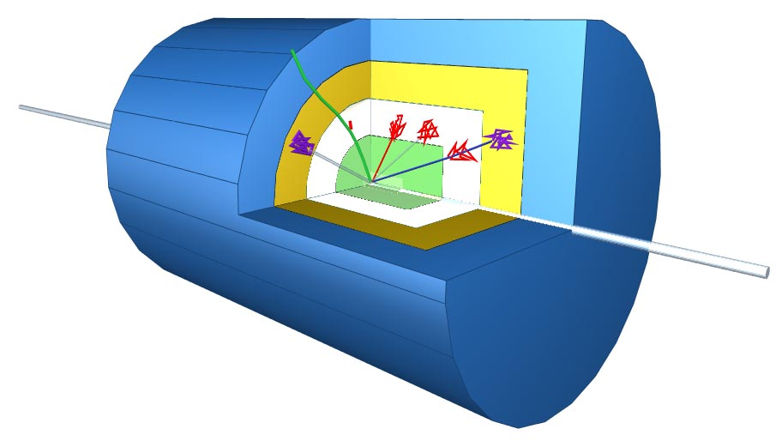
Schematic of a LHC Detector
Physics requirements drive the design!
Analogy with a cylindrical onion:
Technologically advanced detectors comprising many layers, each designed to perform a specific task.
Together these layers allow us to identify and precisely measure the energies and directions of all the particles produced in collisions.
Such an experiment
has ~ 100 Million
read-out channels!!

Slide 25

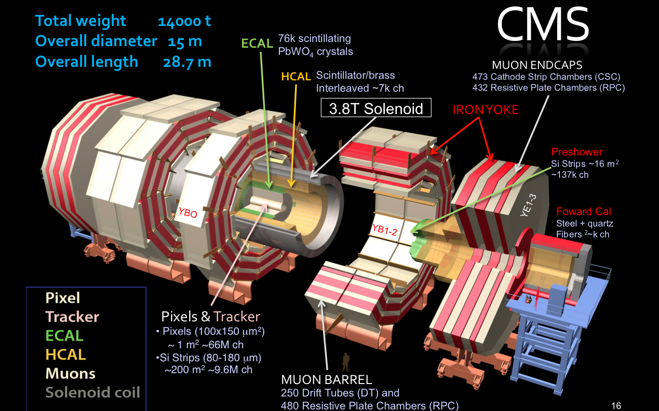
The Higgs Hunters @ the LHC
The ATLAS experiment
The CMS experiment
These experiments use different
technologies for their detector
components

Slide 26
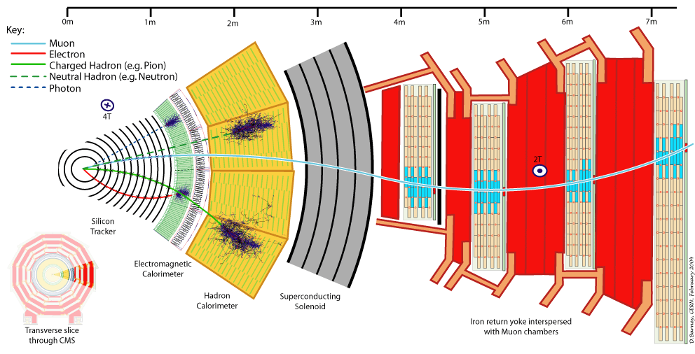
Particles in Detectors
Electromagnetic Calorimeter
Muon Spectrometer
Hadron Calorimeter
Inner Tracker
Magnet
Return flux
25
Notes:
25

Slide 27
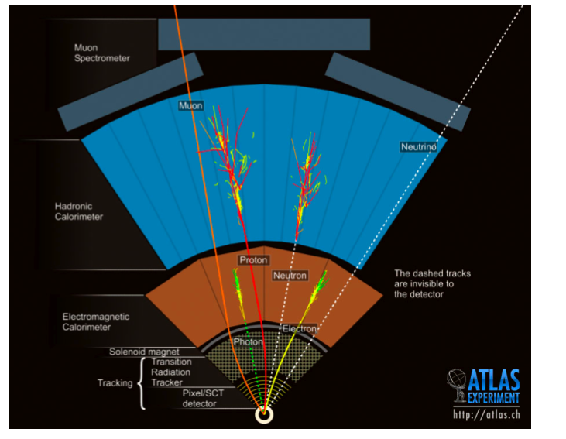
Particles in Detectors
How do they work?

Slide 28
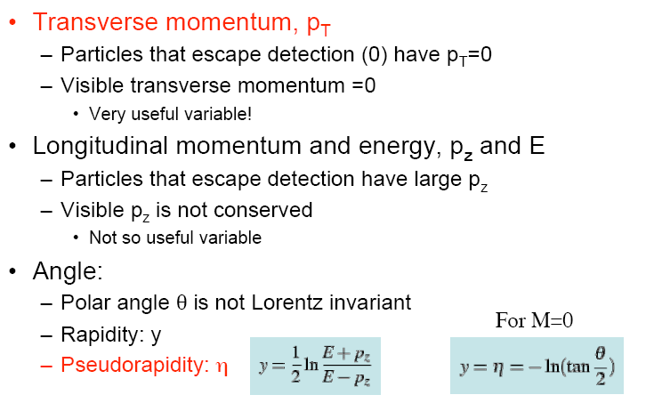
Kinematic Variables for pp Scattering
and E_{T}=E sinθ
p
p_{T}
θ
• Missing E_{T} and P_{T:} : Vectorial sum of all transverse momenta

Slide 29


Slide 30
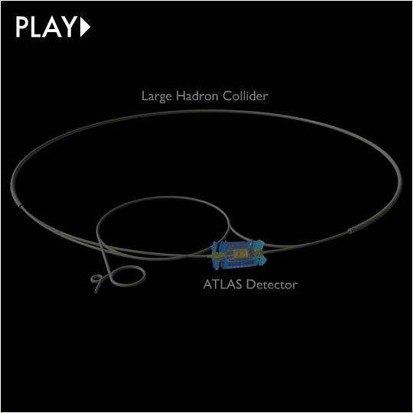

Slide 31
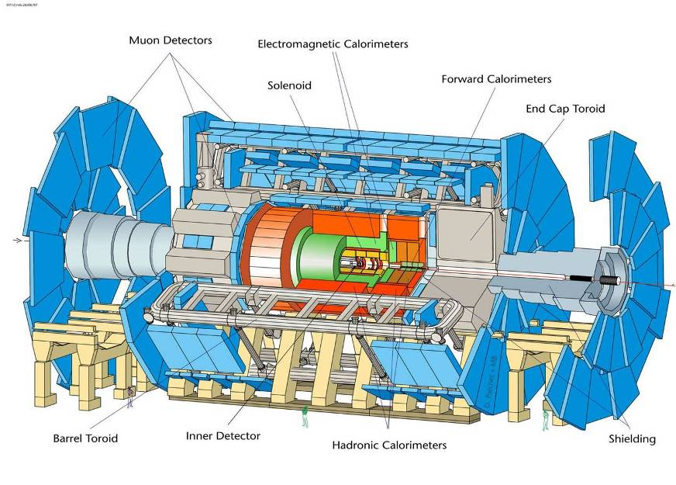
Length = 55 m; Width = 32 m; Height = 35 m; but spatial precision ~ 100 μm

Slide 32
CMS Detector Design Priorities
Expression of Intent (EOI): Evian 1992
1. A robust and redundant Muon system
2. The best possible e/γ calorimeter consistent with 1.
3. A highly efficient Tracking system consistent with 1. and 2.
4. A hermetic calorimeter system.
5. A financially affordable detector.

Slide 33
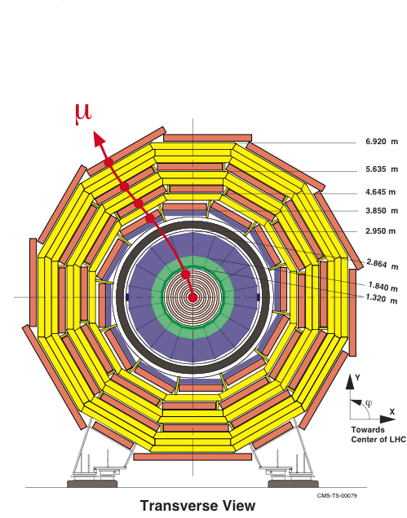
Compact Muon Solenoid (CMS)
Letter of Intent (LOI): LHCC, TDR in 1994
Strong Field 4T
Compact design
Solenoid for Muon P_{T} trigger in transverse plane
Redundancy: 4 muon stations with 32 R-phi measurements
ΔP_{t}/P_{t} ~ 5% @1TeV for reasonable space resolution of muon chambers (200μm)

Slide 34
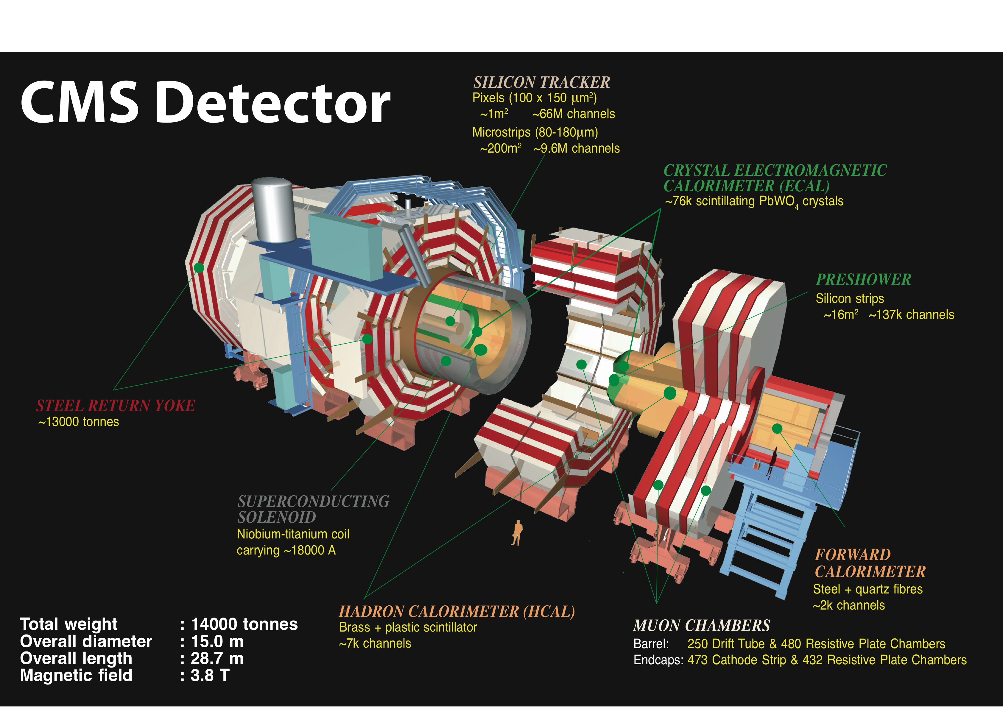
Compact Muon Solenoid
Total weight:
14000 tons
Overall diameter:
15 m
Overall length:
28.7m

Slide 35
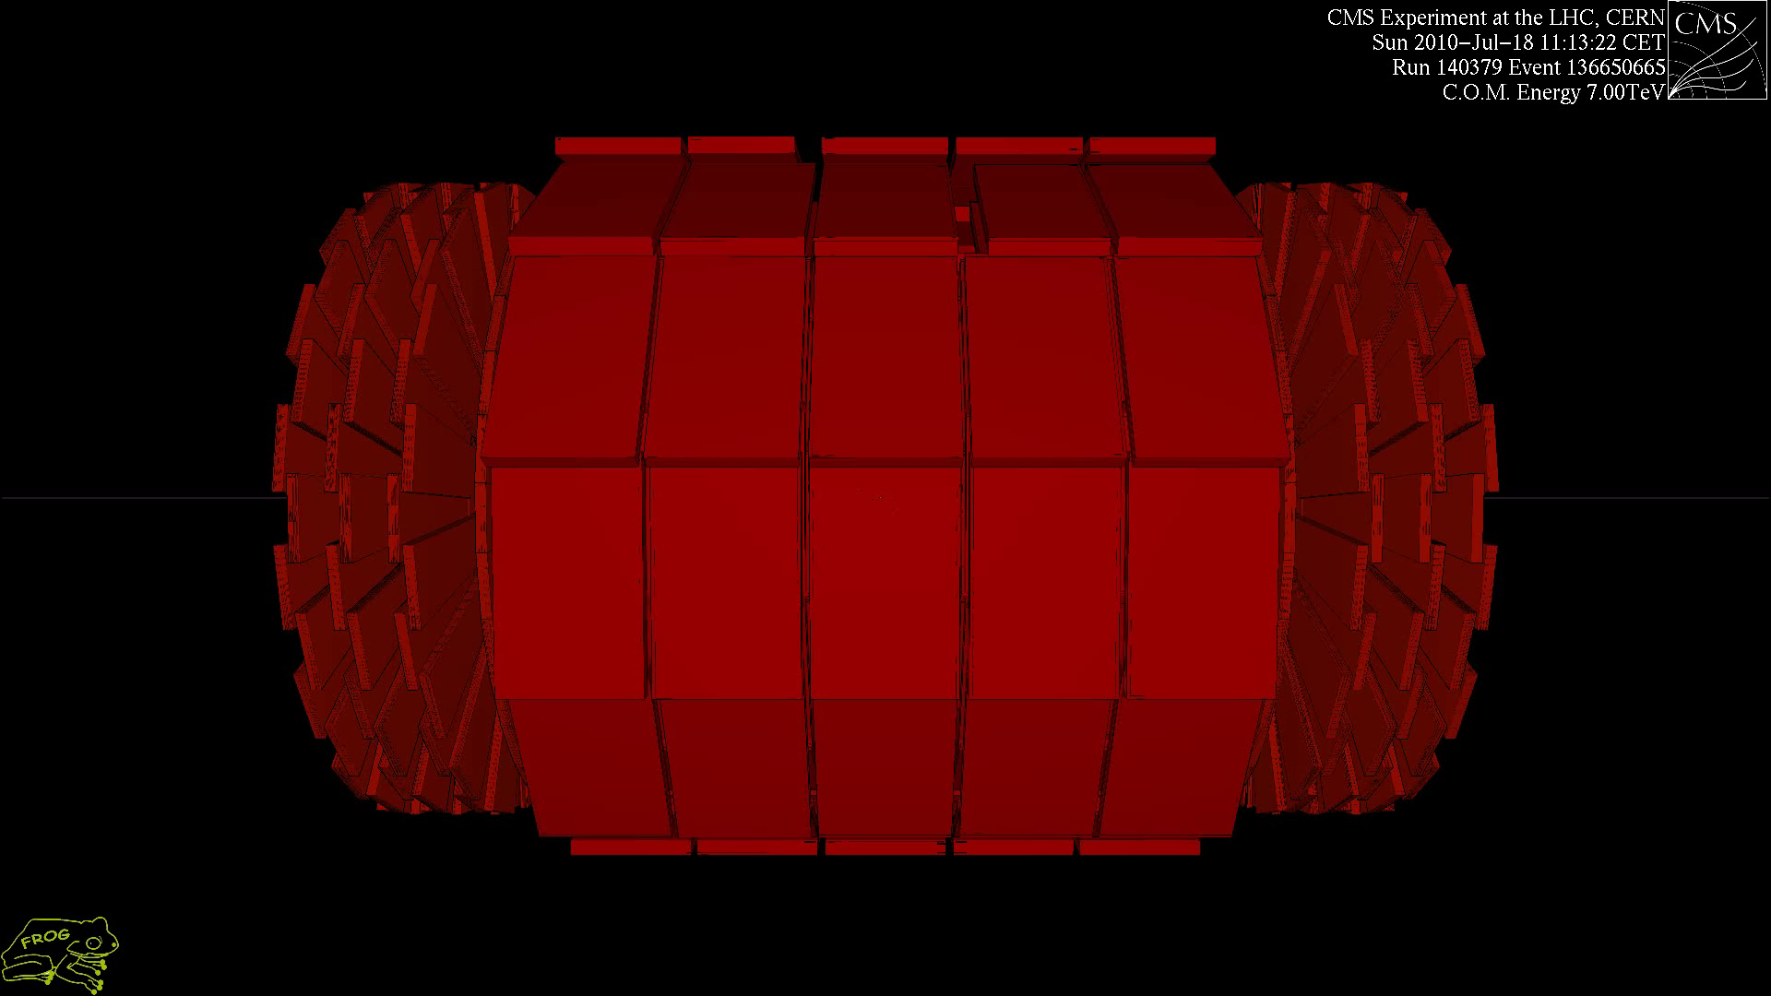

Slide 36
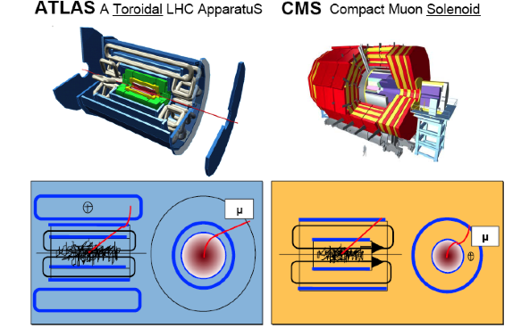
General Purpose Detectors at LHC
In total about
~100 000 000 electronic channels
Each channel checked
20 000 000 times per second (collision rate is 20 MHz, 40 MHz soon)
Amount of data of just one collision
~1 000 000 Bytes
Trigger (online event selection)
Reduce 20 MHz collision rate to ~300 Hz data recording rate
Readout to disk
Few 100 collisions/sec ⇒ petaBytes of data/year

Slide 37
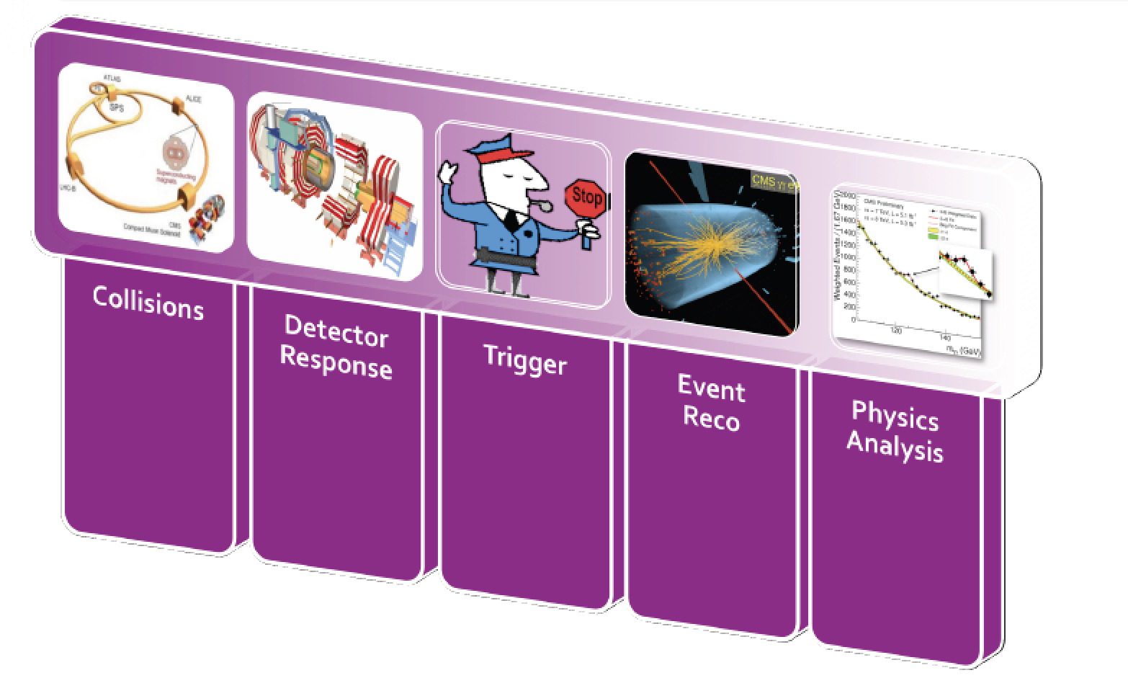
From Collisions to Papers…

Slide 38
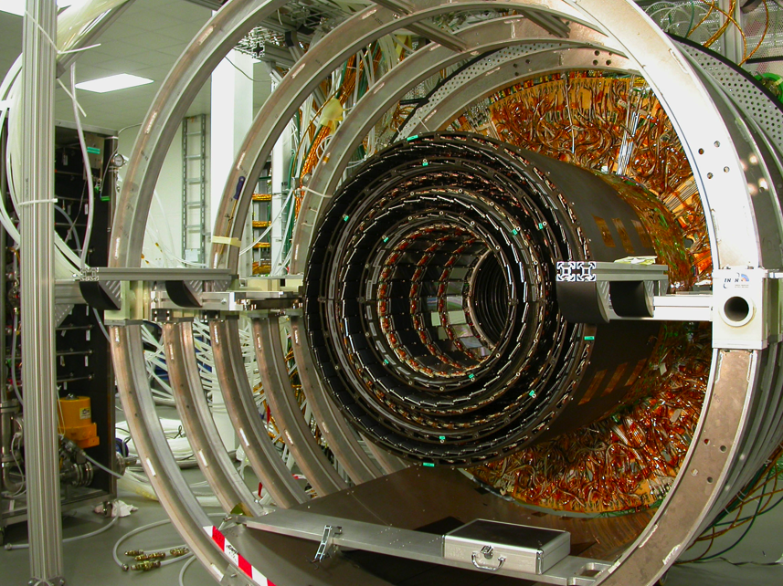
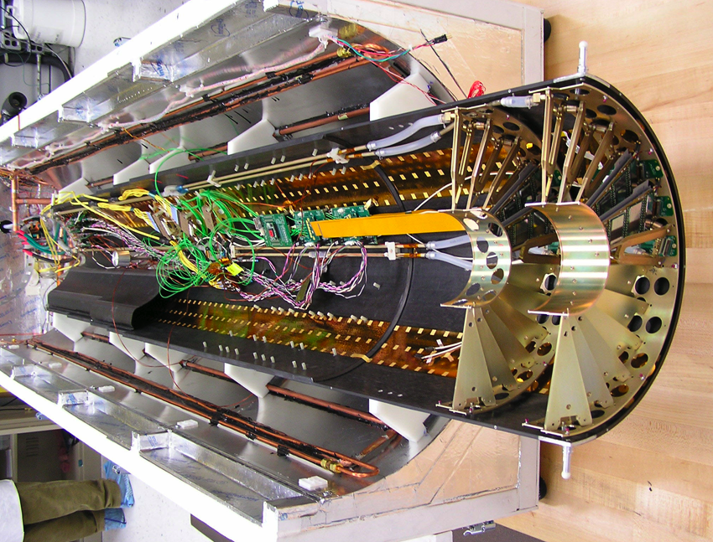
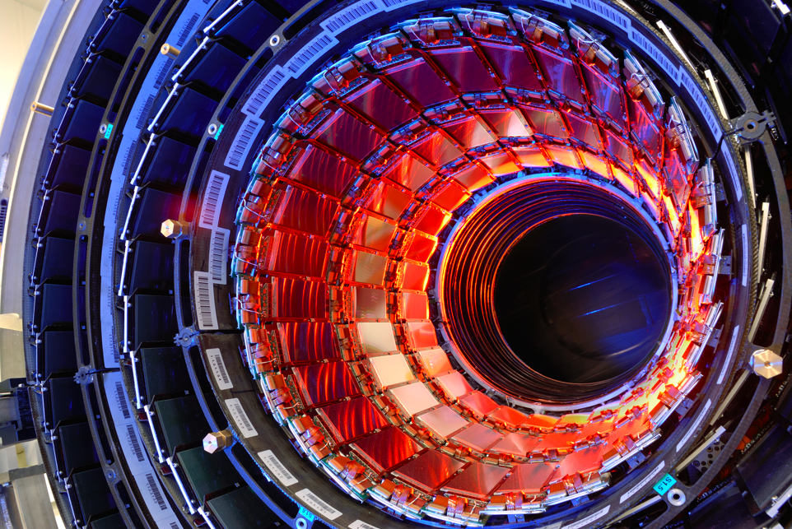
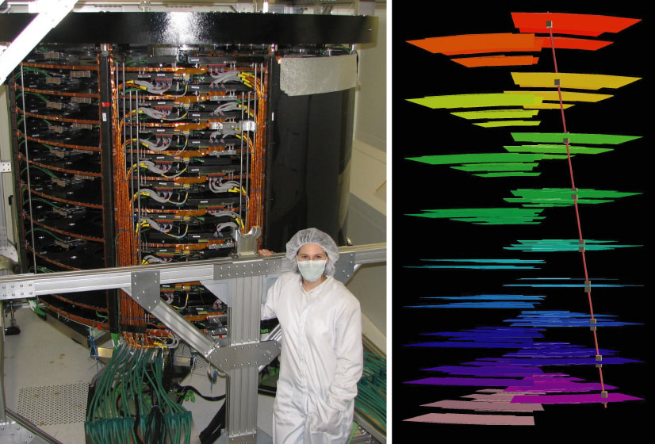
Example: CMS Central Tracker
Silicon strip Detector
Pixel Detector
200 m² silicon strip detectors
(~ tennis court)
~ 10⁷ read-out channels
70 million pixels for pixel detector

Slide 39
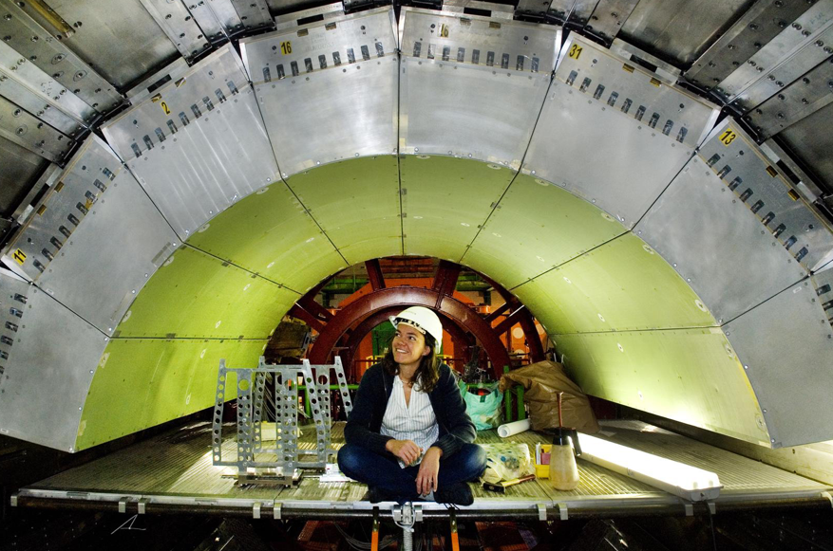
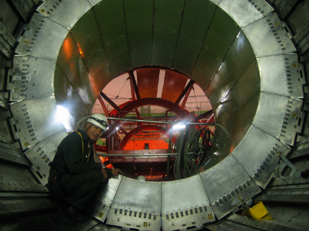


Example: The CMS Calorimeters
ECAL: Barrel 36 super modules/1700 crystals
Endcaps detectors completed in summer 2008
Total of ~70000 crystals for this detector
Lead tungstanate.
Transparent like glass
Heavy as lead!!
Central ECAL installation in CMS
Hadronic Calorimeter (brass/scintillator) completed in 2006
Lowering in the experimental hall

Slide 40
Calorimeter Resolution: eg. Higgs
Excellent energy resolution of EM calorimeters
for e/γ and of the tracking devices for μ in
order to extract a signal over the backgrounds.
Example : H →γγ
H → γγ bad resolution
N_{S}= signal events
N_{B}= background events
H → γγ good resolution
1-2% for CMS
background from
pp →γγ
m_{γγ}

Slide 41


Slide 42

Example : CMS Muon Detectors
250 Drift tube chambers
172,000 channels
468 Cathode strip chambers
500,000 channels
912 Resistive plate chambers
160,000 channels
Total area ~ 6000 m² ie like a
football field

Slide 43

Muon Measurement

Slide 44

CMS before closure

Slide 45

Event Filtering: the Trigger System
Bunch crossing rate is 20 MHz Event size ~1 Mbyte
2007 technology (and budget) allows only to write a few 100 Hz
of events to tape
need a factor ~10⁵ online filtering!!
lost forever!!
written to disk for
offline analysis
The event trigger is one of the biggest challenges at the LHC
⇒ Based on hard scattering signatures: jets, leptons, photons,
missing E_{T},…

Slide 46

Trigger in Detail
Somewhat outdated numbers here

Slide 47

The LHC Data Challenges
Experiments were anticipated to produce about 15 Million Gigabytes of data each year (~20 million CDs!)
The total volume in eg ATLAS is 5 billion detector events and several billion Monte Carlo events amounting to 100 Million Gigabytes of data in 3 years
LHC data analysis requires a computing power equivalent to >100,000 of today's fastest PC processors
=> Requires many cooperating computer centres, as CERN can only provide ~20% of the capacity
GRID Computing
Notes:
46

Slide 48




Object Reconstruction: Examples
Tracker
Energies
Missing E_{T}
Charged particles
ECAL
Muons
Photons
Important! Experiments are not like Monte Carlo Generators: often no unique
assignment of particle type/fakes/backgrounds!!

Slide 49

Global Event Reconstruction
Using all information of the detector together for optimal measurement
Adapted in CMS

Slide 50


B-quark Tagging
Generally: look for jets with displaced vertices (or leptons) from B-meson decays

Slide 51

Tau-finding
Hadronic tau decays are narrow low multiplicity ‘jets’
All di-tau final states used in Higgs search

Slide 52



Operation of the experiments
LHC: pp collisions Luminosity:
5 fb⁻¹ @ 7 TeV
20 fb⁻¹ @ 8 TeV
CMS: sub-detector operation
ATLAS: sub-detector operation efficiency in 2012

Slide 53



The LHC Detectors are Major Challenges
• CMS/ATLAS detectors have about 100 million read-out channels
• Collisions in the detectors happen every 25/50 nanoseconds
• ATLAS uses over 3000 km of cables in the experiment
• The data volume recorded at the front-end in CMS is 1 TB/second
equivalent to the 2008 world wide communication network traffic
• Data recorded during the 10-20 years of LHC life will be about all the
words spoken by mankind since its appearance on earth
• A worry for the detectors: the kinetic energy of the beam is that of
a small aircraft carrier of 10⁴ tons going 20 miles/ hour
>200 m² of silicon
ATLAS pixel detector
CMS silicon tracker

Slide 54
Other Experiments at the LHC

Slide 55



LHCb: Bottom and Charm Physics

Slide 56


ALICE: Heavy Ion Physics at the LHC

Slide 57




A Few Smaller Experiments: TOTEM & LHCf
TOTEM: measuring the total, elastic and
diffractive cross sections
Add Roman pots (and inelastic telescope)
to CMS interaction regions (200 m from IP)
Common runs with CMS planned
TOTal and Elastic cross
section Measurement
LHCf: measurement of
photons and neutral pions
in the very forward region
of LHC
Add a EM calorimeter at
140 m from the Interaction
Point (of ATLAS)
Connection with
cosmic rays

Slide 58





MoEDAL: Monopole and Exotics Detector at the LHC
Heavy particles which carry “magnetic charge”
Could eg explain why particles have “integer
electric charge”
Direct Monopole
production
Remove the sheets after some
running time and inspect for ‘holes’

Slide 59
Summary: Challenges@ LHC
High event rate and pile-up
  High granularity: typically 10x more channels compared to detectors before the LHC
Timing/synchronization of 10⁸ channels is non trivial
Event size (> 1 Mbyte)/Computing
  Limit event rate to a few 100 Hz, use the Grid
Trigger reduce event rate from 40MHz to 100 Hz
  Multi-layered trigger system and pipelined electronics
Detectors need excellent hermeticity (missing E_{T}), lepton identification, B & Tau identification, jet measurements…
Detectors must be radiation hard and reliable for ~ 10-20 years…
We have these detectors: Let’s look at measurements in Lecture II

