Slide 1



Experimental Particle Physics at the
LHC: Beyond the Standard Model
Albert De Roeck
CERN, Geneva, Switzerland
Antwerp University Belgium
UC-Davis California USA
IPPP, Durham UK
BUE, Cairo, Egypt
21th January 2015

Slide 2
Lecture Plan
Overview of the 4 lectures in the next days
Lecture 1: Introduction to Experimental Particle Physics at the LHC
Lecture 2: Measurements and test of the Standard Model
Lecture 3: The Higgs Boson
Lecture 4: Searches beyond the Standard Model at the LHC

Slide 3
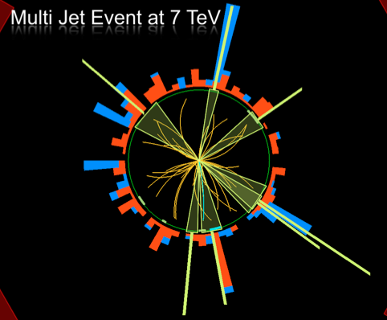
Outline Lecture IV
Search for Physics Beyond
the Standard Model
Search for Exotica
Search for Supersymmetry
The dark matter connection
Summary

Slide 4
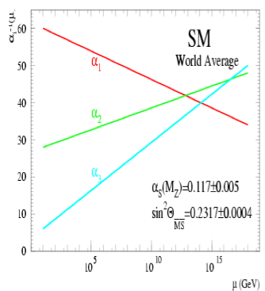
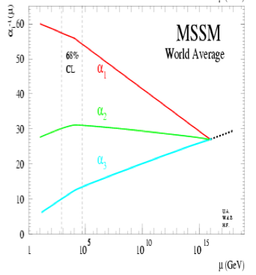
Physics case for new High Energy Machines
Understand the mechanism Electroweak Symmetry Breaking
Discover physics beyond the Standard Model
Reminder: The Standard Model
- tells us how but not why
3 flavour families? Mass spectra? Hierarchy?
- needs fine tuning of parameters to level of 10⁻³⁰ !
- has no connection with gravity
- no unification of the forces at high energy
- Supersymmetry
- Extra space dimensions
Many other ideas: More symmetry and gauge bosons,
L-R symmetry, quark & lepton substructure, Little Higgs models,
Technicolor, Hidden Valleys, 4th generation…
Most popular extensions since 2000
Higgsless models somewhat disfavoured these days

Slide 5
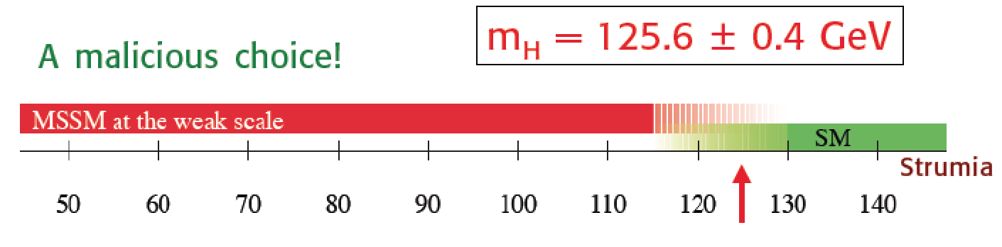

A Higgs…
Guido Altarelli
Stockholm Nobel Symposium
May 2013
We do not understand why the mass of the Higgs is 125 GeV
It most likely tells us something on what is Beyond the Standard Model

Slide 6
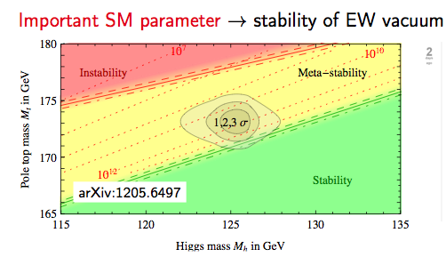
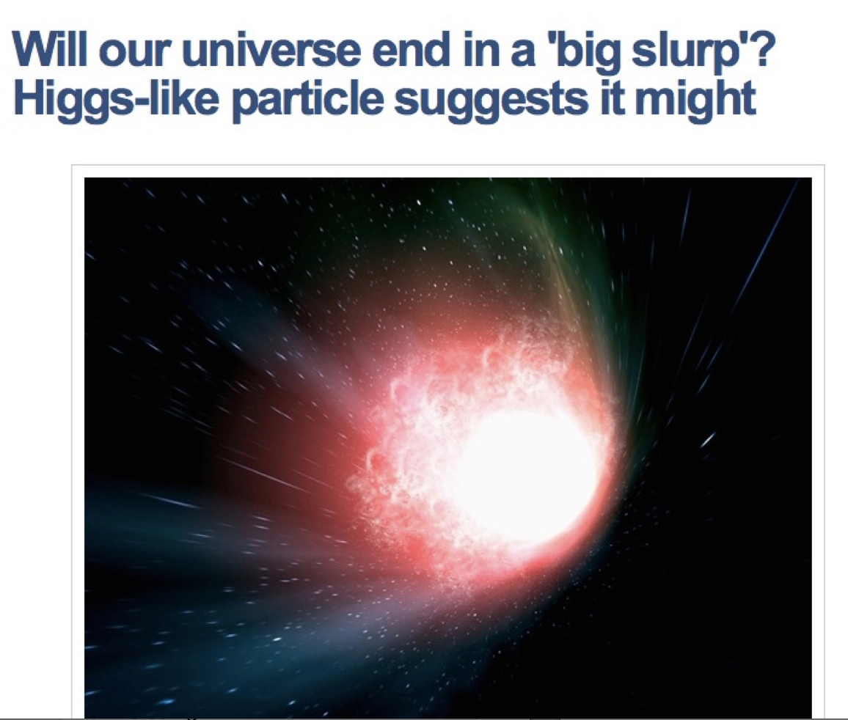
Consequences for our Universe?
Precise measurements
of the top quark and
first measurements of the
Higgs mass:
Our Universe meta-stable ?
Will the Universe disappear
in a Big Slurp? (NBCNEWS.com)
New Physics inevitable?
But at which scale/energy?

Slide 7
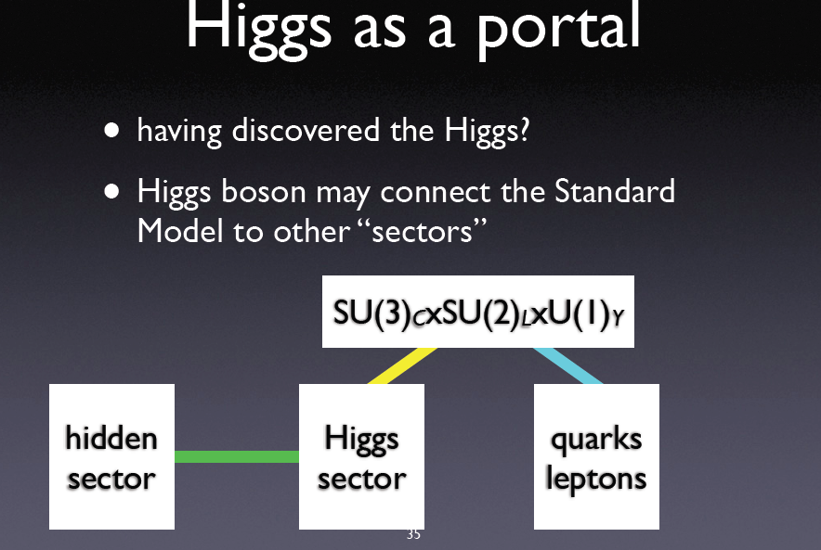
So, what is Next?
The work is not over yet: Many questions still remain unanswered:
•Is it THE Standard Model Higgs boson or a messenger of New Physics ?
•How can we explain a Higgs mass ~ 126 GeV? What stabelizes the mass?
•What explains the mass pattern of the particles that we observe?
•What is Dark Matter and Dark energy? Supersymmetry at higher masses??
•Where is the antimatter in the Universe? How did it disappear??
Need for precision measurements with ~100x the present statistics
LHC upgrade ! Experiment upgrades!! (Other machines?)

Slide 8
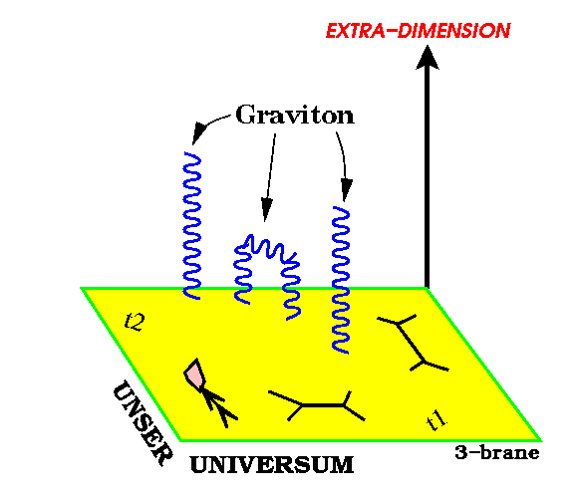
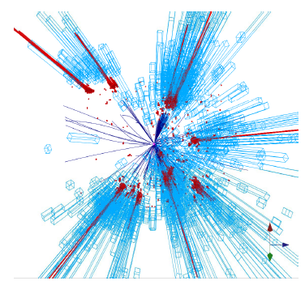
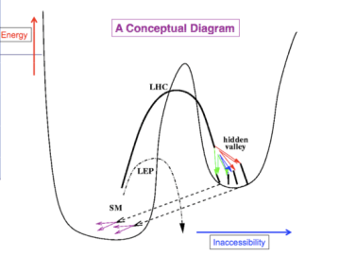
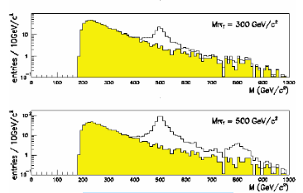
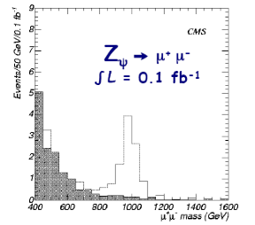
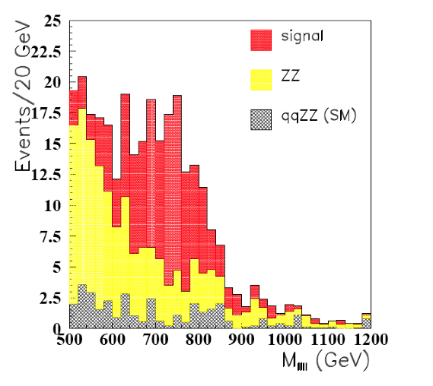
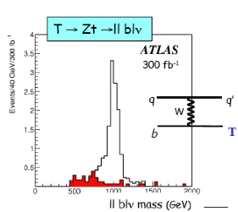
New Physics?
New Gauge Bosons?
Supersymmetry
ZZ/WW resonances?
Technicolor?
Little Higgs?
Extra Dimensions?
Hidden Valleys?
Black Holes???
What stabelizes the Higgs Mass? Many ideas, not all viable any more
A large variety of possible signals. We have to be ready for that
Notes:
7

Slide 9
Exotica
Search for physics beyond the Standard Model.
Looking for something weird and unexpected in the data.
Wide range of possibilities with relative little guidance. Many models and possible phenomena.
Unlike for Higgs or Supersymmetry
  No Exotica hunter’s guide to show you the way
  No SUSY map of parameter space to show you the incremental progress with each search
Instead a wide variety of searches used. Will give examples of that to show the spectrum

Slide 10
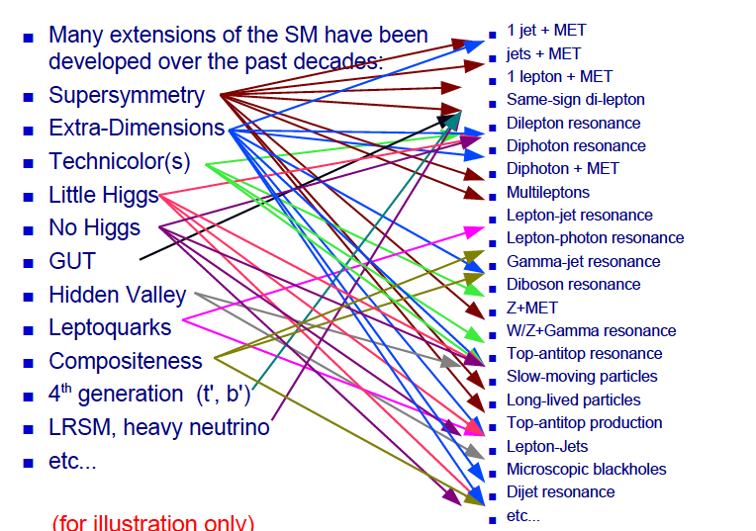
Beyond the SM Signatures

Slide 11
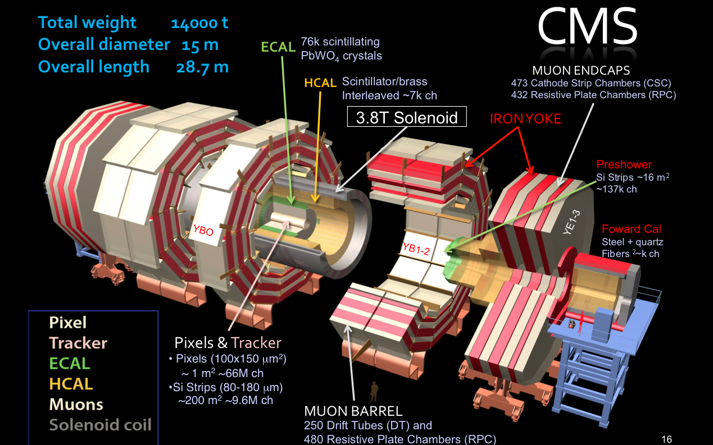
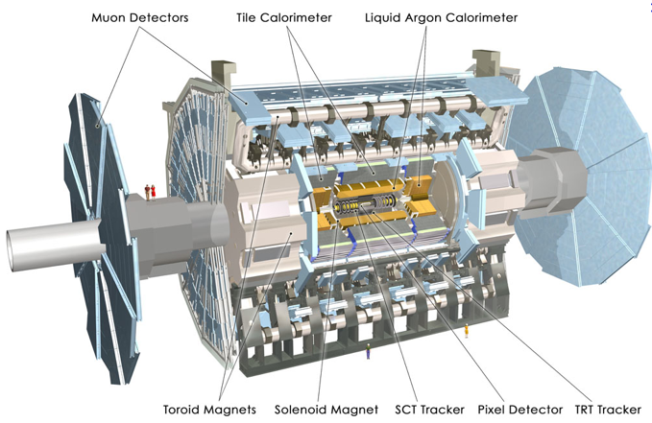
LHC BSM^{(*)} Hunting Detectors
(*) Beyond the Standard Model
The CMS Experiment
Examples from these experiments
The ATLAS Experiment
Also LHCb via eg B_{s}-> μμ
and other precision flavor tests

Slide 12
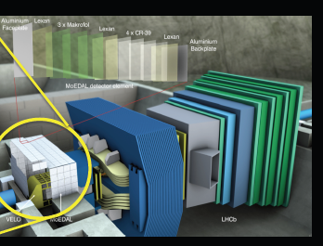
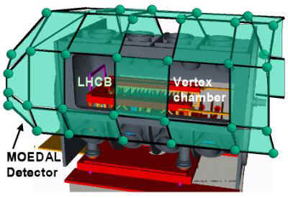
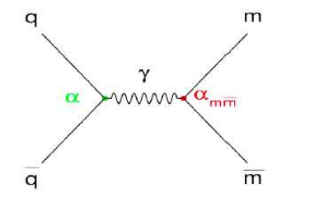
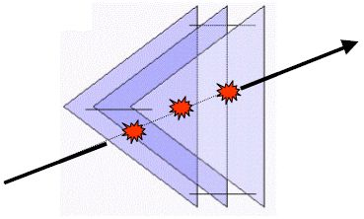
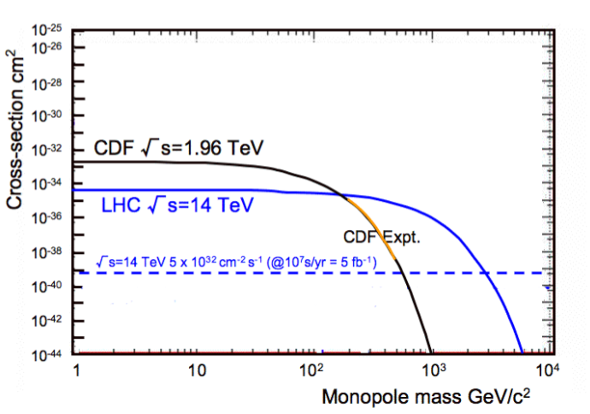
MoEDAL: Monopole and Exotics Detector at the LHC
Heavy particles which carry “magnetic charge”
Could eg explain why particles have “integer
electric charge”
Direct Monopole
production
Remove the sheets after some
running time and inspect for ‘holes’
Monopoles also a topic in CMS/ATLAS

Slide 13



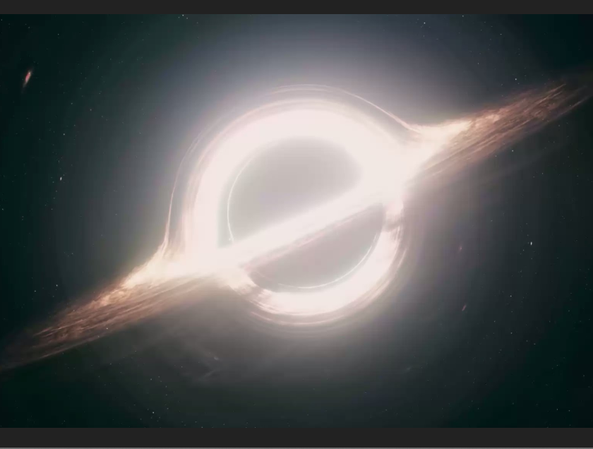
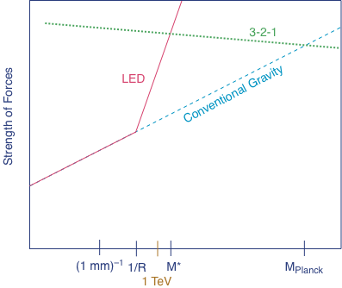

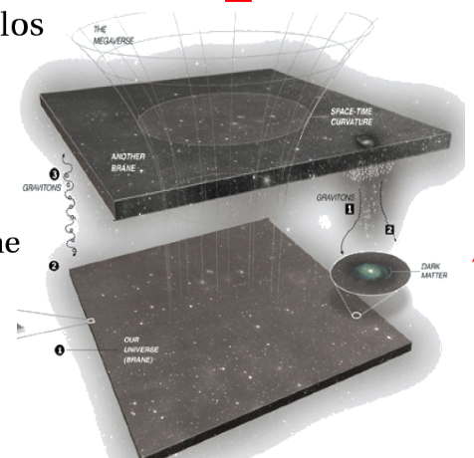
Extra Space Dimensions
Problem:
Interstellar
The Gravity force becomes strong!

Slide 14
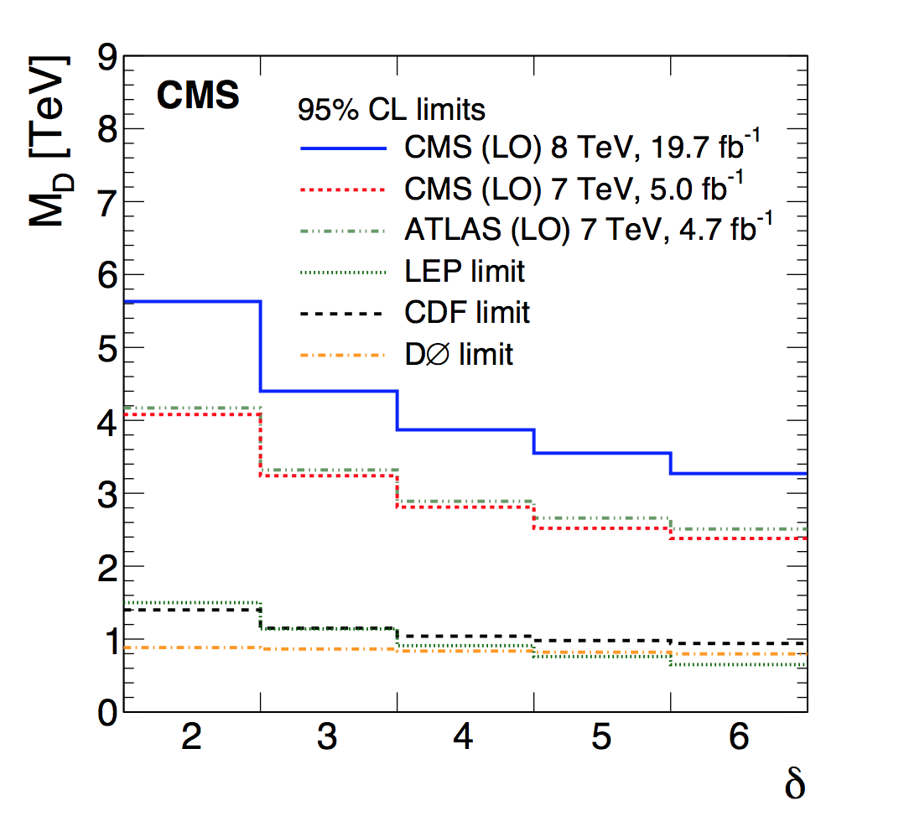
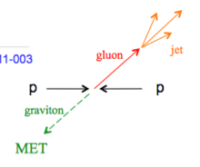
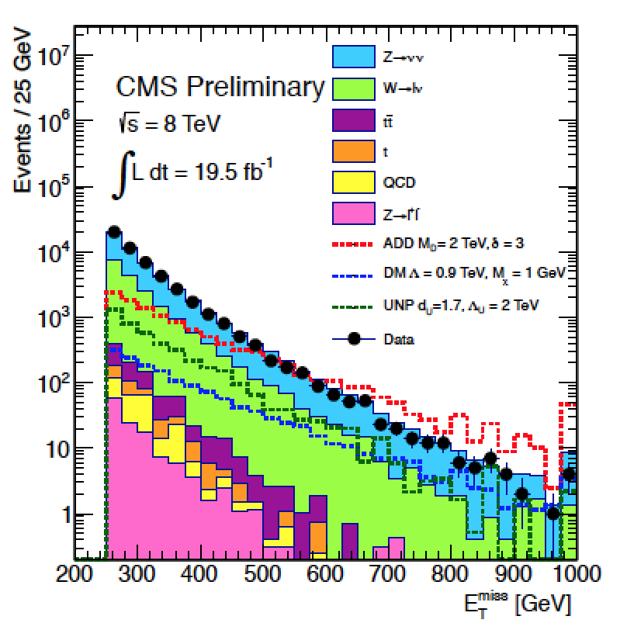
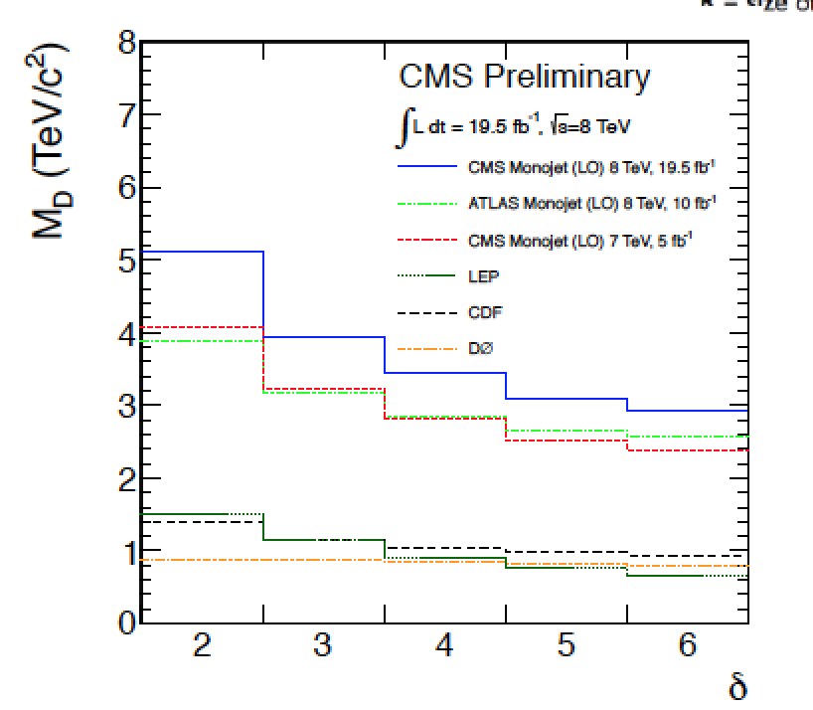
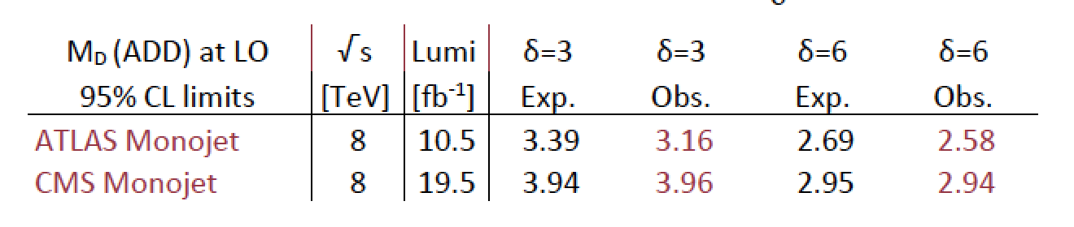
Search for Large Extra Dimensions
Mono-jet final state +Missing E_{T} (ADD)
Limits on M_{D}
between
3 and 4 TeV
arXiv:1408.3583
p_{T} jet > 110 GeV
MET > 200 GeV
Lower limit on the Planck Scale
versus number of extra dimensions

Slide 15
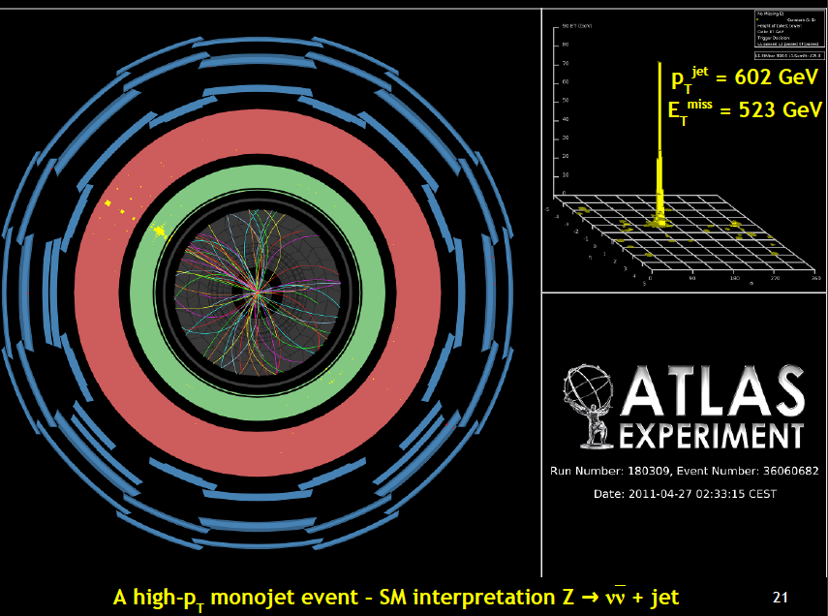
A High p_{T} Mono-jet event

Slide 16
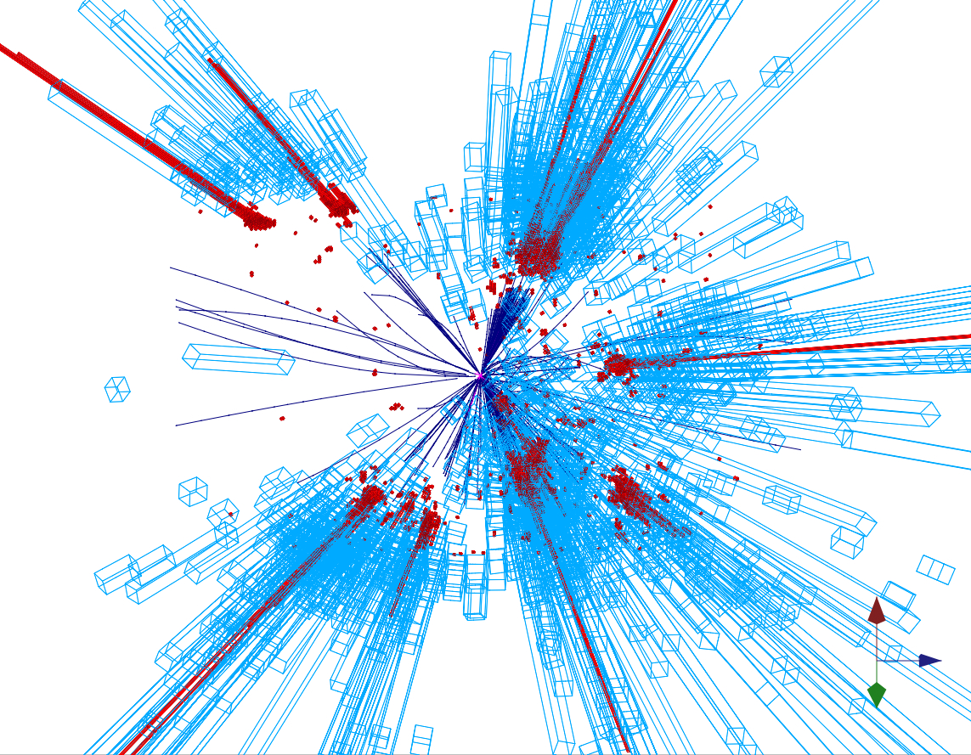
Quantum Black Holes
Schwarzschild radius
Landsberg, Dimopoulos, Giddings, Thomas, Rizzo
4-dim., M_{gravity}= M_{Planck} :
R_{s} → << 10⁻³⁵ m
R_{s} → ~ 10⁻¹⁹ m
4 + n-dim., M_{gravity}= M_{D} ~TeV:
Since M_{D} is low, tiny black holes
of M_{BH} ~ TeV can be produced if
partons ij with √s_{ij} = M_{BH} pass at a
distance smaller than R_{S}
R_{S}
Large partonic cross-section : σ (ij → BH) ~ π R_{S}²
σ (pp → BH) is in the range of 1 nb – 1 fb
e.g. For M_{D} ~1 TeV and n=3, produce 1 event/second at the LHC
Evaporates in 10⁻²⁷ sec
Black holes decay immediately by Hawking radiation (democratic evaporation) :
-- large multiplicity
-- small missing E
-- jets/leptons ~ 5
expected signature (quite spectacular …)

Slide 17
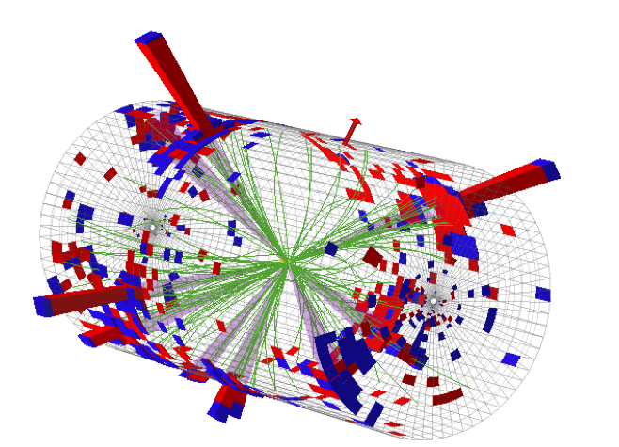
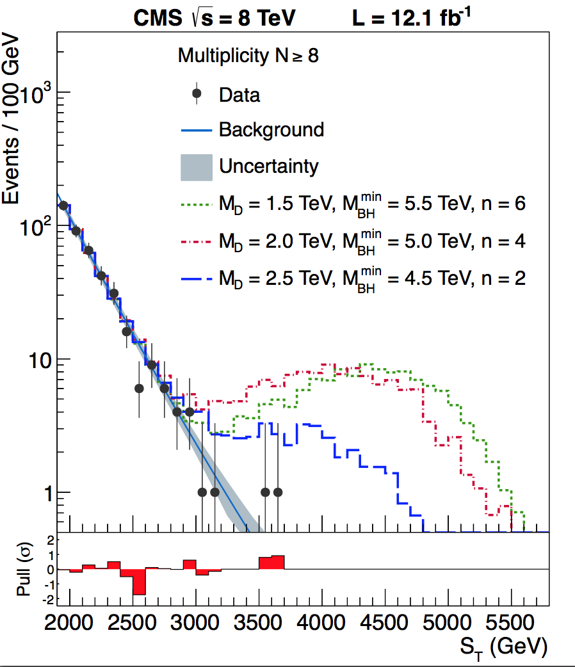
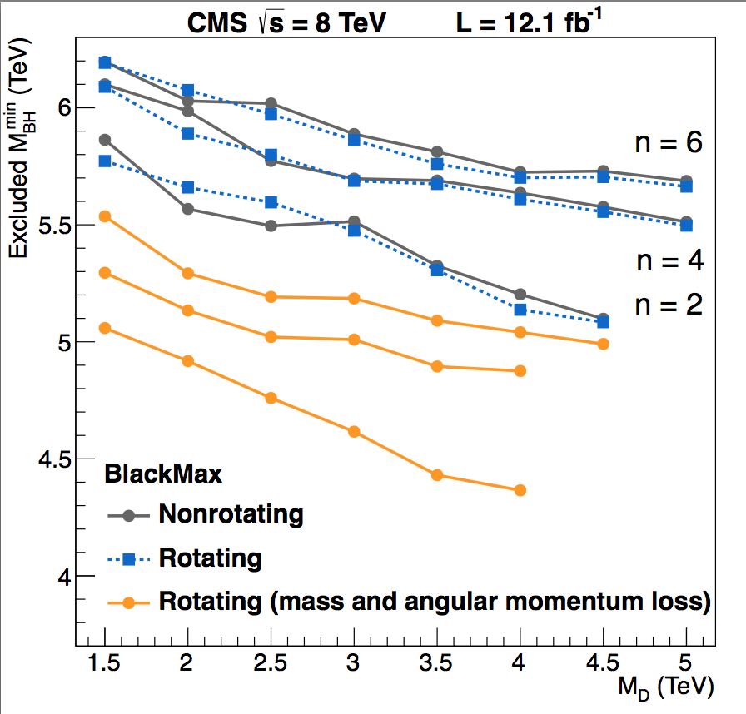
Search for Micro Black Holes
Nice events, eg a 10 jet event
Extra Dimensions!
Planck scale
a few TeV?
arXiv:1202.6396
Look for the decay producs
of an evaporating black hole
•Define S_{T} to be the scalar
sum of all high p_{T} objects
found in the event
•Look for deviations
at high S_{T}
Black hole masses excluded in range below ~5 TeV depending on assumptions

Slide 18
Search for High Mass Resonances

Slide 19
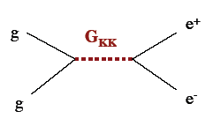

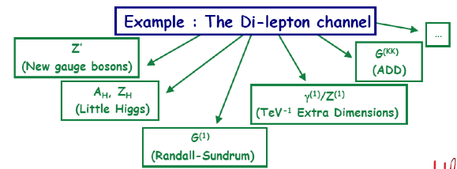
E.g. Di-lepton Resonance
Example
pp→μμ +X
Plot the di-lepton
invariant mass
A peak!!
A new particle!!
A discovery!!
Z’ ?
μ
μ
If we are lucky:
a signal could be
seen very early on

Slide 20

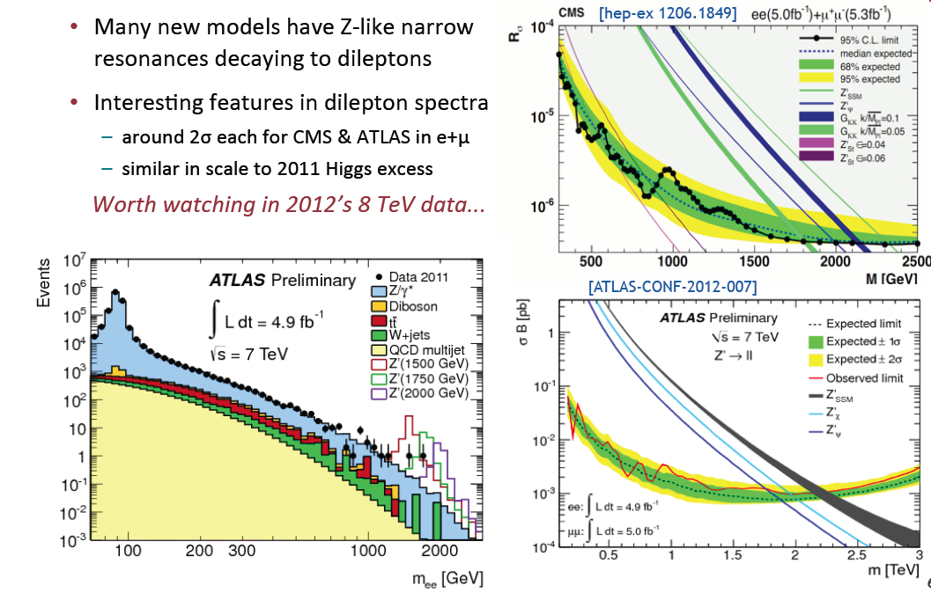
2011: Z’ Boson to ee or μμ?
Extension of the symmetry?
New Gauge bosons?
Mid 2012
Did additional
data confirm
the excess??

Slide 21
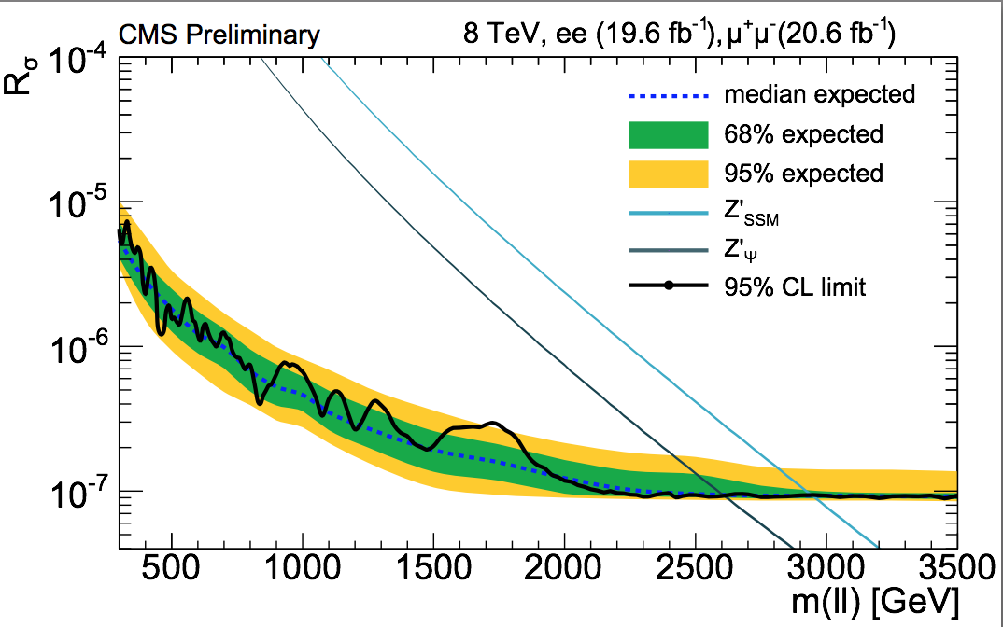
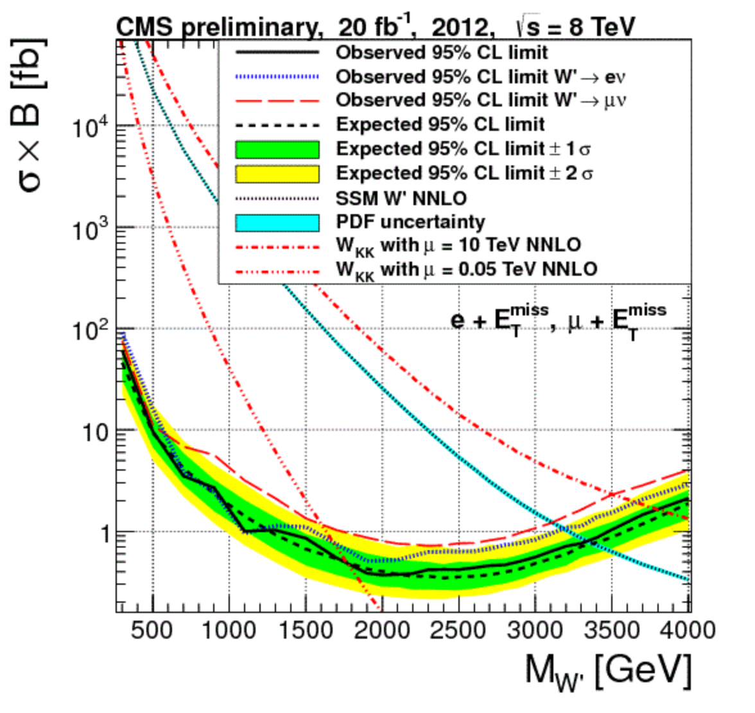
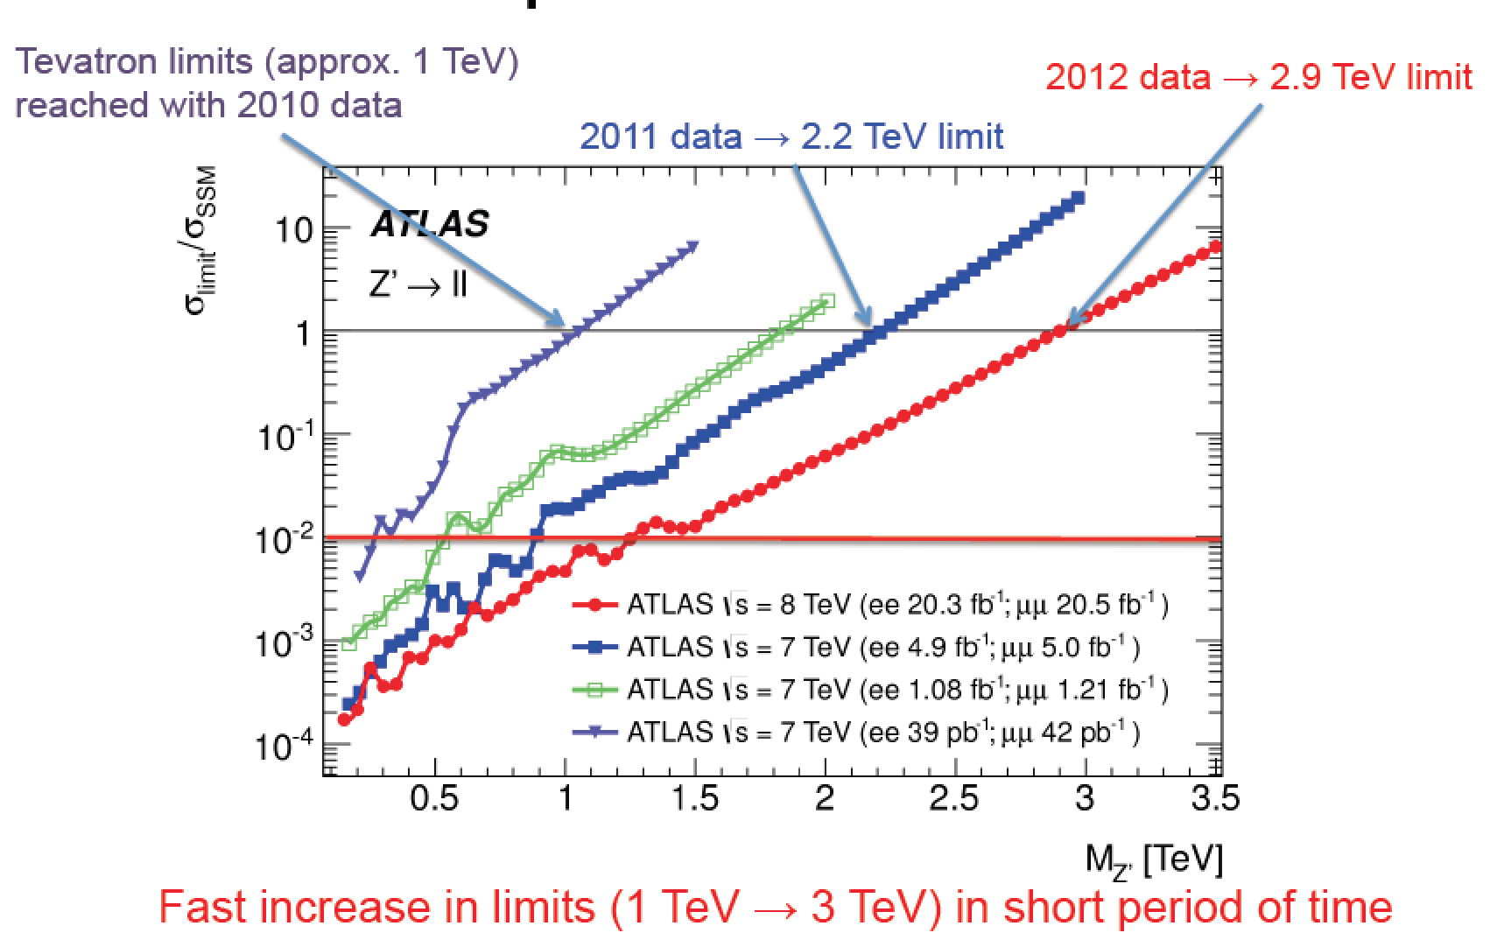
New Gauge Bosons: Z’, W’
Z’
W’
No… ☹
W,’ Z’ Limits are now around 3 TeV

Slide 22
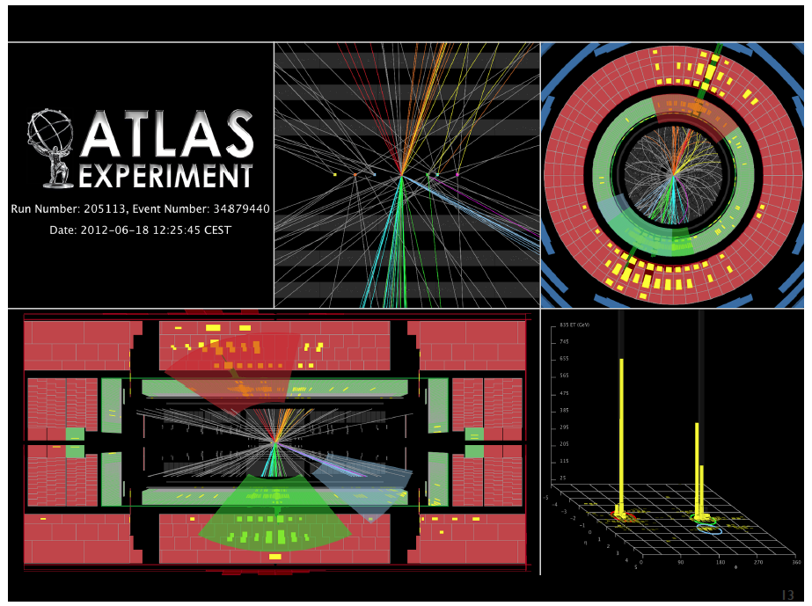
Di-jet Resonances

Slide 23
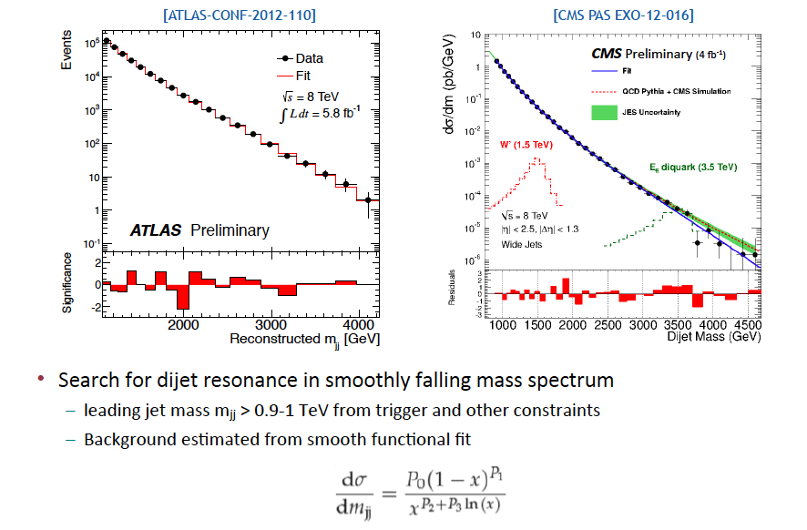
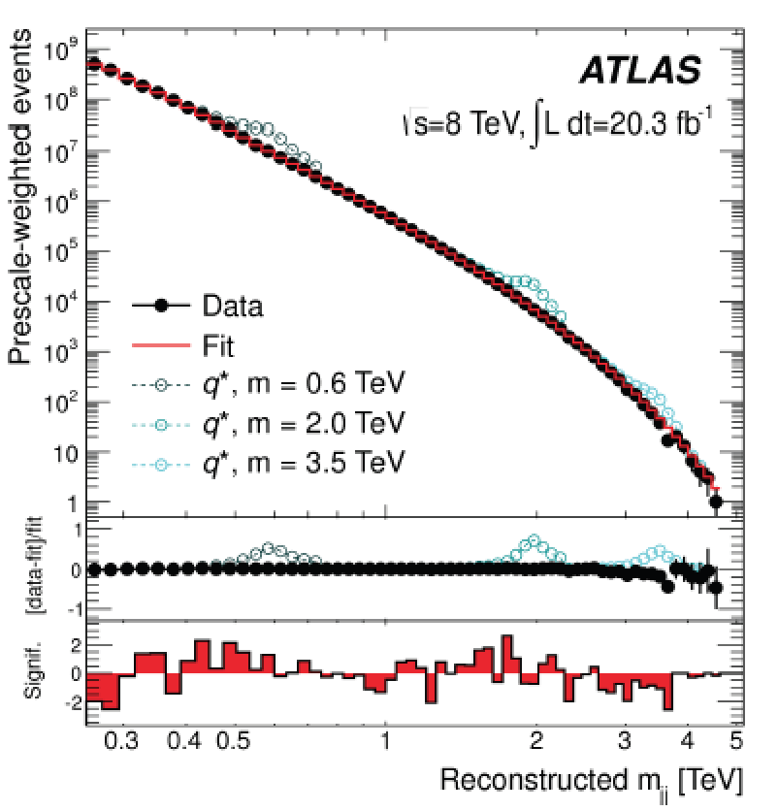
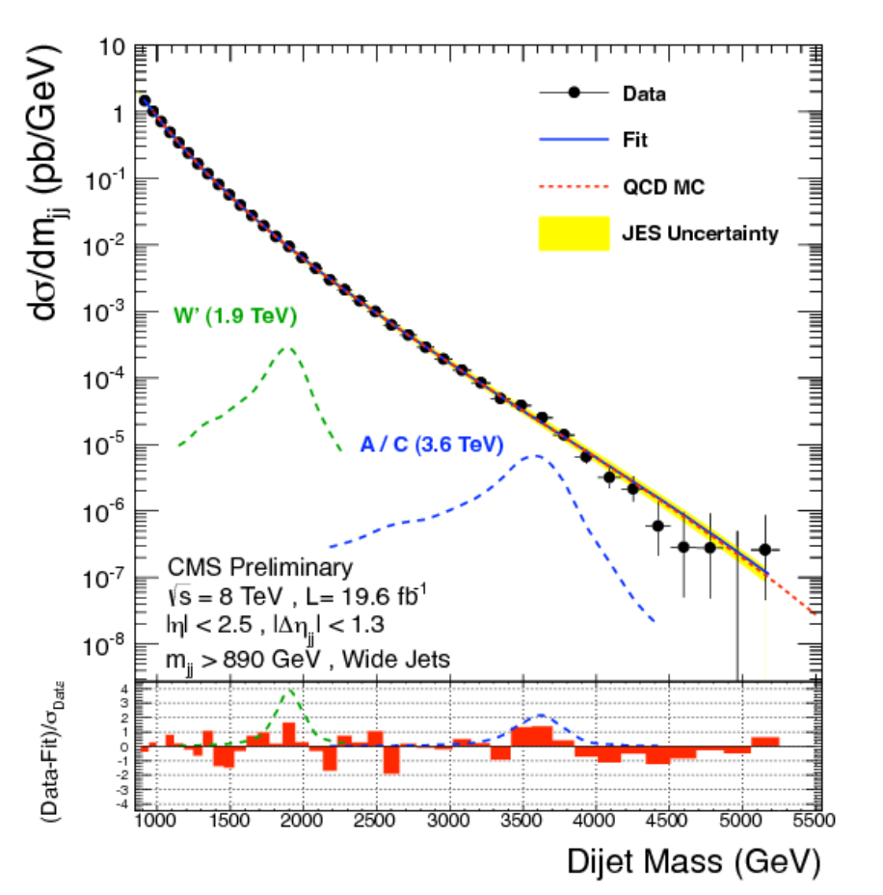
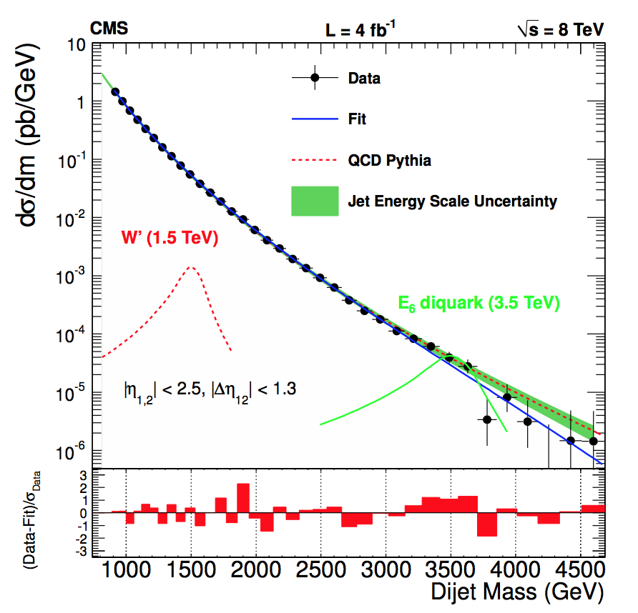
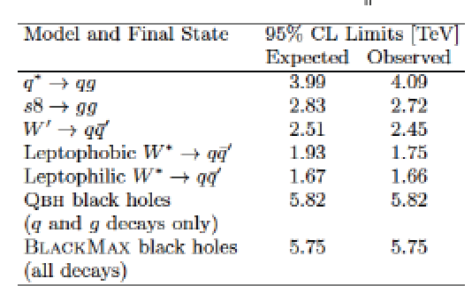
Di-jet Searches
CMS-EXO-12-059
arXiv:1407.1376

Slide 24
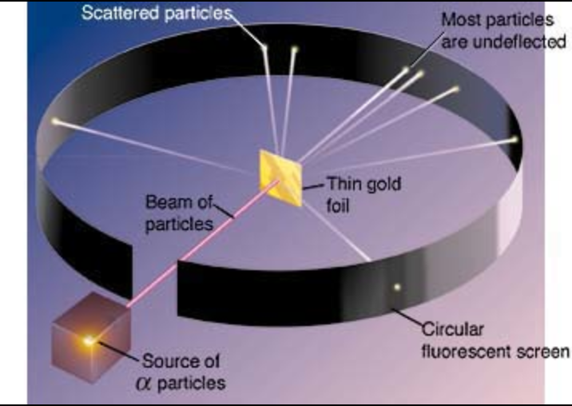

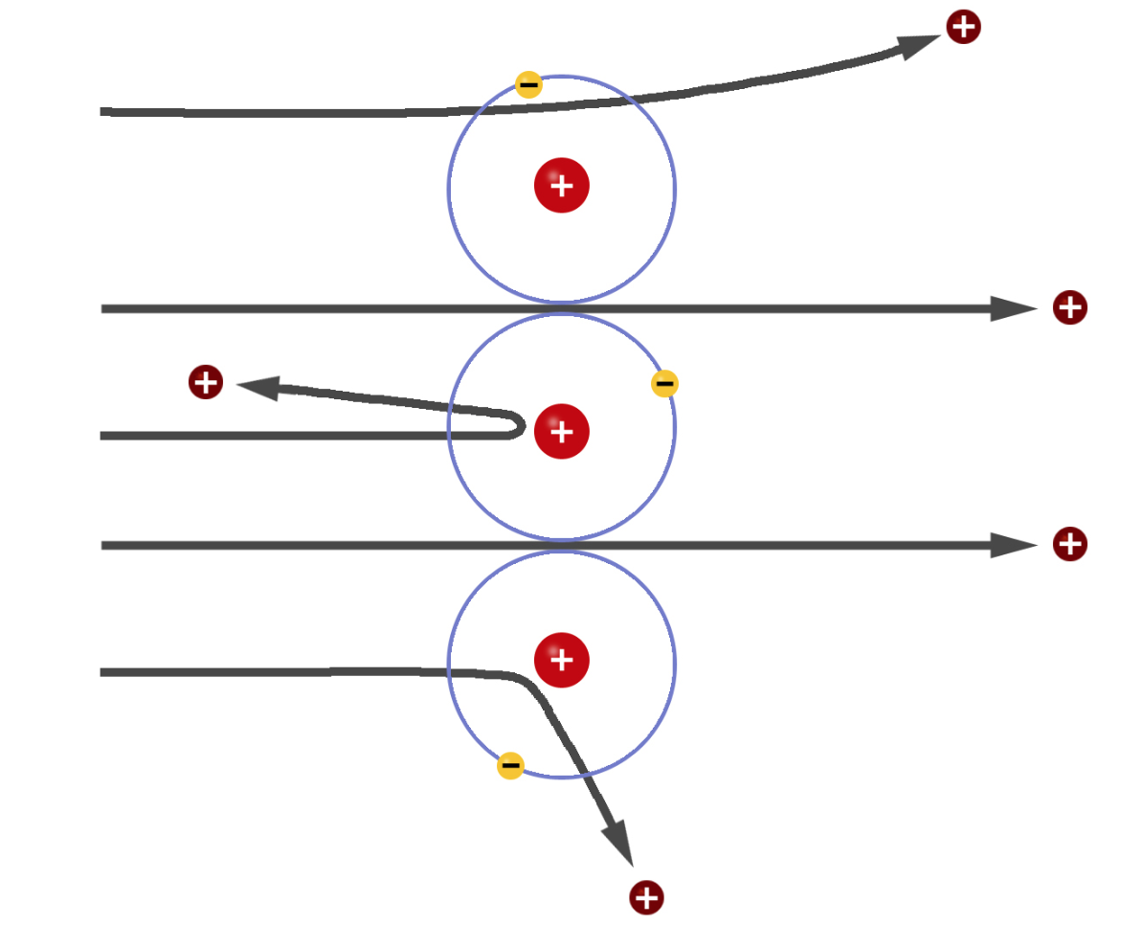
Are Quarks Elementary Particles?
Rutherford experiment:
Unexpected backscattering
of α-particles:
Evidence for the structure
of atoms !! (1911)

Slide 25
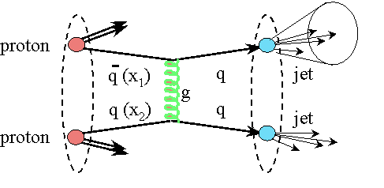




Are Quarks Elementary Particles?
Measurement of the production angle
of the jet with respect to the beam
-> High Energy Rutherford Experiment
Quarks remain elementary particles after these first results

Slide 26




Excited Quark in Dijet Search
invariant mass of 4.69 TeV, and jets with
a jet-p_{T} of 2.29 TeV and 2.19 TeV
arXiv:1407.1376
Limit on the mass of excited quarks > 4.09 TeV at 95% CL

Slide 27




Exotica Searches: Top/Bottom Partners
VLQs: Relevant eg in composite Higgs models

Slide 28



TeV Resonances into Top Quark Pairs
Recent developments in models: a prominent role of top production
light SM fermions live near Planck brane, heavy (top) near TeV brane
decay of Randall Sundrum gravitons into top pairs!!
TeV resonances ⇒ Highly boosted tops
The jets typically appear as ‘fat’ jets
with internal structure
Methods are prepared to tackle the early data

Slide 29


New Physics with Boosted Objects
W,Z and top decays from heavy, typically multi-TeV objects are of special interest at the LHC
•ΔR ~ 2m/p_{T}: decay product merge at large p_{T}
•New techniques developed – and discussed in this
series of topical Workshops- for leptonic and
hadronic decays of W,Z, top…
Eg.: Jet substructure, grooming: mass drop filtering,
trimming, pruning…
ATLAS-CONF-2012-065

Slide 30



Initial Studies: Z’ → tt Search
•Search in the all hadronic decay channel for the tops
•Tops are boosted for high mass Z’, jets merge
•Start from Cambridge-Aachen FAT jets and apply jet pruning to find sub-jets
•QCD background estimate from data (mistag method)
Particle flow an asset for this study!
CMS-EXO-11-006
Exclude KK-Gluons 1<M<1.5 TeV

Slide 31



Top Resonance Study
arXiv:1207.2409
Boosted objects are reconstructed as one fat jet R=1.0, p_{T}> 250 GeV. Analyse the jet substructure
Modified isolation for the leptonic decay side

Slide 32




Search for Heavy Neutrinos and W_{R}
Left-right symmetric extension of the Standard Model
arXiv:1407.3683
Select events with
2 leptons and 2 jets
Large exclusion range
in mass of the W_{R} and
heavy neutrino
Observe a 2.8 sigma
excess in the electron
channel around 2 TeV
W_{R} mass

Slide 33
Real Exotic Objects!

Slide 34
Searches for Unusual Particles
Heavy stable charged particles with unit charge traversing the detector
Heavy stable charged particles with multiple charge traversing the detectors
Heavy stable charge particles with fractional charge traversing the detector
Heavy new particles decaying in the detector
Heavy new particles stuck in the material in or before the detector

Slide 35



Search for Monopoles
arXiv:1207.6411

Slide 36

Stopped Gluinos
Data taken in between accelerator fills!!
Limits up to
800 GeV on
R-hadrons

Slide 37


Heavy Stable Charged Particles
Limits from
0.2 to 1.3 TeV

Slide 38



Beyond the Higgs Boson
Supersymmetry: a new symmetry in Nature?
Candidate particles for Dark Matter
⇒ Produce Dark Matter in the lab
“One day all these trees will
be SUSY phenomenology papers”
SUSY particle production at the LHC
Picture from Marusa Bradac

Slide 39

Why weak-scale SUSY ?
stabilises the EW scale: |m_{F} – m_{B} | < O(1 TeV)
predicts a light Higgs m_{h}< 130 GeV
predicts gauge unification
accomodates heavy top quark
dark matter candidate: neutralino, sneutrino, gravitino, ...
consistent with EW precision tests (discussed yesterday)
Discovering SUSY – A revolution in particle physics!!
Fermion and boson loops cancel,
provided mass ≤ TeV.

Slide 40

Summary: Why SUSY is good for you!!

Slide 41


Detecting Supersymmetric Particles
simulation
Energy produced in the detector
θ
φ
Supersymmetric particles decay and produce a cascade of jets, leptons and missing transverse energy (MET) due to escaping ‘dark matter’ particle candidates
Very prominent signatures in CMS and ATLAS

Slide 42

SUSY Searches: No signal yet to date…
•So far NO clear signal of
supersymmetric particles
has been found
•We can exclude regions
where the new particles
could exist.
•Searches will continue for
the higher energy in 2015
allowed
excluded
Plenty of searches ongoing: with jets, leptons, photons, W/Z,
top, Higgs, with and without large missing transverse energy
Also special searches for contrived model regions
CMS-SUS-11-015

Slide 43

Constrained MSSM: Various Studies
•So far NO clear signal of
supersymmetric particles
has been found
•We can exclude regions
where the new particles
could exist.
•m_{1/2}: universal gaugino
mass at GUT scale
•m₀: universal scalar
mass at GUT scale
allowed
excluded
Plenty of searches ongoing: with jets, leptons, photons, W/Z,
top, Higgs, with and without large missing transverse energy
Also special searches for contrived model regions
CMS-SUS-11-015

Slide 44





Limits on Squarks and Gluinos
Results depend on the topologies studies, assumed mass of the LSP etc.
Popular presentation of data:
Simplified ModelS (SMS)
Examples
Combined limits typically > 1-1.5 TeV on sparticle masses

Slide 45

Electroweakino Searches

Slide 46

What is really needed from SUSY?
End 2011: Revision!
N. Arkani-Ahmed
CERN Nov 2011
Papucci, Ruderman,
Weiler arXiv:1110.6926
LHC data end 2011
Stops > 200-300 GeV
Gluino > 600-800 GeV
Moving away from
constrained SUSY models
to ‘natural’ models
Natural SUSY survived
LHC so far, but we
are getting close to
push it to its limits!

Slide 47


Natural SUSY?
Low mass stops?
Searches for stop quarks are pushing limits now to 700 GeV

Slide 48

Top in SUSY

Slide 49


Summary of SUSY Searches
In short: no sign of SUSY with the data collected so far
https://twiki.cern.ch/twiki/bin/view/CMSPublic/PhysicsResultsSUS
Work ongoing on eg compressed spectra, extended incl. searches, Scharm…

Slide 50

Summary of SUSY Searches
In short: no sign of SUSY with the data collected so far

Slide 51

Summary of Exotica Searches

Slide 52

Searches at the LHC
LHC searches for NP right now: Nothing significant found at present!
However most discoveries start with a hint i.e. less than 3 sigma (standard deviations), or evidence with more than 3 sigma before they become an observation or discovery (more that 5 sigma, like the Higgs)
Any 2-3 sigma effects are of interest to follow up with additional data or check with other channels. They will either grow with luminosity (possible real signal) or get less significant (statistical fluctuation). But no excitement yet…
Some examples ➔

Slide 53

More Searches to Watch…

Slide 54


ATLAS SUSY: Lepton Channels
Study of single and double leptons + jets + MET
•19 channels studies
•One channel has 7 events with expectation
1.6±1.0. Significance is ~ 2.3σ
Two muons with 6<p_{T}<25 GeV, 2 jets +MET
ATLAS-CONF-2013-062
…Also used in the WW anomaly interpretation…

Slide 55

Are we looking at the right place?

Slide 56




A Global View!
Model independent search
•Divide events into exclusive classes
•Study deviations from SM predictions
in a statistical way
CMS-EXO-10-021
ATLAS-CONF-14-006
ATLAS for 20fb⁻¹
Probability distribution as expected
for 35 pb⁻¹ for CMS
→muons, electrons, photons, (b)jets, MET

Slide 57

How does it feel to be a (BSM) Theorist?
H. Murayama
ICFA Seminar October 2011

Slide 58





Dark Matter: The Next Challenge !?!
Astronomers found that most of the matter in the Universe must be invisible Dark Matter
‘Supersymmetric’ particles ?
Vera Rubin ~ 1970
F. Zwicky 1898-1974

Slide 59






The Generic Dark Matter Connection
Searches for mono-jets and mono-photons can be used to search for
Dark Matter (DM)
Use effective theory or better simplified models to relate measurements to Dark Matter studies

Slide 60




Mono-object Searches in CMS
Mono-jets: Generally the most powerful
Mono-photons: First used for dark matter Searches
Mono-Ws: Distinguish dark matter
couplings to u- and d-type of quarks
Mono-Zs: Clean signature
Mono-Tops: Couplings to tops
Mono-Higgs: Higgs-portals
Higgs Decays?
Effective Field Theories for DM
interpretation are under scrutiny!
Alternatives such as SMS proposed…
arXiv:1407.8257
arXiv:1411.0535
Example Monojets
arXiv:1410.8812
arXiv:1408.3583
Dark Matter?

Slide 61
The LHC in 2015 and Beyond…

Slide 62

The LHC Schedule

Slide 63

Physics Program: Key Topics
Properties of the new Higgs boson, precise determination of its characteristics
High mass reach for new particles and interactions
Precision measurements
Rare process

Slide 64


SUSY Prospects @ 2015/2016
Expect ~ 10-20 fb⁻¹ in 2015 & 40 fb⁻¹ in 2016 (present guestimates)
Now 2014
2015-2016
0.5-1 fb⁻¹ would be enough for first analyses entering new territory
We expect that have such a sample by Summer 2015!!

Slide 65



Searches for New Particles in pp
Searches for pair produced SUSY particles
FCC-hh
-Reach sparticle masses
search up to about 20 TeV
for squarks of light quarks
and 6 TeV for stops
-Excited quarks probe the
structure of quarks down to
4x10⁻²¹ m
-Discovery of resonances up
to masses of 40 TeV
Upper limit for higher Higgs
mass in 2HDM models?

Slide 66
Summary: The Searches are on!
The LHC has entered a new territory. The ATLAS and CMS experiments are heavily engaged in searches for new physics. The most popular example is SUSY, but many other New Physics model searches are covered.
No sign of new physics yet in the first 20 fb⁻¹ at 8 TeV with the analyses reported in this lecture.. This starts to cut into the ‘preferred regions’ for a large number of models, like SUSY
More exotic channels are now being covered: monopoles, fractional or multiple charged particles, long lived particles… Still many unexplored channels left to explore
The LHC did its part so far with a great run in 2011 and 2012 Collected about 20 fb⁻¹@ 8 TeV by end of 2012
In 2015 the energy will be 13/14 TeV, excellent for searches
And maybe one day soon:

