Slide 1
Current metrics in Siteview
E. Karavakis
WLCG Monitoring Consolidation
20 June 2014

Slide 2
Introduction to Siteview
Aim is to enable a site administrator to monitor all the activities going on in an easy and fast way
Site’s performance is displayed through a GridMap
Links to the underlying monitoring systems
Mostly used for dissemination purposes; integrated with WLCG Google Earth Dashboard

Slide 3
Metrics
Group metrics in activities
  Site Status, Job Processing and Data Transfers
Evaluation of the site status from the VO perspective
Job processing activity and data transfers

Slide 4
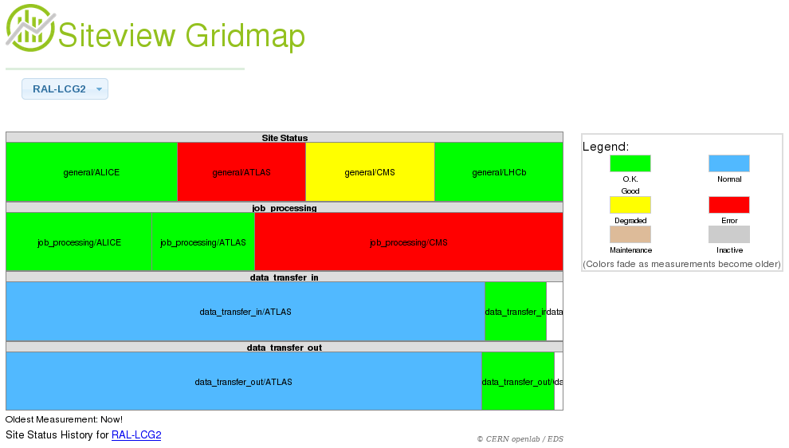

User interface
VO status
Job processing and Data transfers

Slide 5
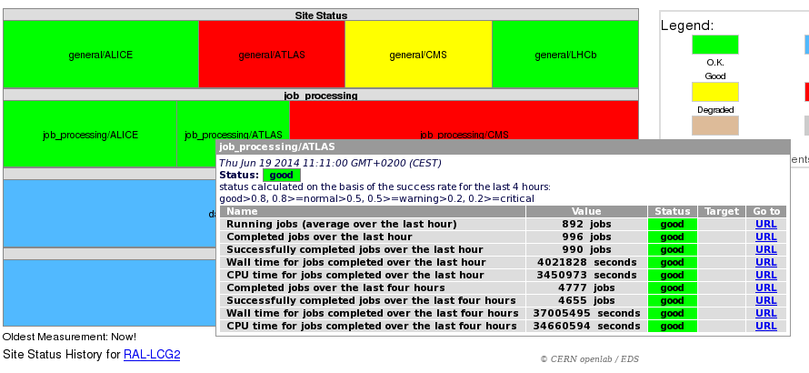
Job-related metrics
Job processing metrics
Direct links to primary info source

Slide 6
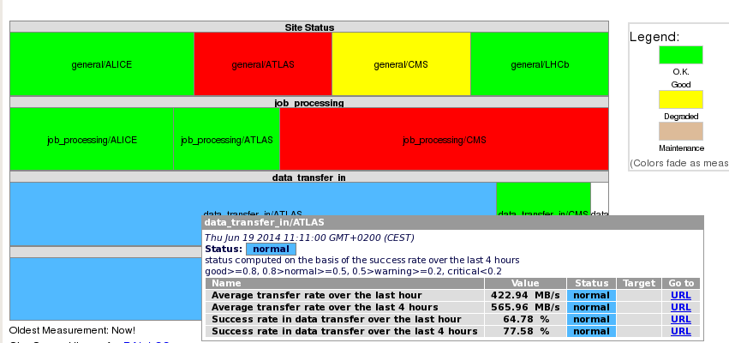
Data-related metrics
Data transfer metrics
Direct links to primary info source

Slide 7
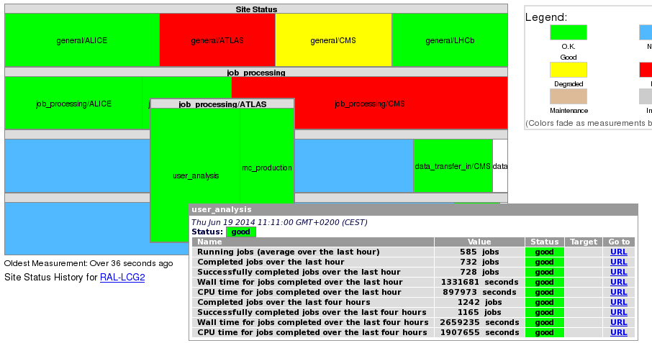
Sub-metrics
Breakdown of metrics & statistics

Slide 8
Information sources
 | ALICE | ATLAS | CMS | LHCb
Site status | MonALISA | SSB Dashboard | SSB Dashboard | SUM Dashboard
Job processing | MonALISA | Jobs Dashboard | Jobs Dashboard | Dirac
Data transfers | MonALISA | DDM Dashboard | PhEDEx | Dirac

Slide 9
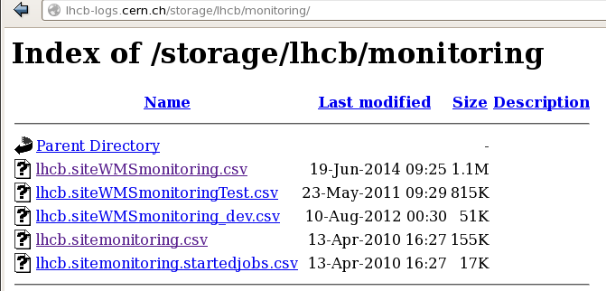
Issues
Metrics are collected every 10 minutes
  Have to maintain a huge database
Metrics are collected in a sliding window
  Should store the metrics in bins
Collecting too many sub-metrics
Source of information
Under-used

