Slide 1

Large Scale Data Projects
Jamie.Shiers@cern.ch
On behalf of the EIROforum IT WG
http://www.eiroforum.org/
CERN, EUROfusion, EMBL, ESA, ESO, ESRF, European XFEL, ILL

Slide 2
Questions ( & Answers )
What are the opportunities wrt data which you see in your work that are relevant to the RDA?
Are any of the first WG results have relevance for your work?
Which RDA groups are working towards solutions that are relevant for your work?
Are there results that you urgently need that you would work towards with others in the RDA?
What are the most efficient + cost-effective solutions in your environment and how might they be relevant to the RDA?
Is cross-border (countries, disciplines, etc.) data exchange and re-use relevant and an issue in your environment?

Slide 3
Project Characteristics
Extremely large data volumes + future growth (EB & beyond);
The distributed nature of the (international) user communities;
Significant computational requirements to process the data;
High network bandwidth / low latency requirements to adequately distribute, collect and / or remotely access the data;
Long (and increasing) project lifetimes (“data preservation”);
The strong desire for “common” solutions = cost effective services + an enabler for data sharing and re-use;
The need – in at least some cases – for highly available services to match the above requirements.

Slide 4
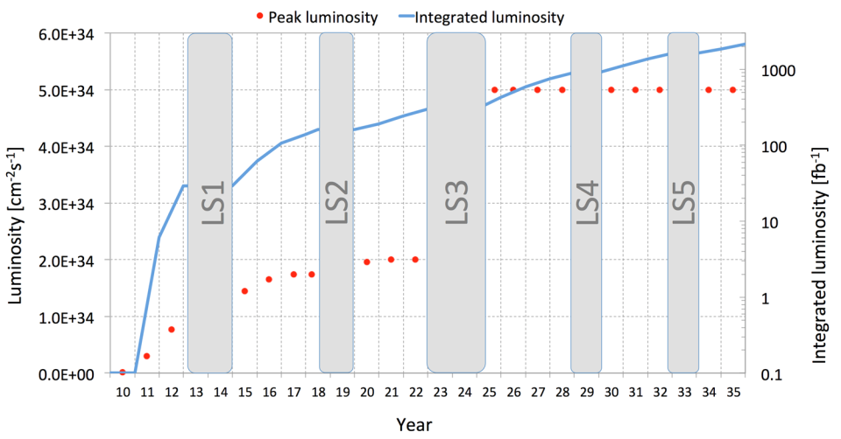
Data: Outlook for HL-LHC @ CERN
PB
0.5 EB / year (2025 – 2035) is probably an under estimate!

Slide 5

Data Preservation plans
The ALICE collaboration is committed to develop a long term program for Data Preservation to serve the triple purpose of
  preserving data, software and know-how inside the Collaboration,
  sharing data and associated software and documentation with the larger scientific community, and
  give access to reduced data sets and associated software and documentation to the general public for educational and outreach activities.

Slide 6
2020 Vision for LT DP in HEP
Long-term – e.g. FCC timescales: disruptive change
  By 2020, all archived data – e.g. that described in DPHEP Blueprint, including LHC data – easily findable, fully usable by designated communities with clear (Open) access policies and possibilities to annotate further
  Best practices, tools and services well run-in, fully documented and sustainable; built in common with other disciplines, based on standards
  DPHEP portal, through which data / tools accessed
    “HEP FAIRport”: Findable, Accessible, Interoperable, Re-usable
Agree with Funding Agencies clear targets & metrics

Slide 7
The Challenge(s)
Reproducibility of results – over long periods of time and changing e-infrastructures
Data Sharing – even with long-ish embargo periods – can translate to significant demands
From Open Access to Open Data to Open Knowledge

