Slide 1
Increase of the T600 maximum drift distance
and
preliminary considerations for larger aluminum vessels
Claudio Montanari
INFN-Pavia, Italy

Slide 2
Foreword
In view of an increase of sensitive mass for the experiment at FNAL, and considering the extremely high LAr purity achieved with the T600 at LNGS, we are evaluating the possibility to increase the actual maximum drift distance of the T600.
This presentation will focus on two technical items:
  The modification of the internal detector mechanics;
  The preliminary evaluation of new aluminum vessels with increased width.

Slide 3
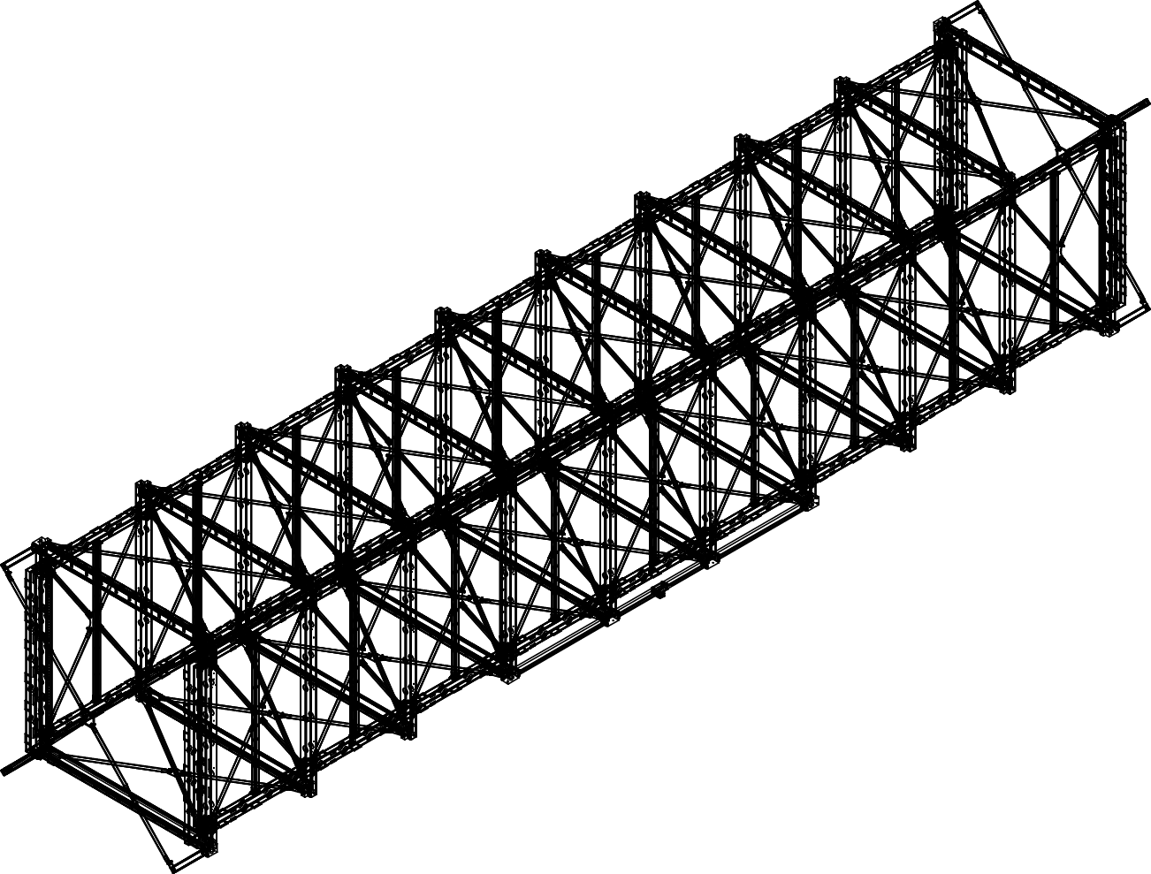
T600 TPC support structure
Fixings between the wires chambers
and the structure supporting race-tracks
and cathode
Wires chambers
There is a total of 10 fixings on the top and 10 on the bottom between the wires chamber structure and the structure of race tracks and cathode.
Other 4 fixings are at the corners.
Fixings at the corners

Slide 4
Wires chambers fixings
Detail of the fixing between the race-tracks /cathode and wires chamber
Race-tracks
Wire chamber
Pin 10x30 UNI 1707 (2x)
Screw M12x35 UNI 5931 (6x)
Detail of the fixing of wires chamber at the corners
Wire chamber
Screw M14x35 UNI 5931 (4x)

Slide 5
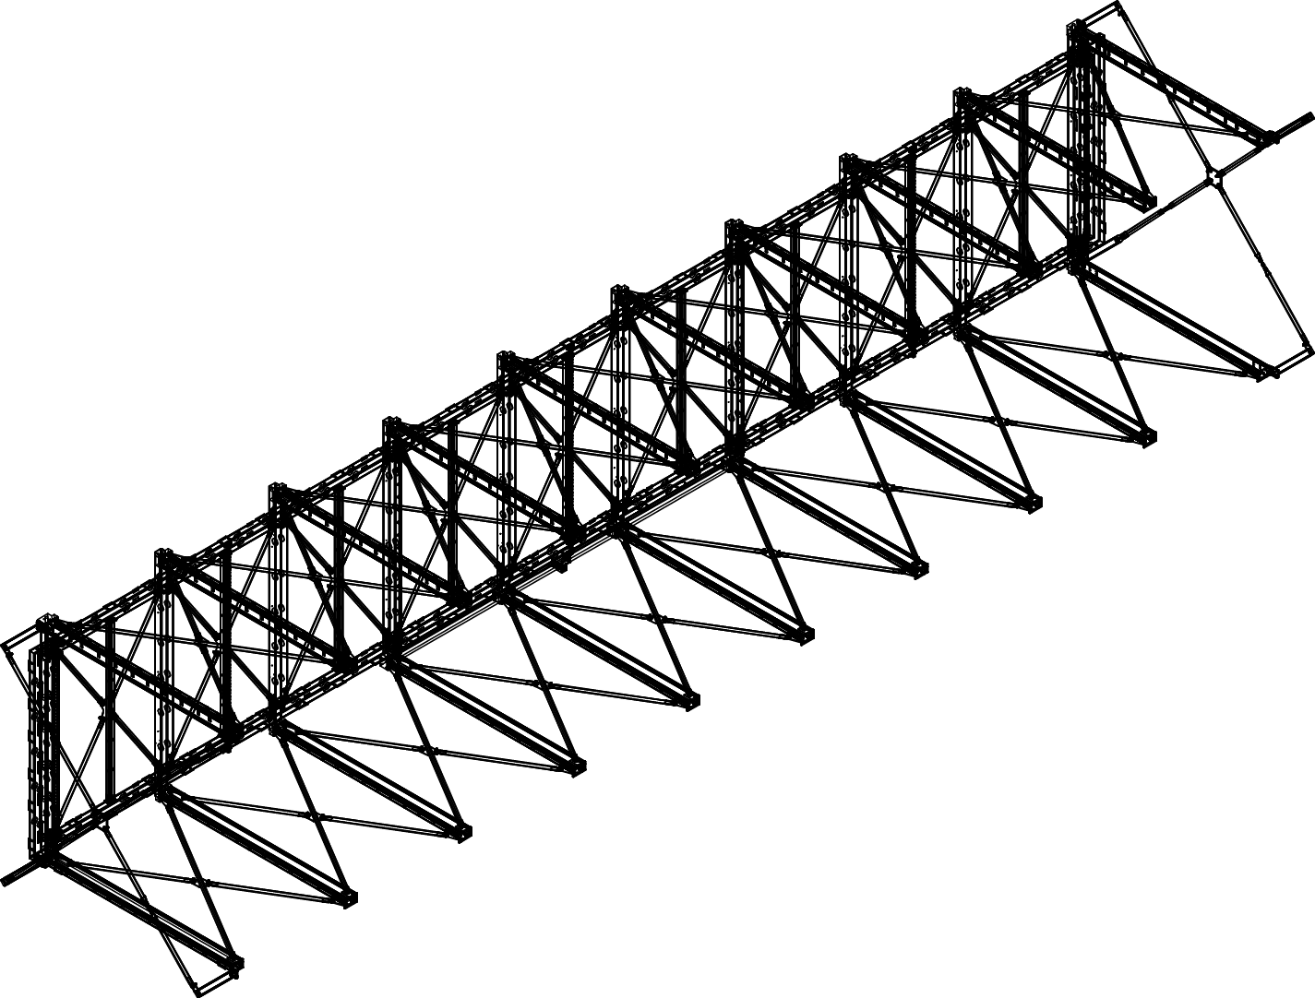
Removal of the wires chamber
The removal of one T600 wires chamber from the rest of the inner detector structure requires only the installation of some provisional stiffening elements and the removal of 24 fixings.
It appears therefore a relatively simple and safe operation.
Provisional stiffening
elements
Removed wires chamber

Slide 6
Increasing the T600 maximum drift
Several options can be considered to increase the T600 drift volume:
  Option 1 (T1200-like):
    the removed wires chamber is replaced with a light structure.
    The cathode is placed at the position of the removed wires (3m drift); the metallic structure is at ≈ 27 cm from the cathode (same as at present).
    Features: modest new design for the light structure; no need to re-design the LAr containers, the insulation and cryogenics.
  Option 2 (T600++):
    the two T300 chambers, with one of the wires chambers being removed, are placed face to face and connected with simple elements.
    a cathode is placed in the middle, reproducing the present T300 layout with ≈ 3.2 m drift. Distance of the cathode from the metallic structure is identical as the one at present.
    Features: minor new design for the connecting elements; the LAr containers have to be re-designed; no need to re-design insulation and cryogenics; assembly schemes and logistics have to be re-considered.
  For both layouts the drift could be further extended with additional structures. In this case the thermal insulation has to be re-designed.

Slide 7
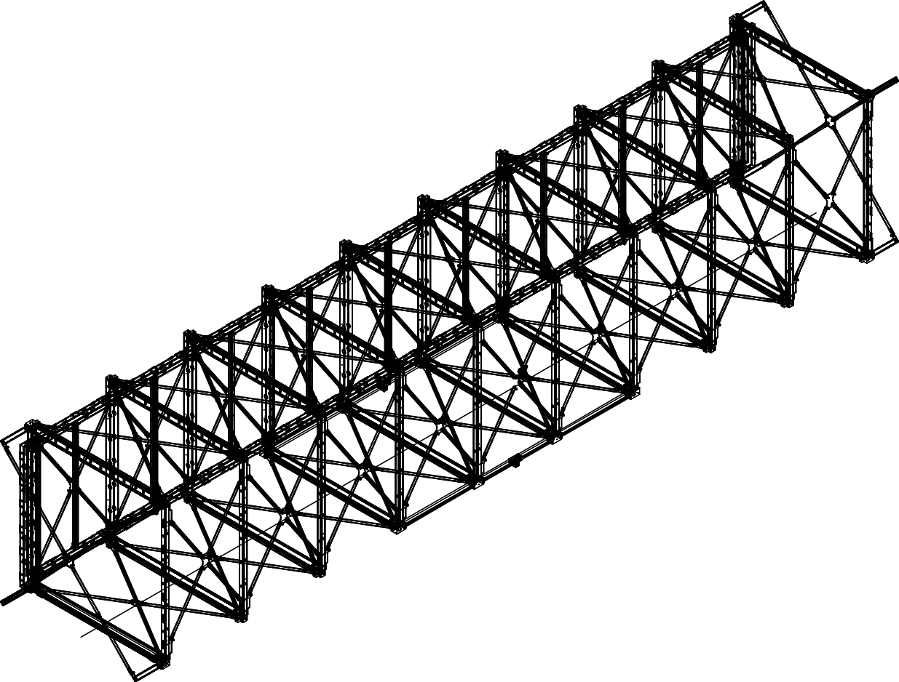
Option 1: (T1200-like)
3 m drift
Wires chamber
Light structure
and cathode

Slide 8
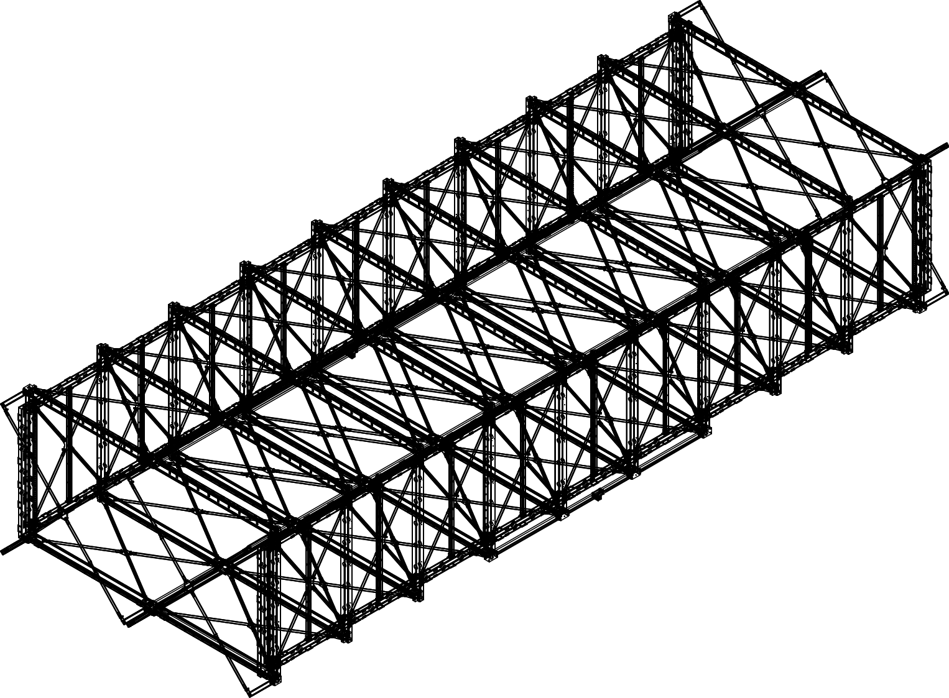
Option 2: (T600++)
Cathode
3 m drift
3 m drift
Wires chamber
Wires chamber

Slide 9
Aluminum vessels with increased (≈ 7.5m) width
A preliminary evaluation for an aluminum vessel with a width adequate to host a T600++ module (central cathode, two chambers with ≈ 3 m drift) has been performed by the structural engineers that made the design of the new containers for the present T600.
The preliminary evaluation shows that the present solution with the same extruded aluminum profiles could also be applied for the larger containers. An additional set of “annular” reinforcements have to be implemented together with a longitudinal reinforcement and a set of central supports on the basement to hold the weight of the LAr. The reinforcements are of the same type as those already designed for the “standard” containers to be used in correspondence of the “feet” of the wires chambers structure.

Slide 10
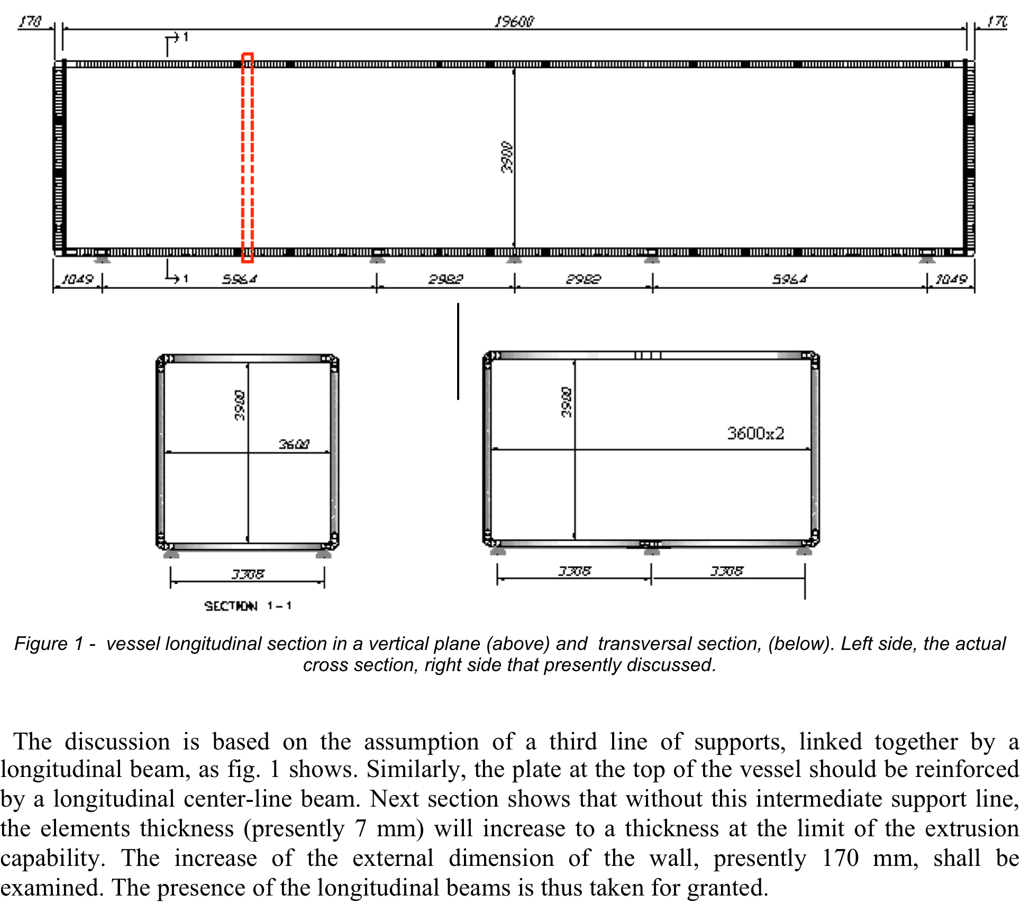
Aluminum containers with increased (≈7.5 m) width
Extracted for the structural engineers reports
“Annular” reinforcements
Present container
Container with 7.6 m int. width
Longitudinal reinforcement and
addition set of supports

Slide 11
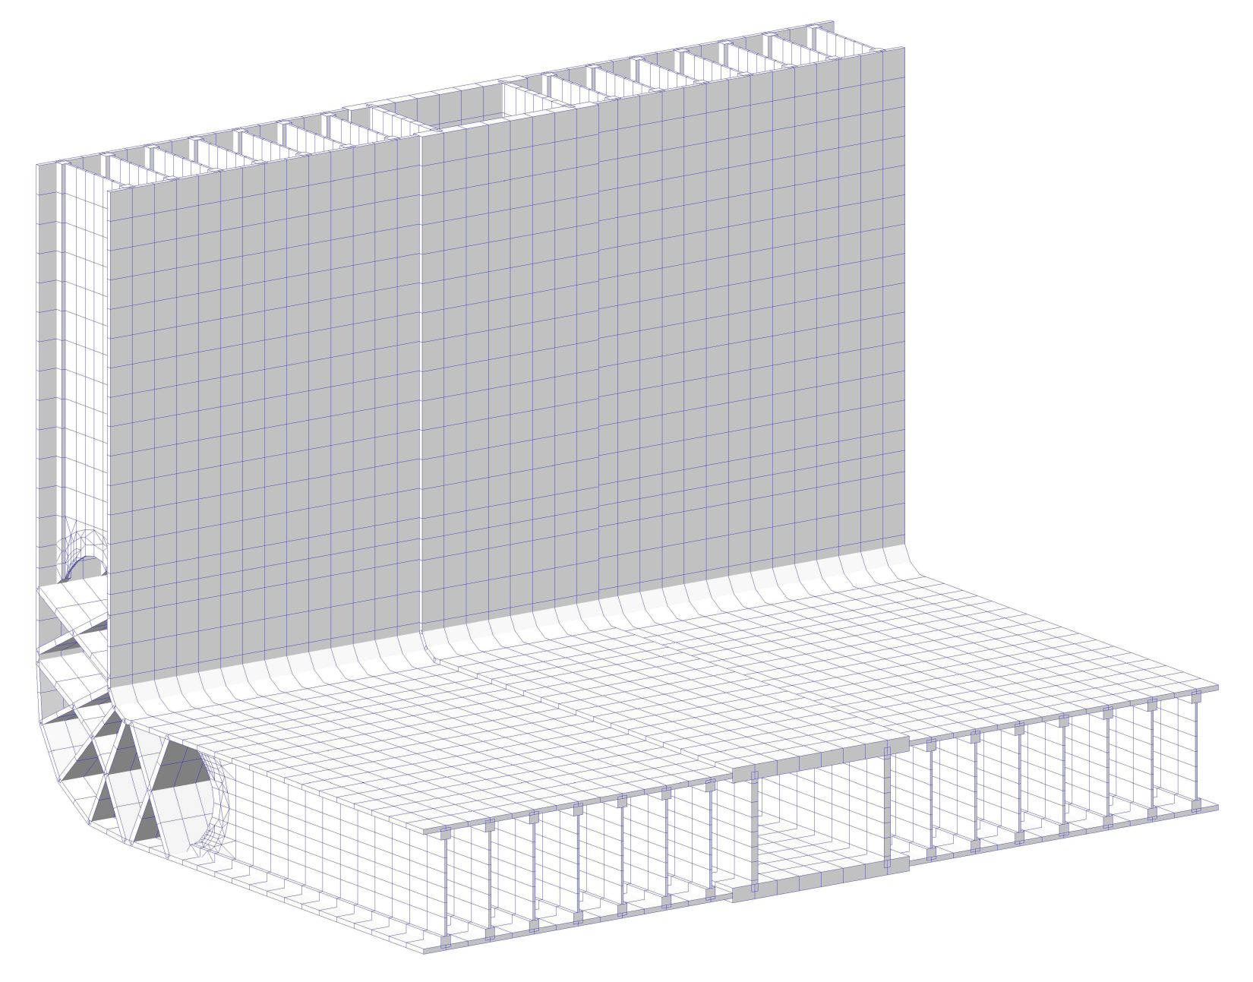
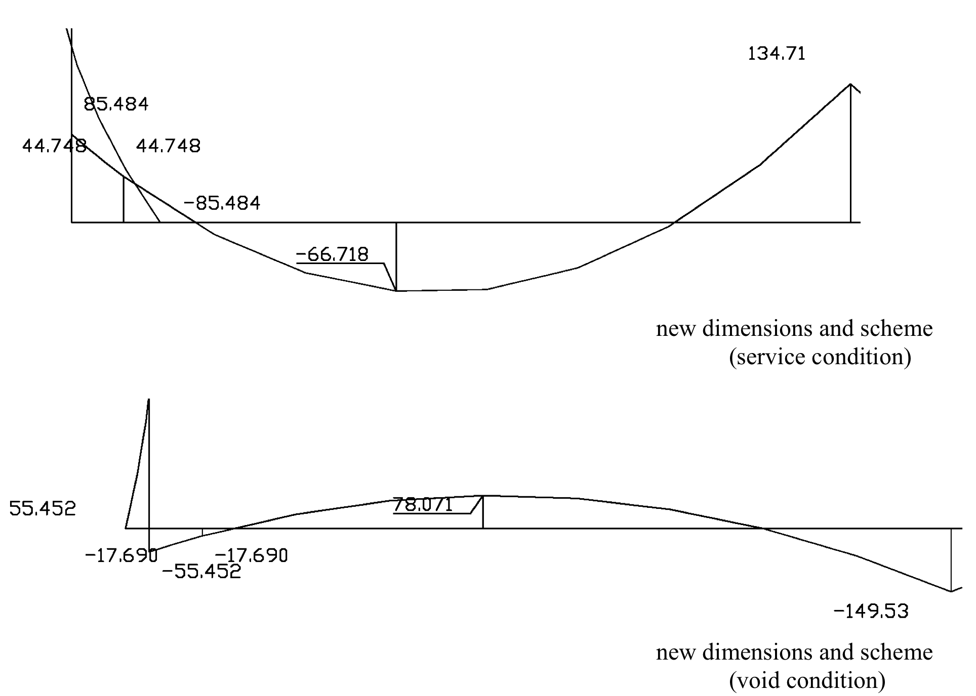
Aluminum containers with increased (≈7.5 m) width
“Annular” reinforcement
Deformations while filled with LAr (Top) and under vacuum (Bottom)
With the reinforcements the maximum bending will be from ≈ 65 mm (with LAr) to 78 mm (under vacuum)

Slide 12
Conclusion
A preliminary evaluation of some options for an increase (to 3 m or more) of the T600 TPCs maximum drift has been performed.
  Separating one of the wires chamber from the present T300 structured appears to be a relatively simple and safe operation
  The enlargement of the drift requires some new mechanical design, the extent of it being determined by the chosen option.
  The “spare” chambers can be equipped with an identical race-tracks + cathode system.
The preliminary study for an aluminum vessel with doubled width shows the most of the present solutions can be retained. A new detailed design with a new set of structural calculations has to be performed for this option.

