Slide 1
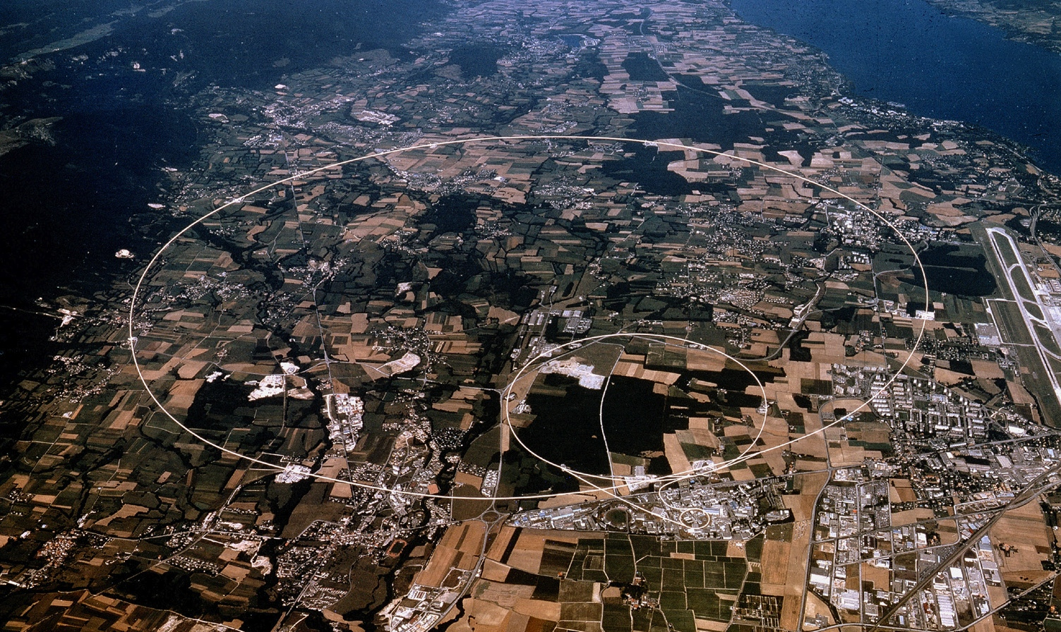

Introduction to Experiments or
How to detect the Higgs boson
H. Danielsson, CERN Teachers program, 2014

Slide 2
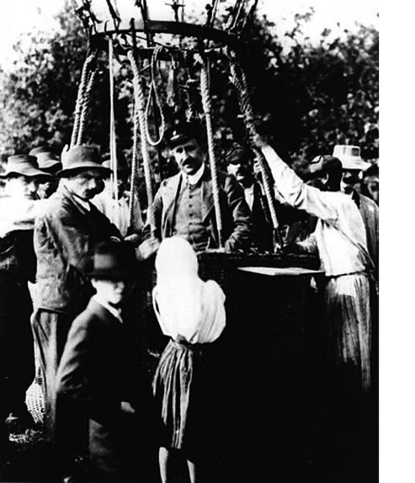
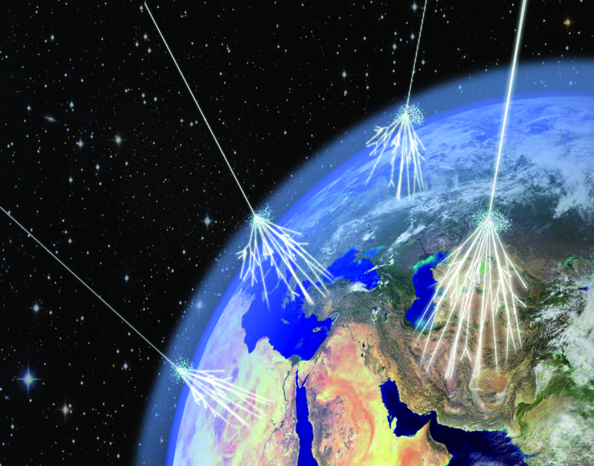
Cosmic rays are used to study the performance of the detector. Free of charge! J
Hess received the Nobel Prize in Physics in 1936 for his discovery (1912)

Slide 3
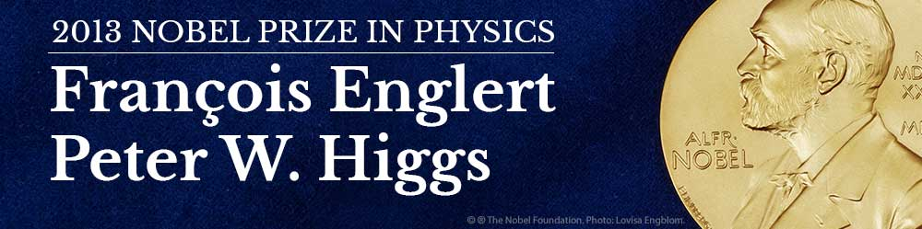
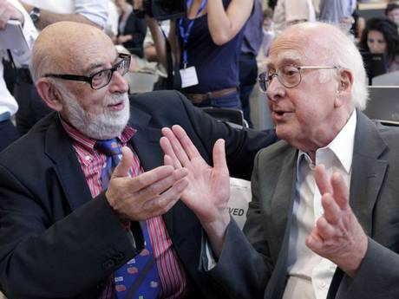
8 October 2013
The Royal Swedish Academy of Sciences has decided to award the Nobel Prize in Physics for 2013 to
François Englert and Peter Higgs
“for the theoretical discovery of a mechanism that contributes to our understanding of the origin of mass of subatomic particles, and which recently was confirmed through the discovery of the predicted fundamental particle, by the ATLAS and CMS experiments at CERN’s Large Hadron Collider”

Slide 4
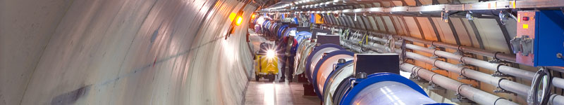
Outline
Introduction
CERN and the Large Hadron Collider (LHC)
  The accelerator
  The detectors
The Higgs discovery
  Spin and parity
  Recent results on Higgs decaying to fermions

Slide 5
The Standard Model
Is a very successful theory and describes the world around us.
The Standard Model is a discovery in itself
However, it explains only a fraction of the universe (~5%)
  95% is dark energy and dark matter. What is made of? The search is ongoing…
  What about super symmetry (SUSY)

Slide 6
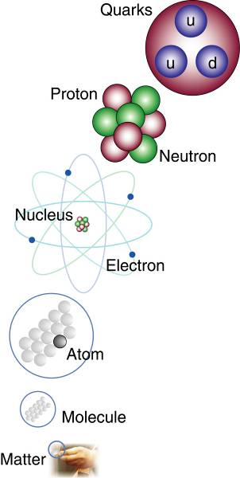
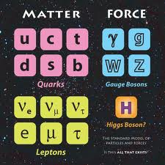
The Standard Model (1970-90s)
Matter particles: fermions (1/2 integer spin)
‘Force’ particles: bosons (integer spin)
Higgs field causes electro weak symmetry breaking and gives particles their masses
→ Nucleon level (partons) : binding energy ~98% of the mass
→ Most of the (luminous) mass in the universe comes from QCD confinement energy

Slide 7
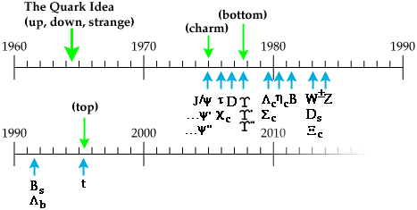
A bit of history
1964 The BEH
mechanism
The Standard Model completed
ν_{τ}
2012 The Higgs boson
discovered at CERN
LHC approved on
16 December 1994

Slide 8
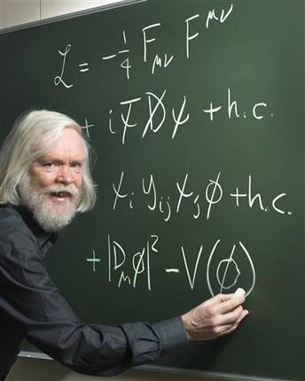
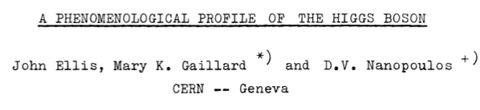
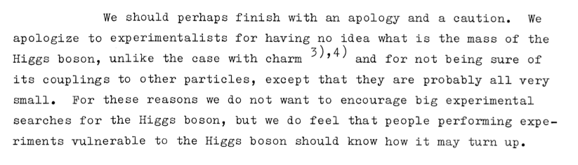
In 1976:
The Roadmap:

Slide 9
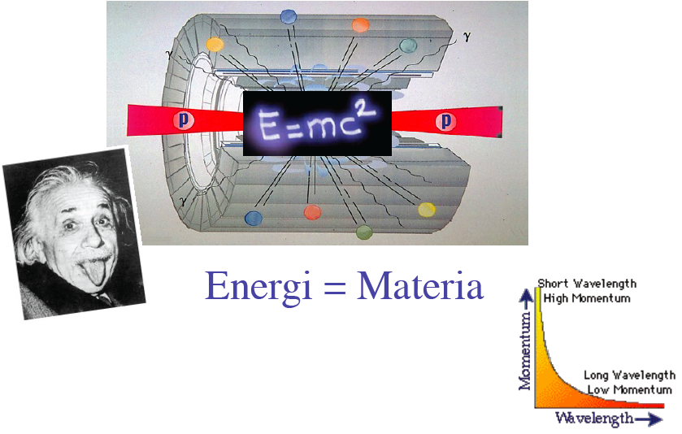
How ?
E=3.5TeV ➔
V=99.999996% of c
Energy = Matter
E²= (m₀c²)² + (pc)²

Slide 10
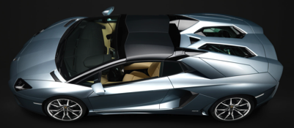
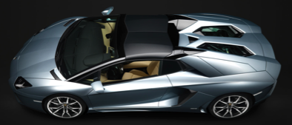
LHC (2012)
2x4 TeV How much energy?
1.9*10¹⁴ protons per beam at 4 TeV
How much energy in the two beams
speed=350 km/h
8 Lamborgini
8 Lamborgini

Slide 11
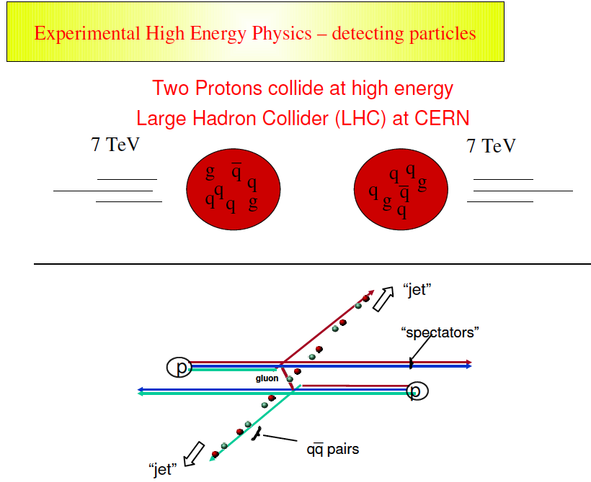
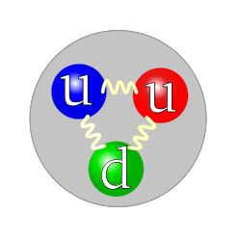
4
4

Slide 12
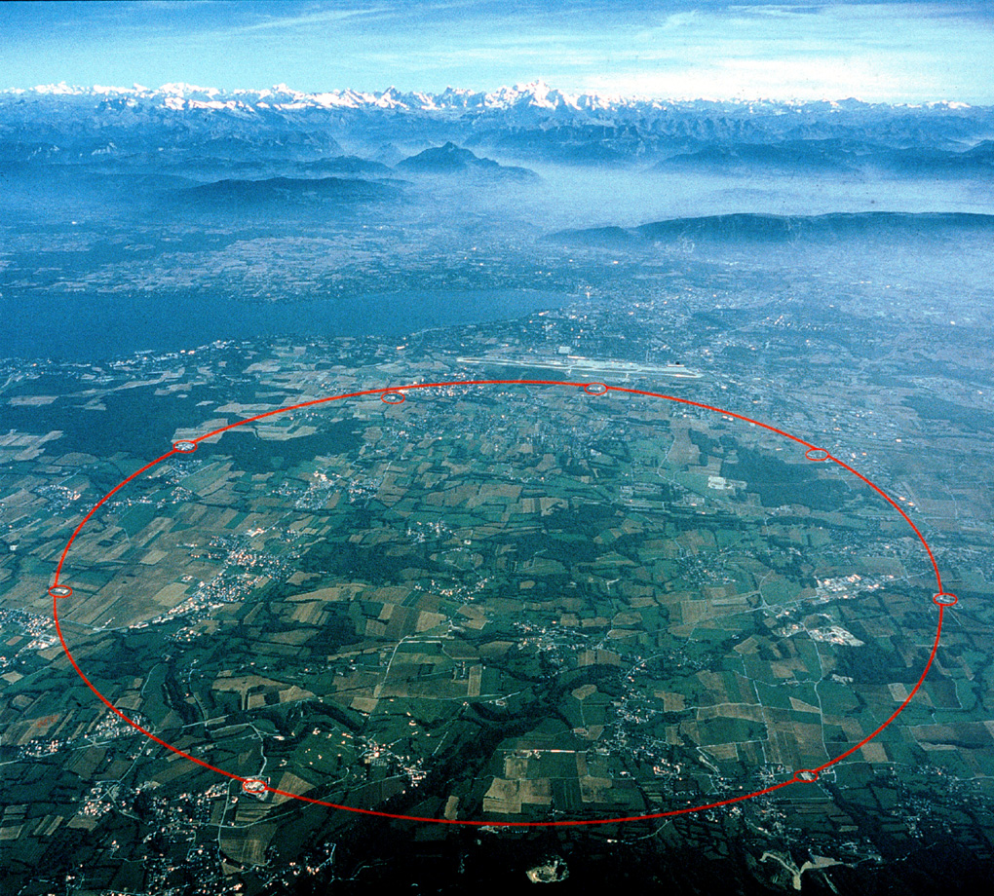
Center-of-Mass Energy (Nominal)
14 TeV ?
Center-of-Mass Energy (close to nominal)
13TeV
Restart in 2015
LHCb
ATLAS
Center-of-Mass Energy (2012)
8 TeV
CMS
ALICE
Center-of-Mass Energy (2010-2011)
7 TeV

Slide 13
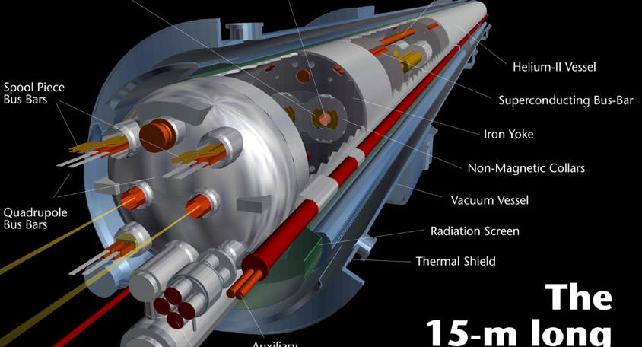
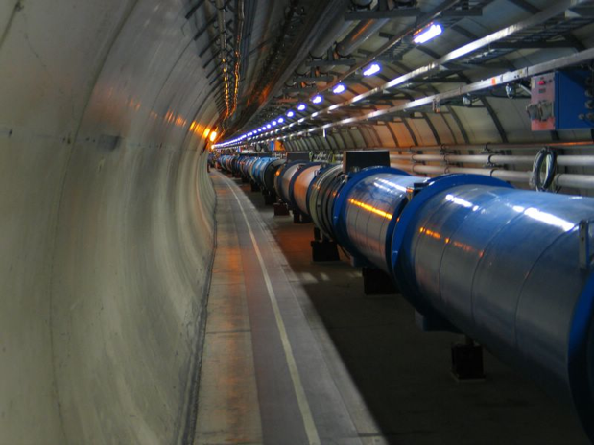
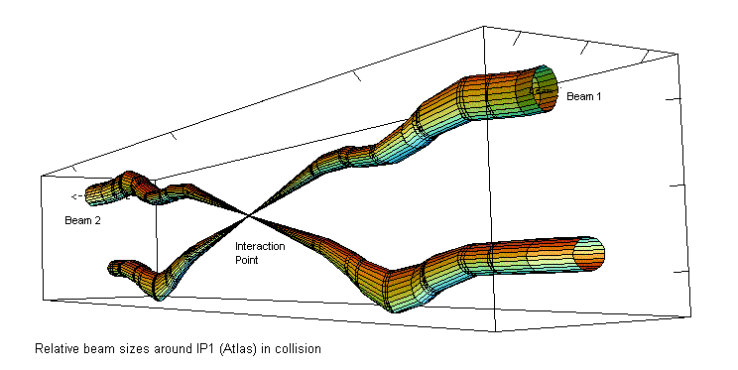
Large Hadron Collider (LHC)
  The Accelerator
    100 - 150 m below surface at 1.9 Kelvin in a tunnel 27 km long.
    The protons circulate at a speed of ~ 11000 turns/sec
    There are 2808 bunches
    Collisions at 40 MHz (every 25 ns)
    600 000 000 collisions per second !

Slide 14
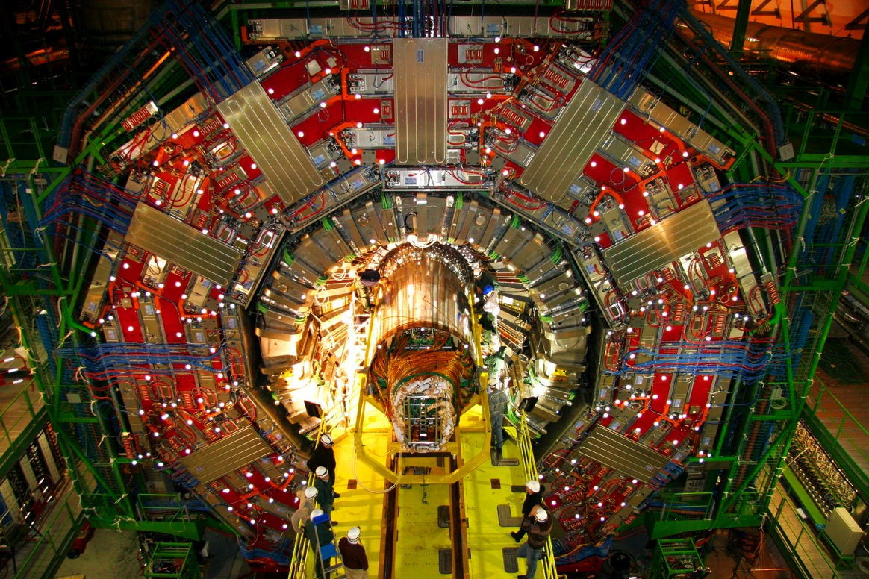
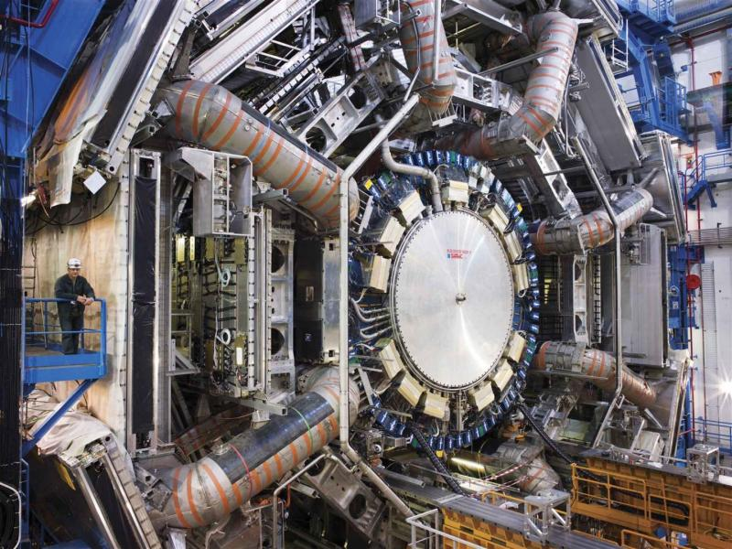
The experiments
CMS: heavier than
the Eiffel Tower
ATLAS: as big as a
5 storey building

Slide 15
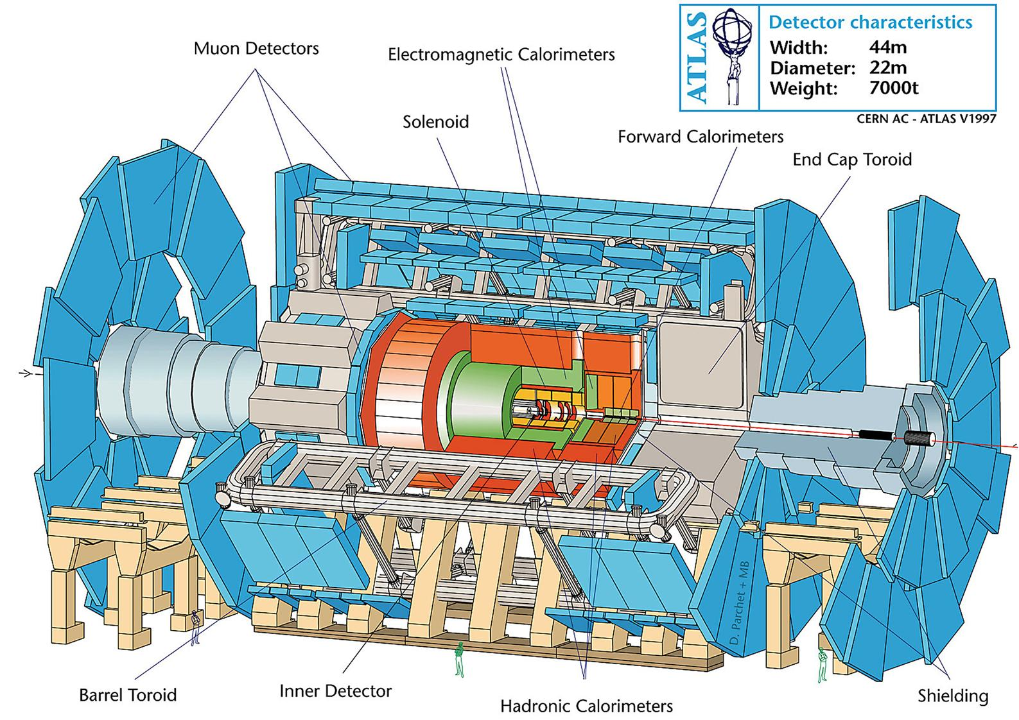
Största och mest sofistikerade detektorer
Thisis
To hide
The legend
Thisis
To hide
The legend

Slide 16
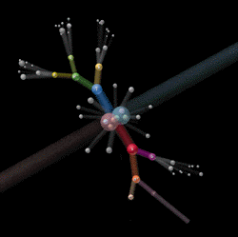

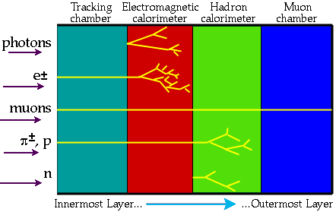
Principles of Detection
The collision energy condenses into particles (e, p, π, μ,γ Κ…)
Detectors surrounding the collision point (or after in case of fixed target) are sensitive to the passage of energetic particles.

Slide 17
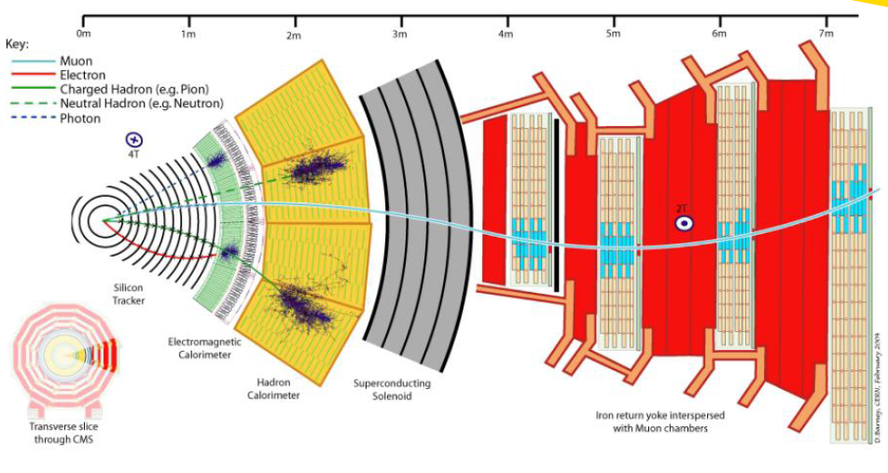
Partikeldetektorer

Slide 18
Interaction of Particles with Matter
In order to detect a particle it must interact with matter!
The most important interaction processes are electromagnetic:
Charged Particles:
Energy loss due to ionization (e.g. charged track in straw detector) heavy particles (not electrons/positrons!)
Energy loss due to photon emission (electrons, positrons) bremsstrahlung
Photons:
Interaction of photons with matter (e.g. EM calorimetry)
Photoelectric effect
Compton effect
Pair production
Other important electromagnetic processes:
Multiple Scattering (Coulomb scattering)
scintillation light (e.g. TOF systems)
Cherenkov radiation
Transition Radiation (e.g. particle id normally electrons)
Can calculate the above effects with a combo of classical E&M and QED.
In most cases calculate approximate results, exact calculations very difficult.

Slide 19
Bethe-Bloch Formula for Energy Loss
Average energy loss for heavy charged particles
Energy loss due to ionization and excitation
Valid for energies <100’s GeV and β >>zα (≈z/137)
heavy= m_{incident}>>m_{e}
proton, k, π, μ
Fundamental constants
r_{e}=classical radius of electron
m_{e}=mass of electron
N_{a}=Avogadro’s number
c=speed of light
=0.1535MeV-cm²/g
Absorber medium
I=mean ionization potential
Z= atomic number of absorber
A=atomic weight of absorber
ρ=density of absorber
δ=density correction
C=shell correction
Incident particle
z=charge of incident particle
β=v/c of incident particle
γ=(1-β²)^{-1/2}
W_{max}=max. energy transfer
in one collision
Note: the classical dE/dx formula contains
many of the same features as the QM version: (z/β)², & ln[]

Slide 20
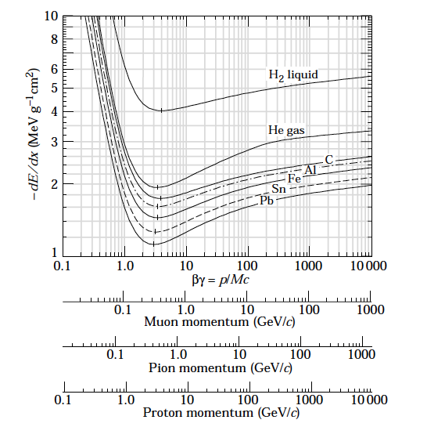
Bethe-Bloch Energy Loss
PDG plots:
http://pdg.lbl.gov/index.html
Calculated

Slide 21
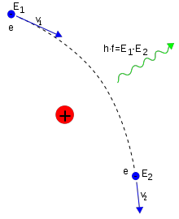
Bremsstrahlung
(braking radiation)
A fast moving particle is decelerated in the electrical field of the nuclei.
Above a few tens MeV, bremsstrahlung is the most dominated process for electrons and positrons
It becomes important to muons (and pions) at a few hundred GeV
What about the atomic electrons? Yes, the electron cloud gives and additional contribution to the bremsstrahlung
Let’s see how this is used in the detector layout later
e⁻
e⁻
e⁻
e⁻
e⁻

Slide 22
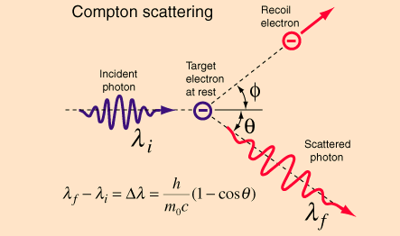
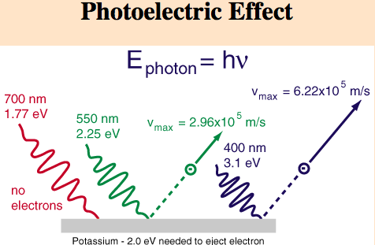
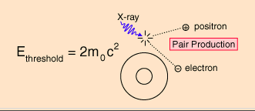
Photons - 3 interactions

Slide 23
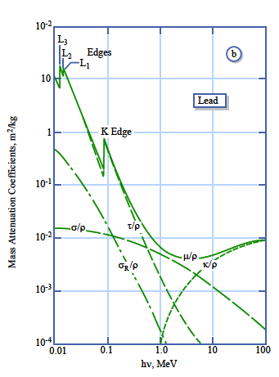
Photons interacting with matter
Photoelectric effect
Compton scattering
Pair production
Mass Attenuation Coefficient = Interaction probability/density

Slide 24
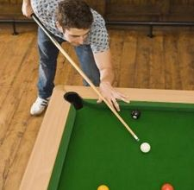
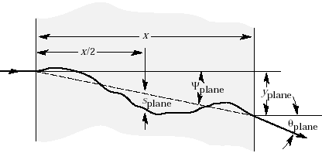
Multiple Scattering
A charged particle traversing a medium is deflected by many small angle scatterings.
These scattering are due to the coulomb field of atoms and are assumed to be elastic.
In each scattering the energy of the particle is constant but the particle direction changes.
In the simplest model of multiple scattering we ignore large angle scatters.
In this approximation, the distribution of scattering angle θ_{plane} after traveling a distance x
through a material with radiation length =L_{r} is approximately gaussian:
with
In the above equation β=v/c, and p=momentum of incident particle
This is not good for tracking!

Slide 25
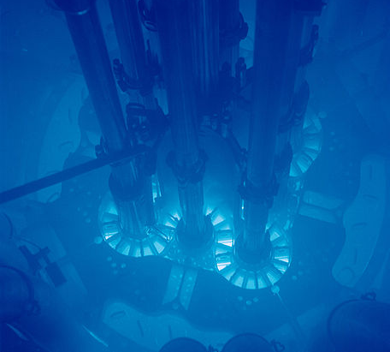
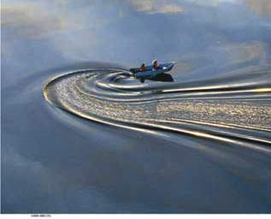
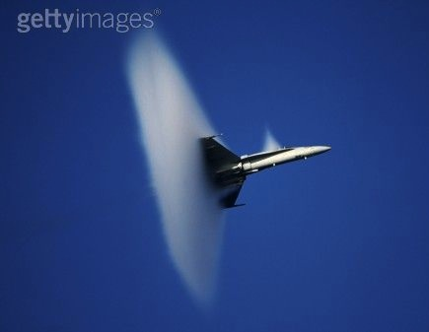
Cherenkov light
Named after the Russian scientist P. Cherenkov who was the first to study the effect in depth (he won the Nobel Prize for it in 1958)
From Relativity, nothing can go faster than the speed of light c (in vacuum)
However, due to the refractive index n of a material, a particle can go faster than the local speed of light in the medium c_{p} = c/n
Fast electrons in a reactor emitting blue light (Cherenkov radiation)
This is analogous to the bow wave of a boat travelling over water
or the sonic boom of an aeroplane travelling faster than the speed of sound

Slide 26
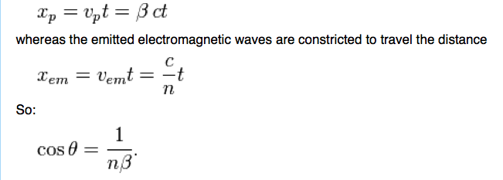
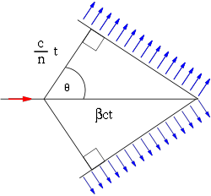
Cherenkov radiation
The left corner of the triangle represents the location of the superluminal particle at some initial moment (t=0). The right corner of the triangle is the location of the particle at some later time t. In the given time t, the particle travels the distance

Slide 27
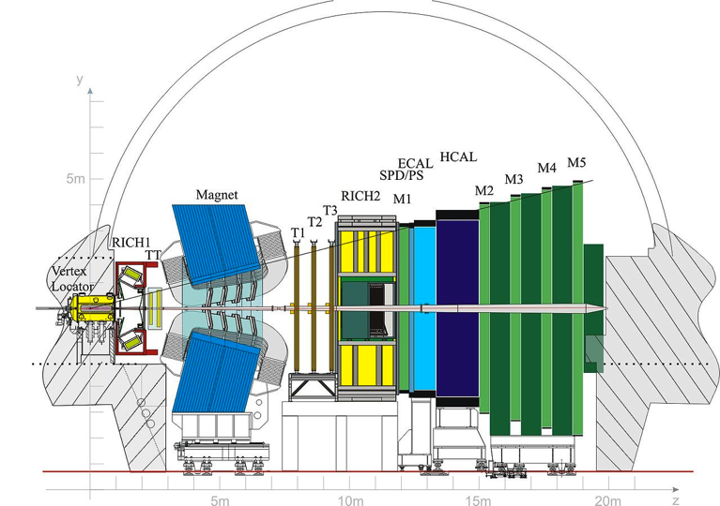
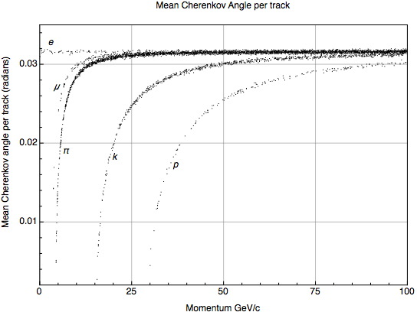
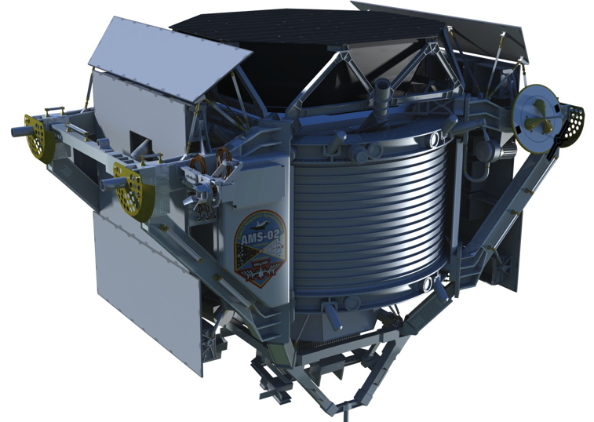
Cherenkov Detector
LHCb
AMS

Slide 28
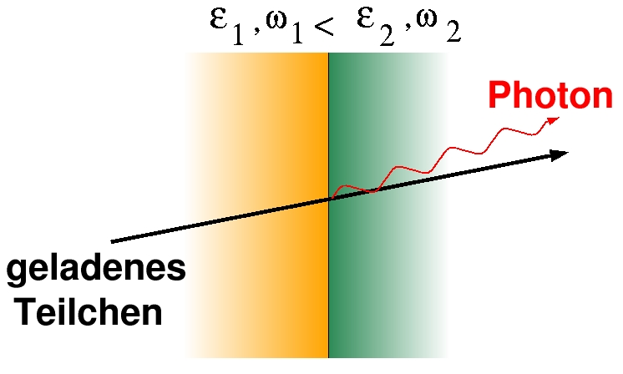
Transition Radiation (Particle ID)
Transition Radiation: photon emitted by a charged particle when traversing the boundary between materials with different dielectrical constants (ε1ε2)
γ > 1000
Intensity: I ~ γ = E/m, θ ~ 1/ γ
  Identification of transition radiation
  photons used for
  particle identification (mostly electrons)
  of particles with momenta between
  1 and few 100 GeV
θ
charged
particle

Slide 29
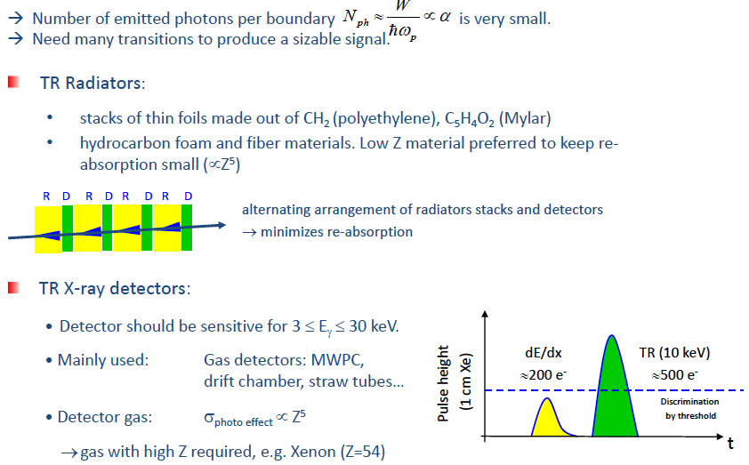
Transition radiation
(particle identification)

Slide 30
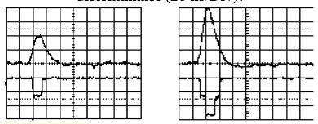
TRT (ATLAS): 3 straws and radiators
Cross section view
TR photon
electrons
High threshold
Low threshold

Slide 31
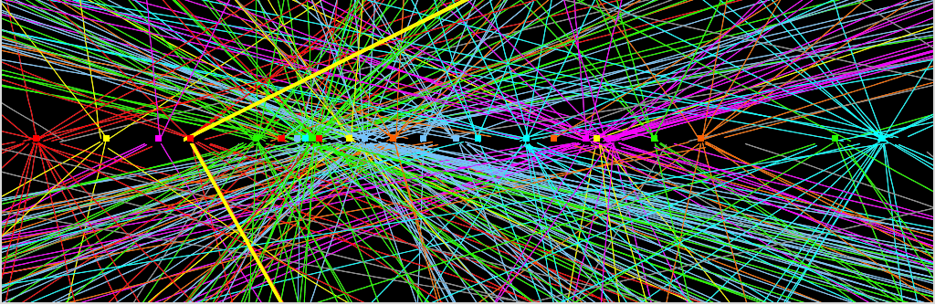
Detector Challenges (Highlights)
10 cm
- Trigger Challenge : How to select 400 out of 20x10⁶ events per second while keeping the interesting (including unknown) physics
- Computing Challenge : How to reconstruct, store and distribute 400 increasingly complex events per second (over 100 Petabite per experiment)

Slide 32
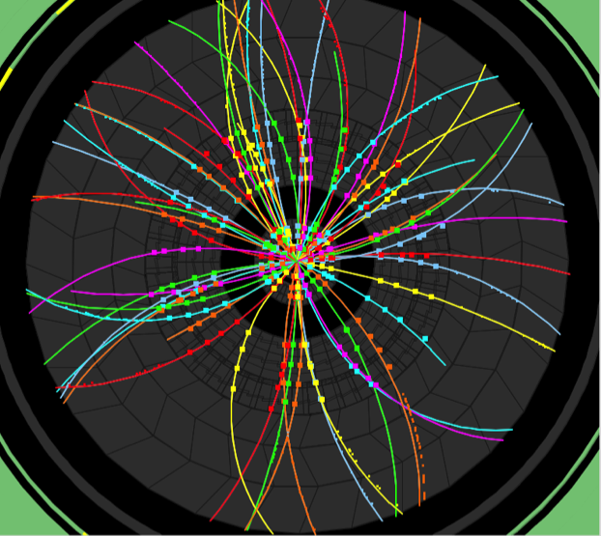
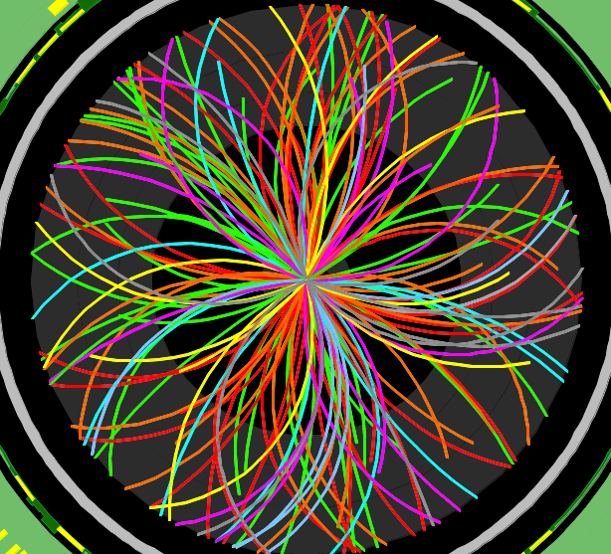
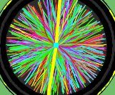
The first LHC run
2010
Event rate = luminosity x cross-sections
2011
O(2) Pile-up events
Event taken at random (filled) bunch crossings
150 ns inter-bunch spacing
2012
23 fb⁻¹
at 8 TeV
2010
0.05 fb⁻¹
at 7 TeV
2011
2011
5.6 fb⁻¹
at 7 TeV
O(10) Pile-up events
Event taken at random (filled) bunch crossings
50 ns inter-bunch spacing
Design value
(expected to be
reached at L=10³⁴ !)
2012
O(20) Pile-up events
50 ns inter-bunch spacing

Slide 33
The detection of the Higgs boson

Slide 34

Higgs production
Vector boson fusion
VBF
Top-antitop fusion
ttH
Higgs strahlung
VH
Gluon-gluon fusion
gg→H

Slide 35



Detect Higgs by decay products
Variety of decay channels
Massive particles more likely
Difficult to detect from background
Life time is 1.56×10−22 s (!)
(predicted in the Standard Model)
γγ is clean, but rare
Ref: hep-ph/0208209
Notes:
35

Slide 36




April-July 2012: 8 TeV, 5.8 fb⁻¹
Measure energy of photons emitted
Measure decay products of Z bosons

Slide 37

H→ 4l

Slide 38

Higgs events H→4l (muons)

Slide 39

H → γγ

Slide 40


From CMS Higgs→γγ

Slide 41
Higgs to Fermions
Recent analysis shows evidence of Higgs boson decaying to fermions (leptons or quarks). Not previously observed!
It is important to measure this decay but no surprise is expected
Difficult due to high background
BR related to mass. High mass fermions preferred (τ,b)
Both ATLAS and CMS has “evidence” in the channel H→ ττ ….but not yet the famous “5 σ” needed to claim discovery

Slide 42


Higgs decays to fermions (ττ) in ATLAS (26 Nov 2013)
The taus decay into an electron (blue line) and a muon (red line)

Slide 43


Higgs decays to fermions (ττ) in CMS (3 Dec. 2013)
One tau decays to neutrinos and a muon (red lines on the right), while the other decays into a charged hadron (blue towers) and a neutrino

Slide 44
Thank You!

Slide 45
Literature
CERN Academic Training
  http://indico.cern.ch/conferenceDisplay.py?confId=266737
CERN ATLAS
  http://www.atlas.ch/HiggsResources/

Slide 46
Spares

Slide 47

Higgs
“exclusion plots”

Slide 48

The ATLAS experiment

Slide 49


LHC
20 Years, projecting, constructing and Simulating…
Accelerators:
Powerful machines capable of accelerating particles to very high energies before being collided with other particles
2. Detectors:
Gigantic instruments that record particle collisions
3. Computers:
To collect, store, distribute and analyze enormous quantities of data generated by detectors
The biggest scientific instrument ever built

Slide 50

The Higgs search as of 18/11/2011 ☺
To be continued……..

Slide 51

After 10 min of LHC running: full history of SM

Slide 52


What LEP (CERN) and
Tevatron (Fermilab)
Until year 2000
Until year 2011

Slide 53


Slide 54

On example: the discovery of the quarks at SLAC in 1968
λ
The quark model was independently proposed by physicists Murray Gell-Mann and George Zweig in 1964.
Gell-Mann found the quarks in:
“Three quarks for Muster Mark!
Sure he has not got much of a bark
And sure any he has it's all beside the mark.”
—James Joyce, Finnegans Wake

