Slide 1
Cloud-Scale Datacenters & Azure
Ronan Geraghty
Microsoft Azure Business Lead
Microsoft Western Europe
Notes:
Hello, my name is _______. I’m here today to talk about our cloud infrastructure facilities, and the processes that we go through in developing software to run our services around the clock around the world.

Slide 2
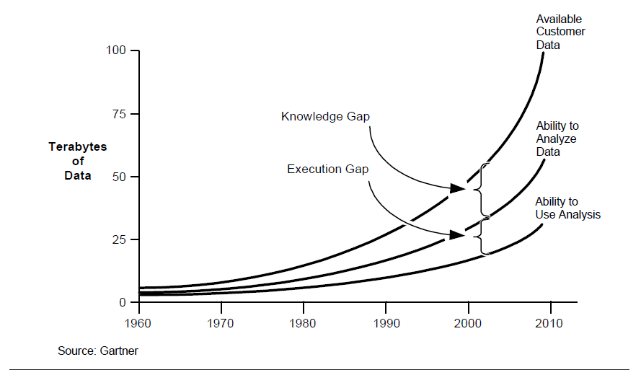
Notes:
Every year we get such statistics from various market research organization. Well, even if we believe fraction of that is true still it’s a big number .
So impact of data quality on general day to day profitability is well known and I don’t need to emphasize .
Lets look how much data quality matter for effective analytics.
1.
- Analytics requires both past and current data about many different things including customers, businesses, products, and the economy.
-All data is a representation of some reality. The more closely the data mirrors that reality, the more accurate the data is.
2.
Analytics is adopted as strategic initiative for most of the organization with a broad consequence.
Data quality issues in a transactional system may cause you too loose a single customer or deal. However same data quality issue once percolated to Analytical system on which strategic decision are made may wipe out a set of customers
Analytics with appropriate attention paid to data quality makes easier than ever for businesses to make accurate market and consumer predictions and thus smarter decisions for the growth of their company.
3.
Garbage in, Garbage out. This holds true for any computing system, but it impact on Analytics and decsion based on that have bigger and larger impact.
The above chart suggest that as the data volume grow our ability to analyze that data is limited to an extent. This knowledge & execution gap is related to multiple factors. It is bcoz of tools availability, skill gap and the business value. You can bridge this knowledge and execution gap by maintiaing proper Data quality .
Some of you may be wondering that we maintain our transaction system so well, how does data quality issues originates.

Slide 3
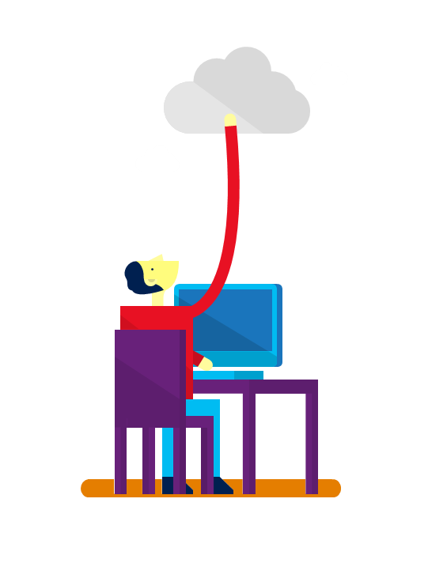











7+ billion
worldwide queries each month
50+ billion
minutes of connections handled each month
250+ million
active users
85%
Fortune 500 users
2.4+ million
emails per day
30+ trillion
objects stored
3.5+ million
subscribers
48+ million
users in 41 markets
50+ million
active users
400+ million
active users
18+ billion
Active Directory authentications per week
200+ Cloud Services
1+ billion customers · 20+ million businesses · 90+ markets worldwide
Notes:
Microsoft operates over 200 online and cloud services from a common set of infrastructure.
Our services are used by over one billion customers, 20 million businesses and are delivered in over 90 markets around the world
The size of infrastructure required by these services allows us to make investments in security development and operations that are much larger than many enterprises and public sector organizations are unable to make on their own.

Slide 4

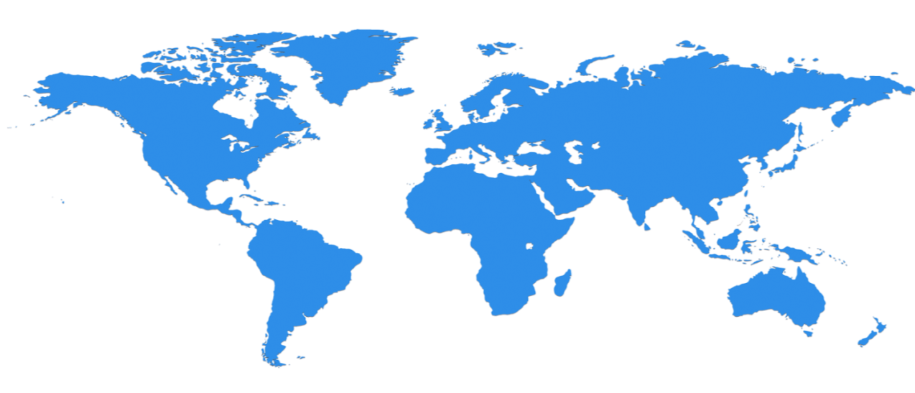
Scale with Microsoft
North Europe
Ireland
West Europe
Netherlands
Central US
Iowa
North Central US
Illinois
US Gov
Iowa
China North *
Beijing
East US
Virginia
Japan East
Saitama
West US
California
China South *
Shanghai
East US 2
Virginia
Japan West
Osaka
India West
TBD
India East
TBD
South Central US
Texas
US Gov
Virginia
East Asia
Hong Kong
SE Asia
Singapore
19 Regions ONLINE…
huge datacenter capacity around the world…and we’re growing
Australia East
Sydney
Brazil South
Sao Paulo
Australia West
Melbourne
Operational
Announced
  * Operated by 21Vianet
Notes:
Over the last few years we’ve truly delivered a huge infrastructure to enable us to grow our services at scale around the globe. Whether it’s our flagship facilities in Quincy, Washington or Boydton, Virginia, or some of the newly announced facilities in Shanghai, Australia and Brazil, it really is key for us to make smart investments around the world to deliver services in a resilient and reliable fashion.
A lot of people ask, what goes into site selection at Microsoft and how do we decide where to place our datacenter investments? There are over thirty-five factors in our site selection criteria. But really, the top elements are around proximity to customers and energy and fiber infrastructure, insuring that we have the capacity and the growth platforms to be able to grow our services.
Another key element is about skilled workforce. We need to insure that we have the right people to run and operate our datacenters on a day to day basis.
We understand that there is a lot of competition when you consider all of the productivity, app, and platform players out there.
We looked hard at what makes Microsoft unique in this space—we asked customers, partners, analysts, and our own people. What are our points of differentiation? What helps set us apart from the rest? Hard questions, soul-searching questions to find the core of what makes us valuable to you.
The big answer that came back was interesting: no other company has a complete and flexible suite of capabilities like Microsoft—and the experience to back it up. Some companies have great productivity capabilities, but don’t have business apps or platform experience. Some companies have great platform expertise but no productivity or apps.
A recent IDC report says that 67 percent of customers expect to purchase multiple services from a single cloud vendor. That means that cloud vendors that provide options and multiple services have a decent shot at getting more business. I know you don’t particularly care about that, but it further validated our approach. We want to give you options, choice, flexibility, and back it up with rock-solid performance and security. That’s what Microsoft has been all about since the beginning.
Let’s take a moment to look at the five things that make the Microsoft Cloud different—things you should be considering when you’re selecting a cloud vendor.
Global scale: We provide the worldwide reach and hyperscale needed to break the cloud entry barrier giving you better economics, business agility, and availability. This is all of our experience running some of the largest cloud services in the world. You get to benefit from all of that knowledge and our global platform. When you’re ready to scale, we’re ready.
Enterprise grade: We have proven enterprise experience coupled with security and compliance investments giving you the confidence that your business demands. We’ve been working very hard for decades to become enterprise grade—a badge of honor that we hold dear.
Comprehensive: We provide an unmatched breadth of capabilities that provide IT simplification and the consistency essential for your business transformation. We make it easy to connect things, for example, a unified identity and access management system enabling single-sign on to employees.
Hybrid cloud: This is the big one. We believe it’s critical that we provide flexible cloud services, scalability, and capacity that increase the value of existing technology investments to best fit your business needs. We understand that you can’t start over in the cloud overnight. You need flexibility when it comes to managing and making best use of existing on-premises investments, providing a path to the cloud, and for all of your cloud needs.
People-centered experiences: We’re committed to providing the experiences that end users want, with the control IT needs—designed to produce higher productivity and extend skillsets to cloud for innovation with minimal training costs. With Office, Dynamics, and Azure all working together, your people will be productive and delighted by the integrated experiences that just work.
So we have talked about what makes the Microsoft Cloud Platform different. Now let’s spend a moment looking at the benefits, or the outcomes you enjoy when making use of the platform.
Enterprise mobility: This is about all the different devices that are coming into the environment today and helping IT manage the needs of the end users in their environments with the governance and support around policies for devices, data, and users as those devices come into the enterprise. Being able to empower enterprise mobility through a unified view is a very powerful value proposition and what we provide with Microsoft Intune.
Internet of Things: As more and more devices and things across your business are connected, you have an opportunity to dramatically improve performance of assets through predictive maintenance, monitor and optimize your supply chain, or get closer to your customer. With Microsoft, you can create the Internet of Your Things—allowing you to make use of what you already have, connect a wide range of things, and gain the visibility you need.
Application development: The Microsoft Cloud Platform enables application innovation—an important strategy for businesses today to differentiate, whether that includes new mobile customer experiences or a new B2B partner portal, or mixing and matching of SaaS, traditional line-of-business apps, and data to create new views and opportunities for the business. Microsoft provides flexible and enterprise-grade development and cloud environments that get the most from existing resources and assets while making the most of new technologies.
Data management and analytics: Relative to data, Microsoft is focused on helping IT, users (employees), and data professionals easily bring together structured relational data inside the enterprise with unstructured non-relational data from the Web. Big Data from the Web, small data in terms of ERP and CRM and other apps inside the firewalls really means all data. Being able to bring these different data sets together to unlock insights on any data for everyone. We deliver the plumbing through SQL Server and port connected analytics capabilities into familiar tools like Excel in Office and Power BI for Office 365. This opens up BI, which uniquely allows every employee—not just data experts—to access data, combine data sets, and uncover insights to answer questions they’ve never before been able to answer on their own— all without help from experts or IT.
Cloud infrastructure: There is so much complexity in how datacenters run today. IT is largely managing infrastructure and trying to consolidate servers and start virtualization to save money. What we really need to do is transform the datacenter by bringing in automation and enabling organizations to use on-premises resources with the cloud—creating a powerful hybrid approach. We can actually help customers think beyond just managing servers, to managing the pooled resource of compute, networking, and storage that sit in the datacenter and the cloud as a shared delivery service for the business.

Slide 5

Think, design, deliver differently at cloud-scale
Cloud-Scale IS…
  Resilient services
  Solving hardware problems in software
  Self-healing solutions that route around failures
  Enabling the business
Cloud-Scale is NOT…
  Brittle software or networks
  Relying on redundancy or special purpose hardware
  People watching screens and responding to alerts
  Reacting to the business
Notes:
Now I’d like to take a minute to talk about what we call Cloud Scale. It’s really a different way of thinking about how we design and deliver datacenter infrastructure and Cloud services here at Microsoft.
Cloud Scale is really about resilient services; the ability for an application to be up and available for end users no matter what happens in the background. It’s about solving hardware problems in software. And, routing around failures and self-healing algorithms to insure that the customer experience is maintained at the highest level no matter what’s happening in the background.
And it’s also about enabling the business. Not just reacting to the business. How can you reach out and scale your resources and scale your experience up faster and cheaper and better.

Slide 6





Microsoft’s cloud environment
Global Foundation Services
Software as a Service (SaaS)
Consumer and small business services
Enterprise
services
Third-party
hosted services
Platform as a Service
(PaaS)
Microsoft IT
Infrastructure as a Service (IaaS)
Infrastructure
Security
Global delivery
Sustainability
Notes:
Microsoft has cloud offerings across what the industry commonly refers to as cloud service models. IaaS & PaaS are Microsoft Azure offerings SaaS offerings from Microsoft are logically grouped in consumer and small business offerings (such as Bing and Messenger) and Enterprise and Public Sector offerings (such as Office 365 and CRM online). 3rd party services running on Microsoft Azure are effectively a third type of SaaS offering which runs in the Microsoft cloud.
All of Microsoft’s cloud services run in a common infrastructure, operated by a team called Global Foundation Services. Global Foundation Services provides the datacenters, networking, operations and security infrastructure that runs Microsoft’s cloud.
This presentation is focused on this infrastructure and the relationship with the services that run in it.

Slide 7
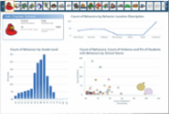

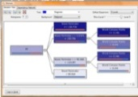

Microsoft Big Data Solution
FAMILIAR END
USER TOOLS
Power View
Excel with PowerPivot
Predictive Analytics
Embedded BI
BI PLATFORM
SSAS
SSRS
Microsoft PDW
Connectors
HDInsight Service
Hadoop On Windows Server
UNSTRUCTURED & STRUCTURED DATA
Sensors
Devices
Bots
Crawlers
ERP
CRM
LOB
APPs
Notes:
Slide Objectives:
Talk from the bottom layer up to discuss the Microsoft big data solution.
Transition:
Transition statement(s) to setup the slide
Speaking Points:
BI Platform: Sql server analysis service and reporting service.
Self service BI: powerview, powerpivot, predictive analysis and embedded BI.
Taking in unstructured data and strutted data sources through Hadoop, or PDW
Notes:
Any notes go here

Slide 8












Microsoft Azure services for IoT
Producers | Event Ingestion | Storage | Transformation | Presentation & action
 | Event Hubs (Service Bus) | SQL Database | Azure ML | Azure Websites
 | Heterogeneous client agents | Table/Blob Storage | HD Insight | Mobile Services
 | Intelligent Systems Service | DocumentDB | Stream Analytics | Power BI
 |  |  |  | Notification Hubs
020ce
{ }

Slide 9

GOALS
Project constraint
5 weeks project duration from planning to delivery
Team of three developers and one analyst-manager
Technical Demo
Performance of ad-hoc queries over 2.4 billion rows
Performance of ETL and cube processing

Slide 10
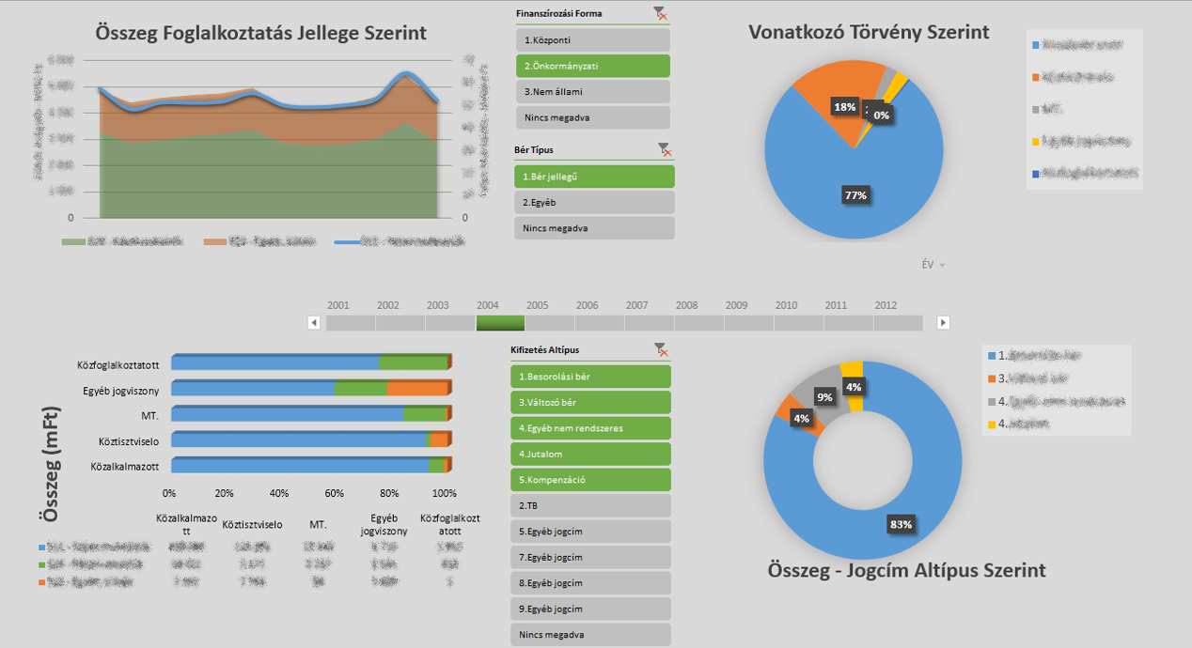
GOALS
Functional Demo
Management dashboards – SharePoint Excel Services (slicer, timeline)

Slide 11
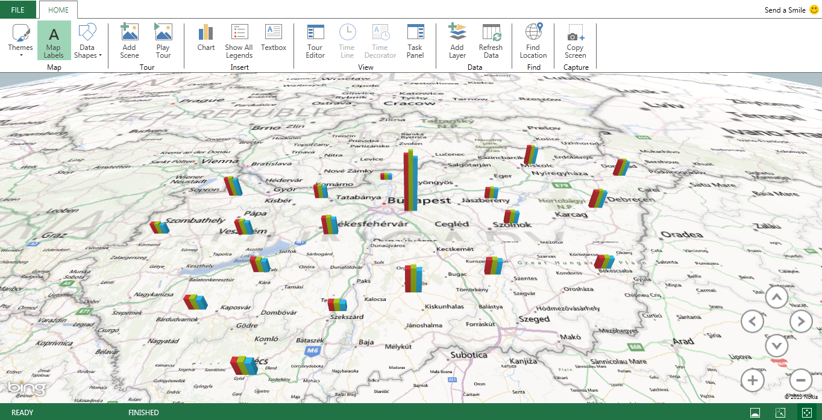
GOALS
Functional Demo
Spatial visualization – Excel PowerView (GeoFlow!)

Slide 12
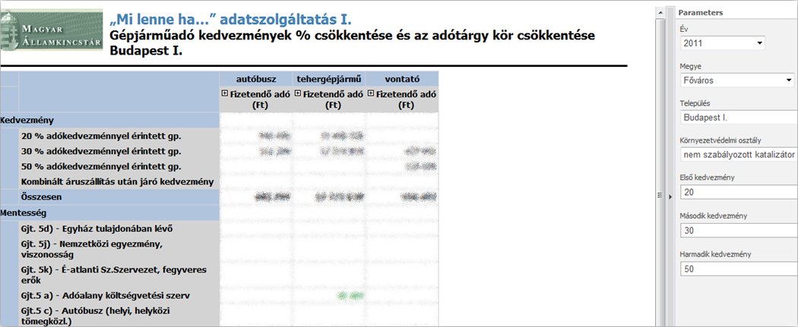
GOALS
Functional Demo
What-if analysis – SQL Server Reporting Services

Slide 13
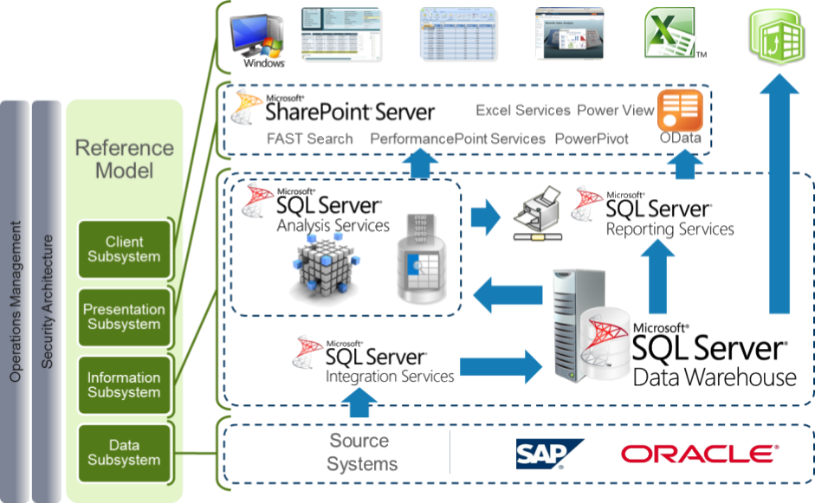
SOLUTION

Slide 14
Source SYSTEMS
KIRINFO
Centralized Payroll System, 12 years of historical data
2.4 billion rows, 450 GB raw data
Oracle RDBMS database
AMFORA
Vehicle Taxation Records, 3 years of historical data
10 million rows
SQL Server database

Slide 15
Data warehouse
Data warehouse
150 GB in snowflake schema
60 GB with SQL Page Compression
+ 60 GB “universal” ColumnStore Index
Initial load
  2.4 billion rows, 12 years historical data
  ETL: <1 hour
  Compression and indexing: Overnight

Slide 16
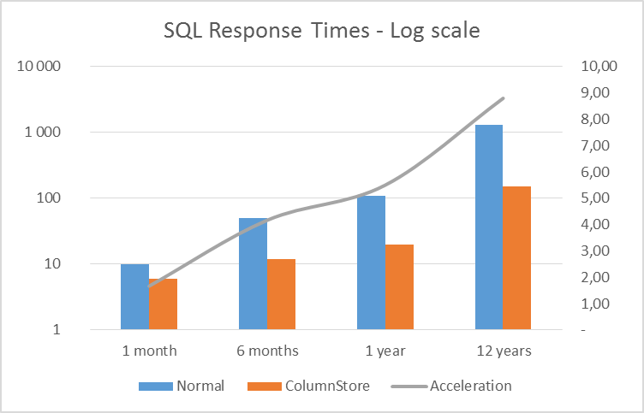
DWH RESPONSE TIMES
SQL Server features
Table Partitioning
Data Compression (page, row)
ColumnStore Index

Slide 17
TabulaR MODEL
Tabular Model
60 GB in Tabular Model
In-memory model
Good performance with ad-hoc queries
Response times <1 sec
Rapid development, no aggregation design needed
Initial load: Overnight

Slide 18
MOLAP
Multidimensional OLAP
140 GB in MOLAP database
Not need to be in-memory
Good performance requires
aggregation design and partitioning
Response times <1 sec
Multidimensional and aggregation design needed
Initial load: Overnight
(Demonstrated <1 sec response times on notebook with 32 GB RAM…)
Four queries executed simultaneously

Slide 19

