Slide 1
A mini-workshop on the ILC Cryogenics and He Inventory
Objectives
    Overview the ILC cryogenics design and further optimize it, to provide reliable inputs for CFS work during the ILC preparation phase.
      Focusing on optimization of locations for major components such as main-compressors and He inventory
      Establishing the safety guideline and design
Agenda (18, June)
9:00 Opening remark: Mike Harrison
9:10 ILC preparation in Japan: Akira Yamamoto
9:30 ILC Cryogenics design including updates: Hirotaka Nakai
- focusing on the main-compressor location and He-inventory, and
- necessary space on surface / underground,
10:10 ILC Geological Conditions and Constraints: Tomoyuki Sanuki
- focusing on vertical shaft/access location for cost-effective design
10:30 Coffee break
10:50 CERN's experience for He inventory and advice: Dimitri Delikaris
- focusing on He main-compressor location, and He inventory
- please show us a safety training video for information,
- please report the recent study.
11:20 Discussion for the ILC He inventory safety and actions required
12:00 Closing remark: Laurent Tavian

Slide 2
ILC Preparation in Japan
Akira Yamamoto
KEK / CERN
to be presented at A mini-workshop on ILC Cryogenics and He Inventory
held at CERN, 18 June, 2014

Slide 3
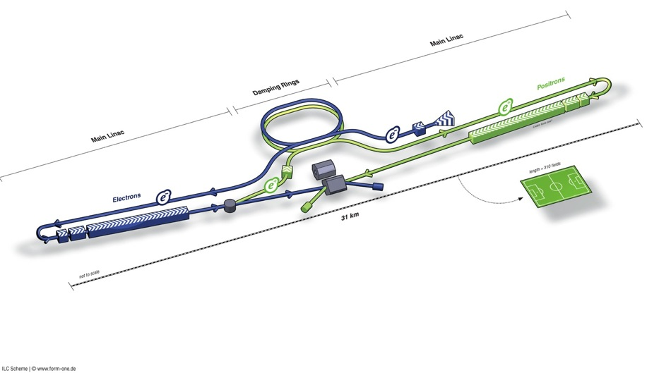
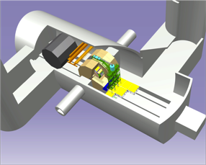
ILC TDR Layout
Damping Rings
Polarised electron source
Ring to Main Linac (RTML)
(including
bunch compressors)
e+ Main Linac
e- Main Linac
Parameters | Value
C.M. Energy | 500 GeV
Peak luminosity | 1.8 x10³⁴ cm⁻²s⁻¹
Beam Rep. rate | 5 Hz
Pulse duration | 0.73 ms
Average current | 5.8 mA (in pulse)
E gradient in SCRF acc. cavity | 31.5 MV/m +/-20% Q₀ = 1E10
E+ source

Slide 4
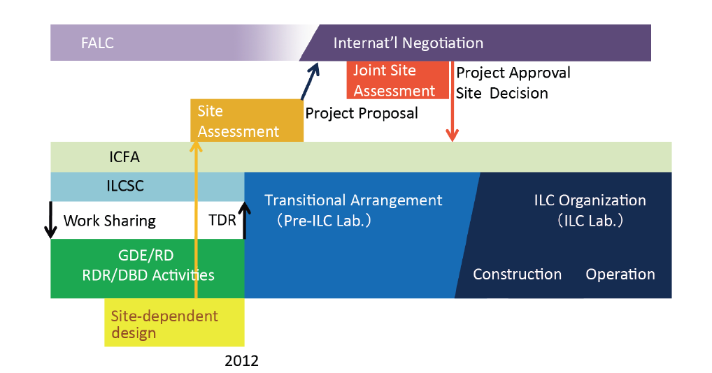
ILC Time Line: Progress and Prospect
Preparation Phase
Expecting ~ (3+2) year
since (middle) 2013
We are here, 2014

Slide 5
LCC-ILC Accelerator Organization
LCC-ILC Director: M. Harrison, Deputies: N. Walker and H. Hayano *KEK LC Project Office Head: A. Yamamoto
Sub-Group | Global Leader Deputy/Contact p. | KEK-Leader* Deputy | Sub-Group | Global Leader Deputy/Contact P. | KEK-Leader* Deputy
Acc. Design Integr. | N. Walker (DESY) K. Yokoya(KEK) | K. Yokoya | SRF | H. Hayano (KEK) C. Ginsburg (Fermi), E. Montesinos (CERN) | H. Hayano Y. Yamamoto
Sources (e-, e+) | W. Gai (ANL) M. Kuriki (Hiroshima U.) | J. Urakawa T. Omori | RF Power & Cntl | S. Michizono (KEK) TBD (AMs , EU) | Michizono T. Matsumoto
Damping Ring | D. Rubin (Cornell) N. Terunuma(KEK) | N. Terunuma | Cryogenics (incl. HP gas issues) | H. Nakai: KEK T. Peterson (Fermi), D. Delikaris (CERN) | H. Nakai Cryog. Center
RTML | S. Kuroda (KEK) A. Latina (CERN) | S. Kuroda | CFS | A. Enomoto (KEK) V. Kuchler (Fermi), J. Osborne (CERN), | A. Enomoto M. Miyahara
Main Linac (incl. B. Compr. & B. Dynamics) | N. Solyak (Fermi) K. Kubo (KEK) | K. Kubo | Radiation Safety | T. Sanami (KEK) TBD (AMs, EU) | T. Sanami T. Sanuki
BDS | G. White (SLAC), R. Tomas (Cern) T. Okugi(KEK) | T. Okugi | Electrical Support (Power Supply etc.) | TBD | TBD
MDI | K. Buesser (DESY) T. Tauchi (KEK) | T. Tauchi | Mechanical S. (Vac. & others) | TBD | TBD
 |  |  | Domestic Program, Hub Lab. Facilities | TBD | H. Hayano T. Saeki
Major Task: Fix technical design parameters to be optimized, and reflect them to CFS design optimization, within a few years.

Slide 6
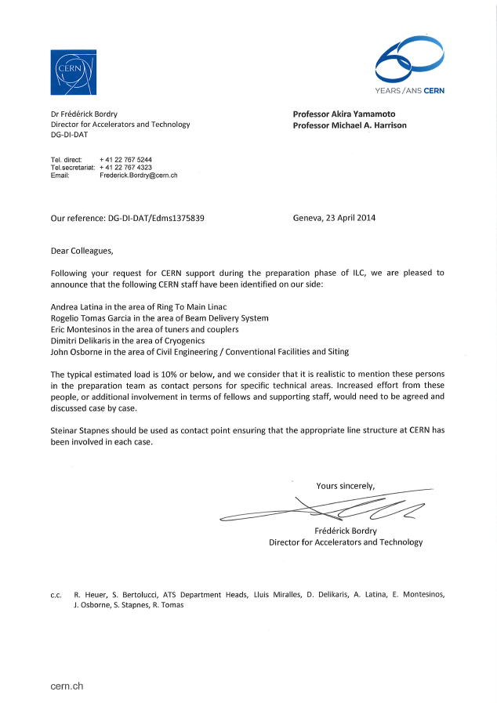
LCC-ILC Accelerator Organization
LCC-ILC Director: M. Harrison, Deputies: N. Walker and H. Hayano *KEK LC Project Office Head: A. Yamamoto
Sub-Group | Global Leader Deputy/Contact p. | KEK-Leader* Deputy | Sub-Group | Global Leader Deputy/Contact P. | KEK-Leader* Deputy
Acc. Design Integr. | N. Walker (DESY) K. Yokoya(KEK) | K. Yokoya | SRF | H. Hayano (KEK) C. Ginsburg (Fermi), E. Montesinos (CERN) | H. Hayano Y. Yamamoto
Sources (e-, e+) | W. Gai (ANL) M. Kuriki (Hiroshima U.) | J. Urakawa T. Omori | RF Power & Cntl | S. Michizono (KEK) TBD (AMs , EU) | Michizono T. Matsumoto
Damping Ring | D. Rubin (Cornell) N. Terunuma(KEK) | N. Terunuma | Cryogenics (incl. HP gas issues) | H. Nakai: KEK T. Peterson (Fermi), D. Delikaris (CERN) | H. Nakai Cryog. Center
RTML | S. Kuroda (KEK) A. Latina (CERN) | S. Kuroda | CFS | A. Enomoto (KEK) V. Kuchler (Fermi), J. Osborne (CERN), | A. Enomoto M. Miyahara
Main Linac (incl. B. Compr. & B. Dynamics) | N. Solyak (Fermi) K. Kubo (KEK) | K. Kubo | Radiation Safety | T. Sanami (KEK) TBD (AMs, EU) | T. Sanami T. Sanuki
BDS | G. White (SLAC), R. Tomas (Cern) T. Okugi(KEK) | T. Okugi | Electrical Support (Power Supply etc.) | TBD | TBD
MDI | K. Buesser (DESY) T. Tauchi (KEK) | T. Tauchi | Mechanical S. (Vac. & others) | TBD | TBD
 |  |  | Domestic Program, Hub Lab. Facilities | TBD | H. Hayano T. Saeki
Major Task: Fix technical design parameters to be optimized, and reflect them to CFS design optimization, within a few years.

Slide 7
Further Global Cooperation Expected
Category | Work-base | Specific subject | Global Collaboration w/
Positron Source |  | Positron source | PosiPol Collaboration
Nano Beam | ATF | 37 nm beam 2 nm stability | ATF collaboration
SCRF Cavity Integration | STF | Power Input Coupler Tuner He-Vessel | CERN-DESY-KEK CEA-Fermi/SLAC-KEK DESY-KEK (WS at CERN? Autumn. 2014)
CM integration | STF, ILC | Conduction-cooled SC Quadrupole | Fermilab-KEK
Cryogenics | ILC | Cryog. Underground He inventry High p. Gas Safety | CERN-Fermilab-KEK (WS at CERN, 18 June)
CFS | ILC | CFS design prep. | CERN-Fermilab-KEK
Radiation Safety | ILC | ML radiation shield | SLAC-DESY-CERN-KEK (Session during this week)

Slide 8
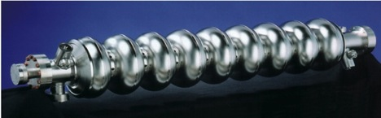
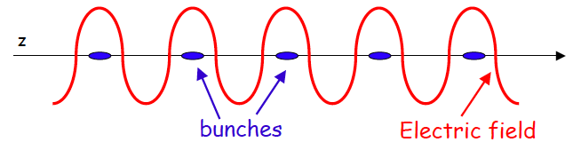
ILC Accelerator Technology
Nano-beam Technology
SRF Technology
8
Notes:
8

Slide 9
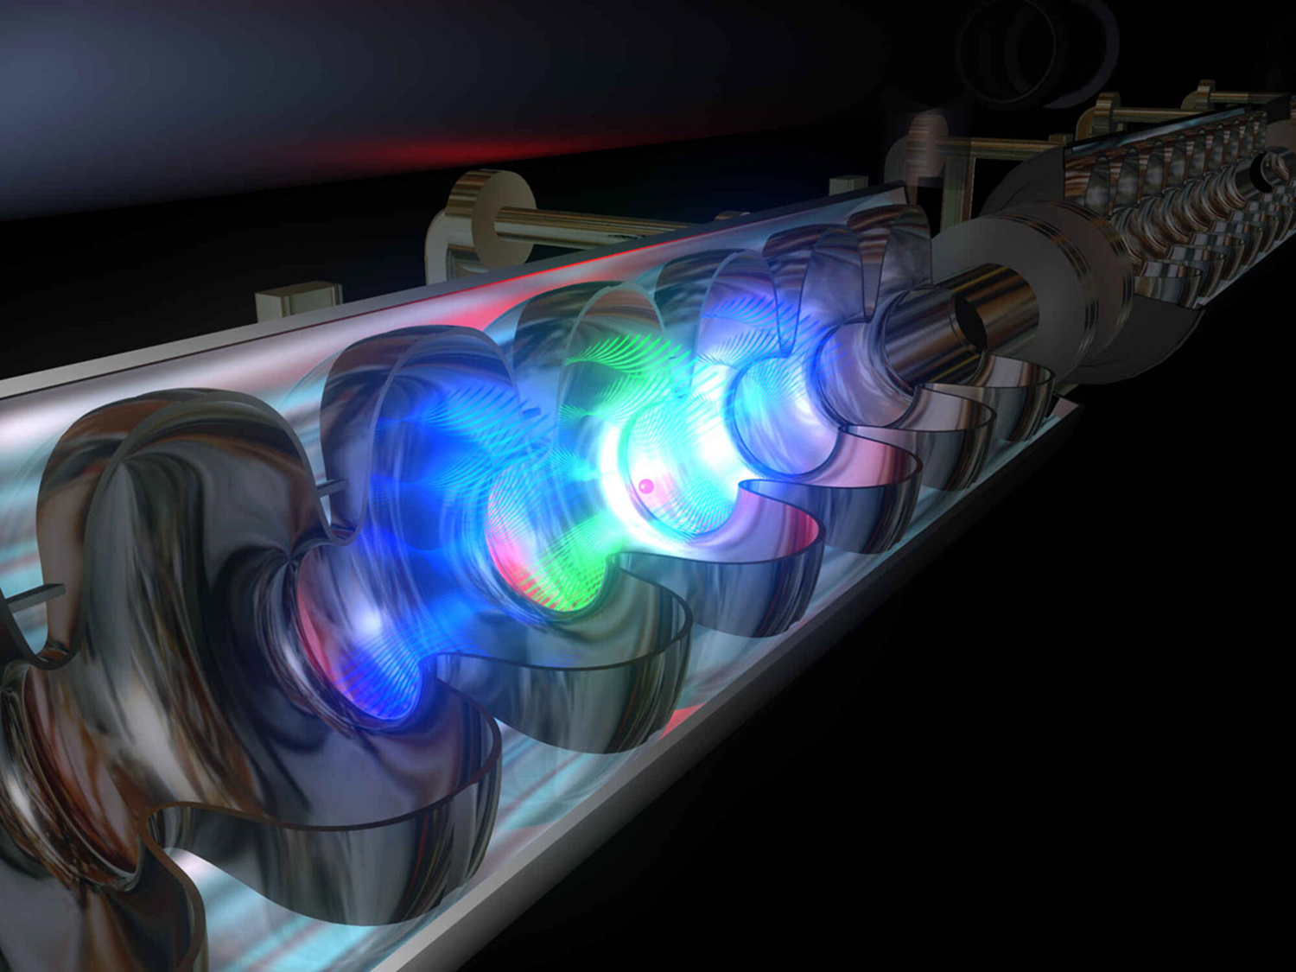
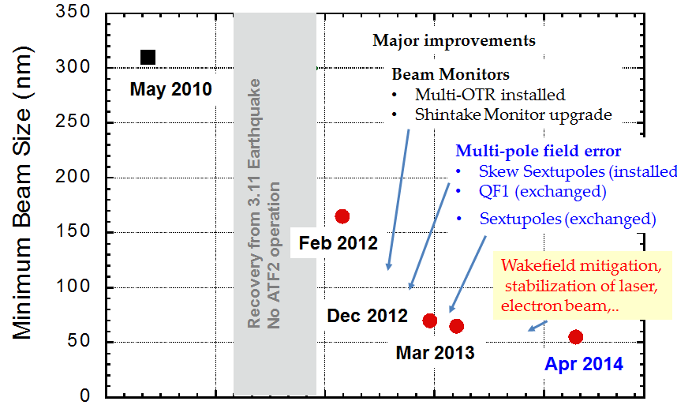
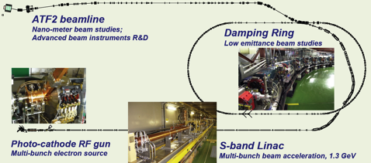
ATF2: Final Focus Test Beamline
History of ATF2 minimum beam size:
Beam trajectory stabilization with nm precision:
April 2014: routinely reach < 60 nm vertical beam size (low intensity)
Future Goals:
→achieve beam size of 37 nm
(beam-size monitor improvement required;
optics for final focusing needs to be established)
→achieve beam stability of a few nm and
ILC-like intra-train feedback
(instrumentation improvement to reach IPBPM
resolution of 2 nm in the 2 ~ 3 years)
Further improvement will be reported by the
ATF2 collaboration at the IPAC14
N. Terunuma
Major improvements in beam-size tuning:
Quick recovery of beam size down to < 60 nm (in less than 1 day)
Good reproducibility (after machine is off for an extended period of time)
April 2014:

Slide 10

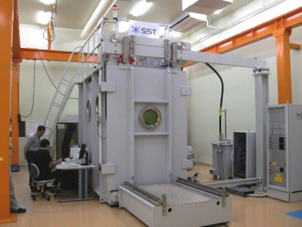
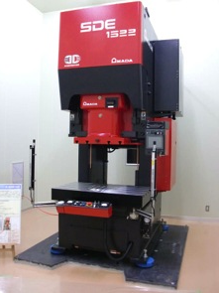
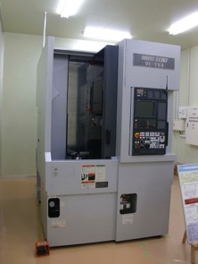
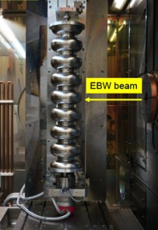
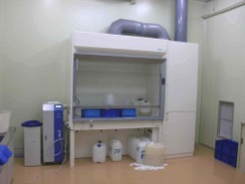
Effort to lead industrialization technology at KEK
EBW
Press
Trim
SST EBOCAM KS-110 – G150KM
Chamber (Stainless Steel chamber)
AMADA digital-survo-press SDE1522
150t, 50stroke/min, 225mmstroke
MORI VKL-253
Vertical CNC lathe
More discuss w/
Y. Yamamoto,
T. Saeki,
H. Hayano
Chemical
process

Slide 11
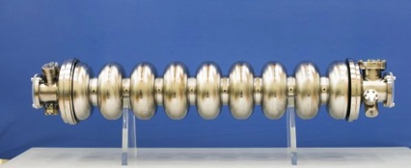
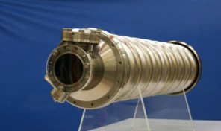
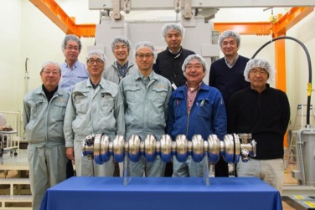
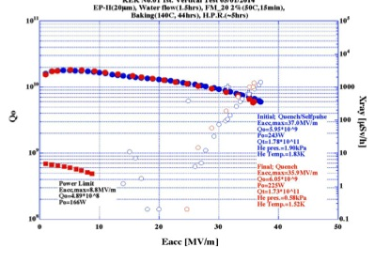
KEK (in-house) 9-Cell Cavity (KEK-01) completed, and tested, April, 2014
Reached 36 MV/m at the first vertical RF Test at 1.9 K, April, 2014

Slide 12
Required ADI Information
Expected Input (for facility arrangement)
  Determination of DH (Detector Hall) Location
    IR point (including elevation)
    Layout of the Beam Line route and elevation
  Access way to DH (Vertical or Horizontal or,)
Expected Input (for Cross section)
  Decision of the Cross-section for the main part
    BDS Beam Line Layout & Cross-section
    Shield Wall thickness in ML-tunnel (Sanami-san reported)
  Cryogenics Equipment layout
    Arrangement of He-Tank & Cold box
    Anti-vibration measure of the Compressor
  Install Method to MLT (include AH Cross-section)
    Cryomodules & RF, Cold box

Slide 13
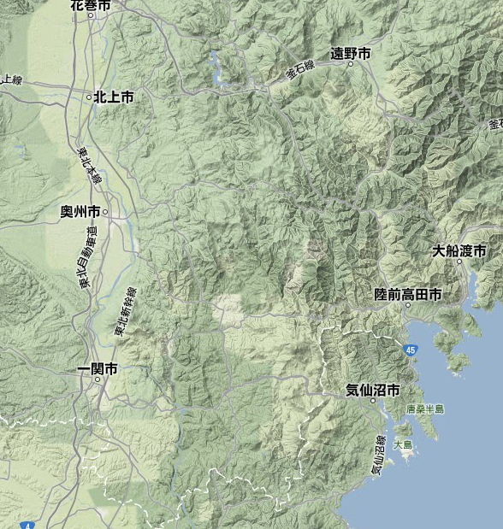
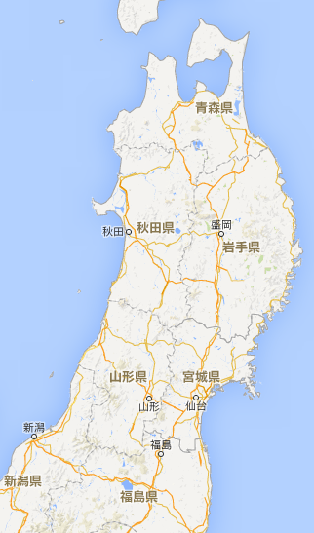
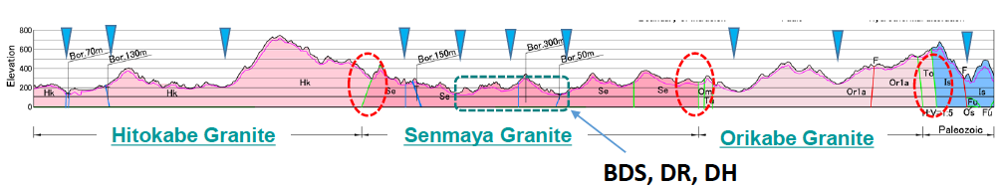
ILC Candidate Location: Kitakami Area
High-way
Ofunato
Oshu
Express-
Rail
Kesen-numa
Sendai
Ichinoseki
IP Region

Slide 14
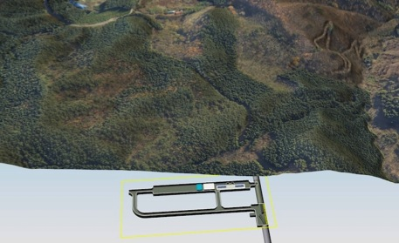
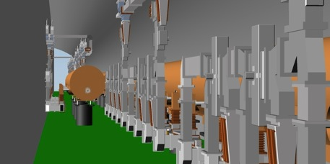
ILC Design Integration and 3D Modeling implemented into the ILC-EDMS: in cooperation with DESY-EDMS Team
B. List and H. Lars
Objectives:
Study relation of underground structures and surface buildings to landscape
Adjust caverns and tunnels to accelerator lattice and vice versa
Allocate space in tunnel for transport, installation, survey, safety, infrastructure
Reserve sufficient space for beamline components
Share a common vision of the project between involved people: scientists, engineers, politicians, local population, general public

Slide 15
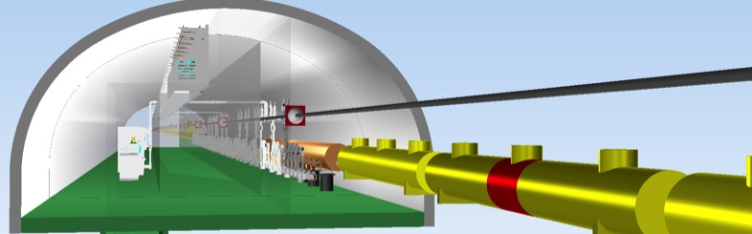
Engineering Data Management (EDMS)
B. List and H. Lars
Collaborative engineering:
- Design integration, visualisation, traceability, configuration management
Design integration:
- Geology, Civil engineering, accelerator design, experimental groups
Different user groups in remote:
- ILC Community, Planning team, local team, sub-contractors
Standardization:
- Names, procedures, formats, conventions, design rules
Tunnel
RF Distribution
Lattice
Cryomodules

Slide 16
Pre Construction Schedule
Long term & Medium term
1 annual |  | 2 annual |  | 3 annual |  | 4 annual |  | 5 annual
Predesign Phase
Design Phase
Contract Phase
Basic Planning
Basic Design
Detailed Design
Contract
Estimation
Construction Phase
LCC Review
LCC Review
LCC Review
Basic Plan Report
Basic Design Document
Detailed Design Document
Contract Document
Investigation in the Design Phase
Topographical Survey
Geological Survey
Environmental Impact Assessment

Slide 17
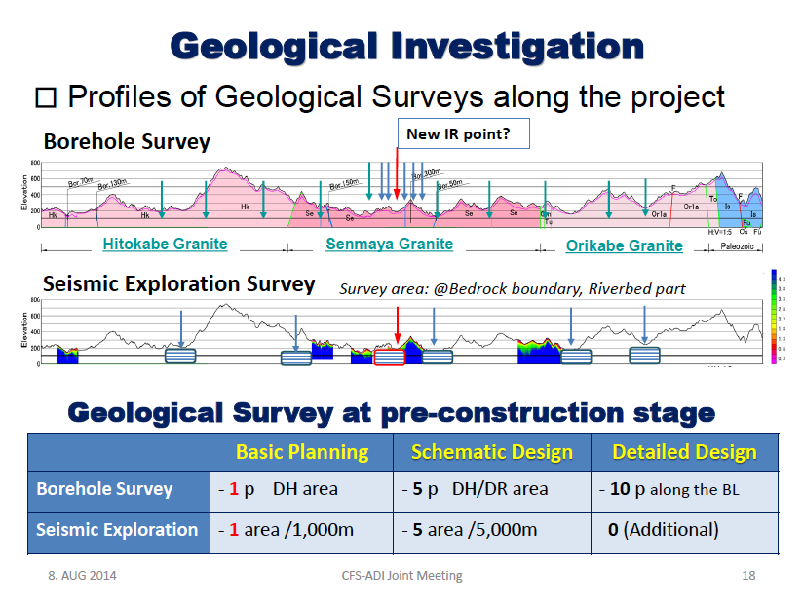

Slide 18
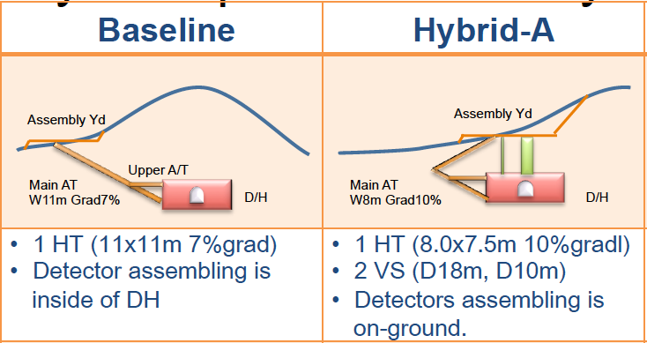
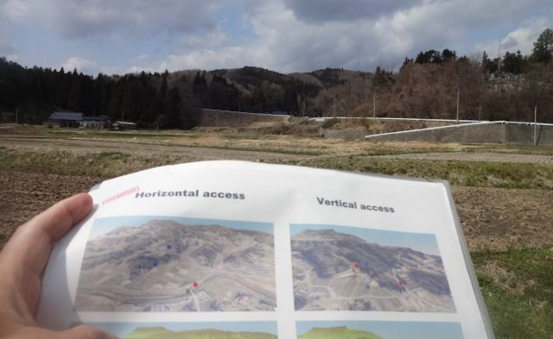
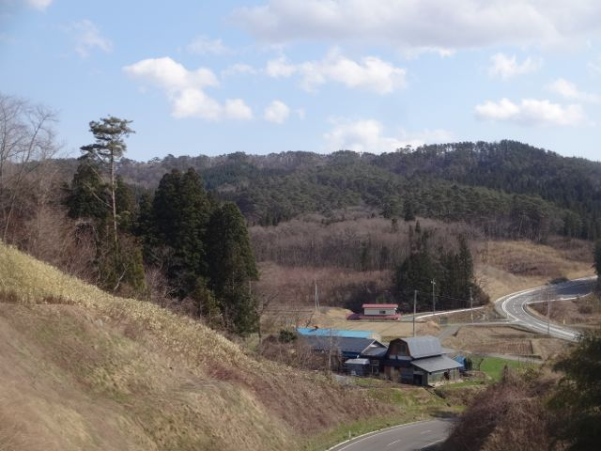
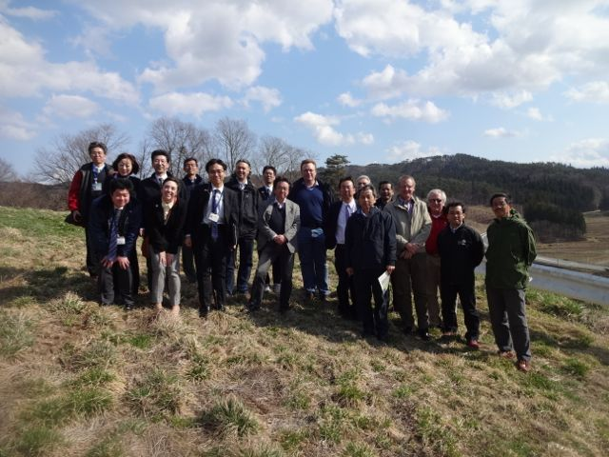
IP Access Design under Re-investigation
TDR IP point

Slide 19
Hybrid - A
One Vertical Shaft
One Access Tunnel
Main Shaft D18m
Main Shaft
Utility Shaft
DH Access Tunnel
DR Access Tunnel

Slide 20
Hybrid – A´
One Vertical Shaft
One Access Tunnel
(for DH/DR)
DR/DH Access Tunnel
Main Shaft D18m
Main Shaft
Utility Shaft
DR/DH Access Tunnel

Slide 21
ILC Preparation in Japan focusing on to
Establish a cite-specific Civil Engineering Design (CFS), assuming “Kitakami” as a primary candidate site in Japan,
  Optimum cryogenics design to be established
    Location of Major components, access, and He Inventory / Safety
      Can we consider variation/combination of vertical and horizontal access?
Demonstrate:
  Nano-beam handling at ATF, hosted in Japan
  SRF beam acceleration at STF, hosted in Japan
Establish, in Japan, the technology with the best cost-effective approaches and industrialization,

Slide 22
Main Subjects to be discussed
Optimum Cryogenics Layout
  Locations of Main compressors and He Inventory, and possible variations from view points of
    Cost effective construction, operation, and maintenance
    Environment
    Vibration
    Safety for liquid-gas handling (LHe and LN2 (if necessary))
Input to CFS design
    Within a period of ~ one year,
    A goal to establish a basic consensus on the cryogenics layout, by LCWS-14, October, this year

