Slide 1
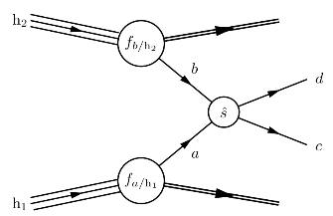
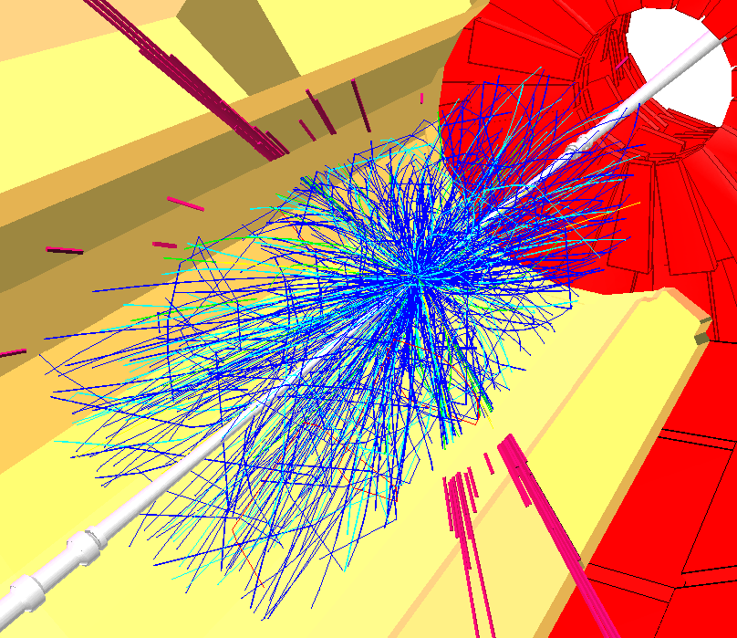

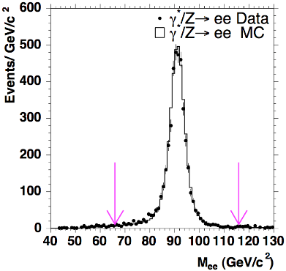
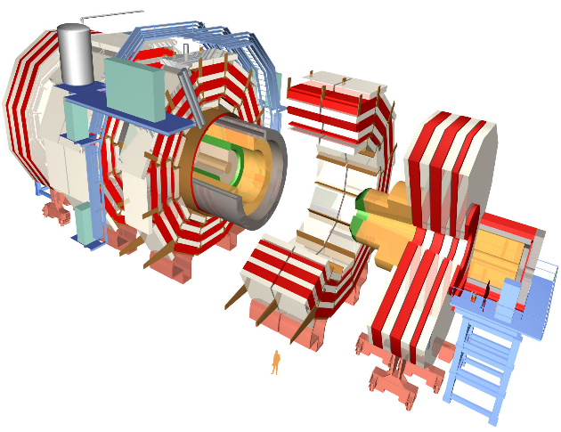

From Detectors to Publications
Helge Meinhard
CERN
CERN Openlab Summer Student Lectures 2014

Slide 2
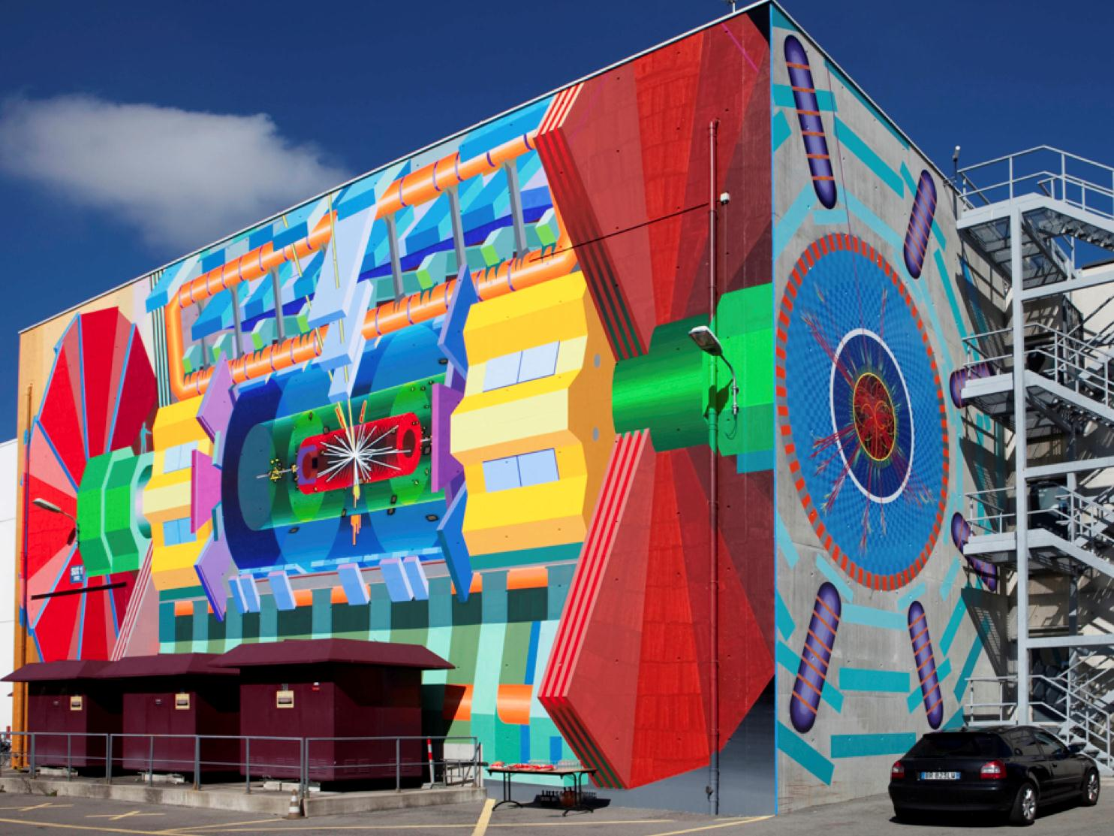
Outline
Brief introduction to CERN
Overview of process from detectors to results
Reconstruction
Simulation
Physics Analysis
Computing
Summary
  Acknowledgement: Contents partly based on 3-part lecture given in 2013 summer student lecture programme
  Thanks to Jamie Boyd et al.

Slide 3
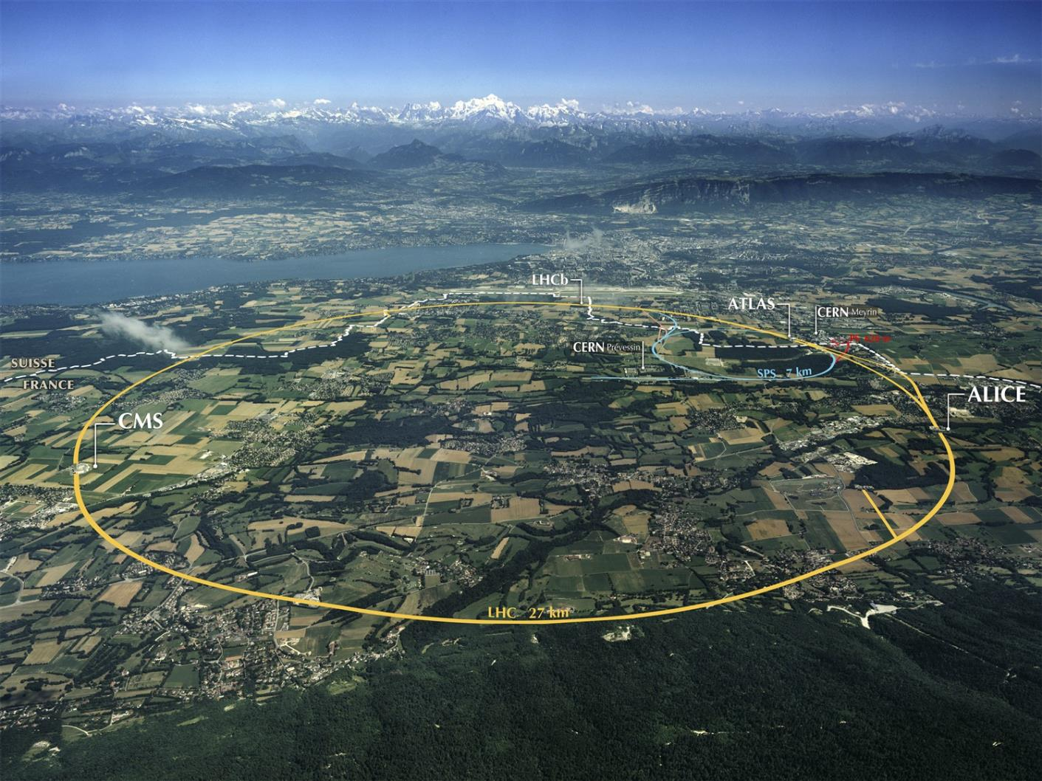
1. Introduction to CERN

Slide 4
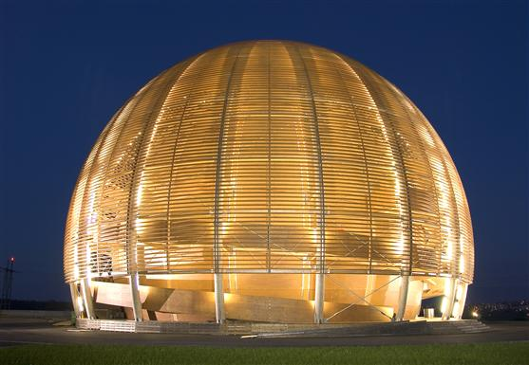
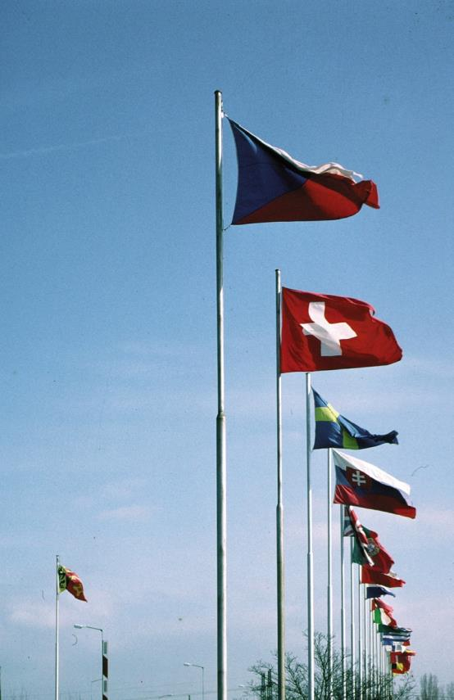
CERN
“Science for peace”
International organisation close to Geneva, straddling Swiss-French border, founded 1954
Facilities for fundamental research in particle physics
21 member states,
1 B CHF budget
3’360 staff, fellows, students, apprentices, …
11’000 users
1954: 12 Member States
Members: Austria, Belgium, Bulgaria, Czech republic, Denmark, Finland, France, Germany, Greece, Hungary, Israel, Italy, Netherlands, Norway, Poland, Portugal, Slovak republic, Spain, Sweden, Switzerland, United Kingdom
Candidate for membership: Romania
Associate member: Serbia
Observers: European Commission, India, Japan, Russia, Turkey, UNESCO, United States of America
Numerous non-member states with collaboration agreements
2’512 staff members, 540 fellows, 315 students, 24 apprentices
6’700 member states, 1’800 USA, 900 Russia, 236 Japan, …

Slide 5
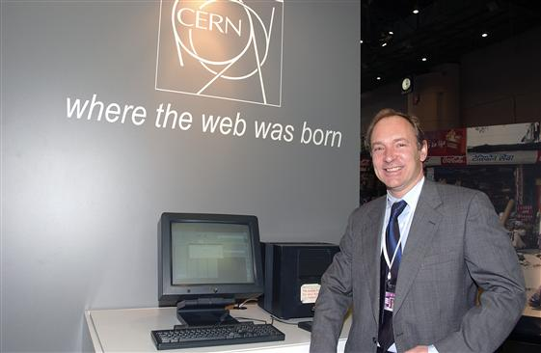
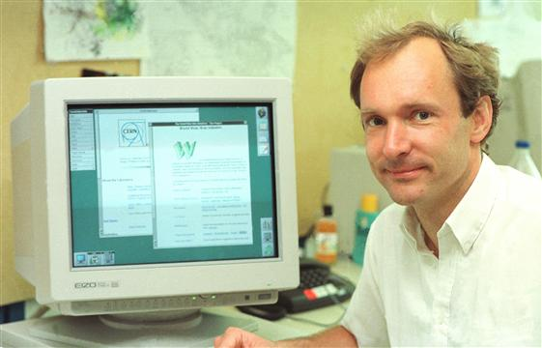

CERN – where the Web was born

Slide 7
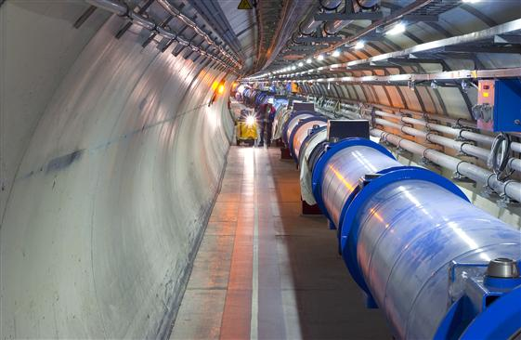
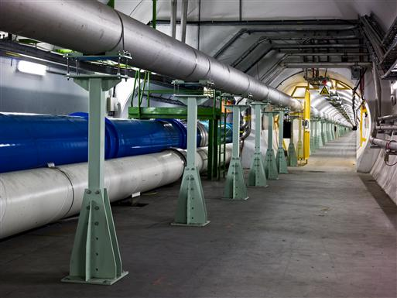
LHC – Large Hadron Collider
Proton-proton collider
27 km circumference
Started operation in 2010 with 3.5 + 3.5 TeV, continued in 2011, 4 + 4 TeV in 2012
  World’s most powerful particle accelerator
Run 1 until early 2013
Now in Long Shutdown 1 – machine upgrade
Restart early 2015 at 6.5 + 6.5 TeV

Slide 8
Four Large Detectors
ATLAS, CMS, ALICE, LHCb
Some ATLAS facts:
  100 million channels
  25 m diameter, 46 m length, 7’000 tons
  3’000 scientists (including 1’000 grad students)
  40 MHz collision rate
  Run 1: 300 Hz event rate after filtering
All LHC experiments: 30’000 TB in 2012, 100’000 TB in total

Slide 9
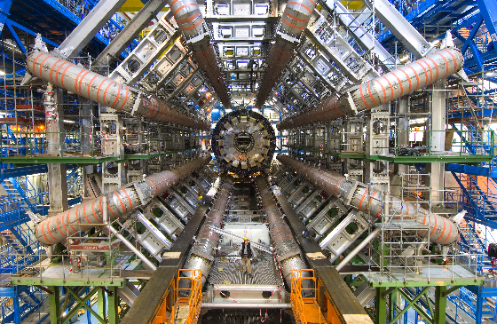

Slide 10
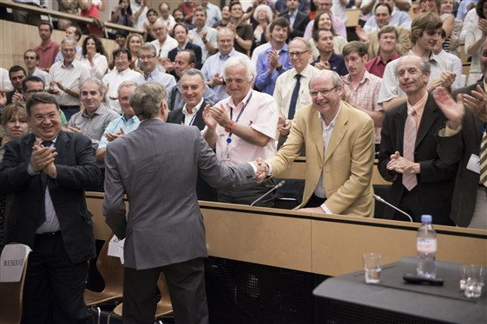
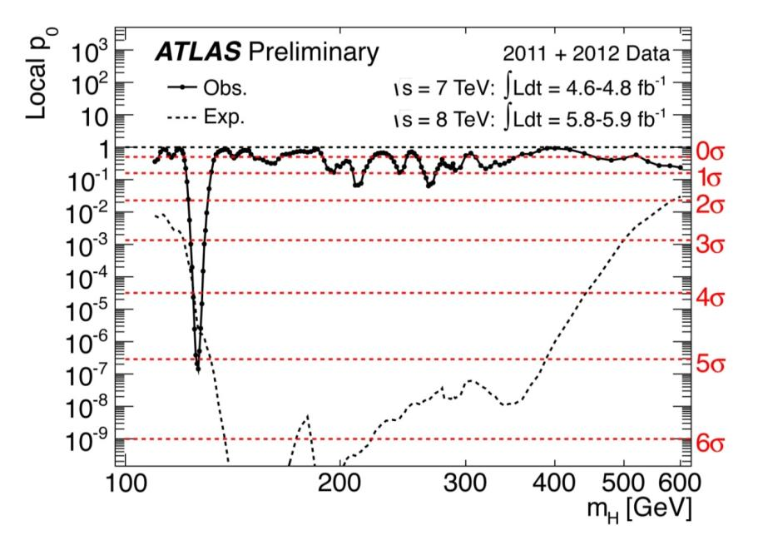
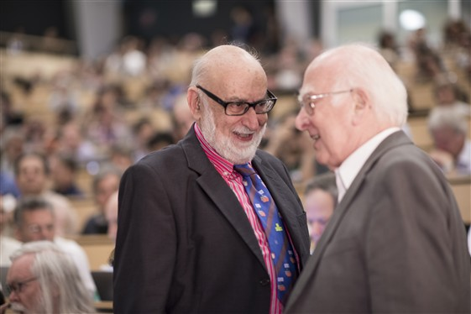

Results so far
Many… the most spectacular one being
04 July 2012: Discovery of a “Higgs-like particle”
March 2013: The particle is indeed a Higgs boson
08 Oct 2013 / 10 Dec 2013: Nobel price to Peter Higgs and François Englert
  CERN, ATLAS and CMS explicitly mentioned

Slide 11
2. Overview of the process

Slide 12
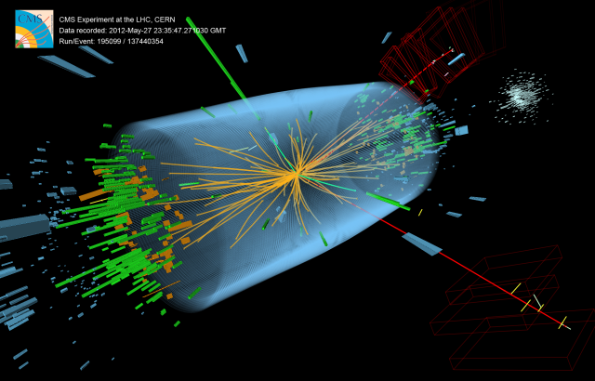
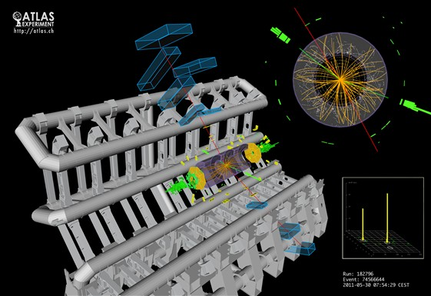
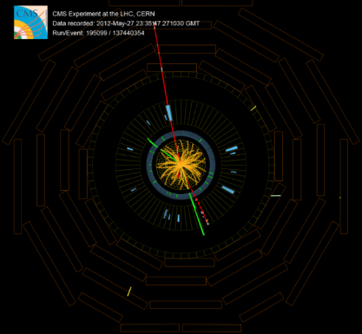
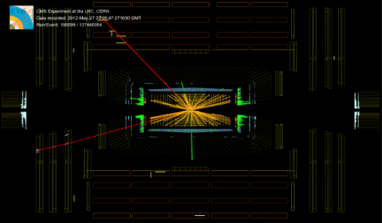
Physics Results ARE NOT…
Finding a single ‘golden’ event (or a few of them)

Slide 13

Physics Results ARE…
… statistical comparisons of experimental data with theoretical predictions

Slide 14
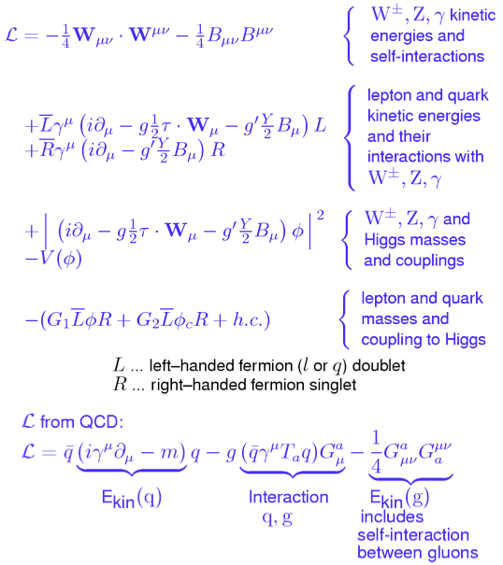
Theory...
eg.
the Standard Model
has parameters
coupling constants
masses
predicts:
cross sections,
branching ratios, lifetimes, ...

Slide 15
Experiment…
150 million active elements
20 (40) million bunch crossings per second
O(1 PB/s) internal data rate
Data reduction:
Suppress electronic noise
Decide to read out and save event, or throw it away (trigger)
Build the event (assemble all data)
O(300 Hz) event rate
O(500 MB/s) data rate

Slide 16
Compare Theory with Experiment
Define “observables”: Physics quantities that are sensitive to variations in theoretical predictions
  Cross sections (probability of a certain type of interaction to occur)
  Branching ratios
  Particle masses
  Particle lifetimes
  …
Calculate statistically these observables over a large number of events recorded
Calculate statistically these observables as you expect them from theory
Compare the two
  Fit parameter(s)
  Check fit quality

Slide 17
Analysis Flow
Detector & Trigger
Simulated data
Reconstruct event candidates
Reconstruction
Reconstruction
Select events
Calculate observables
Cut on observables
Physics Analysis
Physics Analysis
Compare theory and experiment
21

Slide 18
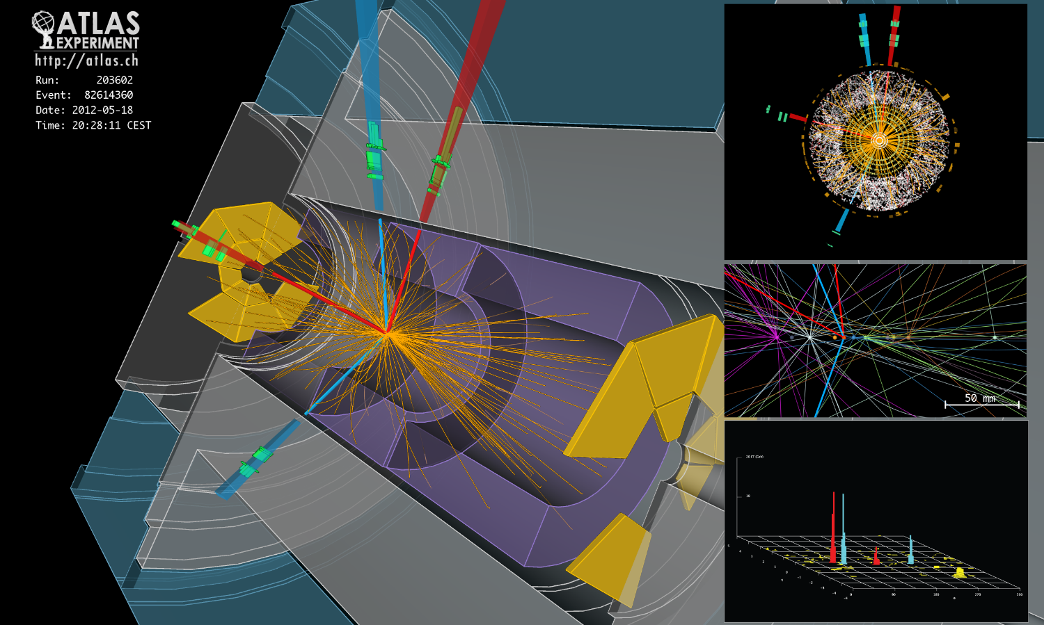
Detector (and Trigger) (1)
Proton-proton collisions create numerous secondary particles at interaction point
These secondary particles must be detected

Slide 19
Detector (and Trigger) (2)
Particle detectors generally consist of two major elements:
  Tracking detectors in the centre: measure precisely tracks of secondary particles
  Calorimeters surrounding: Let particles dump all their energy and measure the energy deposited
A magnetic field in the detector forces charged particles on a helix path

Slide 20
Detector (and Trigger) (3)
Secondary particles are detected by their ionising effect on the detector material
  Different techniques: gaseous devices, semiconductor devices, light-emitting devices, …
Every cell can deliver a single measurement
  Often 3-dimensional, sometimes 2-dimensional points
Detector/trigger/data acquisition system deliver raw data of an ‘event’: a collection of such points

Slide 21
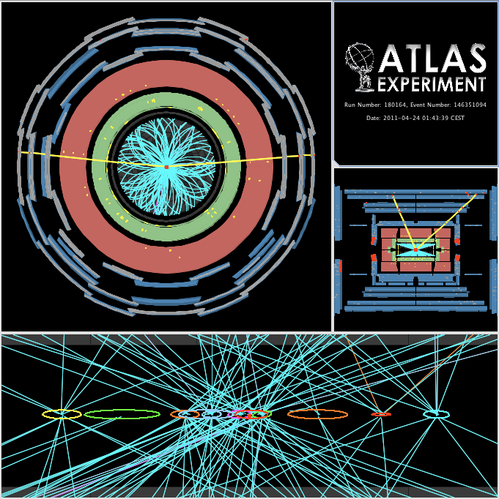
3. Reconstruction

Slide 22
Reconstruction
From points to identified particles:
Detector reconstruction
  Tracking
    finding path of charged particles through the detector
    determining momentum, charge, point of closest approach to interaction point
  Calorimeter reconstruction
    finding energy deposits in calorimeters from charged and neutral particles
    determining energy deposit, location, and direction
Combined reconstruction
  Electron/photon identification
  Muon identification
  Jet finding

Slide 23
Reconstruction: Figures of Merit
Efficiency
  How often do we reconstruct the object correctly?
Resolution
  How accurately do we reconstruct it (momentum / energy, vertex position etc.)?
Fake rate
  How often do we reconstruct an object different from the real one?
These figures depend on
  Detector
  Reconstruction algorithms, calibration, alignment
We want/need
  High efficiency, good resolution, low fake rate
  … to know the efficiency, resolution, fake rate
  Robustness against detector problems
  Fit into computing resource limitations (CPU, memory)

Slide 24
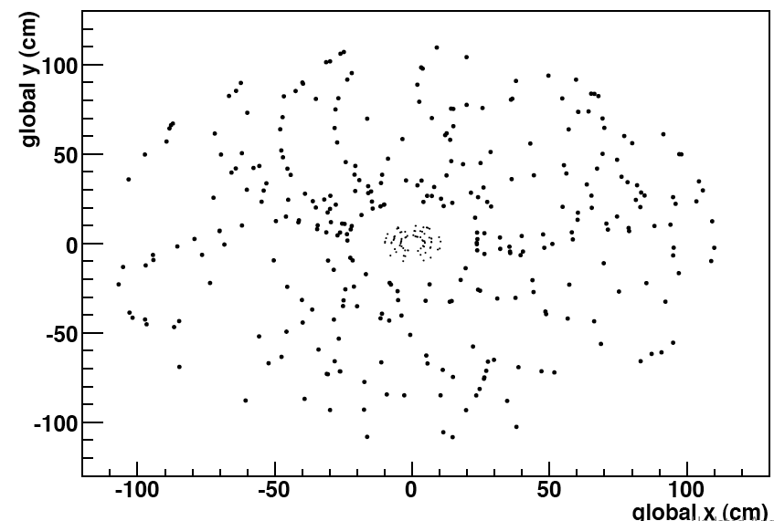
Tracking: An Example
Where is the 50 GeV track?

Slide 25
Tracking Issues
Ionisation is a statistical process
Ionisation means energy loss: momentum and direction of original particle get (slightly) changed
Detector elements not perfectly aligned
(LHC) Pile-up: a single collision of two proton bunches results in more than one proton-proton collision
  Up to around 30 in Run 1, expected > 50 in Run 2

Slide 26
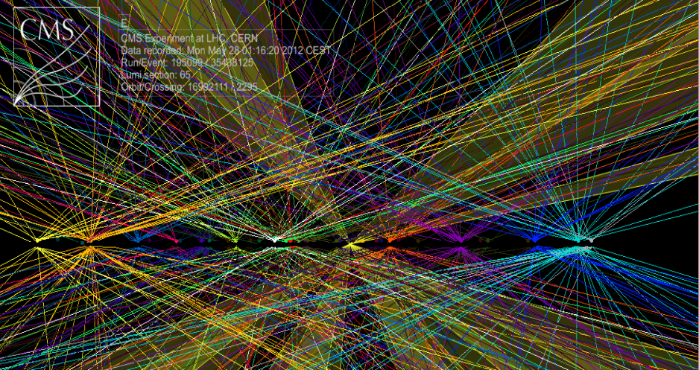
Pile-up Example

Slide 27
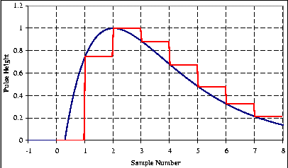
q
e⁺
Z⁰
q
e⁻
4. Simulation
particle
detector
element

Slide 28
Why Simulation?
Compare observables with expectations from theoretical models, which leads to physics results
Design detectors
Optimise trigger settings
Tune analysis selections
Estimate background and systematic errors
Estimate efficiency, resolution and fake-rate
…

Slide 29
Simulation Steps: 1. Physics
Simulate physics interaction at proton-proton collision
Input: parameters of physics model
Output: events with four-vectors of secondary particles
q
e⁺
Z⁰
q
e⁻

Slide 30
Simulation Steps: 2. Detector
Simulate interaction of secondary particles with the detector material
  Includes ionisation, bending of charged particles in magnetic field, …
  Requires very complete and detailed detector description
Based on standard toolkit GEANT 4
Very CPU-intensive (more so than reconstruction)
particle
detector
element

Slide 31
Simulation Steps: 3. Electronics
Simulate the response of the detector elements to interactions of secondary particles passing through
  Requires very detailed description of detector electronics
Technically often combined with step 2 (detector simulation) – GEANT 4
Output is very similar to detector raw data
  Information of ‘truth’ kept all the way through

Slide 32
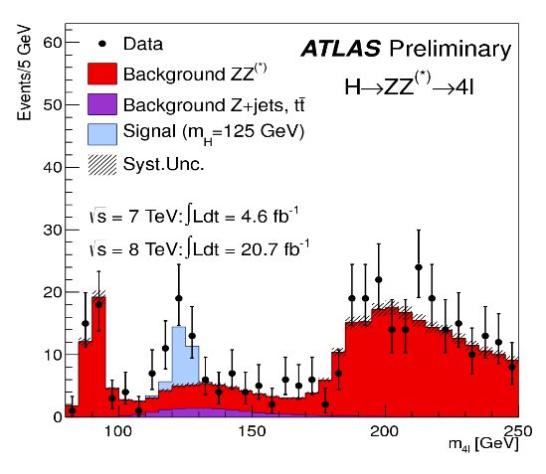
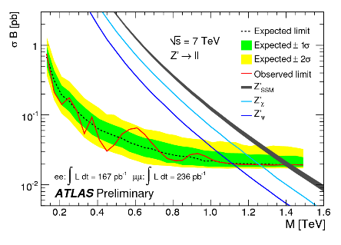
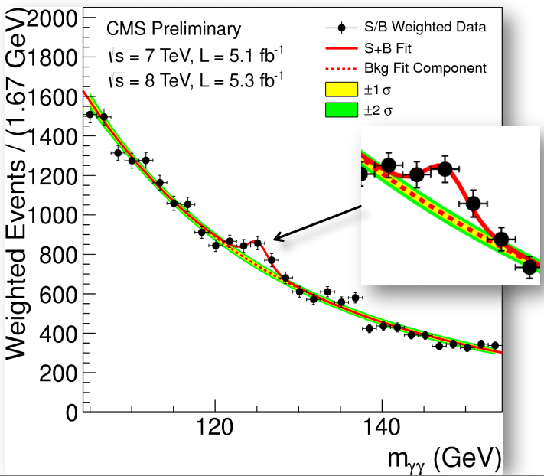
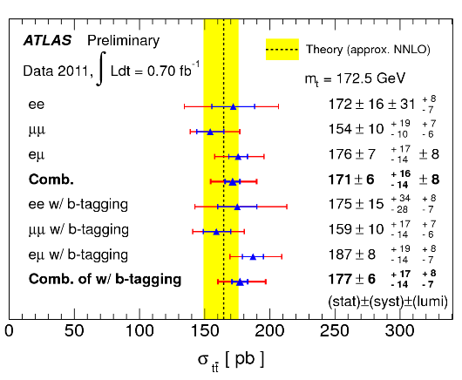
5. Physics Analysis
125 GeV

Slide 33
Types of Physics Analyses
Search for new particles / phenomena
  Usually limited by statistics
  Negative result (nothing found) sets new exclusion limits
Precision measurements
  Usually limited by systematic uncertainties
  Serve as consistency check of the underlying theory (mostly the Standard Model)

Slide 34
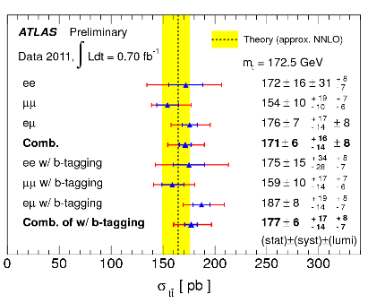
Physics Analysis Workflow (1)
Start with the output of reconstruction
Apply an event selection based on the reconstructed object quantities
  Often calculate new information, e.g. masses of combinations of particles
  Event selection designed to improve the ‘signal’ to ‘background’ in your event sample
Estimate
  Efficiency of selection (& uncertainty)
  Background after selection (& uncertainty)
  Can use simulation for these – but have to use data-driven techniques to understand the uncertainties
Make final plot
  Comparing data to theory
  Correcting for efficiency and background in data
  Include the statistical and systematic uncertainties

Slide 35
Physics Analysis Workflow (2)
Output of reconstruction is large (order of tens of PBs); simulation similarly large
LHC experiments have defined reduced data sets (both general and specific to certain physics channels)
Sometimes, final steps of analysis are based on an even more reduced private data set
Many of the analyses use standard packages for their final steps including presentation of plots and histograms, e.g. ROOT

Slide 36
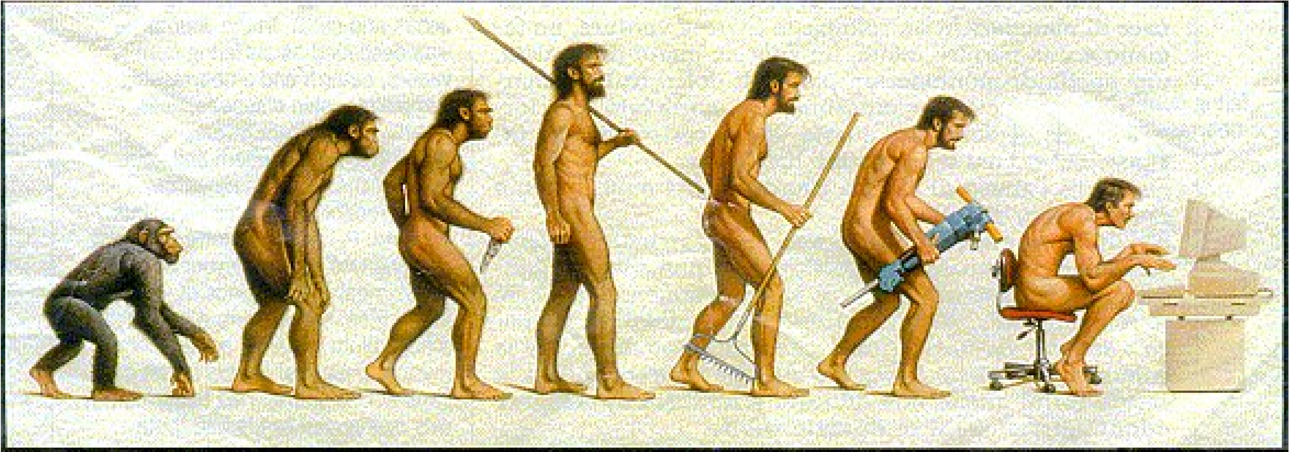
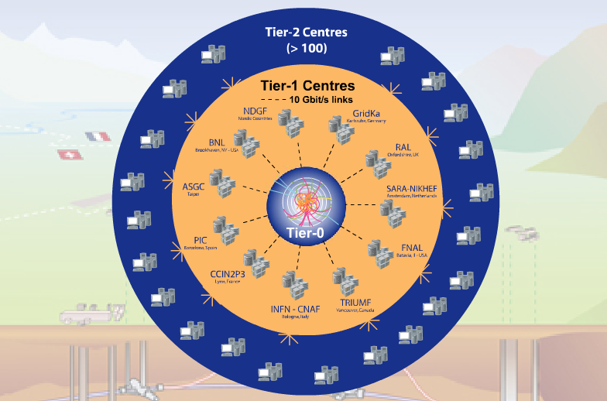
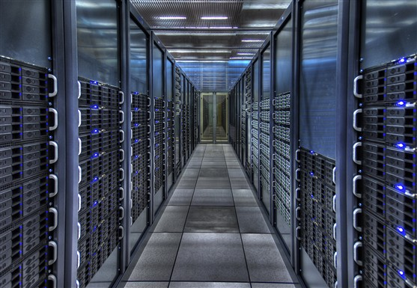
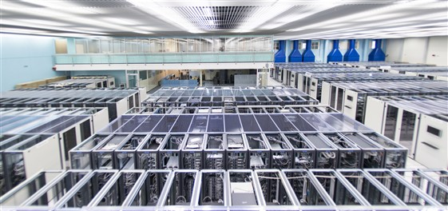
6. Computing

Slide 37
The Nature of the Problem
Enormous numbers of collisions of proton bunches with each other
  Data from each collision are small (order 1…10 MB)
  Each collision independent of all others
No supercomputers needed
  Most cost-effective solution is standard PC architecture (x86) servers with 2 sockets, SATA drives, Ethernet network
  Linux (Scientific Linux, RHEL variant) used everywhere
Calculations are mostly combinatorics – integer (rather than floating-point) intensive

Slide 38
The Scale of the Problem
2012: 30’000 TB of new data from LHC experiments
  CD tower of 50 km height, or 1’000 years of videos on DVD
Requires 250’000 fast compute cores, 200’000 TB disk space, 207’000 TB tape space
CERN able to provide some 15% of this capacity

Slide 39
WLCG – what and why?
A distributed computing infrastructure to provide the production and analysis environments for the LHC experiments
Managed and operated by a worldwide collaboration between the experiments and the participating computer centres
The resources are distributed – for funding and sociological reasons
Our task was to make use of the resources available to us – no matter where they are located
Tier-0 (CERN):
  Data recording
  Initial data reconstruction
  Data distribution
Tier-1 (11 centres):
Permanent storage
Re-processing
Analysis
Tier-2 (~130 centres):
Simulation
End-user analysis
Notes:
The Tier 0 centre at CERN stores the primary copy of all the data. A second copy is distributed between the 11 so-called Tier 1 centres. These are large computer centres in different geographical regions of the world, that also have a responsibility for long term guardianship of the data. The data is sent from CERN to the Tier 1s in real time over dedicated network connections.
In order to keep up with the data coming from the experiments this transfer must be capable of running at around 1.3 GB/s continuously. This is equivalent to a full DVD every 3 seconds.
The Tier 1 sites also provide the second level of data processing and produce data sets which can be used to perform the physics analysis. These data sets are sent from the Tier 1 sites to the around 130 Tier 2 sites.
A Tier 2 is typically a university department or physics laboratories and are located all over the world in most of the countries that participate in the LHC experiments. Often, Tier 2s are associated to a Tier 1 site in their region. It is at the Tier 2s that the real physics analysis is performed.

Slide 40
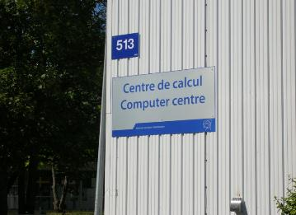
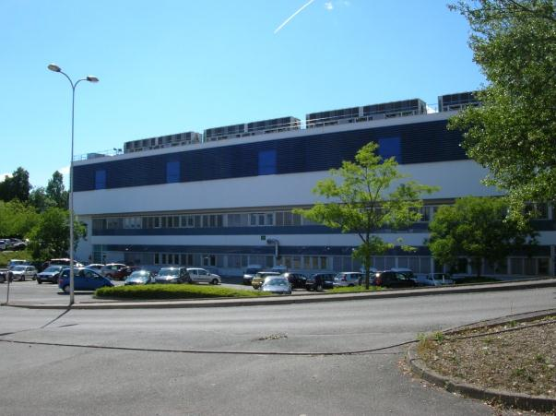
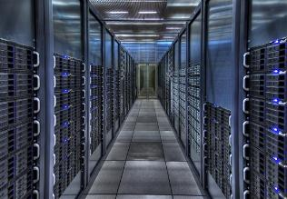
CERN Computer Centre
15% of LHC compute requirements
Services for other (smaller) experiments
Computing infrastructure for CERN and the collaborations hosted
January 2014: 10’500 servers, 76’000 disk drives, 52’000 tape cartridges
Total power/cooling envelope for IT equipment: 3.5 MW
  Not sufficient for requirements of LHC Run 2

Slide 41
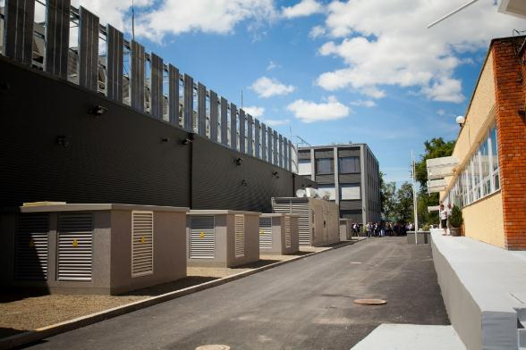
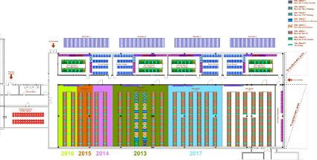
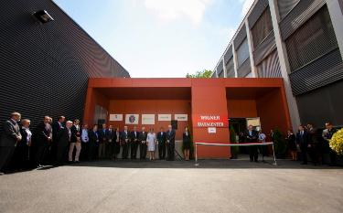
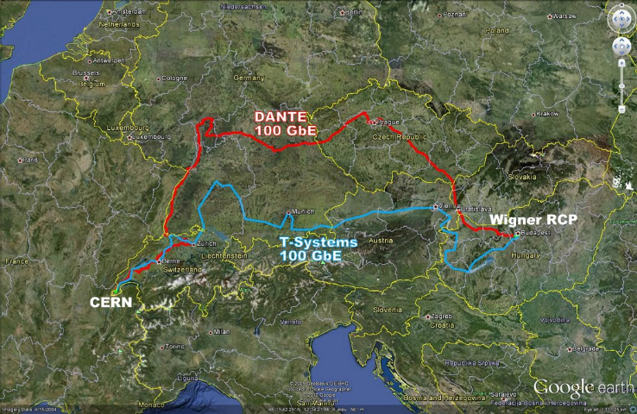
Extension: Wigner data centre in Budapest, Hungary
Result of open tender in CERN member states
First few 100 machines in production
Final envelope: 2.5 MW

Slide 42


CERN openlab in a nutshell
A science – industry partnership to drive R&D and innovation with over a decade of success
Evaluate state-of-the-art technologies in a challenging environment and improve them
Test in a research environment today what will be used in many business sectors tomorrow
Train next generation of engineers/employees
Disseminate results and outreach to new audiences

Slide 43


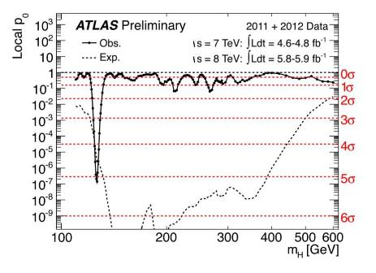

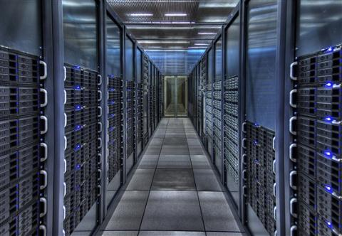
7. Summary

Slide 44
Physics results are statistical comparisons of observables with their theoretical predictions
Trigger/data acquisition, reconstruction, analysis, and simulation is how we get there
Sophisticated algorithms needed for reconstruction and analysis
  Calibration and alignment must be well controlled
Detailed simulation is key to the success
The single event is small and simple, but the computing scale is enormous
Software and computing must work very well in order to achieve results with the LHC

Slide 45
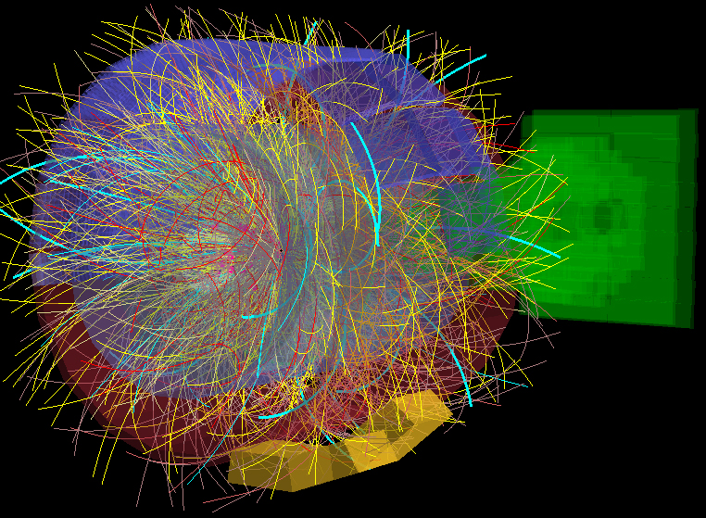
Thank you

