Slide 1
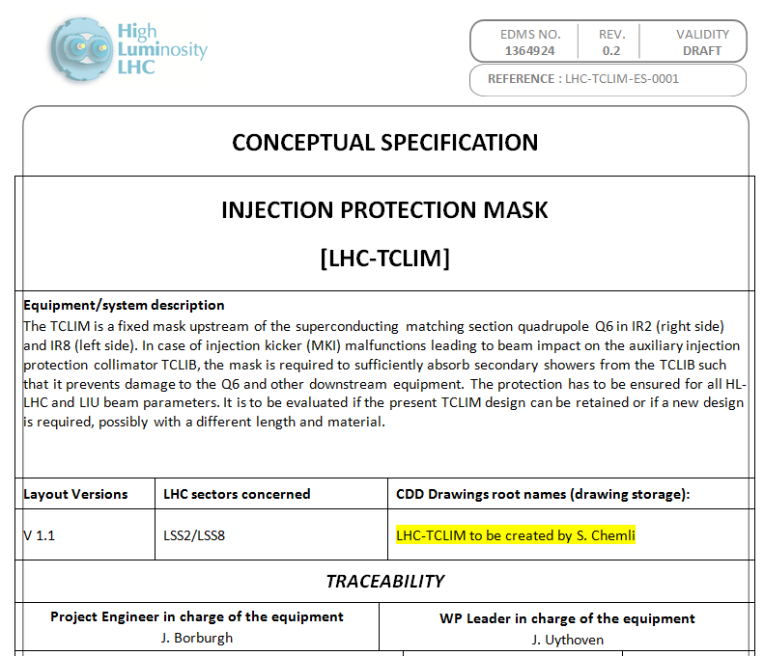

Slide 2
Main Points
Fixed mask to protect Q6 and other downstream elements at the other side of the IP where injection takes place, in case of injection failures
  Takes the shower from the TCLIB
  Presently made out of C
Studies ongoing if changes are required – together with TDIS – TCLIA – TCLIB protection studies

Slide 3
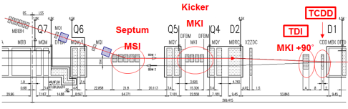
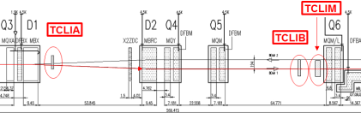
Layout
IP

