Slide 1

Hadron Spectroscopy
Alex Bondar
BINP, Novosibirsk
Novosibirsk State University
(Ljubljana, August 18, 2015)

Slide 2


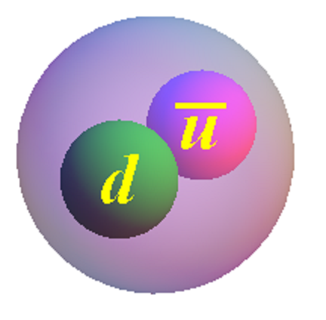

Gell-Mann
Constituent Quark Model
Mesons are bound states of quark and anti-quark:
Zweig
Baryons are bound states of 3 quarks:

Slide 3
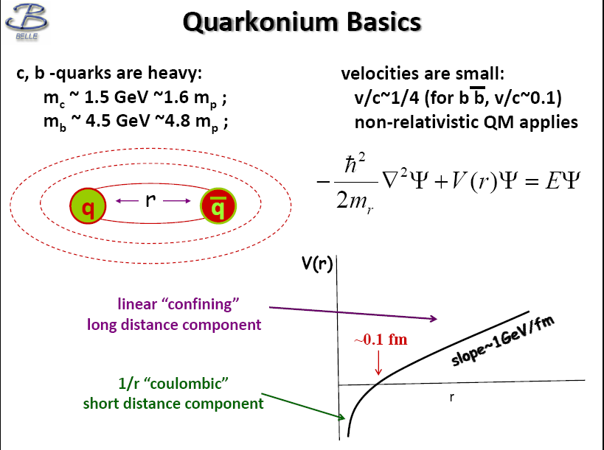
linear “confinement”
long distance component

Slide 4
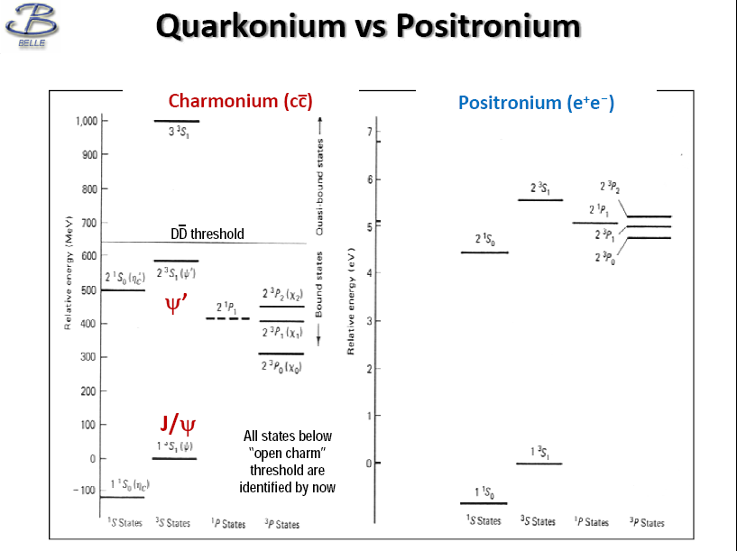
η_{c}’
χ_{c}
h_{c}
η_{c}

Slide 5
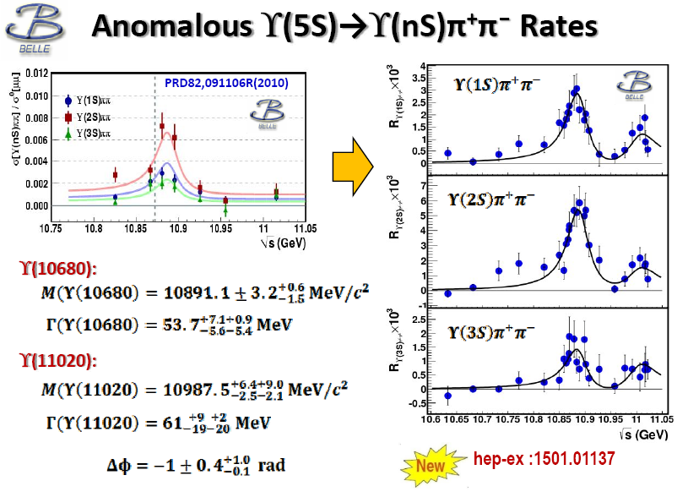

Slide 6


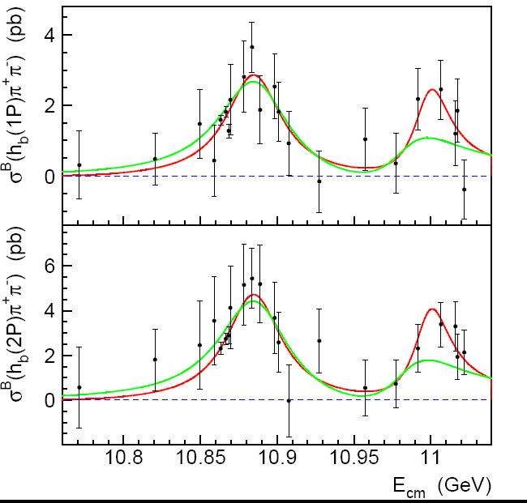
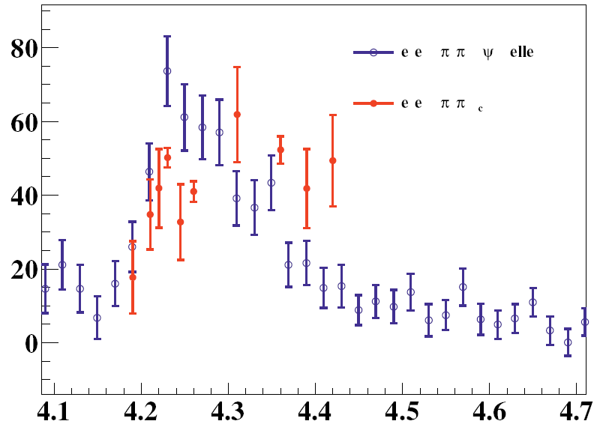
Energy dependence of h_{b}(1P,2P)π⁺π⁻
Υ(10680):
M(Υ(10680))=10884.7 MeV/c²
Γ(Υ(10680))=44.2 MeV
Υ(11020):
M(Υ(11020))=10998.6 + 6.1 MeV/c²
Γ(Υ(11020))=29 MeV
Δφ = 0.3 rad.
h_{b}(1P)π⁺π⁻
+3.2 +8.6
-2.9 -0.6
Y(2S)π⁺π⁻
+11.9 +2.2
-7.8 -15.8
+16.1
-1.1
+20 +2
-12 -7
h_{b}(2P)π⁺π⁻
Belle PRELIMINARY
+1.0
-1.5
σ,pb
J/Ψπ⁺π⁻
h_{c}π⁺π⁻
σ(h_{c}ππ)
m²Y(5S) q_{c}² ΓY(5S)
=
~
7
σ(h_{b}ππ)
m²Y(4260) q_{b}² ΓY(4260)
E_{cm}, GeV

Slide 7
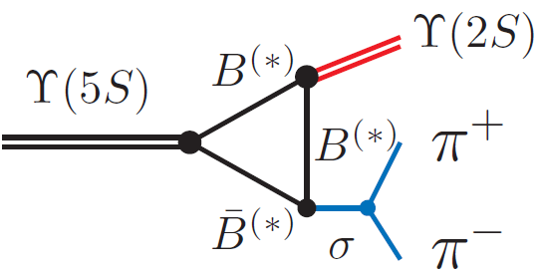

_
Anomalies in ϒ(5S)→(bb)π⁺π– transitions
ϒ(11020)
Belle: PRL100, 112001 (2008)
11.00
∼100
ϒ(10860)
Γ[ϒ(5S) →ϒ(1,2,3S) π⁺π–] >> Γ[ϒ(4,3,2S) →ϒ(1S) π⁺π–]
_
10.75
260
π⁺π–
⇐ Rescattering of on-shell B⁽*⁾B⁽*⁾ ?
2M(B)
ϒ(4S)
10.50
2
330
ϒ(3S)
Mass, GeV/c²
h_{b}(2P)
10.25
430
1
190
η_{b}(2S)
ϒ(2S)
Belle: PRL108, 032001 (2012)
10.00
h_{b}(1P)
290
6
ϒ(5S) → h_{b}(1,2P) π⁺π– are not suppressed
9.75
partial Γ(keV)
9.50
ϒ(1S)
expect suppression ∼Λ_{QCD}/m_{b}
η_{b}(1S)
spin-flip
Heavy Quark Symmetry
J^{PC} = 0⁻⁺ 1⁻⁻ 1⁻⁺
h_{b} production mechanism? ⇒ Study resonant structure in h_{b}(mP)π⁺π–

Slide 8
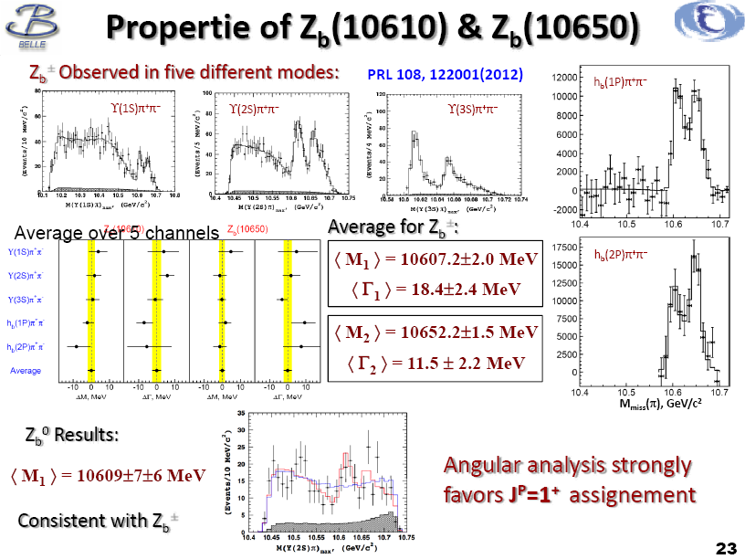
Properties of Z_{b}(10610) & Z_{b}(10650)
Z_{b}(10610)
Z_{b}(10650)
+
M₁-M_{B}-M_{B*} = 2.36 ⁺ 2.1 MeV
M₂-M_{B*}-M_{B*} = 1.8 ⁺ 1.75 MeV

Slide 9
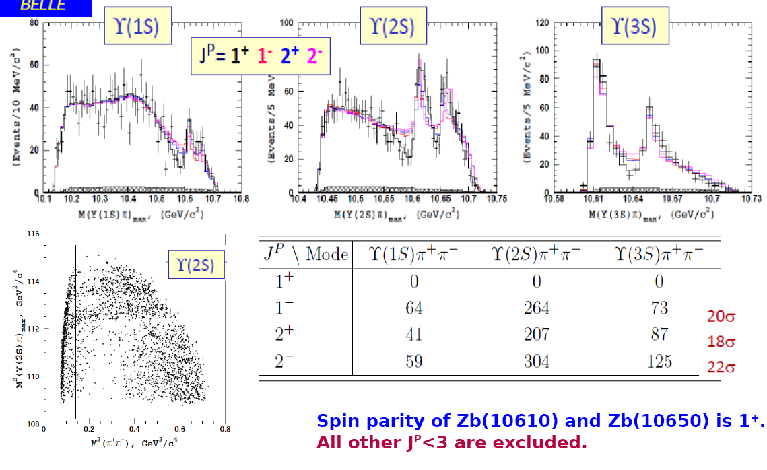
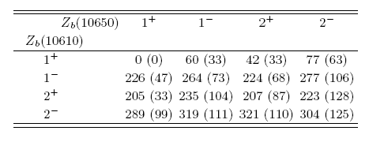
Amplitude analysis of e⁺e⁻ → Y(nS)π⁺π⁻
-
Belle: PRD 91,072003 (2015)

Slide 10
Molecule?

Slide 11
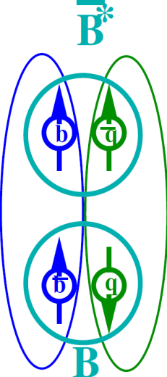

Heavy quark structure in Z_{b}
A.B.,A.Garmash,A.Milstein,R.Mizuk,M.Voloshin PRD84 054010 (arXiv:1105.4473)
Wave func. at large distance – B(*)B*
Explains
Why h_{b}ππ is unsuppressed relative to ϒππ
Relative phase ~0 for ϒ and ~180⁰ for h_{b}
Production rates of Z_{b}(10610) and Z_{b}(10650) are similar
Widths –”–
Dominant decays to B(*)B*
Other Possible Explanations
Coupled channel resonances (I.V.Danilkin et al, arXiv:1106.1552)
Cusp (D.Bugg Europhys.Lett.96 (2011),arXiv:1105.5492)
Tetraquark (M.Karliner, H.Lipkin, arXiv:0802.0649)
Notes:
11

Slide 12
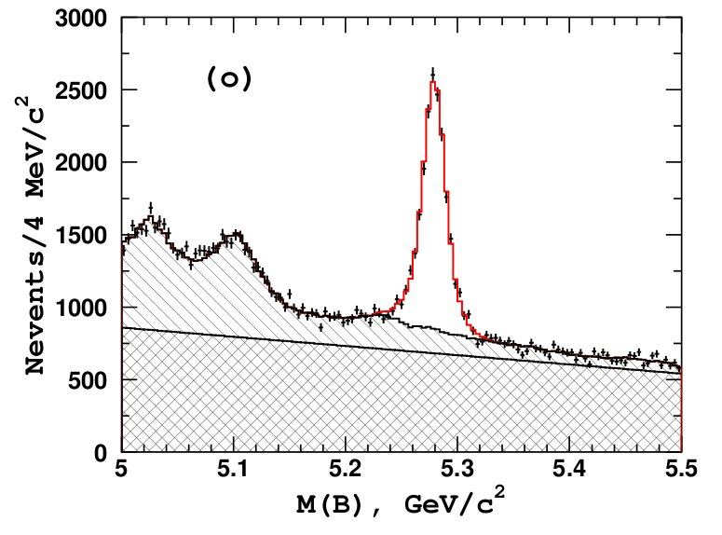
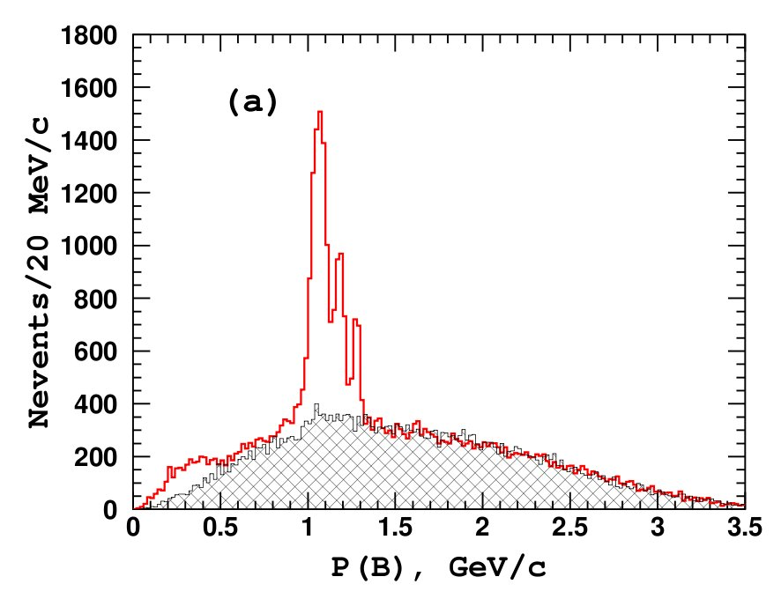
ϒ(5S)→Z_{b} π±
Masses of the observed Z_{b} resonances are close to the BB* and B*B* thresholds, respectively: branching fractions Z_{b} →B(*)B* might be large (dominant).
–
Analysis strategy:
B
π
Full reconstruction of one B meson
e+
e-
B*
18 B decay modes combined
_
B background
B*B*
B Signal
B signal
_
BB*
12263±168
_
BB
B sidebands
qq background
B⁽*⁾B⁽*⁾π + BBγ

Slide 13
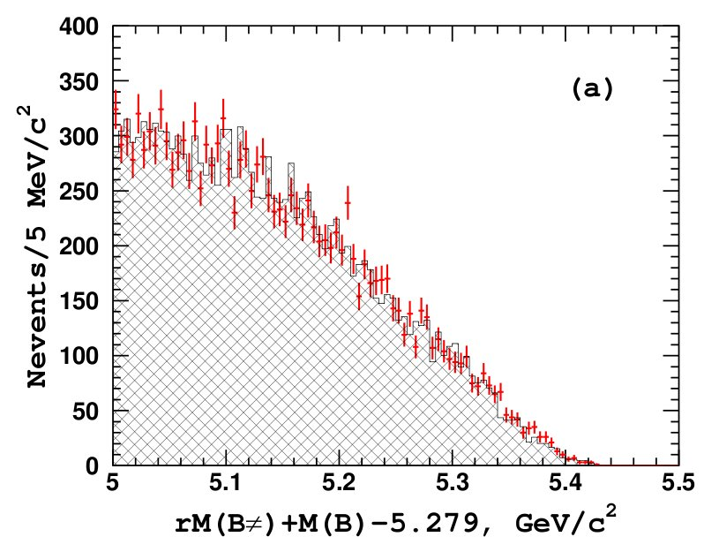

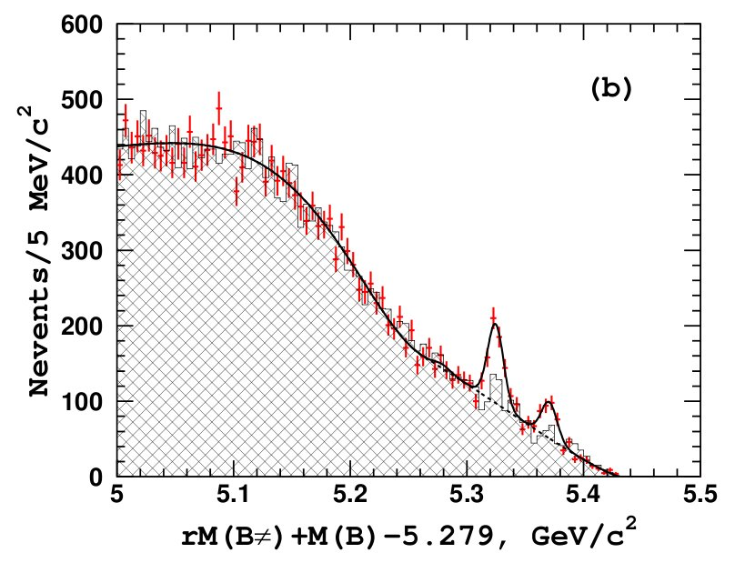
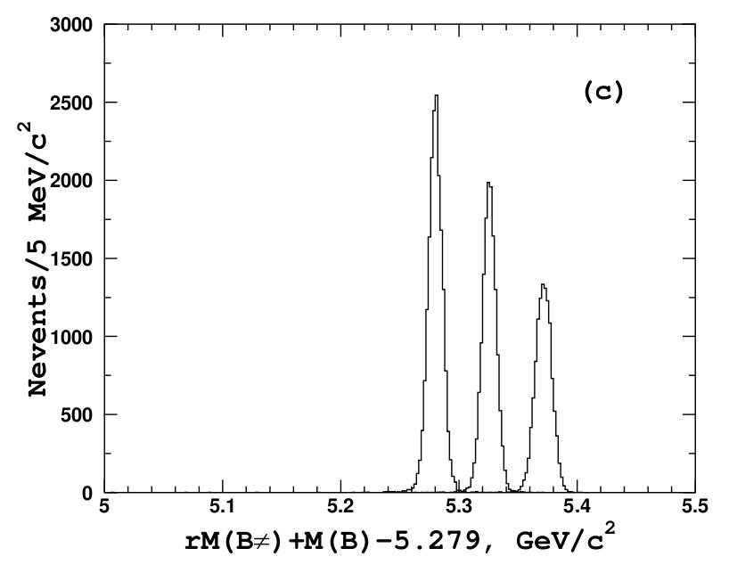

ϒ(5S)→Z_{b} π±
Analysis strategy:
Data:
M(B) sidebands
Combine the B with a charged pion from the rest of the event → calculate recoil mass against the Bπ system
RS data
WS data
BB threshold
RS data
rM(Bπ), GeV/c²
WS data
Fit
B⁽*⁾B⁽*⁾π
signal MC
rM(Bπ), GeV/c²
rM(Bπ), GeV/c²
N(BBπ ) = 13 ± 25
σ(e⁺e⁻→BBπ ) <
N(BB⁽*⁾π ) = 357 ± 30
σ(e⁺e⁻→BB⁽*⁾π ) =
N(B⁽*⁾B⁽*⁾π ) = 161 ± 21
σ(e⁺e⁻→ B⁽*⁾B⁽*⁾π ) =

Slide 14
ϒ(5S)→Z_{b} π±
Analysis strategy:
Data:
M(B) sidebands
Combine the B with a charged pion from the rest of the event → calculate recoil mass against the Bπ system
RS data
WS data
BB threshold
RS data
rM(Bπ), GeV/c²
WS data
Fit
B⁽*⁾B⁽*⁾π
signal MC
rM(Bπ), GeV/c²
rM(Bπ), GeV/c²
N(BBπ ) = 13 ± 25
Oops… Sorry, Belle Collaboration
is not ready yet to show official numbers.
σ(e⁺e⁻→BBπ ) < 2.1 pb
N(BB⁽*⁾π ) = 357 ± 30
σ(e⁺e⁻→BB⁽*⁾π ) = 10.0±1.2±1.1 pb
N(B⁽*⁾B⁽*⁾π ) = 161 ± 21
σ(e⁺e⁻→ B⁽*⁾B⁽*⁾π ) = 5.61±0.92±0.67 pb

Slide 15
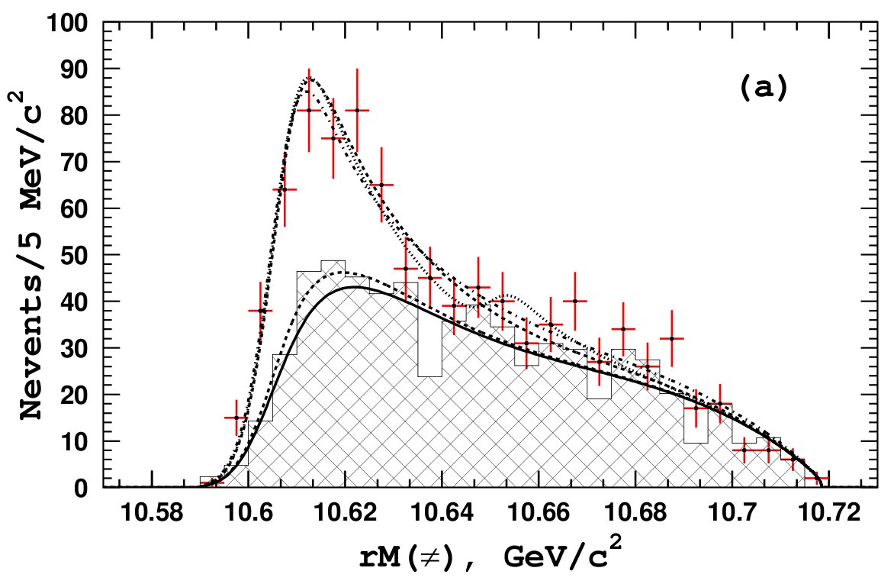
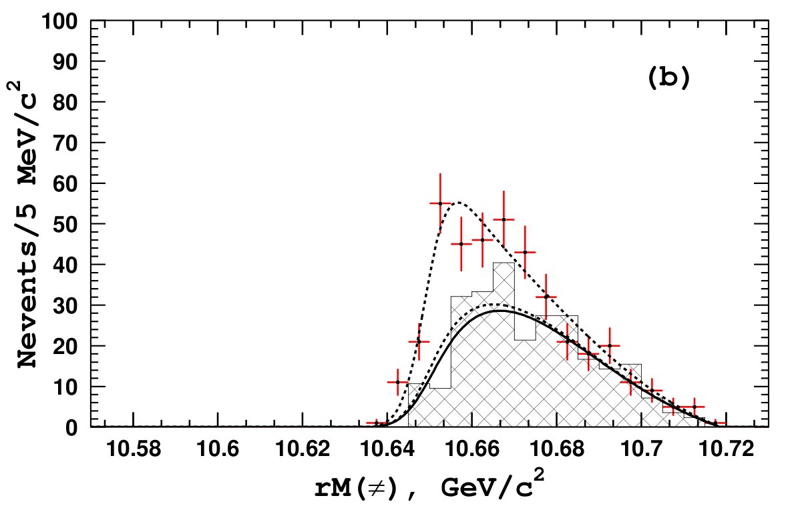
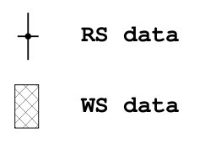
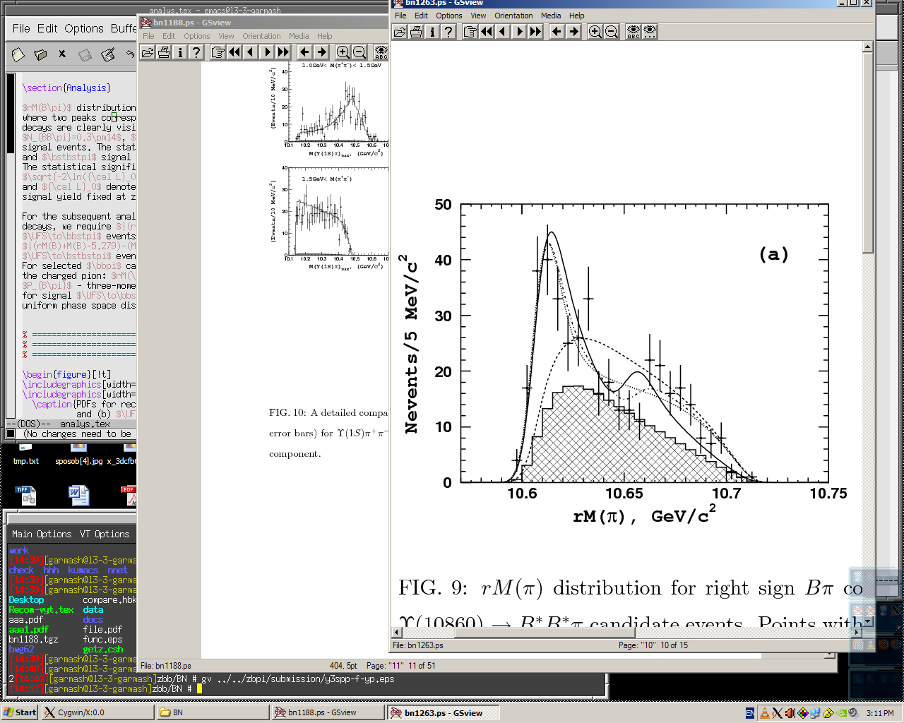
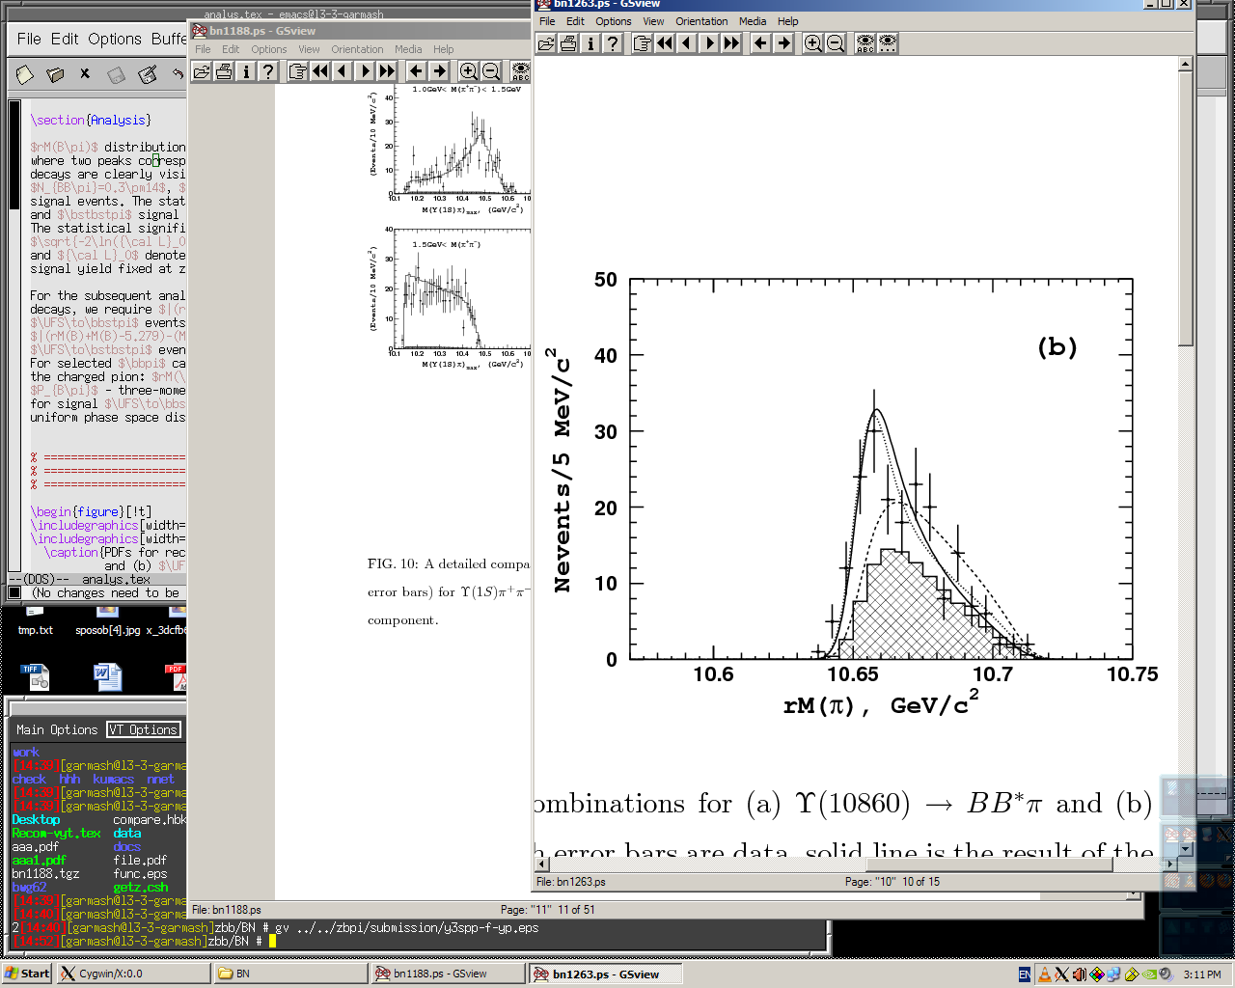
ϒ(5S)→Z_{b} π±
For events from 3-body sig. region → recoil mass against primary π±
BB*π
background
B*B*π
Z_{b}(10610) only
Z_{b}(10610) + NR
Z_{b}(10610) + Z_{b}(10650)
background
Z_{b}(10650) only
rM(π), GeV/c²
rM(π), GeV/c²
BB*π and B*B*π data fits well to just Z_{b}(10610) and Z_{b}(10650) signal, respectively
Assuming Z_{b} decays are saturated by already observed channels
BB*π
B*B*π
Belle PRELIMINARY arXiv:1209.6450
B⁽*⁾B* channels dominate the Z_{b} decays

Slide 16
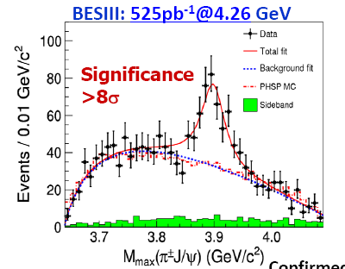
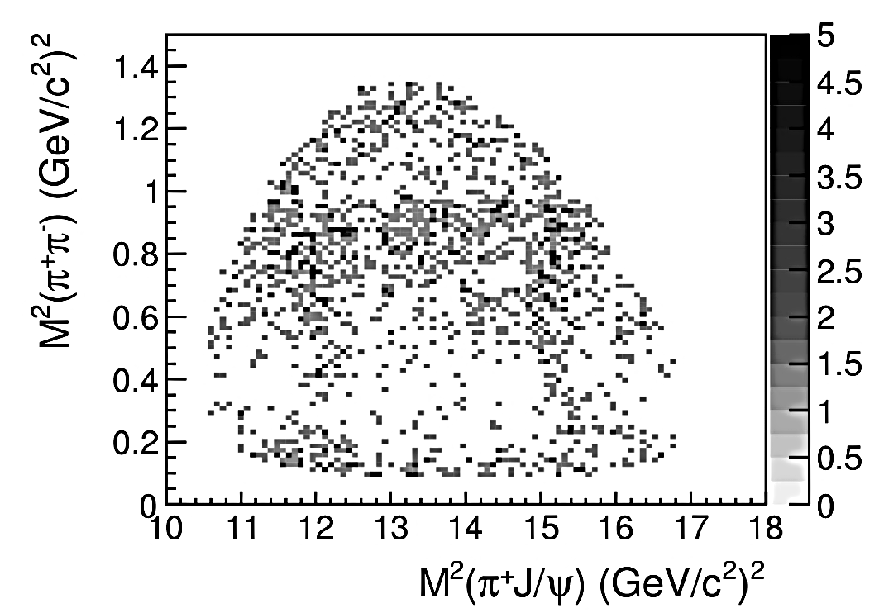

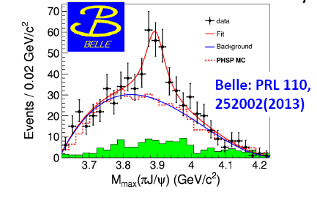
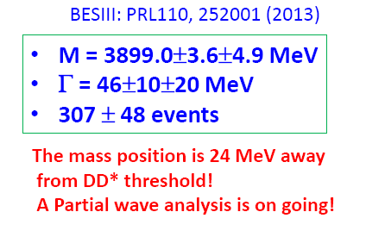
Observation of Z_{c}(3900) at BESIII & Belle

Slide 17
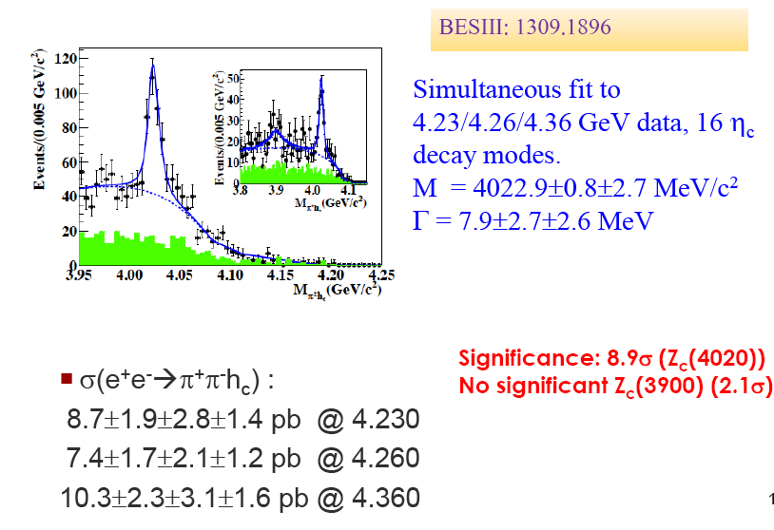
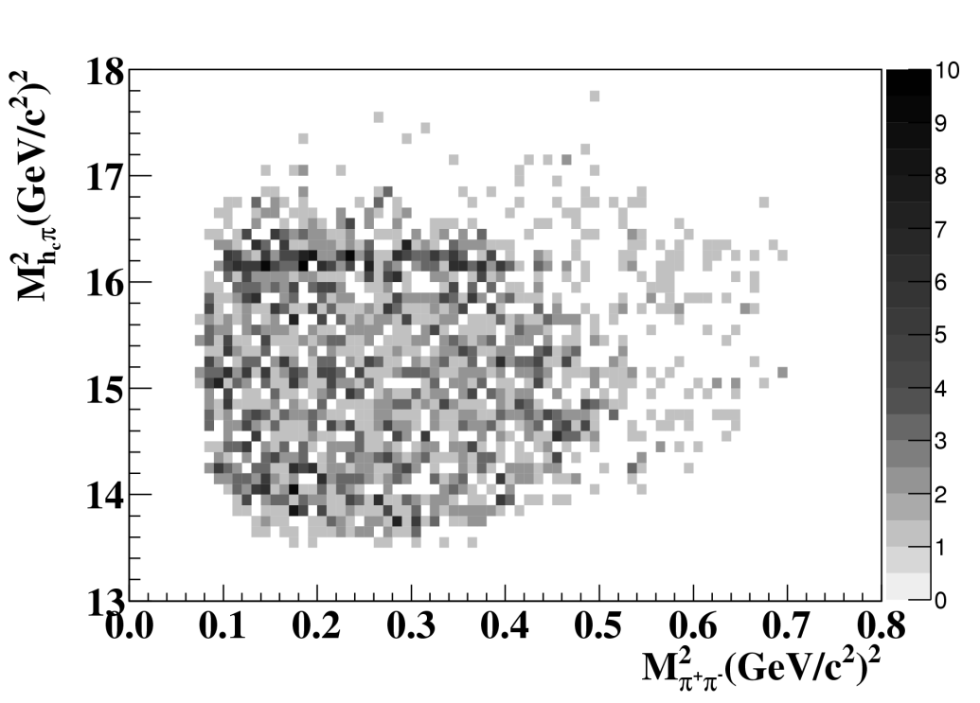
Observation of Z_{c}(4020) in e⁺e⁻ -> h_{c}π⁺π⁻
BESIII: PRL 111, 242001 (2013)

Slide 18
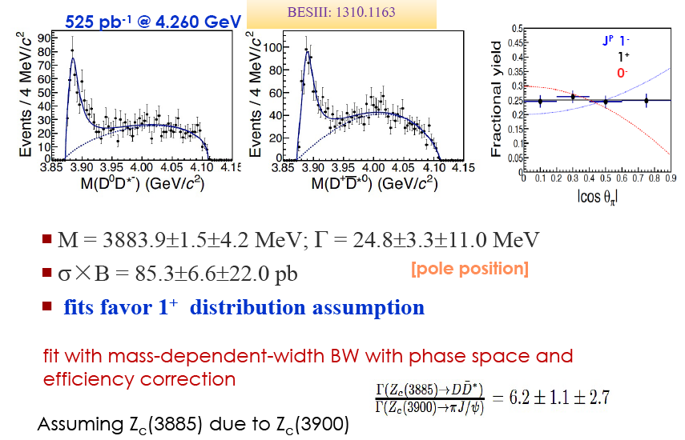
Observation of Z_{c}(3885) in e⁺e⁻ -> π⁻(D*D)⁺
BESIII: PRL 112, 022001 (2014)
Z_{c}(4020)
Z_{c}(4020)

Slide 19
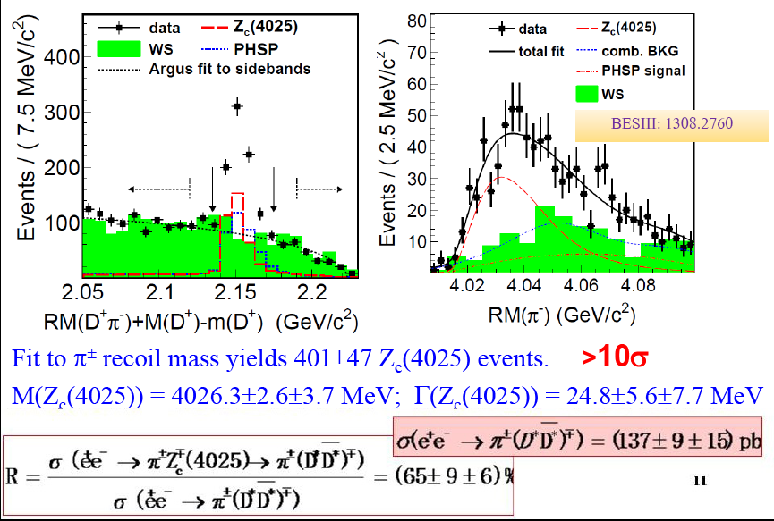
Observation of Z_{c}(4025) in e⁺e⁻ -> π⁻(D*D*)⁺
BESIII: PRL 112,132001(2014)
%

Slide 20
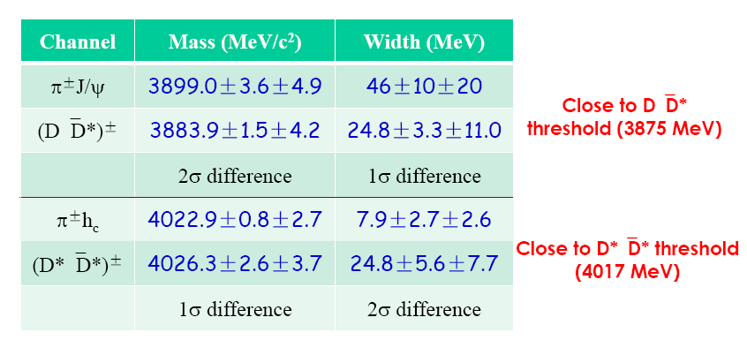
Summary of the Z_{c} states
Near threshold, but all the measurements are the results of 1D fits
without interference, to be improved by amplitude analysis;
Couple to D*D⁽*⁾ final states stronger than to final states with charmonium;
Necessary to measure the energy dependence of the Z_{c}π⁺ production
cross-sections;
As well as D⁽*⁾D*π;

Slide 21
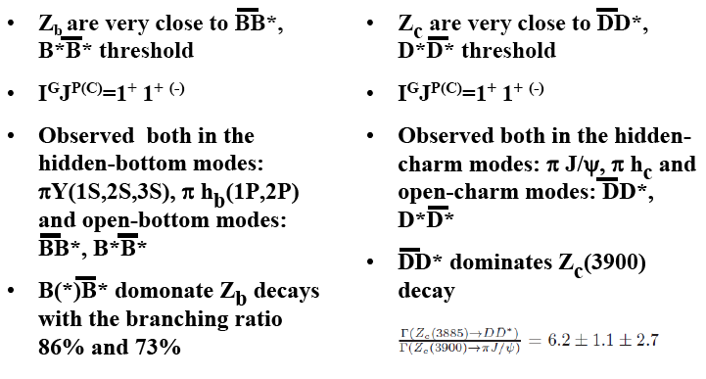
Bottomonium-like vs Charmonium-like states
-
dominate
; D*D* dominates Z_{c}(4020)
no Z_{c}(3900) decay to π h_{c} ?
no Z_{c}(4020) decay to π J/ψ ?
Energy behaviors h_{c}ππ and J/ψ ππ
are different
Energy behaviors h_{b}(mP)ππ
and Y(nS)ππ are similar
-
Z_{b} properties agree well with B⁽*⁾B* molecular structure, while in case of
Z_{c} the situation is still unclear (masses too far above thresholds,
no J/Ψ π⁺ at D*D* threshold)

Slide 22

Pentaquark?
See for details Tomasz Skwarnicki presentation

Slide 23
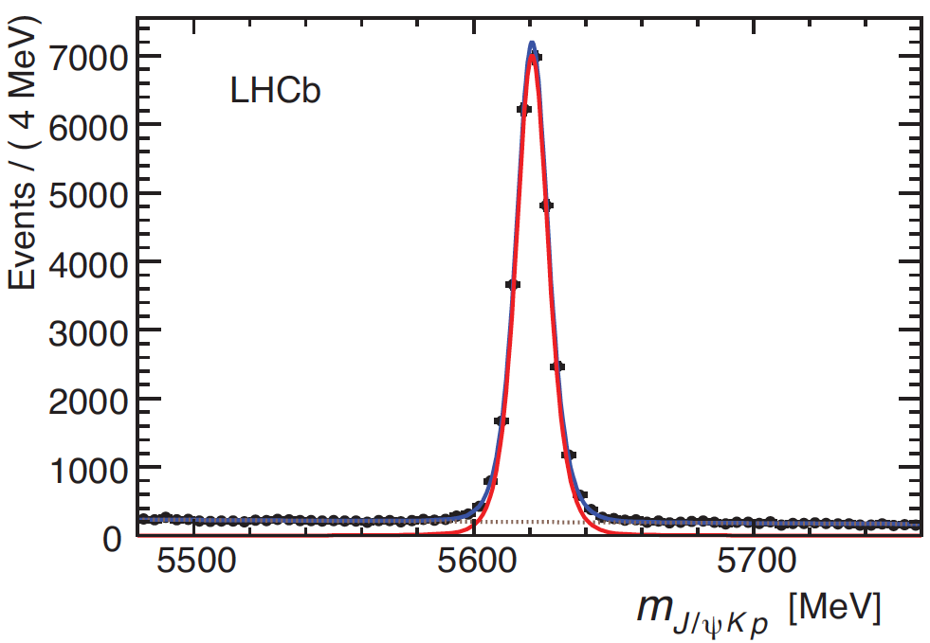
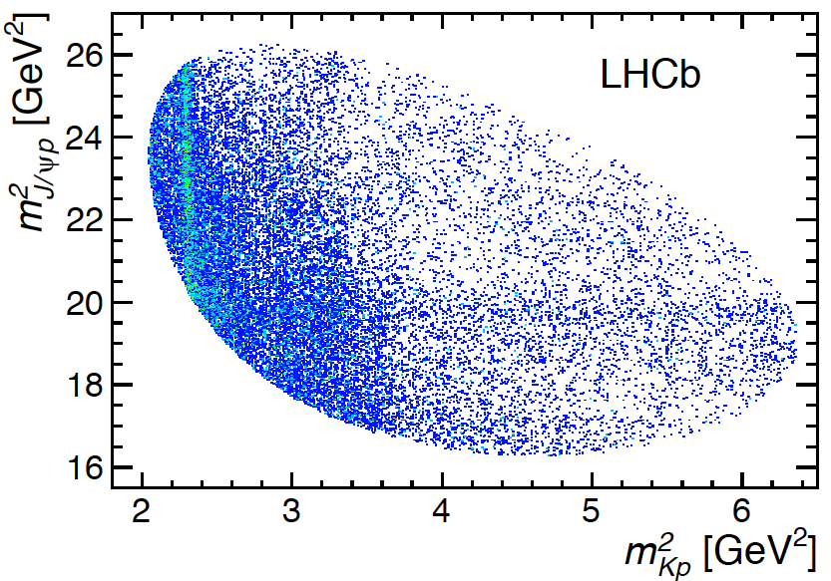
Λ_{b}→J/ψK⁻p
First looked for at LHCb as a potential background for B⁰→J/ψK⁺K⁻
Large signal found, used for Λ_{b} lifetime
  Dalitz plot showed an unusual feature
26,000
signal
+ 5.4%
bkgrnd
within ±2σ
of peak
m(J/ψK⁻p) [MeV]
…Λ*’s
m²(J/ψ p)
PRL 115, 072001 (2015) ,arXiv:1507.03414
m²(K⁻p)

Slide 24
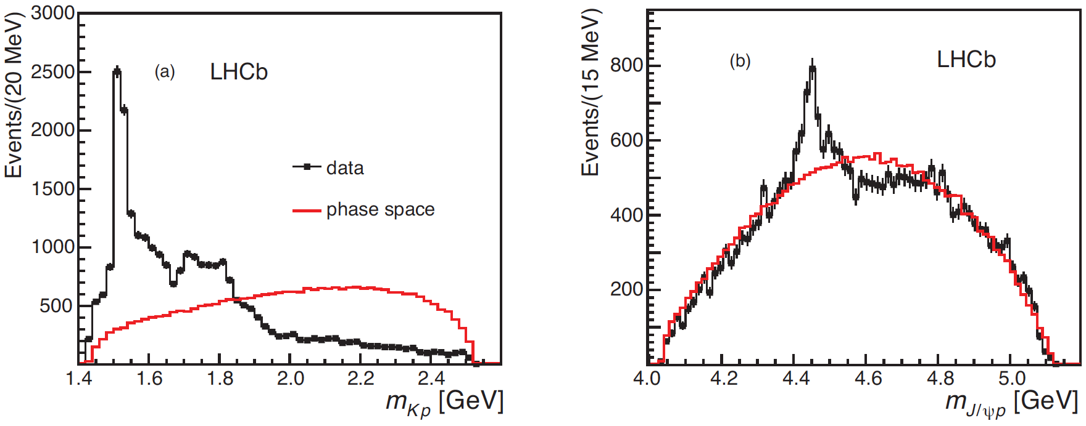
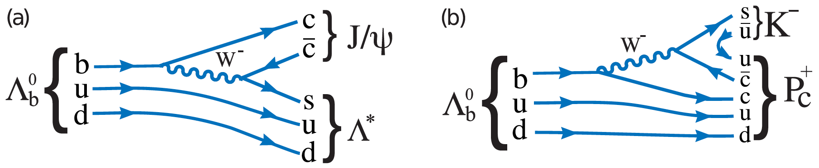
Projections
arXiv:1507.03414
?

Slide 25
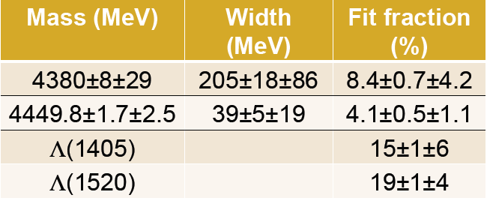
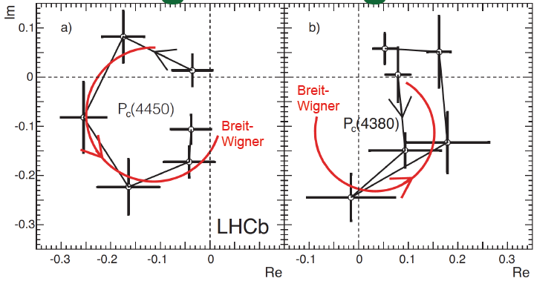
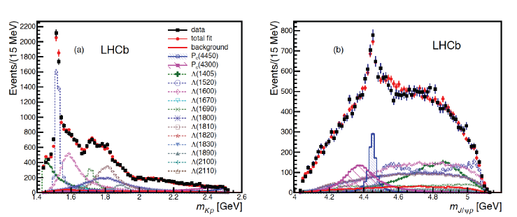
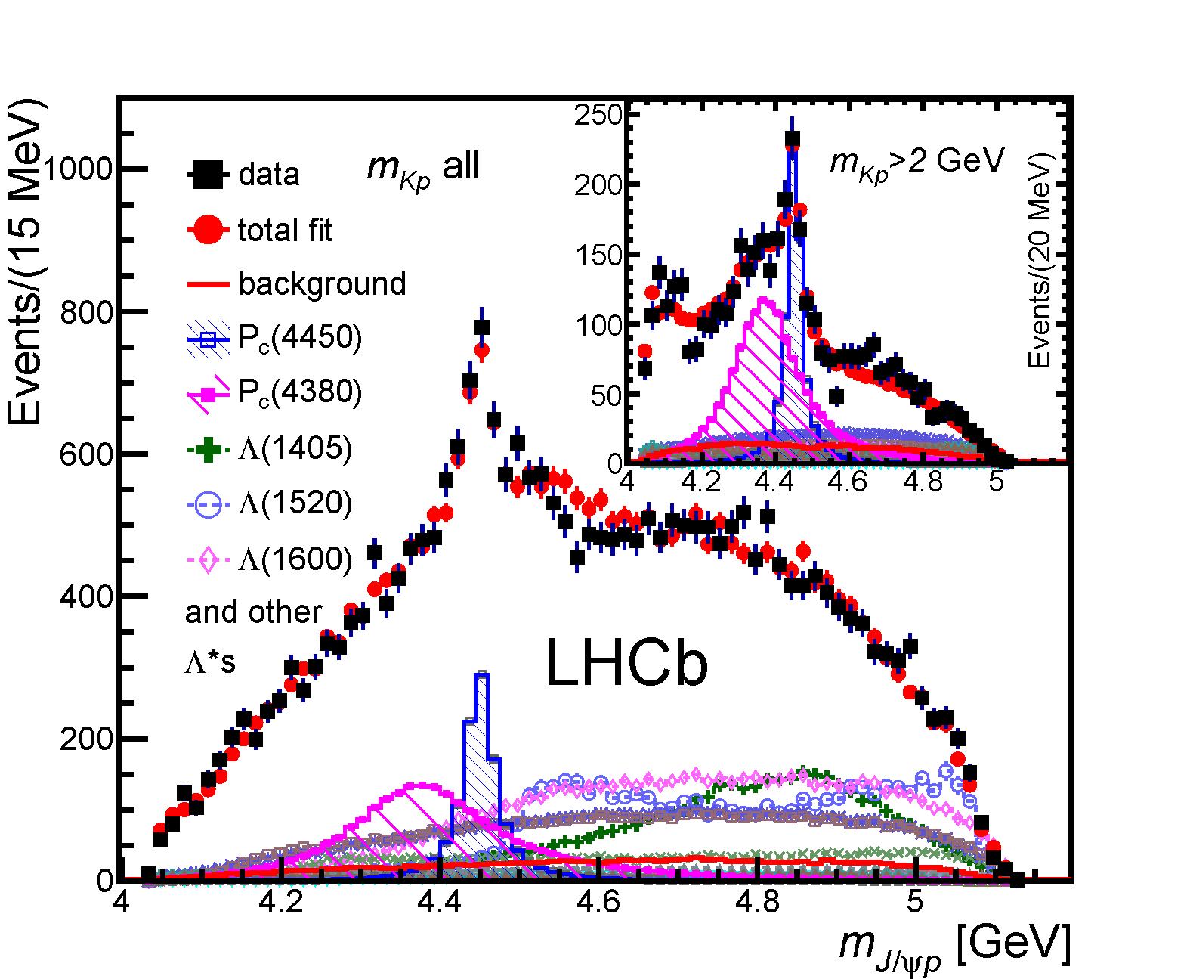

Slide 26
Models
Tightly bound quarks
  Two colored diquarks plus the anti-quark, L.Maiani, et. al, [arXiv:1507.04980], ibid [PRD20(1979) 748]
  Colored diquark + colored triquark, R. Lebed [arXiv:1507.05867]
  Hadroquarkonium
  χ_{c1}p resonance ,U. Meißner,J. Oller[arXiv:1507.07478]
  Rescattering
  The narrow peak in pJ/ψ spectra at 4450 MeV is antiquark diquark-diquark state, while the broad bump is the result of rescatterings in the (pJ/ψ)-channel, V.V.Anisovich et.al [arXiv:1507.07652]
  Molecule
  Baryon-meson molecule generally with meson exchange for binding ,
  Törnqvist [Z.Phys. C61 (1994) 525]
  π exchange dominance, Σ_{c} (2445)D* S-wave molecule,
  M.Karliner/J.Rosner [arXiv:1506.06386]

Slide 27
What can we do more?
  Search for other possible P_{c} decay channels (J/Ψ pπ, χ_{c1}p, Σ_{c}^{(*)} D^{(*)} ,Λ_{c} D^{(*)} …)
  Search in the inclusive production at LHC
  Search in the inclusive production at e⁺e⁻ factories
  Similar structures in the Ξ_{b}-> J/ΨΛK?
  Photoproduction in γ-nucleon interactions
  Qian Wang, Xiao-Hai Liu, Qiang Zhao [arXiv:1508.00339],V.Kubarovsky, M.Voloshin [1508.00888],M.Karliner/J.Rosner [arXiv:1508.01496]
  Peak cross section for γ + p → Pc → J/ψ + p, proportional to [Br(Pc → J/ψ + p)]² , can reach tens of nanobarns or more, if Br(Pc → J/ψ + p) ∼ 10% (Eγ ∼ 10GeV)

Slide 28
Tetraquark?

Slide 29
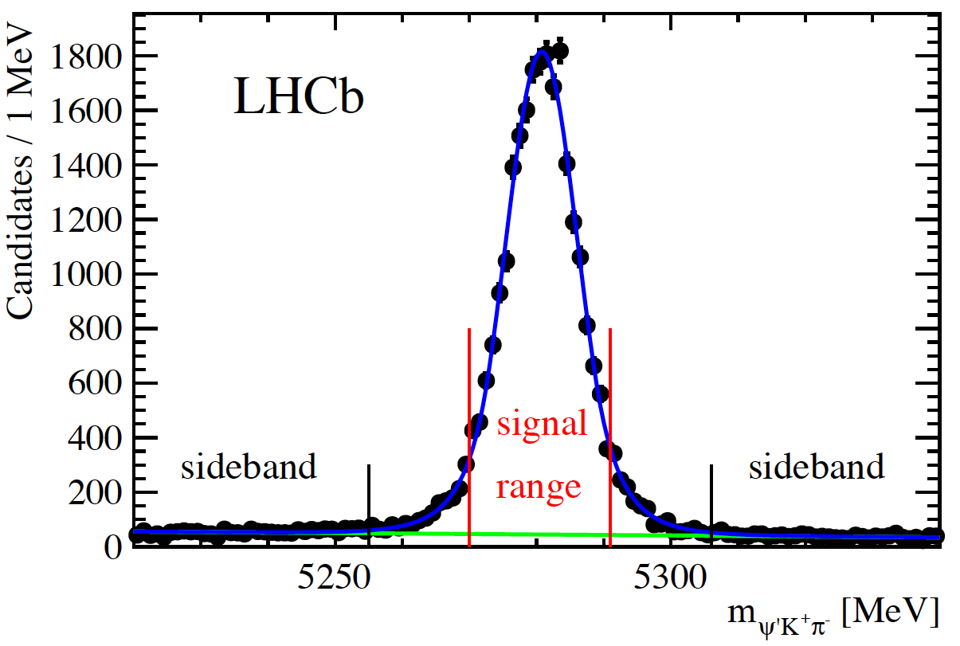
Z(4430)⁺
B⁰→ψ´π⁻K⁺, peak in m(ψ´π⁻), charged charmonium state must be exotic, not qq
  First observed by Belle M=4433±5 MeV, Γ=45 MeV
  Challenged by BaBar: explanation in terms of K*’s
  Belle reanalysis using full amplitude fit: M= MeV, Γ=200 MeV, 1⁺ preferred [Belle PRD 88, 074026 (2013)]
LHCb analysis also uses
full amplitude fit
  M= MeV
  Γ=172 MeV
  [LHCb PRL 112, 222002 (2014)]

Slide 30
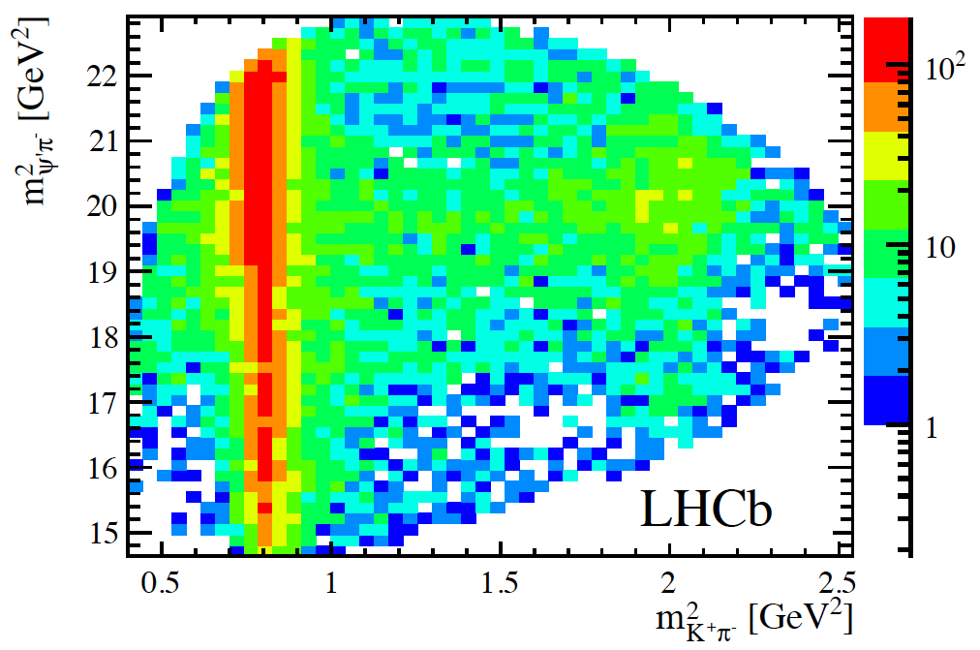
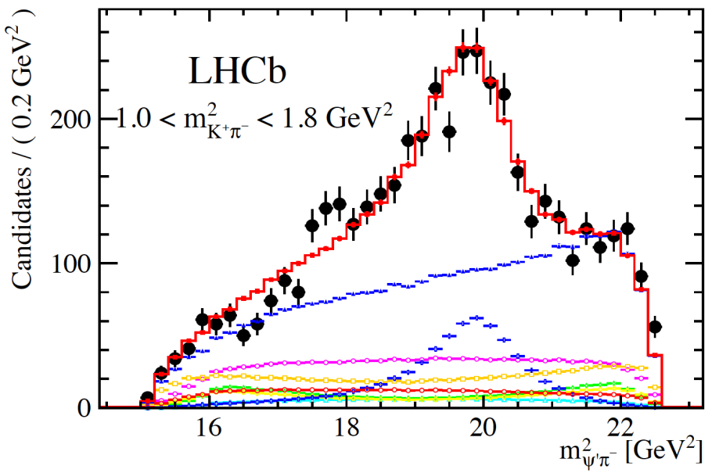
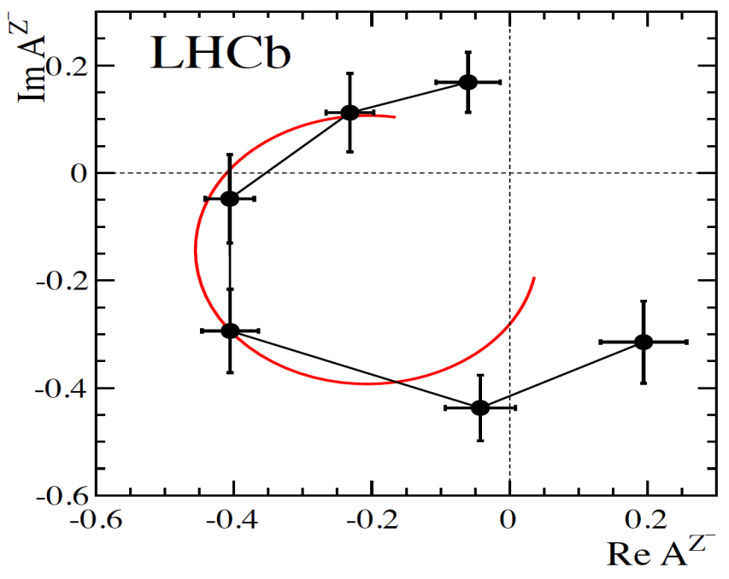
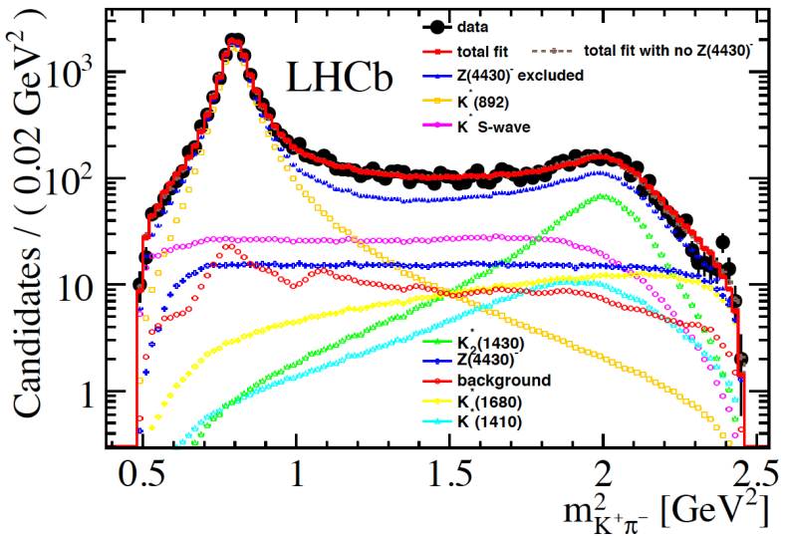
LHCb Amplitude analysis
Full 4D fit to both K*→K⁻π⁺ & Z→ψ′π⁻ states
J^{P}=1⁺
Unambiguously
Low
Z mass
Breit-Wigner
prediction
High
Z mass

Slide 31
Hadron Spectroscopy enters the new region – Physics of Highly Excited Quarkonium or/and
Chemistry of Heavy Flavor
We can expect much more from Super B factory, BESIII and Run2 at LHC
We need new Theoretical instruments for analysis

Slide 32


What about other color-singlet combinations?
Other possible “white” combinations of quarks & gluons:
Pentaquark: H-diBaryon
Glueball
Tetraquark mesons
qq-gluon hybrid mesons
u
d
u
d
u
_
s
S=+1 Baryon
d
s
tightly bound
6-quark state
u
d
s
Color-singlet multi-
gluon bound state
D⁰
_
_
c
u
tightly bound
diquark-diantiquark
u
c
loosely bound
meson-antimeson
“molecule”
_
π
_
u
c
_
u
_
_
c
D*⁰
_
_
c
c

Slide 33
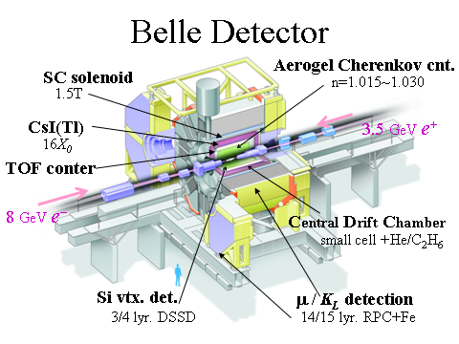
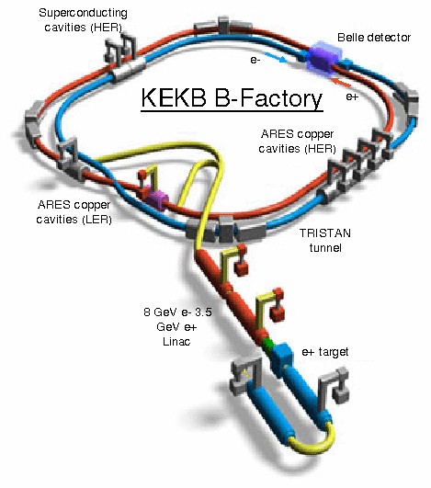
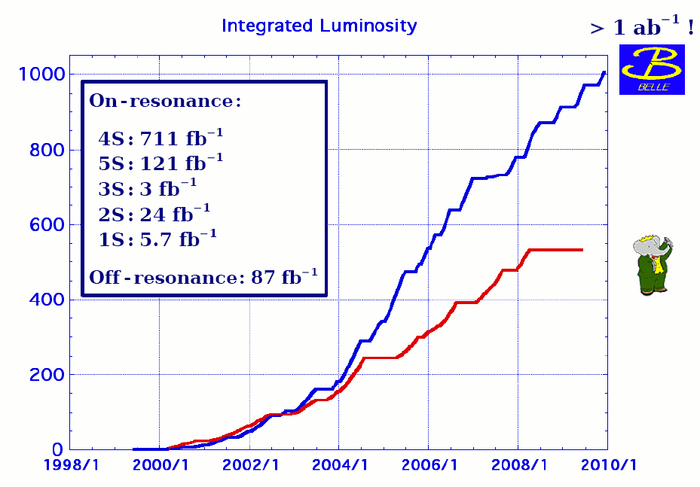

Slide 34
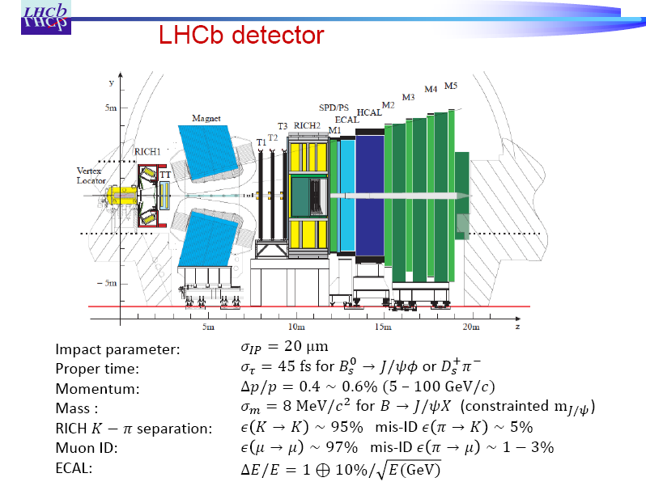

Slide 35
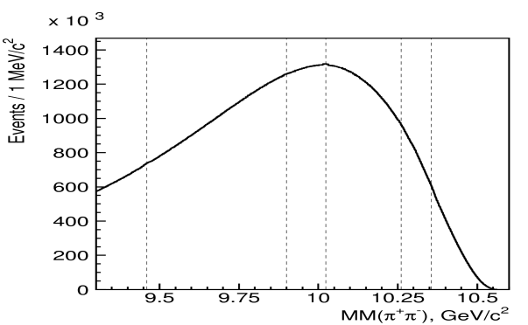
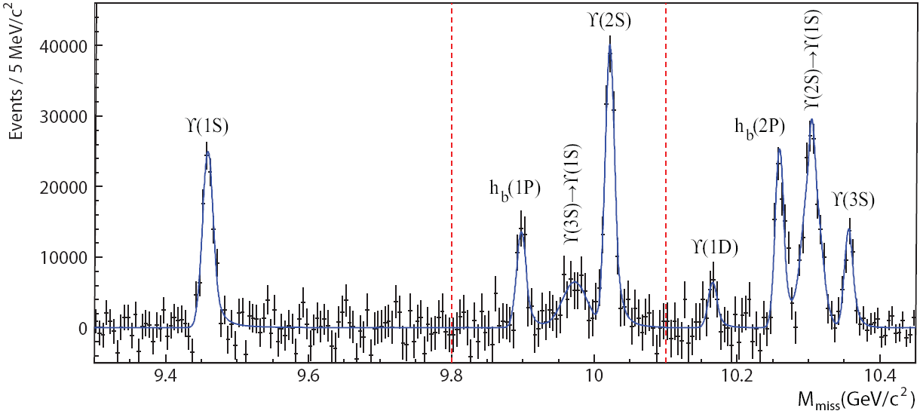
Observation of h_{b}(1P,2P)
e⁺e⁻ → ϒ(5S) → h_{b}(nP) π⁺π–
reconstructed, use M_{miss}(π⁺π⁻)
√(P_{e+e-} – P_{π+π-})²
ϒ(11020)
11.00
ϒ(10860)
PRL108,032001(2012)
10.75
π⁺π⁻
raw distribution
ϒ(4S)
2M(B)
h_{b}(2P)
10.50
η_{b}(3S)
ϒ(3S)
residuals
h_{b}(1P)
h_{b}(2P)
χ_{b}(2P)
10.25
η_{b}(2S)
ϒ(2S)
10.00
h_{b}(1P)
χ_{b}(1P)
ΔM_{HF}(1P)
9.75
Belle PRL 109. 232002 (2012)
ΔM_{HF}(1P) = +0.8 ± 1.1 MeV
ΔM_{HF}(2P) = +0.5 ± 1.2 MeV
consistent with zero,
as expected
ϒ(1S)
9.50
η_{b}(1S)
-
--
-
J^{PC} = 0 ⁺
1
1 ⁺
(0,1,2)⁺⁺
Large h_{b}(1,2P) production rates
c.f. CLEO/BESIII e⁺e⁻ → h_{c} π⁺π⁻

Slide 36




h_{b}(2P)ππ
h_{b}(2P)ππ
h_{b}(1P)ππ
h_{b}(1P)ππ
h_{b}(1P)ππ
h_{b}(2P)ππ

Slide 37


e⁺e⁻ hadronic cross-section
BaBar PRL 102, 012001 (2009)
ϒ(1S)
ϒ(5S)
ϒ(6S)
ϒ(4S)
ϒ(2S)
ϒ(3S)
ϒ(4S)
Belle took data at
E=10867± 1 MэВ
2M(B)
2M(B_{s})
_
e⁺ e⁻ ->ϒ(4S) -> BB, where B is B⁺ or B⁰
_
_
_
_
_
e⁺ e⁻ -> bb (ϒ(5S)) -> B⁽*⁾B⁽*⁾, B⁽*⁾B⁽*⁾π, BBππ, B_{s}⁽*⁾B_{s}⁽*⁾, ϒ(1S) ππ , ϒ X …
main motivation
for taking data at ϒ(5S)
Notes:
AAAA
A.Drutskoy, 32 Int'l Conference on HEP, August 16-22, 2004
37
e^+e^-\to\Upsilon(4S)\to B\bar B
B\bar B\ {\rm threshold}
b\bar b

