Slide 1
Theoretical Results on Neutrinos
Shun Zhou
IHEP, CAS, Beijing
Number of Papers
1. Driven by experiments(peaks)
2. Theorists working hard (papers)
3. More to be discovered (Patience)
INSPIRE-HEP: find t neutrino and date xx
XXVII International Symposium on Lepton-Photon Interactions at High Energies
Ljubljana, Slovenia, August 17-22, 2015

Slide 2
Outline
Fundamental Properties of Neutrinos
Origin of Neutrino Masses and Mixing
News from Astrophysical Neutrinos
Summary and Outlook

Slide 3
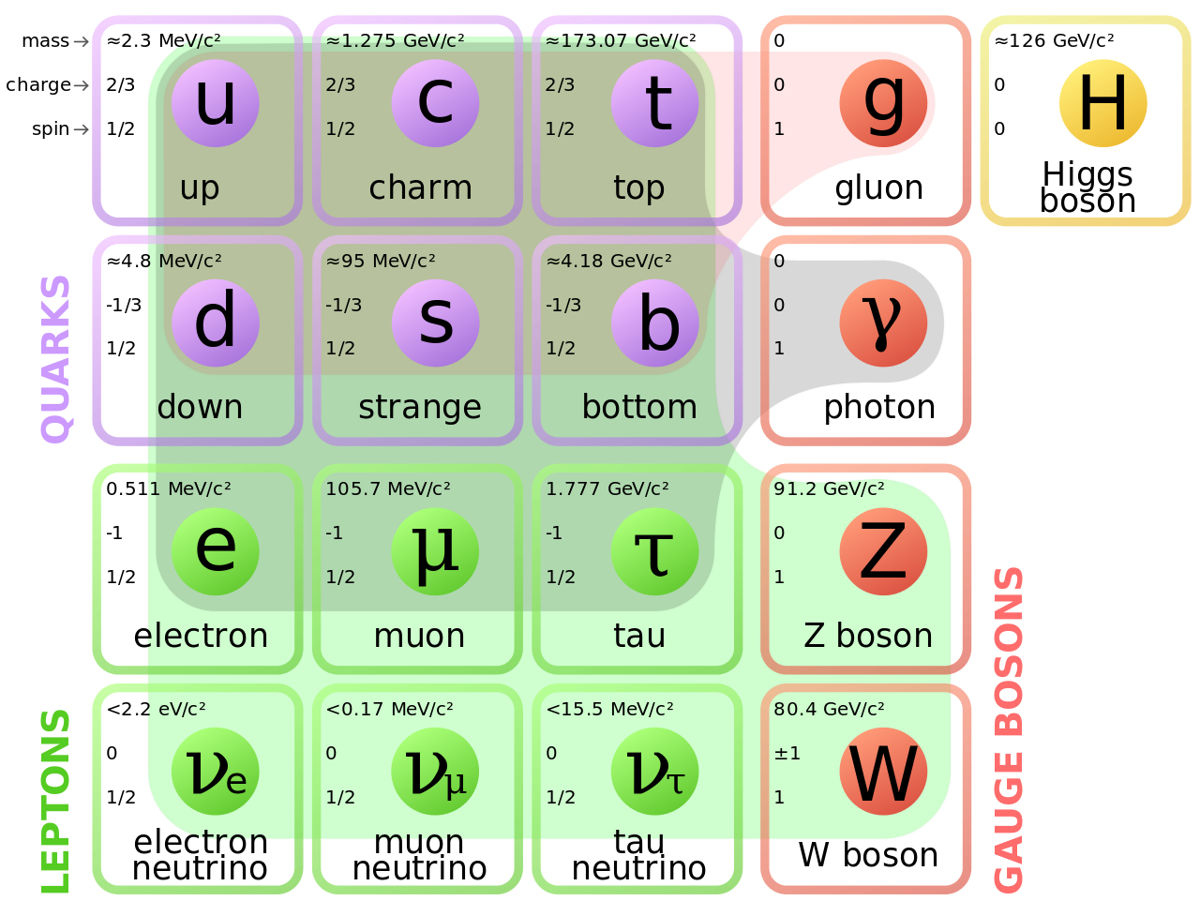
Fundamental Properties of Neutrinos
Neutrinos in SM
Spin = 1/2
Charge = 0
Mass = 0
Species = 3
Neutrino Oscillations & Massive Neutrinos
Spin = 1/2
Charge = 0
Mass = (0?) sub-eV
Mass type = Majorana?
Species = 3 (+ n sterile?)
EM Moments = ?
Lifetime = ?
Interactions = exotic?
Standard Model of Elementary Particles © MissMJ from wiki

Slide 4
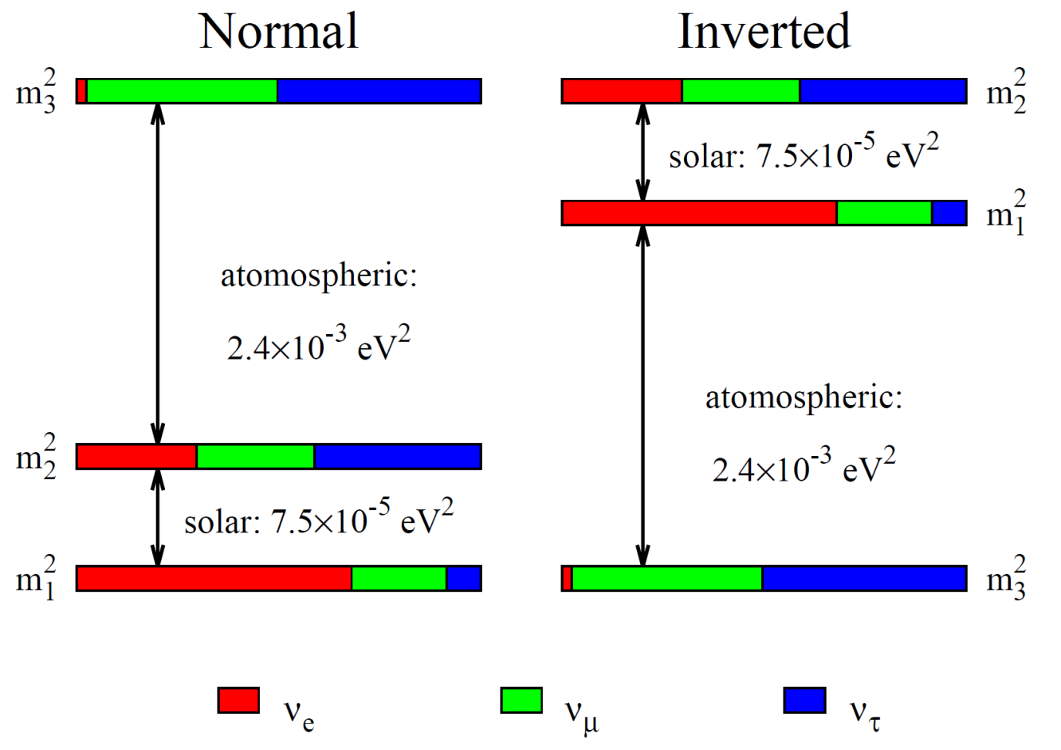




Fundamental Properties of Neutrinos: mass ordering
Quark and Lepton Mass Spectra
$$m_{u}≪ m_{c}≪m_{t}$$
$$m_{d}≪ m_{s}≪m_{b}$$
$$m_{e}≪ m_{μ}≪m_{τ}$$
$$m_{1} <m_{2}<m_{3}?$$
See Long’s talk for future neutrino programs
Neutrino Oscillation Experiments
two independent mass-squared differences
m₁ < m₂ < m₃ (NO) or m₃ < m₁ < m₂ (IO)
No information on the absolute mass scale
Lightest neutrino could still be massless

Slide 5




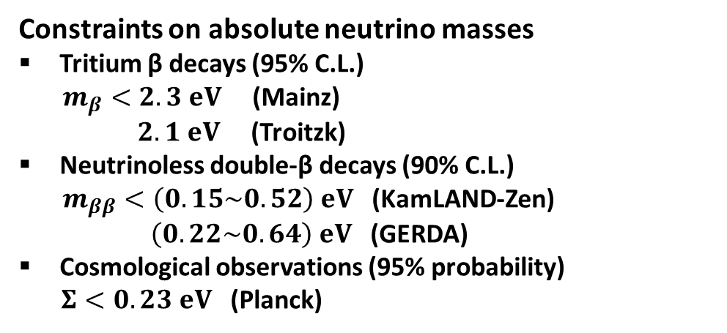
Fundamental Properties of Neutrinos: absolute masses
Neutrinoless double-β decays
Tritium β decays (KATRIN)
IO
IO
Cosmological Bound
NO
Cosmological Bound
NO
$m_{ββ}=\left|{Σ_{i}U}_{ei}^{2}m_{i}\right|$[eV]
$m_{β}=\sqrt{Σ_{i}{\left|U_{ei}\right|}^{2}m_{i}^{2}}$ [eV]
$Σ=m_{1}+m_{2}+m_{3}$ [eV]
$Σ=m_{1}+m_{2}+m_{3}$ [eV]
Constraints on absolute neutrino masses
Tritium β decays (95% C.L.)
$m_{β}<2.3 eV$ (Mainz)
$2.1 eV$ (Troitzk)
Neutrinoless double-β decays (90% C.L.)
$m_{ββ}<\left(0.15\sim 0.52\right) eV$ (KamLAND-Zen)
$\left(0.22\sim 0.64\right) eV$ (GERDA)
Cosmological observations (95% probability)
$Σ<0.23 eV$ (Planck)
sum of neutrino masses [eV]
Abazajian et al., 15; See van Eijndhoven’s talk
lightest neutrino mass [eV]

Slide 6
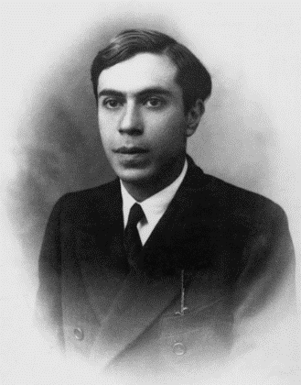
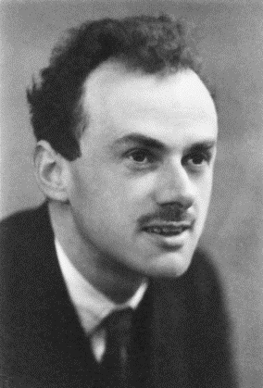
Fundamental Properties of Neutrinos: types of masses
Majorana Neutrinos
LN violating
ν = ν^{c}
ν = ν_{L} + (ν_{L})^{c}
Dirac Neutrinos
LN conserving
ν ≠ ν^{c}
ν = ν_{L} + ν_{R}
Strumia & Vissani, 06
Dirac, 28; Majorana, 37
Gedanken experiment
ν_{μ} prepared at rest
accelerated upward
ν₋ ≈ ν_{L}
accelerated downward
ν₊ ≈ (ν_{L})^{c} Majorana
ν₊ ≈ ν_{R} Dirac
Practical experiments 0νββ
Rodejohann, 12; Bilenky, Giunti, 15
Majorana vs. Dirac
(LNV processes)
Hint for mass origin
Absolute mass scale
Majorana CP phases

Slide 7
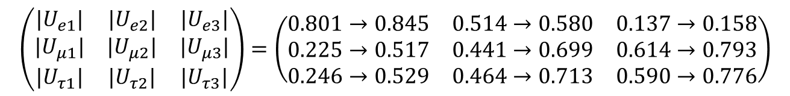
Fundamental Properties of Neutrinos: flavor mixing
Global-fit analysis
mass ordering
octant of θ₂₃
CP phase δ
Capozzi et al., 14;
Foredo et al., 14;
Gonzalez-Garcia et al.,
14 ; Bergstrom et al., 15; www. nu-fit.org
ordering & θ₂₃
nontrivial δ ?
Pontecorvo-Maki-Nakagawa-Sakata (PMNS) Matrix
P, 57; MNS, 62
$$\left(\begin{matrix}{|U}_{e1}| & {|U}_{e2}| & {|U}_{e3}| \\ {|U}_{μ1}| & {|U}_{μ2}| & {|U}_{μ3}| \\ {|U}_{τ1}| & {|U}_{τ2}| & {|U}_{τ3}|\end{matrix}\right)=\left(\begin{matrix}0.801→0.845 & 0.514→0.580 & 0.137→0.158 \\ 0.225→0.517 & 0.441→0.699 & 0.614→0.793 \\ 0.246→0.529 & 0.464→0.713 & 0.590→0.776\end{matrix}\right)$$
μ-τ symmetry $\text{|}U_{μi}\text{|= }\left|U_{τi}\right|$: (1) θ₂₃ = 45º & θ₁₃ = 0º (excluded)
(2) θ₂₃ = 45º & δ = 90º or 270º (allowed)
Partial μ-τ symmetry $\text{|}U_{μ1}\text{|= }\left|U_{τ1}\right|$: θ₂₃ ≠ 45º & δ ≈ 270º (favored)
Xing, S.Z., 14

Slide 8
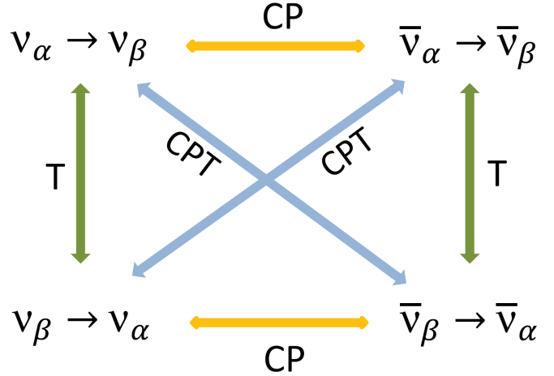
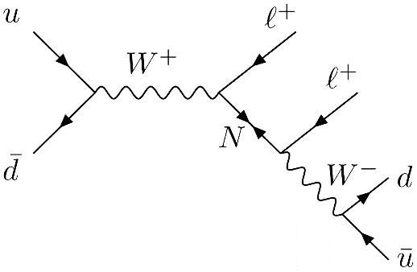
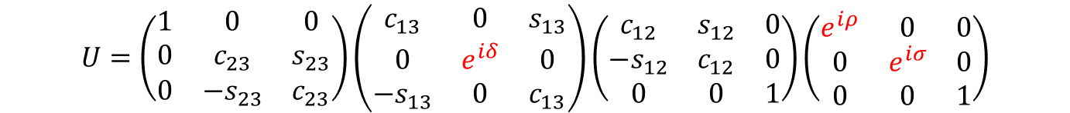
Fundamental Properties of Neutrinos: CP violation
CP violation in neutrino oscillations
Branco et al., 12
PMNS matrix for Majorana neutrinos
$$U=\left(\begin{matrix}1 & 0 & 0 \\ 0 & c_{23} & s_{23} \\ 0 & −s_{23} & c_{23}\end{matrix}\right)\left(\begin{matrix}c_{13} & 0 & s_{13} \\ 0 & e^{iδ} & 0 \\ −s_{13} & 0 & c_{13}\end{matrix}\right)\left(\begin{matrix}c_{12} & s_{12} & 0 \\ −s_{12} & c_{12} & 0 \\ 0 & 0 & 1\end{matrix}\right)\left(\begin{matrix}e^{iρ} & 0 & 0 \\ 0 & e^{iσ} & 0 \\ 0 & 0 & 1\end{matrix}\right)$$
Dirac CP phase δ measures the strength of leptonic CP violation
Majorana CP phases ρ and σ are present in LNV processes (e.g., 0νββ)
How to determine ρ and σ if neutrinos are proved to be Majorana particles?
Pontecorvo, 57; Schechter, Valle, 81; Li, Wilczek, 82; Langacker, Wang, 98; Xing, 13; Xing, Y.L. Zhou, 13

Slide 9

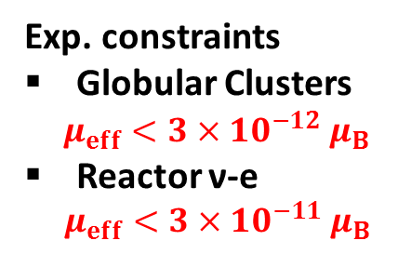
Fundamental Properties of Neutrinos: EM dipole moments
Magnetic dipole moment for massive Dirac neutrinos
Majorana neutrinos have no EM dipole moments (ν = ν^{c})
Dirac & Majorana neutrinos can have transition moments
Main processes
Radiative decays
Energy-loss rate
ν-e scattering
Exp. constraints
Globular Clusters
$μ_{eff}<3×{10}^{−12} μ_{B}$
Reactor ν-e
$μ_{eff}<3×{10}^{−11} μ_{B}$
$$μ_{eff}=\sqrt{|{μ|}^{2}+{|ε|}^{2}}$$
Place for New Physics?
Raffelt, 99; Giunti, Studenikin, 14

Slide 10















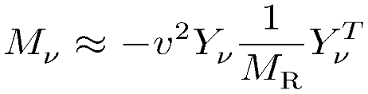
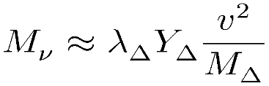

Origin of Neutrino Masses
Difficulties with Dirac neutrinos
Tiny Dirac masses worsen fermion mass hierarchy problem (i.e., m_{i}/m_{t} < 10⁻¹²)
Mandatory lepton number conservation, which is actually accidental in the SM
Majorana neutrinos: a natural way to understand tiny neutrino masses (seesaw)
Type-I: SM + 3 right-handed Majorana ν’s (Minkowski 77; Yanagida 79; Glashow 79; Gell-Mann, Ramond, Slanski 79; Mohapatra, Senjanovic 79)
Type-II: SM + 1 Higgs triplet (Magg, Wetterich 80; Schechter, Valle 80; Lazarides et al 80; Mohapatra, Senjanovic 80; Gelmini, Roncadelli 80)
Type-III: SM + 3 triplet fermions (Foot, Lew, He, Joshi 89)
Can naturally be embedded into the SO(10) GUT (e.g., type-I + type-II seesaw)
Responsible for both tiny neutrino masses and matter-antimatter asymmetry

Slide 11
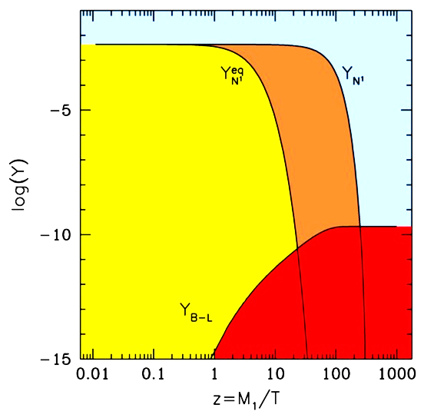
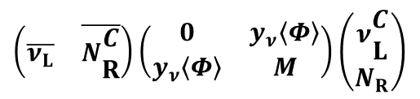




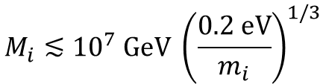
Origin of Neutrino Masses
A natural seesaw scale (e.g., type-I)
Close to an energy scale of fundamental physics: the GUT scale
$$M_{ν}=−\frac{y\begin{matrix}2 \\ ν\end{matrix}{\left\langle Φ\right\rangle }^{2}}{M}$$
ν
Fukugita, Yanagida, 86
B-number Asymmetry
$$\left\langle Φ\right\rangle$$
10⁻¹⁰ GeV
$$η_{B}=\frac{n_{B}}{n_{γ}}≃6×{10}^{−10}$$
Real abundance
determined by
decay rate
N
Leptogenesis
CP violation
B-L violation
Out-of-equili.
Sphaleron
10² GeV
10¹⁴ GeV
$$\left(\begin{matrix}\overline{ν_{L}} & \overline{N\begin{matrix}C \\ R\end{matrix}}\end{matrix}\right)\left(\begin{matrix}0 & y_{ν}\left\langle Φ\right\rangle \\ y_{ν}\left\langle Φ\right\rangle & M\end{matrix}\right)\left(\begin{matrix}ν\begin{matrix}C \\ L\end{matrix} \\ N_{R}\end{matrix}\right)$$
Created
lepton-number
abundance
Vissani, 98; Casas et al., 04; Abada et al., 07; Xing, 09; Volkas et al., 15
Seesaw-induced hierarchy problem
In type-I seesaw models:
$$M_{i}≲{10}^{7} GeV {\left(\frac{0.2 eV}{m_{i}}\right)}^{1/3}$$
for $δM_{H}^{2} \sim 0.1 {TeV}^{2}$

Slide 12
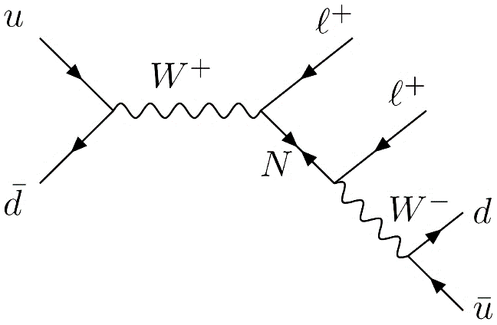
Origin of Neutrino Masses
Seesaw models at the EW or TeV scales
motivated by the naturalness and testability problems of conventional seesaws
Keung, Senjanovic, 83;
Han, Zhang, 06
Signals:
same-sign
dileptons
CMS, arXiv: 1501.05566
For M_{N} > 600 GeV,
t-channel γ-mediated
production dominates
over Drell-Yan process
ATLAS, arXiv: 1506.06020
Dev, Pilaftsis, Yang, 14
Type-II: 1207.2666 (CMS), 1210.5070 (ATLAS)
Type-III: 1506.01291 (CMS), 1506.01839 (ATLAS)

Slide 13
Origin of Neutrino Masses
Beyond seesaw models
Radiative mechanism
Scale-invariant extension of the SM
Zee, 80; Babu, 88; Ma, 98, 13
Coleman, E. Weinberg, 73
Remove mass terms of scalar fields
Symmetry breaking triggered radiatively
Solve the hierarchy problem of SM
Fermion-Scalar vertex
4-Scalar
Generation of neutrino masses
Model with A₄ x U(1)_{D} symmetries
Tree-level mass forbidden by A₄ flavor symmetry
Symmetry also responsible for flavor structure
New fermions as DM
Lindner, Schmidt, Smirnov, 14

Slide 14

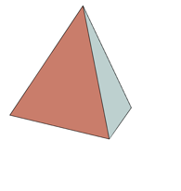




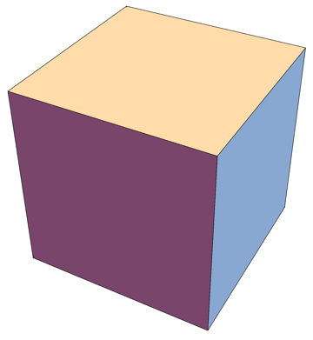





Origin of Flavor Mixing
Flavor Symmetry
Paradigm of flavor symmetries
Breaking
Tri-bimaximal neutrino mixing matrix
Harrison, Pekins, Scott, 02; Xing, 02; He, Zee, 03
PMNS matrix is (partially) determined by the structure of symmetry groups
See, Ishimori et al., 10; Altarelli, Feruglio, 10; King et al., 14, for recent reviews

Slide 15
Origin of CP Violation
μ-τ reflection symmetry
Harrison, Scott, 02, 04; Grimus, Lavoura, 04
Invariant under:
Predictions: θ₂₃ = 45°, δ = 90°or 270°, but θ₁₂ and θ₁₃ are left arbitrary
If combined with a flavor symmetry, both θ₁₂ and θ₁₃ can be constrained
Generalized CP
Both δ=0 or 180° and 90° or 270° are predicted by popular symmetry groups, e.g., A₄ and S₄.
X depends on a chosen
flavor symmetry
Non-typical values are also possible for some other groups, e.g., Δ(48).
Holthhausen et al., 13
Ding, Y.L. Zhou, 14

Slide 16
Some Recent Works
★ Holthhausen et al., JHEP (13)
★ Holthhausen et al., JHEP (13)
★ Holthhausen et al., PLB (13)
★ de Medeiros Varzielas et al, JPG (13)
★ Antusch et al., PRD (13)
★ Ding et al, JHEP (13)
★ Ahn et al, PRD (13)
★ Nishi, PRD (13)
★ Luhn, NPB (13)
★ Hagedorn et al., JPA (13)
★ Feruglio et al, EPJC (14)
★ King, JHEP (14)
★ Girardi et al., JHEP (14)
★ Chen et al., NPB (14)
★ Li, Ding, NPB (14)
★ King et al., NJP (14)
★ Ding, King, PRD (14)
★ King, Neder, PLB (14)
★ Ding, Zhou, JHEP (14)
★ Zhao, JHEP (14)
★ Ding, Zhou, CPC (15)
★ Hagedorn et al, NPB (15)
★ Everett et al, JHEP (15)
★ Fallbacher, Trautner, NPB (15)
★ Chen, Li, Ding, PRD (15)
★ Branco et al., arXiv: 1502.03105
★ Feruglio, arXiv:1503.04071
★ Di Lula et al, arXiv:1503.04140
★ Ballett et al, arXiv:1503.07543
★ Mohapatra, Nishi, arXiv:1506.06788
★ Chen, Yao, Ding, arXiv:1507.03419
★ de Medeiros Varzielas , arXiv:1507.00338
★ Shimizu, Tanimoto, arXiv:1507.06221
★ Turner, arXiv:1507.06224
★ ……
S₃, A₄, S₄, A₅
T’, T₇, T₁₃
Δ(27), Δ(48), Δ(54), Δ(96), …
Anyone universal for quarks and leptons?
How to experimentally distinguish one symmetry group from another?

Slide 17
Origin of Flavor Mixing
Non-abelian discrete flavor symmetries: (1) Testability & Uniqueness Problem
(2) Mixing is decoupled from Masses
Weinberg, 77
Fritzsch, 78, 79
In the basis where charged-lepton mass matrix is diagonal, there are texture zeros
in the symmetric Majorana neutrino mass matrix: Two-Zero Textures
Frampton, Glashow, Marfatia, 02; Xing, 02
A₁
B₁
B₃
C
Fritzsch, Xing, S.Z., 11
1-zero textures: less predictive
2-zero textures: survive
3-zero textures: excluded
A₂
B₂
B₄

Slide 18




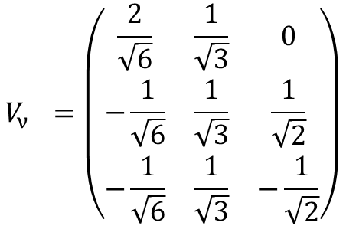

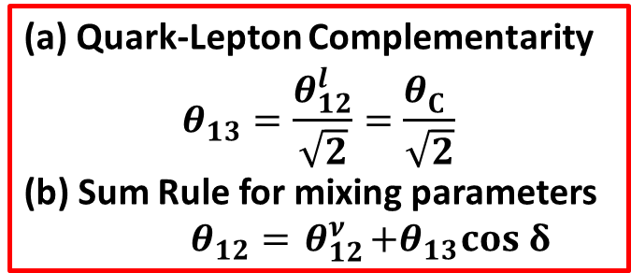






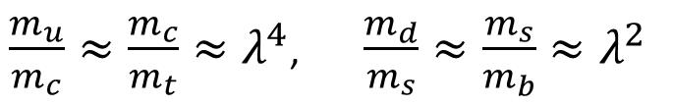

Origin of Flavor Mixing
Inspired by the quark-lepton relations in GUT’s, and strong quark mass hierarchy
Antusch, Maurer, 11; Mazocca et al., 11; King, 12; Antusch et al., 12, 13;
$\frac{m_{u}}{m_{c}}≈\frac{m_{c}}{m_{t}}≈λ^{4}$, $\frac{m_{d}}{m_{s}}≈\frac{m_{s}}{m_{b}}≈λ^{2}$
$$M_{u}$$
$$M_{d}$$
$$θ_{12}^{d}≈θ_{C}$$
$$U_{CKM}=V_{u}^{†}V_{d}^{}$$
GUT relations
$$(\frac{m_{τ}}{m_{b}}=c_{33}=1, \frac{3}{2})$$
$c_{ij}:$ Clebsch factors
$$M_{ν}$$
$$M_{l}$$
$$U_{PMNS}=V_{l}^{†}V_{ν}^{}$$
$$θ_{12}^{l}≈\frac{c_{12}}{c_{22}}θ_{12}^{d}≈\frac{c_{12}}{c_{22}}θ_{C}^{}$$
Tri-bimaximal or Bimaximal mixing for${ V}_{ν}^{}$
Model predictions
$$V_{ν}^{}=\left(\begin{matrix}\frac{2}{\sqrt{6}} & \frac{1}{\sqrt{3}} & 0 \\ −\frac{1}{\sqrt{6}} & \frac{1}{\sqrt{3}} & \frac{1}{\sqrt{2}} \\ −\frac{1}{\sqrt{6}} & \frac{1}{\sqrt{3}} & −\frac{1}{\sqrt{2}}\end{matrix}\right)$$
(a) Quark-Lepton Complementarity
$$θ_{13}=\frac{θ_{12}^{l}}{\sqrt{2}}=\frac{θ_{C}^{}}{\sqrt{2}}$$
(b) Sum Rule for mixing parameters
$θ_{12}={ θ}_{12}^{ν}+θ_{13}cos δ$
with $θ_{13}^{ν}=0$

Slide 19
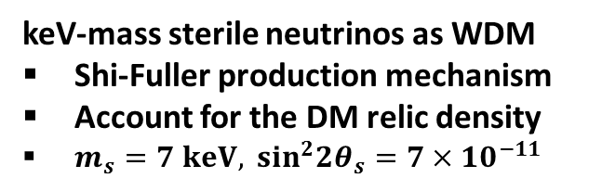
Neutrino Dark Matter
keV-mass sterile neutrinos as WDM
Shi-Fuller production mechanism
Account for the DM relic density
$m_{s}=7 keV, \sin^{2}2θ_{s}=7×{10}^{−11}$
White Paper on keV Sterile Neutrino Dark Matter
Editors: M. Drewes, T. Lasserre, A. Merle, S. Mertens
Neutrinos in the Standard Model of Particle Physics and Beyond
Neutrinos in the Standard Model of Cosmology and Beyond
Dark Matter at Galactic Scales: Observational Constraints and Simulations
Established Constraints on keV Neutrino Dark Matter
Constraining keV Neutrino Production Mechanisms
keV Neutrino Theory and Model Building
Current and Future keV Neutrino Search with Astrophysical Experiments
Current and Future keV Neutrino Search with Laboratory Experiments
Pros and Cons for keV Neutrinos as Dark Matter and Perspectives
Discovery of a 3.5 keV X-ray line at 4σ?
Bulbul et al.,arXiv:1402.2301;
stacked XMM-Newton spectrum of 73 galaxy clusters
Boyarsky et al., arXiv:1402.4119;
also in Andromeda galaxy and Perseus galaxy cluster

Slide 20
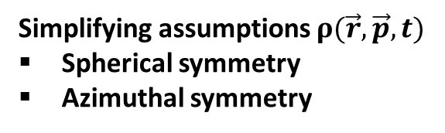
Collective Oscillations of SN Neutrinos
SN neutrinos streaming off the ν sphere
Oscillations driven by mass differences
MSW effects via the matter potentials
Collective effects via self-interactions
Simplifying assumptions $ρ(\vec{r},\vec{p},t)$
Spherical symmetry
Azimuthal symmetry
Duan, Fuller, Qian, 06; Hannestad et al., 06; Fogli et al., 07; Raffelt, Smirnov, 07; Duan et al., 07; Dasgupta et al., 09; …
Spontaneous symmetry breaking
Symmetry not enforced
Perturbations added
Instability found
Raffelt et al., 1305.7140;
Raffelt, Seisas, 1307.7625;
Mirizzi, 1308.1402;
Duan, 1309.7377;
Chakraborty et al., 1412.0670 ;
Duan, Shalgar, 1412.7097
Mirizzi, 1506.06805;
Duan, 1506.08629;

Slide 21
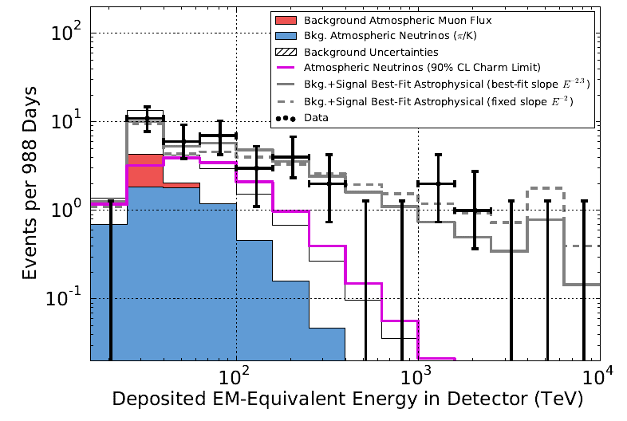
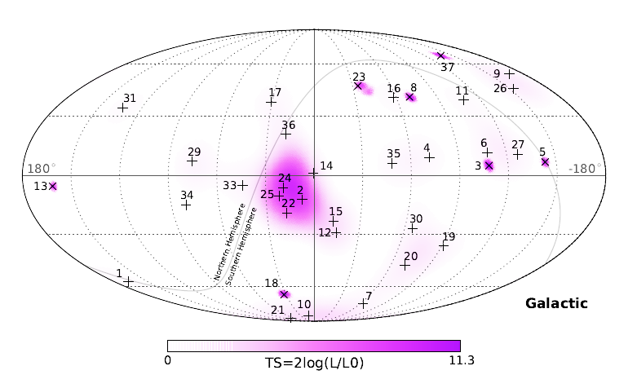
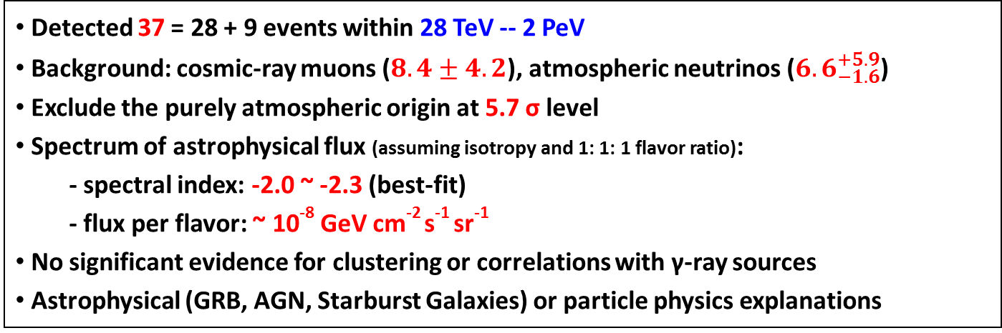
PeV Neutrinos at IceCube
IceCube, PRL 113, 101101 (2014)
Detected 37 = 28 + 9 events within 28 TeV -- 2 PeV
Background: cosmic-ray muons ($8.4±4.2$), atmospheric neutrinos (${6.6}_{−1.6}^{+5.9}$)
Exclude the purely atmospheric origin at 5.7 σ level
Spectrum of astrophysical flux (assuming isotropy and 1: 1: 1 flavor ratio):
  - spectral index: -2.0 ~ -2.3 (best-fit)
  - flux per flavor: ~ 10⁻⁸ GeV cm⁻² s⁻¹ sr⁻¹
No significant evidence for clustering or correlations with γ-ray sources
Astrophysical (GRB, AGN, Starburst Galaxies) or particle physics explanations
Review by Anchordoqui et al., 14

Slide 22
PeV Neutrinos at IceCube
“Secret Neutrino Interactions”: ν-ν interaction (coupling g) mediated by φ (mass M)
Ng, Beacom, 1404.2288;
Test of secret neutrino interactions
Only possible in astrophysical environments
UHE neutrinos will be absorbed by CνB
Requirement of no significant absorption
Exotic energy loss for SN 1987A
Extra radiation density at ν decoupling
Free-streaming neutrinos at γ decoupling
S.Z., 11; Cyr-Racine, Sigurdson, 13; Ahlgren, Ohlsson, S.Z., 13; Laha, Dasgupta, Beacom, 14; Ng, Beacom, 14; Ibe, Kaneta, 14; Ioka, Murase, 14; Kamada, Yu, 15; DiFranzo, Hooper, 15
Need more data to fit neutrino spectra

Slide 23


Summary and Outlook
We have known neutrinos much better than ever before, but some important information is still missing
Quark masses
Hierarchy problem
LFV
In the near future, we hope
neutrino mass ordering, leptonic Dirac CP phase,
Majorana nature (LNV),
the absolute mass scale
will be fixed experimentally
CP phases
Quark mixing
ν mass ordering
Majorana
Remember astrophysics and cosmology provide good opportunities to study neutrinos as well
Dark Matter
Be optimistic and patient. A complete picture will finally emerge, I believe.
sterile

