Slide 1
EHBS integration in the control system
Enrique Blanco on behalf of the Cryogenics Controls Project members (EN/ICE – TE/CRG)

Slide 2

EH Integration (Analog object)
CRYO SCADA
CIET
AL
TS₂
Ethernet Comms.
Analog
AL
TS₁
AO
Analog setpoint
EH
PLC
FEC
DI
AI
Analog feedback
Status
15 0
OverTemp
IOError
IOError
Analog feedback
Status
Analog setpoint
OverTemp
AL: Alarm TS: Temporary Stop
DI: Digital Input FS: Full Stop
AI: Analog Input
AO: Analog Output
EH Electronics
Board
Wfip Comms.

Slide 3
EHBS Integration (AnaDO object)
FESA CRYO application v3.0.8
PLC
AL
FS
Full Stop (if 3 TS1 within a time window)
Temporary Stop TS1: if Heater OverTemperature
Full Stop: if Card Overtemperature (Not done before RUN2-TS3)
FEC
AL
TS₂
AnaDO
DO
Activation
AL
FS
AL
TS₁
EH
AO
Analog setpoint
DI
DI
AI
Analog feedback
Status
IOError
15 10 1 0
Card
OverTemp
Heater
OverTemp
On/Off
Status
Enable/Disable
Analog feedback
Analog setpoint
IOError
AL: Alarm TS: Temporary Stop
DI: Digital Input FS: Full Stop
AI: Analog Input
AO: Analog Output DO: Digital Output
Heater OverTemp
EH Electronics
Board
Card OverTemp

Slide 4
EH vs. EHBS
Availability
  EH
    Automatic recovery when conditions are fulfilled
  EHBS
    Need explicit action to recover in several situations
Safety (Self-protection)
  EH
    Not safe state when Wfip communication fails
  EHBS
    Handshake protocol (one direction): watchdog to get in a safe state when lost of Wfip communications

Slide 5
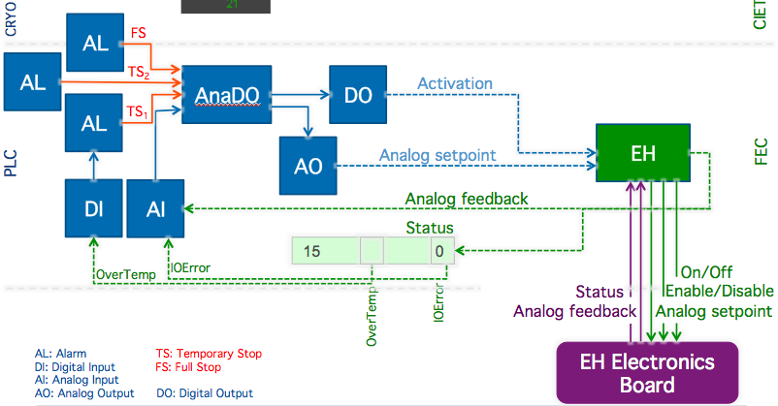
EHBS Status
Integration with :
  TS on overtemp
  FS* (Fullstop) if 3 times of TS overtemp during the last 2 hours.
  IOError signal when all anomalous conditions.
Consequences:
  Operation: In case of a card severe error (other than overtemp) the operator will only see an “E” in the widget but not an alarm.
  In case of card malfunction the control and/or operator will only realize when the perturbed by the collateral effect in the process.
All 8 sectors deployed: ~ 60 EHBS per sector.
*FS needs a manual action of an operator: ACK alarm

Slide 6
Integration Principles
Principles
  The card must protect itself if possible
  (The FEC & PLC must protect otherwise)
  The card (and the FEC software) must enlarge availability as much as possible
    Card: Recovering automatically when a problem disappears.
    FEC: Detecting the problem and enabling the card back when the problem disappears
  All the complexity of the card must be hidden to the control system and/or operator
    Activation by successive pulses (~15 seconds each)
    Activation (PLC command) vs. On/Off and Enable/Disable (CARD commands)
    Relays blocking (Off command when operating in AC mode)
    Operation around the switching AC/DC point

Slide 7
Components failure Analysis
Case | PLC | FEC | Card | Action
(1) PLC |  | ✔ |  | Set SP=0 (after 2 min)
(2) FEC |  |  | ✔ | Protection (after 30 s)
(3) Ethernet: switch and/or cable |  | ✔ |  | Set SP=0 (after 2 min)
(4) WFip repeater, PCI card and/or cable |  |  | ✔ | Protection (after 30 s)
(5) WFip agent |  |  | ✔ | Protection (after 30 s)

Slide 8
Improvement proposals
Operation requirement: Need of an alarm (BEEP) when a heater is not working properly (To define!)
Solutions:
  Keeping the current control system objects. Customize the IOError information and include this condition in the existing FullStop (FS).
    Pros: No need of changing specs (update in DB). Only downloading new code.
    Cons: Cases 8,9,10,11,12 (Card auto-recovery by itself) will not be set as IOError for the PLC -> No Interlock (full stop). Those cases will not be noticed by operation.
  Include new objects to make a dedicated FullStop alarm
    Pros: Clear separation between errors which need FS (manual ACK) and IOError information for all the remaining anomalous situations (Cases 8,9,10,11,12)
    Cons: Full generation: Cryo controls (~60 Dis and 60 Alarms per sector)

Slide 9
Protection cases: Solution 1
Case | Card auto-recovery | TS | FS | IOError
Card reset / Power-up | No
(2) Overtemp (load) | No | ✔ | ✔* | ✔
(3) Watchdog** | No
(4) Disable: Input | No
(5) On/Off: Input | No
(6) Heatsink (card) | No |  | ✔ | ✔
(7) Relay error | No |  | ✔ | ✔
(8) Vref out of bounds | Yes
(9) ADC conversion error | Yes
(10) Unstable setpoint on the crate | Yes
(11) Unstable addressing on the crate | Yes
(12) Thermocouple ref. out of bounds | This is handled by the FEC code.
* FS after 3 times TS in 2 hours.
** Watchdog is not detected until comms recover

Slide 10
Protection cases: Solution 2
Case | Card auto-recovery | TS | FS | IOError
Card reset / Power-up | No | ✔ |  | ✔
(2) Overtemp (load) | No | ✔ |  | ✔
(3) Watchdog** | No | ✔ | ✔* | ✔
(4) Disable: Input | No
(5) On/Off: Input | No
(6) Heatsink (card) | No |  | ✔ | ✔
(7) Relay error | No |  | ✔ | ✔
(8) Vref out of bounds | Yes | ✔ |  | ✔
(9) ADC conversion error | Yes | ✔ |  | ✔
(10) Unstable setpoint on the crate | Yes | ✔ |  | ✔
(11) Unstrable addressing on the crate | Yes | ✔ |  | ✔
(12) Thermocouple ref. out of bounds | This is handled by the FEC code.
* FS after 3 times TS in 2 hours.
** Watchdog is not detected until comms recover

Slide 11
Protection cases: Solution 3 (1 + CIET Alarms)
Case | Card auto-recovery | CIET alarm | TS | FS | IOError
Card reset / Power-up | No | ✔
(2) Overtemp (load) | No | ✔ | ✔ | ✔* | ✔
(3) Watchdog** | No | ✔
(4) Disable: Input | No
(5) On/Off: Input | No
(6) Heatsink (card) | No | ✔ |  | ✔ | ✔
(7) Relay error | No | ✔ |  | ✔ | ✔
(8) Vref out of bounds | Yes | ✔
(9) ADC conversion error | Yes | ✔
(10) Unstable setpoint on the crate | Yes | ✔
(11) Unstrable addressing on the crate | Yes | ✔
(12) Thermocouple ref. out of bounds | This is handled by the FEC code.
* FS after 3 times TS in 2 hours.
** Watchdog is not detected until comms recover

Slide 13

EHBS Integration (AnaDO object).
Previous slide to 30 Jul 2015 development
CRYO SCADA
Not up to date!
CIET
AL
FS
AL
TS₂
AnaDO
DO
Activation
AL
TS₁
EH
AO
Analog setpoint
FEC
PLC
DI
AI
Analog feedback
Status
15 0
IOError
On/Off
OverTemp
Status
Enable/Disable
IOError
Analog feedback
Analog setpoint
OverTemp
AL: Alarm TS: Temporary Stop
DI: Digital Input FS: Full Stop
AI: Analog Input
AO: Analog Output DO: Digital Output
EH Electronics
Board

