Slide 1
EHBS integration in the control system
Enrique Blanco on behalf of the Cryogenics Controls Project members (EN/ICE – TE/CRG)

Slide 2

EH Integration (Analog object)
CRYO SCADA
CIET
AL
TS₂
Ethernet Comms.
Analog
AL
TS₁
AO
Analog setpoint
EH
PLC
FEC
DI
AI
Analog feedback
Status
15 0
OverTemp
IOError
IOError
Analog feedback
Status
Analog setpoint
OverTemp
AL: Alarm TS: Temporary Stop
DI: Digital Input FS: Full Stop
AI: Analog Input
AO: Analog Output
EH Electronics
Board
Wfip Comms.

Slide 3

EHBS Integration (AnaDO object)
CRYO SCADA
CIET
AL
FS
AL
TS₂
AnaDO
DO
Activation
AL
TS₁
EH
AO
Analog setpoint
FEC
PLC
DI
AI
Analog feedback
Status
15 0
IOError
On/Off
OverTemp
Status
Enable/Disable
IOError
Analog feedback
Analog setpoint
OverTemp
AL: Alarm TS: Temporary Stop
DI: Digital Input FS: Full Stop
AI: Analog Input
AO: Analog Output DO: Digital Output
EH Electronics
Board

Slide 4
EH vs. EHBS
Availability
  EH
    Automatic recovery when conditions are fulfilled
  EHBS
    Need explicit action to recover in several situations
Safety (Self-protection)
  EH
    Not safe state when Wfip communication fails
  EHBS
    Handshake protocol (one direction): watchdog to get in a safe state when lost of Wfip communications

Slide 5
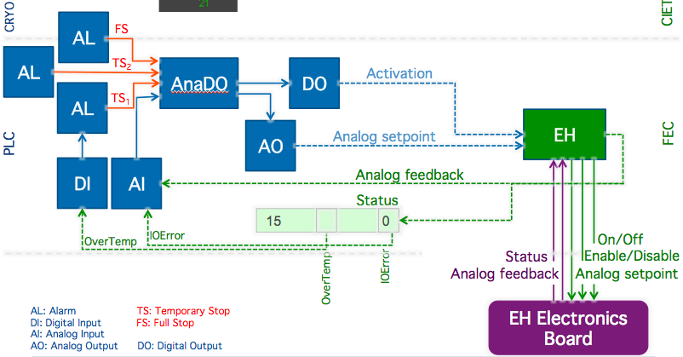
EHBS Status
Integration with :
  TS on overtemp
  FS* (Fullstop) if 3 times of TS overtemp during the last 2 hours.
  IOError signal when all anomalous conditions.
Consequences:
  Operation: In case of a card severe error (other than overtemp) the operator will only see an “E” in the widget but not an alarm.
  In case of card malfunction the control and/or operator will only realize when the perturbed by the collateral effect in the process.
All 8 sectors deployed: ~ 60 EHBS per sector.
*FS needs a manual action of an operator: ACK alarm

Slide 6
Integration Principles
Principles
  The card must protect itself if possible
  (The FEC & PLC must protect otherwise)
  The card (and the FEC software) must enlarge availability as much as possible
    Card: Recovering automatically when a problem disappears.
    FEC: Detecting the problem and enabling the card back when the problem disappears
  All the complexity of the card must be hidden to the control system and/or operator
    Activation by successive pulses (~15 seconds each)
    Activation (PLC command) vs. On/Off and Enable/Disable (CARD commands)
    Relays blocking (Off command when operating in AC mode)
    Operation around the switching AC/DC point

Slide 7
Components failure Analysis
Case | PLC | FEC | Card | Action
(1) PLC |  | ✔ |  | Set SP=0 (after 2 min)
(2) FEC |  |  | ✔ | Protection (after 30 s)
(3) Ethernet: switch and/or cable |  | ✔ |  | Set SP=0 (after 2 min)
(4) WFip repeater, PCI card and/or cable |  |  | ✔ | Protection (after 30 s)
(5) WFip agent |  |  | ✔ | Protection (after 30 s)

Slide 8
Improvement proposals
Operation requirement: Need of an alarm (BEEP) when a heater is not working properly (To define!)
Solutions:
  Keeping the current control system objects. Customize the IOError information and include this condition in the existing FullStop (FS).
    Pros: No need of changing specs (update in DB). Only downloading new code.
    Cons: Cases 8,9,10,11,12 (Card auto-recovery by itself) will not be set as IOError for the PLC -> No Interlock (full stop). Those cases will not be noticed by operation.
  Include new objects to make a dedicated FullStop alarm
    Pros: Clear separation between errors which need FS (manual ACK) and IOError information for all the remaining anomalous situations (Cases 8,9,10,11,12)
    Cons: Full generation: Cryo controls (~60 Dis and 60 Alarms per sector)

Slide 9
Protection cases: Solution 1
Case | Card auto-recovery | TS | FS | IOError
Card reset / Power-up | No
(2) Overtemp (load) | No | ✔ | ✔* | ✔
(3) Watchdog** | No
(4) Disable: Input | No
(5) On/Off: Input | No
(6) Heatsink (card) | No |  | ✔ | ✔
(7) Relay error | No |  | ✔ | ✔
(8) Vref out of bounds | Yes
(9) ADC conversion error | Yes
(10) Unstable setpoint on the crate | Yes
(11) Unstable addressing on the crate | Yes
(12) Thermocouple ref. out of bounds | This is handled by the FEC code.
* FS after 3 times TS in 2 hours.
** Watchdog is not detected until comms recover

Slide 10
Protection cases: Solution 2
Case | Card auto-recovery | TS | FS | IOError
Card reset / Power-up | No | ✔ |  | ✔
(2) Overtemp (load) | No | ✔ |  | ✔
(3) Watchdog** | No | ✔ | ✔* | ✔
(4) Disable: Input | No
(5) On/Off: Input | No
(6) Heatsink (card) | No |  | ✔ | ✔
(7) Relay error | No |  | ✔ | ✔
(8) Vref out of bounds | Yes | ✔ |  | ✔
(9) ADC conversion error | Yes | ✔ |  | ✔
(10) Unstable setpoint on the crate | Yes | ✔ |  | ✔
(11) Unstrable addressing on the crate | Yes | ✔ |  | ✔
(12) Thermocouple ref. out of bounds | This is handled by the FEC code.
* FS after 3 times TS in 2 hours.
** Watchdog is not detected until comms recover

Slide 11
Protection cases: Solution 3 (1 + CIET Alarms)
Case | Card auto-recovery | CIET alarm | TS | FS | IOError
Card reset / Power-up | No | ✔
(2) Overtemp (load) | No | ✔ | ✔ | ✔* | ✔
(3) Watchdog** | No | ✔
(4) Disable: Input | No
(5) On/Off: Input | No
(6) Heatsink (card) | No | ✔ |  | ✔ | ✔
(7) Relay error | No | ✔ |  | ✔ | ✔
(8) Vref out of bounds | Yes | ✔
(9) ADC conversion error | Yes | ✔
(10) Unstable setpoint on the crate | Yes | ✔
(11) Unstrable addressing on the crate | Yes | ✔
(12) Thermocouple ref. out of bounds | This is handled by the FEC code.
* FS after 3 times TS in 2 hours.
** Watchdog is not detected until comms recover

