Slide 2
Specifications and available protection mechanisms of the Beam Screen Heater electronic card
TRIKOUPIS Nikolaos

Slide 3
Content
Presentation: Specifications and available protection mechanisms, by Nikolaos
Power on-load, AC/DC modes
Protections mechanisms
Operating the card
Operation of sector 6-7
Presentation: Integration of the Electrical Heaters in the control system, by Enrique
Discussion:
AC/DC modes of operation
Automatic enabling
I/O error, temporary and full stops

Slide 4
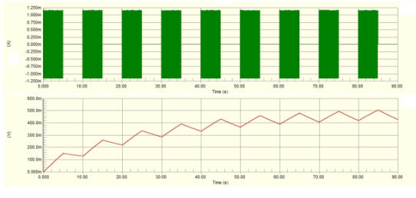
Power on-load
Specifications | Value
Modes of operation | DC or AC (Approx. 4 seconds for switching between modes)
DC power output | 0-30W, Linear voltage 0-55V
DC power feedback | Valid immediately (after 2 seconds)
AC power output | 0-200W, Pulse-Width-Modulation of AC over 10 sec
AC power feedback | Stable after 3τ ~ 36 sec. Updated every 10 seconds.
AC power measurement

Slide 5
DC/AC mode of operation
DC mode of operation
Load: Connected
AC mode of operation
Load: Connected
DC/AC mode of operation
Load: Disconnected
AC/DC or DC/AC transitions last max 4.2 sec

Slide 6
Protections
Channel disabled when: | Auto recovery | Comments
Crate power-ON | No
Reset | No
Overtemperature of the heater | No | Diagnostic error is stored until acknowledged by an “Enable” command
Communication loss for > 10 sec | No | Diagnostic error is stored until acknowledged by an “Enable” command
Channel “Disable” command | No
Channel “Disconnect” command | No
Card heatsink overtemperature | No | Diagnostic error is stored until acknowledged by an “Enable” command
Relays malfunction (on DC->AC or AC->DC transition) | No | Diagnostic error is stored until acknowledged by an “Enable” command
PCB card reference out of bounds | Yes | As long as error is present, no min/max time
PCB signal digitization malfunction | Yes | Minimum 5 seconds on error, then automatic reset attempt
PCB backpanel unstable setpoint | Yes | As long as error is present, no min/max time
PCB backpanel unstable address | Yes | As long as error is present, no min/max time
Thermocouple reference out of bounds | Yes | This protection is managed by CIET and not the card

Slide 7

Overtemperature protection
Upper hard interlock (On EH card)
Soft interlock (Instrument specialist)
Lower hard interlock (On EH card)
Blue: ThC correct polarity
Red: ThC inverse polarity
The soft interlock is set by the instrument specialist through the communication card
  Soft interlock is currently set to 40°C.
The hard interlocks are set on the EH card by jumpers
The 3 protections trigger an “Overtemperature” protection.

Slide 8
Operation of the EHBS card
Commands |  |  | Result
Channel Enable/Disable | Load Connect/Disconnect | Mode DC/AC
Enable | Connect | DC | Channel enabled, load connected to DC, delivering DC power
Disable | Connect | DC | Channel disabled, load connected to DC, no DC power
Enable | Disconnect | DC | Channel disabled, load disconnected to DC, no DC power
Disable | Disconnect | DC | Channel disabled, load disconnected to DC, no DC power
Enable | Connect | AC | Channel enabled, load connected to AC, delivering AC power
Disable | Connect | AC | Channel disabled, load connected to AC, no AC power
Enable | Disconnect | AC | Channel disabled, load disconnected to AC, no AC power
Disable | Disconnect | AC | Channel disabled, load disconnected to AC, no AC power
Enable | Connect | DC->AC or AC->DC | Channel enabled, mode transition, load connected to AC/DC
Disable | Connect | DC->AC or AC->DC | Channel disabled, mode transition, load connected to AC/DC
Enable or Disable | Disconnect | DC->AC or AC->DC | Channel disabled, relays do not move, relay error
Enable command: ‘0’ for 15 sec and then ‘1’ for 15 sec
Disable command: ‘1’ for 15 sec and then ‘0’ for 15 sec

Slide 9
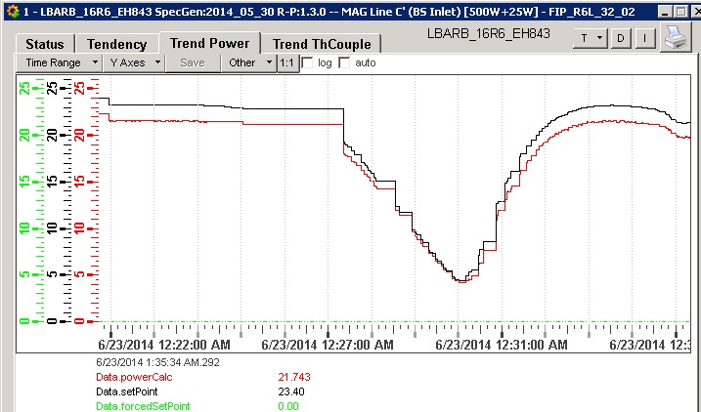
Power DC precision

Slide 10
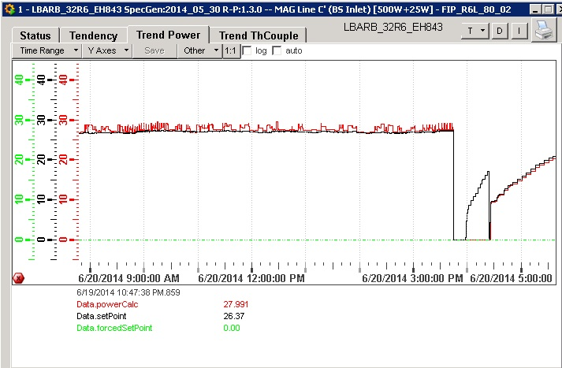
Power AC precision

Slide 11
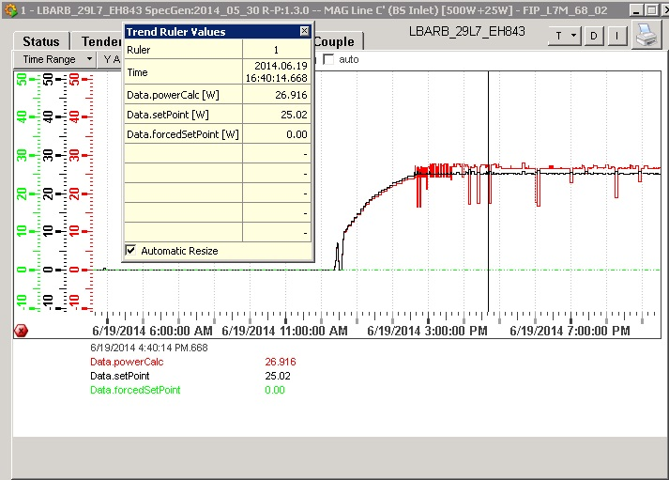
Power DC->AC transition

Slide 12
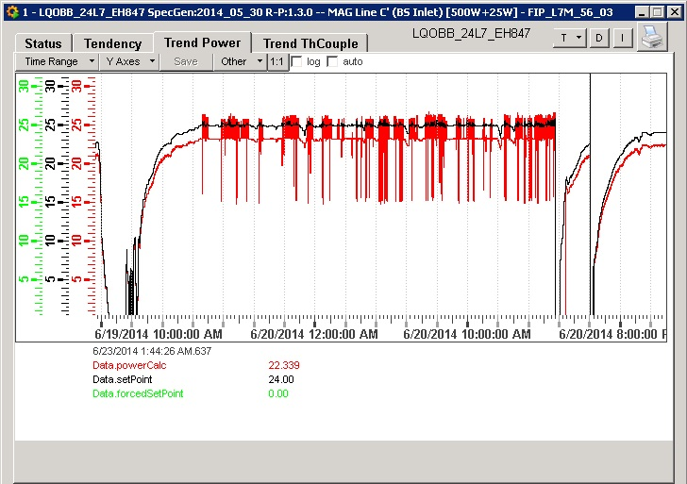
Power setpoint of 25W

Slide 13
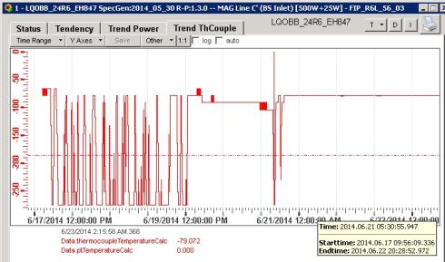
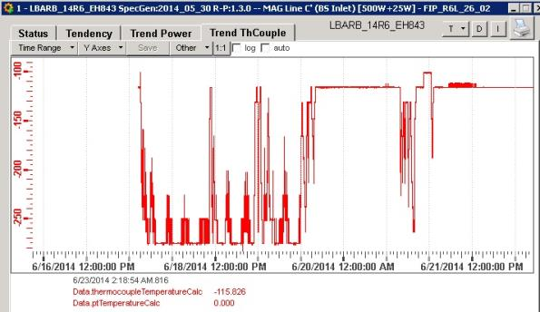
Typical thermocouple reading

Slide 14
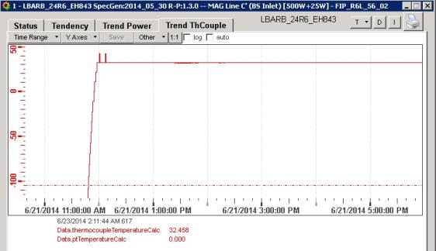
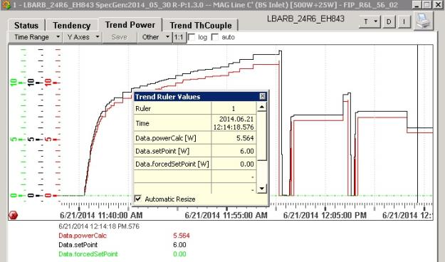
LBARB_24R6_EH843

Slide 15
Questions?

