Slide 2
Pt4-Pt1-Pt5 surface and underground space requirements
C. Collazos, P. Fessia, C. Magnier
With key inputs from (and many thanks to)
J.-P. Burnet,
R. Calaga, S. Claudet, K. Dahlerup-Petersen, B. Feral, G. Ferlin, E. Todesco

Slide 3
Summary
Pt 4: installation of the cryo-plant for RF
Pt1 and Pt5
  Space requirement system by system
    Crab cavities
    Cryogenics
    Cold powering
  Arrangement concepts
  Analysis building by building point by point
    Crab building
    Cold powering building
    Point 5
    Point 1
  Option comparisons
Conclusions

Slide 4
Remarks
Space requirements shall be taken with an error band of ± 25 % in particular
All civil engineering structure are concepts not yet discussed with the CE team (no feasibility, costs,… ). The work with them starts today
Crab cavities: information according to the RF study performed till now.
Cryogenics
  Based on the LHC know how, probably well defined but piping could affect space need
Cold powering
  Power converters can be optimised for equipment cost or for volume occupancy according to project requirement and cost driving term
  DFH: the volume is guessed on the base of present DFBA as no other information is presently available
  QDS and QEE: based on 1st guess.

Slide 5
Point 4:
Cryogenic power plant for RF
This topic will the subject of an extended presentation by C. Magnier in an upcoming HL-TC where the proposal will be described in details and submitted to approval. As results it shall become baseline and it will affect the way in which CRG team will prepare the tendering

Slide 6
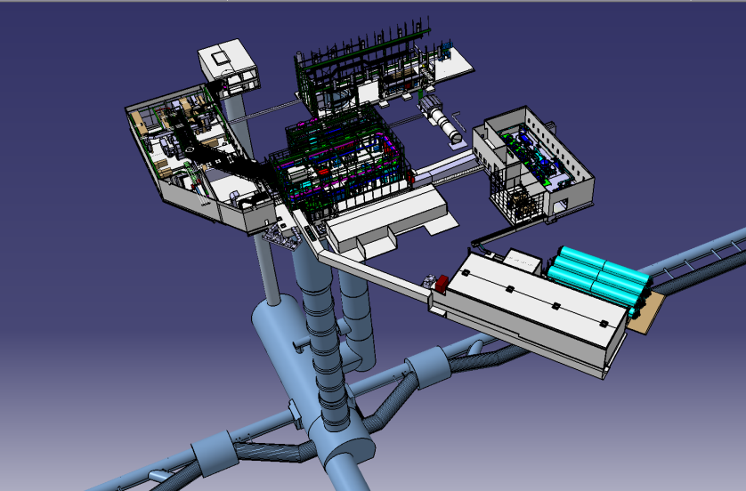
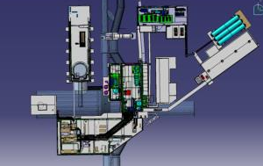
Point 4 : 3D overview
SZ4
SX4
SU4
SH4
SD4
PZ45
PX46
SHM4
UX45
TX46
PM45
UJ44
UJ46
US45

Slide 7
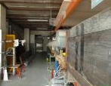
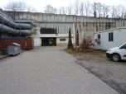
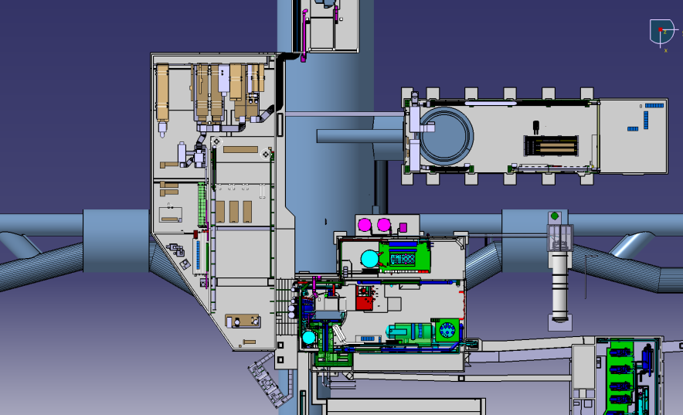
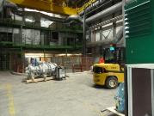
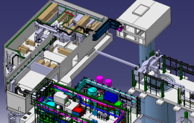
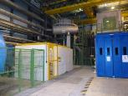
Pt4 surface : top view
in yellow the concerned
area
SZ4
PX46
SX4
SU4
PM45
POINT 5
UJ44
UJ46
SUH4
SD4

Slide 8
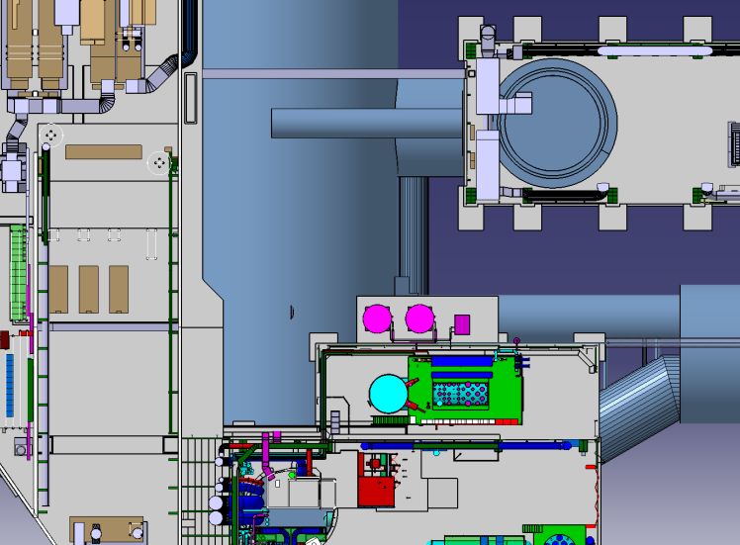
Cryogenics area
PX46
SX4
NEW TECHNICAL GALLERY
PLACE TO BE DEFINED (1.8mx2m)
Halfen supports
EXISTING TECHNICAL GALLERY
SUH4

Slide 9
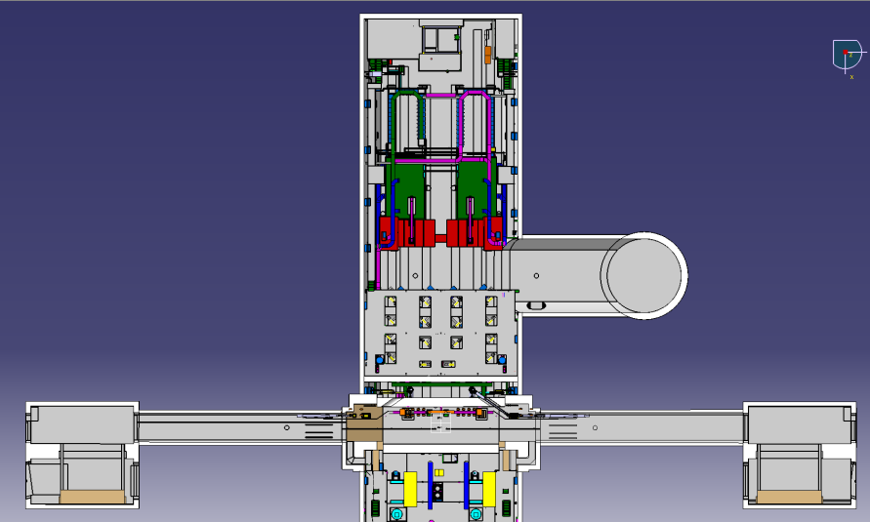
Underground installation of cold box:
New proposition in TX46
PZ45
- TX46 is an empty cavern
- We could use PX46 for the pipes
- TX46 is “closed” to existing cryogenic
installation
UX45”RF” side
TX46
PX46
UJ44
RB44
RB46
UJ46
UX45 ”CRYO” side

Slide 10
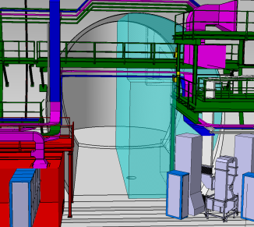
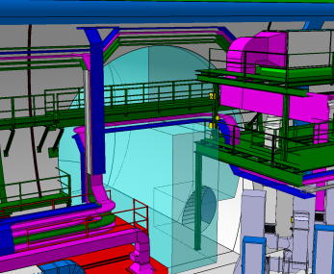
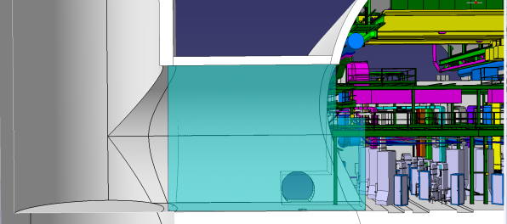
Vertical installation volume
Installation volume
65 m²
Height 7.5 m

Slide 11
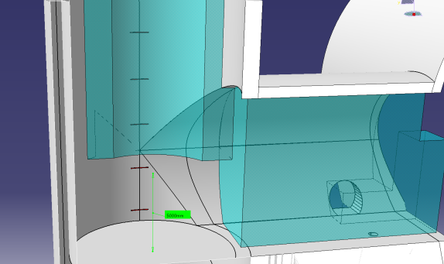
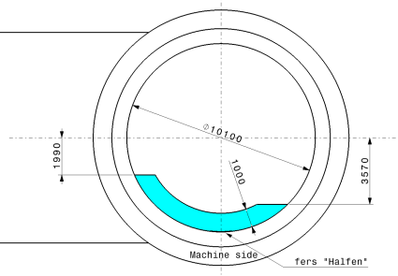
Space reservation in PX46 for services
8 m2

Slide 12
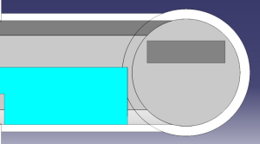
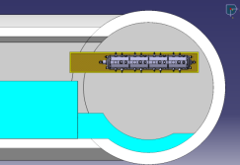
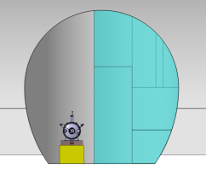
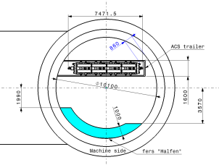
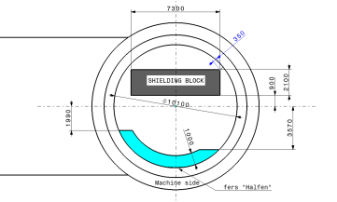
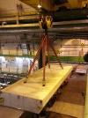
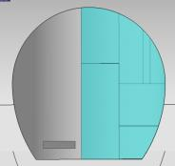
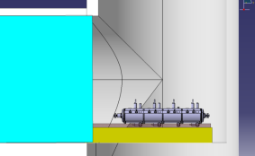
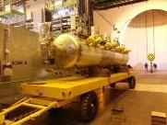
Handling volume
RUX45 shielding
7300x2100x475h
ACSGA on trailer
400mm

Slide 13
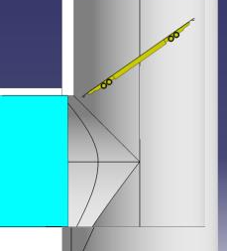
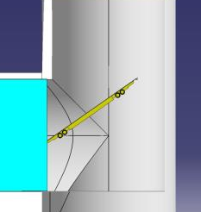
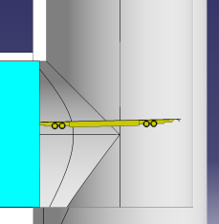
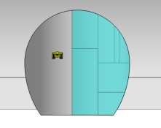
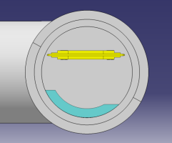
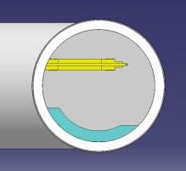
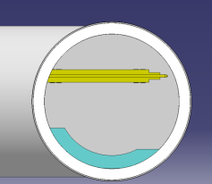
SSS trailer handling for vertical solution
35 degrees/floor
350mm

Slide 14
Point 4 summary
The proposed solution in Point 4
  Minimizes the surface civil engineering
  Reduces the lengths of the underground cryogenic piping respect previous proposals
  Provides installation zone for the cold box in the nearest possible position respect the LHC machine tunnel
  Still provides all the required volume needed for transport manipulation
  In principle could allow anticipation of activities before LS2 start (to be studied)

Slide 15
Point 1 and Point 5:
Cryogenic power plant, RF crab cavity infrastructures, cold powering

Slide 16
Space requirement system by system

Slide 17
Crab cavities

Slide 18
Crab cavities
 | Requirement | Area | Baseline/Option
RF power (2×IP) | 2×[3×14] m | 2×42 m² | Underground/surface
LLRF racks (2×IP) | 2×[(5.6+4.4+7)×3.8] m | 2×65 m² | Underground/surface
LLRF central racks(1×IP) | 2×3.8 m | 8 m² | Underground/surface
HVPS (2×IP) | 2×[4×16] m | 2×65 m² | Surface
Remark
LLRF requires Electromagnetic shielding and it is radiation sensitive

Slide 19
Cryogenics

Slide 20
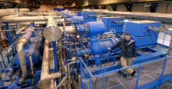
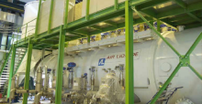
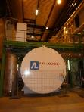

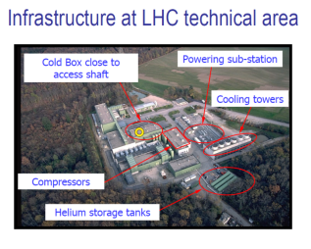
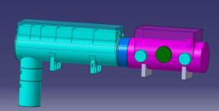
STOCKAGE HELIUM (warm & cold)
WARM COMPRESSOR
BUILDING
600m2
Surface building (SD) (30mx10m)
PIT
QPLB
UNDERGROUND
CAVERN
Illustrations : Serge Claudet (CRG)

Slide 21
Cryogenics
Cryogenic system | Where
Warm compressor | Surface | Area | 700 m²
 |  | Crane | 20 t
 |  | Type | Noise insulated
Surface SD building | Surface | Area | 30×10=300 m²
 |  | Crane | 5 t
Cold Compressor | Underground | Volume | 200 m³
 |  | Surface | 0 m²
 |  | Crane | 2 t
Remark
The electronics for the magnetic bearings of the cold compressor is radiation sensitive and maximum distance from its control electronics to the compressor is
50 m

Slide 22
Cold powering

Slide 23
Cold powering Circuits Q1 to D1
Q1 to D1 (for each IP side)
circuits connected to the DFHX
C.M. | Circuit / magnet | Op. current [kA] | PC current rating [kA] | N of circuits | N. of 19” racks /PC | Total racks/ Circuit type
Q1-Q3 | MQXF | 17.5 | 20 | 1 | 10 | 10
 | trim MQXF Q3 | ±2 | ±3.2 | 1 | 3 | 3
Q2A-Q2B | MQXF | 17.5 | 20 | 1 | 10 | 10
 | trim MQXF Q2 | ±0.3 | ±0.8 | 1 | 0.5 | 0.5
 | MCBXB | ±2.5 | ±3.2 | 4 | 3 | 12
CP | MCBXA | ±2.5 | ±3.2 | 2 | 3 | 6
 | MQSXF | ±0.182 | ±0.2 | 1 | 0.5 | 0.5
 | MCTXF | ±0.17-0.2 | ±0.2 | 1 | 0.5 | 0.5
 | MCTSXF | ±0.17-0.2 | ±0.2 | 1 | 0.5 | 0.5
 | MCDXF | ±0.193 | ±0.2 | 1 | 0.5 | 0.5
 | MCDSXF | ±0.193 | ±0.2 | 1 | 0.5 | 0.5
 | MCOXF | ±0.17-0.2 | ±0.2 | 1 | 0.5 | 0.5
 | MCOSXF | ±0.17-0.2 | ±0.2 | 1 | 0.5 | 0.5
 | MCSXF | ±0.17-0.2 | ±0.2 | 1 | 0.5 | 0.5
 | MCSSXF | ±0.17-0.2 | ±0.2 | 1 | 0.5 | 0.5
D1 | MBXF | 11.8 | 16 | 1 | 9 | 9
Space needed
circuits connected to the DFHX
Total racks | 55
Installation surface [m²] | 40
Access/manipulation surface [m²] | 43
Linear installation extension [m] | 35
Height [m] | 2.6
Installation volume [m³] | 100
Cooling water flow rate [l/min] | 305

Slide 24
Cold powering Circuits D2 to Q6
D2 to Q6 (for each IP side)
Circuits connected to the DFHM
C.M. | Circuit / magnet | Op. current [kA] | PC current rating [kA] | N. of circuits | N. of 19” racks /PC | Total/ circuit type
D2 | MBRD | 12.4 | 16 | 1 | 9 | 9
 | MCBRD | ±3 | ±4 | 4 | 4 | 16
Q4 | MQYY | 16.1 | 20 | 2 | 10 | 20
 | MCBYY | ±3 | ±4 | 4 | 4 | 16
Q5 | MCBY | 0.088 | ±0.12 | 6 | 0.25 | 1.5
 | MQY | 4.2 | 8 | 2 | 4 | 8
Q6 | MCBC | 0.1 | ±0.12 | 2 | 0.25 | 0.5
 | MQML | 5.39 | 8 | 2 | 4 | 8
Space needed
Circuits connected to the DFHM
Total racks | 79
Installation surface [m²] | 56
Access/manipulation surface [m²] | 60
Linear installation extension [m] | 50
Height [m] | 2.6
Installation volume [m³] | 145
Cooling water flow rate [l/min] | 400

Slide 25
Cold powering arc
Continuous cryostat presently fed from DFBA (for each IP side)
Circuits connected to the DFHA
Magnet | PC current rating [kA] | N. of circuits | N. of 19” racks /PC | Total/ circuit type
MQT | ±0.6 | 2 | 0.5 | 1
MQS | ±0.6 | 2 | 0.5 | 1
MQTL | ±0.6 | 2 | 0.5 | 1
MQT | ±0.6 | 2 | 0.5 | 1
MSS | ±0.6 | 2 | 0.5 | 1
MO | ±0.6 | 4 | 0.5 | 2
MQM | 6 | 4 | 4 | 16
MQML | 6 | 4 | 4 | 16
D11 T trim | ±0.6 | 2 | 0.5 | 1
Space needed
Circuits connected to the DFHA
Total racks | 38
Installation surface [m²] | 27
Access/manipulation surface [m²] | 29
Linear installation extension [m] | 25
Height [m] | 2.6
Installation volume [m³] | 68
Cooling water flow rate [l/min] | NA
Space becoming free in RR by DFHM related PC
Racks removed | 34
Installation surface made available | 24
Linear installation extension [m] | 22

Slide 26
Spare Power Converters
Q1 to D1 (for each IP side)
“DFHX”
N. spare | PC current rating [kA] | N. Circuit served | N. of 19” racks
1 | 20 | 2 | 10
1 | 16 | 1 | 9
1 | ±3.2 | 7 | 3
1 | ±0.8 | 1 | 0.5
1 | 0.4 | 10 | 0.5
D2 to Q6 (for each IP side)
“DFHM”
N. spare | PC current rating [kA] | N. Circuit served | N. of 19” racks
1 | 20 | 2 | 10
1 | 8 | 4 | 3
1 | ±4 | 4 | 0.5
1 | ±0.12 | 8 | 0.5
Cont. cryostat (for each IP side)
“DFHA”
N. spare | PC current rating [kA] | N. Circuit served | N. of 19” racks
Total 5 racks
Q1 to Q6 (for each IP side)
DFHX+ DFHM spares
Installation surface [m²] | 10
Access/manipulation surface [m²] | 12
Linear installation extension [m] | 9
Height [m] | 2.6
Installation volume [m³] | 18
Cooling water flow rate [l/min] | 100
Q1 to Q6 (for each IP side)
DFHX+ DFHM spares
N. spare | PC current rating [kA] | N. Circuit served | N. of 19” racks
1 | 20 | 5 | 10
1 | 8 | 4 | 3
1 | ±4 | 12 | 0.5
1 | 0.4 | 10 | 0.5
1 | ±0.12 | 8 | 0.25

Slide 27
Quench detection, Q.H. powering
Plus 0.5 rack for each SC link itself
Q1 to D1 (for each IP side)
circuits connected to the DFHX
C.M. | Circuit | DQS | Q.H. | Total racks
Q1-Q3 | MQXF | 1 | 2 | 1.5
 | trim MQXF Q3 | 1 | NA | 0.5
Q2A-Q2B | MQXF | 1 | 2 | 1.5
 | trim MQXF Q2 | 1 | NA | 0.5
 | MCBXB | 4 | Not def | 2
CP | MCBXA | 2 | 1 | 1.5
 | MQSXF | 1 | 0 | 0.5
 | MCTXF | 1 | 0 | 0.5
 | MCTSXF | 1 | 0 | 0.5
 | MCDXF | 1 | 0 | 0.5
 | MCDSXF | 1 | 0 | 0.5
 | MCOXF | 1 | 0 | 0.5
 | MCOSXF | 1 | 0 | 0.5
 | MCSXF | 1 | 0 | 0.5
 | MCSSXF | 1 | 0 | 0.5
D1 | MBXF | 1 | 1* | 0.5
D2 to Q6 (for each IP side)
Circuits connected to the DFHM
C.M. | Magnet | DQS | Q.H. | Total racks
D2 | MBRD | 1 | 1* | 1
 | MCBRD | 4 | Not def | 2
Q4 | MQYY | 2 | 1* | 1.5
 | MCBYY | 4 | Not def | 2
Q5 | MCBY | 6 | 0 | 3
 | MQY | 2 | 1 | 1
Q6 | MCBC | 2 | 0 | 1
 | MQML | 2 | 1 | 1
*
Present design does not feature Q.H.
Space needed SC link included
 | DFHX related | DFHM related
Total racks | 14 | 14
Installation surface [m²] | 9 | 9
Access/manipulation surface [m²] | 11 | 11
Linear installation extension [m] | 9 | 9
Height [m] | 1.8 | 1.8
Installation volume [m³] | 25 | 25

Slide 28
Quench extraction
Quench extraction system main equipment modules
Equipment | Dimensions [m] | remark
Energy extraction switch | 2×2×2 [L×W×H] | Solid state based switches best guess for dimension 20 kA
Dump resistor | 1×1×1 [L×W×H] | Cooled dump resistor with water to coolant heat exchanger. Best guess dimension for 10 MJ
Quench extraction number and volume approximation
Equipment | No of units | Volume best guess on the base of energies and current
Energy extraction switch | 5 | 2×[2×2×2]+3×[2×2×1]
Dump resistor | 7 | 4×[1×1×1]+3×[0.5×0.5×0.5]
Quench extraction 1st guess installation surface and volume
Equipment | Surface including access [m²] | Volume [m³]
Energy extraction switch | 42 | 30
Dump resistor | 20 | 5

Slide 29
Cold Powering volume and surface total needs
Q1 to D1 (for each IP side) including DFHX and DFHM
 | Q1 to D1 | D2 to Q6 | Spare PC Q1 to Q6 | QDS | QEE | total
Installation surface [m²] | 52 | 68 | 10 | 18 | 25 | 173
Access/manipulation surface [m²] | 56 | 73 | 12 | 22 | 37 | 200
Linear installation extension [m] | 46 | 61 | 9 | 18 | 14 | 148
Installation volume [m³] | 120 | 164 | 18 | 50 | 35 | 387
Cooling water flow rate [l/min] | 305 | 400 | 100 | NA | NA | 810
DFH (X M A)
Length [m] | 11
Width [m] | 0.95
Height [m] | 1800
Installation surface [m²] | 11
Access surface [m²] | 13
Installation volume [m³] | 19
Arc including DFHA
Installation surface [m²] | 37
Access/manipulation surface [m²] | 41
Linear installation extension [m] | 35
Installation volume [m³] | 86

Slide 30
Summary per IP
Maximum in surface
 | Crab cavities | Cryogenics | Cold Powering | Total
Installation area on surface | 2×172 m² + 8 m² | 1000 m² | 2×450 m² | 2244 m²
Installation area underground |  | 150 m² |  | 150 m²
Maximum in tunnel
 | Crab cavities | Cryogenics | Cold Powering | Total
Installation area on surface | 2×65 m² | 1000 m² |  | 1130 m²
Installation area underground | 2×107 m² + 8 m² | 150 m² | 2×450 m² | 1280 m²
DFHA in RR
 | Crab cavities | Cryogenics | Cold Powering | Total
Installation area on surface | 2×172 m² + 8 m² | 1000 m² | 2×372 m² | 2096 m²
Installation area underground |  | 150 m² | 2×88 m² (RR) | 150+176 m²
DFHA + QDS in RR
 | Crab cavities | Cryogenics | Cold Powering | Total
Installation area on surface | 2×172 m² + 8 m² | 1000 m² | 2×332 m² | 2016 m²
Installation area underground |  | 150 m² | 2×128 m² (RR) | 150+256 m²

Slide 31
Possible concepts of arrangements tunnel-surface

Slide 32
Option A: long service tunnel
System | Sub-system | Location proposed | Building/structure
Crab cavity | RF power (2×IP) | Underground | Service Tunnel
 | LLRF racks (2×IP) | Underground | Service Tunnel
 | LLRF central racks | Underground | Service Tunnel Cryo
 | HVPS (2×IP) | Underground | Service Tunnel
Cryogenics | Warm compressor | Surface | Surface building Cryo
 | “SD” building | Surface | Surface building Cryo
 | Cold Compressor Box | Underground | Service Tunnel Cryo
Cold powering | DFHX (2×IP) | Surface/Underground | Sur. buildings CP/Service Tunnel
 | DFHX PC ( 2×IP) | Surface/Underground | Sur. buildings CP/Service Tunnel
 | DFHX QDS+QEE | Surface/Underground | Sur. buildings CP/Service Tunnel
 | DFHM (2×IP) | Surface/Underground | Sur. buildings CP/Service Tunnel
 | DFHM PC (2×IP) | Surface/Underground | Sur. buildings CP/Service Tunnel
 | DFHX QDS+QEE | Surface/Underground | Sur. buildings CP/Service Tunnel
 | DFHA (2×IP) | Surface/Underground | Sur. buildings CP/RR Service Tunnel
 | DFHA PC (2×IP) | Surface/Underground | Sur. buildings CP/RR Service Tunnel
 | DFHX QDS+QEE | Surface/Underground | Sur. buildings CP/RR Service Tunnel

Slide 33
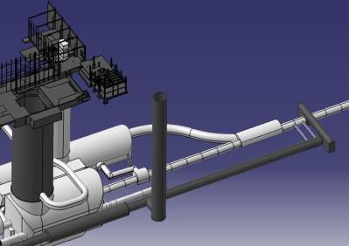
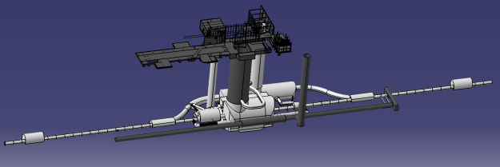
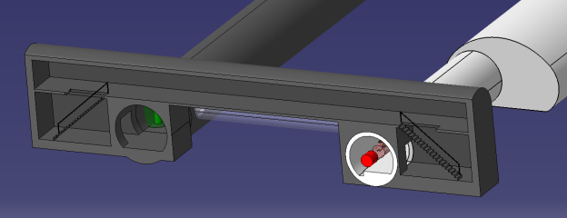
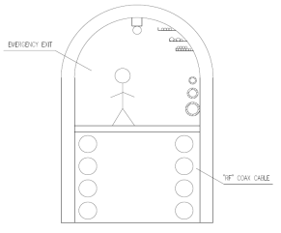
Option A: long service tunnel
MACHINE
TUNNEL
NEW CORES FOR COAX CABLE TRANSPORT
EMERGENCY EXIT
SERVICE TUNNEL
A2
A1

Slide 34
Option B: crab to the surface
- B1 enlargement of an existing structure
- B2: short service tunnel
System | Sub-system | Location proposed | Building/structure
Crab cavity | RF power (2×IP) | Surface | Crab service building Left and Right
 | LLRF racks (2×IP) | Surface | Crab service building Left and Right
 | LLRF central racks | Surface | Surface building Cryo+CP or specific building
 | HVPS (2×IP) | Surface | Crab service building Left and Right
Cryogenics | Warm compressor | Surface | Surface building Cryo
 | “SD” building | Surface | Surface building Cryo
 | Cold Compressor Box | Underground | Underground extension/ short service tunnel
Cold powering | DFHX (2×IP) | Surface | Surface building CP
 | DFHX PC ( 2×IP) | Surface | Surface building CP
 | DFHX QEE+QDS | Surface | Surface building CP+RR
 | DFHM (2×IP) | Surface | Surface building CP
 | DFHM PC (2×IP) | Surface | Surface building CP
 | DFHM QEE+QDS | Surface | Surface building CP+RR
 | DFHA (2×IP) | Underground | Surface building CP/RR
 | DFHA PC (2×IP) | Underground | Surface building CP/RR
 | DFHA QDS | Surface | Surface building CP/RR
Crab positions in lay-out blocked !!!!

Slide 35
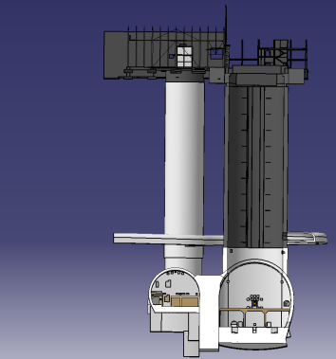
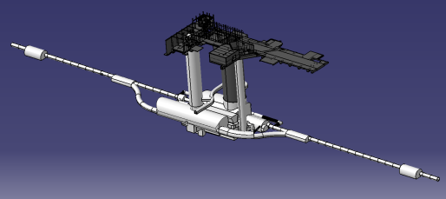
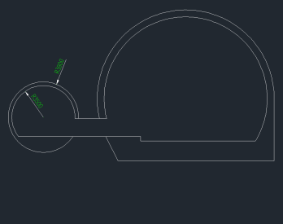
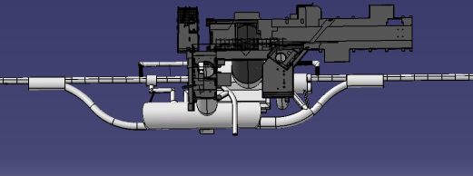
Option B1:
enlargement of existing tunnel
RR53
UJ53
Enlargement of existing tunnel
(Frontal View)
USC55
UJ57
RR57
UXC55
USC55
Enlargement of existing tunnel
Length_50m
(Top View)
USC55
Enlargement of existing tunnel
(Cross Section)

Slide 36
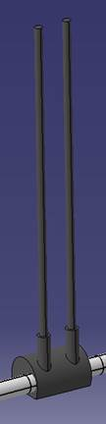

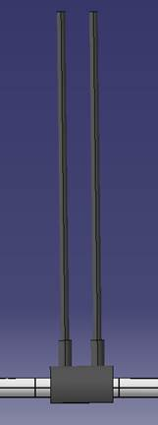
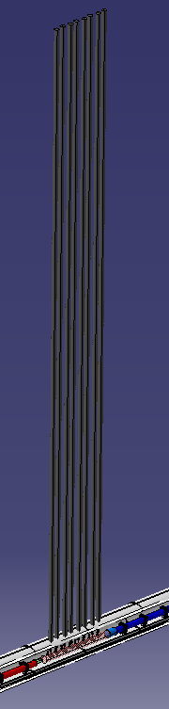
From surface to tunnel for crab
Necessity to accommodate 8 coax. 270 mm diameter
From 1 to 8 ducts.
Exit in the tunnel in a new alcove or just on top of the cavities

Slide 37
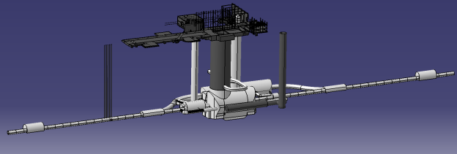
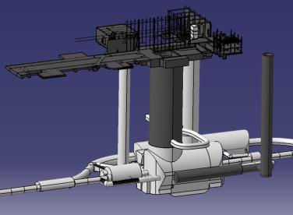
Option B2: short service tunnel

Slide 38
Analysis building by building point by point

Slide 39
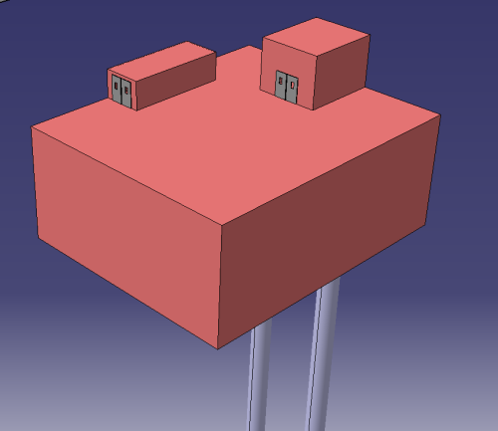


Crab building
TRANSPORT ACCESS
PERSONAL ACCESS
22 m
18 m
9 m
CRAB CAVITY SURFACE BUILDING
(22.1 x 18.2 x 9 m3)
IMPORTANT!!! The surface consider, it’s taking into account the space around the equipments.
So, it’s TOTAL surface
Partial underground building to reduce environmental impact (see later slides for positions)
LLRF Racks
Slow Control
Drivers & Control
26.60 m2
16.72 m2
21.28 m2

Slide 40

Crab building with some dimensions

Slide 41

CP building, preliminary
DFHX (Power Converters): 55
DFHX
DFHM
DFHM (Power Converters): 79
DFHA (Power Converters): 38
DFHA (Spare Power Converters): 5
DFHX + DFHM (Spare Power Converters): 14
DFHA
Cold Powering. Space Required. 316.5 m2 ( This for each IP side to be doubled)

Slide 42
Point 5

Slide 43




POINT 5 Underground infrastructure
Crab Module position
152399 mm/IP
Total length: 13400 mm
UJ53
UJ57
RR57
Q4
Crab Module
D2
*HL_LHC future integration of the Crab Module (152399 mm/IP) (Total length: 13400mm)
Crab Module
LHC position;
D2_151930 mm from the IP
Q4_163350 mm from the IP
D2
Q4

Slide 44


POINT 5 Surface building
Crab Module position
152399 mm/IP
Total length: 13400 mm
UJ53
RR57
Q4
Crab Module
D2
*HL_LHC future integration of the Crab Module (152399 mm/IP) (Total length: 13400mm)
Crab Module
D2
LHC position;
D2_151930 mm from the IP
Q4_163350 mm from the IP
Q4

Slide 45




Point 5 option B2
Surface buildings
CL+CR left
175m2 (10x17.5)
Underground buildings (new or modified)
2 cores dia 1.1m L 70m
CL+CR RIGHT
175m2
DFXJL
2 cores dia 1.1m L 75m
Cold compressor
DFXJR
New junction for RF
New junction for RF
Connection machine
US54

Slide 46

Point 5 option B2
Warm Compressors cryo 600m2
“SD” cryo
300m2
Cold powering
1000m2 (25x40)
LLRF central
PM54

Slide 47


CRAB LSS5l
CRYO SD
CRAB LSS5R
Cold powering
1000m2
Warm Comp.
600m2

Slide 48
Point 1

Slide 49



POINT 1 Underground infrastructure
Crab Module position
152399 mm/IP
Total length: 13400 mm
RR17
Building 2160: “Station electrique”
UJ17
UJ13
RR13
Q4
Crab Module
*HL_LHC future integration of the Crab Module (152399 mm/IP) (Total length: 13400mm)
D2
LHC position;
D2_151930 mm from the IP
Q4_163350 mm from the IP
Crab Module
D2
Q4

Slide 50


POINT 1 Surface building
RR17
Building 2160: “Station electrique”
UJ17
UJ13
RR13
*HL_LHC future integration of the Crab Module (152399 mm/IP) (Total length: 13400mm)
Q4
Crab Module
D2
LHC position;
D2_151930 mm from the IP
Q4_163350 mm from the IP
Crab Module
D2
Q4

Slide 51





POINT 1 : existing access points
PX14 et PX16 : fully used by experiments
PM15 (9.1m)
PX16 (12.6m)
Pt8
Space reserved to
lower material
too small
PX15 (9.1m)
UJ17
PX14 (18m)
UJ16
US15
UX15
Can we enlarge the USA15 and build
connection tunnels ?
UJ14
Space reserved to
lower material
Big enough
PX15 (9.1m)
UJ13
Pt2
USA15
Construction SD 300m2 difficult

Slide 52

PX15
The lowering and transport vertical space is still there ?
Can we use it ?

Slide 53

If we can dream then … it could be something like this
CRYO SD (300m2) no place near pit PX15
PX15 (9.1m)
CRYO SD + new pit
Warm Comp.
600m2
Cold powering
900m2

Slide 54




SD “cryo” + pit 400m2
Cold
Powering
1000m2
Wam compressor cyo 600m2

Slide 55




Surface buildings and cores for Crab
LSS1R : impossible to drill core and build an other CE work directly up the crab
LSS1L : HT line in the area

Slide 56
Option comparisons
 |  | Option A1 CP: service tunnel RF: service tunnel New pit | Option A2 CP: surface RF: service tunnel New pit |  | Option B1 CP: surface RF: surface New pit | Option B2 CP: surface RF: surface Extension | Option B1 CP: surface RF: surface New pit | Option B2 CP: surface RF: surface Extension
 |  | SC link to the DFHA |  |  |  |  | No SC link to the DFHA
S | Central building CRY | 1000 m² | 1000+900 m² 1900 m² | 1000+900+8 m² 1908 m² |  | 1000+900+8 m² 1908 m² | 1000+644+8 m² 1652 m² | 1000+280+8 m² 1288 m²
 |  | Cryo | Cryo + CP (X+M+A) | Cryo + CP (X+M+A) + LLRF |  | Cryo + CP (X+M+A) + LLRF | Cryo + CP (X+M) + LLRF | Cryo + CP (X+M) + LLRF
S | Crab buildings CL and CR |  |  | 175 m² +175 m² |  | 175 m² +175 m² | 175 m² +175 m² | 175 m² +175 m²
U | Underground Extension |  |  |  |  | 150 m² |  | 150 m²
 |  |  |  |  |  | plus connection to LHC machine |  | plus connection to LHC machine
U | RR |  |  |  |  |  | 2×128 m² | 2×128 m²
U | Service Tunnel | 2×(175+ 450) + 8 + 150 m² 2×625+150 m² | 2×(175) + 8 + 150 m² 2×175+150 m² | 150 m² |  |  | 150 m²
 |  | RF+CP+LLRF+Cbox | RF + LLRF + Cbox | Cbox |  |  | Cbox
U | Vertical access | New PIT | New PIT | New PIT |  | PM54 New pit | New PIT | PM54 New pit

Slide 57
Option comparisons I
 | Option A1 CP: service tunnel RF: service tunnel New pit | Option A2 CP: surface RF: service tunnel New pit | Option B1 CP: surface RF: surface New pit | Option B2 CP: surface RF: surface Extension | Option B1 CP: surface RF: surface New pit | Option B2 CP: surface RF: surface Extension
 | SC link to the DFHA |  |  |  | No SC link to the DFHA
Access Crab | - | - | + | + | + | +
Access PC | - | + | + | + | + | +
Access QDS | - | + | + | + | + | +
Access QEE | - | + | + | + | + | +
Radio shielding PC | + | + | ++ | ++ | + | +
Radio shielding | + | + | + | + | + | +
Civil work impact on planning | Limited Connection to machine tunnel | Limited Connection to machine tunnel | Limited Crab connection | Important Common pit use | Limited Crab connection | Important Common pit use
Tunnel installation complexity | Very high | High | Mild | Mild | Easiest | Easy
Integration complexity | Difficult Cryo to SC link | Difficult Cryo to SC link | Mild | Mild | Easiest No SC link to DFBA | Easy No SC link to DFBA
Equipment simplification | Very high (only hor. SC link) | None | None | None | 4 SC link less probably the most complex to install and integrate no modif. of DFBA | 4 SC link less probably the most complex to install and integrate no modif. of DFBA

Slide 58
Option comparisons II
 | Option A1 CP: service tunnel RF: service tunnel New pit | Option A2 CP: surface RF: service tunnel New pit | Option B1 CP: surface RF: surface New pit | Option B2 CP: surface RF: surface Extension | Option B1 CP: surface RF: surface New pit | Option B2 CP: surface RF: surface Extension
 | SC link to the DFHA |  |  |  | No SC link to the DFHA
Extension of underground civil work | +++ | +++ | ++ | + | ++ | +
Service underground installation | ++++ | +++ | ++ | ++ | + | +

Slide 59
Conclusions
Point 4: ready for detailed discussion and approval from HL-TC in order to go ahead with detailed studies (CRG), tendering pre-work (CRG) and 1st detailed activities list
Point 1 and point 5
  All needs have been collected and put together
    Cryo ok
    PC ok
    QDS and QEE 1st guess
    SC link: need of more information in particular taking into account DFHM (see PLC where we approved the lay-out)
  Various options have been looked at putting in evidence pro and cons
Next steps
  Define baseline
  Perform feasibility, technical and cost estimation by CE. The present presentation shall be taken as base document to start the analysis work.
  Improve installation studies by the concerned WP in the order
    CRG
    SC link
    Crab cavities
  Add services to the analysis

Slide 60
END

