Slide 1
HL-LHC Organization:
Now and post HiLumi options for discussion
Oliver Brüning
4th Joint Annual HL-LHC and US-LARP meeting, KEK, Nov 2014; Oliver Brüning CERN
1

Slide 2
HL-LHC Organization: Now and post HiLumi
Meant as a trigger for discussion
  Summary of current organization
  List of general questions
  Presentation of some options for discussion
Final organization needs to be settled after this meeting but in time for the end of the EU funded Design Study
  Requires further discussion with CERN management
  Requires input from all HL-LHC partners (to be triggered here
  but to be continued and collected after this meeting)
  ➔ end of the year?

Slide 3
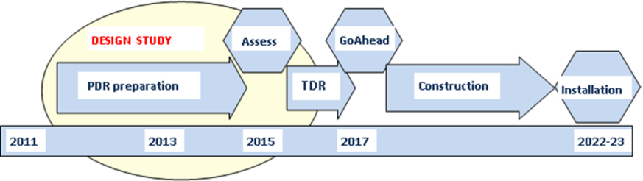
HiLumi
Design Study:
PDR (Preliminary Design Report) in 2014;
TDR (Technical Design Report) by 2015
HL-LHC Installation : 2018-19 (LS2) and mainly in 2023-24 (LS3)
19 Work Packages with 6 WP under the EU funded HiLumi Design Study
Integration started with vigor as well as Preliminary Technical Specifications and Quality Assurance
Several upgrades already in LS2: e.g. Cryo, SC link P7, Cryo-Collimators with 11 T , MoGr Coll’s)
Proof of main hardware by 2016
Final Prototypes to be tested by 2017-2018 (IT, D1, D2, LRBBwire, CC)
Start construction 2017/18 for IT, CC, other main hardware
IT String test (integration) in 2019-20; Main Installation 2023-24
Though schedule, but – based on LHC experience – feasible; 6 months shift of LS2 and 1 y shift of LS3 of the new LHC schedule ease the task.
Cost: 750 MCHF (Material, CERN accounting)
4th Joint Annual HL-LHC and US-LARP meeting, KEK, Nov 2014; Oliver Brüning CERN

Slide 4






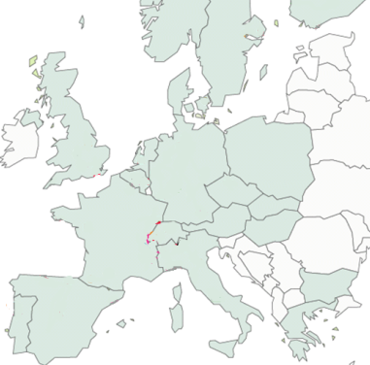












High Luminosity LHC Participants today:

Slide 5
Project Governance: Managerial bodies
HL-LHC Collaboration Board
Top-level body for the HiLumi Collaboration
Has representatives of all HiLumi Partners
Meets at least once per year
HL-LHC Coordination Group
Forum for setting common and coherent set of
goals, parameters & plans for the HL-LHC project,
Forum for official information transfer
Chaired by Project Leader, representatives of all
Experiments (spokes persons); LIU, Research and
A&T Directors; HL-LHC Technical coordinator
Project Coordination Office
Meets weekly:
PL and DPL, Technical Coordinator, Safety Officer,
Budget and Resource Manager, Outreach,
FP7 HiLumi Admin Manager, Integration Officer
HL-LHC Steering Committee
Forum for setting information exchange between
the different Work Packages (1 / month)
All HL-LHC WP coordinators & USLARP represent.

Slide 6
Project Governance: Technical Bodies
HL-LHC TC
Defines the technical baseline of the project.
Technical Specification of the individual
HL-LHC Components & Layout and Integration
➔ Detailed technical discussions
HL-LHC PLC
The PLC establishes and maintains a coherent
and dynamic list of parameters and the associated
hardware lay-out for the HL-LHC
➔ Official approval of Layout and Parameters
LMC
The central CERN LHC Committee:
Assures transfer of operational experience from
LHC to the HL-LHC project and assures that
LHC upgrades and modifications remain
Compatible with the HL-LHC requirements.
C-MAC
External Scientific Advisory board.
Looks after all of CERN’s accelerator facilities.

Slide 7
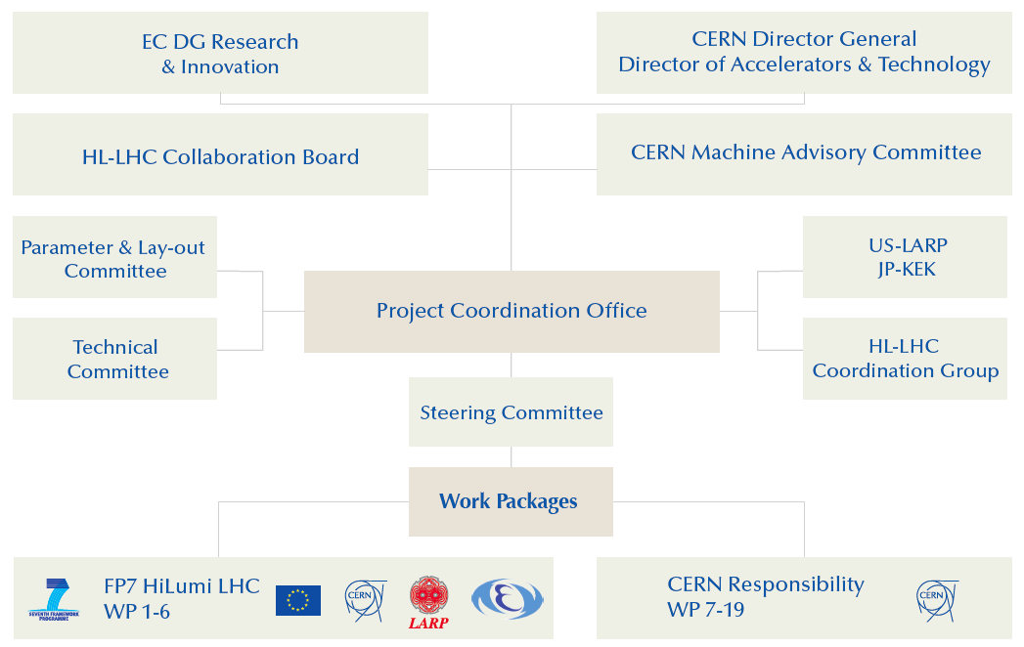
Project Governance: Current Organization

Slide 8
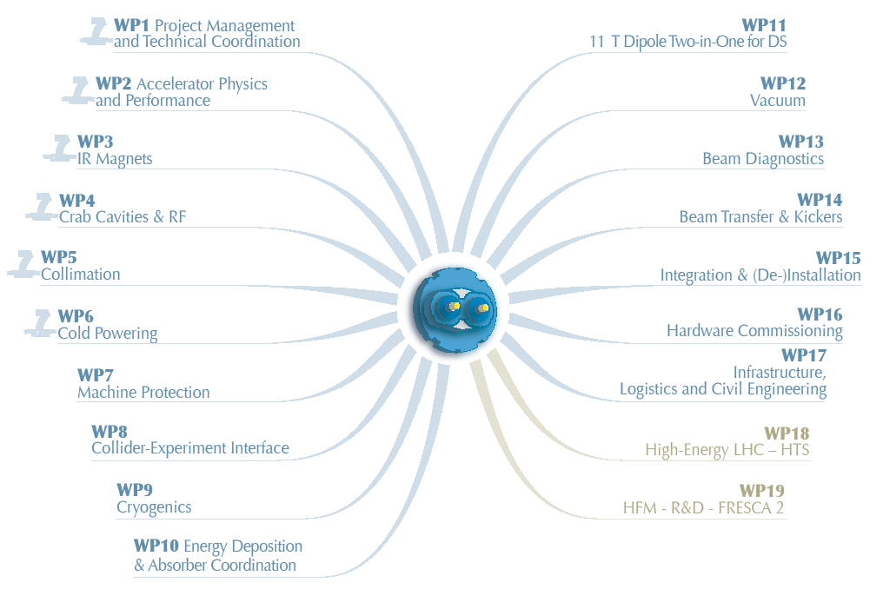
HL-LHC Work Packages:
19 Work packages with 6 WP under the HiLumi organization

Slide 9
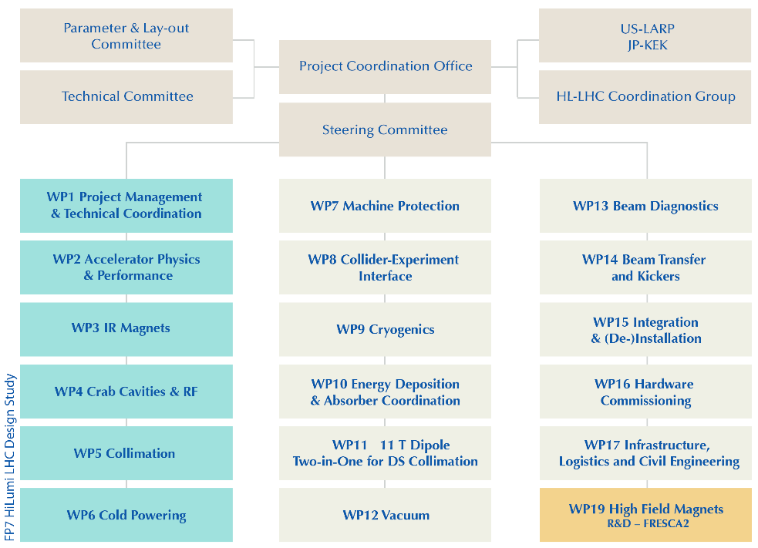
High Luminosity WP Coordination:

Slide 10
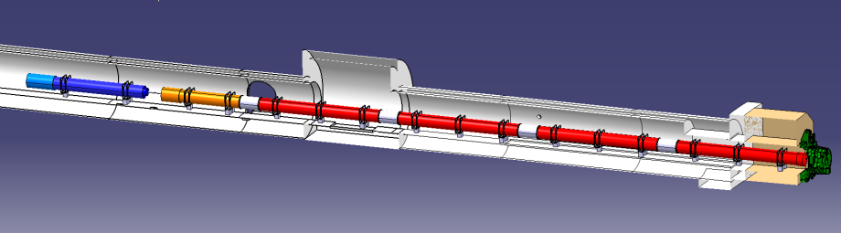





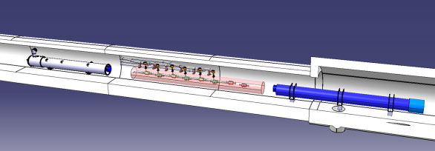


In-kind contribution and Collaboration for HW design and prototypes
HL-LHC is in the process of preparing a list
of items for potential additional in-kind
Contributions
e.g.: hollow electron lens, TANX, etc.
ATLAS
CMS
Q1-Q3 : R&D, Design, Prototypes and in-kind USA
D1 : R&D, Design, Prototypes and in-kind JP
MCBX : Design and Prototype ES
HO Correctors: Design and Prototypes IT
Q4 : Design and Prototype FR
CC : R&D, Design and in-kind USA
CC : R&D and Design UK
4th Joint Annual HL-LHC and US-LARP meeting, KEK, Nov 2014; Oliver Brüning CERN

Slide 11
Post Design Study Questions I:
The HiLumi Design Study will evolve from a Design Study into:
  Hardware Validation project
  Construction project
  Installation project
  Commissioning preparation project
  Do we need the PLC and TC once the HL-LHC TDR is finished?
    Probably not in the current forms.
    But we certainly need a Technical Coordination Committee
    for following up on the technical validations (e.g. CC in the
    SPS and Triplet String test) and installation preparation.

Slide 12
Post Design Study Questions II:
Do we still need a Collaboration Board?
  Probably Yes!
  But composition should be re-assessed based on the in-kind contributions and involvement in the post FP7 HL-LHC studies.
Do we still need a Steering Committee once TDR has been delivered?
  Yes, but Probably not in the current form!
          Technical Coordination Committee!
Do we still need a Coordination Group once the HL-LHC has delivered the TDR and once the schedule has been fixed?

Slide 13
Post Design Study Questions III:
Coordination with the LHC Injector Upgrade Project LIU:
  So far this is mainly done via the annual Chamonix meetings and
  dedicated workshops (e.g. RLIUP) and the related preparations
  Do we need a more formal and regular coordination between the HL-LHC and the LIU projects? ➔ Probably Yes!
The HL-LHC project will look after several 100s MCHF worth of equipment:
  Do we need a closer integration of the project into the CERN departmental structures? ➔ Probably Yes!

Slide 14
Project Governance during FP7 DS:

Slide 15
Project Governance: Proposal for Discussion
CERN Director General
Director of Accelerators & Technology
Scientific Advisory Committee
➔ C-MAC
LMC:
LHC operation &
HL-LHC comm. preparation
HL-LHC Project Office
Revised Collaboration board
US-LARP, JP-KEK
& In-kind contributions and commissioning preparations)
CERN HL-LHC
Technical
Committee
LIU:
Project and injector operation
Work Packages

Slide 16
4th Joint Annual HL-LHC and US-LARP meeting, KEK, Nov 2014; Oliver Brüning CERN
16

Slide 17
LHC roadmap: schedule beyond LS1
LS2 starting in 2018 (July) => 18 months + 3 months BC
LS3 LHC: starting in 2023 => 30 months + 3 months BC
Injectors: in 2024 => 13 months + 3 months BC
Physics
Shutdown
Beam commissioning
Technical stop
(Extended) Year End Technical Stop: (E)YETS
30 fb⁻¹
YETS
EYETS
YETS
LS 2
YETS
Run 2
Run 3
Run 2
LS 2
Run 3
PHASE 1
YETS
LS 3
Run 4
YETS
LS 3
Run 4
300 fb⁻¹
PHASE 2
LS 4
Run 5
LS 5
LS 4
Run 5
LS 5
3’000 fb⁻¹
4th Joint Annual HL-LHC and US-LARP meeting, KEK, Nov 2014; Oliver Brüning CERN
17

