Slide 1
US Future Program for Accelerator R&D
Steve Gourlay for the High Energy Physics Advisory Panel (HEPAP) Subpanel on Accelerator R&D

Slide 2
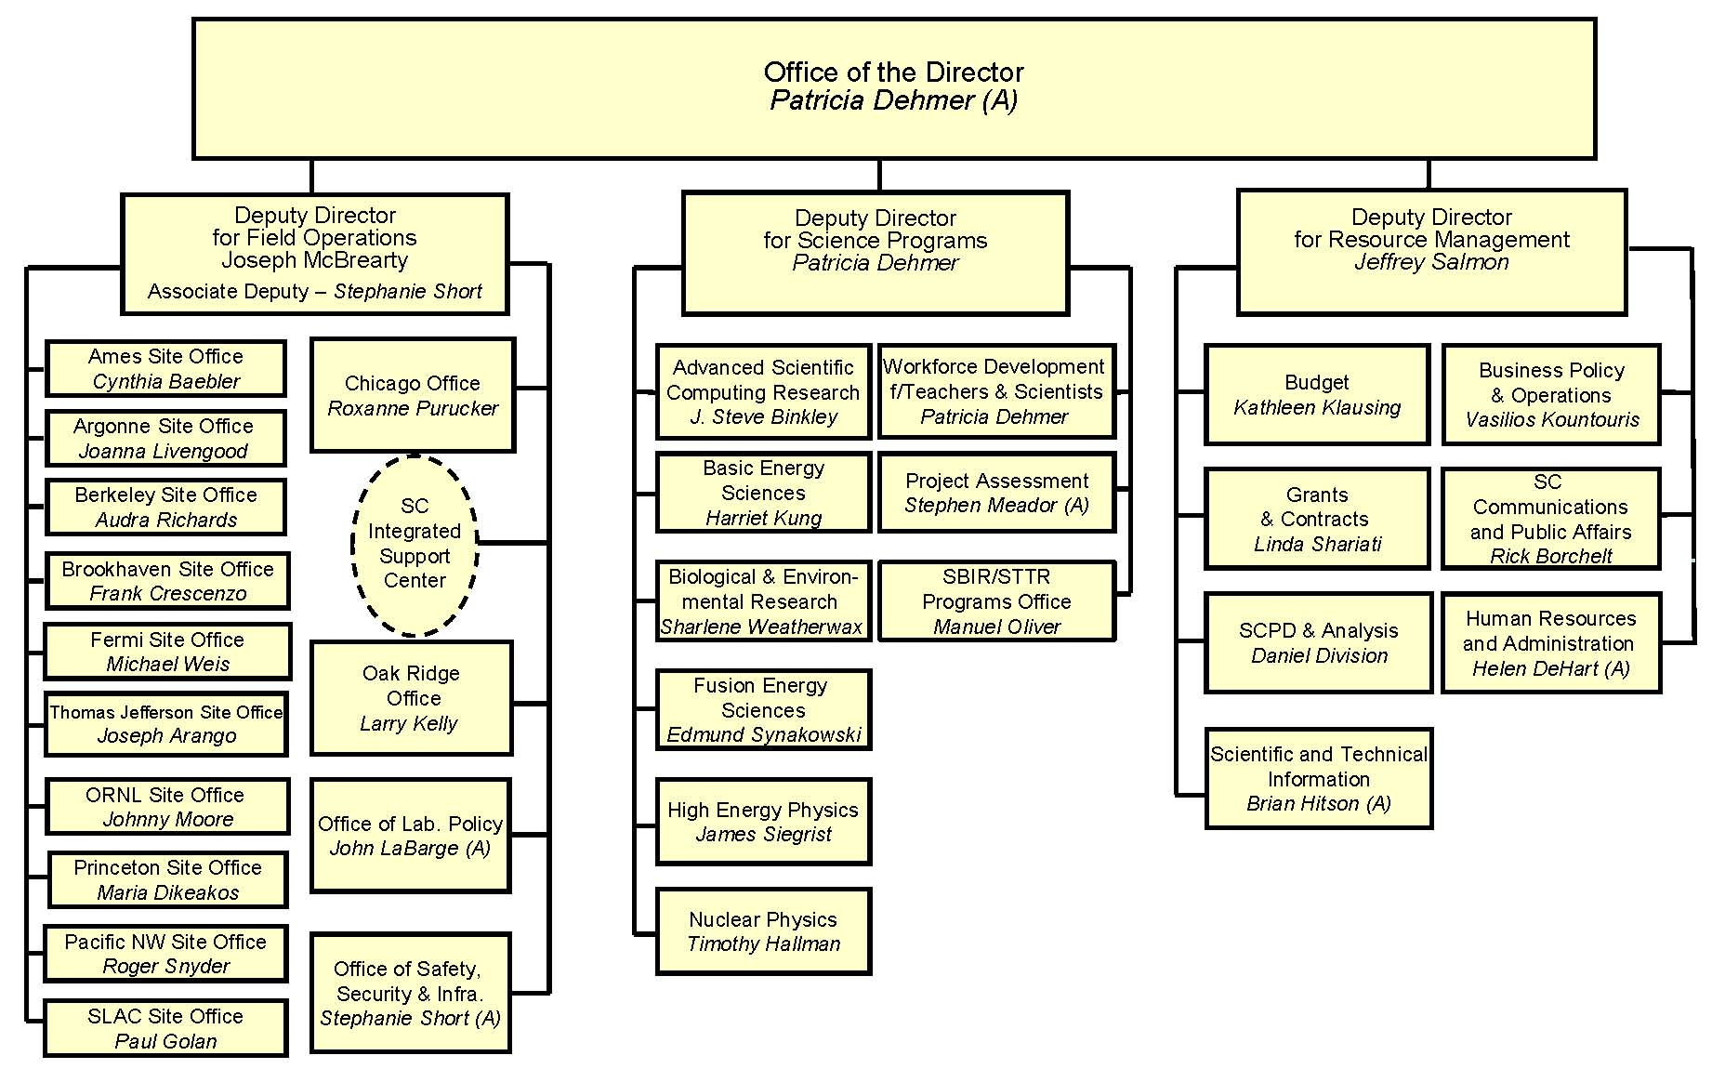
DOE/SC Organization chart
2

Slide 3
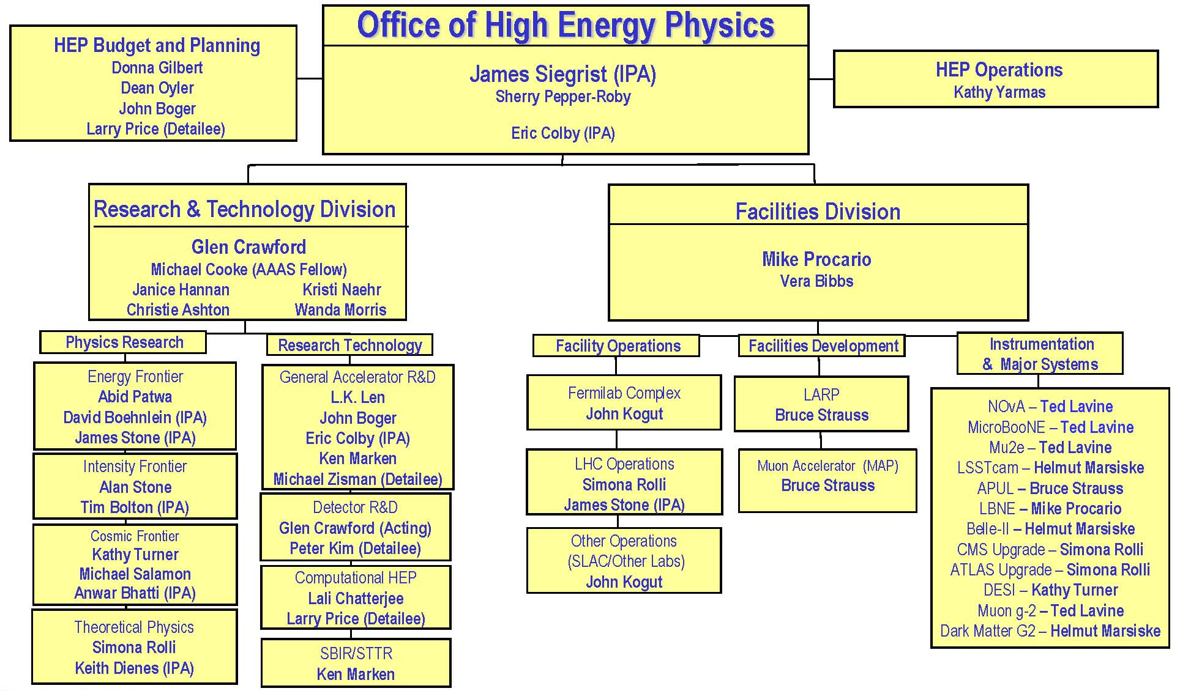
HEP Organization chart
where accelerator budget lines reside
3

Slide 4
P5 Highlights

Slide 5
Science Drivers
Use the Higgs boson as a new tool for discovery
  LHC and HL-LHC
  e⁺e⁻ collider
  Future generation accelerators
Pursue the physics associated with neutrino mass
  Long Baseline Neutrino Facility (LBNF)
  PIP-II
Identify the new physics of dark matter
Understand cosmic acceleration: dark energy and inflation
Explore the unknown: new particles, interactions, and physical principles
  HL-LHC
  Mu2e
  Very high-energy e⁺e⁻ colliders and very high-energy proton colliders

Slide 6
Enabling R&D
Advances in accelerators, instrumentation, and computing are necessary to enable the pursuit of the Drivers. Greater demands are being placed on the performance in all three areas, at reduced cost, necessitating continued investments in R&D.
The DOE General Accelerator R&D (GARD) program and Accelerator R&D Stewardship program, as well as the new NSF Basic Accelerator Science program, form the critical basis for both long- and short-term accelerator R&D, enriching particle physics and other fields.

Slide 7
GARD Subpanel
Recommendation 26: Pursue accelerator R&D with high priority at levels consistent with budget constraints. Align the present R&D program with the P5 priorities and long-term vision, with an appropriate balance among general R&D, directed R&D, and accelerator test facilities and among short-, medium-, and long-term efforts. Focus on outcomes and capabilities that will dramatically improve cost effectiveness for mid-term and far-term accelerators.
A HEPAP subcommittee on accelerator R&D will provide detailed guidance on the implementation of accelerator R&D aligned with P5 priorities.

Slide 8
Subpanel Members
Bill Barletta MIT Young-Kee Kim U of Chicago
Ilan Ben-Zvi BNL& Stonybrook Tadashi Koseki KEK/J-PARC
Marty Breidenbach SLAC Geoff Kraft (NP) JLAB
Oliver Bruning CERN Andy Lankford UC Irvine
Bruce Carlsten Los Alamos Lia Merminga Triumf
Roger Dixon Fermilab Jamie Rosenzweig UCLA
Steve Gourlay LBNL Mike Syphers MSU
Don Hartill (Chair) Cornell Bob Tschirhart Fermilab
Georg Hoffstaetter Cornell Rik Yoshida Argonne
Zhirong Huang (BES) SLAC

Slide 9
Charge Summary
National Goals: Appropriate goals in broad terms for medium ( < 10 years ) and long term ( < 20 years ) U. S. Accelerator R&D for a world leading future program in accelerator based particle physics consistent with P5
Current Effort: Examine the scope of the current effort and evaluate how well these address the HEP mission as expressed by P5
Impediments: Describe any impediments that may exist in achieving these goals

Slide 10
Charge Summary
Training: Accelerator R&D efforts play a major role in training future accelerator scientists and technologists. How are we doing?
Balance: How do we maintain a healthy and appropriately balanced national program? Provide further guidance for a plan based on the science and technology case for increased investment in HEP Accelerator R&D called for in P5’s Scenario C

Slide 11
Information Gathering
Meetings were held at BNL, Fermilab, Argonne, SLAC and LBNL.
Subpanel Website: http://www.usparticlephysics.org/p5/ards
Website has the agendas and the talks for the lab visits.
Town Hall meetings were held at each of the lab visits.

Slide 12
Meetings
First Meeting (Organizational) at SLAC July 7 & 8.
Road Trip to BNL, Fermilab & Argonne, and SLAC & LBNL week of August 25 to 30.
Two Day Meeting Newport Beach, CA Nov. 6 & 7
Final Two Day Meeting Chicago, IL Dec. 3 & 4

Slide 13
Road Trip
Energy frontier was the focus at BNL.
Intensity frontier was the topic at Fermilab.
Novel Particle Acceleration was the theme at SLAC/LBNL.
Two hour executive session at LBNL followed by a two page report by each subpanel member on their impressions from the road trip.

Slide 14
Current GARD Program
In FY 14 the General Accelerator Research and Development budget was 85.5 M$
Includes HEP Directed Accelerator R&D (LARP and MAP), and is exclusive of the Office of Science (SC) Accelerator R&D Stewardship program.
Since the P5 report, 26 M$ of SRF R&D at Fermilab has been redirected to the PIP II project and test facility operation support.
Also included in the GARD program is 12 M$ for wakefield acceleration operations and 5 M$ for superconducting magnet facility operating costs.
This leaves a net of 42.5 M$ for GARD base programs and is divided among the seven GARD thrusts and is illustrated by the following chart:

Slide 15
Current GARD Program

Slide 16
NSF Program in Accelerator Science
In addition to the DOE GARD program, NSF has started their new program in Accelerator Science with a total funding level of 9.8 M$ this year.
Fourteen awards have been made covering a broad range of topics in Accelerator Science.
It is a very welcome addition to the NSF portfolio.

Slide 17
Future Collider Options
An ILC in Japan is under study.
Muon colliders were not endorsed by P5.
The Future Circular Collider collaboration meeting was held earlier this year. The URL for all the talks is https://indico.cern.ch/event/333236/other-view?view=standard
FCC R&D is now part of the CERN medium term plan and they have applied for H2020 funding to support some of the R&D. More than 25 institutions have signed MOU’s to carry out different parts of the needed R&D. The FCC could initially be a ~ 200 GeV e+e- collider or a ~ 100 TeV pp collider.

Slide 18
Future Collider Options
The high energy physics community in China is pressing forward with a proposal for a 50 to 80 km ring. It would first be a ~ 200 GeV e+e- collider with a proposed construction start in the early 2020’s followed by a pp collider in the mid 2030’s.
In addition, there is a 150 MEuro EU initiative spread over ten years in laser plasma acceleration with a focus on developing compact synchrotron radiation sources including FELs.

Slide 19
US GARD Opportunities
For the Intensity Frontier, the measure is MW•Ktons•beamtime/yr so accommodating higher beam power has significant leverage. Beam stability at synchrotron injection energies combined with higher power targets could have large benefits.
Future high energy colliders are expensive. Optimization studies will be key in lowering the cost and maximizing operating efficiency. Optimized superconducting magnet design both in field and manufacturablity will require R&D. For e+e-, more efficient RF would lower operating costs.
Advanced acceleration technology potentially has the promise of dramatically increasing the accelerating gradient and thereby significantly reducing the cost of a very high energy accelerator or collider.

Slide 20
Subpanel Challenges
The Accelerator R&D Subpanel is not a project review panel. Our task is to recommend a balanced program in accelerator R&D to OHEP to provide the US with a world leading program in accelerator based particle physics. And, parenthetically developing an exciting program that will attract additional funding to the program.
We were briefed on several initiatives each with a price tag of ~ 25 M$ per year including capital investment, operations, and experiments. One on-going program will stop at the end of FY16 unless a significant investment is made to reconfigure a portion of the SLAC linac because of the LCLS II construction project.

Slide 21
Subpanel Challenges
To make a contribution to future high energy colliders, the superconducting magnet program will need increased investment both in going to higher magnetic fields and in developing manufacturing techniques that significantly reduce the magnet assembly labor costs.
For the LCLS II cryomodules, the cost of Nb for the cavities is only 10% of the cost, so improved manufacturing techniques have the potential of significantly reducing the cost of the completed cryomodules for a high energy SRF based collider.

Slide 22
Process
After the Road Trip we have set up the following six accelerator R&D areas to study in more detail:
Accelerator physics computation and simulation:
Advanced acceleration:
Normal conducting RF structures and sources
Wakefield accelerators
Beam driven plasma wakefield acceleration
Laser driven plasma wakefield acceleration
Dielectric laser acceleration
Fundamental aspects of muon acceleration

Slide 23
Process
Beam dynamics, instrumentation and controls:
Space charge dominated beams
Timing systems, beam controls, beam loss monitoring, etc.
Similar activities at universities
Particle Sources and Targets:
High power beams, horns, targets, and collimators
Beam dumps
Superconducting Magnets and Materials:
Superconducting RF:

Slide 24
Process
The R&D needs for future very high energy colliders will be covered in the six areas mentioned previously rather than setting up a separate area.
High field superconducting magnets, beam dynamics and instrumentation, along with efficient RF acceleration are the key areas.
To make sure everything is included, a separate list of needed R&D will be maintained for these very high energy colliders.

Slide 25
Process
Each area has at least two subpanel members assessing the information provided to the subpanel and developing appropriate guidance and recommendations.
Good progress is being made by each of these subgroups and preliminary draft reports are being written by each subgroup. Some early drafts have already been produced.
Discussion between the subgroups takes place during our weekly telecons.

Slide 26
Process
Written comments were accepted on the subpanel website until October 17.
Draft reports from each subgroup were discussed at the November 6, 7 meeting and are being assembled into a very preliminary draft report.
Refinement of the report will be done through frequent teleconferences.

Slide 27
P5 is very supportive of superconducting magnet R&D
“The HL-LHC is strongly supported and is the first high-priority large-category project in our recommended program.”
“The U.S. also contributed critical components . . . . . the construction of the LHC accelerators. Similarly, the experiments and accelerator upgrades cannot occur without the unique U.S. technical capabilities (e.g., the high-field magnets necessary for the success of the project) and resources.”
“Going much further, however, requires changing the capability-cost curve of accelerators , which can only happen with an aggressive, sustained, and imaginative R&D program.”
“Primary goal, . . . . build the future-generation accelerators at dramatically lower cost. For, example, the primary enabling technology for pp colliders is high-field accelerator magnets, . . .”
“The U.S. is the world leader in R&D on high-field superconducting magnet technology, . . . .”
“Strengthen national laboratory-university R&D partnerships, leveraging their diverse expertise and facilities.”

Slide 28
Community Input
  McIntyre (TAMU)
  Inexpensive 4.5 T magnets for large ring
Palmer (BNL)
  Optimum magnet field 8 – 10 T
Prestemon (representing US program)
  Aggressive conductor development
  Emphasize magnet “science”
  Significant potential for performance improvement and cost reduction requires multi-prong effort
Shiltsev (FNAL)
  SC magnet technology guarantees the energy frontier
  Address feasibility of acceptable cost
  Explore cost/performance trade-offs
  Coordinate with global design studies

Slide 29
Community Input
Apollinari (LARP)
  LARP benefited from synergy with GARD activities
  Emphasized the need for LARP2 to continue R&D activities and support HL-LHC
Nagaitsev (FNAL)
  High-field magnets and materials are Fermilab’s highest GARD priority
  Significant T*m cost reduction, modest support of global design
Eichorn (Cornell)
  Increased interest in Bi-2212
  Three possible conductors
    New and very much improved Nb₃Sn
    Further developed Bi-2212 round wire
    Cable-friendly REBCO
Boudry (CERN)
  HTS complementary to LTS but unlikely to displace it
  Focus on Nb3Sn (affordability, performance, collider-ready)

Slide 30
Community Input
Joint Whitepaper from BNL, FNAL, LBNL, FSU/NHMFL
  Calls for creation of US National Program coordinated with international efforts to support P5 priorities (100 TeV pp)
The Program aims at the following goals:
Goal 1: Develop accelerator magnets at the limit of Nb₃Sn capabilities. This is presently believed to be approximately 16 T.
Goal 2: Explore LTS accelerator magnets with HTS inserts for fields beyond the Nb3Sn capabilities. The present target is 20 T or above.
Goal 3: Drive high-field conductor development, both Nb₃Sn and HTS materials, for accelerator magnets.
Goal 4: Address fundamental aspects of magnet design, technology and performance that could lead to substantial reduction of magnet cost.

Slide 31
Conclusions for Magnets
Subpanel (and the community as well) is supportive of Superconducting Magnet R&D
Calls for transformative R&D
Cost reduction (from P5) is high priority

Slide 32
General Conclusions
A healthy program in accelerator R&D is key to insuring that the US accelerator based high energy particle physics program is world leading.
Training of the next generation of accelerator scientists and technologists is a very important element of this R&D program. See the HEPAP Subpanel report on personnel needs published this past spring.
Our hope is that our report will provide useful guidance to DOE OHEP in charting the future of accelerator R&D in the US.

