Slide 1
HL-LHC
Work and Dose Planning exercises for inner triplet interventions
Cristina Adorisio and Stefan Roesler
(CERN - DGS/RP)

Slide 2
Outline
Optimization and ALARA principle implementation
Dose rate outlook in the inner triplet area
      Operational scenarios
      Evolution until HiLumi era
Work and Dose Planning exercises
    Valve exchange intervention
    PIM exchange intervention
Summary and Conclusions

Slide 3
Optimization during design

Slide 4
Intervention doses
Methodology
1. Calculation of residual dose rate maps
→ for cooling times typical for interventions on the respective component
→ based on nominal operational parameters
→ definition of geometry and materials as detailed as needed (and available)
2. Calculation of individual and collective intervention doses
→ based on as realistic as possible work scenarios, including locations, duration, number of persons involved,..
→ identification of cooling times below which work will be impossible
design criterion:
2 mSv/intervention/yr
→ communication of results and constraints to equipment groups
3. Revision of design and/or work scenario
→ start with work steps that give highest individual or collective doses
→ consider optimization measures (distance, tooling, material choices, etc.)
→ identify if remote handling is possible
New design?
Step 1
Start of iteration
Revised working scenario?
Step 2

Slide 5
Optimization during design
Design options
Material choice
Low activation properties to reduce residual doses and minimize radioactive waste (optimization with ActiWiz code, Web-site: https://actiwiz.web.cern.ch)
Avoid materials for which no radioactive waste elimination pathway exists (e.g., highly flammable metallic activated waste)
Optimized handling
Provisions for fast installation/ maintenance/ repair, in particular, around beam loss areas (e.g., plugin systems, quick-connect flanges, remote survey, remote bake-out)
Limitation of installed material
Install only components that are absolutely necessary, in particular in beam loss areas
Reduction of radioactive waste
Radiation resistant
Foresee easy dismantling of components
Easy access to components that need manual intervention or complex manipulation

Slide 6
Dose rate outlook

Slide 7
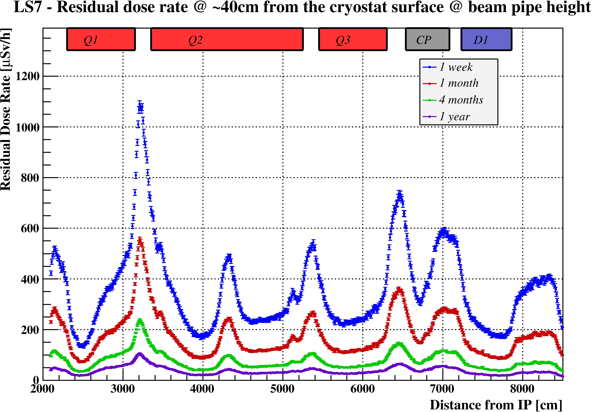

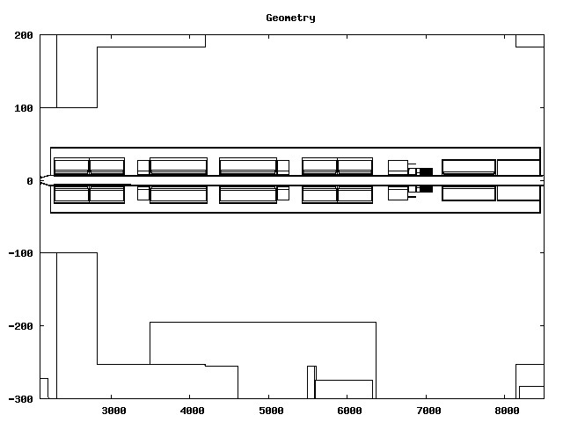
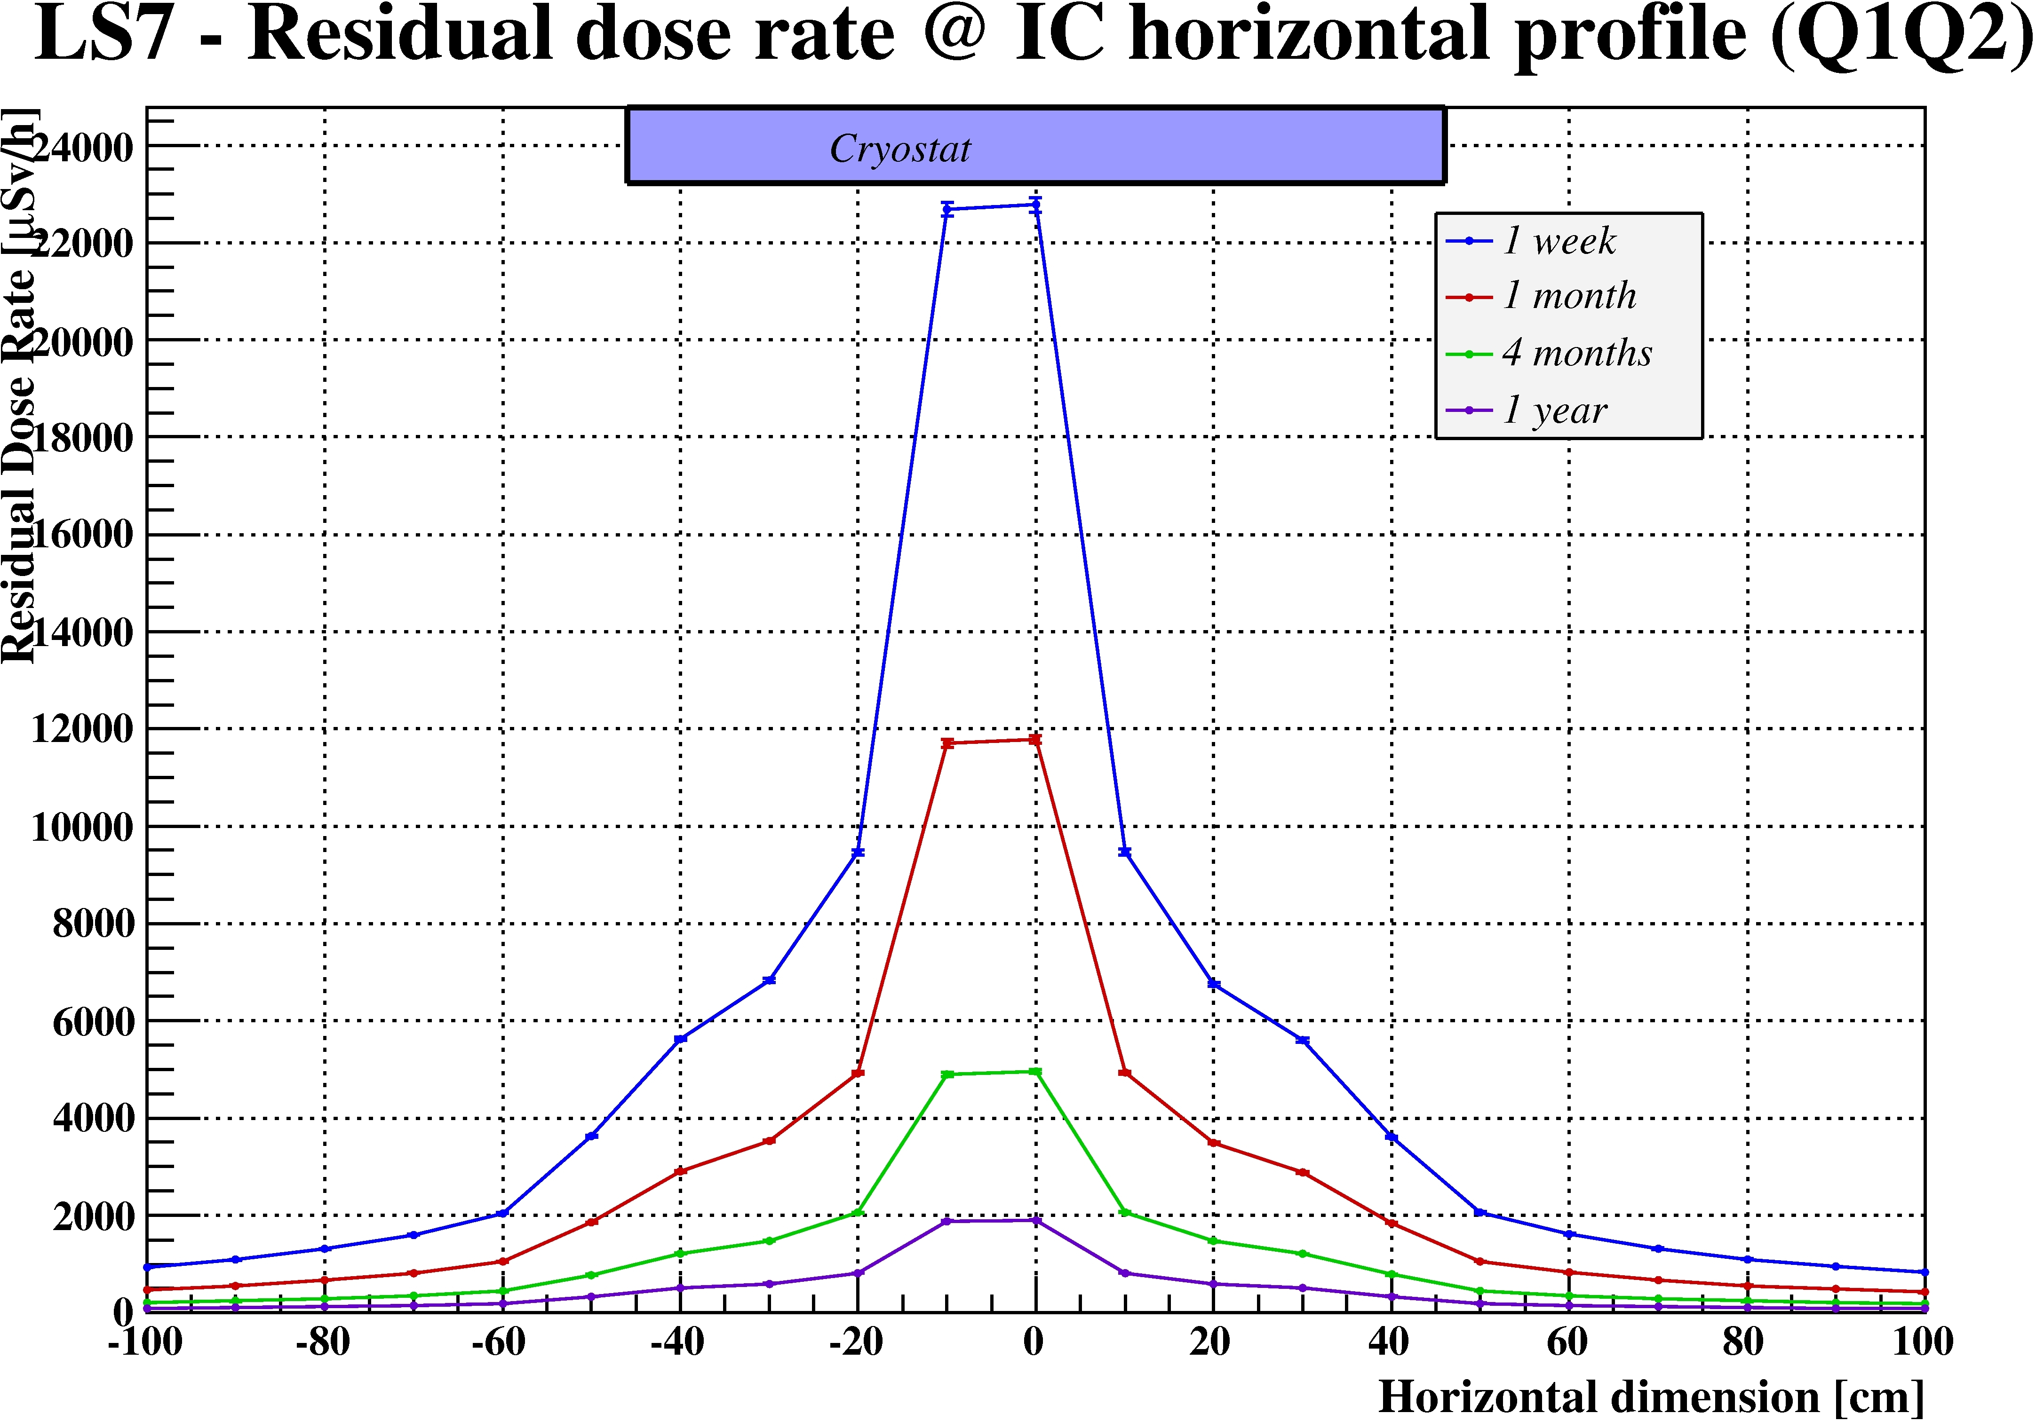
Ambient Dose Equivalent Rates
Cooling time dependence
Nominal scenario
Total integrated luminosity 3060 fb⁻¹
@ 40 cm
IR5 LHC Fluka geometry - Inner triplet area ^{(courtesy Fluka team)}
Q1
Q2
Q3
CP
D1
FB
across IC
Cooling time | Scaling factor
1 week | 2.0
1 month | 1.0
4 months | 0.4
1 year | 0.2

Slide 8
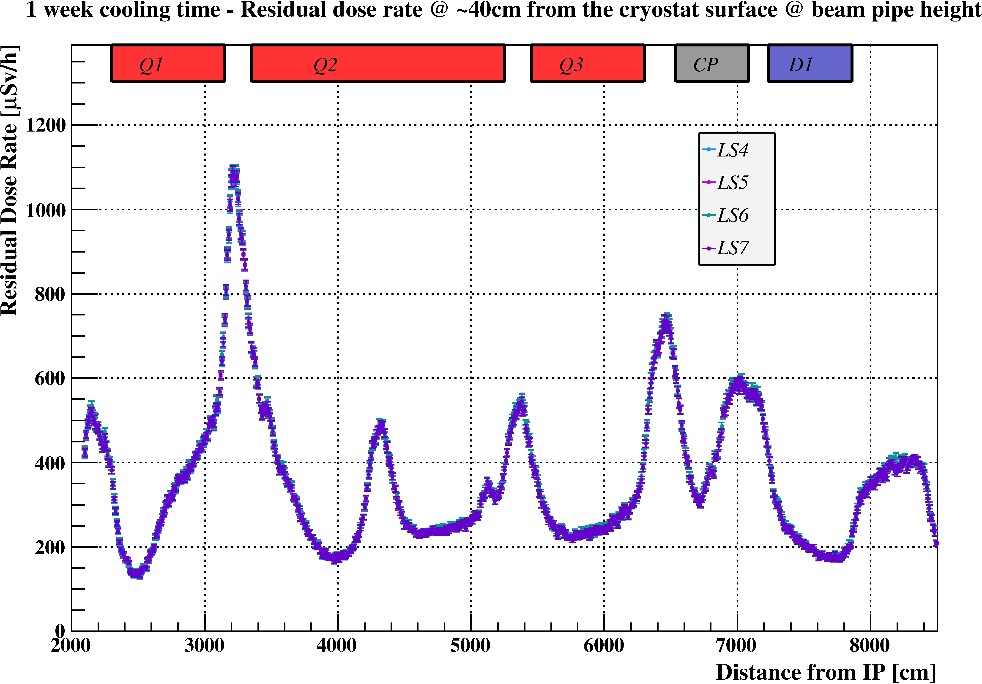
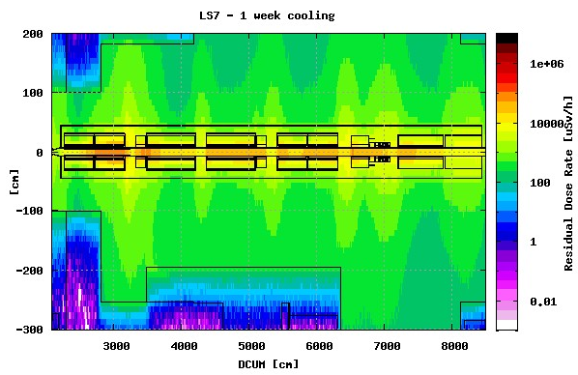
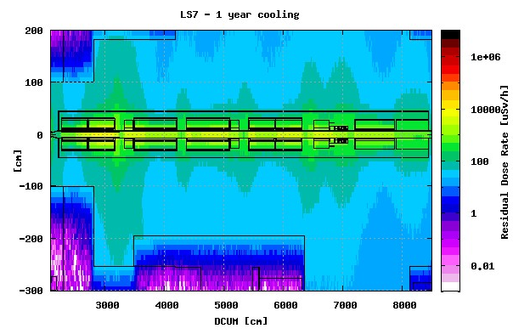
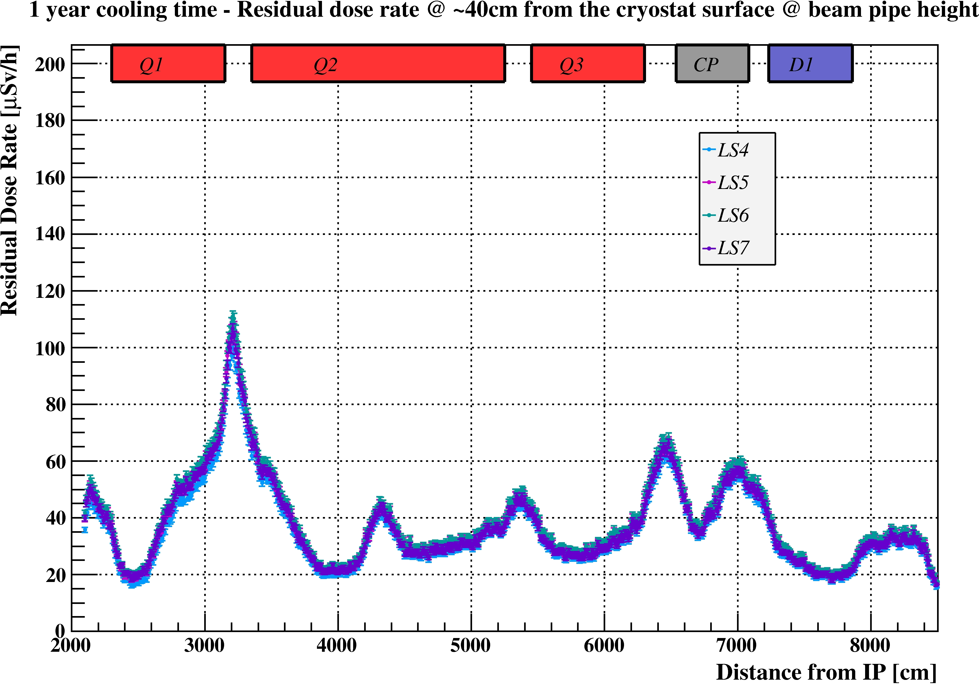
Ambient Dose Equivalent Rates
Time evolution
Nominal scenario
@ 40 cm

Slide 9
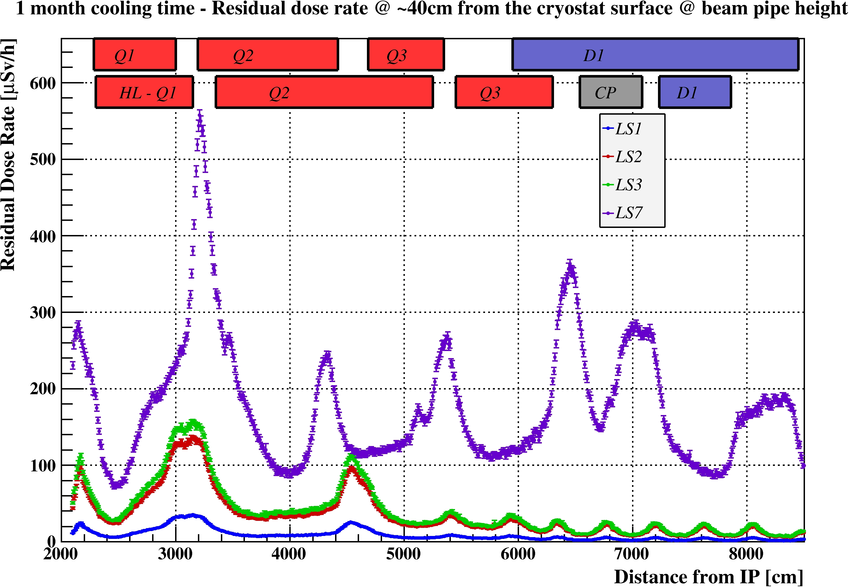
Ambient Dose Equivalent Rates
Time evolution
1 month cooling time, dose rates at 40 cm from the cryostat
Total integrated luminosity 310 fb⁻¹
~16
Nominal scenario
Representing any LS after LS3
~4

Slide 10
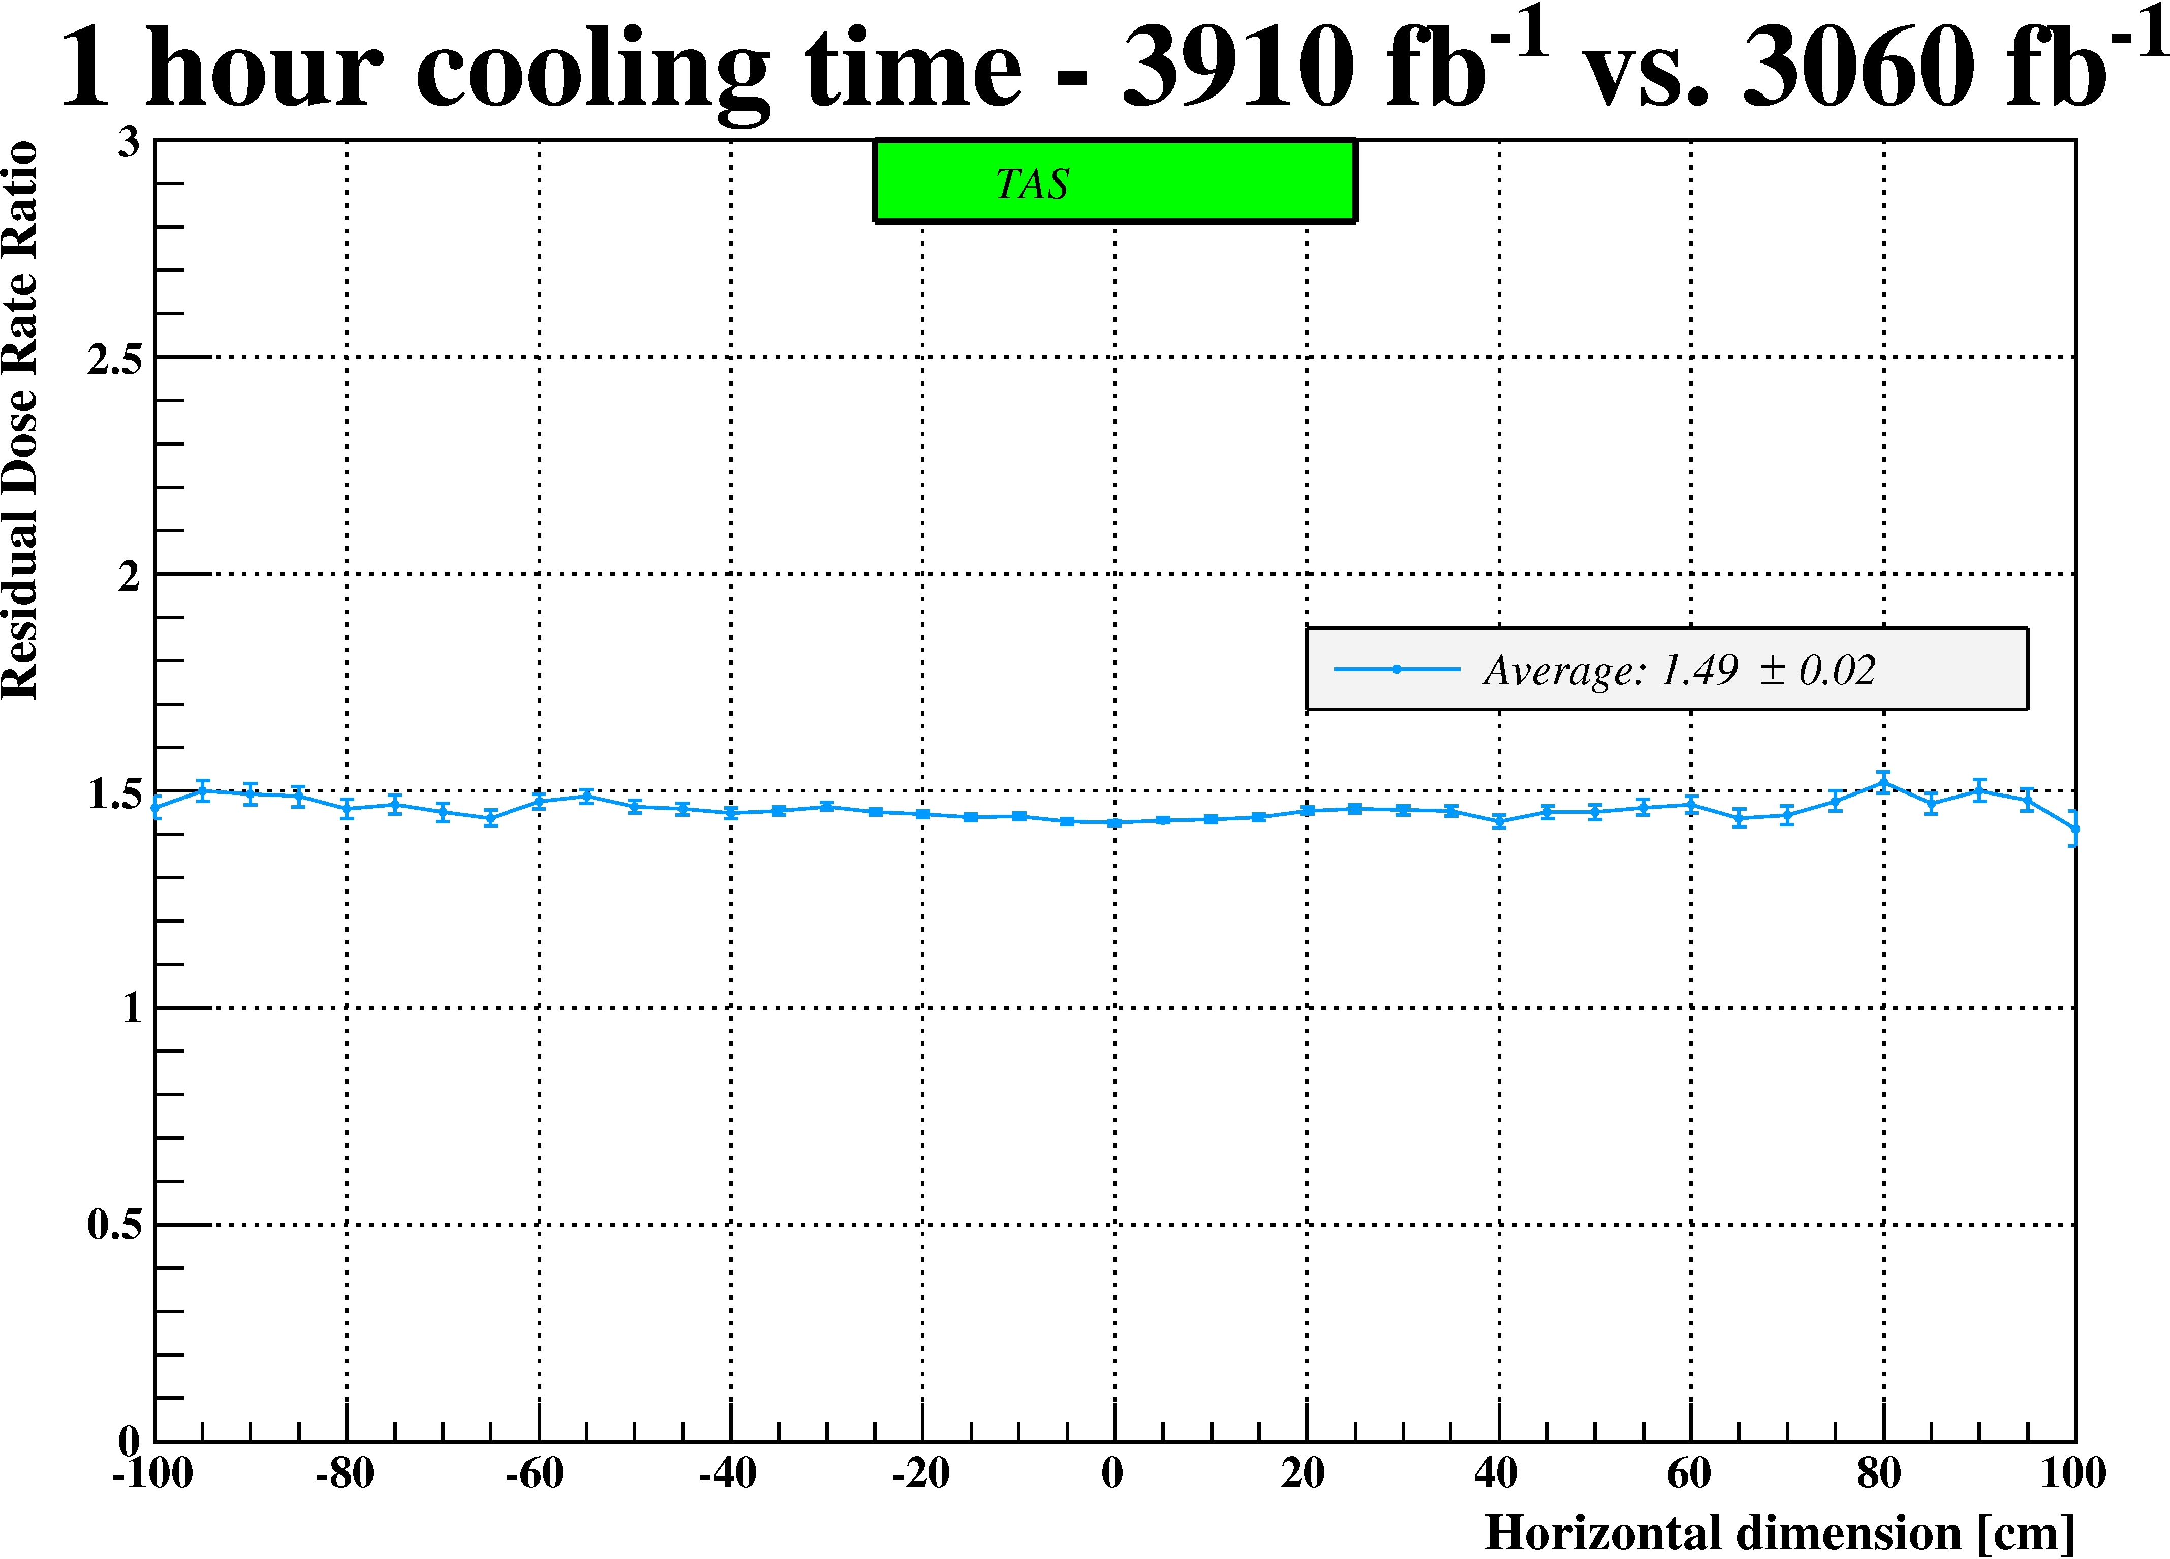
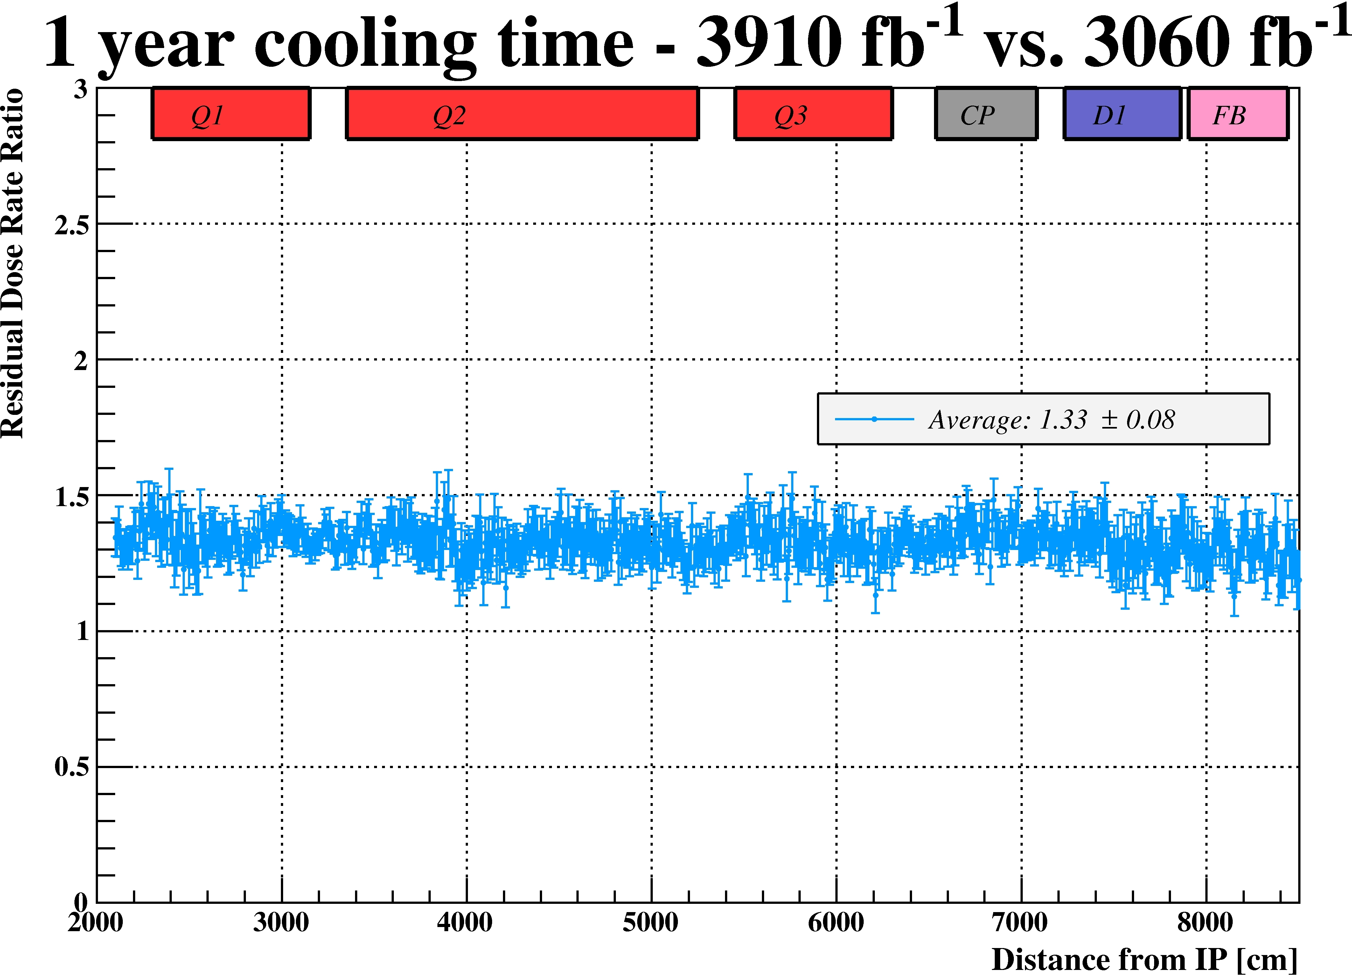
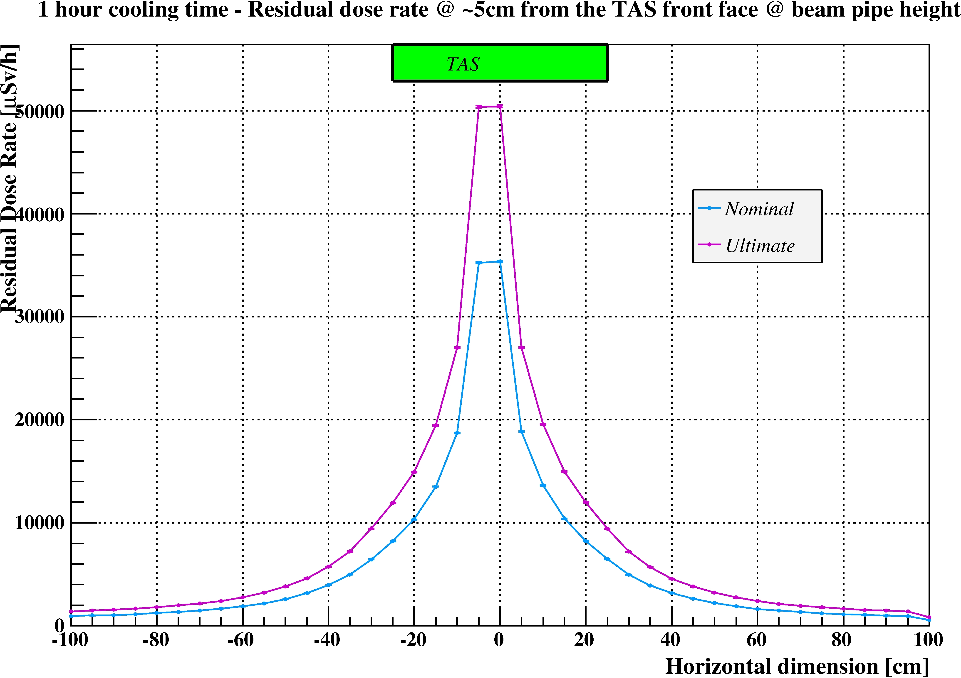
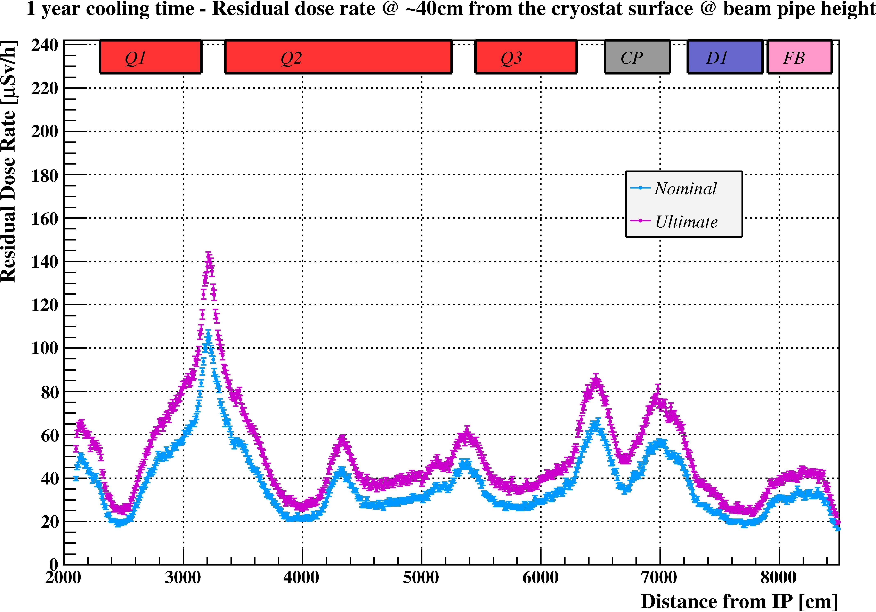
Ambient Dose Equivalent Rates
Nominal vs Ultimate
1 hour cooling time @ contact
1 year cooling time @ 40cm from cryostat surface
Ultimate ~50% more than Nominal
Ultimate ~30% more than Nominal

Slide 11
Work and Dose Planning exercises

Slide 12
WDP example 1: Valve exchange intervention
Intervention description and timing from Cedric Garion
WHEN: any LS during HL-LHC (Ultimate scenario)
WHERE: region in between TAS and Q1
team | # person | action description | distance from the beam pipe (cm) | Duration (minutes) | dose per action (man μSv) | individual dose (μSv) | dose per action (man μSv) |  | individual dose (μSv)
 |  |  |  |  | 1 month cooling time |  | 4 months cooling time
T0 | 2 | Valve investigation | 40 | 60 | 747 | 374 | 290 |  | 145
A | 1 | Jacket and cabling removal | in contact | 30 | 283 |  | 103
B | 2 | Pneumatic system disconnection | 40 | 10 | 125 | 1162 | 48 |  | 427
B | 2 | Flanges disconnection | in contact | 20 | 377 |  | 138
B | 2 | valve removal | in contact | 30 | 566 |  | 206
B | 2 | valve re-installation | in contact | 30 | 566 |  | 206
B | 2 | Flanges reconnection | in contact | 30 | 566 |  | 206
B | 2 | Pneumatic system reconnection | 40 | 10 | 125 |  | 48
A | 1 | Jacket and cabling installation | in contact | 45 | 425 | 708 | 155 |  | 258
 |  |  |  |  | Collective dose (man mSv)
 |  |  |  |  | 3.8 |  |  | 1.4
 |  |  |  |  | Collective dose (man mSv)
 |  |  |  |  | 2.8 |  |  | 1.0
Estimations done using simulation data
3 different teams
5 workers involved
Nominal scenario

Slide 13
Lesson learnt from WDP example 1
½ working day could cost (Ultimate/1 month cooling)
    ~4 mSv in terms of collective dose
    ~1.2 mSv individual dose for the most exposed worker
    i.e. 1/5 (1/16) of the annual dose for a Category B (A) worker,
    ~1/2 of the dose design criterion (2 mSv/intervention/year)
More exercises needed in a more refined/realistic description

Slide 14
WDP example 2: PIM exchange intervention (1/2)
Intervention description and timing from Herve Prin
WHEN: any LS during HL-LHC (Ultimate scenario)
WHERE: inner triplet – Q1Q2 interconnection (IC with the highest residual dose rate)
team | # person | action description | distance from cryostat (cm) | Duration (minutes) | dose per action (man μSv) | individual dose (μSv) | dose per action (man μSv) | individual dose (μSv)
 |  |  |  |  | 1 month |  | 4 months
A | 1 | BLM removal | 40 | 30 | 351 | 820 | 147 | 343
C | 3 | Open W bellow and thermal screen (including tie-rods disassembly) | 40 | 180 | 6325 | 4217 | 2643 | 1762
D | 1 | Environment protection | in contact | 30 | 1057 | 9861 | 426 | 3973
D | 1 | PIM cutting | in contact | 240 | 8452 |  | 3405
E | 1 | Inspection | 40 | 20 | 234 | 234 | 98 | 98
F | 1 | PIM installation and welding | in contact | 120 | 4226 | 4226 | 1703 | 1703
G | 1 | Welding inspection | 40 | 10 | 117 | 117 | 49 | 49
D | 1 | Environment protection removal | in contact | 10 | 352 |  | 142
C | 3 | Closing W bellow and thermal screen (including tie-rods assembly) | 40 | 180 | 6325 |  | 2643
A | 1 | BLM installation | 40 | 40 | 469 |  | 196
 |  |  |  |  | Collective dose (man mSv)
 |  |  |  |  | 28 |  | 11
 |  |  |  |  | Collective dose (man mSv)
 |  |  |  |  | 21 |  | 8
Estimations done using simulation data
6 different teams
8 workers involved
Nominal scenario
Survey HLS and WPS removal and installation and magnet realignment NOT TAKEN into account in this estimation.

Slide 15
WDP example 2: PIM exchange intervention (2/2)
Intervention description and timing from Herve Prin
WHEN: any LS during HL-LHC (Ultimate scenario)
WHERE: inner triplet – Q2Q3 interconnection (IC with the lowest residual dose rate)
team | # person | action description | distance from cryostat (cm) | Duration (minutes) | dose per action (man μSv) | individual dose (μSv) | dose per action (μSv) | individual dose (man μSv)
 |  |  |  |  | 1 month cooling time |  | 4 months cooling time
A | 1 | BLM removal | 40 | 30 | 153 | 357 | 59 | 138
C | 3 | Open W bellow and thermal screen (including tie-rods disassembly) | 40 | 180 | 2755 | 1837 | 1068 | 712
D | 1 | Environment protection | in contact | 30 | 434 | 4049 | 163 | 1525
D | 1 | PIM cutting | in contact | 240 | 3470 |  | 1307
E | 1 | Inspection | 40 | 20 | 102 | 102 | 40 | 40
F | 1 | PIM installation and welding | in contact | 120 | 1735 | 1735 | 654 | 654
G | 1 | Welding inspection | 40 | 10 | 51 | 51 | 20 | 20
D | 1 | Environment protection removal | in contact | 10 | 145 |  | 54
C | 3 | Closing W bellow and thermal screen (including tie-rods assembly) | 40 | 180 | 2755 |  | 1068
A | 1 | BLM installation | 40 | 40 | 204 |  | 79
 |  |  |  |  | Collective dose (man mSv)
 |  |  |  |  | 12 |  | 5
 |  |  |  |  | Collective dose (man mSv)
 |  |  |  |  | 9 |  | 3
Estimations done using simulation data
6 different teams
8 workers involved
Nominal scenario
Survey HLS and WPS removal and installation and magnet realignment NOT TAKEN into account in this estimation.

Slide 16
Lesson learnt from the WDP example 2
Survey HLS and WPS removal/re-installation and magnet realignment have not been taken into account
2 working days could cost (at worst IC / Ultimate / 4 months cooling)
    ~11 mSv in terms of collective dose
    ~4 mSv individual dose for the most exposed worker
      do not match the design criterion of 2 mSv/intervention/year
estimated individual dose (4 months cooling time) exceeds the design criterion by 50% (nominal) or a factor two (ultimate)
The results of this estimation exercise show that the intervention cannot be done accordingly to the present working description (coming from actual experience) and the necessity of revising the working scenario in order to optimize the dosed to personnel
Individual dose (mSv) – intervention at worst IC (Q1Q2)
Cooling time | 1 month | 4 months | 1 year
Nominal scenario | 7.3 | 2.9 | 1.3
Ultimate scenario | 9.9 | 4.0 | 1.7

Slide 17
Summary and Conclusions
4 months VS 1 month cooling time: a factor 2.5 less
Nominal VS Ultimate: a factor 1.35 less
The estimation is done using residual dose rate maps from simulation study based on nominal and ultimate operational parameters and on the last available geometry
Doing more exercises in this phase of the project is important for the optimization of the design of the component and for the optimization of the future working scenario
Estimation of WDP can also be done for LS3 and the removal of the present inner triplet magnets to optimize the work-methods

Slide 18
Thank You for your attention!

